Slide 1

The EACPR EXPERT flowchart programme: a tool to prescribe exercise training in the setting of cardiac rehabilitation
Dominique Hansen, PhD, FESC
Hasselt University, Faculty of Medicine and Life Sciences, Hasselt, Belgium
Heart Centre Hasselt, Hasselt, Belgium

Slide 2
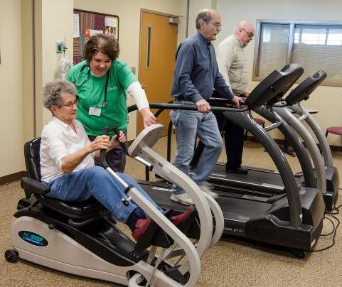
Introduction
Exercise-based rehabilitation is of significant importance to patients with cardiovascular disease (risk)
  Better CVD risk factor control
  Improved quality of life
  Reductions in hospitalisation frequency
  Cost saving effects

Slide 3
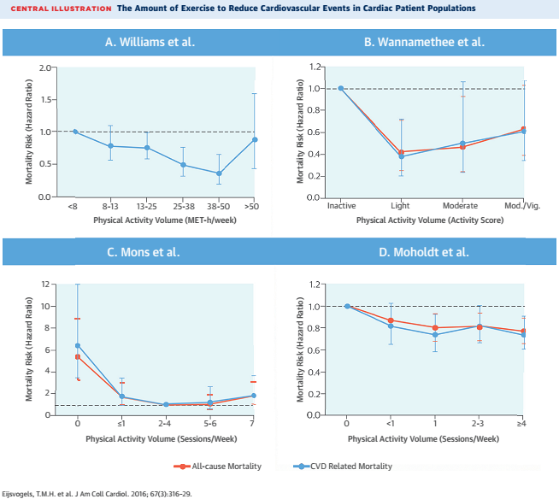

Slide 4
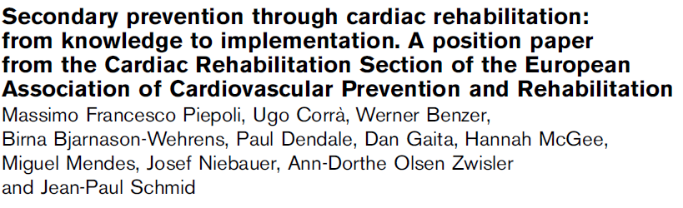
Guidelines for exercise prescription
exercise >150 min/week (spread over >2 exercise sessions/week)
low-to-moderate endurance intensity
weekly caloric expenditure of 1000-2000 kcal/week
combination with resistance exercises
Piepoli MF, Eur J Prev Cardiol 2010;17:1-17

Slide 5

Troubles ahead…

Slide 6

Troubles ahead…
AMI with PCI or CABG
Hypercholesterolemia
Heart failure
Hypertension
Cardiomyopathy
Type 2 diabetes
Cachexia
Type 1 diabetes
Obesity
Pacemaker/ICD
Claudicating intermittens
Insulin resistance

Slide 7
Troubles ahead…
AMI with PCI or CABG
Hypercholesterolemia
Heart failure
Hypertension
Cardiomyopathy
Type 2 diabetes
Cachexia
Type 1 diabetes
Obesity
Pacemaker/ICD
Claudicating intermittens
Insulin resistance

Slide 8
Troubles ahead…
AMI with PCI or CABG
Hypercholesterolemia
Heart failure
Hypertension
Cardiomyopathy
Type 2 diabetes
Cachexia
Type 1 diabetes
Obesity
Pacemaker/ICD
Claudicating intermittens
Insulin resistance

Slide 9
Troubles ahead…
AMI with PCI or CABG
Hypercholesterolemia
Heart failure
Hypertension
Cardiomyopathy
Type 2 diabetes
Cachexia
Type 1 diabetes
Obesity
Pacemaker/ICD
Claudicating intermittens
Insulin resistance

Slide 10

Troubles ahead…
And what to do with prescription of certain medications?
      Beta-blockers
      Statins
      Sulfonylurea/meglitinide
      Exogenous insulin administration
      …
And what to do with certain anomalies during exercise testing?
      Myocardial ischemia
      Exercise-induced cardiac arrhythmias
      …

Slide 11
Troubles ahead…
And what to do with prescription of certain medications?
      Beta-blockers
      Statins
      Sulfonylurea/meglitinide
      Exogenous insulin administration
      …
And what about safety precautions during exercise for all these indications?
Nobody really knows….

Slide 12


for exercise prescription

Slide 13



Slide 14
Training modalities
Exercise intensity
Interval or continuous?
Additional specific
exercises
Exercise frequency
Session duration
Exercise type
Minimal program duration

Slide 15
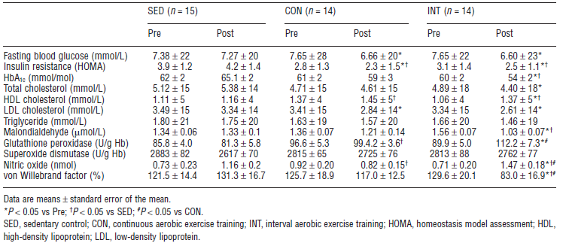
Exercise = exercise? An example in type 2 diabetes
Mitranun W, et al. Scand J Med Sci Sport 2014 Apr;24(2):e69-76

Slide 16
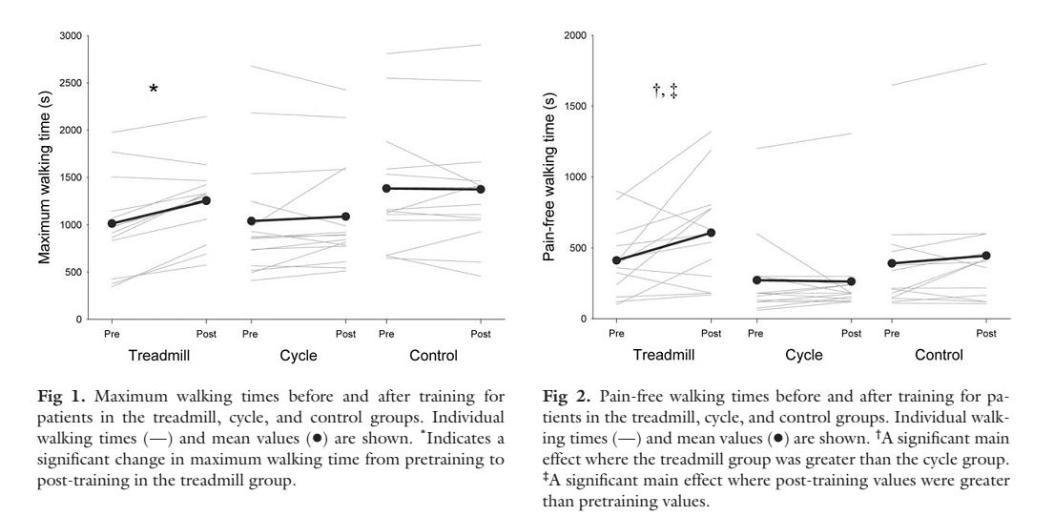

Exercise = exercise? An example in peripheral arterial disease

Slide 17
Critical reflection
Were the exercise modalities optimized according to type of CVD (risk factor) in previous studies?
Are then the potential maximal clinical benefits of exercise-based rehabilitation in CVD (risk) really known?

Slide 18
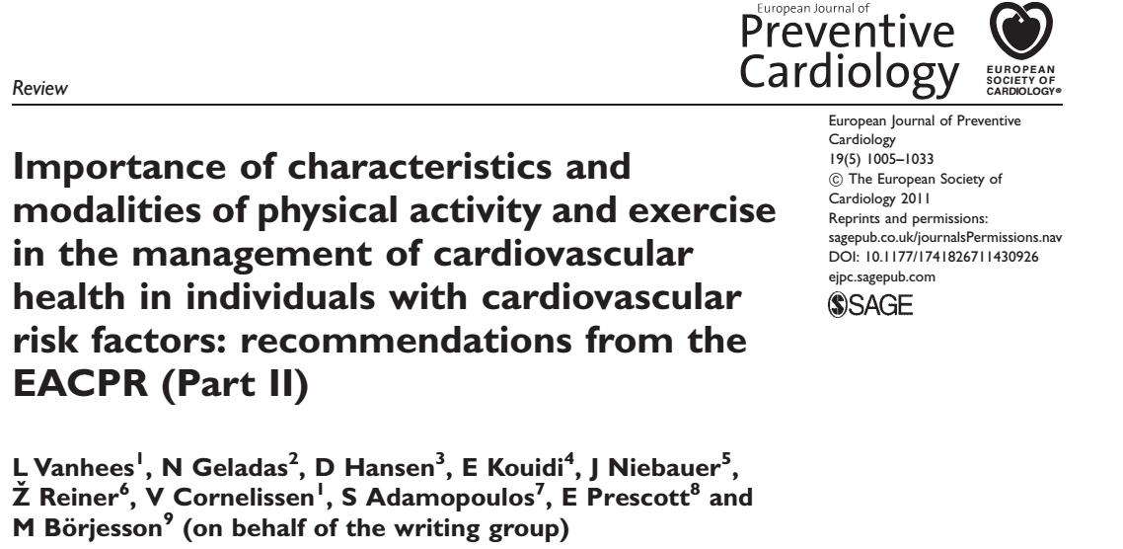
Efforts to optimize training prescription

Slide 19
EXPERT tool project
EXPERT (EXercise Prescription in Everyday practice & Rehabilitative Training)
Launched at EuroPrevent congress 2013 in Rome
Creation of digital, interactive decision support tool for exercise prescription
Notes:
19

Slide 20
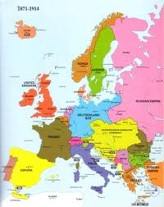
EXPERT tool project
33 members (rehabilitation experts, cardiologists, rehabilitation physicians)
    Dominique Hansen (coordinator, BEL), Ana Abreu (POR), Marco Ambrosetti (ITA), Olga Barna (UKR), Paul Beckers (BEL), Maurizio Bussotti (ITA), Karin Coninx (BEL), Veronique Cornelissen (BEL), Ugo Corra (ITA), Constantinos Davos (GRE), Paul Dendale (BEL), Patrick Doherty (UK), Frank Edelmann (GER), Robert Fagard (BEL), Pompilio Faggiano (ITA), Esteban Garcia-Porrero (ESP), Eva Geurts (BEL), Eugenio Greco (ITA), Evangelia Kouidi (GRE),Michel Lamotte (BEL), Daniel Neunhauserer (AUT), Joseph Niebauer (AUT), Roberto Pedretti (ITA), Massimo Piepoli (ITA), Bernhard Rauch (GER), Rona Reibis (GER), Simona Sarzi Braga (ITA), Jean-Paul Schmid (GER), Martijn Spruit (NL), Christoph Stettler (CH), Tim Takken (NL), Cajsa Tonoli (FRA), Luc Vanhees (BEL), Carlo Vigorito (ITA), Heinz Voller (GER)
out of 12 European countries

Slide 21

EXPERT tool project
Experts in informatics/computer science
    K. Coninx and E. Geurts (BEL)
    Expertise Centre for Digital Media (EDM), Hasselt University

Slide 22
EXPERT tool project
PRIMARY INDICATIONS
CVD RISK FACTORS
CHRONIC DISEASES THAT MODIFY
EXERCISE PRESCRIPTION

Slide 23
EXPERT tool project
Stable CAD
Peripheral arterial disease
Cardiomyopathy
Heart failure
Cardiac transplantation
Congenital heart disease
Valve disease
Pacemaker/ICD
Assist devices
Pulmonary hypertension
CVD RISK FACTORS
CHRONIC DISEASES THAT MODIFY
EXERCISE PRESCRIPTION

Slide 24
EXPERT tool project
Stable CAD
Peripheral arterial disease
Cardiomyopathy
Heart failure
Cardiac transplantation
Congenital heart disease
Valve disease
Pacemaker/ICD
Assist devices
Pulmonary hypertension
Type 2 diabetes
Type 1 diabetes
Dyslipidemia
Obesity
Hypertension
CHRONIC DISEASES THAT MODIFY
EXERCISE PRESCRIPTION

Slide 25
EXPERT tool project
Stable CAD
Peripheral arterial disease
Cardiomyopathy
Heart failure
Cardiac transplantation
Congenital heart disease
Valve disease
Pacemaker/ICD
Assist devices
Pulmonary hypertension
Type 2 diabetes
Type 1 diabetes
Dyslipidemia
Obesity
Hypertension
Sarcopenia
Chronic pulmonary disease
Renal failure

Slide 26
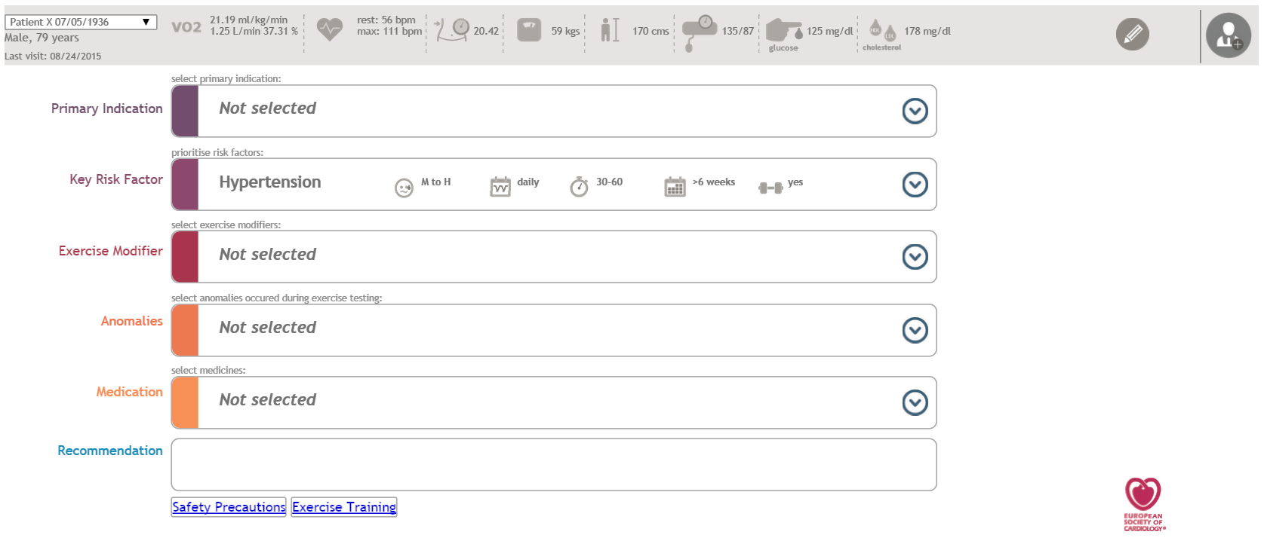
Tool in digital format

Slide 27
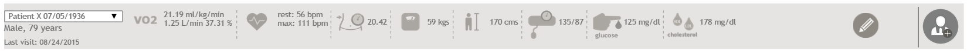
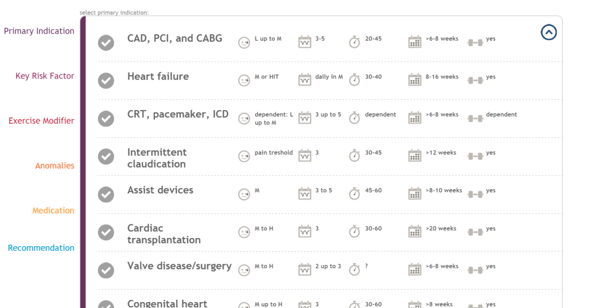
Tool in digital format

Slide 28
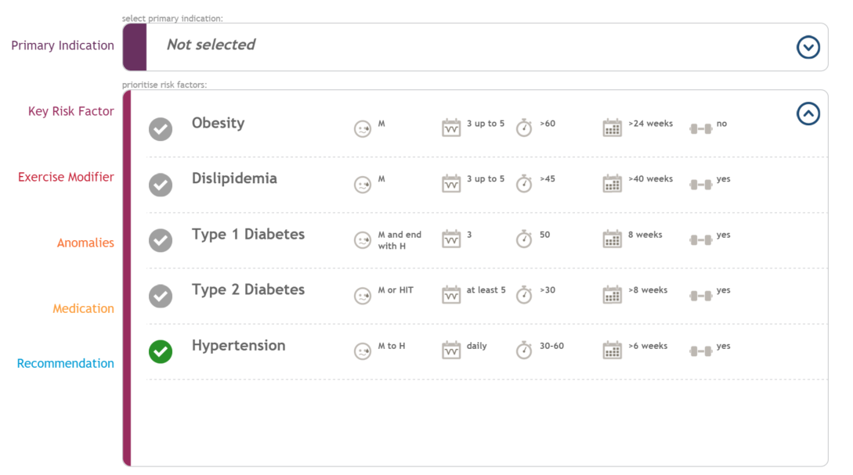
Tool in digital format

Slide 29
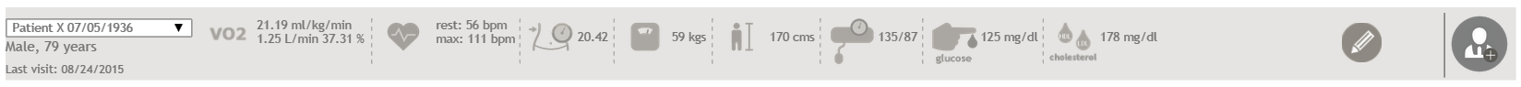
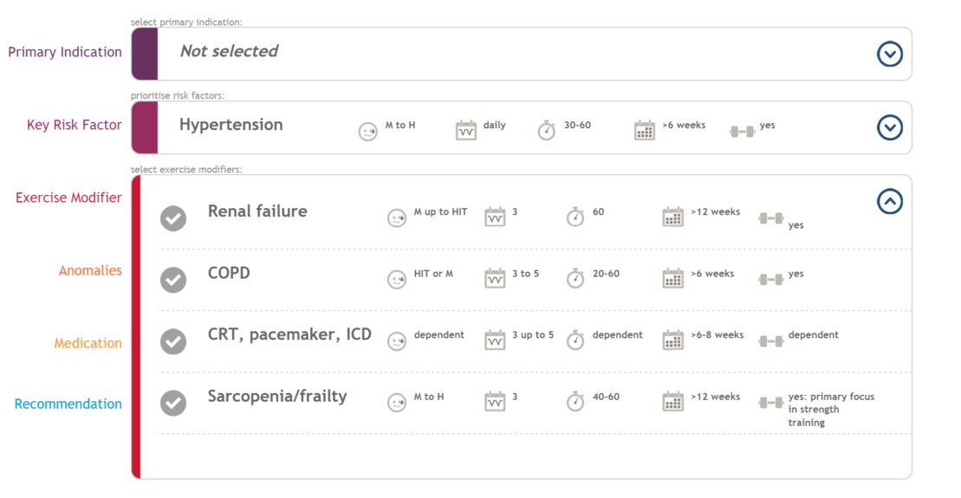
Tool in digital format

Slide 30
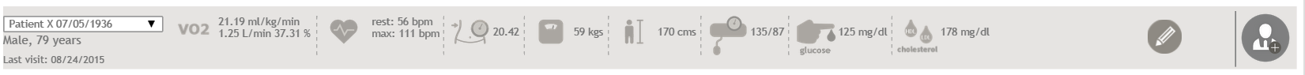
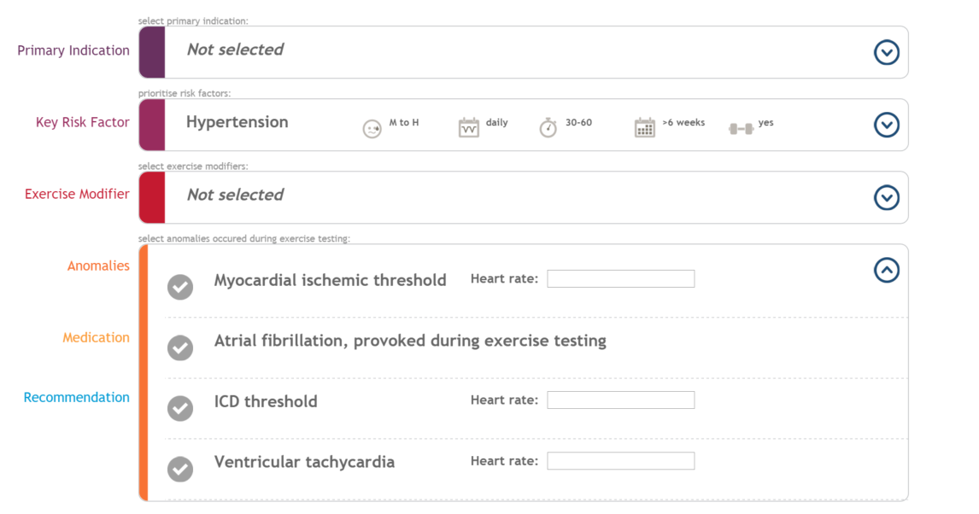
Tool in digital format

Slide 31
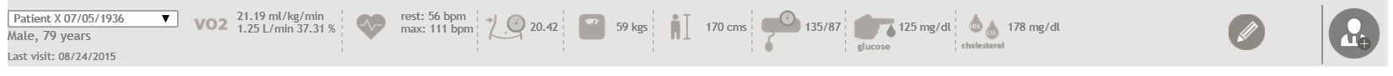
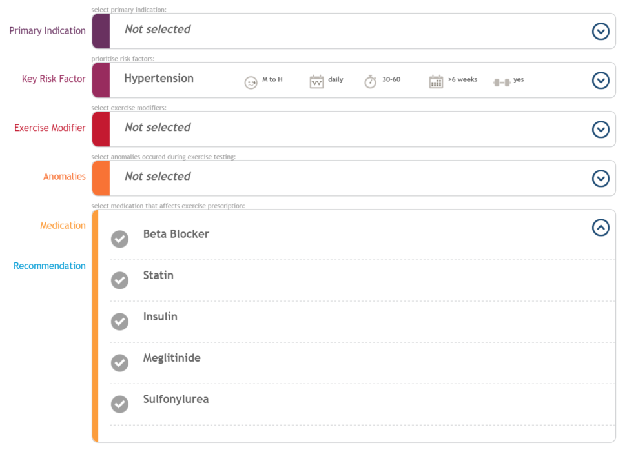
Tool in digital format

Slide 32
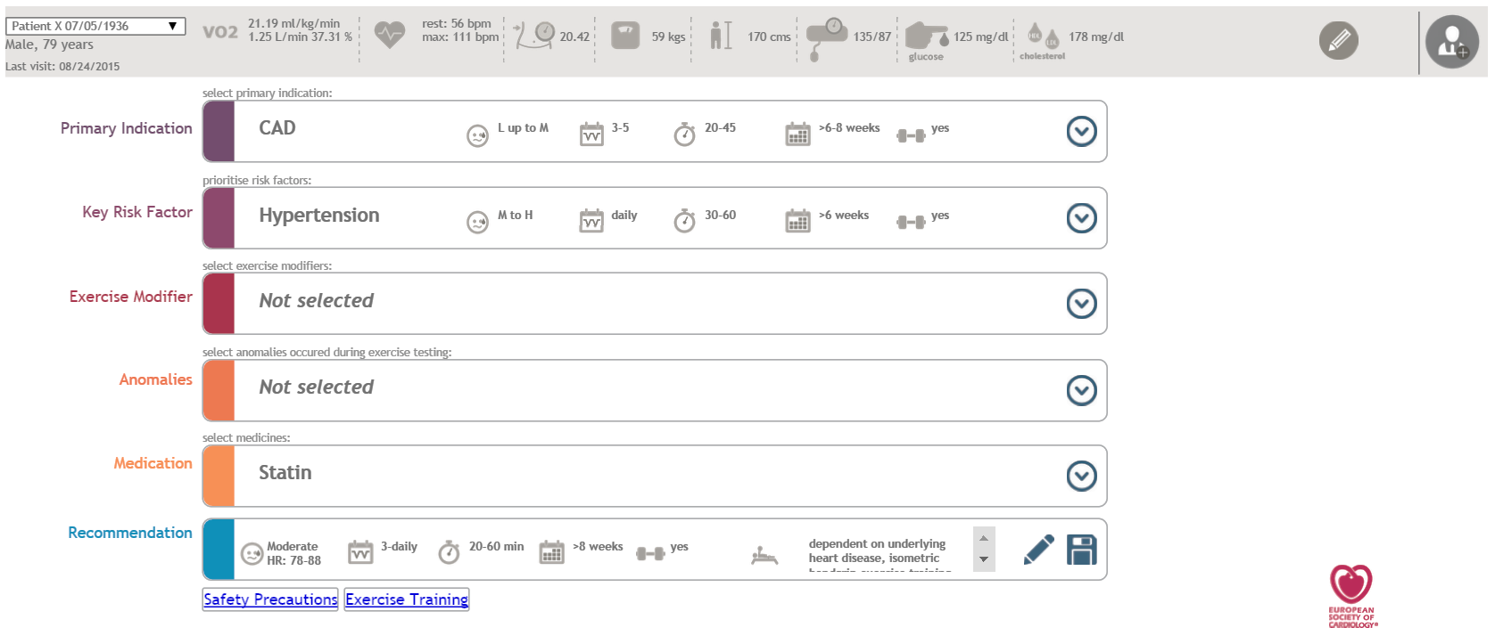
Tool in digital format

Slide 33
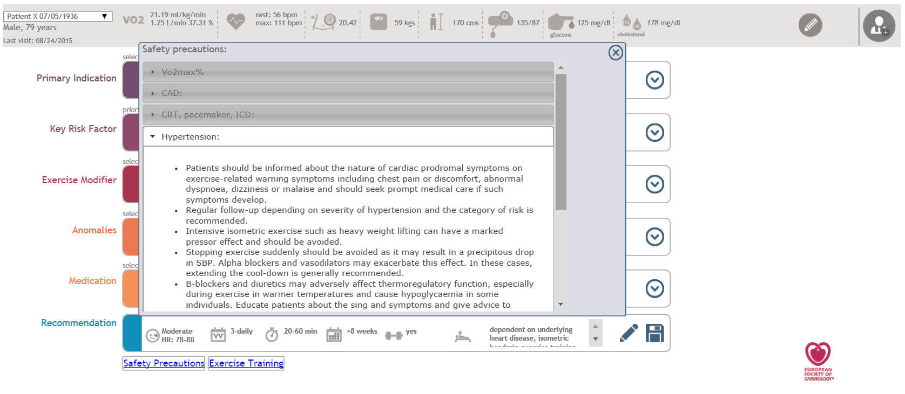
Tool in digital format

Slide 34
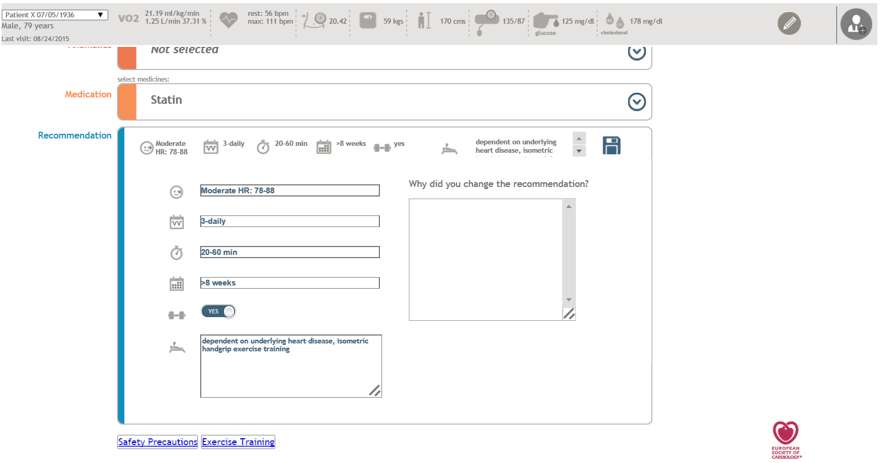
Tool in digital format

Slide 35
Next steps in project
Position papers
Validation phase and first clinical study
Big European study in 2016 and beyond
Continuous update of tool
Extensions on tool

Slide 36

To all colleagues who contribute…
Contact: dominique.hansen@uhasselt.be

