Slide 1

Contemporary health challenges. How can physiotherapy have an impact?
Obesity and physical inactivity
Dominique Hansen, PhD, FESC
Hasselt University, Faculty of Medicine and Life Sciences, Hasselt, Belgium
Heart Centre Hasselt, Hasselt, Belgium

Slide 2


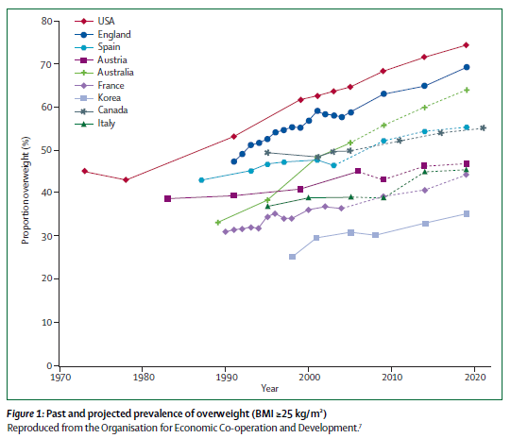
Obesity epidemic

Slide 3
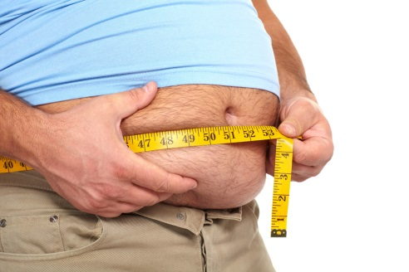

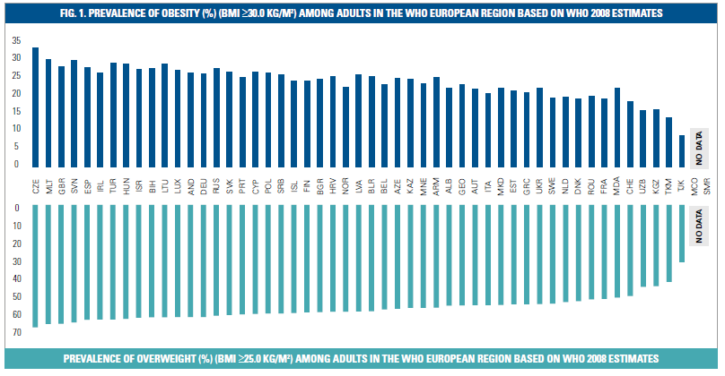
Obesity epidemic

Slide 4
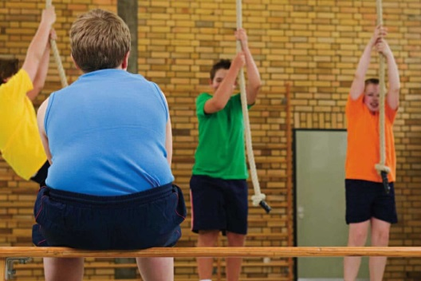
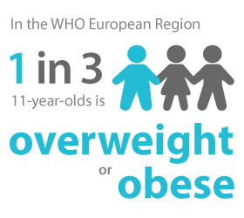
Obesity epidemic

Slide 5
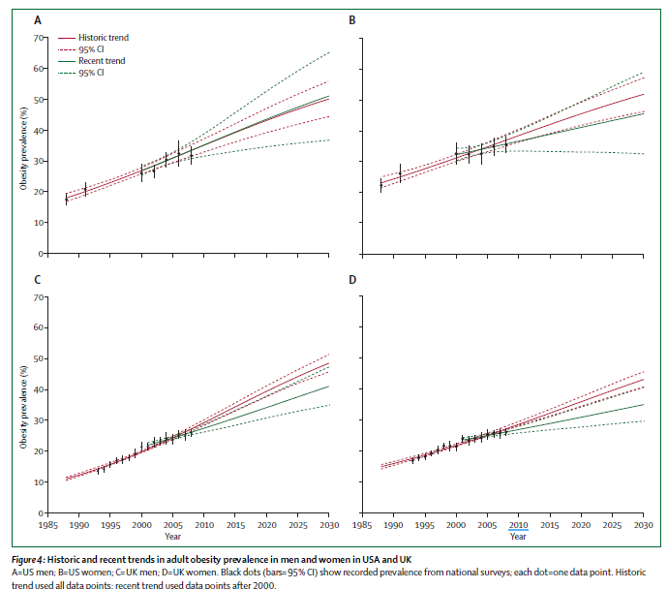
Obesity epidemic

Slide 6
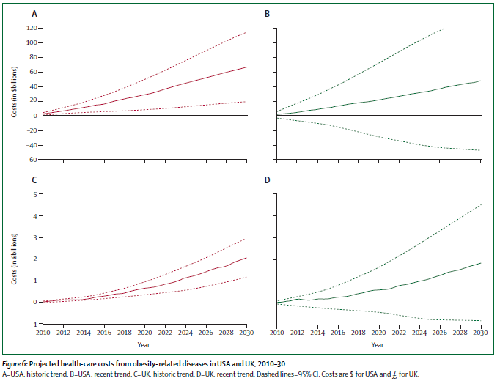
Obesity epidemic
We are currently failing to
suppress the obesity epidemic

Slide 7
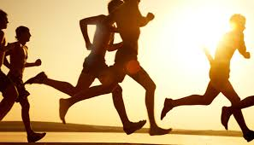
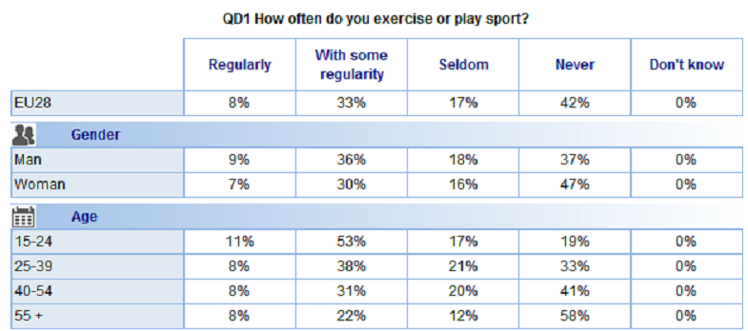
Physical inactivity epidemic
European Opinion Research Group: Eurobarometer Report 2014

Slide 8
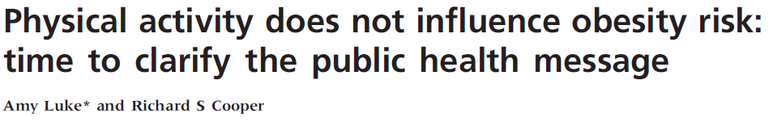
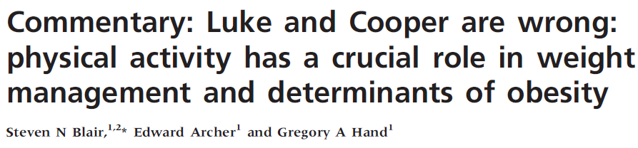
Relation obesity – physical (in)activity

Slide 9

What is the role of the European physiotherapist?
The European physiotherapist plays a crucial role!
They are experts in exercise training in obesity:
  Knowledge of exercise physiology
  Knowledge of pathology/pathophysiology
  Knowledge of pharmacotherapy
  Knowledge of how to approach patients

Slide 10
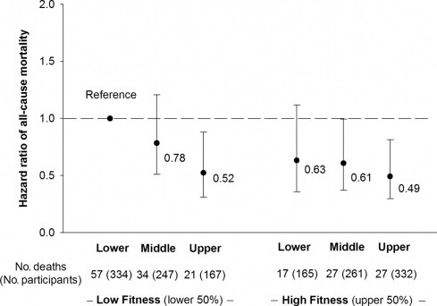
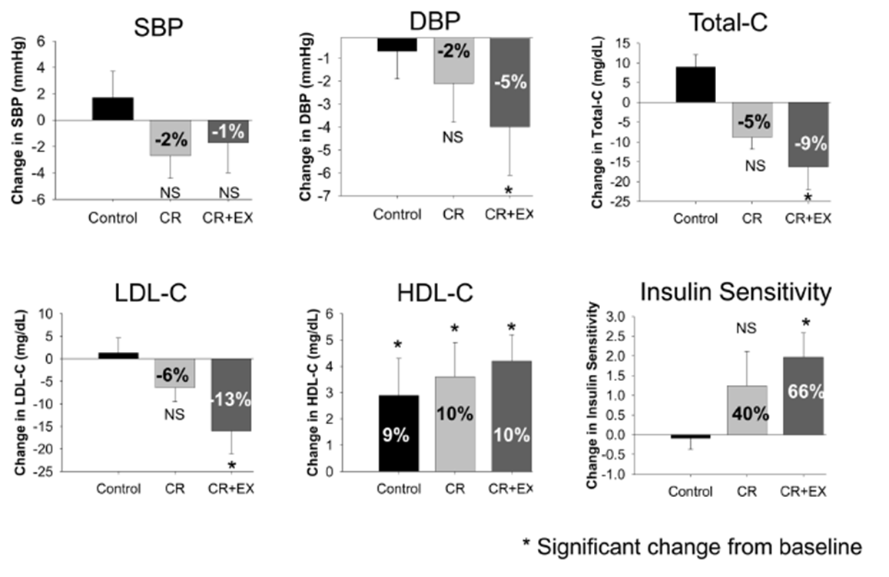
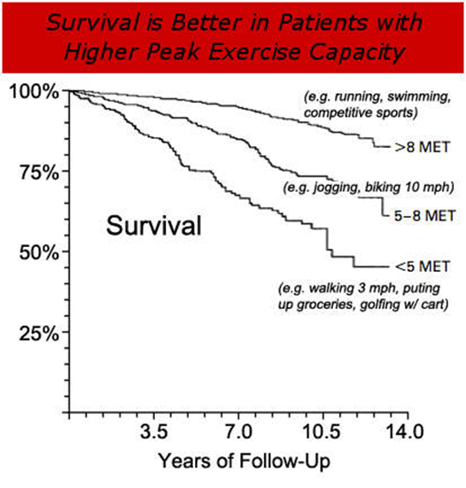
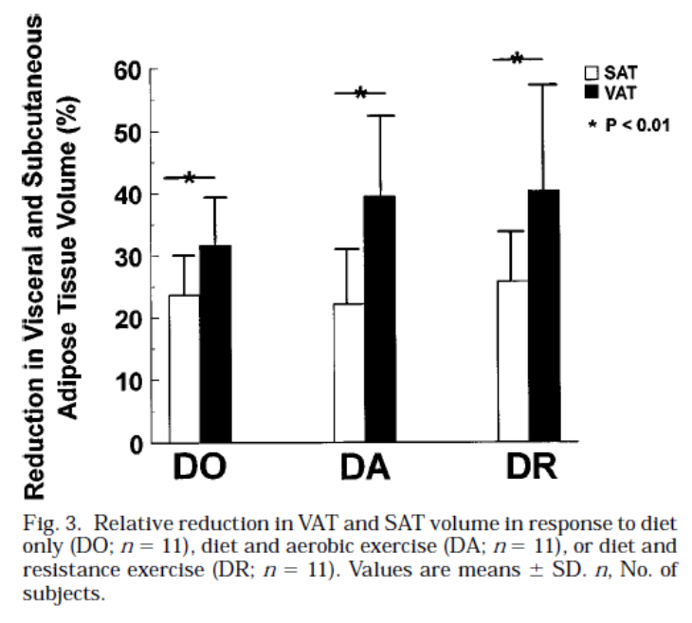
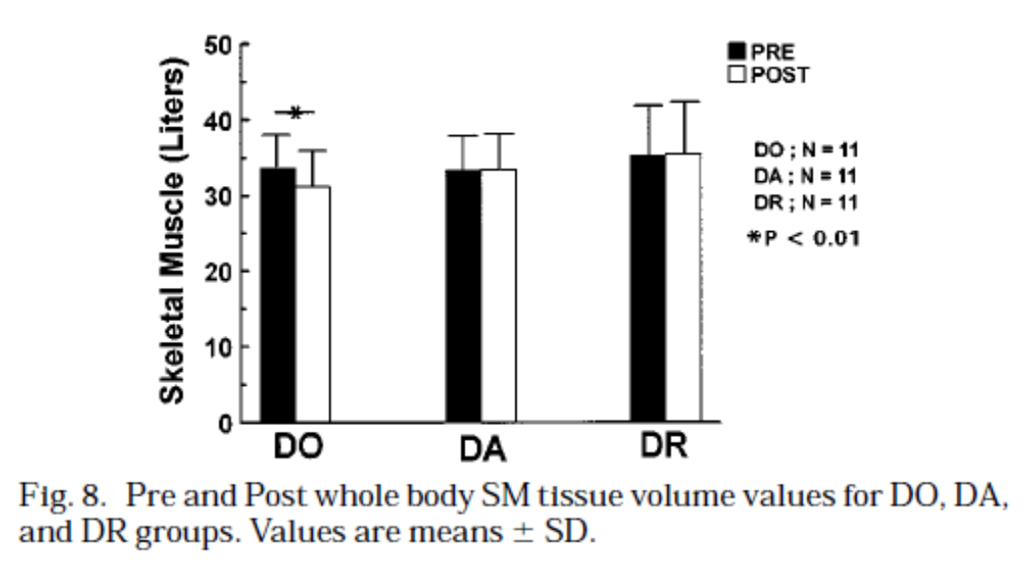
Importance of exercise should not be underestimated
Ross R, et al J Appl Physiol 1996; 81: 2445-55
Larson-Meyer DE, et al. Med Sci Sports Exerc 2010; 42: 152
Myers J. et al. N Engl J Med 2002; 346:793-801.
Artero EG, et al. J Am Coll Cardiol. 2011; 57:1831-1837

Slide 11
Importance of exercise should not be underestimated
Physiotherapy for obese individuals is not only about body weight or adipose tissue mass
  It goes much further: explain so to patients and allied healthcare professionals
Physiotherapy is highly effective in ‘internal diseases’
  Does the term ‘cardiorespiratory physiotherapy’ cover all our competences?

Slide 12
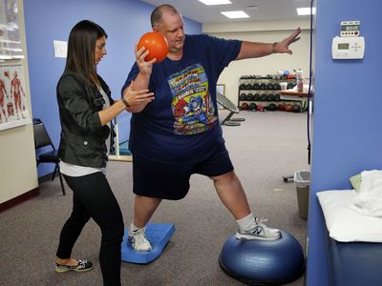
Assess for co-morbidities in our patients

Slide 13

Exercise must be prescribed correct
Exercise training at low intensity
To accelerate fat mass loss
Exercise training in fasted state
Local strength training
To induce local fat mass loss
Exercise should last >45 min
Threshold for better fat mobilisation
Maximize caloric expenditure
Monitor what happens AFTER exercise
Stimulation of daily physical activity
Prevention of compensations in diet
Generate permanent lifestyle change

Slide 14

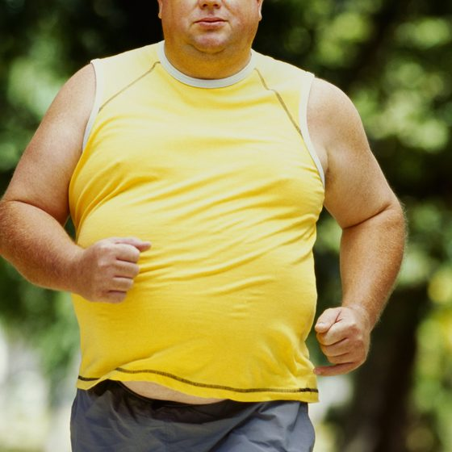
Exercise must be prescribed correct
Different exercise physiology
  Chronotropic incompetence
    HR – workload relation is altered
  Endocrine abnormalities
    Leading to lowered fat mobilisation
  Changes in muscle phenotype
    Lowered type 1 fibre %
  Ventilatory abnormalities
    Lowered tidal volumes
  Be aware of sarcopenic obesity in some patients!
  Elevated risk for orthopaedic injuries

Slide 15
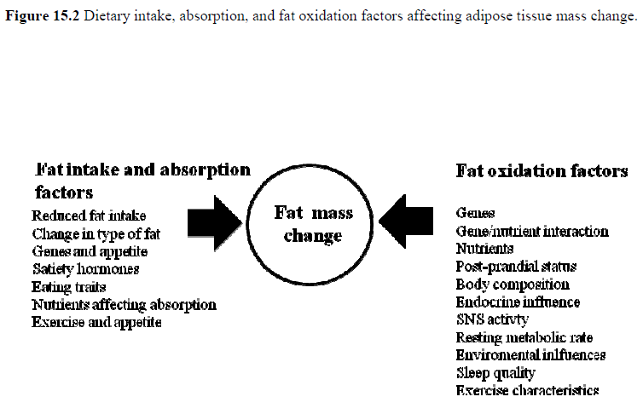
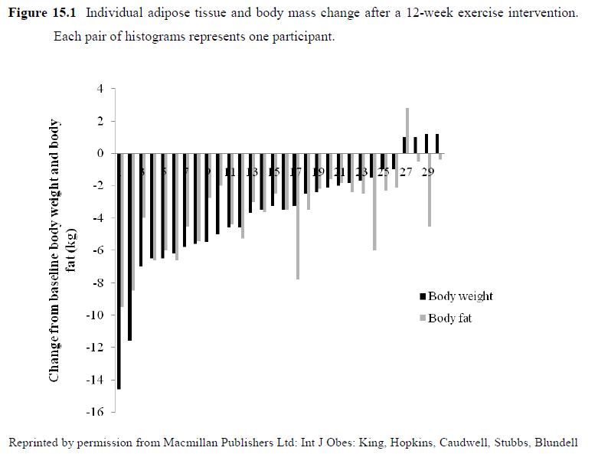
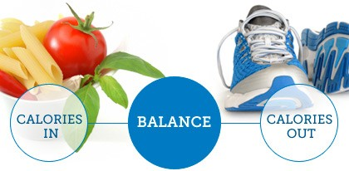
Lifelong learning
Hansen D, Exercise therapy in adult individuals with obesity, New York, 2014, Nova Science Publishers

Slide 16
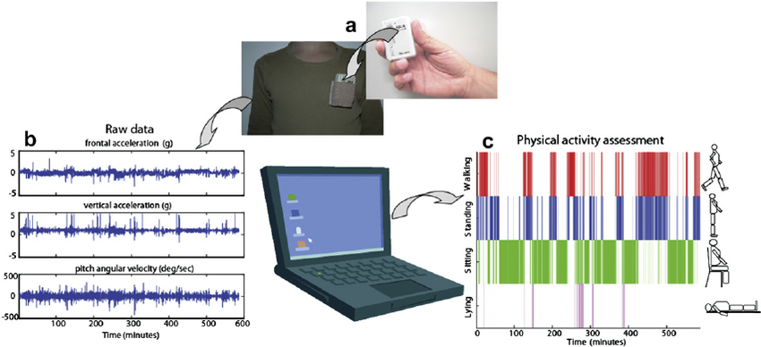


Change in current practice
PROLONGED PROGRAMME
From one-on-one in-practice exercise
LIMITED PROGRAMME DURATION
…to mentoring, coaching and re-assessing

Slide 17
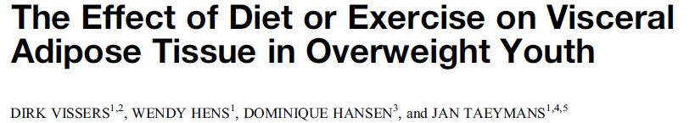

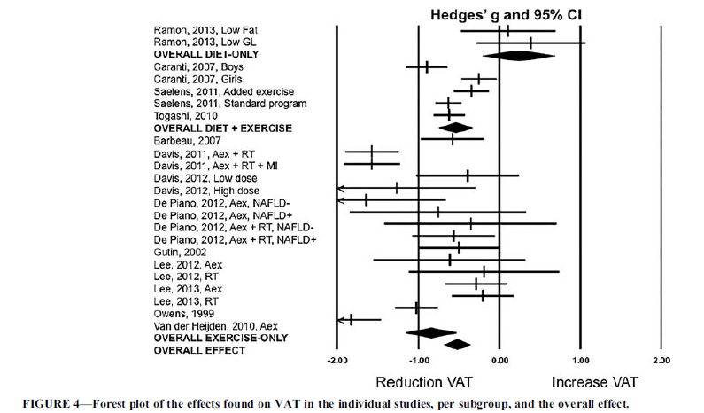
Change in current practice
START AT YOUNGER AGE

Slide 18
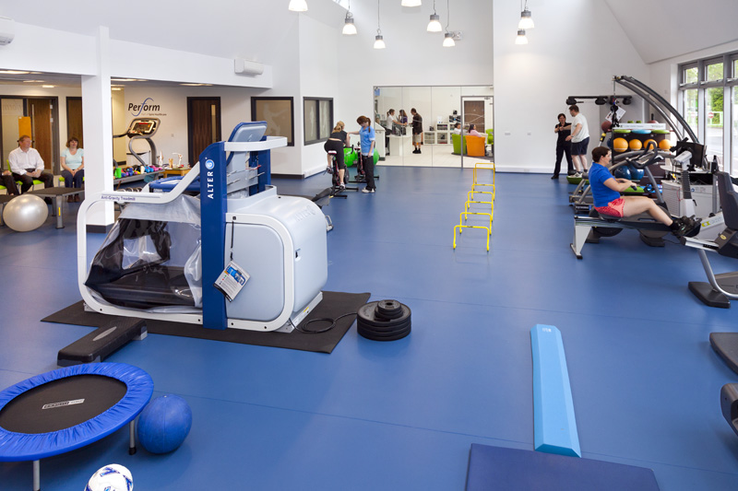
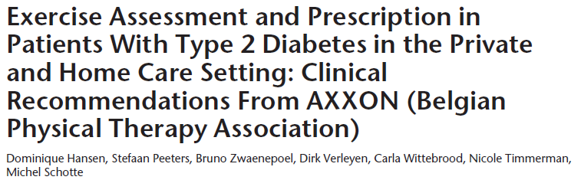


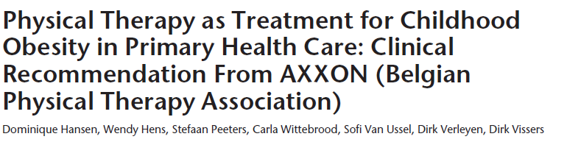

How to apply clinical guidelines in first-line practices?
?

Slide 19

Contact: Dominique.hansen@uhasselt.be

