Slide 1
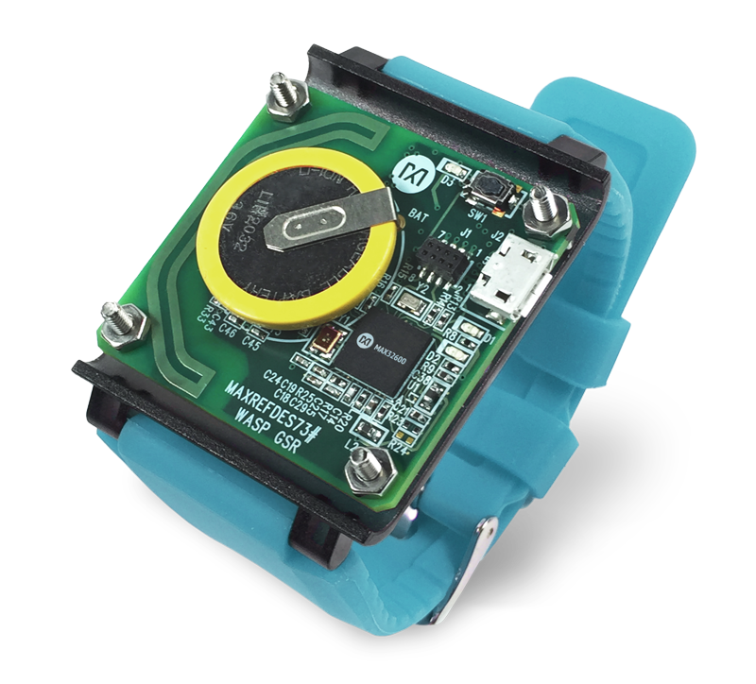
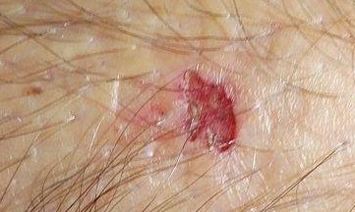
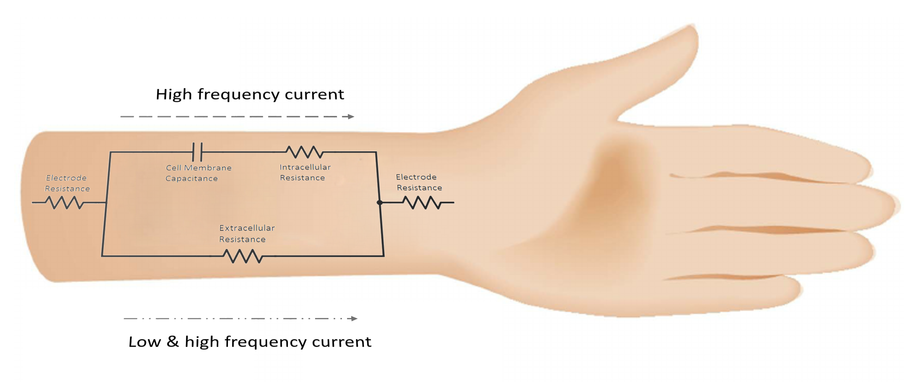
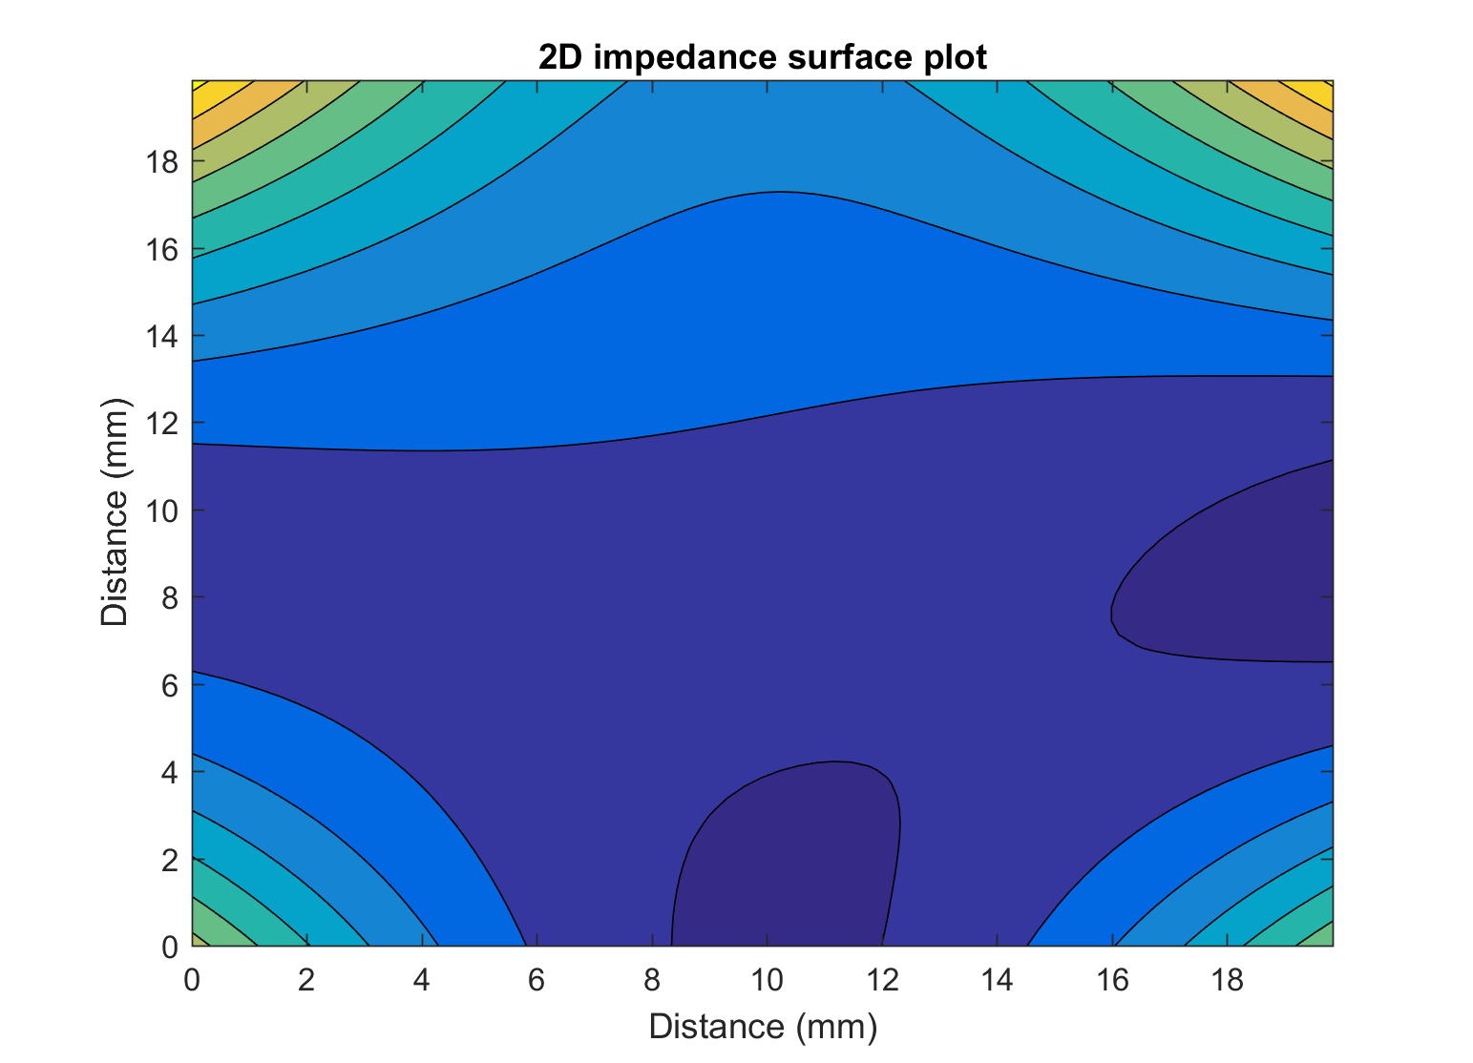
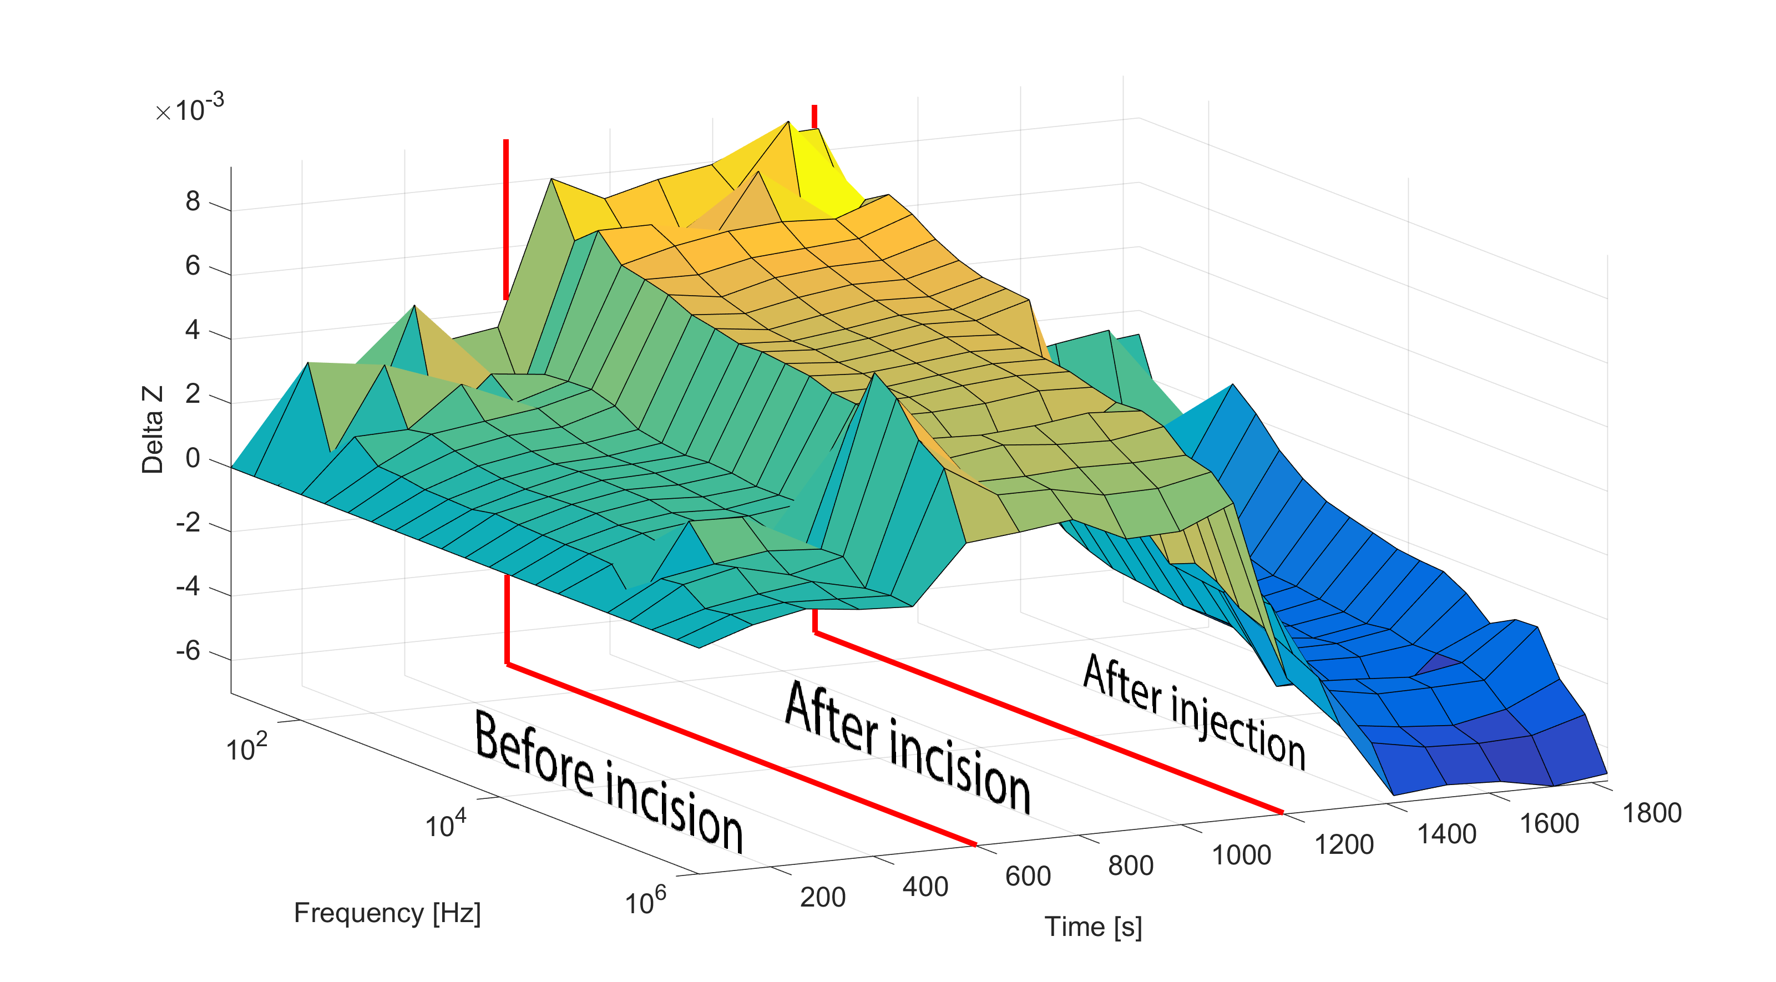


Excluding indecisive decisions by bringing machine learning and Electric Cell-substrate Impedance Sensing (ECIS) together in wound healing
M. Lemmens¹, R. Thoelen^{1,2}, T. Vandenryt¹, W. De Raedt³, L.Grieten^{4,5}
¹Hasselt University, Institute for materials research, Wetenschapspark 1; 3590 Diepenbeek, Belgium
²IMEC vzw division IMOMEC, wetenschapspark 1, 3590 Diepenbeek; Belgium
³IMEC vzw MCP-HDIP Group, Kapeldreef 75, B-3001 Leuven, Belgium
⁴Ziekenhuis Oost-Limburg; Department of Cardiology, Schiepse Bos 6, 3600 Genk, Belgium
⁵Hasselt University; Mobile Health Unit, Faculty of Medicine and Life Sciences, Martelarenlaan 42, 3500 Hasselt, Belgium
Introduction
Monitoring and analysing of chronic wounds is still primarily based on visual inspections and interpretations of medical professionals. By maintaining this method, there is a chance of misinterpretation due to diverse ways of examining the wound. Further, for each assessment the wound dressing needs to be removed, which results into an intermission of the healing process. The Bioelectrical Impedance Spectroscopy (BIS) technique is tested to observe a difference in impedance between a dry- and festering wound. By injecting a solution of 0.9 % NaCl into a wound, representing the fluid in a festering wound, the fluctuations of impedance magnitude is measured. This information in turn can be used to alter the conditions in which a wound is healing so an optimal state of healing can be realized.
Materials & Methods
Monitoring System
Machine Learning
Impedance measurement
The goal is to have a more uniform way of determining the healing stage of a wound. The solution to this consists out of two components, firstly the need to monitor the wound going consecutive through each and every wound healing stage. Besides determining in which stage a wound is in and analyse the behaviour of the wound in each of those stages, it is equally important to monitor the conditions in which the wound is healing in.
This gives us a two-way monitoring system, on the one hand a long term monitoring system is set-up where the phases of wound healing are the point of focus. On the other hand there is a short term monitoring system, this system gives real-time feedback of critical data on how the wound healing is progressing.
Wearable device
Measurement technique | Single-ended
Measurement range | 10 Hz – 16 kHz
Communication | Bluetooth Low Energy
Channels | Single channel
Error rate | 0.2 %
A prediction model is made and can be used to compare new measurements done by the impedance sensor. Predictive features, those who are used in the training dataset to predict the model, need to be extracted from measurements of chronic wounds by the use of the developed impedance sensor.
Measurements are performed by using an array of printed conductive electrodes on a flexible substrate.
Silver printed electrode array
By analysing the acquired magnitude and phase values it is possible to determine the location of the damaged regions of the skin.
2D impedance surface plot
Results
Conclusion
Firstly, the printed electrode sensor array can be used to indicate changes in bio-impedance. With the experiment an increase in impedance magnitude was observed after incision. In contrast, filling of the previously made incision showed a decrease in impedance magnitude, supporting the fact that dry- and festering wounds are characterized by high- and low impedance values respectively.
The incision made with a depth of 1.5 cm resulted in a increase of impedance magnitude. After injecting a solution of 0.9 % NaCl, the impedance showed a decrease.
We thank our colleagues from Q Care Medical Service and Wondzorgcentrum who provided insight and expertise in this research.

