Slide 1
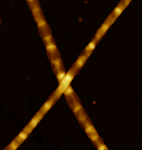








Characterization of the conductive structures in the periplasm of cable bacteria using combined TOF-SIMS/AFM
Raghavendran Thiruvallur Eachambadi, Henricus T.S. Boschker, Valentina Spampinato, Alexis Franquet, Silvia Hidalgo-Martinez, Filip J.R. Meysman, Jean V. Manca
ragha.thiruvallur@uhasselt.be
18.09.2018

Slide 2
Outline
Why study cable bacteria?
Instrumentation
Results
Cable bacteria model

Slide 3
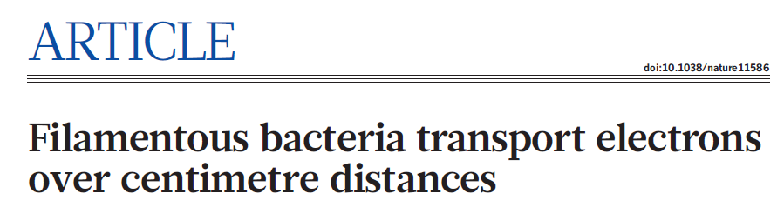
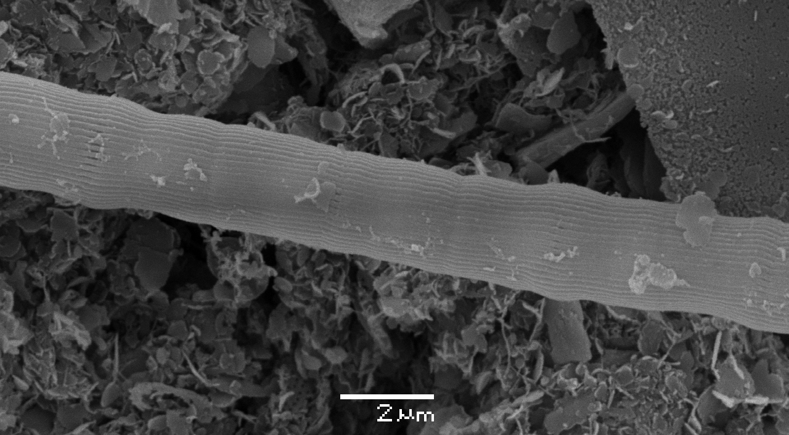
Pfeffer, Christian; Larsen, Steffen; Song, Jie; Dong, Mingdong; Besenbacher, Flemming; Meyer, Rikke Louise; Kjeldsen, Kasper Urup; Schreiber, Lars; Gorby, Yuri A.; El-Naggar, Mohamed Y.; Leung, Kar Man; Schramm, Andreas; Risgaard-Petersen, Nils; Nielsen, Lars Peter
SY Malkin et al., 2014
Notes:
Indications of LDET: EFM, cutting experiment (Oxygen consumption)

Slide 4
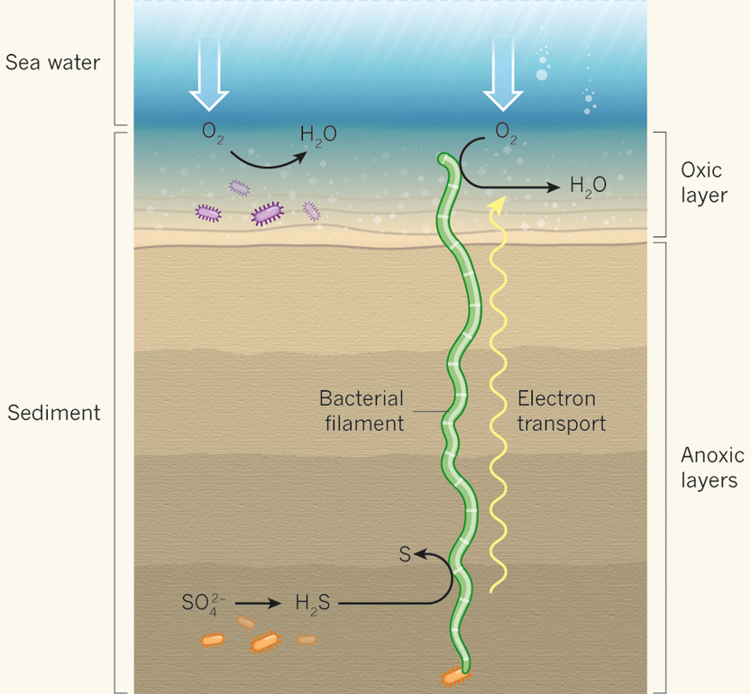
What are cable bacteria?
Long, unbranched chain of cells: >30 mm and up to 2 x 10⁴ cells
Freshwater/saltwater sediments
Respiration via redox reaction
Electron transport in the range of centimeter
Long, unbranched chain of cells: >30 mm and up to 2 x 10⁴ cells
Freshwater/saltwater sediments
Respiration via redox reaction
Electron transport in the range of centimeter
Pfeffer et al. Nature, 2012
Image courtesy: microbial-electricity.eu

Slide 5
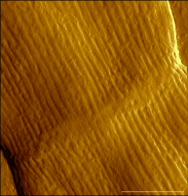
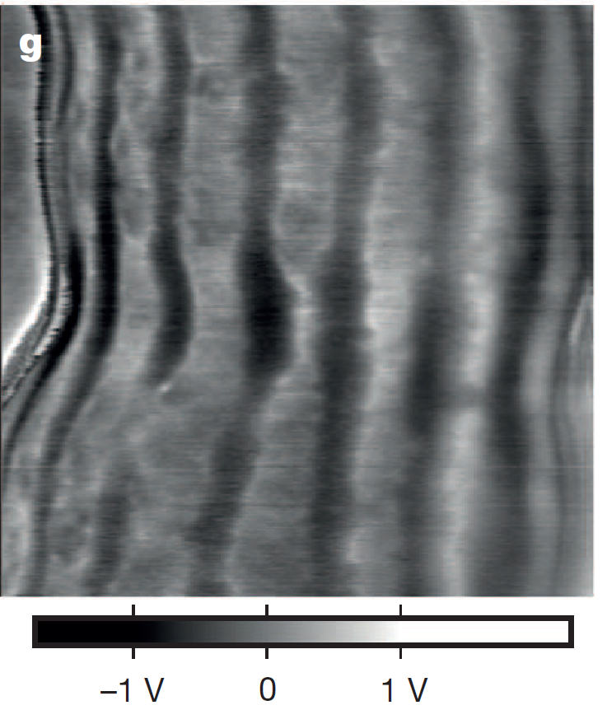
SEM image of a cable bacterium filament
SY Malkin et al. 2014
Electrostatic force microscopy imaging at meeting point of two cells
AFM imaging at junction
R. Cornelissen et al. Manuscript under review
Pfeffer et al. Nature, 2012

Slide 6

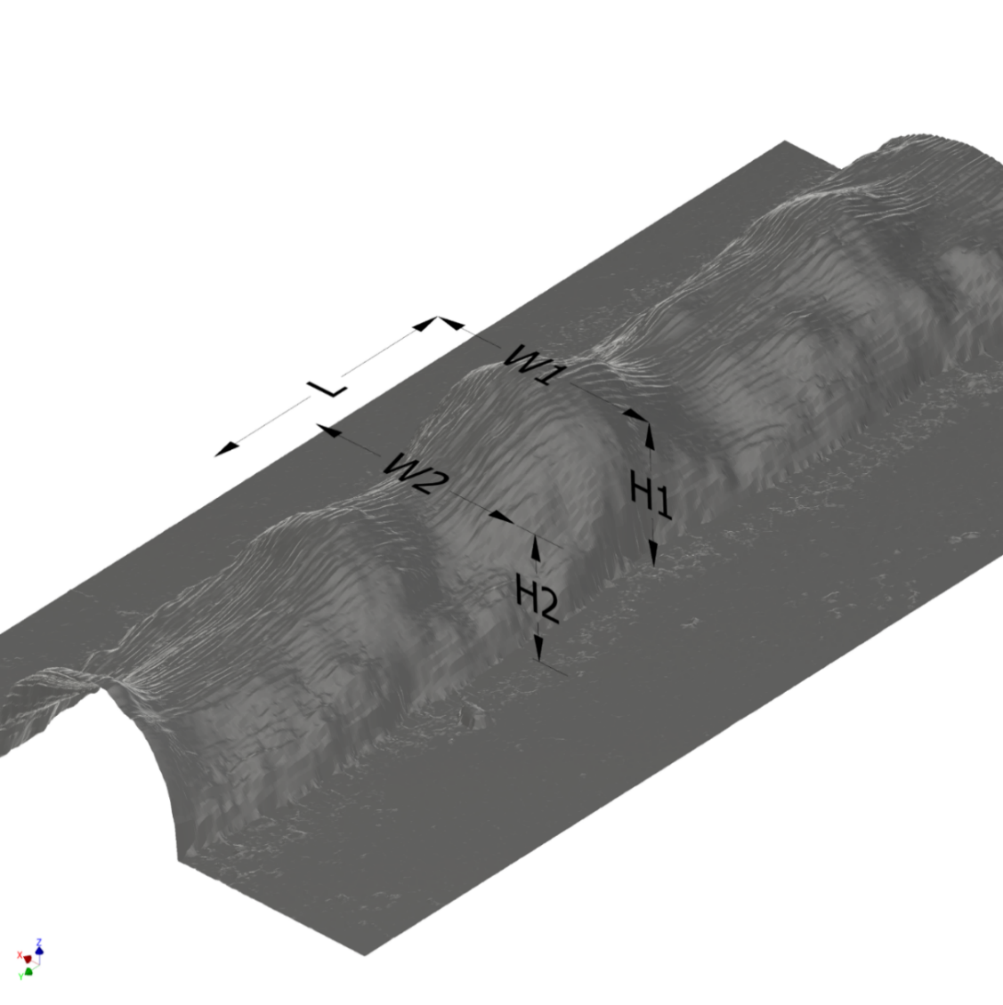
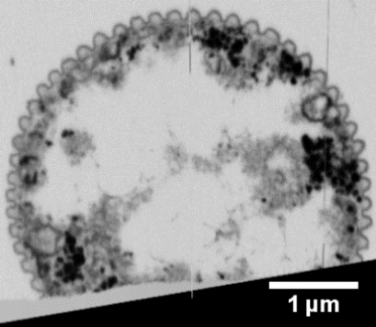
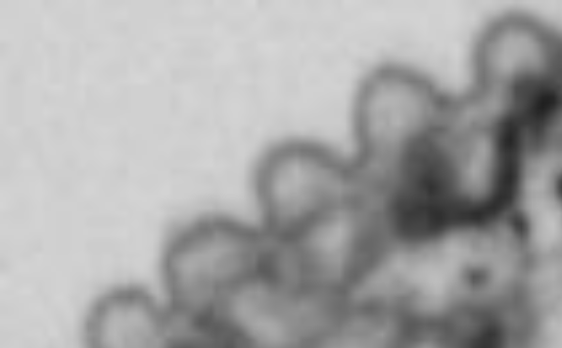
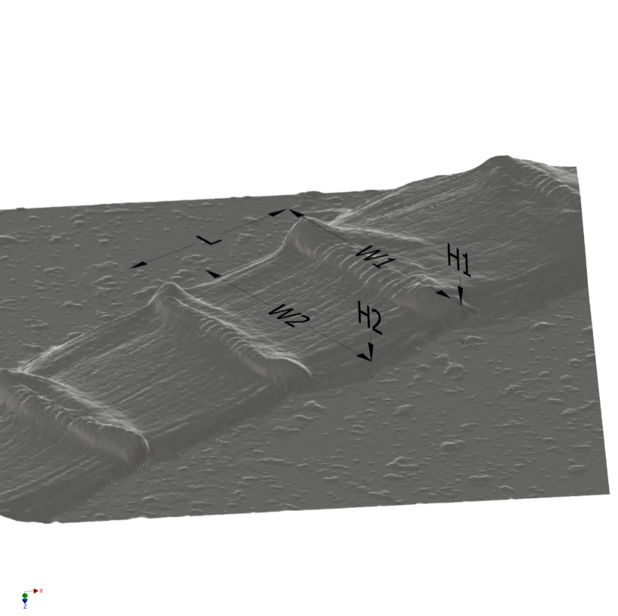
Typical dimensions of a cable bacteria cell
Fiber-to-fiber distance
180±15 nm
Fiber shell
117±10 nm
4.93 µm
3.38 µm
3.71 µm
1.13 µm
Fiber core
46±6 nm
0.87 µm
Extraction procedure
Cross section image from FIB/SEM
3D view obtained from AFM height image
Representative cross-section of a cell body
R. Cornelissen et al. Manuscript under review

Slide 7
Objectives
Composition of the conductive structures c.f. fibers using TOF-SIMS/AFM
Develop a model of electron conduction in cable bacteria

Slide 8
Outline
Why study cable bacteria?
Instrumentation
Results
Cable bacteria model

Slide 9
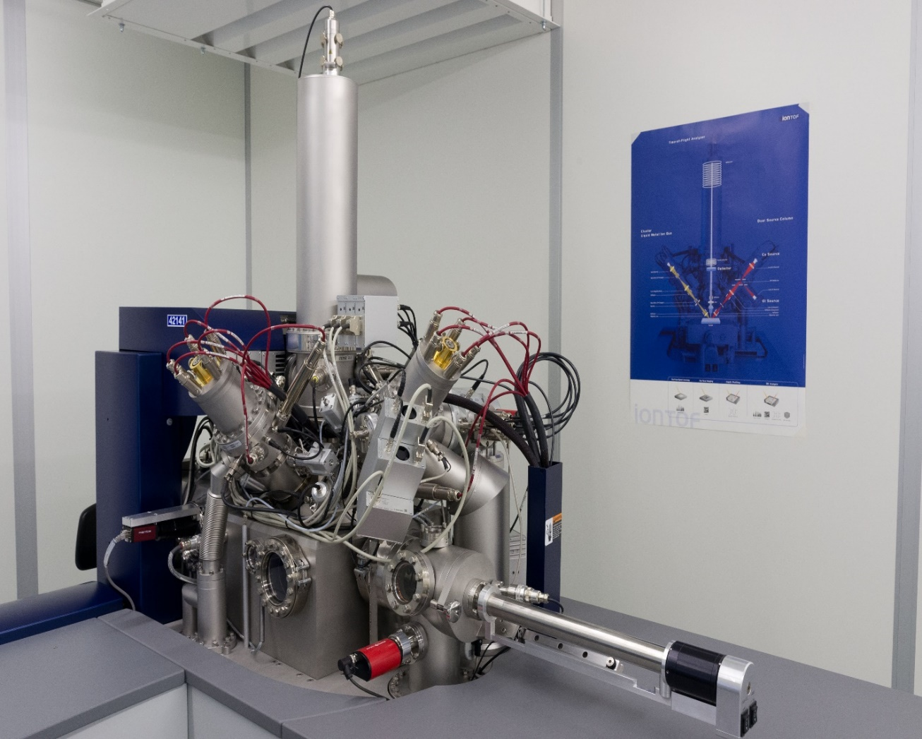
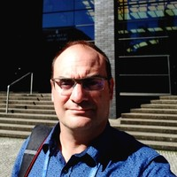

Instrumentation
TOF-SIMS V at imec, Belgium
Sputter source: Ar cluster 10 keV (4000 atoms/cluster); Analysis source: Bi₃⁺ at 30 keV
Depth profiles obtained with alternating sputtering and analysis beams; delayed extraction
In-situ AFM used in contact mode
ToF
O₂, Cs beams
Bi beam
AFM
Ar cluster beam
Ga FIB
Alexis Franquet
Valentina Spampinato

Slide 10
Outline
Why study cable bacteria?
Instrumentation
Results
Cable bacteria model

Slide 11
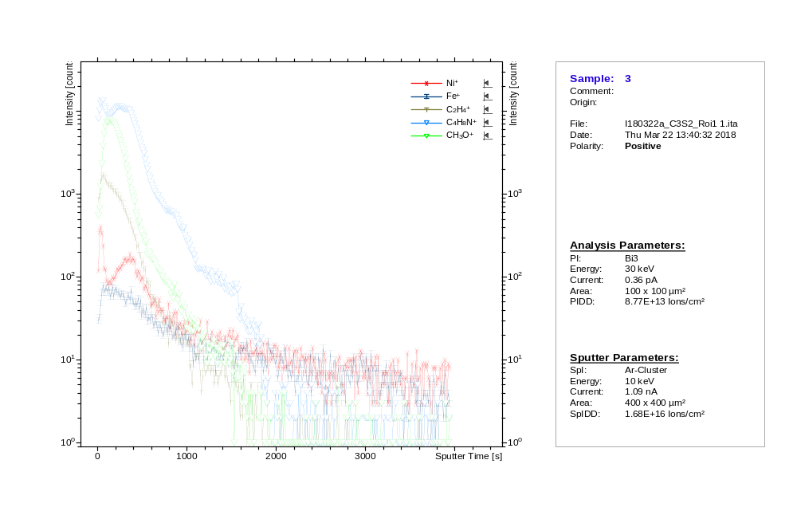
Ni⁺
C₄H₈N⁺
Depth profiling in positive polarity
CH₃O⁺

Slide 12
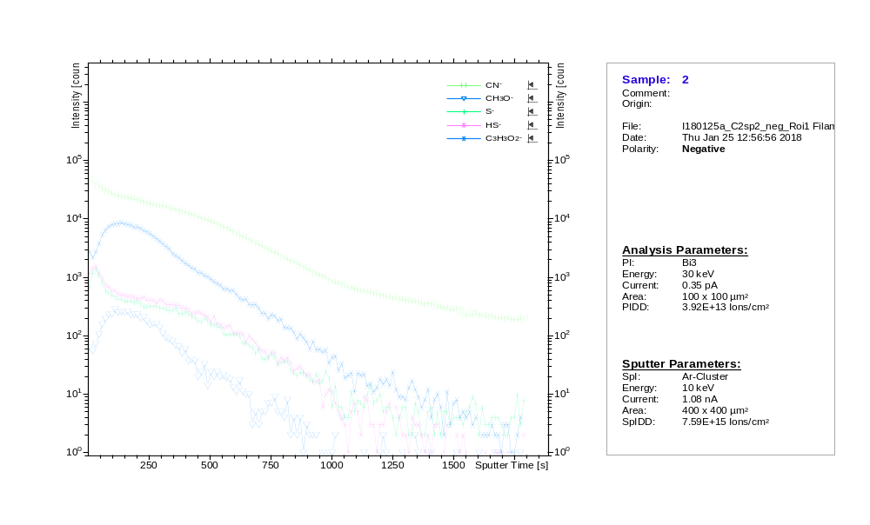
CN⁻
Depth profiling in negative polarity
HS⁻ , S⁻
CH₃O⁻
C₃H₃O₂⁻

Slide 13
Comparison of depth profiling in both polarities
S⁻
C₄H₈N⁺
C₃H₂N⁻
CH₃O⁺
CH₃O⁻
Ni⁺
H.T.S. Boschker, R. T. Eachambadi et al. Manuscript under preparation

Slide 14
ToF-SIMS: 3 most common depth profiles
Nitrogen containing organics:
pos and neg mode → many N and NO containing fragments, characteristic ions of many amino acids (pos mode)
Ni and S:
pos mode → Ni and isotopes
neg mode → S- and isotopes, HS-, C2S-, NaHS-, NaH2S-, C2HS-, CSN-, C3SN-, C2S2-
Oxygen containing organics:
pos mode → CH3+, H3O+, CHO+, CH2O+, CH3O+, C2HO+, C2H2O+, C2H3O+, C2H5O+, C3HO+, C3H5O+, C2H3O2+, C2H4O2+, C3H3O2+, C3H5O2+, CHO2Na2+, C4H2O2Na+
neg mode → CHO-, CH3O-, C2HO-, C2H3O-, CHO2-, C3HO-, CH2ONa-, C3H3O-, C2HO2-, C3H5O-, C2H2O2-, C2H3O2-, C2H4O2-, C4H3O-, C3HO2-, C4H5O-, C3H2O2-, C3H3O2-, C2HO3-, C4H5O2-, C3H2O3-, C3H3O3-, C4H3O3-, C4H5O3- , C4H5O4-, C7H5N2O2-, C5H4N5O-/C4H8NO5-
Protein
Organic ligated NiS group
N
C-C-C-S-S-Ni⁺
Polysaccharides
H.T.S. Boschker, R. T. Eachambadi et al. Manuscript under preparation

Slide 15
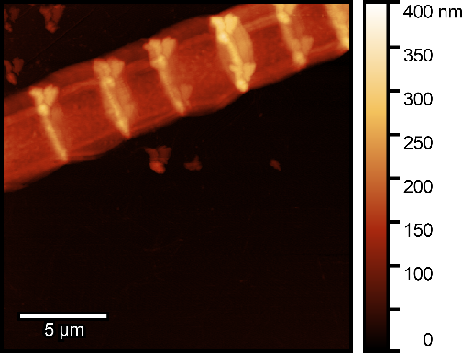

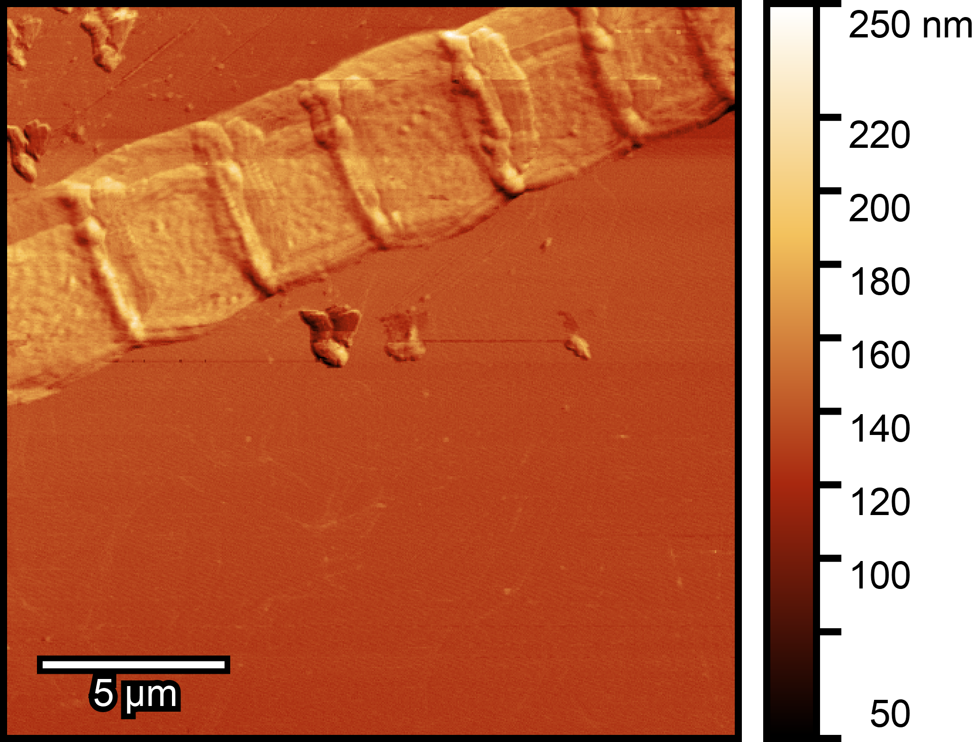
Calibration of sputter depth with the in-situ AFM
Ni and S
N-org
O-org
Before Sputter
After sputter
Difference image
H.T.S. Boschker, R. T. Eachambadi et al. Manuscript under preparation

Slide 16
Outline
Why study cable bacteria?
Instrumentation
Results
Cable bacteria model

Slide 17
Cable bacteria model
Protein rich fibers (N-organics)
ca. 100 nm
Ni and S rich core
Polysaccharide rich layer that holds the fibers together (O-organics)
H.T.S. Boschker, R. T. Eachambadi et al. Manuscript under preparation

Slide 18
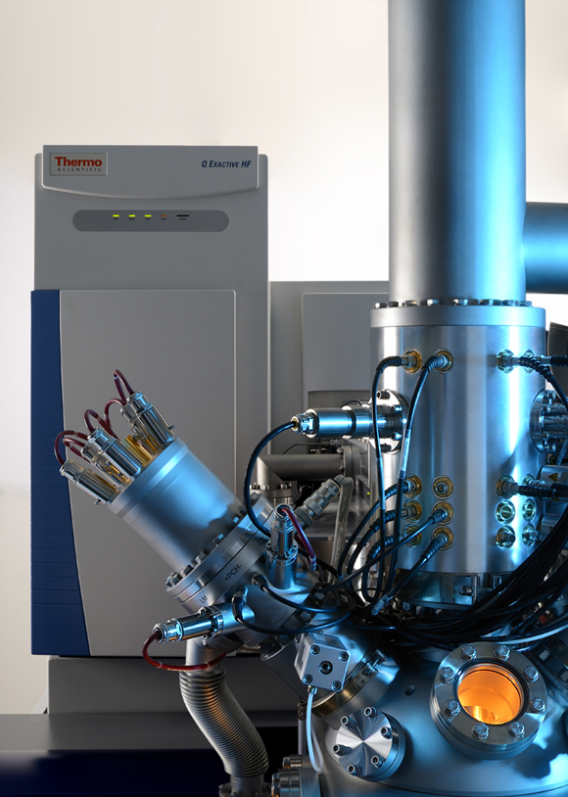
Hybrid SIMS
Provides high mass resolution (>240k) and mass accuracy (<1 ppm)
Gas cluster imaging
Dual analyser: TOF and Orbitrap
Advantageous in biological samples
Hybrid SIMS: courtesy: iontof.com

Slide 19

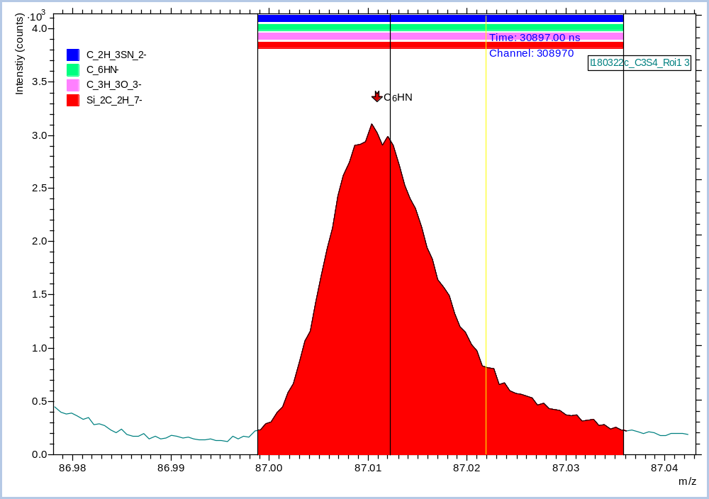
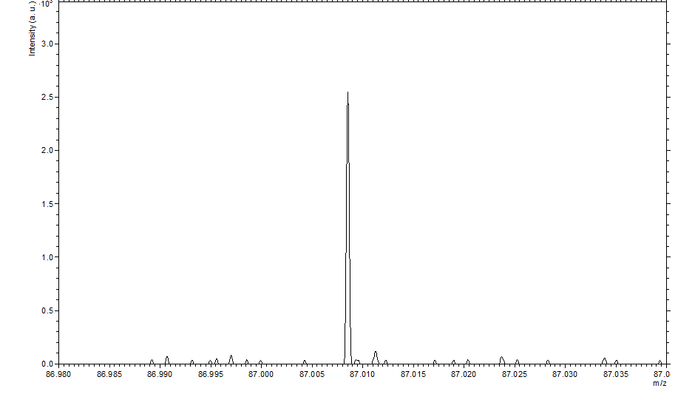
Hybrid-SIMS: Better peak identification
ToF-SIMS (Res ~ 6 k)
Orbitrap-SIMS (Res ~300 k)
Intensity (counts)
Intensity (counts)
C₂H₃SN₂⁻
C₆HN⁻
C₃H₃O₃⁻
Si₂C₂H₇⁻
C₃H₃O₃⁻ 87.0082
Si₂C₂H₇⁻ 87.0087
C₂H₃SN₂⁻ 87.0017
C₆HN⁻ 87.0109
m/z
m/z
The highly increased mass resolution of Orbitrap-SIMS leads to much better peak identification for organic biological samples (Mz > 75)
Notes:
The main issue was to separate H3H3O3- from C6HN-. Si2C2H7- is also a less likely fragment as it contains Si which is low in the samples. C2H3SN2- is already too far off in ToF-SIMS.

Slide 20
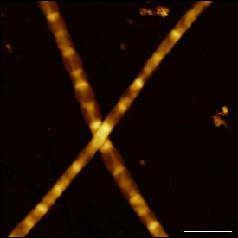

ThanX for your attention!
Acknowledgements
X-LAB/UHasselt :
R. Bonné, R. Cornelissen, J. L. Hou, J. V. Manca, B. Cleuren, R. Valcke
UAntwerpen :
H. T. S. Boschker, S. Hidalgo-Martinez, J. Geelhoed, F. J. R. Meysman
Imec :
Valentina Spampinato, Alexis Franquet
Funding :
UHasselt and FWO/Hercules

Slide 21
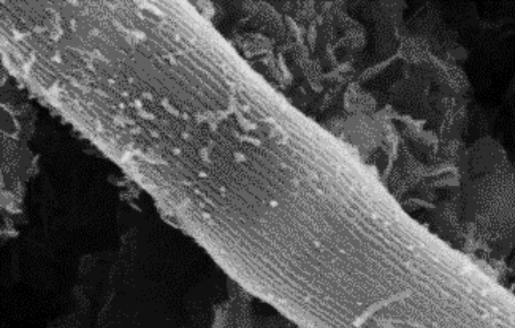

Why makes cable bacteria interesting?
Abundance in different environments
Electron transport over cm length scale
Potential applications in bio-electronics
Conduction mechanism unknown: Analysis needed
SEM image of a cable bacterium filament

Slide 22
Sample preparation (extraction treatment)
Washed in MilliQ water
Incubation for 10 min at RT in a 1 % (w/w) aqueous solution of sodium dodecyl sulfate (SDS); wash in MilliQ
Incubation for 10 min at RT in 1 mM aqueous solution of ethylene diamine tetra acetic acid (EDTA), incubated for 10 min at RT
“Extracted” filaments laid on gold sputtered Si substrates
3.85 µm
3.05 µm
3.78 µm
0.32 µm
0.12 µm

Slide 23
Understanding the structure of Cable bacteria
Focused Ion Beam/Scanning electron microscopy imaging
1 µm
1 µm
1 µm
Cell junction
Cell body
R. Cornelissen et al. Manuscript under review

Slide 24
Structural composition of cable bacteria
Ridge segment
Outer membrane
(4 µm)
Radial connection
Periplasm
Fiber (50 nm)
Fiber (50 nm)
Outer membrane
(4 µm)
Inner membrane
Central node
Cytoplasm
Cross-section at the cell body
Cell junction
The conductive structures are present in the periplasm!
3D representation of cable bacteria
R. Cornelissen et al. Manuscript under review

Slide 25
Conductive fibers
1 µm
After extraction treatment
Conducting fiber (50 nm)

Slide 26
Cable bacteria model
Protein rich fibers
ca. 100 nm
Ni and S rich core
Polysaccharide rich layer that holds the fibers together (peptidoglycan?)
Often only first transition most clearly visible in ToF-SIMS:
Smearing of depth profiles by uneven sputtering with depth
Signal from junctions
Variation in SDS+EDTA extraction efficiency
H.T.S. Boschker, R. T. Eachambadi et al. Manuscript under preparation

Slide 27
Future work
To use Ar cluster as analysis beam to study higher m/z data
To understand the exact location of elements such as Ni and S using fast imaging techniques
To study electrical properties such as conductivity and relative permittivity using the in-situ AFM

Slide 28
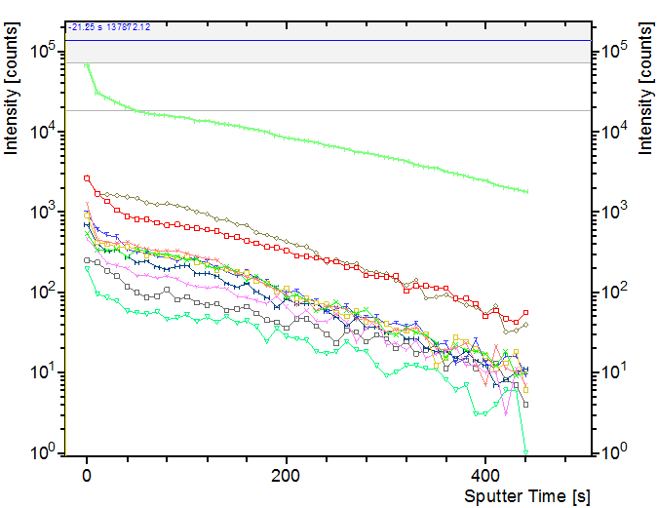
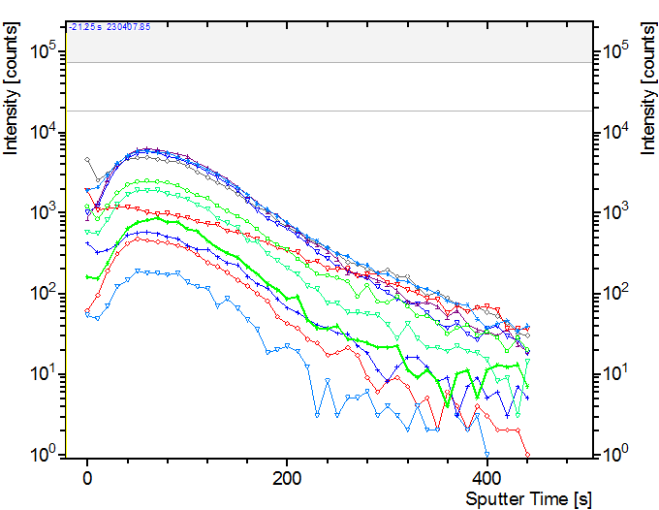
Depth profiling in negative polarity
All N-organics
All O-organics
H.T.S. Boschker, R. T. Eachambadi et al. Manuscript under preparation

Slide 29
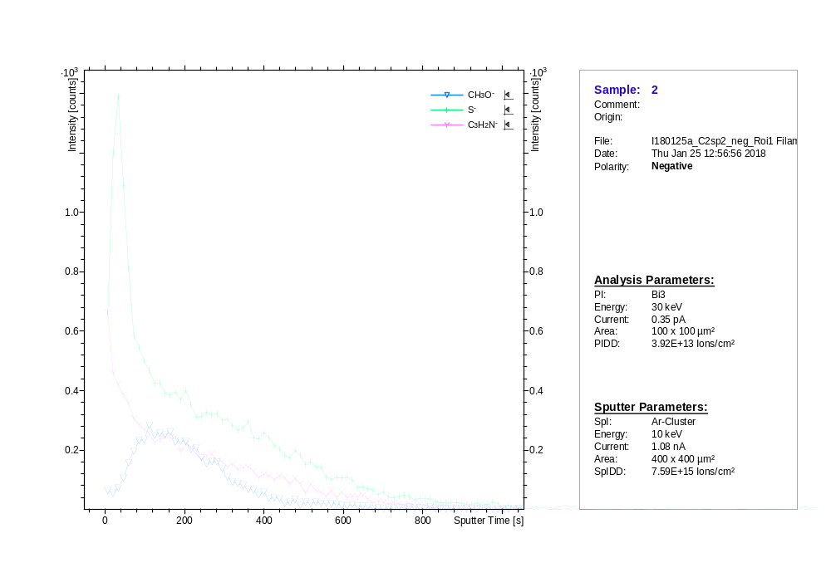

Slide 30
Typical dimensions of a cable bacteria cell
Fiber-to-fiber distance
180±15 nm
4.93 µm
3.38 µm
Fiber shell
117±10 nm
3.71 µm
1.13 µm
0.87 µm
Fiber core
46±6 nm
Cross section image from FIB/SEM
3D view obtained from AFM height image
R. Cornelissen et al. Manuscript under review

Slide 31
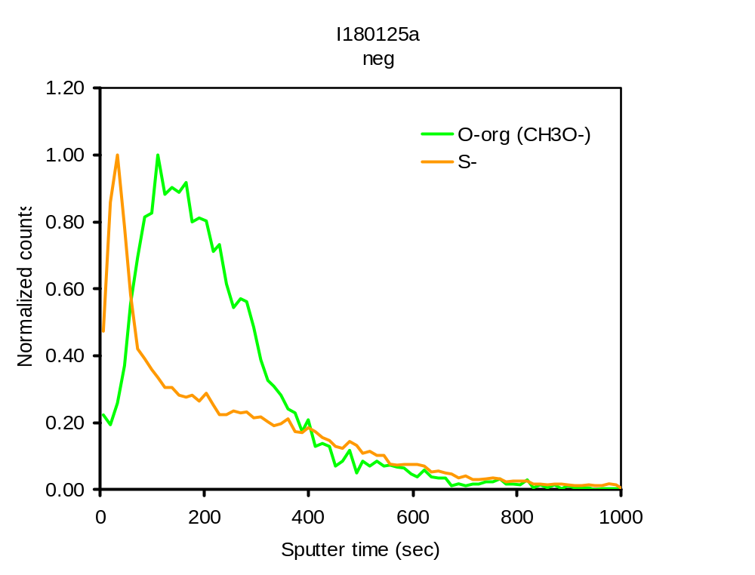
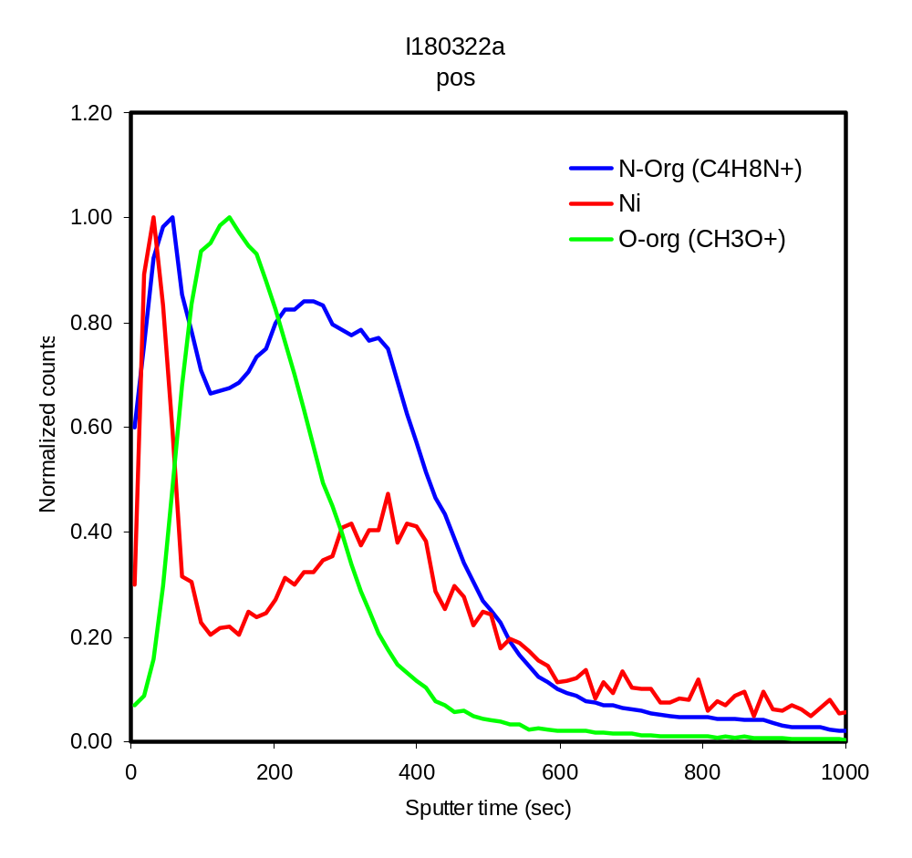
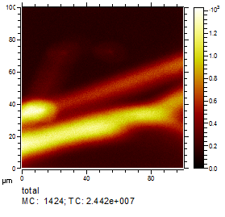
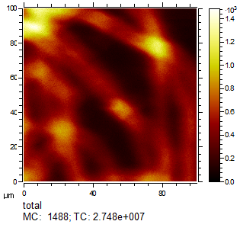
Comparisons of depth profiling in both polarities
Normalized counts
Sputter time (sec)
Sputter time (sec)
H.T.S. Boschker, R. T. Eachambadi et al. Manuscript under preparation

