Slide 1

The benefits: exercise and cardiometabolic disease
Dominique Hansen, PhD, FESC

Slide 2
Faculty Disclosure
The presenter has advised that the following presentation will NOT include discussion on any commercial products or service and that there are NO financial interests or relationships with any of the Commercial Supporters of this years ASM.

Slide 3
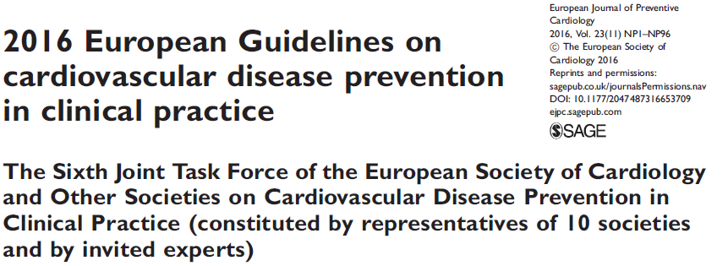
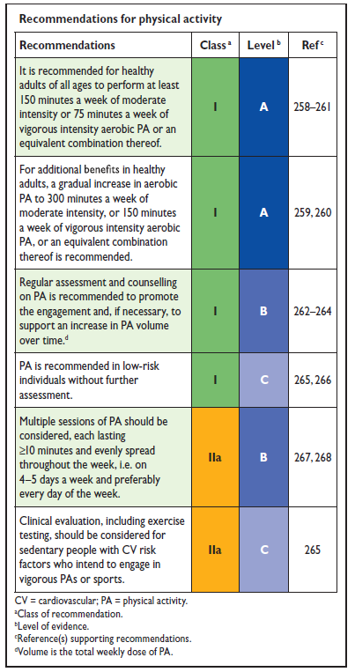
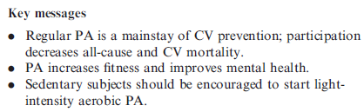
Exercise in cardiovascular disease: guidelines
Piepoli MF, et al. Eur J Prev Cardiol 2016;23:NP1-96

Slide 4

But do we follow and implement these guidelines?

Slide 5
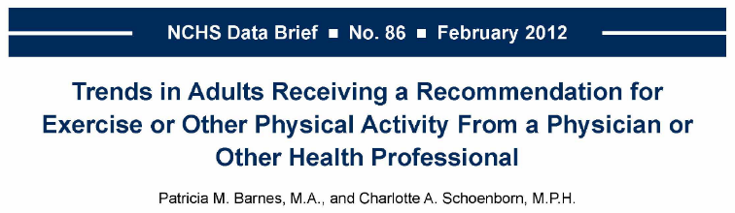
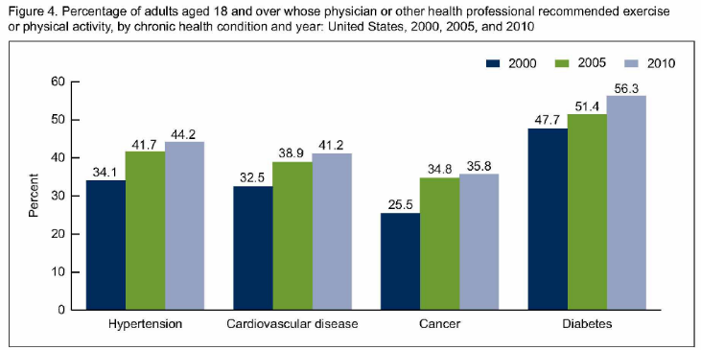
Do we adhere to the guidelines?

Slide 6
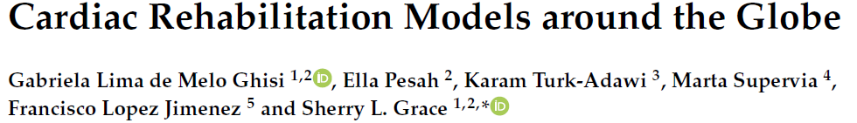
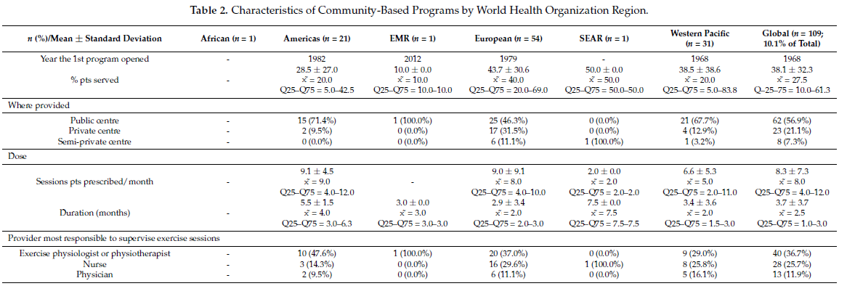
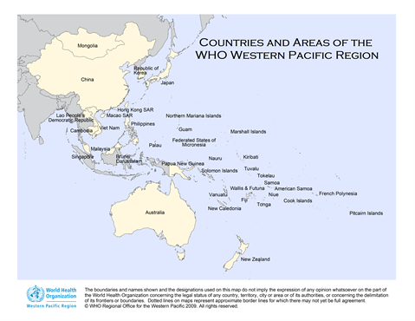
Do we adhere to the guidelines?

Slide 7
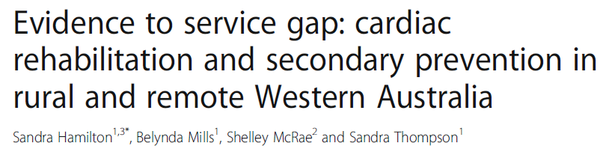
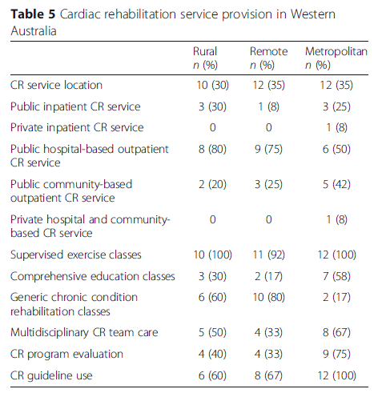
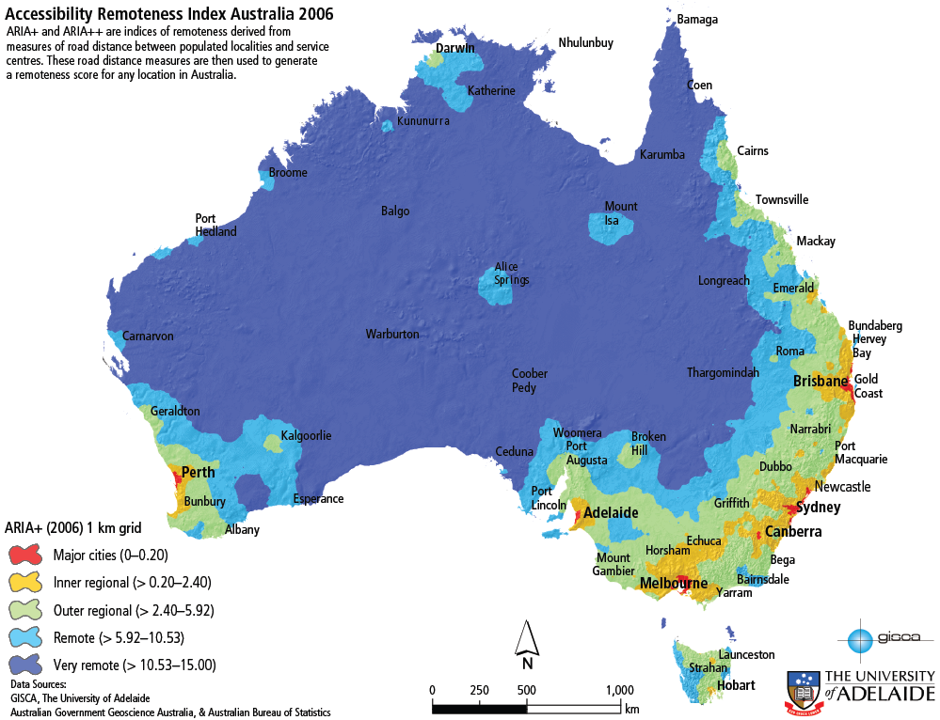
Do we adhere to the guidelines?

Slide 8

Physical activity in healthy people: why?

Slide 9
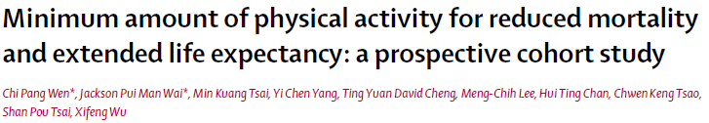
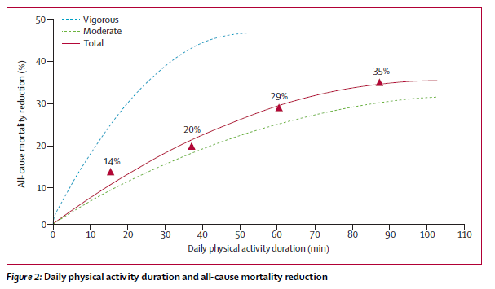

Physical activity in healthy people: why?

Slide 10
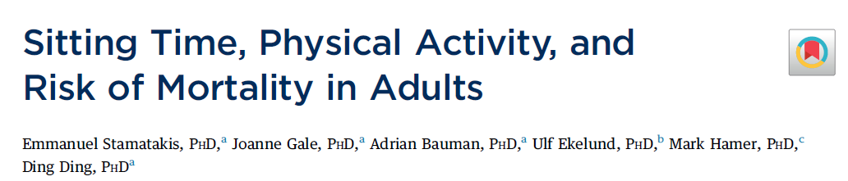
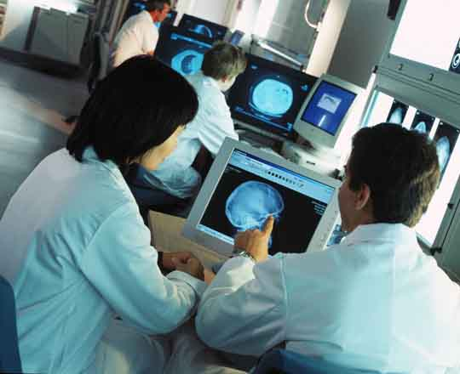

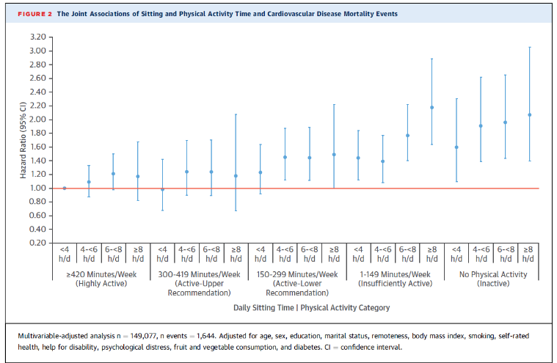
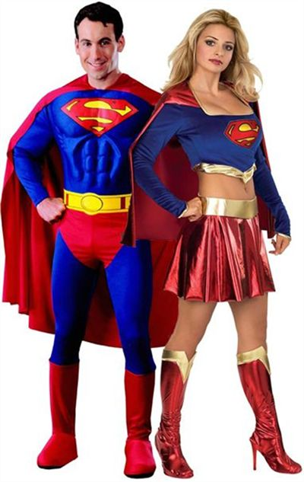

Physical activity in healthy people: why?
149,077 participants over an 8.9-year (median) follow-up

Slide 11

Seven days of bed rest in healthy individuals leads to:
  1.4 kg muscle mass loss
  7% reduction in muscle strength
  8% reduction in skeletal muscle oxidative capacity
  6% reduction in VO_{2peak}
  29% reduction in insulin sensitivity
Dirks M, et al. Diabetes. 2016; 65: 2862-75

Slide 12

Physical activity in people with cardiometabolic disease: why?

Slide 13

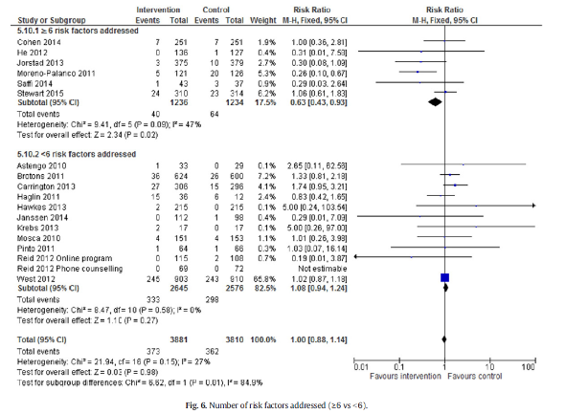
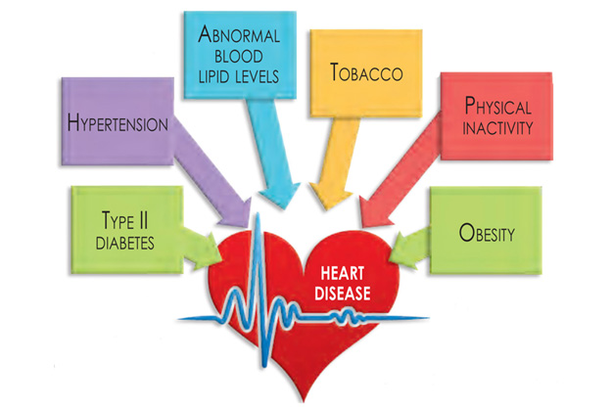
Importance of CVD risk factor management

Slide 14

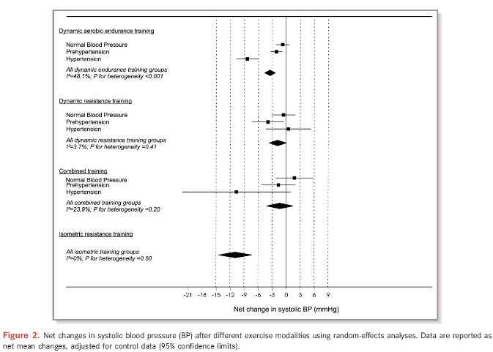

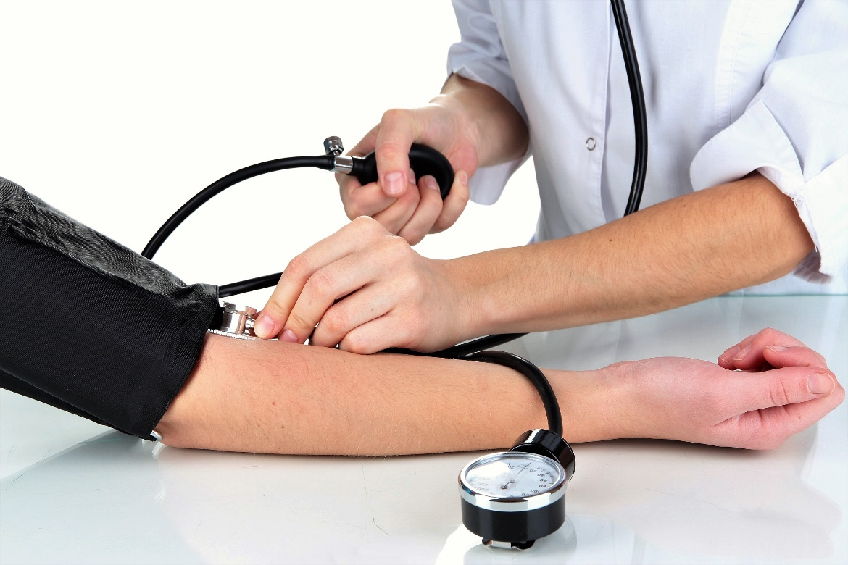

Role of exercise in hypertension

Slide 15
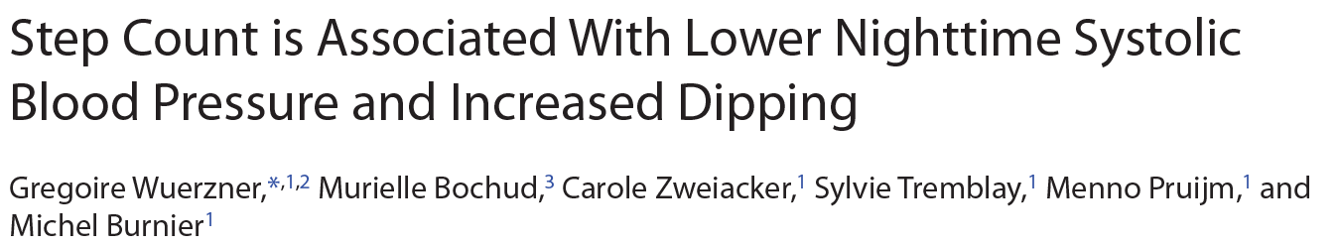
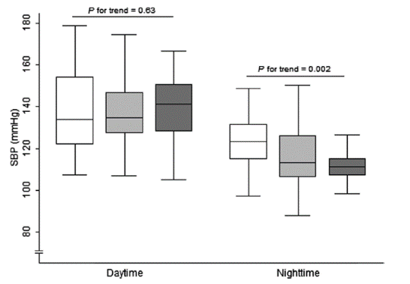
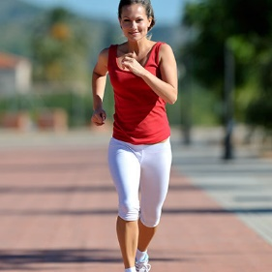

Role of exercise in hypertension

Slide 16
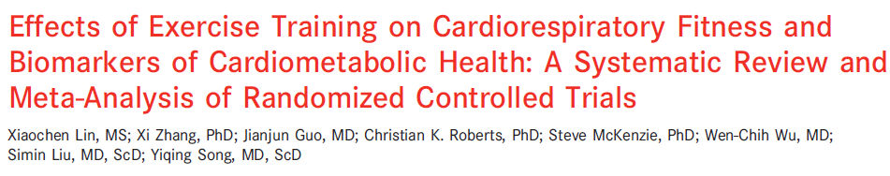
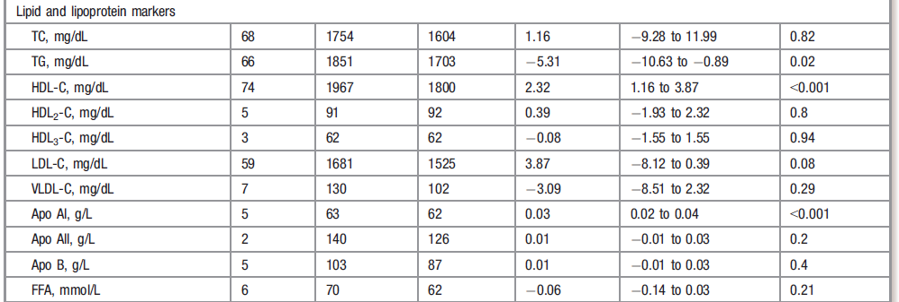
Role of exercise in dyslipidaemia

Slide 17

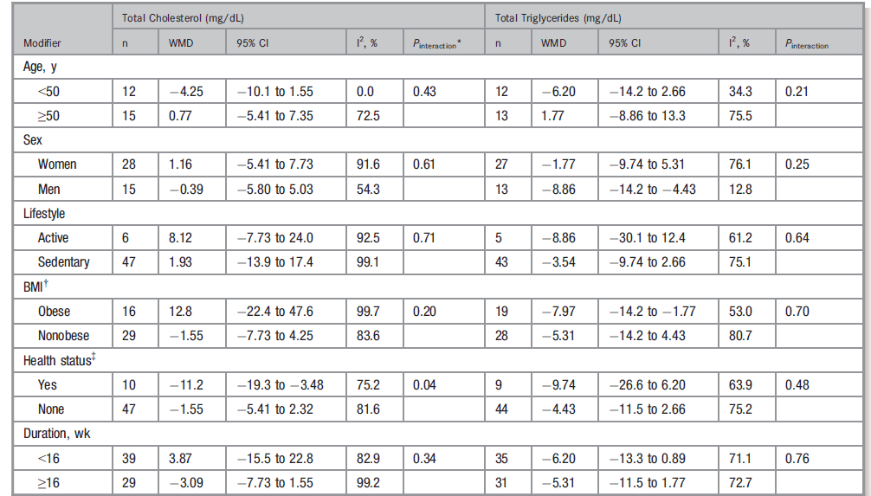
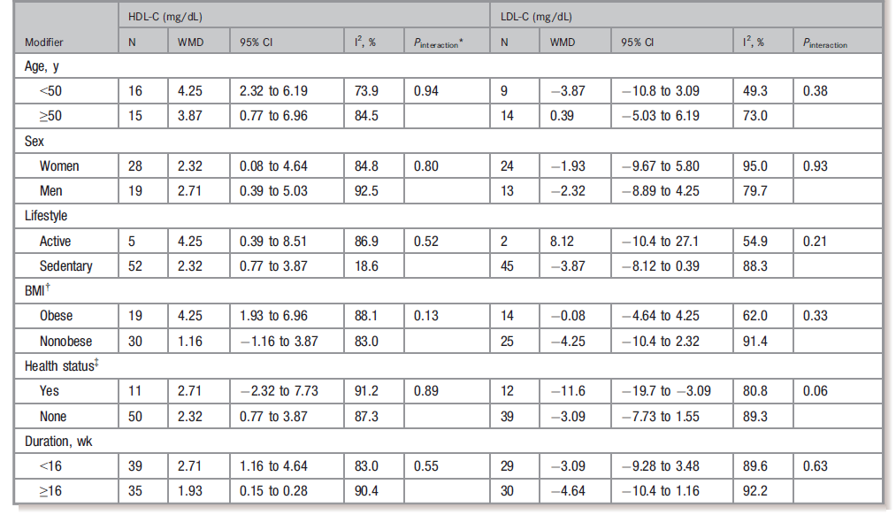
But patient phenotype matters…

Slide 18
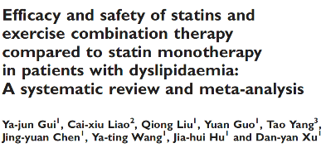
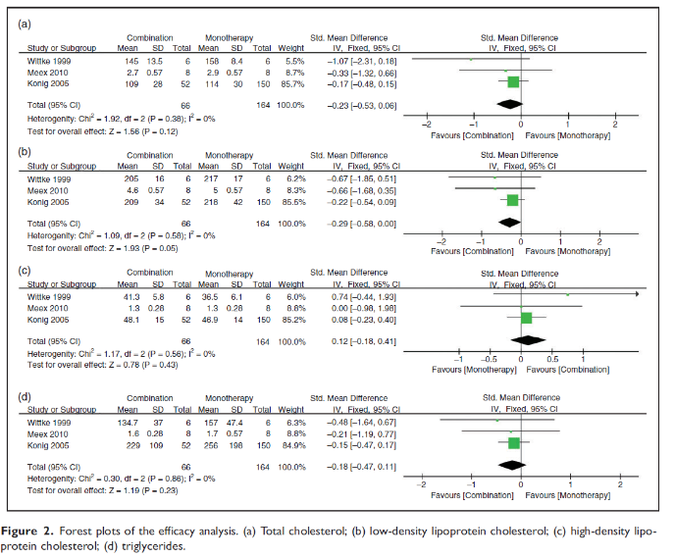


And statin intake matters…

Slide 19
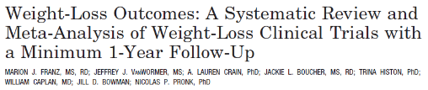
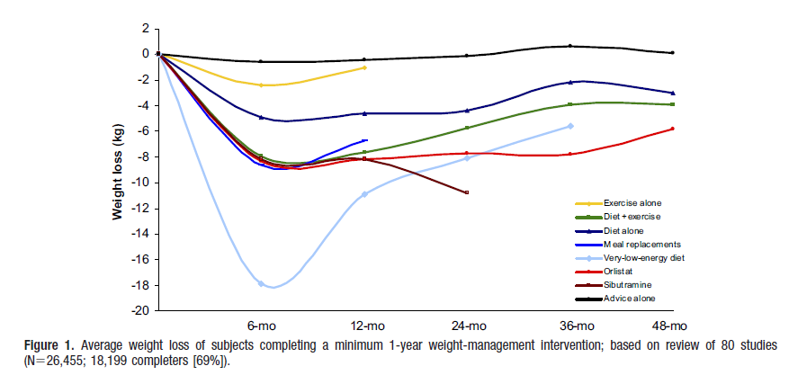
Role of exercise in obesity

Slide 20
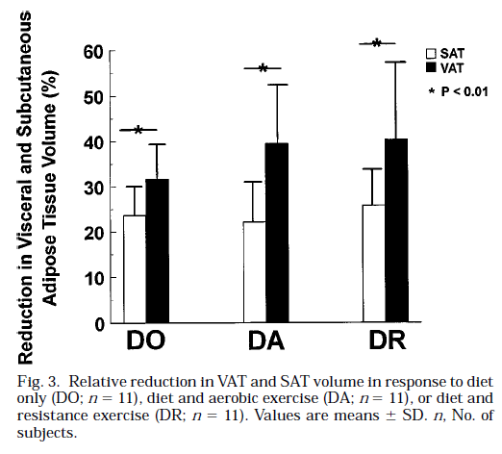
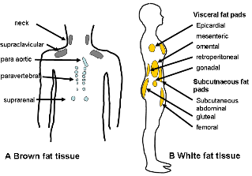
What is then the role of exercise in obesity?
Ross R, et al J Appl Physiol 1996; 81: 2445-55
Notes:
20

Slide 21
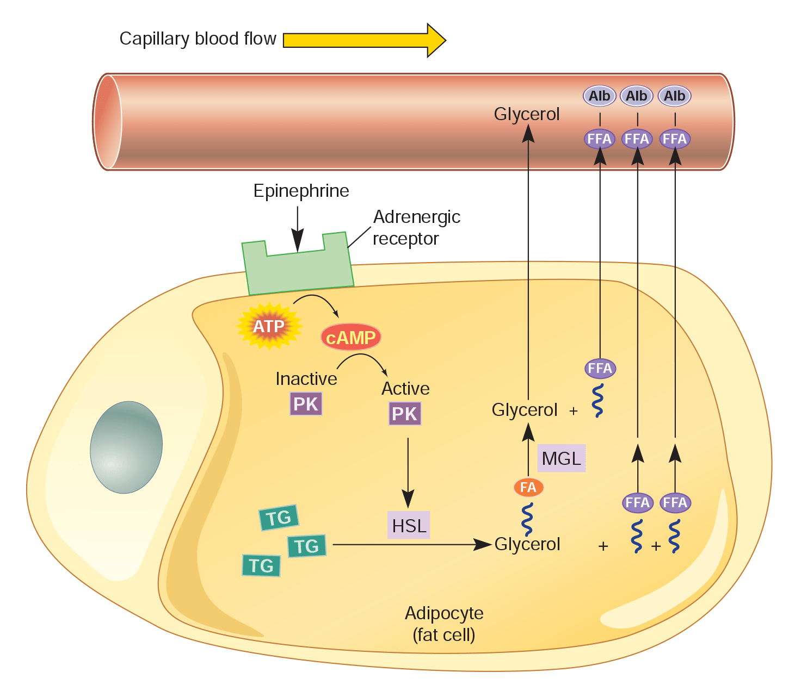
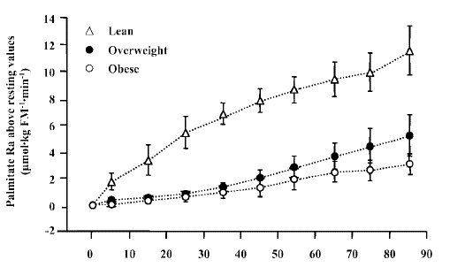
What is then the role of exercise in obesity?
Duration of endurance exercise
Mittendorfer B, et al. Am J Physiol 2004; 286: E354
Notes:
21

Slide 22
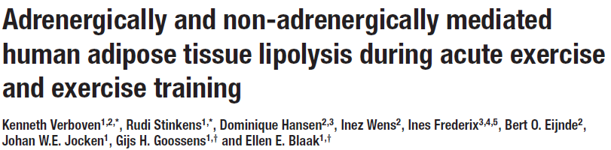
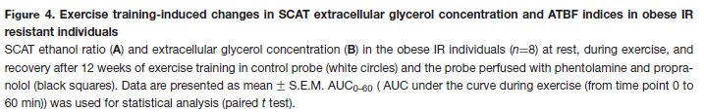
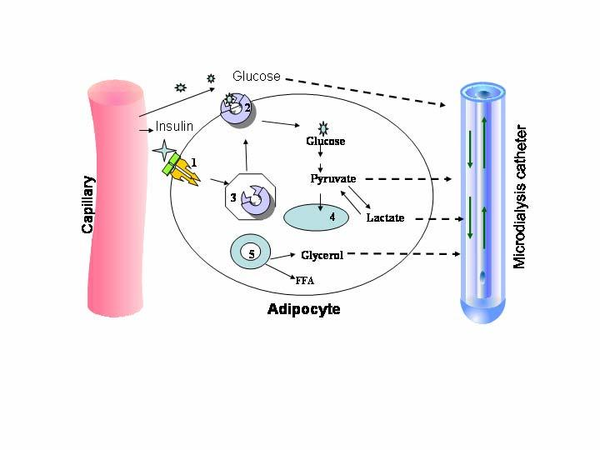
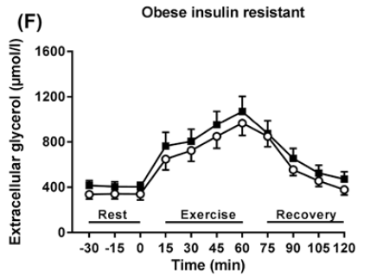
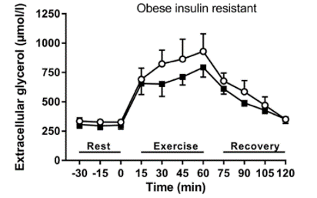
What is then the role of exercise in obesity?

Slide 23
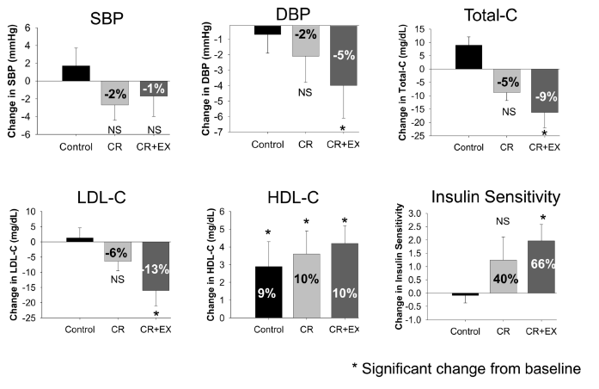
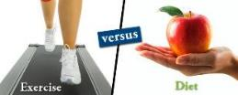
What is then the role of exercise in obesity?
Larson-Meyer DE, et al. Med Sci Sports Exerc 2010; 42: 152
Notes:
23

Slide 24
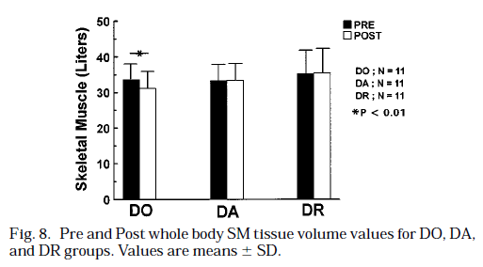
What is then the role of exercise in obesity?
Ross R, et al J Appl Physiol 1996; 81: 2445-55

Slide 25
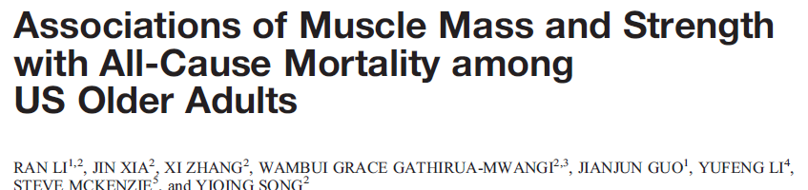
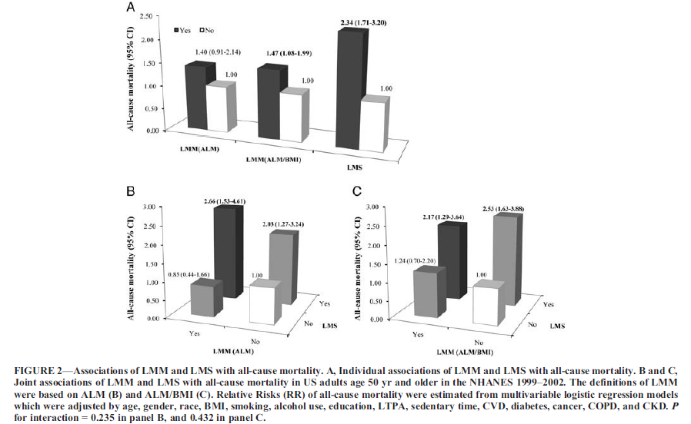

What is then the role of exercise in obesity?

Slide 26
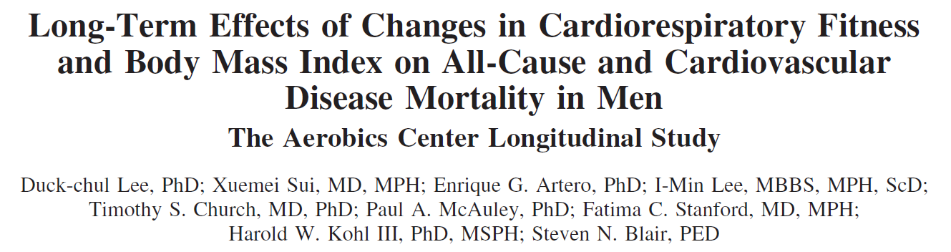
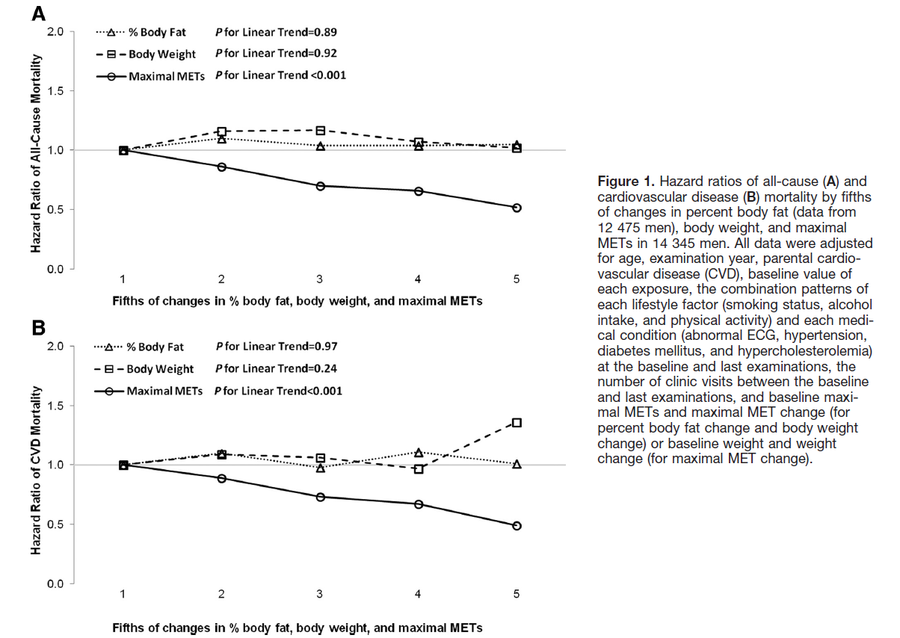

What is then the role of exercise in obesity?
fatness vs fitness

Slide 27

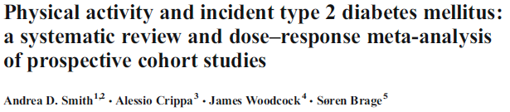
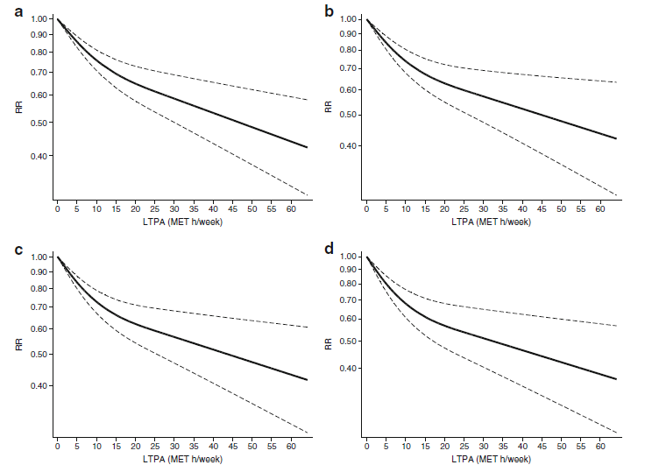

Role of exercise in type 2 diabetes

Slide 28




Role of exercise in type 2 diabetes
Umpierre D, et al. JAMA 2011; 305: 1790-99

Slide 29


Role of exercise in type 1 diabetes

Slide 30



Imp act on glycaemic variability?

Slide 31



Imp act on glycaemic variability?

Slide 32



Role of exercise in deconditioning

Slide 33


Role of exercise in deconditioning
Dependency

Slide 34

Role of exercise in deconditioning

Slide 35



Economic impact of exercise

Slide 36

Role of exercise in coronary artery disease

Slide 37



Role of exercise in coronary artery disease

Slide 38





Role of exercise in coronary artery disease

Slide 39





Role of exercise in coronary artery disease

Slide 40




Role of exercise in heart failure

Slide 41

Role of exercise in heart failure

Slide 42

Role of exercise in heart failure

Slide 43



Role of exercise in heart failure

Slide 44

Role of exercise in heart failure

Slide 45



Role of exercise in heart failure

Slide 46
Conclusions
Exercise intervention is potent to improve CVD risk, and lead to better treatment of cardiometabolic disease
However, current gaps in knowledge should be addressed and clinicians must be aware of what exercise is not capable of doing (yet)

Slide 47





Contact:
Dominique.hansen@uhasselt.be
https://twitter.com/hansen_phd
https://www.researchgate.net/profile/Dominique_Hansen2

