Slide 1

Exercise training/prescription in obesity, diabetes, cardiovascular disease
Dominique Hansen, PhD, FESC

Slide 2
Faculty Disclosure
The presenter has advised that the following presentation will NOT include discussion on any commercial products or service and that there are NO financial interests or relationships with any of the Commercial Supporters of this years ASM.

Slide 3
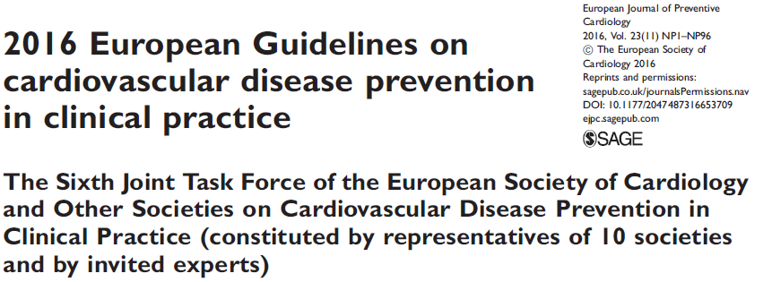
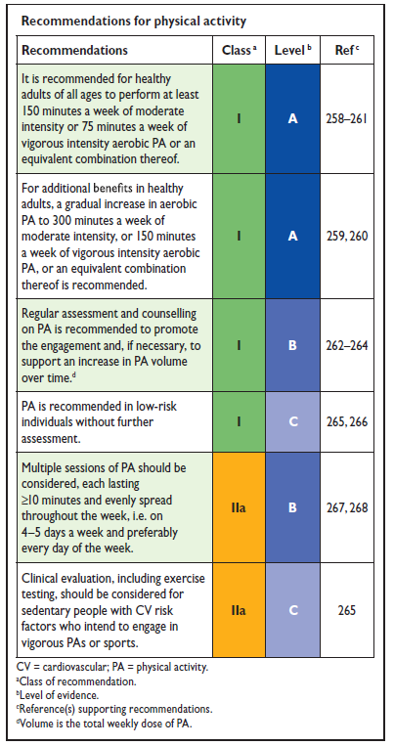

Exercise in cardiovascular disease: guidelines
Piepoli MF, et al. Eur J Prev Cardiol 2016;23:NP1-96

Slide 4
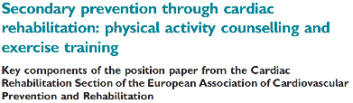
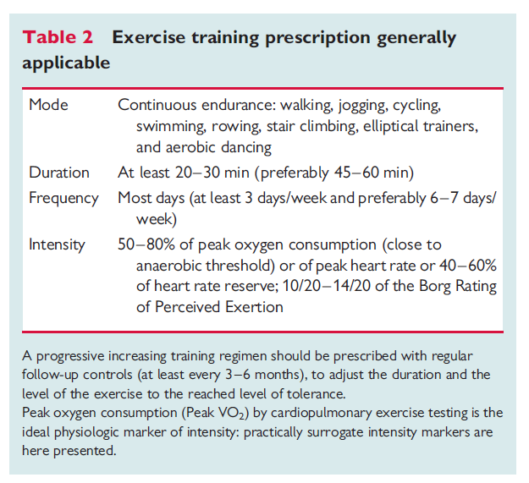
Exercise in cardiovascular disease: guidelines

Slide 5
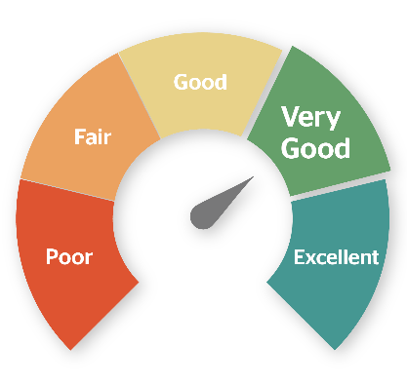
But how good are we in prescribing exercise to these patients?

Slide 6

Compare exercise prescriptions from different clinicians to the same patient
…and observe whether they agree between themselves

Slide 7
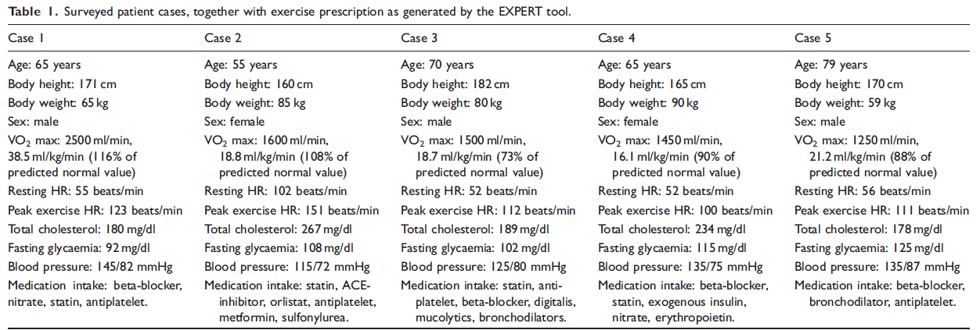
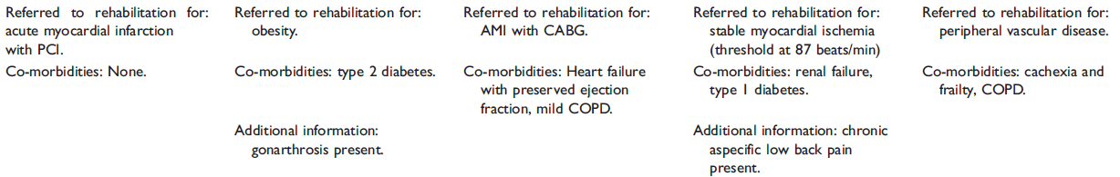
Comparing different clinicians
Hansen D, et al. Eur J Prev Cardiol. 2018;25:682-91.

Slide 8
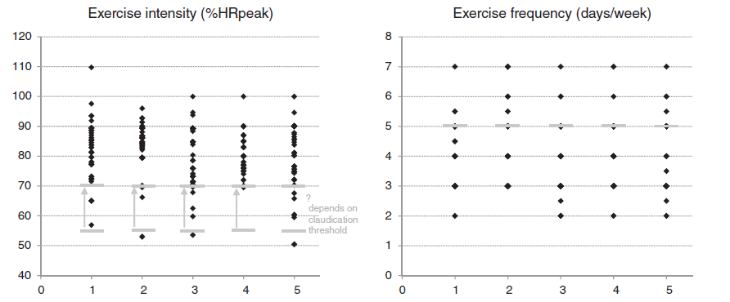
Comparing different clinicians
Hansen D, et al. Eur J Prev Cardiol. 2018;25:682-91.

Slide 9
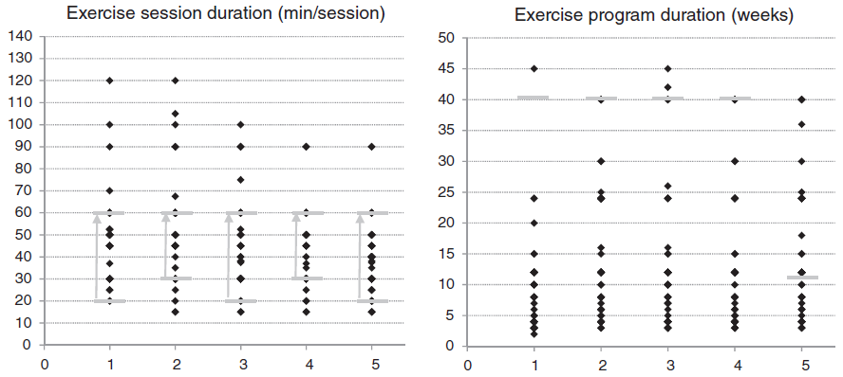
Comparing different clinicians
Hansen D, et al. Eur J Prev Cardiol. 2018;25:682-91.

Slide 10
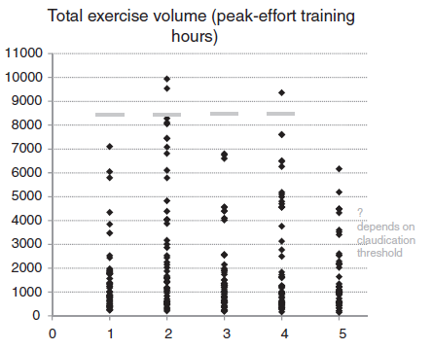

Comparing different clinicians
Hansen D, et al. Eur J Prev Cardiol. 2018;25:682-91.

Slide 11

A gap is present
Clinical practice
Guidelines

Slide 12
If we aim for maximum improvement of the CVD risk and physical fitness, but with optimal medical safety, to prevent cardiovascular disease we should…
Tailor our intervention

Slide 13






Approach in tailoring exercise
Patient phenotype
Prevalent CV diseases
CVD risk profile
Blood lipid profile
Glycemic control
Fat mass
Medication intake
Physical fitness and
exercise response
Exercise prescription
Hansen D, et al. Eur J Prev Cardiol. 2019;26:273-6.

Slide 14
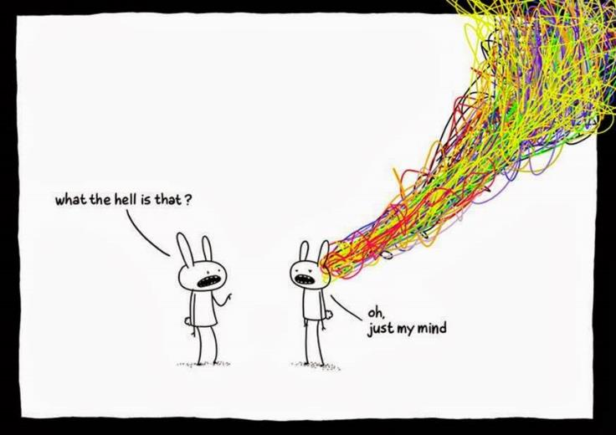
Exercise prescription in CVD is not easy
Patient
Poor CV rehabilitation clinician

Slide 15
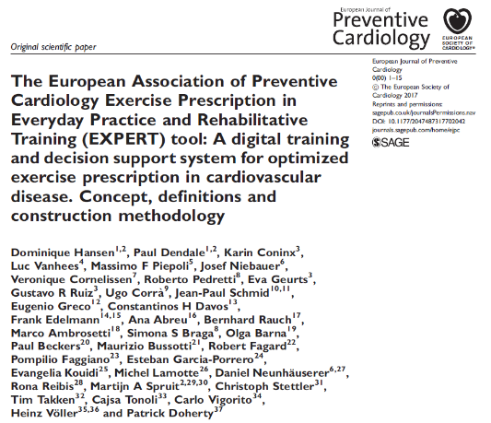

EXPERT Tool
Hansen D, et al. Eur Heart J 2017; 38: 2318-20
Hansen D, et al. Eur J Prev Cardiol 2017; 24: 1017-31

Slide 16



EXPERT Tool
Digital, interactive decision support tool for exercise prescription
Endorsed by the European Association of Preventive Cardiology
Access: https://expert-tool.edm.uhasselt.be
License: www.escardio.org/Education/Practice-Tools/CVD-prevention-toolbox/expert-tool

Slide 17

Case 1
Jim
Age: 28 years
Body height: 165 cm
Body weight: 95 kg
Sex: male
VO2max: 2100 ml/min (72% of predicted normal value)
Resting HR: 70 bts/min
Peak exercise HR: 195 bts/min
Total cholesterol: 189 mg/dl
Fasting glycemia: 101 mg/dl
Blood pressure: 115/75 mmHg
Medication intake: none
Referred to rehabilitation for: obesity
Co-morbidities: None
Exercise intensity (based on HR)
Exercise session duration
Exercise frequency
Minimal program duration
Addition of strength training?
Additional exercise types?

Slide 18
Case 1
  Start from regular exercise prescription
    150 min low-to-moderate intense endurance exercise training per week (spread over 3-5 days) for at least 12 weeks
  But further adjust for:
    Lower exercise tolerance
    Obesity

Slide 19

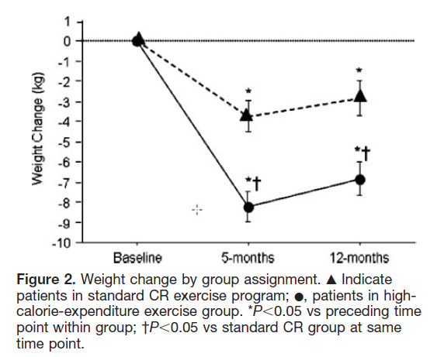

Fat mass reduction (obesity)
Standard CR
25-40 minutes/session
65% to 70% VO_{2peak}
3 days/week
Adapted CR
45 to 60 min/sessions
50-60% VO_{2peak}
5-7 days/week

Slide 20
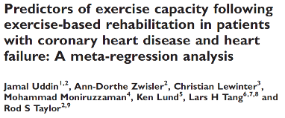
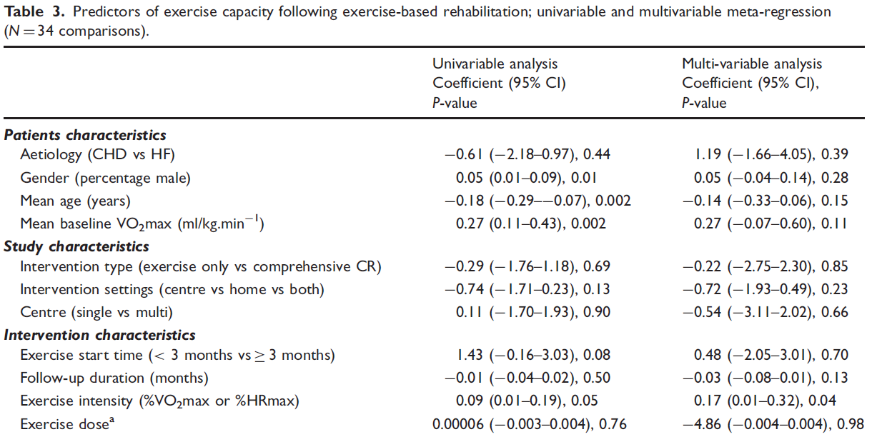

Physical fitness (deconditioning)

Slide 21
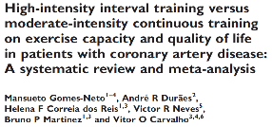
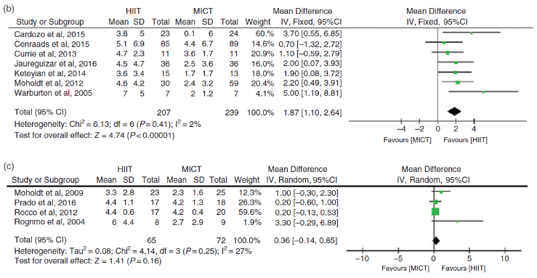
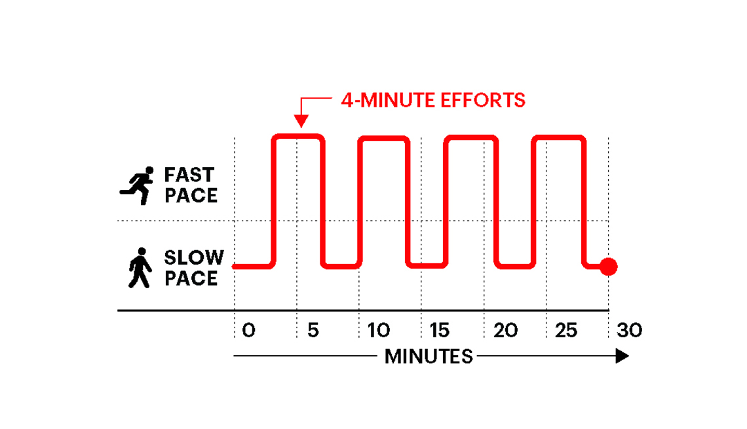
Physical fitness (deconditioning)
Eur J Prev Cardiol. 2017;24:1696-707
Notes:
21

Slide 22
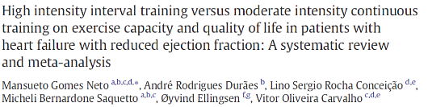
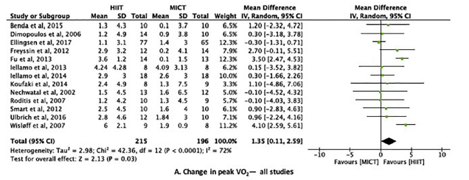
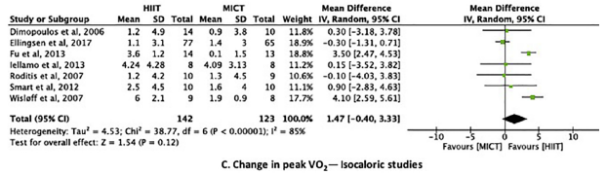
Physical fitness (deconditioning)
Notes:
22

Slide 23

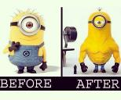
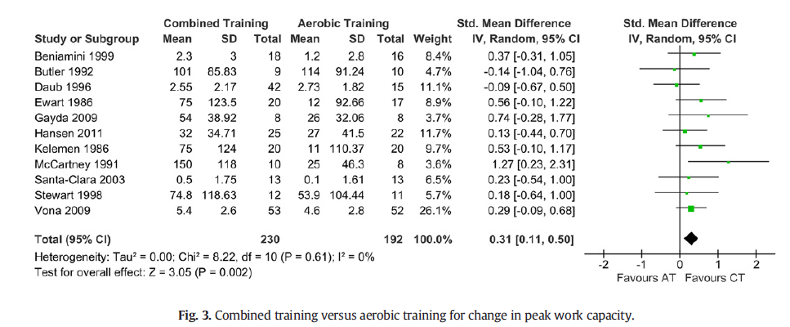
Physical fitness (deconditioning)

Slide 24
Case 1
INTENSITY
Moderate: HR going up to 144 bts/min
Low-intensity exercise training may lead to suboptimal training adaptations.
Potential modifier: beta blocker treatment, chronotropic incompetence in obesity
SESSION DURATION
20 up to 60 min: try to progress as soon as possible: a weekly energy expenditure >2500 kcal should be aimed at.
FREQUENCY
Go for 5 days/week, to maximize energy expenditure.
MINIMAL PROGRAM DURATION
24 weeks: Prolonged exercise interventions are needed to significantly affect adipose tissue mass.
STRENGTH TRAINING
Yes: muscle weakness?
Be aware: type 2 diabetes, diet
ADDITIONAL TRAINING STRATEGIES
Consider every high-caloric exercise type

Slide 25

Case 2
Julie
Age: 53 years
Body height: 160 cm
Body weight: 56 kg
Sex: female
VO2max: 1350 ml/min (96% of predicted normal value)
Resting HR: 65 bts/min
Peak exercise HR: 135 bts/min
Total cholesterol: 165 mg/dl
Fasting glycemia: 129 mg/dl
Blood pressure: 125/75 mmHg
Medication intake: statin, beta-blocker, antiplatelets
Referred to rehabilitation for: PCI
Co-morbidities: none
Additional information: gonarthrosis present
Exercise intensity (based on HR)
Exercise session duration
Exercise frequency
Minimal program duration
Addition of strength training?
Additional exercise types?

Slide 26
Case 2
  Start from regular exercise prescription
    150 min low-to-moderate intense endurance exercise training per week (spread over 3-5 days) for at least 12 weeks
  But further adjust for:
    Beta-blocker intake = hypertensive
    Elevated blood glucose (T2DM)
    Statin intake = dyslipidemic

Slide 27

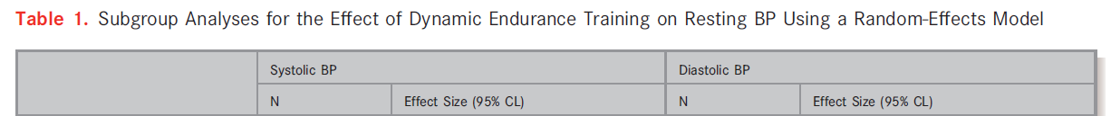
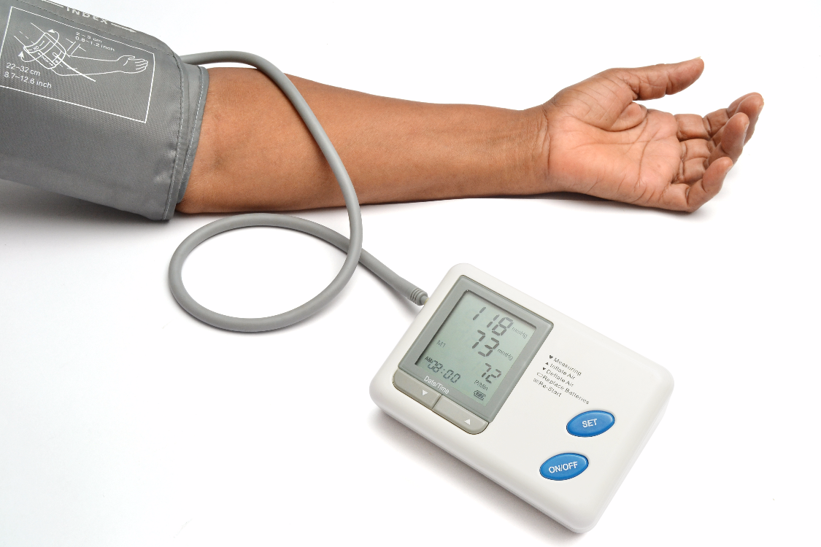



Blood pressure reduction (hypertension)

Slide 28
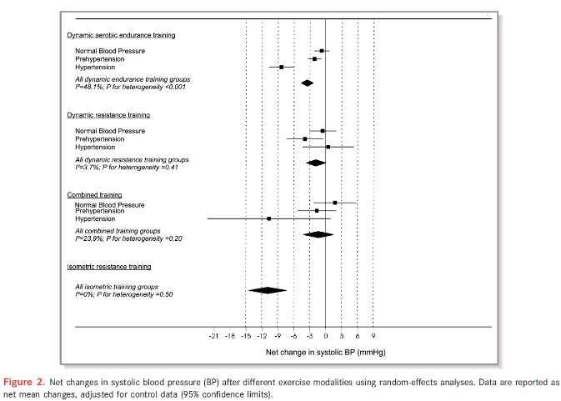
Blood pressure reduction (hypertension)

Slide 29
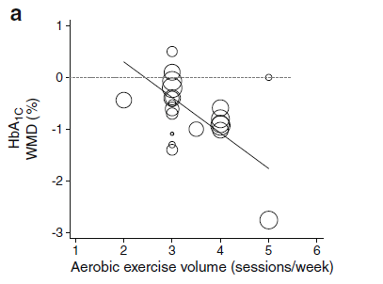
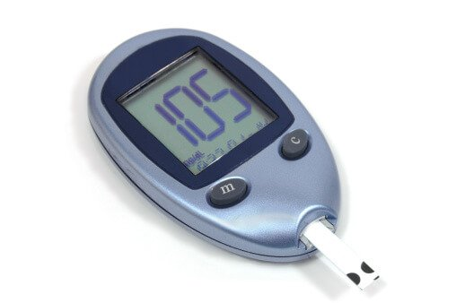
Glycaemic control improvement (type 2 diabetes)
Umpierre D, et al. Diabetologia 2013; 56: 242-51

Slide 30
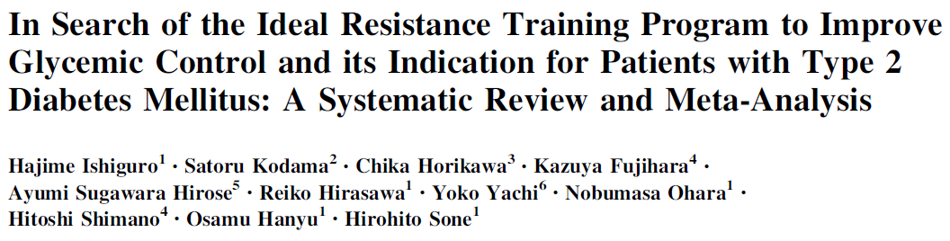
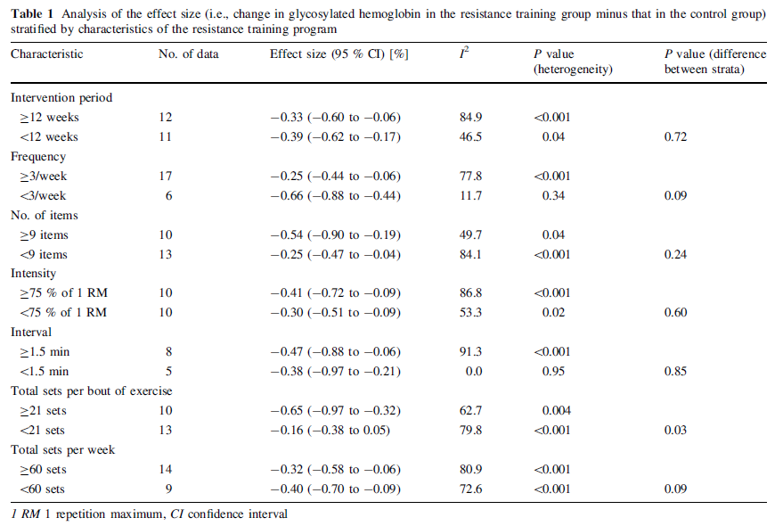

Glycaemic control improvement (type 2 diabetes)

Slide 31
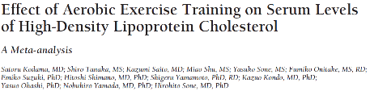
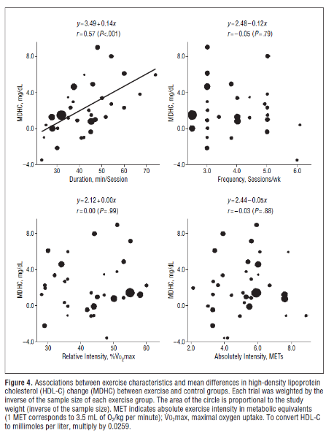
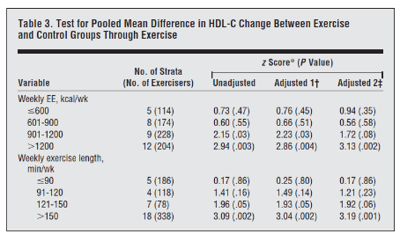
Blood lipid improvement (dyslipidemia)

Slide 32
Case 2
INTENSITY
Moderate: HR up to 120 bts/min, or go higher
Good fitness, hypertension.
SESSION DURATION
From 30 building up to 60 min
Dyslipidemia: a weekly exercise energy expenditure >900 kcal is advised.
FREQUENCY
5 days/week: The patient suffers from type 2 diabetes (T2DM). To lower blood pressure and sufficiently improve glycemic control, daily exercise training is recommended.
MINIMAL PROGRAM DURATION
12 weeks (but actually much longer): For the treatment of dyslipidemia and T2DM prolonged exercise interventions are recommended.
STRENGTH TRAINING
Yes: glycemic control is affected significantly by strength training exercises.
ADDITIONAL TRAINING STRATEGIES
Additional isometric handgrip exercise training is advised to lower blood pressure.
Potential modifier: choice of antidiabetic drug

Slide 33


Case 3
Jack
Age: 70 years
Body height: 175 cm
Body weight: 65 kg
VO2max: 1050 ml/min (57% of predicted normal value)
Resting HR: 56 bts/min
Peak exercise HR: 112 bts/min
Total cholesterol: 167 mg/dl
Fasting glycemia: 89 mg/dl
Blood pressure: 135/65 mmHg
Medication intake: statin, beta-blocker, antiplatelets,…
Referred to rehabilitation for: CHF
Co-morbidities: frailty, T1DM
Exercise intensity (based on HR)
Exercise session duration
Exercise frequency
Minimal program duration
Addition of strength training?
Additional exercise types?

Slide 34
Case 3
  Start from regular exercise prescription
    150 min low-to-moderate intense endurance exercise training per week (spread over 3-5 days) for at least 12 weeks
  But further adjust for:
    Low exercise capacity
      Patient needs progression
    Beta-blocker intake and statin intake
      Handgrip strength training, higher volume
    T1DM
      Consider additional measures
    CHF
      IMT
    Frailty
      Strength training, balance training

Slide 35
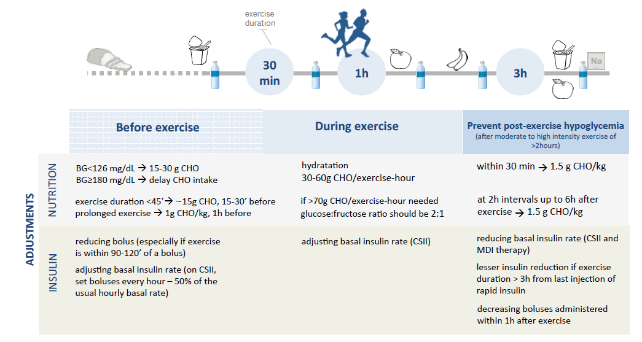
Exercise for T1DM
Codella R, et al. Acta Diabetologica 2017;54;615-30

Slide 36
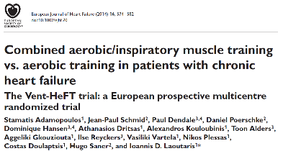
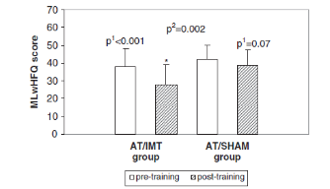
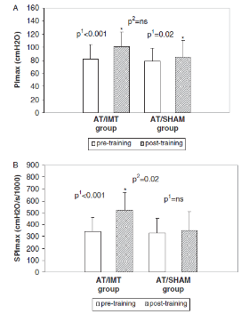
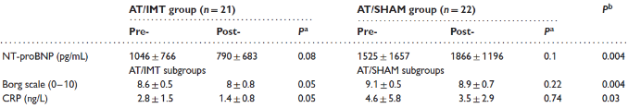
IMT for heart failure

Slide 37
Case 3
INTENSITY
Start low, go to moderate: HR up to 89 bts/min
Due to deconditioning, it may be relevant to start at a lower exercise intensity but reach the target exercise intensity as soon as possible.
SESSION DURATION
20 up to 60 min: To affect blood lipid profile, a weekly exercise energy expenditure >900 kcal is advised. To achieve this goal exercise duration must be sufficiently long.
FREQUENCY
3-5 days/week: The patient needs many different intervention types.
MINIMAL PROGRAM DURATION
12 weeks (but actually a lot longer): This patient suffers from CHF: this co-morbidity leads to prolongation of the exercise intervention. It is thus advised to try to elevate daily physical activity level for this period after the in- our out-patient rehabilitation program.
STRENGTH TRAINING
Yes, because of frailty.
ADDITIONAL TRAINING STRATEGIES
Add inspiratory muscle training (IMT) because CHF is present. Additional isometric handgrip exercise training is advised for the treatment of hypertension. Balance training may be indicated to lower fall risk.
Additional issues: (re-)consider CHO intake, insulin dose and assessments of blood glucose.

Slide 38


Slide 39
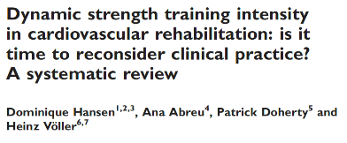

Controversies in cardiovascular rehabilitation
‘General recommendations for training
regimens include using 30–40% of the 1-repetition maximum for the upper body and 40–50% of the 1-repetition maximum for lower body exercises, with 12 to 15 repetitions in 1 set repeated two to three times weekly.’
Piepoli MF, et al. Eur Heart J 2010; 31: 1967-76

Slide 40
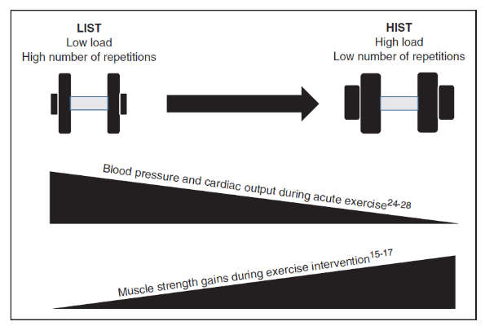


Controversies in cardiovascular rehabilitation
2019; E-pub ahead of print

Slide 41
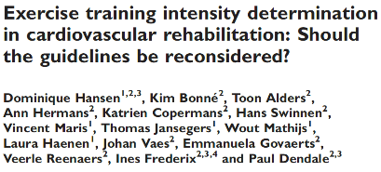
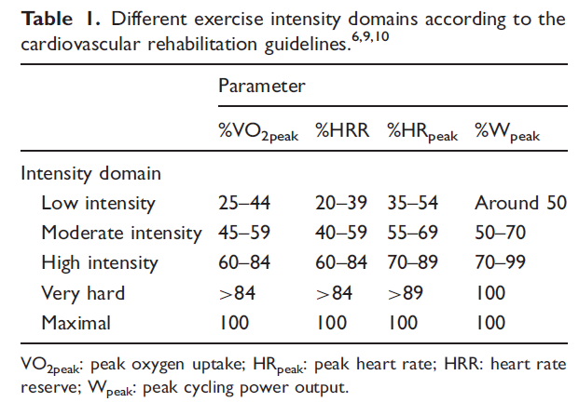
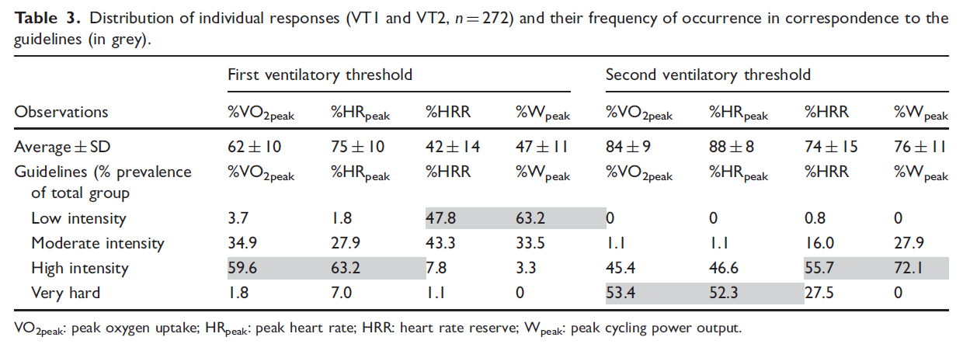
Controversies in cardiovascular rehabilitation
2019; E-pub ahead of print

Slide 42
Conclusions
Exercise intervention is potent to improve CVD risk, but correct exercise prescription is mandatory and requires standardisation
Tailor your exercise prescription to every different individual…but be aware of its complexity

Slide 43

Dominique.hansen@uhasselt.be
https://twitter.com/hansen_phd
https://www.researchgate.net/profile/Dominique_Hansen2

