Slide 1
Exercise after ACS: what should be unquestionably done and the potential role of decision support systems
Dominique Hansen, PhD, FESC

Slide 2


Slide 3
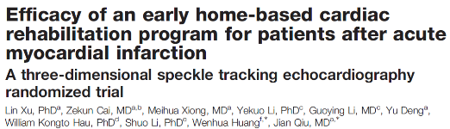
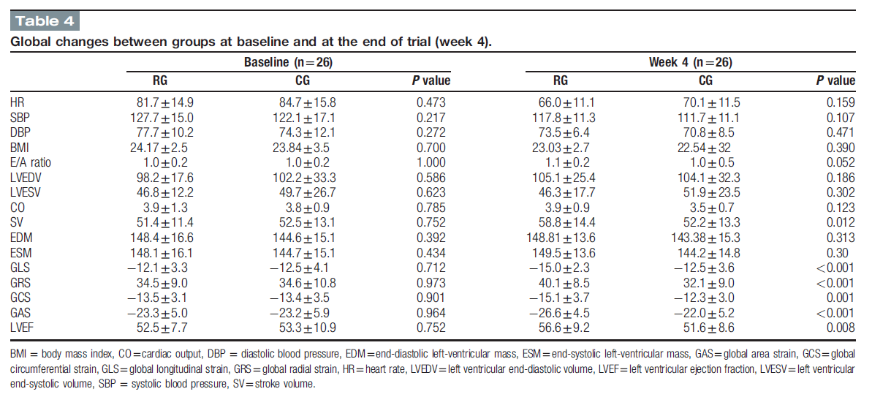

Improvements in LV function after AMI are mainly related to recovery from myocardial stunning, defined as the dysfunctional but viable myocardial regions.
Exercise intervention could accelerate this recovery process.

Slide 4
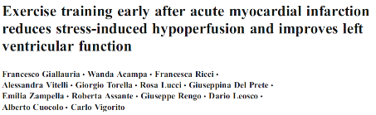
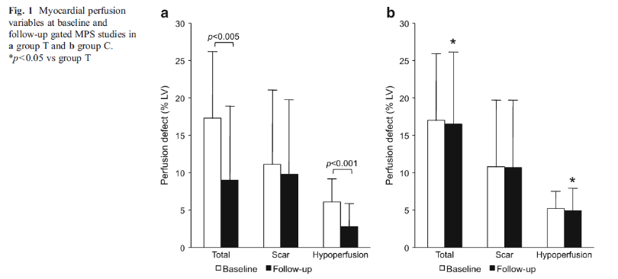
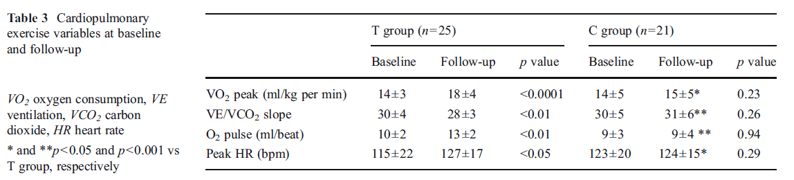
Exercise training early after acute myocardial infarction reduces the amount of postinfarction stress-induced hypoperfusion.

Slide 5
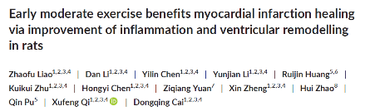
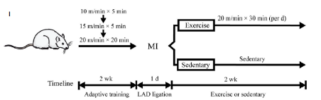
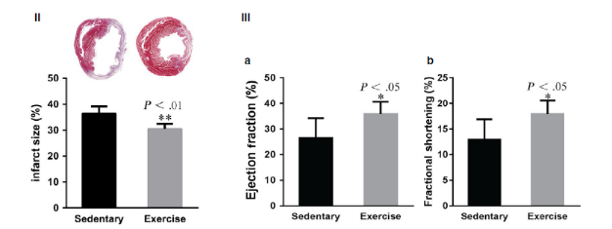
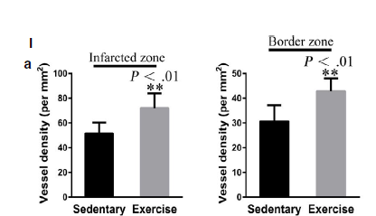

Slide 6
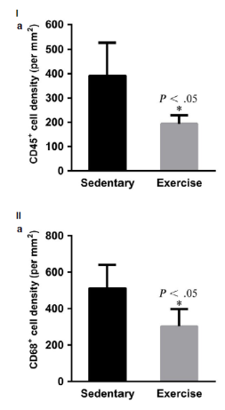
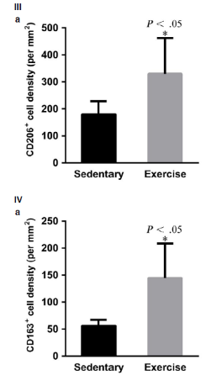

Slide 7

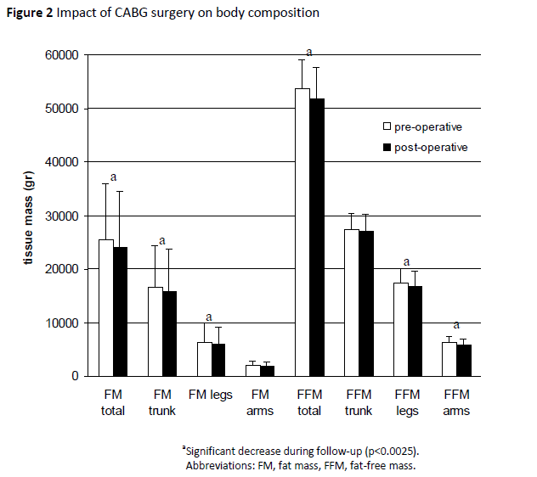
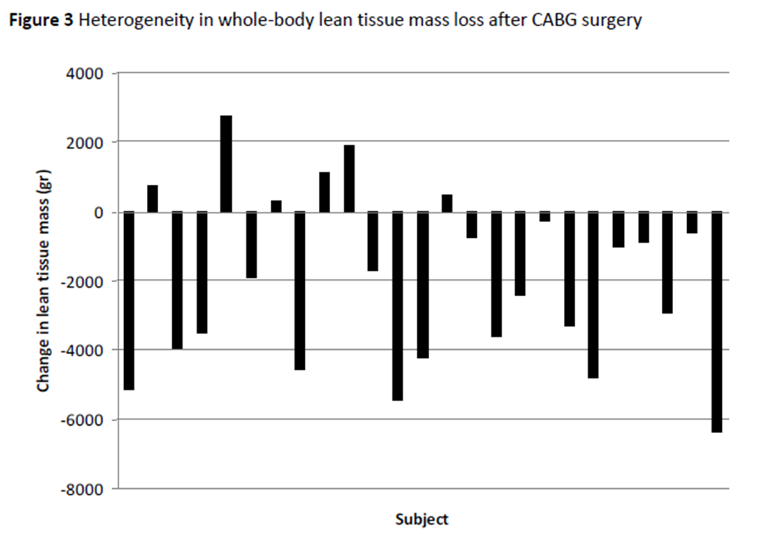
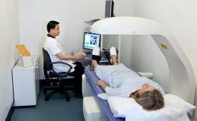
Change in fat mass = -1.4 kg
Change in fat-free mass = -1.9 kg
Exp Physiol 2015;100:818-28.

Slide 8

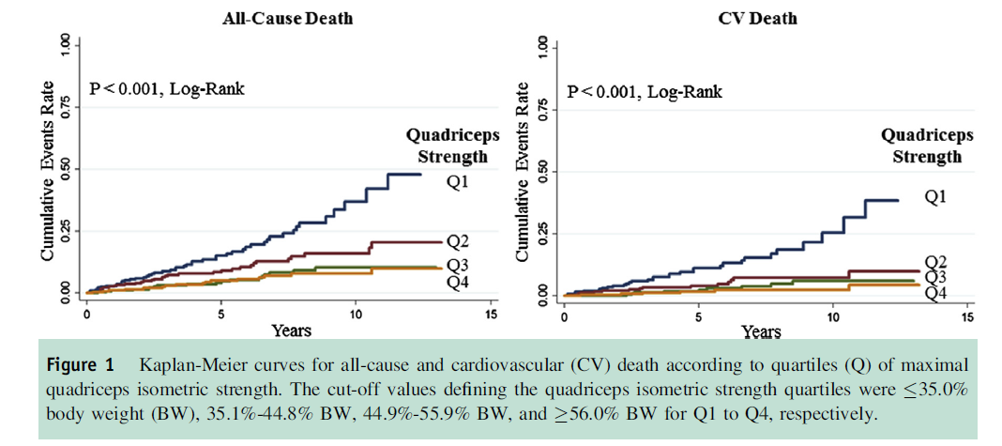

Slide 9
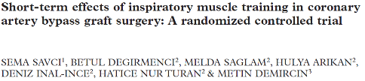
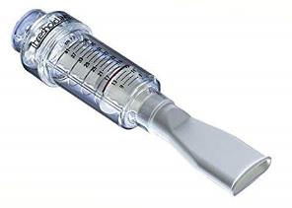
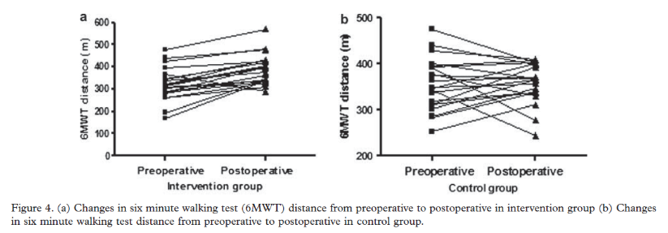
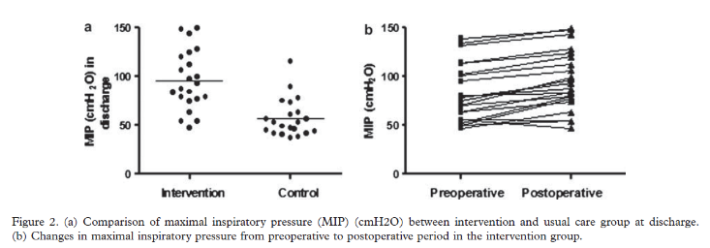

Slide 10
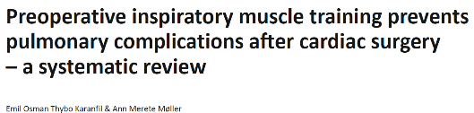
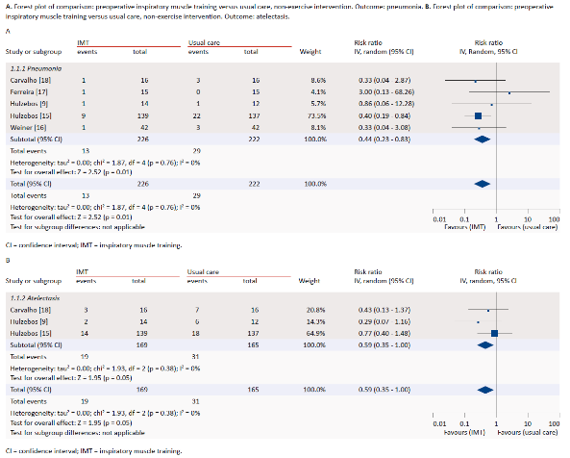

Slide 11


Slide 12

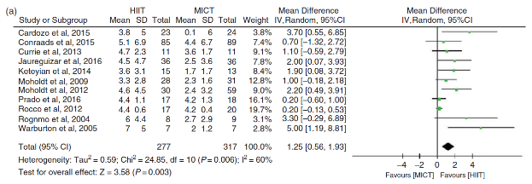
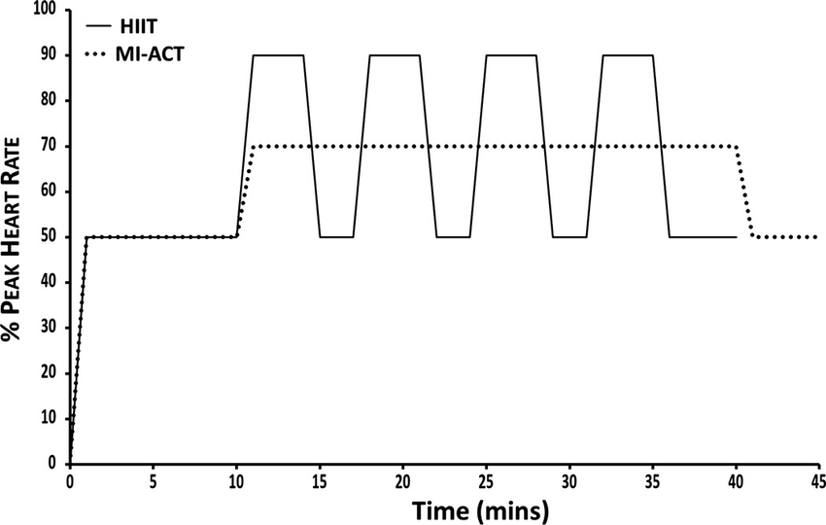
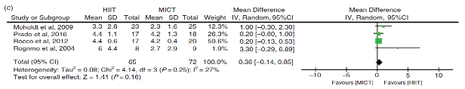
Eur J Prev Cardiol. 2017;24:1696-1707.

Slide 13
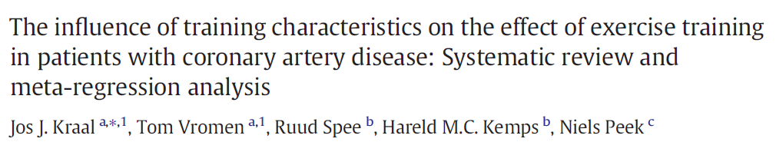
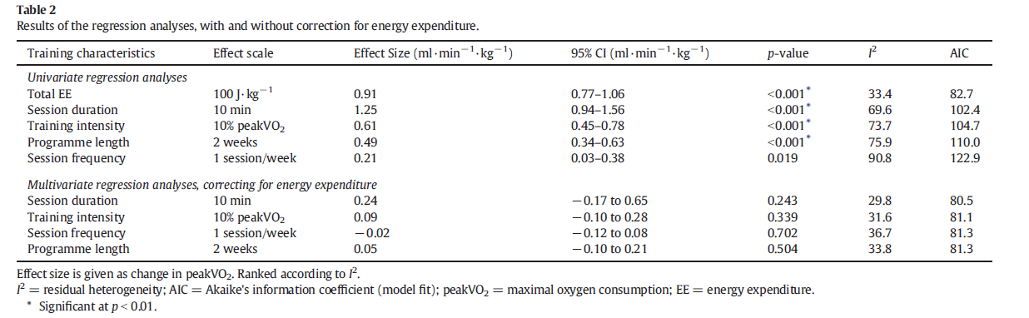

Slide 14
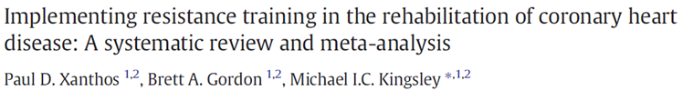
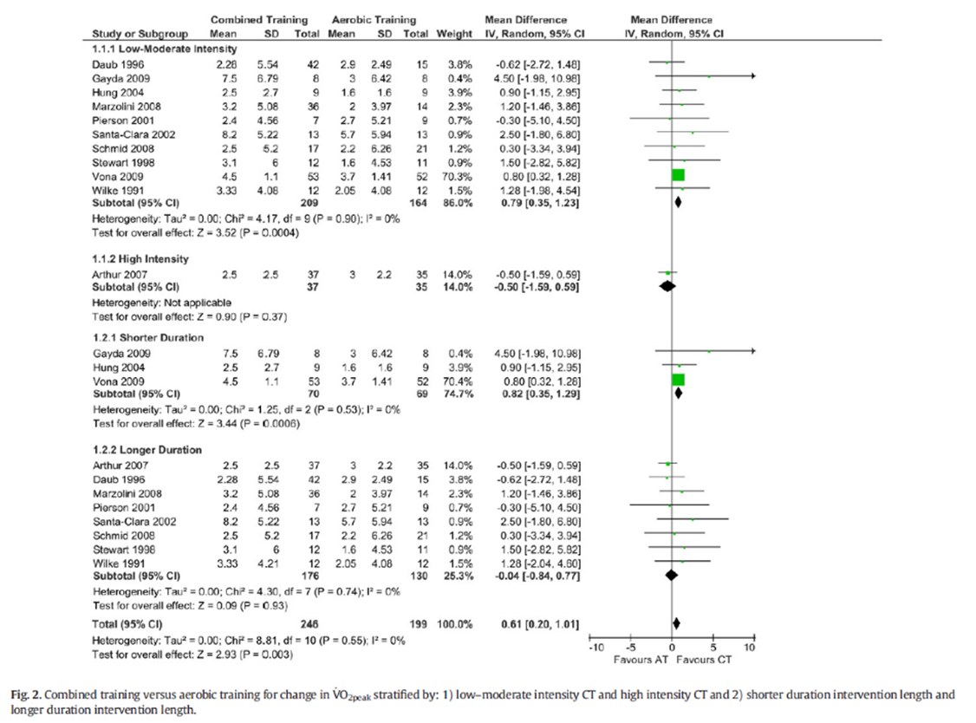
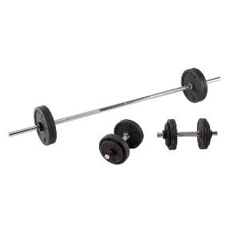

Slide 15
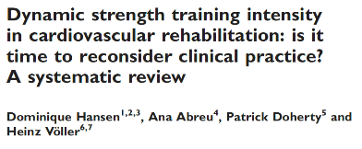
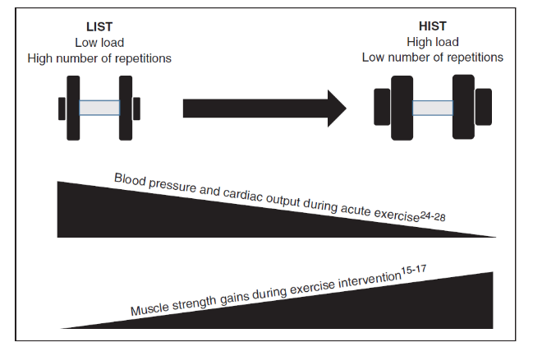
Eur J Prev Cardiol. 2019;26:1483-1492.

Slide 16


Slide 17






Approach in tailoring exercise
Patient phenotype
Prevalent CV diseases
CVD risk profile
Blood lipid profile
Glycemic control
Fat mass
Medication intake
Physical fitness and
exercise response
Exercise prescription
Hansen D, et al. Eur J Prev Cardiol. 2019;26:273-6.

Slide 18
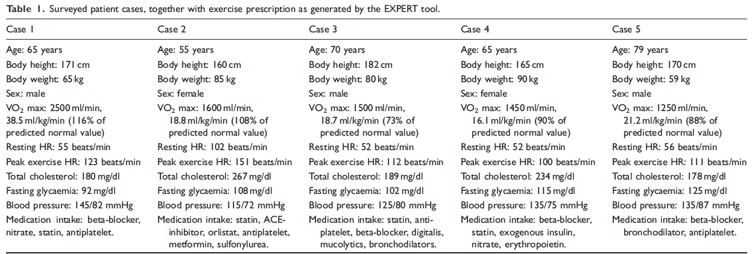
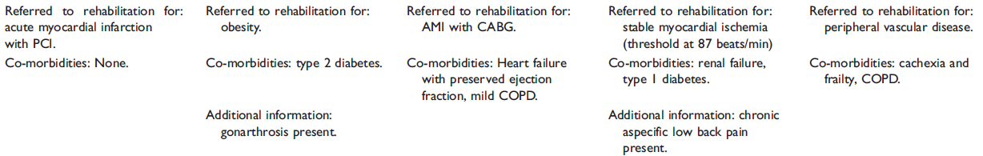
Comparing different clinicians
Hansen D, et al. Eur J Prev Cardiol. 2018;25:682-91.

Slide 19
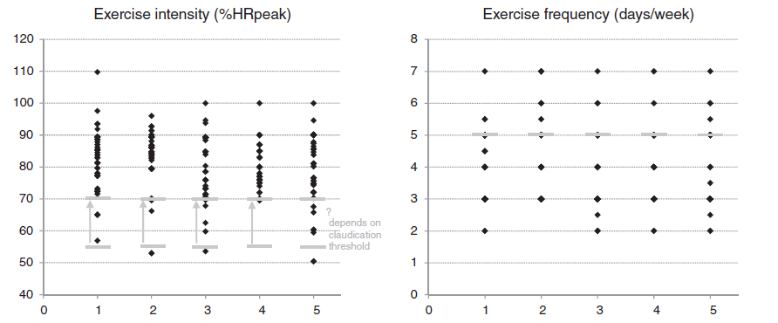
Comparing different clinicians
Hansen D, et al. Eur J Prev Cardiol. 2018;25:682-91.

Slide 20
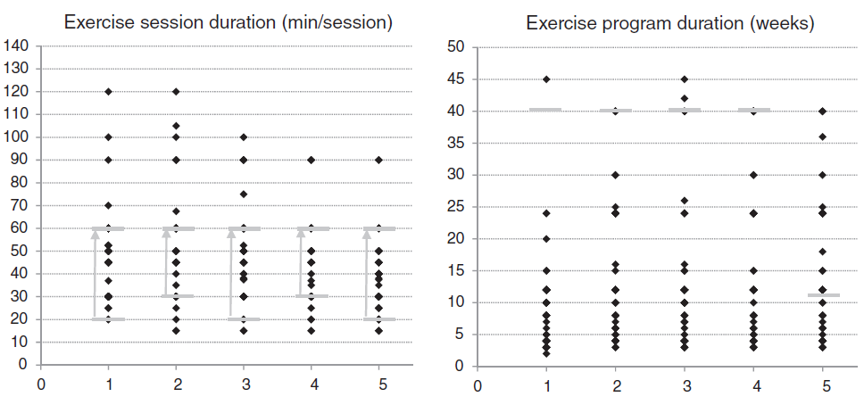
Comparing different clinicians
Hansen D, et al. Eur J Prev Cardiol. 2018;25:682-91.

Slide 21
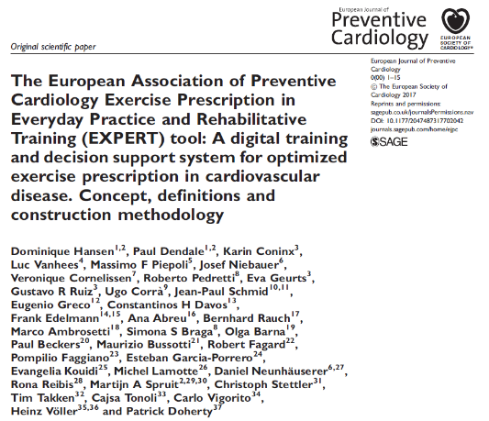

EXPERT Tool
Hansen D, et al. Eur Heart J 2017; 38: 2318-20
Hansen D, et al. Eur J Prev Cardiol 2017; 24: 1017-31

Slide 22


Slide 23
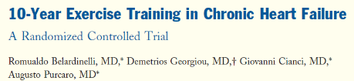
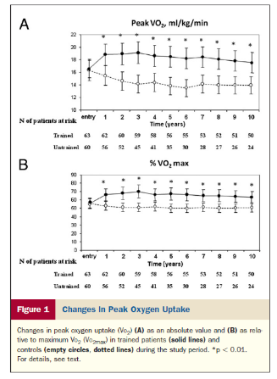
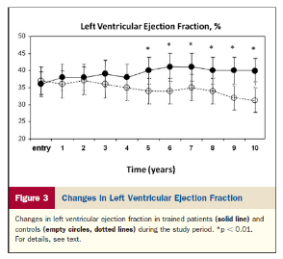
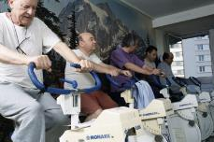

Slide 24
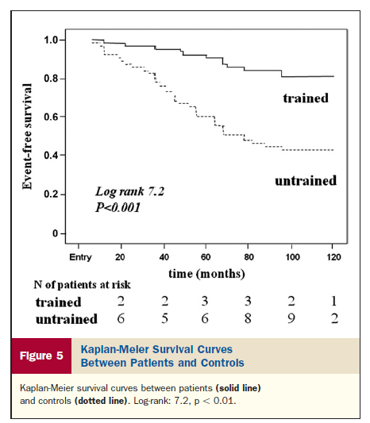

Slide 25
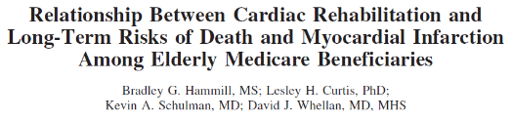
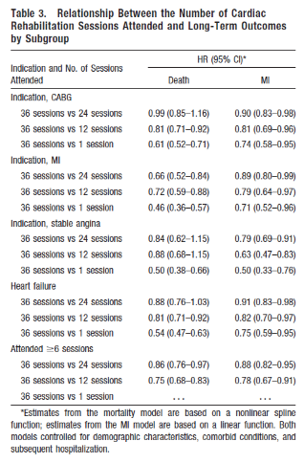

After adjustment, each additional 6 cardiac rehabilitation sessions is associated with:
a 5% lower risk of MI among patients who underwent CABG
a 6% lower risk among patients with a previous MI
an 11% lower risk among patients with stable angina

Slide 26
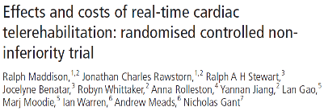
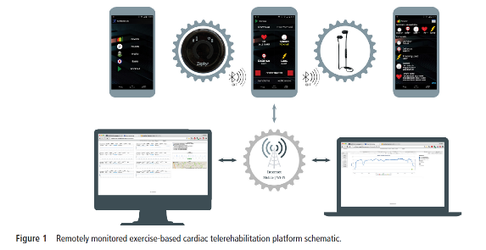


Slide 27

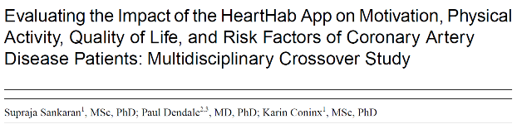

Slide 28
Conclusions
Exercise intervention after ACS: what should be in there?
  Early start
  Tailoring of exercise prescription
    Correct selection of exercise modalities
  Prolonged intervention
How can decision support systems help?
  In the tailoring process and optimisation of exercise prescription

Slide 29





Contact:
Dominique.hansen@uhasselt.be
https://twitter.com/hansen_phd
https://www.researchgate.net/profile/Dominique_Hansen2

