Slide 1



Session on Radiation Measurements
14 June 2019
Microdosimetry with a sealed mini-TEPC at the SOBP of CATANA
A. Bianchi^{1,2,3}, V. Conte³, A. Selva³, P. Colautti³, G. Petringa⁴, G. A. P. Cirrone⁴, A. Parisi¹, B. Reniers², F. Vanhavere¹
Corresponding author: A. Bianchi (abianchi@sckcen.be)
¹ Belgian Nuclear Research Center, SCK• CEN, Boeretang 200, 2400 Mol, Belgium
² Uhasselt, Faculty of Engineering Technology, Campus Diepenbeek, Agoralaan, 3590 Diepenbeek, Belgium
³ INFN Laboratori Nazionali di Legnaro, Viale dell’università 2, I-35020 Legnaro, Padova, Italy
⁴ INFN Laboratori Nazionali del Sud, Via Santa Sofia 62, 95125 Catania, Italy
Anna Bianchi (abianchi@sckcen.be) – RAD7, Herceg Novi – 14/06/2019

Slide 2
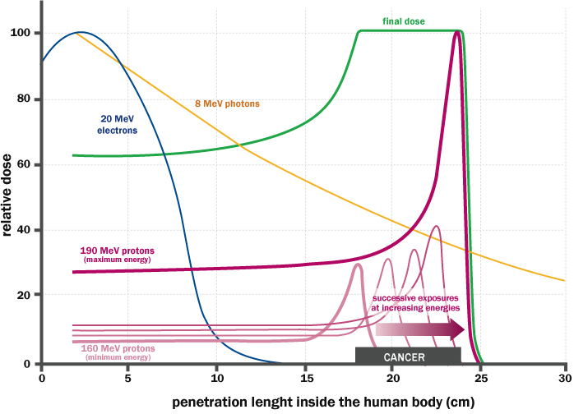
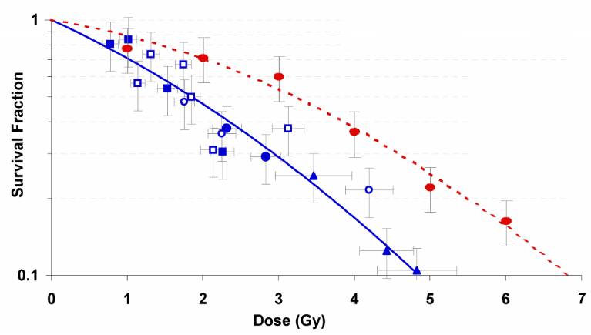
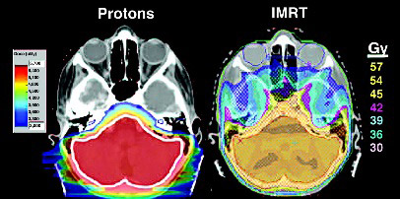
Hadrontherapy
Cancer treatment with accelerated charged particles
Physical advantage
Biological advantage
Doria D. et al., AIP Conference Proceedings. (2012)
More effective in cell killing
Relative
Biological
Effectiveness
Anna Bianchi (abianchi@sckcen.be) – RAD7, Herceg Novi – 14/06/2019

Slide 3
Microdosimetry
Stochastic Nature of Energy Deposition
1Gy – 60MeV ¹H
1Gy – Photons
1Gy – 150MeV ¹²C
Anna Bianchi (abianchi@sckcen.be) – RAD7, Herceg Novi – 14/06/2019

Slide 4
Microdosimetry
Online Monitor of Radiation Quality
Anna Bianchi (abianchi@sckcen.be) – RAD7, Herceg Novi – 14/06/2019

Slide 5
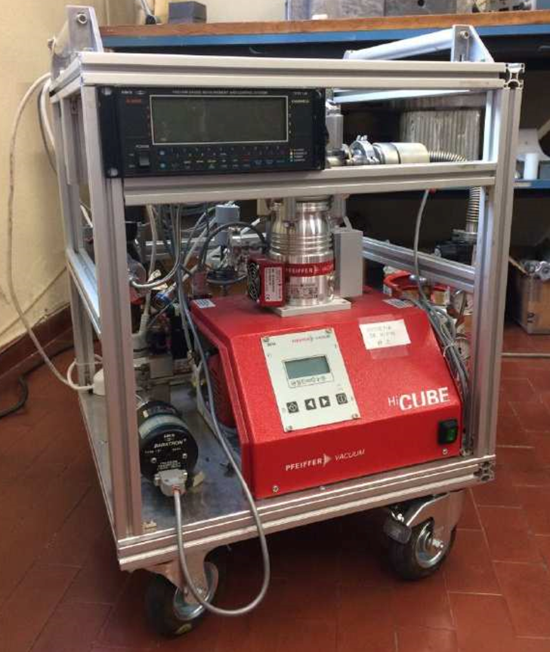
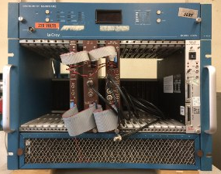
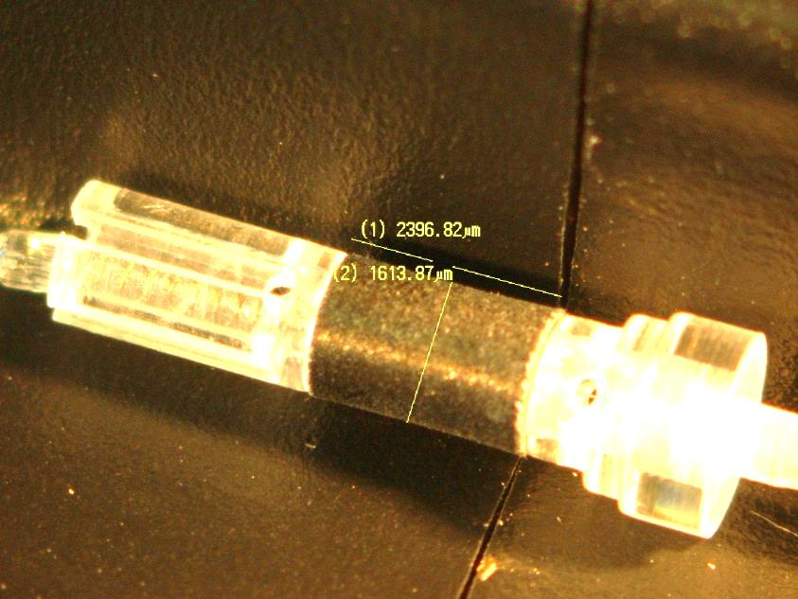
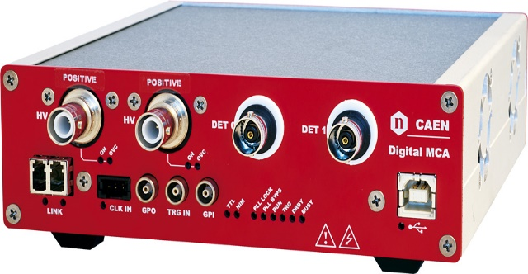

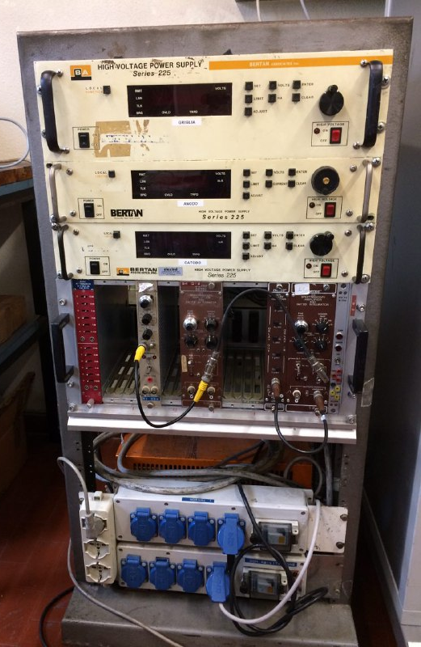
Mini-TEPC
Reference devices
Gas-steady modality
Tissue
-
Equivalent
Mini
Proportional
Counter
High intensity beams
Anna Bianchi (abianchi@sckcen.be) – RAD7, Herceg Novi – 14/06/2019

Slide 6

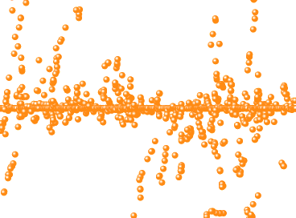
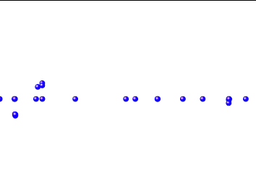
Gas – Steady Modality
Gas aging
Time
LET
Counting rate
Anna Bianchi (abianchi@sckcen.be) – RAD7, Herceg Novi – 14/06/2019

Slide 7
Detector Characterization at 1µm
Gas-steady modality feasibility study in different radiation fields

Slide 8
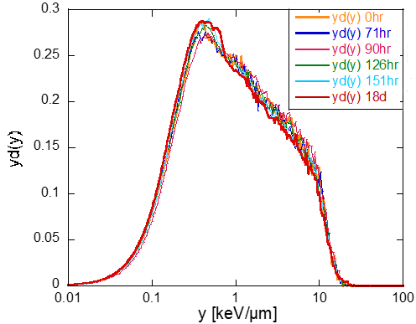
Gamma rays radiation field
Low LET-Low Rate
2.4
2.3
Yd
2.2
Yf
2.1
2
1.9
1.8
0.44
0.42
0.4
0.38
0.36
0.34
0.32
0
100
200
300
400
Hours
Anna Bianchi (abianchi@sckcen.be) – RAD7, Herceg Novi – 14/06/2019

Slide 9
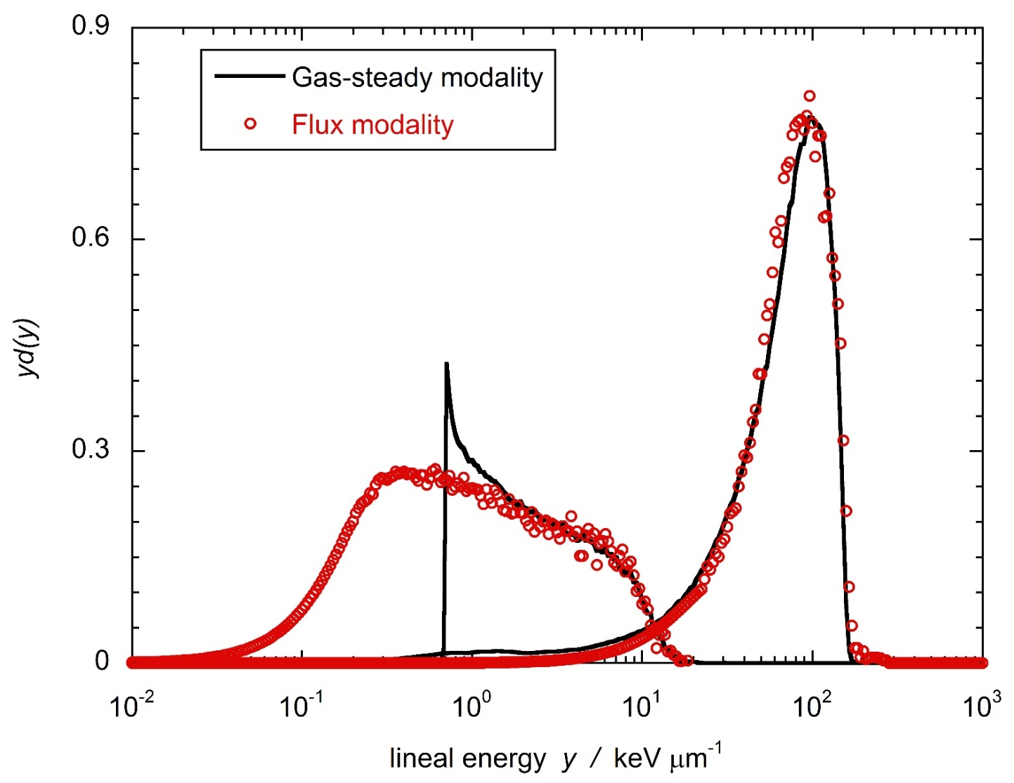
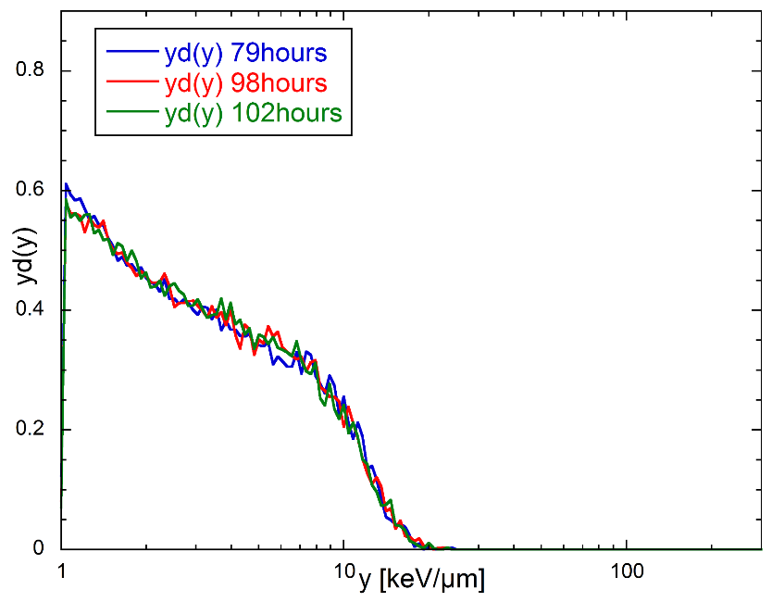
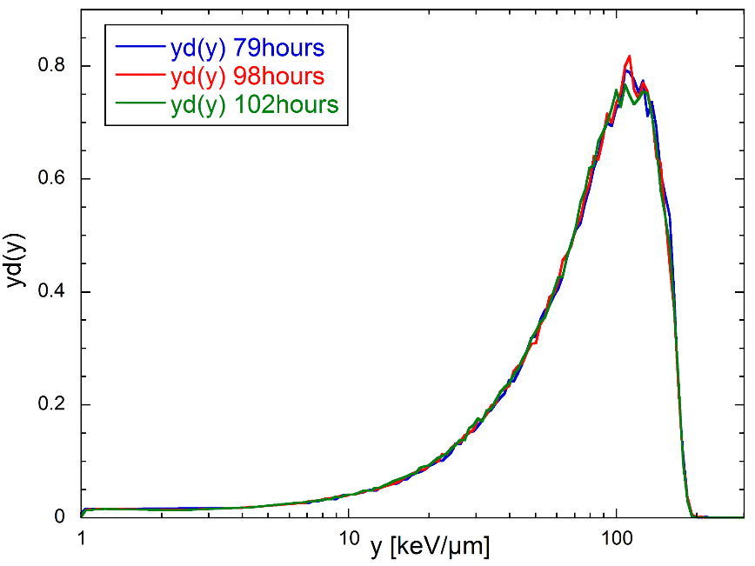
Neutron radiation field
Medium LET-Low Rate
γ-spectrum
n-spectrum
Anna Bianchi (abianchi@sckcen.be) – RAD7, Herceg Novi – 14/06/2019

Slide 10
62 MeV proton beam of CATANA
Medium LET-High Rate
2 measurement campaigns 4 months apart
Anna Bianchi (abianchi@sckcen.be) – RAD7, Herceg Novi – 14/06/2019

Slide 11
62 MeV proton beam of CATANA
Anna Bianchi (abianchi@sckcen.be) – RAD7, Herceg Novi – 14/06/2019

Slide 12
Conclusions
Detector Characterization
Time stability in 4 months STABLE
Gas aging due to LET (<100 keV/µm) ABSENT
Gas aging due to counting rate ABSENT
Anna Bianchi (abianchi@sckcen.be) – RAD7, Herceg Novi – 14/06/2019

Slide 13
Beam Characterization at 1µm
Characterization of the CATANA 62 MeV proton SOBP with a sealed mini-TEPC

Slide 14
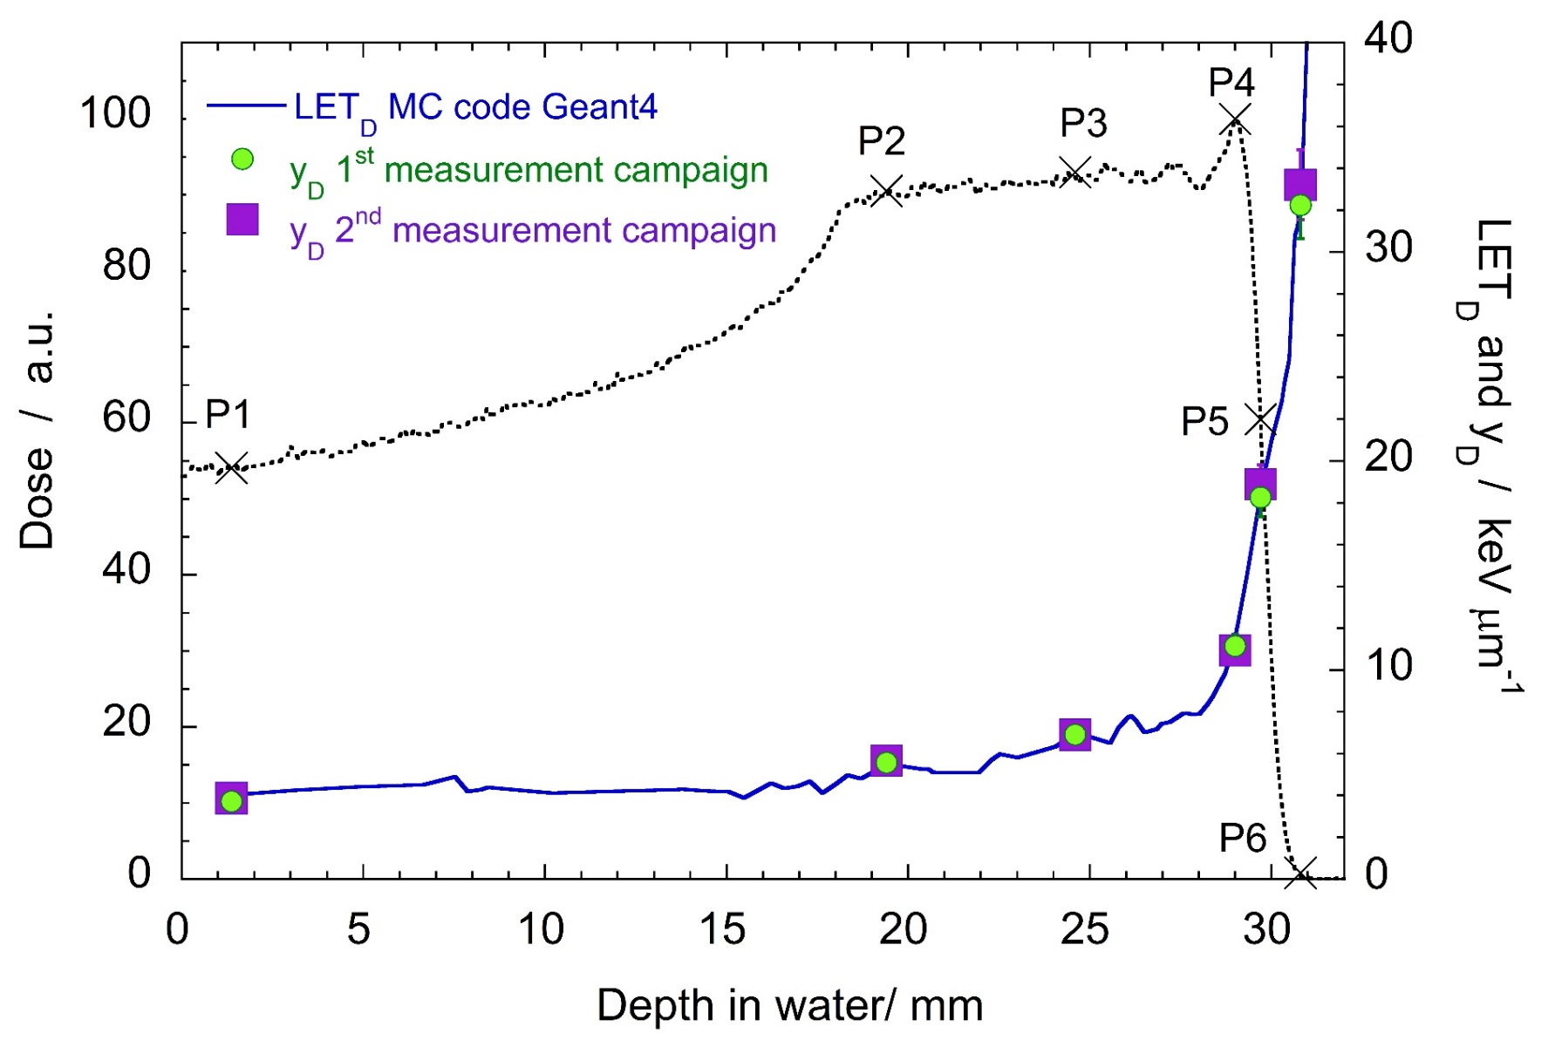

Microdosimetry of the 62 MeV proton beam CATANA
Dose-averaged lineal energy
Dose-averaged LET
$$\overline{y_{D} }∝tot−\overline{{LET}_{D}}$$
Anna Bianchi (abianchi@sckcen.be) – RAD7, Herceg Novi – 14/06/2019

Slide 15
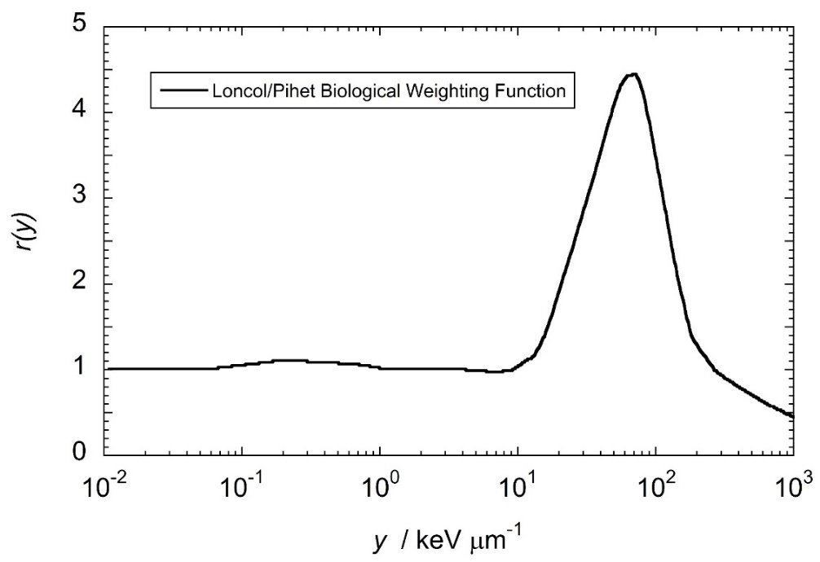
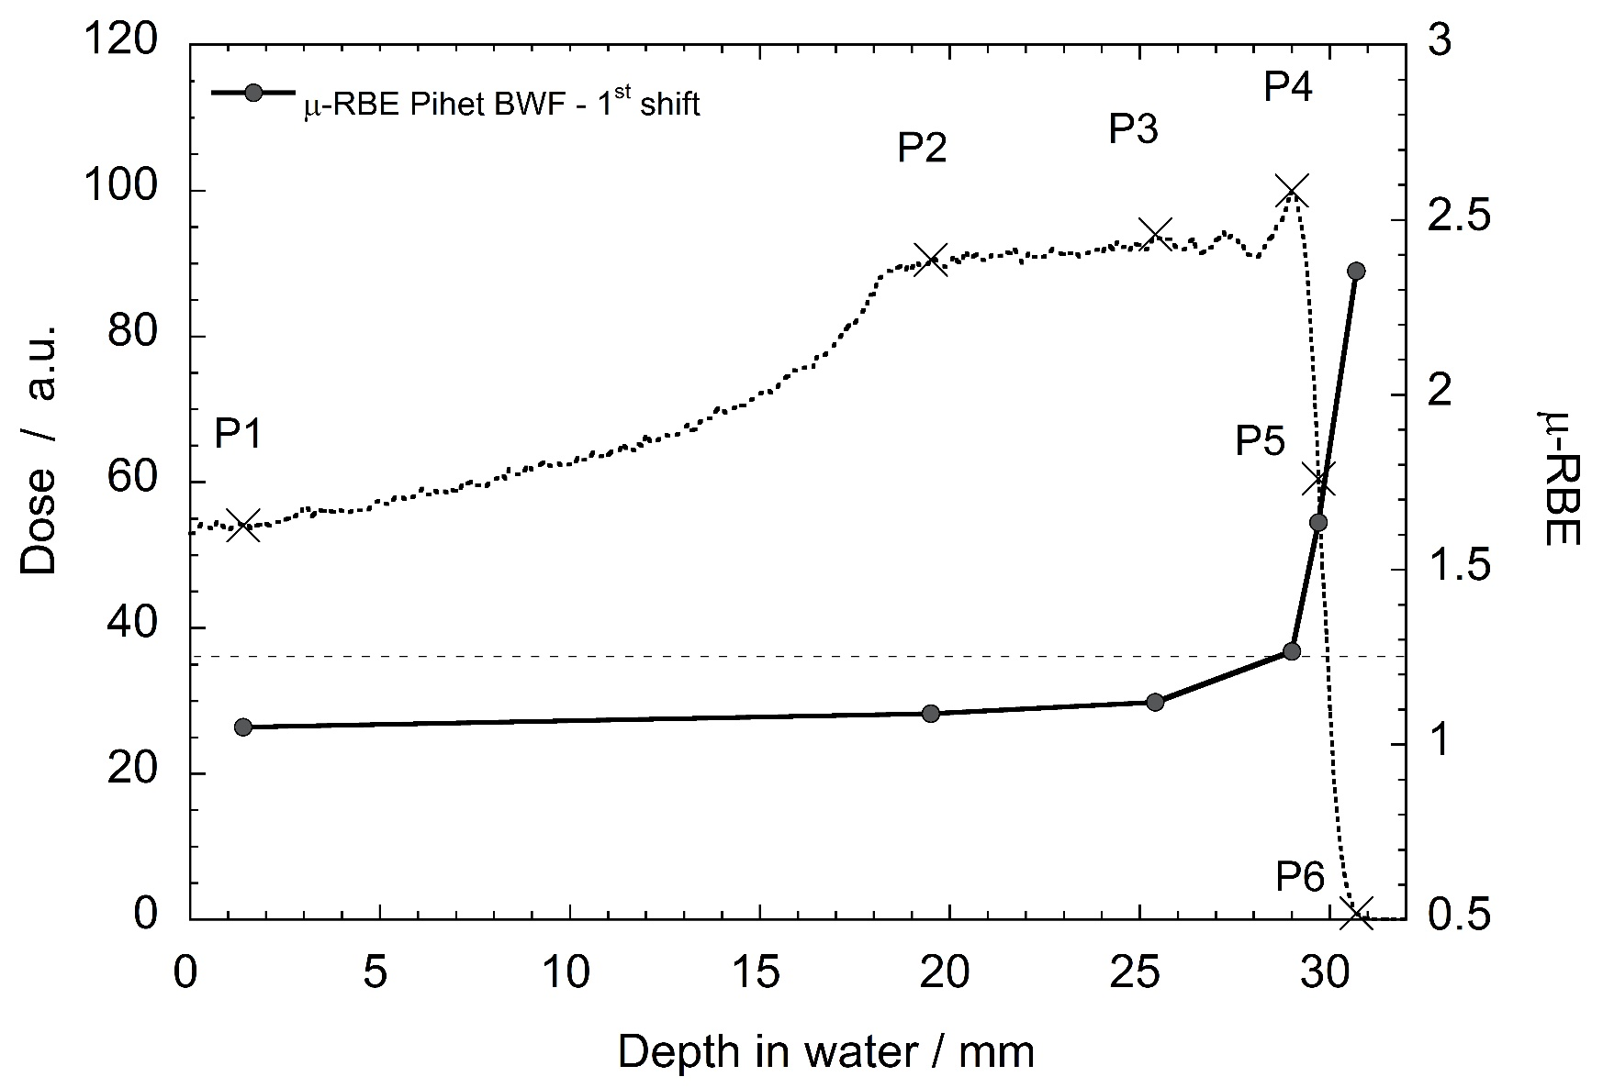
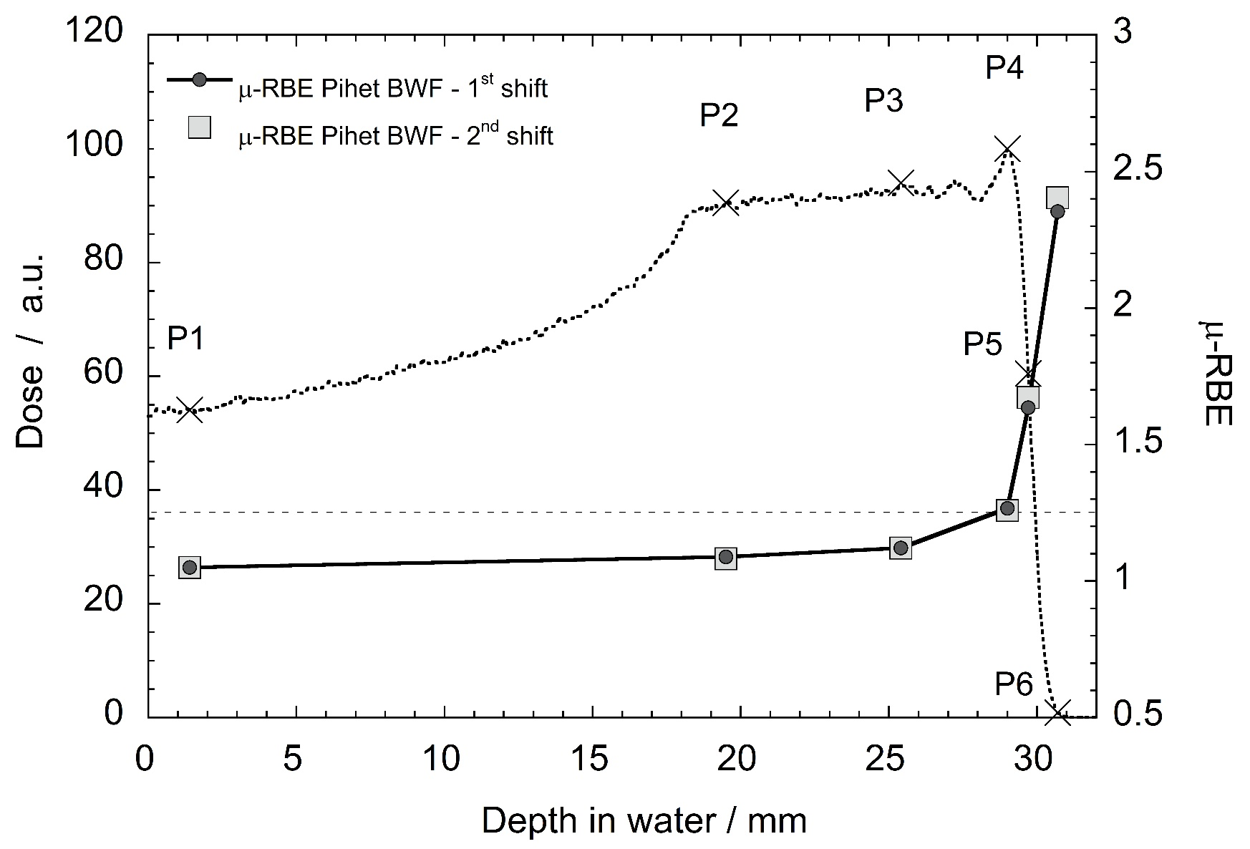
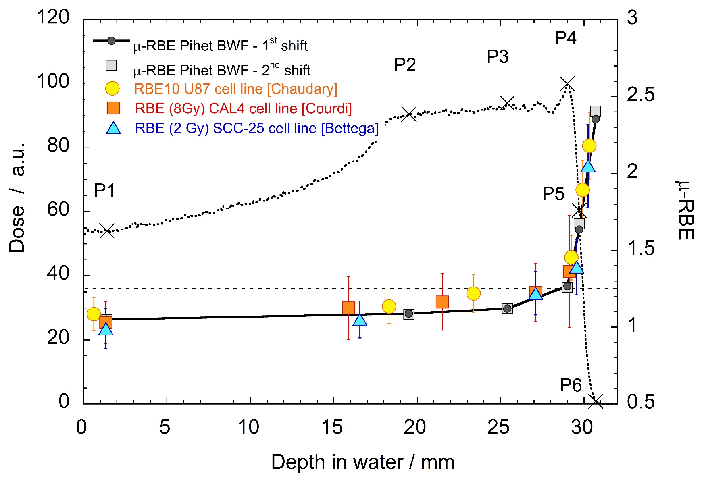
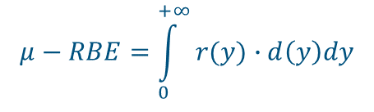
Microdosimetry of the 62 MeV proton beam CATANA
$$μ−RBE=\int_{0}^{+∞}{r(y)∙d\left(y\right)dy}$$
8 Gy neutrons, early intestinal tolerance assessed by crypt regeneration in vivo
Advantages of microdosimetry:
FAST measurement technique
REPRODUCIBLE results
ACTIVE detector for online monitoring
Anna Bianchi (abianchi@sckcen.be) – RAD7, Herceg Novi – 14/06/2019
Notes:
CAL-4: (Centre Antoine Lacassagne-4) melanoma human cells form metastatic site: Axillary lymph node
SCC-25: Human tongue squamous cell carcinoma

Slide 16
Conclusions
Detector Characterization
Detector Characterization
Time stability in 4 months STABLE
Gas aging due to LET (<100 keV/µm) ABSENT
Gas aging due to counting rate ABSENT
Time stability in 4 months STABLE
Gas aging due to LET (<100 keV/µm) ABSENT
Gas aging due to counting rate ABSENT
Next step:
New generation of mini-TEPCs optimized for gas-steady modality
Beam Characterization
Reproducible and consistent in 2 different measurement campaigns
Consistent with MC simulations and it reproduces RBE data trend
Anna Bianchi (abianchi@sckcen.be) – RAD7, Herceg Novi – 14/06/2019

Slide 17

Conclusions
Detector Characterization
Next step:
New generation of mini-TEPCs optimized for gas-steady modality
Time stability in 4 months STABLE
Gas aging due to LET (<100 keV/µm) ABSENT
Gas aging due to counting rate ABSENT
Thank you!
Beam Characterization
Reproducible and consistent in 2 different measurement campaigns
Consistent with MC simulations and it reproduces RBE data trend
Anna Bianchi (abianchi@sckcen.be) – RAD7, Herceg Novi – 14/06/2019

Slide 18
Copyright © 2018 - SCK•CEN
PLEASE NOTE!
This presentation contains data, information and formats for dedicated use only and may not be communicated, copied, reproduced, distributed or cited without the explicit written permission of SCK•CEN.
If this explicit written permission has been obtained, please reference the author, followed by ‘by courtesy of SCK•CEN’.
Any infringement to this rule is illegal and entitles to claim damages from the infringer, without prejudice to any other right in case of granting a patent or registration in the field of intellectual property.
SCK•CEN
Studiecentrum voor Kernenergie
Centre d'Etude de l'Energie Nucléaire
Belgian Nuclear Research Centre
Stichting van Openbaar Nut
Fondation d'Utilité Publique
Foundation of Public Utility
Registered Office: Avenue Herrmann-Debrouxlaan 40 – BE-1160 BRUSSELS
Operational Office: Boeretang 200 – BE-2400 MOL

