Slide 1



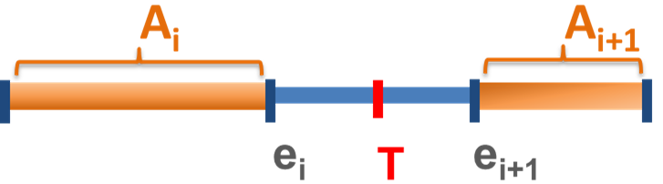
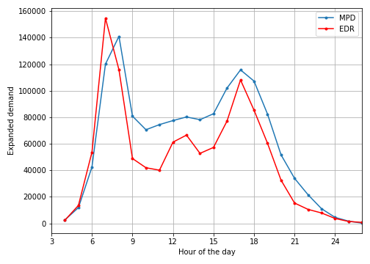
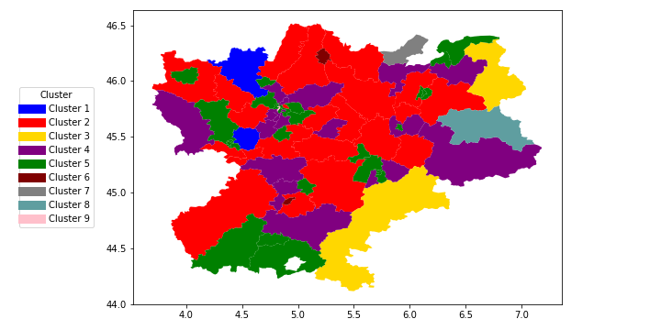
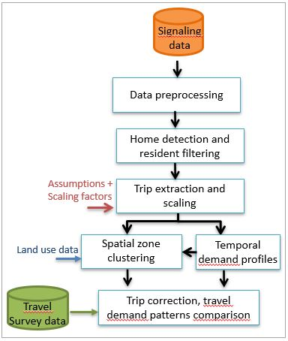
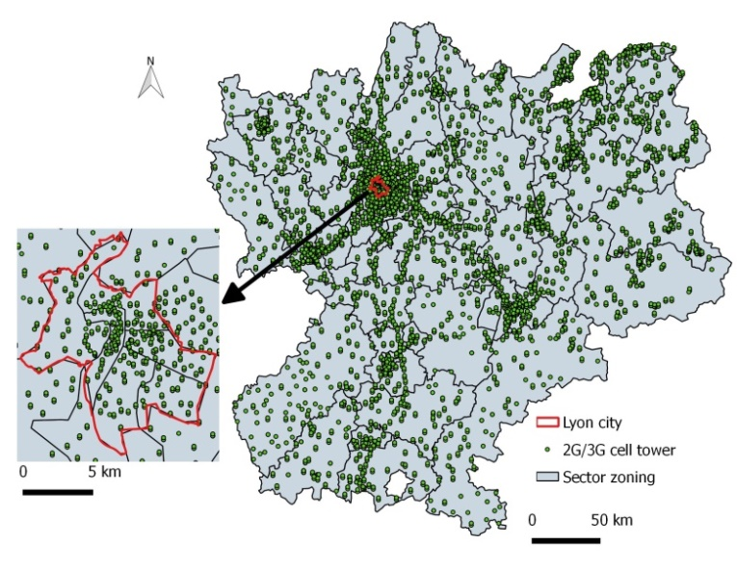
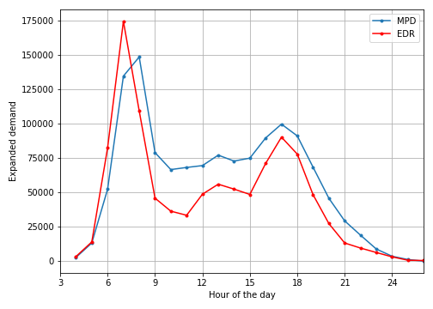
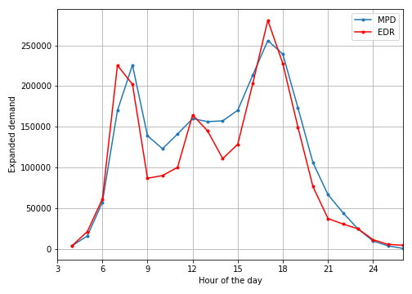
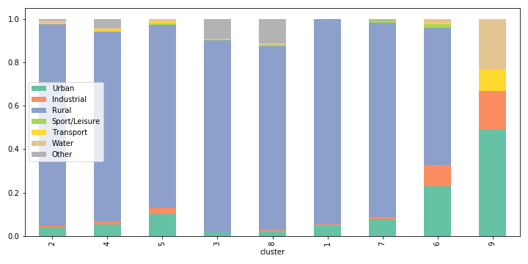
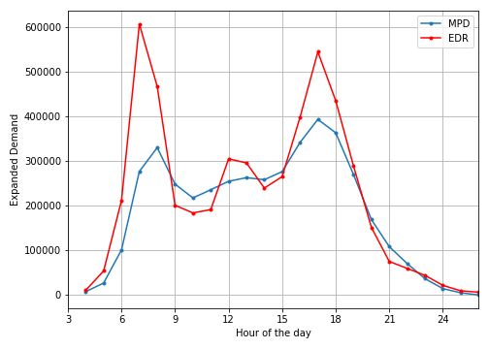
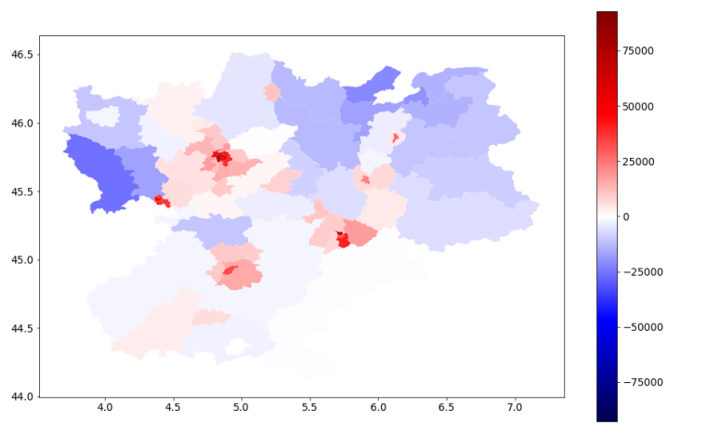
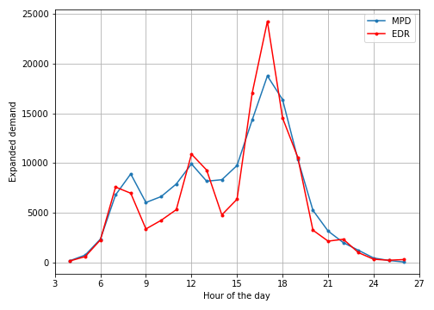
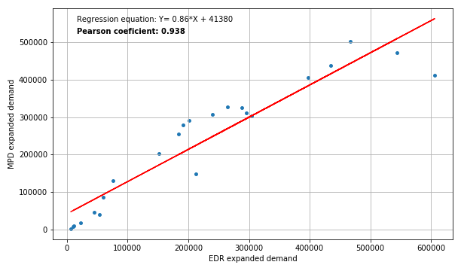

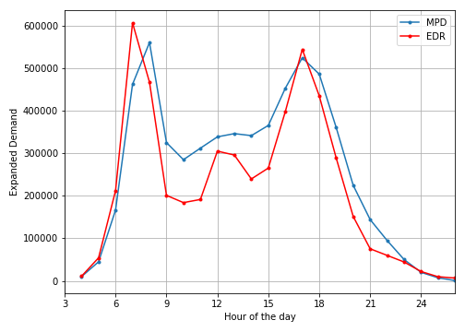


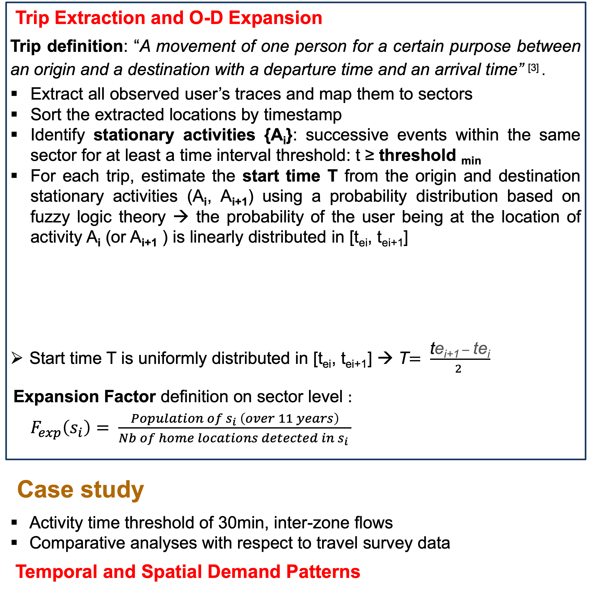
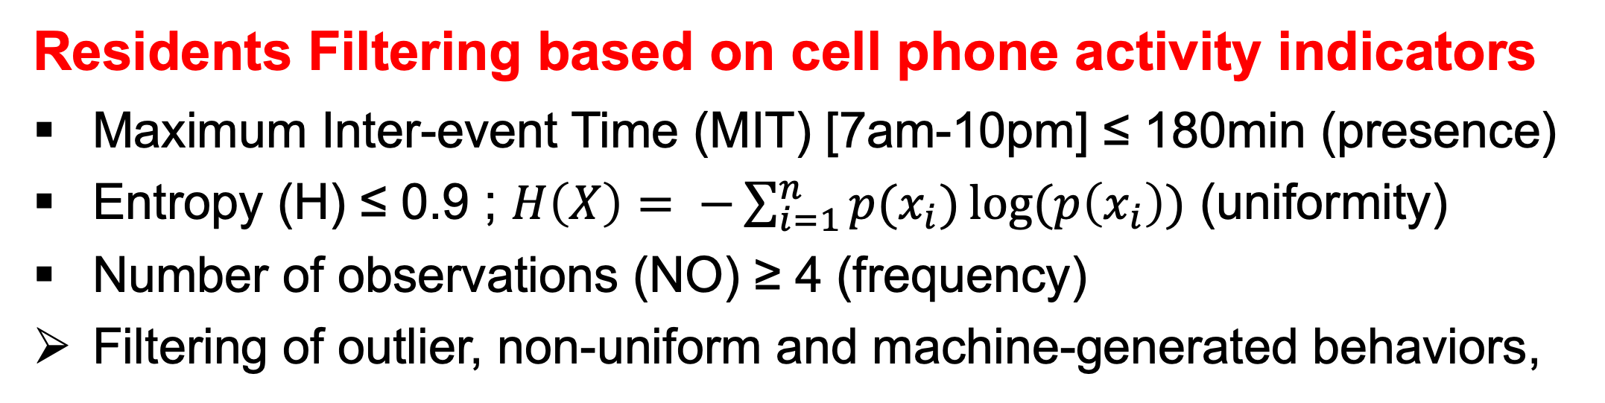
ASSESSING THE POTENTIAL OF CELLULAR SIGNALING DATA TO GENERATE DYNAMIC TRAVEL PATTERNS: A COMPARATIVE STUDY WITH TRAVEL SURVEY DATA
Mariem Fekih^{1,2} , Tom Bellemans², Angelo Furno^{3,4}, Loïc Bonnetain^{3,4}, Patrick Bonnel³, Zbigniew Smoreda¹, Stéphane Galland⁵
¹Orange Labs , ² IMOB (Hasselt university) , ³ ENTPE , ⁴ IFSTTAR, ⁵ UTBM
Introduction
Dynamic Origin-Destination flows are critical inputs to mobility studies for transportation planning and urban management purposes.
Traditional approaches rely on high-cost and rapidly obsolescent household travel surveys to collect mobility data ^{[1]} .
Our study proposes a data-driven approach to infer trip flows and dynamic travel demand patterns based on passively-collected cellular signaling data ^{[2]} in the Rhône-Alpes region, France. The results of our comparative analysis, performed using data from regional travel survey, prove the potential of cellular signaling data to unveil meaningful and reliable dynamic mobility behaviors.
Trip Extraction and O-D Expansion
Trip definition: “A movement of one person for a certain purpose between an origin and a destination with a departure time and an arrival time” ^{[3]} .
Extract all observed user’s traces and map them to sectors
Sort the extracted locations by timestamp
Identify stationary activities {A_{i}}: successive events within the same sector for at least a time interval threshold: t ≥ threshold _{min}
For each trip, estimate the start time T from the origin and destination stationary activities (A_{i}, A_{i+1}) using a probability distribution based on fuzzy logic theory → the probability of the user being at the location of activity A_{i} (or A_{i+1} ) is linearly distributed in [t_{ei}, t_{ei+1}]
Start time T is uniformly distributed in [t_{ei}, t_{ei+1}] → T$= \frac{\text{t}\text{e}\text{i}\text{+1} − \text{t}\text{e}\text{i}}{2 }$
Expansion Factor definition on sector level :
${ F}_{exp}\left(s_{i}\right)= \frac{Population of s_{i} \left(over 11 years\right)}{Nb of home locations detected in s_{i} }$
Case study
Activity time threshold of 30min, inter-zone flows
Comparative analyses with respect to travel survey data
Temporal and Spatial Demand Patterns
Temporal debiasing:
A ratio of 1.3 between the afternoon and the morning peak of the LAU 24-hours profile has been observed → All mobile phone trips starting in [5AM, 8AM] are scaled of a 1.3 correction factor
Spatial debiasing:
A linear correlation has been observed between the difference of the sector-emitted demand from survey and mobile phone data and the sector urban density → A spatial correction factor has been estimated per zone based on the regression equation, to remove such correlation
Spatial zone clustering : using hierarchical agglomerative clustering.
Correlation coefficient as similarity measure between temporal profiles
Number of clusters: 9 based on silhouette and Davies-Bouldin scores
Methodology
e_{i+1} first event of A_{i+1}
e_{i} last event of A_{i}
(a)
(e)
(b)
Comparison of hourly travel demands from signaling and EDR data per each cluster, i.e.: (a) #2 (b) #4 (c) #5 (d) #6.
(e) Map of generated clusters (f) Land use coverage per cluster
(f)
Cell tower (2G /3G) distribution and administrative sector zoning in the Rhône-Alpes region (5.2 million population aged over 11 years old)
(c)
d
Datasets
2G/3G signaling data (2017) ~2 million users, 24-hour period User ID, timestamp & cell tower ID Call, SMS, data, attach/detach, handover, Location area update | Household Travel Survey (EDR 2015) ~37,000 individuals; 143,000 trips Temporal and spatial trip attributes 77 zones called “EDR sectors”
(d)
Very similar shapes for urban (C#5 and C#6) and mixed/rural areas (C#4 and C#2)
Signaling data indicate higher flows surrounding the midday period, hardly observable via the survey
Home Location Detection
Select user traces at night-time periods, i.e., [3am-7am] and [10pm-3am], highly likely generated in a stationary state
Extract all observed cell towers from the selected user traces
Derive the most frequent observed cell tower and map it to the sector zoning → user home sector
1.27 million resident users, 25% of total region population
The total demand from signaling data is lower than the one observed from the survey
The emitted demand tends to be higher in rural areas and lower in urban dense areas
Conclusion & Perspectives
Full workflow to parse, filter, scale-up trips and extract relevant dynamic mobility patterns from a large-scale cellular network signaling dataset as an alternative for travel demand modeling
Low-cost and time-efficient method, an opportunity to up-to-date travel models for transport planners and policy-makers
Future work: improve the method to detect activity’s start/end time; analysis of individual’s motifs and typical patterns (e.g., route choice)
Residents Filtering based on cell phone activity indicators
Maximum Inter-event Time (MIT) [7am-10pm] ≤ 180min (presence)
Entropy (H) ≤ 0.9 ; $H\left(X\right)= −\sum_{i=1}^{n}{p(x_{i})\log{(p\left(x_{i}\right))}}$ (uniformity)
Number of observations (NO) ≥ 4 (frequency)
Filtering of outlier, non-uniform and machine-generated behaviors,
A de-biasing procedure is applied by defining temporal and spatial correction factors
References
^{[1]} Nitsche et al. (2014) Supporting large-scale travel surveys with smartphones – A practical approach.
^{[2]} Fekih et al. (2018) Suitability of cellular network signaling data for Origin-Destination matrix construction
^{[3]} CERTU (2008) L’enquête ménages déplacements standard CERTU.
Contact information: mariem.fekih@uhasselt.be, angelo.furno@univ-eiffel.fr, loic.bonnetain@entpe.fr, patrick.bonnel@entpe.fr
http://promenade.licit-lyon.eu

