Slide 1
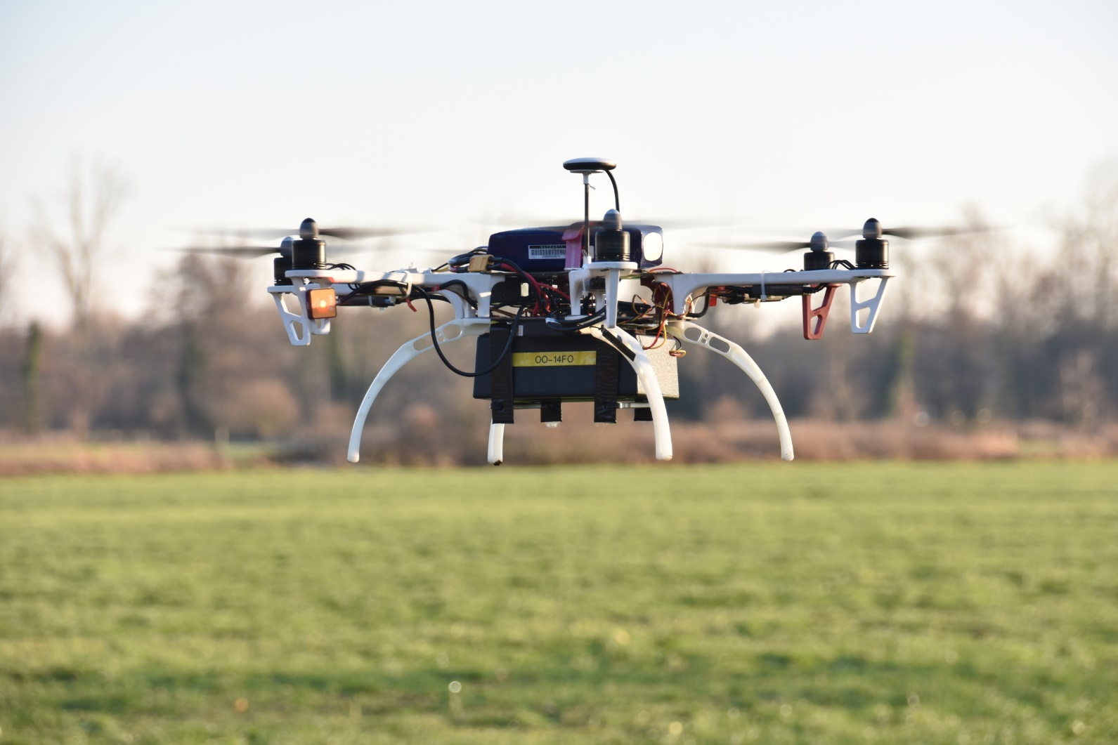
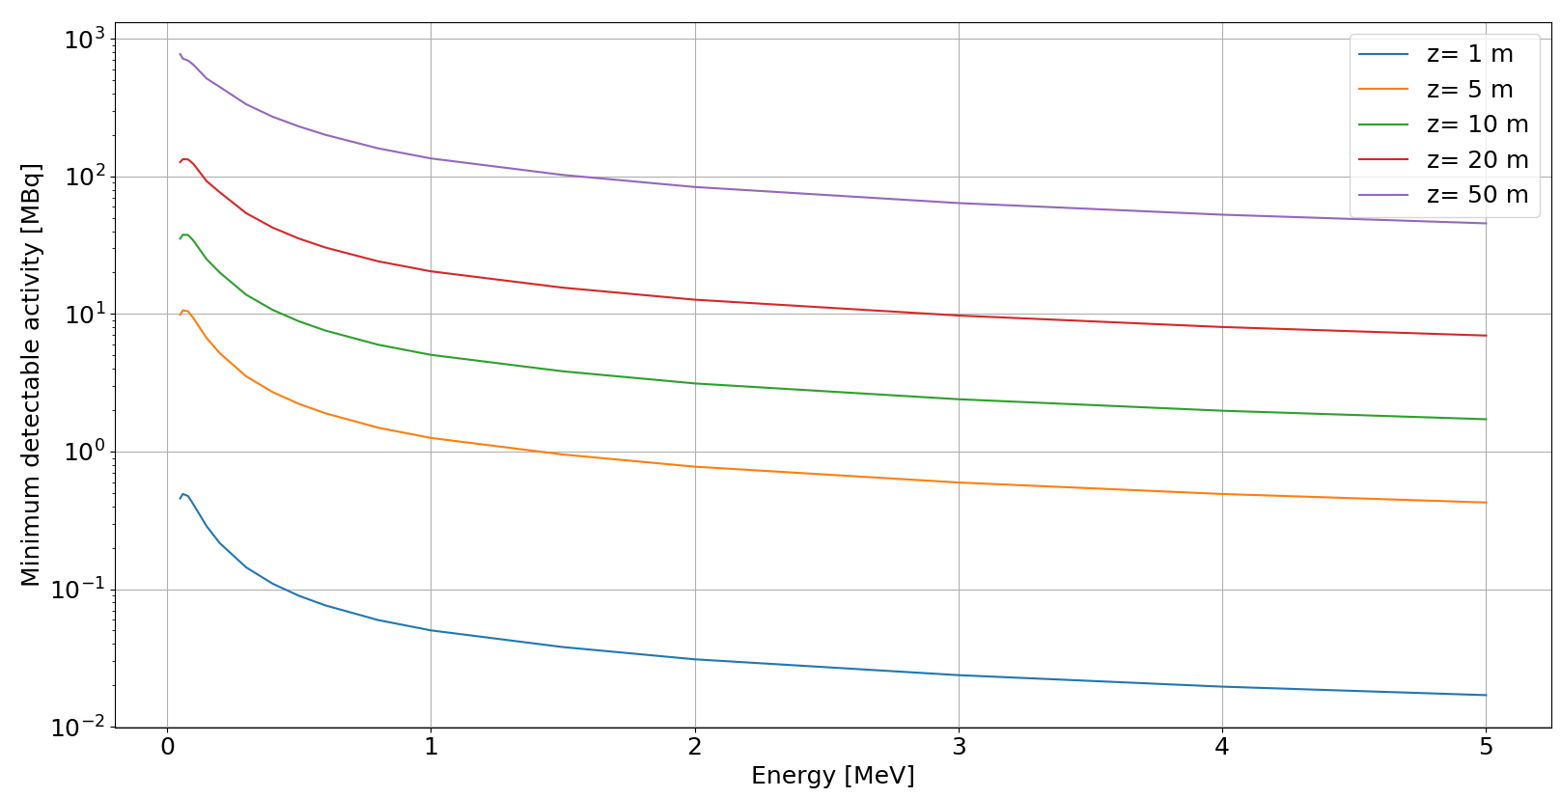
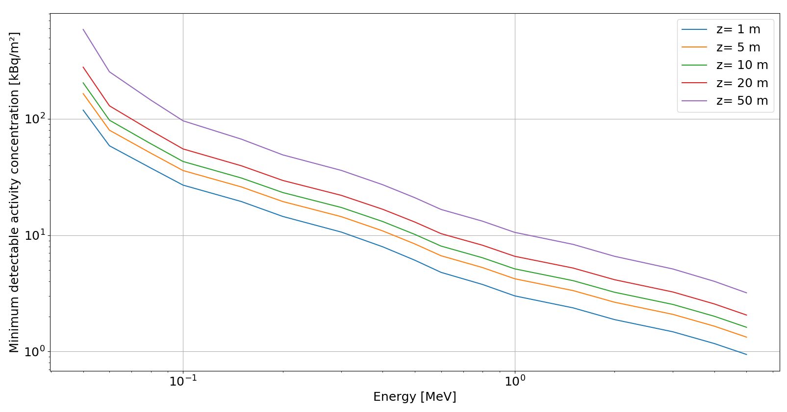
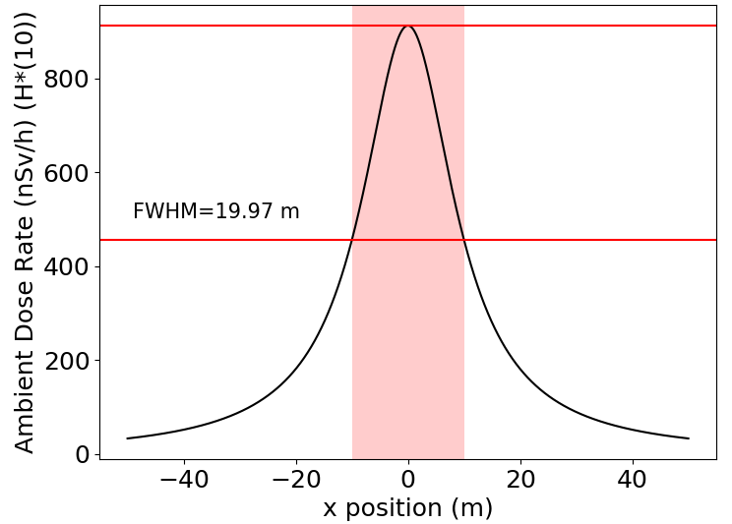
Efficiency of a drone measuring radioactivity
Stef Geelen ^{1,2}, Johan Camps ¹, Tim Vidmar ¹, Wouter Schroeyers²
¹ Belgian Nuclear Research Centre, SCK•CEN, Mol, Belgium
² University of Hasselt, UHasselt, NuTeC, Diepenbeek, Belgium
E-mail: stef.geelen@sckcen.be
Introduction
Unmanned Aerial Vehicles (UAV’s) or drones are a very flexible and easy to use tool for first responders to locate lost sources or to evaluate a contaminated area after a radiological of nuclear event. However, the obtained results of the measurements are not always easy to interpret. Therefor, first responders would need a better understanding of the measurements these drones do and the capabilities and the limitations these drones have. By simulating different scenarios in Python, 3 parameters were investigated, to have a first insight of the possibilities and limitations that these drones have.
Objectives
Calculate the minimum detectable activity for a point source.
Calculate the minimum detectable activity concentration for a homogenous surface contamination.
Investigate the influence of height on the detector’s resolution.
Materials and methods
For the simulations of the drone and point source Anaconda was used, a free and open source Python distribution in the environment Spyder. The simulations were done analytically with Formula 1 [1] that calculates the Air Kerma rate free-in-air, $\dot{K}$.
(1)
Herein, k is the conversion factor from eV → J, μen is the energy absorption coefficient, g is the bremsstrahlung fraction, Eϒ is the gamma energy, B is the buildup factor, r is the distance to the source, µ is the attenuation coefficient and C is the activity. The Air kerma rate was used with conversion coefficients KH [2] to get the Ambient dose rate H*(10). The obtained results were then compared to the dose rate calculator of [3]. Nuclide data was retrieved from [4] and the attenuation coefficients and buildup factors from [5].
Results
Minimal detectable activity
In Figures 1 and 2 the minimal detectable activity is shown for respectively a point source and a surface contamination for gamma energies between 50 keV and 5 MeV. As a dose rate limit 150 nSv/h was chosen because it is approximately the double of the background in Flanders, Belgium. However, when a more robust or specific dose rate limit has to be chosen this is easily adaptable.
Point Spread Function
In Figure 3 a point spread function, PSF, is shown at a height of 10 m with a Cs-137 point source at (0,0,0). The PSF was calculated by simulating a drone flying directly above the point source and measuring the ambient dose rate H*(10). From this PSF the full width half maximum (FWHM) can be used as a measure for the resolution. The FWHM of a PSF of a Cs-137 point source and the height are correlated through the following formula: FWHM(z)=1.981z+0.103.
Figure 4: Drone with GM-tube available at the SCK•CEN for dose rate measurements.
Figure 1: Graph depicting the minimal detectable activity of a point source in function of the energy with a dose rate limit of 150 nSv/h.
Figure 2: Graph depicting the minimal detectable activity concentration of a surface contamination in function of the energy with a dose rate limit of 150 nSv/h.
Figure 3: Point Spread Function of a 1 GBq Cs-137 point source at a height of 10 m.
Discussion
The influence of height is more pronounced with the minimal activity of a point source than with the minimal activity concentration of a surface contamination. In case of the point source, the distance r is solely dependent on the position of the point source. In case of the homogenous surface contamination the complete surface has to be accounted for and by increasing the off axis distance the influence of the height on the distance r is reduced. Therefor, the influence of the height is more pronounced in Figure 1. However, the minimal activity that is listed here was theoretically calculated with a detector that has an efficiency of 1 and no angular dependence. This means that in reality the activity should be even higher to pass the dose limit.
The FWHM of a PSF is approximately equal to the double of the height for any gamma energy in the range of 50 keV to 5 MeV. Further it was also found that the gamma energy has a minimal influence on the FWHM when the height is kept to reasonable values for a drone.
Conclusion
A methoddology of calculating the minimal detectable activity was executed with Python. The influence of the height is clearly visible in the results of a point source and a surface contamination. A next goal is introducing correction factors for the angular dependency and efficiency of the detector underneath the drone.
The FWHM of a PSF is found to be an adequate measure of resolution. Besides this, it could also serve as a method to discriminate 2 closely placed point sources.
[1] K. Kenis, L. Vervecken, and J. Camps, “Gamma dose assessment in near-range atmospheric dispersion simulations." SCK-CEN, Mol, Belgium, Tech. Rep. ER-242, 2013.
[2] ICRP, 1996. Conversion Coefficients for use in Radiological Protection against External Radiation. ICRP Publication 74. Ann. ICRP 26 (3-4).
[3] Nucleonica, “App Portal.” [Online]. Available: https://nucleonica.com/Application/AppPortal.aspx. [Accessed: 18-Jan-2019].
[4] Laboratoire National Henri Becquerel, “Lara Application – Laboratoire National Henri Becquerel,” 2017. [Online]. Available: http://www.lnhb.fr/nuclear-data/module-lara/.
[5] American Nuclear Society, “gamma-ray attenuation coefficients and buildup factors for engineering materials,” 1991.
Acknowledgements:
SCK•CEN || Boeretang 200 || BE-2400 Mol || www.sckcen.be || info@sckcen.be || Posternr:

