Slide 1
Detection and Discrimination of Point Sources and Surface Contaminations with a Drone-Borne Dose Rate Detector
Stef Geelen
Stef.geelen@sckcen.be
Stef.geelen@uhasselt.be
Notes:
Name
Detection and Discrimination of point sources and surface contaminations with a drone-borne dose rate detector
First of all, I would like you to imagine that a dirty bomb exploded at the campus at this moment.
I don’t know about you but I would be running now. However, afterwards civil protection will have to clean up debris from this event. This will give multiple people an unnecessary dose when they are looking for sources. My answer to solve this would be:

Slide 2
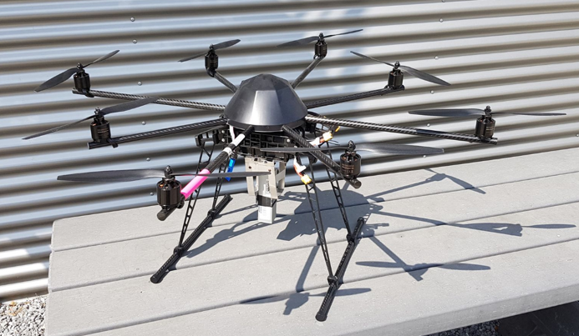
Drones
Remote controlled
Easy to control
Fast
Small
Fly
Notes:
DRONES:
Remote controlled (no personal dose)
Easy to control (harder as the toys you can buy but still)
They can be deployed fast and scan a relatively large area fast
They are rather small what gives the opportunity to do measurements inside buildings
And the most obvious one: they can fly what gives them the ability to reach difficult places

Slide 3
Ambient Dose rate H*(10)
1
2
3
Ambient Dose Rate [Sv/h]
Ambient Dose / Air Kerma [Sv/Gy]
Air Kerma Rate [Gy/h]
Notes:
I have developed a model that calculates the ambient dose rate at the position of a drone.
This is done by calculating the Air Kerma rate and converting it to the Ambient dose rate with conversion factors taken from the ICRP 74.

Slide 4
Notes:
Hereafter, I validated my model by monte carlo simulations done with the monte carlo code Penelope.
This resulted in a relative difference of less than 6 % for the investigated energies. And a mean relative difference of approximately 4 %.

Slide 5
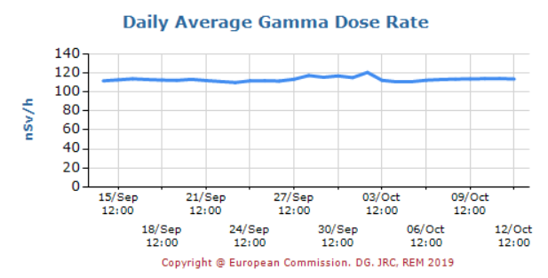
Minimum Detectable Activity (MDA)
Dose Rate detector
2 x Background as detection limit
Stockholm: 220 nSv/h
Point source
Surface contamination
Notes:
With the validated model I was able to calculate the minimum detectable activity for a dose rate measurement. To do this I us a detection limit of 2 times the background. For Stockholm this would be approximately 220 nSv/h.(FOTO).
I calculated the MDA for a point source and a surface contamination

Slide 6
MDA point source

Slide 7
MDA surface contamination

Slide 8
Discrimination between point source and surface contamination
Scanning pattern until maximum
x coordinate
Perpendicular scanning pattern until maximum
y coordinate
At (x,y)
Dose Rate at height= 10 m
Dose Rate at height= 15 m
Inverse r²-law

Slide 9
Discrimination Point Source
10² m / 15² m ≈ 406 nSv/h / 915 nSv/h
0.4444 ≈ 0.4436

Slide 10
Discrimination Surface Contamination
10² m / 15² m ≠ 233 nSv/h / 385 nSv/h
0.4444 ≠ 0.6060

Slide 11
Conclusion
Dose rate calculations agreed within 6 % relative difference
MDA for point sources and surface contaminations for a preset limit
Discriminate between point sources and large surface contaminations

Slide 12
Copyright © 2014 - SCK•CEN
All property rights and copyright are reserved.
Any communication or reproduction of this document, and any communication or use of its content without explicit authorization is prohibited. Any infringement to this rule is illegal and entitles to claim damages from the infringer, without prejudice to any other right in case of granting a patent or registration in the field of intellectual property.
SCK•CEN
Studiecentrum voor Kernenergie
Centre d'Etude de l'Energie Nucléaire
Belgian Nuclear Research Centre
Stichting van Openbaar Nut
Fondation d'Utilité Publique
Foundation of Public Utility
Registered Office: Avenue Herrmann-Debrouxlaan 40 – BE-1160 BRUSSEL
Operational Office: Boeretang 200 – BE-2400 MOL

