Slide 1
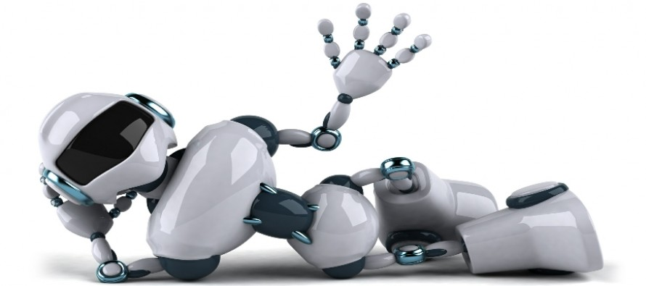
Toward a Consumer-Based Framework For Balancing Touch & Tech in Service Interactions
Eline Hottat, Sara Leroi-Werelds, & Sandra Streukens
Notes:
Hello, I’m Eline and I’m excited to present you my first work in progress paper entitled “x”
I’m working on this paper together with my supervisor and co-supervisor

Slide 2
INTRODUCTION
Human employee
Service robot (SR)
Self-service technology (SST)
Notes:
Nowadays, it’s becoming increasingly clear that the role of technology in the service context is rising. Consider, for instance, current technological advances in the restaurant industry.
Where once traditional human-to-human interactions between customers and waiters were common practice, you increasingly see a shift to human-to-tech interactions.
For example, some restaurants allow customers to order via self-service kiosks (e.g. McDonalds), while other restaurants start to employ service robots to serve customers (e.g. Pizza Hut).
In fact, the role of technology is increasingly shifting from supporting service employees to substituting them (Bowen 2016). Moreover, these technological advances are marking a new age of automation - referred to as the ‘The Fourth Industrial Revolution’.

Slide 3
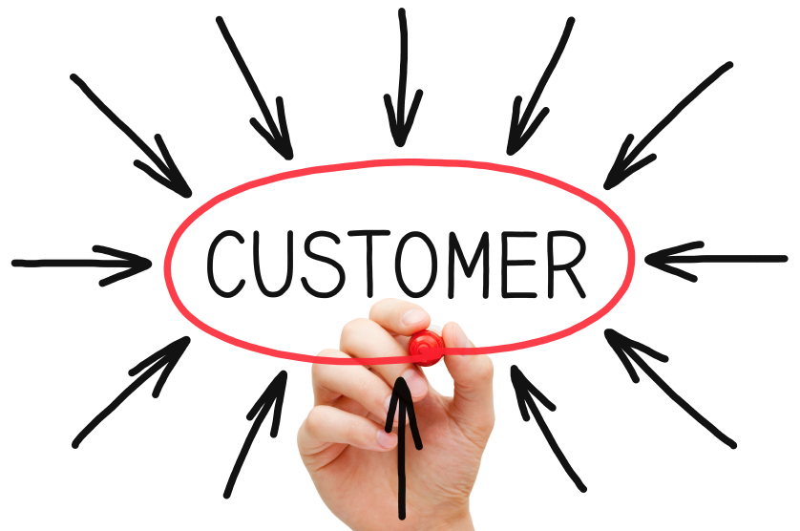
THEORETICAL BACKGROUND
Increasing role of technology is mainly due to its rising possibilities
Although automating service interactions can be technically and economically feasible, it should also be feasible from a customer perspective
Prior research (e.g. Gremler & Gwinner 2008) indicates that the behaviors of frontline service employees have a significant impact on customers’ experiences which affects their satisfaction, loyalty, and word-of-mouth
Hence, the automation of these behaviors has a profound effect on the customer experience and its outcomes (Van Doorn et al. 2017)
Notes:
This increasing role of technology is mainly due to its rising possibilities. For example, where once automation was limited to routine manufacturing tasks, this is nowadays not the case anymore. Even non-routine cognitive tasks and non-predictable manual tasks are becoming automatable.
However, while automating service interactions can be technically and economically feasible (e.g. lower costs), it should also be feasible from a customer perspective. Prior research (e.g. Gremler and Gwinner 2008) indicates that customers’ interactions with frontline service employees (i.e. employees who directly interact with customers) have a significant impact on their customer experience. Hence, automating these interactions has a profound effect on the customer experience and subsequent customer outcomes such as customer satisfaction (Van Doorn et al. 2017). This view is supported by Kunz, Heinonen, and Lemmink (2019) who state that technologies indeed have the opportunity to change the customer experience significantly.

Slide 4
THEORETICAL BACKGROUND
Prior studies provide preliminary insights into the impact of replacing touch by tech on the customer experience:
Meuter et al. (2005) and Scherer et al. (2015) | technologies can enhance the customer experience by providing benefits (e.g. more control).
Caic et al. (2018) | contrasting results regarding the potential roles for service robots in value networks of elderly care (i.e. value creation versus value destruction).
Mende et al. (2017) | customers report an inferior customer experience when their food is served by a robot versus a human waiter.
Reinders et al. (2008) | completely replacing all human service employees by technologies has a negative effect on the customer experience.
Giebelhausen et al. (2014) | customers’ reactions to technology-induced service interactions depend on the presence of employee rapport.
Notes:
In particular, automation can have a positive or negative effect on the customer experience. For instance, previous studies (Meuter, Bitner, Ostrom, and Brown 2005; Scherer, Wünderlich, and Von Wangenheim 2015) indicate that technologies can enhance the customer experience by providing benefits such as saving time or increasing customers’ control. However, Reinders, Dabholkar, and Frambach (2008) demonstrate that forcing customers to use a self-service technology (i.e. completely replacing all human service employees by technologies) has a negative effect on the customer experience. In a similar vein, Mende et al. (2017) show that customers report an inferior customer experience when their food is served by a robot versus a human employee.
Although prior studies provide initial insights into the impact of automation from a customer perspective, empirical research examining when automation positively or negatively affects the customer experience is currently lacking:

Slide 5
RESEARCH GAP
“Considering the prevalence of technology in service encounters and the conflicting viewpoints about its merits, it seems that clarity is needed with respect to when technology functions as a barrier or benefit to service exchanges” (Giebelhausen et al. 2014, p. 113).
Do restaurant customers prefer to be welcomed by a human or by a robot?
Do they like ordering their meals via a tablet or do they prefer ordering via a human waiter?
Is there a difference between fast-food restaurants and luxury restaurants?

Slide 6
RESEARCH OBJECTIVE
This study aims to develop a consumer-based framework of human versus automated interactions that presents an overview of the relevant characteristics that should be taken into account when examining customers preferences for human versus technological interfaces
Notes:
Based on this research gap, we aim to present an overview of the relevant characteristics - with special attention for FSBs - that should be taken into account when examining customers preferences for human versus technological interfaces. More specifically, we develop a consumer-based framework of human versus automated FSBs.

Slide 7
RESEARCH APPROACH
Service design approach (Patricio et al. 2018)
This is a human-centered, holistic, and creative approach which offers a mind-set for envisioning service experiences, through an iterative process of exploring, visualizing, and reflecting.
EXPLORATION
CREATION
REFLECTION
Generation of in-depth insights to understand customer
Notes:
Given our focus on balancing tech and touch to improve the customer experience, a service design thinking approach is suitable.
The exploration phase encompasses the generation of in-depth insights in order to understand the customer.

Slide 8
EXPLORATION
Diary study
To explore various service experiences to understand customers and their contexts
30
Diary for 3 weeks
Event-based diary design
Gioia method
Nvivo
Follow-up interviews
To clarify diaries and understand perceptions about automating interactions
27
Semi-structured
SIT – guided by blueprints
Gioia method
Nvivo
Aim
Sample size
Research procedure
Data analysis
Notes:
We captured this exploration phase by using 2 different methods.
Respondents were asked to keep an online or written diary for three weeks. We used an event-based diary design which implies that participants had to report their experiences each time a predefined event occurred .
In total 30 respondents participated, of which 70 percent are female. The average age is 45 years and varied from 23 to 78 years. Appendix 4 summarizes the key characteristics of the respondents. This recruiting process resulted in a collection of 281 diary inputs with an average of 9 inputs per respondent.
Research Protocol. An individual semi-structured follow-up interview was conducted guided by the service blueprint and their diary (Stauss and Weinlich 1997).
During the interviews, we followed ‘the Sequential Incidents Technique’ (SIT). The SIT adopts the “describing an incident” approach from the CIT, but instead of only focusing on ‘critical’ (i.e. very positive or very negative) incidents, it also records ‘normal’ incidents. Moreover, the SIT follows a process-based approach by including the subsequent steps in the service process (Stauss and Weinlich 1997; Roos 2002).

Slide 9
RESEARCH APPROACH
Service design approach (Patricio et al. 2018)
This is a human-centered, holistic, and creative approach which offers a mind-set for envisioning service experiences, through an iterative process of exploring, visualizing, and reflecting.
EXPLORATION
CREATION
REFLECTION
Visualization of service processes, illustration of associations, and development of solutions
Notes:
During the creation phase service processes are visualized, associations are illustrated and solutions are generated and developed.

Slide 10
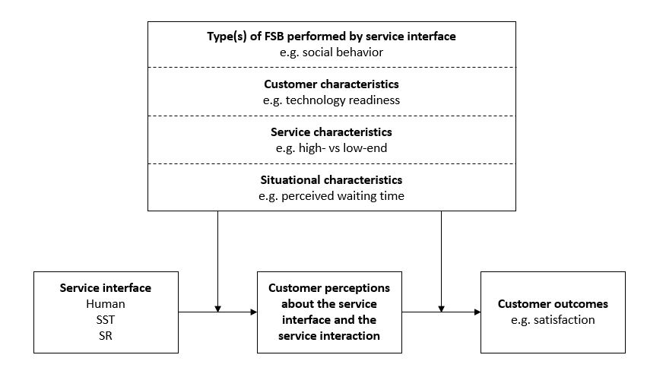
CREATION
Simplified version of the framework
Notes:
Guided by the emerging codes and supported by relevant service research, we developed a framework that outlines the components, relationships, and relevant characteristics which contribute to the understanding of how automation affects customers.
Overall, we discovered four categories influencing customer perceptions and outcomes: type(s) of FSB performed by service interface, service characteristics, customer characteristics and situational characteristics.
Social behavior, information sharing behavior
TR, need for interaction
High vs low, product category risk
Waiting time, shopping orientation

Slide 11
RESEARCH APPROACH
Service design approach (Patricio et al. 2018)
This is a human-centered, holistic, and creative approach which offers a mind-set for envisioning service experiences, through an iterative process of exploring, visualizing, and reflecting.
EXPLORATION
CREATION
REFLECTION
Collection of feedback to test and improve findings from the previous phase
Notes:
Finally, feedback is collected during the reflection phase in light of testing and improving the findings from the previous creation phase (Stickdorn and Schneider 2010).

Slide 12
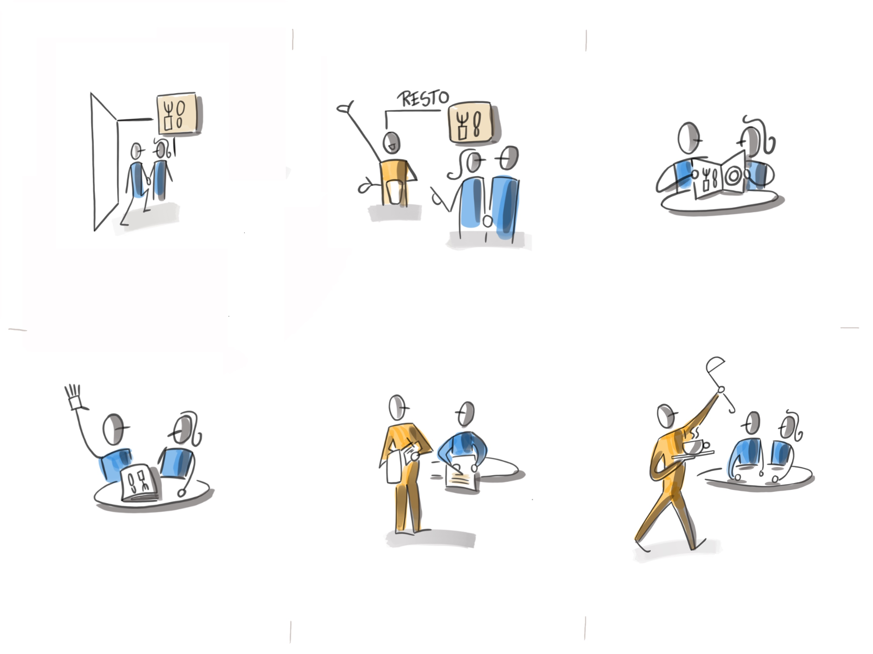
REFLECTION
Storyboarding
Reflect on findings to refine framework
~20
Combination of storyboards and context disruption interview protocol
Experts
Check if framework is complete
~10
Collect reflections on framework from experts via e-mail
A storyboard shows how a service develops over time.
It consists of graphical representations such as drawings, images or pictures and can be complemented by a narrative.
Aim
Sample size
Research procedure
Notes:
We are planning to capture this reflection phase also by using 2 different methods.
Storyboards allow us to combine a process-based visualization with a context disruption interview protocol.
Hier uitleg:
1) wat is storyboard: shows how a service develops over time (visualization of touch points of a service experience)
consists of graphical representations such as drawings, images or pictures and can be complemented by a narrative
Introduce disruption and rate its functions. In the third phase, we introduced a card that pictured a ‘tablet’ and a card representing a ‘robot’ and explained its properties via an instructive story/ movie. Then, we asked the participants about their general opinion regarding this technology, its features, its use in service visits, and its value creating or destroying possibilities.

Slide 13
CONSLUSION
Theoretical contributions
Managerial implications
provides a useful tool for strategic decisions about service design from a customer perspective
bridges theoretical and conceptual studies about the service experience (e.g. Lemon and Verhoef 2016; Voorhees et al. 2017) with empirical studies on specific touch-versus-tech experiments (e.g. Giebelhausen et al. 2014; Mende et al. 2017)
provides an excellent starting point to organize existing as well as future research on specific touch versus tech questions
widens the lens through which we view the balance between touch and tech
Notes:
To conclude,
The resulting framework of human versus automated interactions is valuable in multiple ways. First, it bridges theoretical and conceptual studies about the service experience (e.g. Lemon and Verhoef 2016; Voorhees et al. 2017) with empirical studies on specific tech-versus-touch experiments (e.g. Giebelhausen et al. 2014; Mende et al. 2017). Second, the proposed framework widens the lens through which we view the balance between tech and touch. Third, the framework provides an excellent starting point to organize existing as well as future research on specific tech versus touch questions. More specifically, starting from this framework, a research agenda is put forward to guide future research on the tech-touch balance. Fourth, it provides a useful tool for strategic decisions about service design from a customer perspective.

Slide 14
Questions or suggestions?
eline.hottat@uhasselt.be

