Slide 1
Economic Empowerment through Cultural Inclusion in Stellenbosch
Workshop 4
Bert Willems & Dirk Kenis, PXL-MAD, School of Arts, Hasselt
Elizabeth Miller-Vermeulen, EECI Project Coordinator for Stellenbosch University, South-Africa

Slide 2
Talented South African artists from historically deprived communities Cultural and socio-economic difficulties No acces to networks of enablers Essential attitudes and skills are missing
Why?

Slide 3
PXL-MAD @ Stellenbosch 2018 RADA
Context
Notes:
Cape Town, Spier Arts Academy, Yellowwood Arts
Grabouw, Crafting Hope through Arts

Slide 4
Preparing these artists for the art market Preparing the art market for these artists > Cultural inclusion > Socio-economic empowerment
Aims

Slide 5
Talented South African artists from historically deprived communities Stellenbosch University (visual arts) University of Western Cape (business) PXL (visual arts, communication, business) & UHasselt (business) > Co-creation
Who?

Slide 6
Selection participants Workshop & course-development Buddies Contact with enablers (active network) …
What?
Artists
Support
EECI
Activation
Art Market
Notes:
Criteria!!
Skills in the workshops: artistic & economic

Slide 7
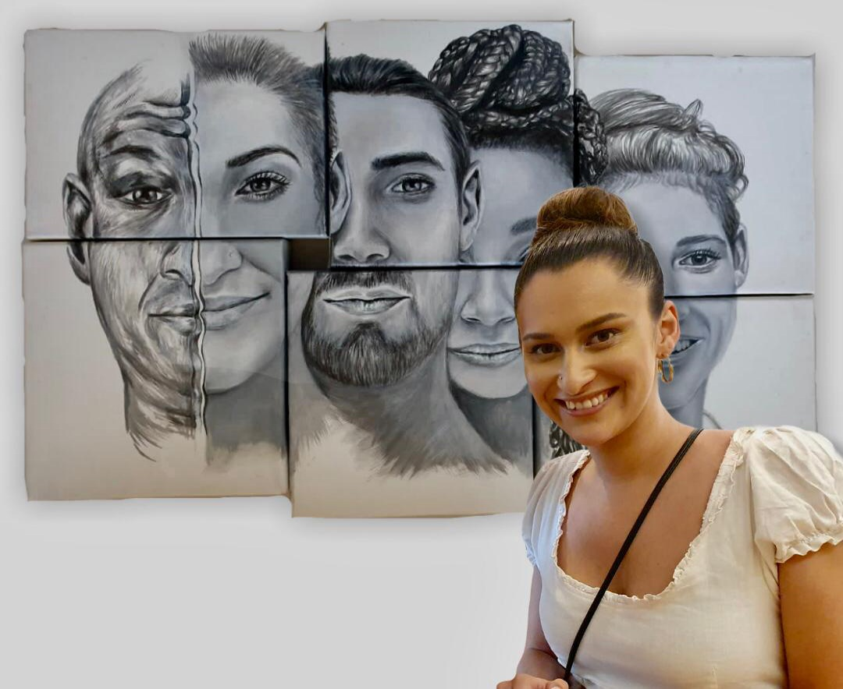
Sascha-Lee Lawrence Visual art Also works as a model Originally from the rural village of Pniel
Participants

Slide 8
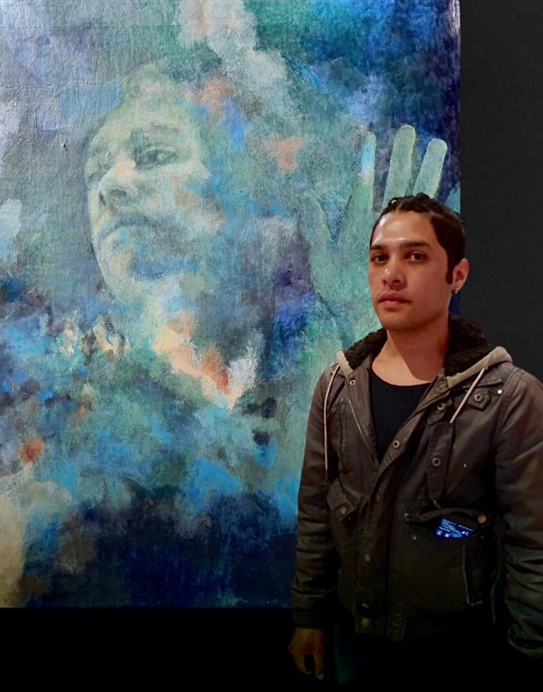
Nathan Petersen Visual art From Paarl Worked as a graphic designer at a media house
Participants

Slide 9
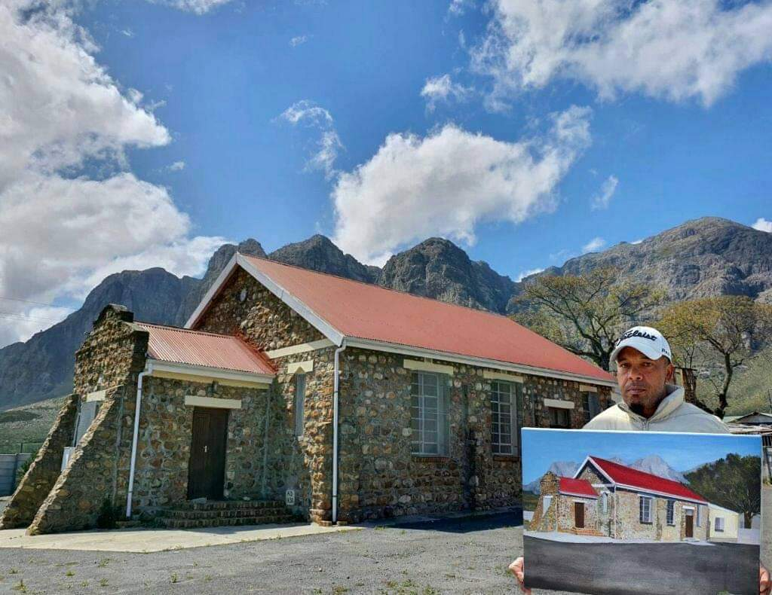
Gerald Maketees Visual art From Kylemore, a small rural village located in the mountains outside Stellenbosch Works as a forklift operator at a winery in Stellenbosch
Participants

Slide 10
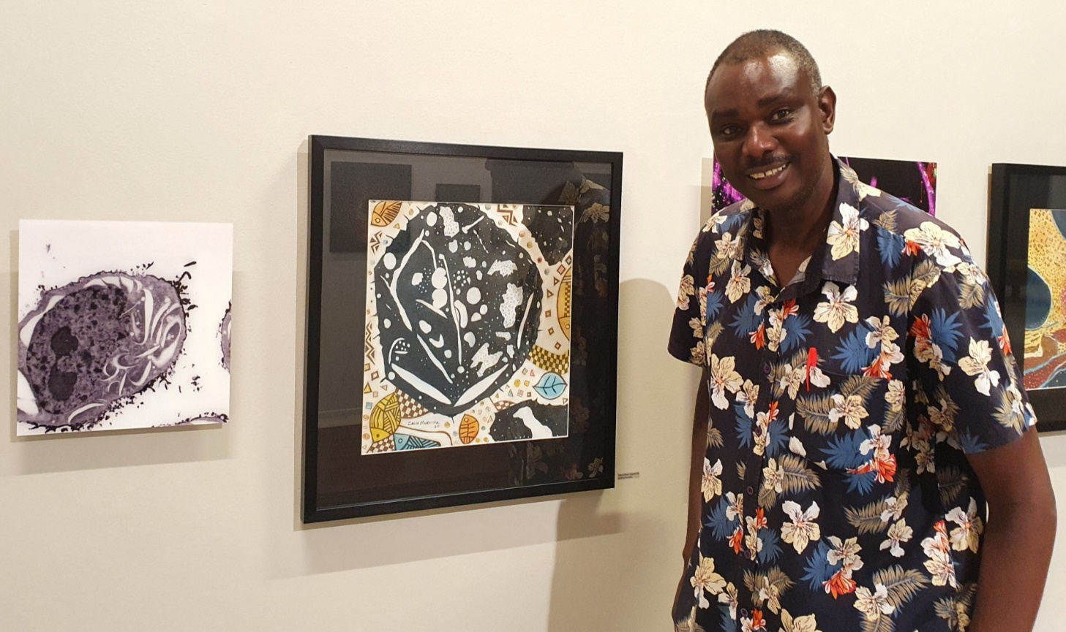
Zacharia Mukwira Visual art and collagraph printing Originally from Zimbabwe
Participants

Slide 11
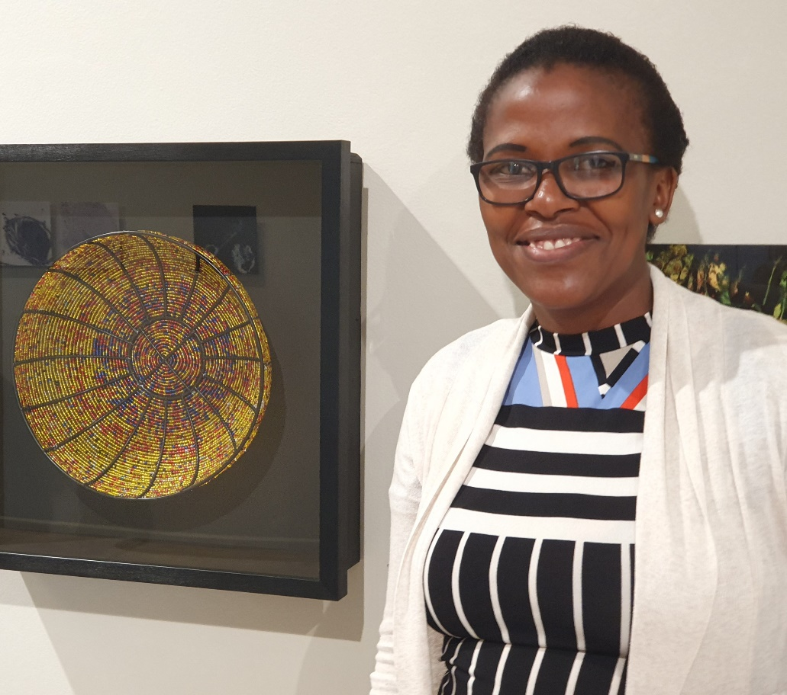
Nomsa Mukwira Beadwork Creating functional and decorative glass bead bowls Originally from Zimbabwe
Participants

Slide 12
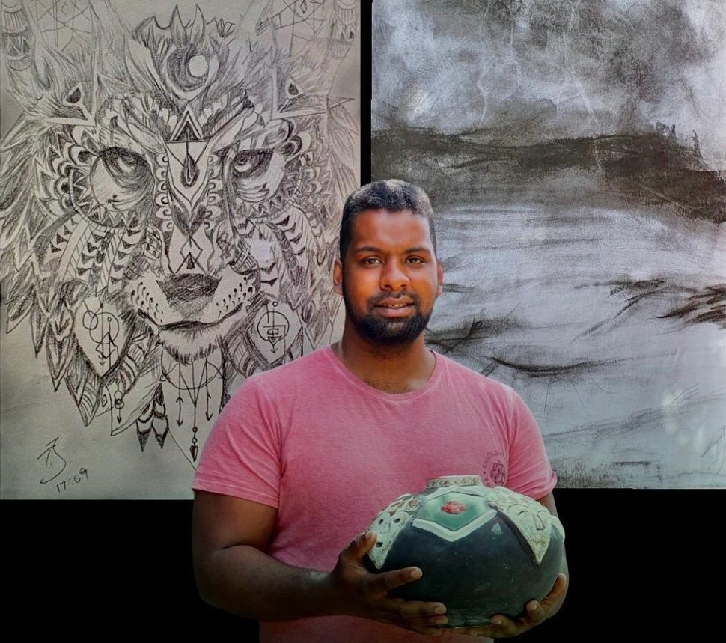
Tiaan Jacobs Visual art Also trained in mosaics Lives in Kylemore
Participants

Slide 13
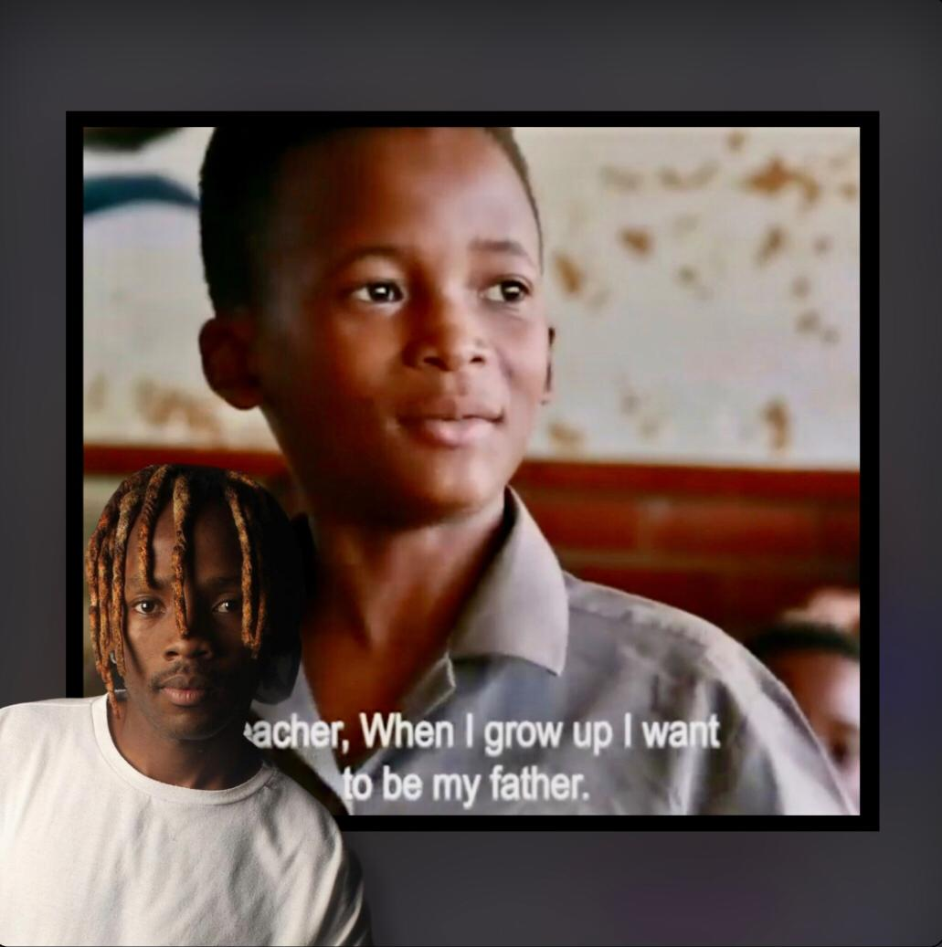
Thando Dyantyi Videographer and short film editor and director Lives in Kayamandi, Stellenbosch.
Participants

Slide 14
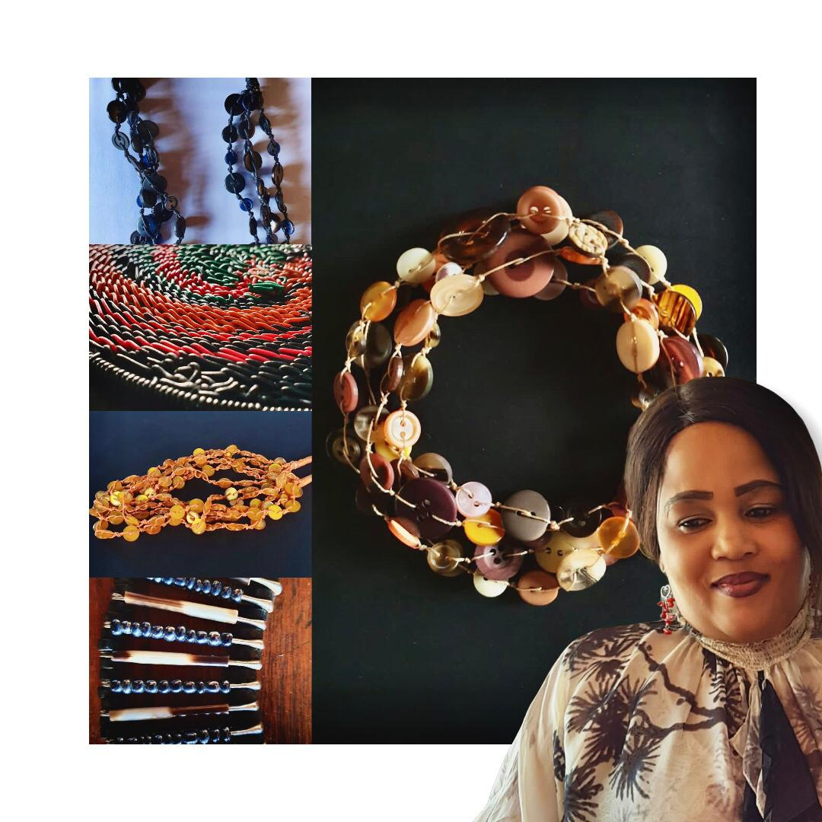
Portia Mphangwa Jeweller using recycled material including cable and buttons Lives in Kayamandi
Participants

Slide 15
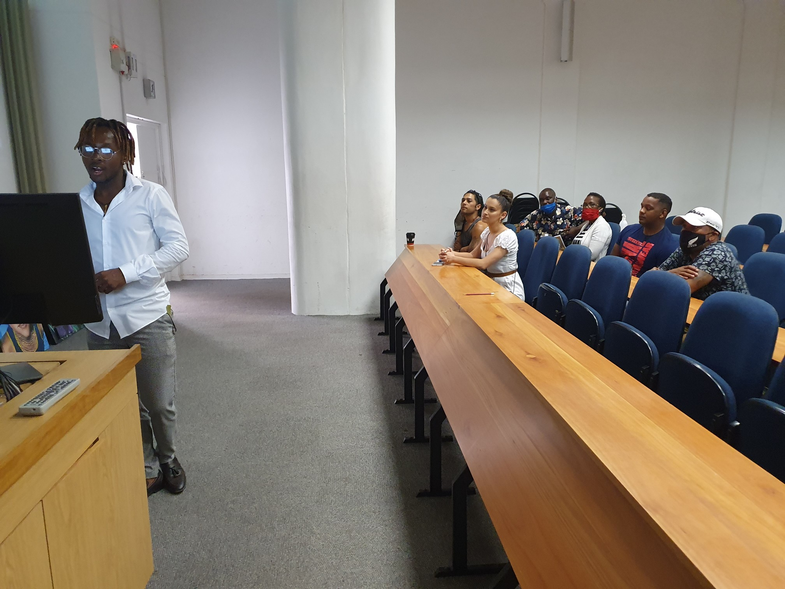
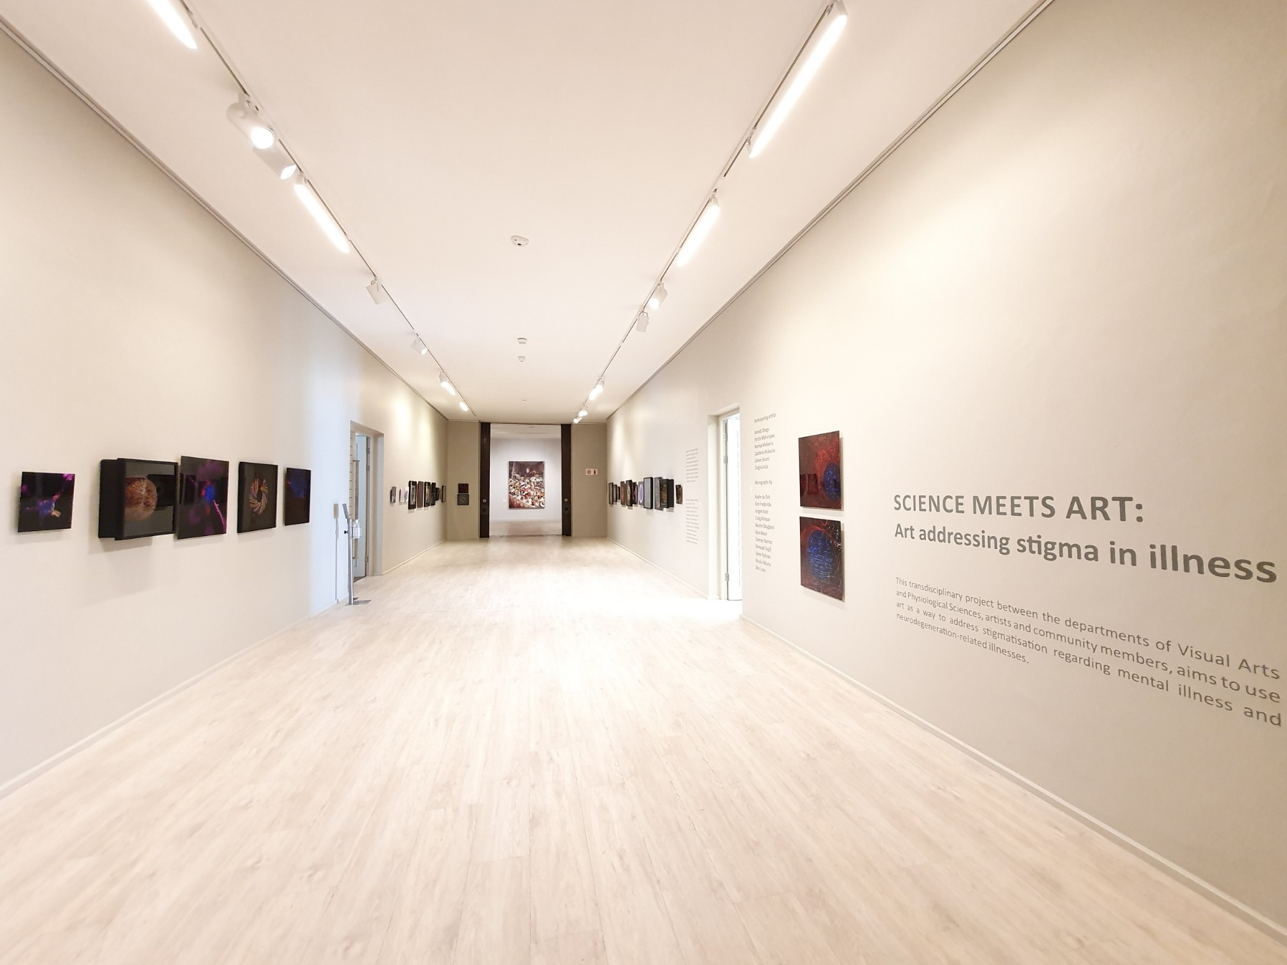
Visual Arts Department, Stellenbosch University Campus - Seven participants - Prof Elmarie Costandius (SU) - Elizabeth Miller-Vermeulen (Project coordinator) - PXL-MAD (Hasselt, BE) & UWC (Cape Town, SA) via Teams Introduction (focusing on individual participants’ profiles) & Presentation SCIENCE MEETS ART exhibition (Rupert Museum, Stellenbosch)
Introductory workshop – 14 November 2020
Notes:
Co-creation!!
A walkabout was presented by Elizabeth Miller-vermeulen (curator and exhibition coordinator of the exhibition).

Slide 16
Three EECI participants are included in the current SCIENCE MEETS ART exhibition at the Rupert Museum, Stellenbosch. (31 Oct 2020 – 21 Feb 2021). This is a transdisciplinary project exhibition between the Stellenbosch University Physiological Sciences and Visual Arts departments, community members, six artists and crafters. Addressing stigma in illness, art and micrograph images are exhibited together, creating a unique opportunity for cross-talk and discussion. A 30 page exhibition document augments the project. Four participants are included in the REIMAGINING THE ARTS group exhibition at GUS gallery, Stellenbosch, Feb 2021. This is a Social Impact Project Exhibition of the Department of Visual Arts, Stellenbosch University, focusing on the collection of material culture, namely objects, traces and/or events among local communities in and around Stellenbosch.
Impact

Slide 17
Continuation of intake interviews, identifying potential participants All new participants to be included/presented on the RADA website All participants to be assigned to buddies All participants to be assigned to various workshops on a needs-analysis basis All current participants to be supported re developement of own artistic careers
Plans for the future
Notes:
Career-support: networking/identifying opportunities, inclusion in collaborations, marketing of own work and establishing/developing of own artistic profile.

Slide 18
Thank you for your participation.
Workshop 4
Bert Willems & Dirk Kenis, PXL-MAD, School of Arts, Hasselt
Elizabeth Miller-Vermeulen, EECI Project Coordinator for Stellenbosch University, South-Africa

