Slide 1
Probabilistic index models (PIM) for differential gene expression analysis
Application to single cell RNA-sequencing data
Alemu Takele Assefa¹, Jo Vandesompele^{2,3,4}, Olivier Thas ^{1,3,5,6}
¹Department of Data Analysis and Mathematical Modeling, Ghent University, Belgium; ²Department of Biomolecular Medicine, Ghent University, Belgium; ³Cancer Research Institute Ghent, Ghent University, Belgium; ⁴Center for Medical Genetics, Ghent University, Belgium; ⁵National Institute for Applied Statistics Research, University of Wollongong, Australia; ⁶I-BioStat, Hasselt University, Belgium
December 5 2018
CRIG single cell mini-symposium

Slide 2
PIM offers a flexible and robust approach for testing differential gene expression (DGE).
PIM is a regression framework,
generalizes rank based tests,
can be used for simple and complex experimental designs,
e.g. multi-group comparison,
PIM requires no distributional assumption,
adaptable to various gene expression units

Slide 3
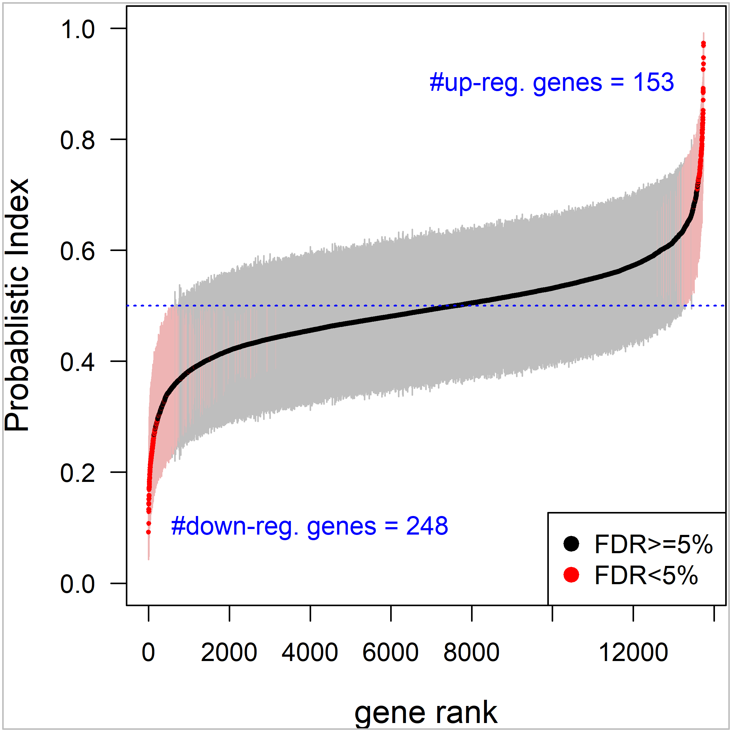
PIM augments DGE with informative effect size parameters
Effect size in terms of probabilistic index
Straightforward for interpretation
Ranking genes
accounts for different sources of variation
e.g. sequencing depth, batch effect,

Slide 4
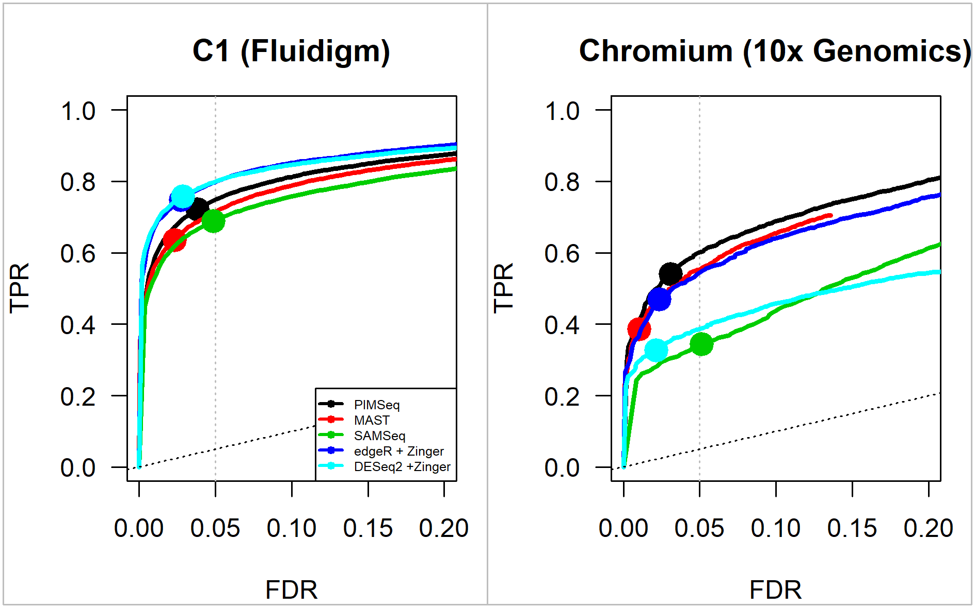
PIM has competitive performance to the parametric tools
Simulation studies

