Slide 2


Differential Gene Expression Analysis of RNA-sequencing Data
department of Data analysis and mathematical modeling
  Biostatistics Research group
Evaluation of DGE tools for long non-coding RNA-sequencing data
Alemu Takele Assefa¹, prof.dr.ir. Olivier Thas^{1,2}, prof.dr.ir. Jo Vandesompele³
¹Depertment of Data Analysis and Mathematical Modeling, Ghent University
²National Institute or Applied Statistics Research, University of Wollongong, Wollongong, Australia
³Department of Pediatrics and Medical Genetics, Ghent University, Ghent, Belgium

Slide 3
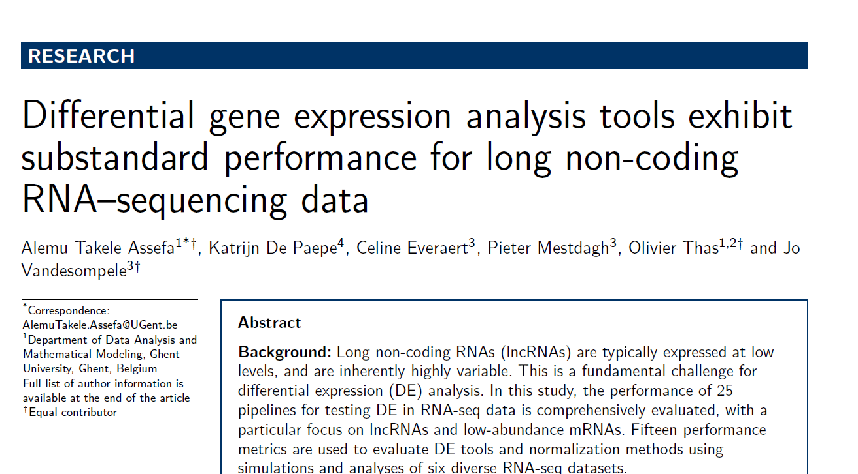

Accepted by

Slide 4
lncRNA lncRNA-sequencing Data

Slide 5
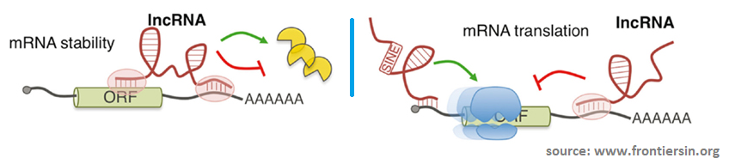
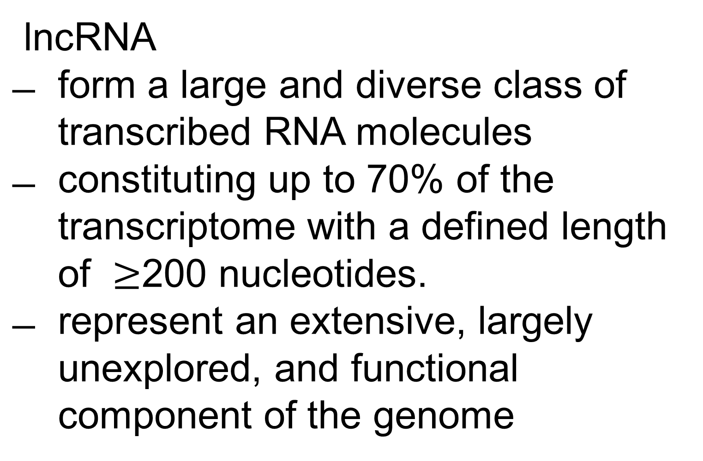
The study of lncRNA is of a major relevance to human health and disease
mRNA | lncRNA
Important roles in dieases and development | Important roles in diseases and development
Protein coding transcript | Non-protein coding, regulatory functions
Well conserved between species | Poorly conserved between species
Present in both nucleus and cytoplasm | Many predominantly nuclear, others nuclear and/or cytoplasmic
Total 20-24,000 mRNAs | Currently ~30,000 lncRNA transcripts, predicted 3-100 fold of mRNA in number
Expression level: low to high | Expression level: very low to moderate
lncRNA
form a large and diverse class of transcribed RNA molecules
constituting up to 70% of the transcriptome with a defined length of $≥$200 nucleotides.
represent an extensive, largely unexplored, and functional component of the genome

Slide 6
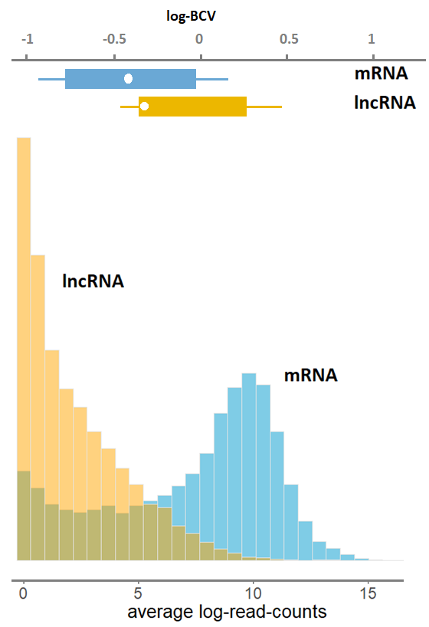
lncRNA-seq data is characterized by low signal and high noise
In contrast to mRNA, lncRNAs have lower expression and higher variability
… a fundamental challenge for DGE analysis
  noisier inferential behavior
noise
signal
DGE: differential gene expression

Slide 7
Differential Gene expression analysis

Slide 8
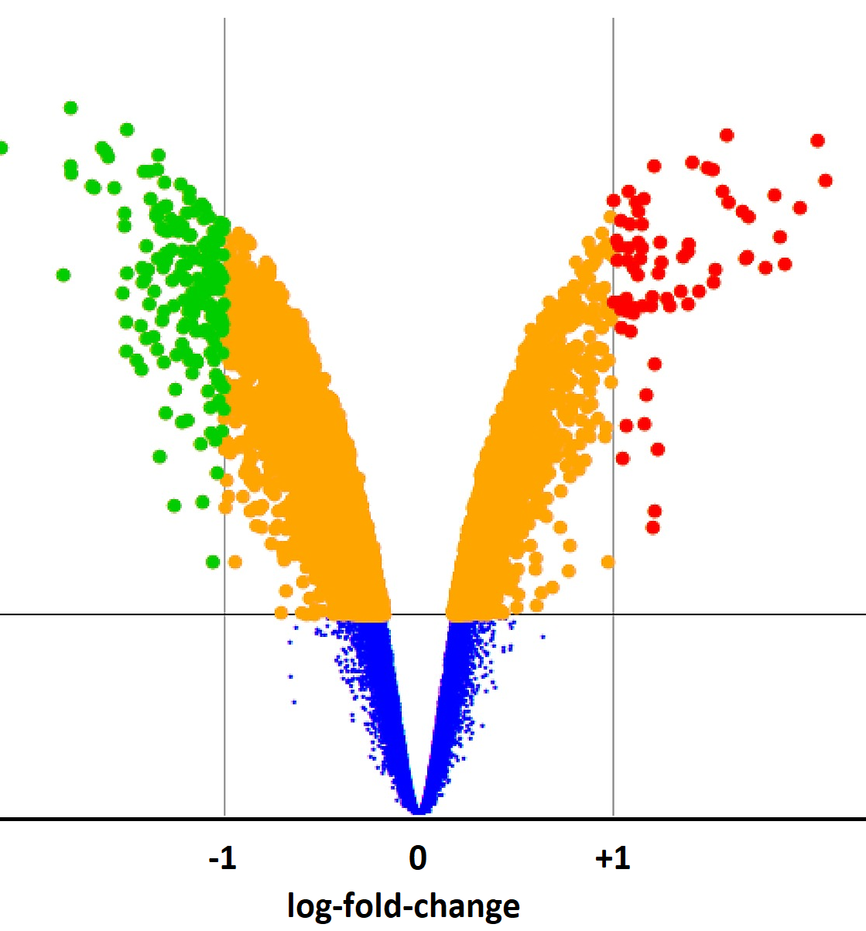
DGE analysis of RNA-seq
identifies a set of genes/transcripts that are transcribed with statistically significantly different number of RNA molecules across conditions
  e.g. treatment vs control
The assessment of DE can be affected by the analysis pipelines
  experiment design, quantification algorithm, normalization procedure, statistical methods, …
  the expression magnitude of a gene

Slide 9
DGE analysis tools
Several DGE tools have been introduced each with a unique statistical approach
  Negative binomial models (edgeR, DESeq(2), …)
  Normal linear models (limma)
  (Empirical) Bayesian models (baySeq, EBSeq)
  Non-parametric approaches (SAMSeq, NOISeq)
tools | pipelines
edgeR | exact test, GLM, robust GLM, QL
DESeq | exact test
DESeq2 | GLM
limma | voom, woom+QW, trend, …
SAMSeq | Wilcoxon rank-sum test
NOISeq | Nonparametric
QuasiSeq | GLM, QL, …
PoissonSeq | Poisson log-linear model
baySeq | empirical Bayesian model
… | …

Slide 10
Comparison of DGE tools

Slide 11
Previous comparative studies lack comprehensiveness and realistic simulation
DGE software tools have been compared in various studies,
However, these studies
  focus on mRNA-seq data
  rely on parametric simulation procedures
  limited use of real RNA-seq data
  not comprehensive (limited number of DE tools, scenarios, …)

Slide 12

Overview of common RNA-seq simulation procedures
Parametric: generate counts from a distribution (e.g. NB) with parameters learned from real data
  pros: easy, flexible, many scenarios can be simulated, truth is known
  cons: unrealistic, biased (beneficial to tools relying on the distribution)
Re-sampling (from one population): sampling from one group and divide into two mock groups
  pros: realistic,
  cons: single scenario (no DE genes), not flexible, requires large datasets to start from
Re-sampling (from two populations):
  pros: realistic, some flexibility, several scenario can be simulated
  cons: not fully flexible, requires large datasets to start from

Slide 13
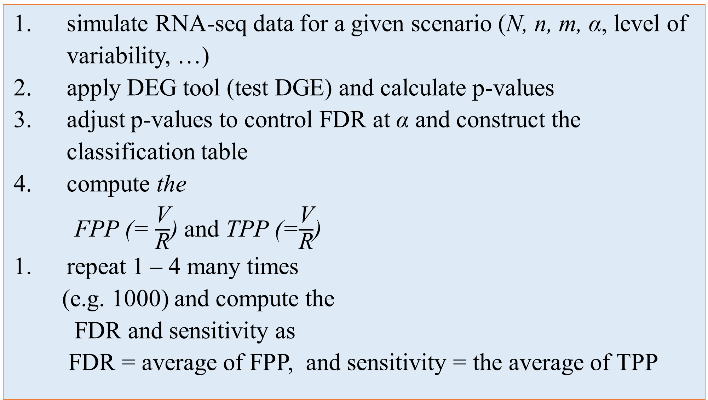
Monte Carlo simulations of RNA-seq experiments allow evaluation of DGE tools performance
simulate RNA-seq data for a given scenario (N, n, m, α, level of variability, …)
apply DEG tool (test DGE) and calculate p-values
adjust p-values to control FDR at α and construct the classification table
compute the
FPP (= $\frac{\text{V}}{\text{R}}$) and TPP (=$\frac{\text{V}}{\text{R}}$)
repeat 1 – 4 many times
(e.g. 1000) and compute the
FDR and sensitivity as
FDR = average of FPP, and sensitivity = the average of TPP
N = # genes
n = # samples
m = # DE genes
α = nominal FDR level
R = # rejected null hypotheses
V = # rejected true null hypotheses
U = # rejected false null hypotheses
 |  | Truth
 |  | + | - | row total
predicted | + | U | V | R
 | - | U’ | V’ | R’
column total |  | m₁ | m₀ | N
Hypothesis i ( i = 1, 2, .. N)
H_{0i}: gene i is not DE
H_{1i}: gene i is DE

Slide 14
Non-parametric procedures are used to simulate realistic gene expression data.
  Sub-sampling of samples from a real RNA-seq dataset
    using SimSeq R software package
  3 sets of simulations, each starting from a different source data
    each source data represent a different level of biological variability: low, intermediate, and high
Non-parametric procedures
various samples sizes
different level of intra-group variability
different proportion of DE genes
constituting of mRNA & lncRNA
24 DE pipelines
Simulations
Analysis of Simulated Data
Intra-group variability
Cultured cell line
Actual FDR and TPR
Normal tissue
Performance Evaluation
Cancer Tissues
R shiny application
Web Tool
Using countsimQC R package
Simulation quality assessment

Slide 15

Further reading on our paper
  Concordance analysis between 25 DE tools using 6 diverse type of real RNA-seq data
    similarity in the number of SDE genes
    overlapping in the set of SDE
    similarity of log-FC estimates
    gene ranking agreement
    sensitivity to outliers
    computation time
  DGE pipelines’ recovering ability of a known biological truth

Slide 16
Results

Slide 17
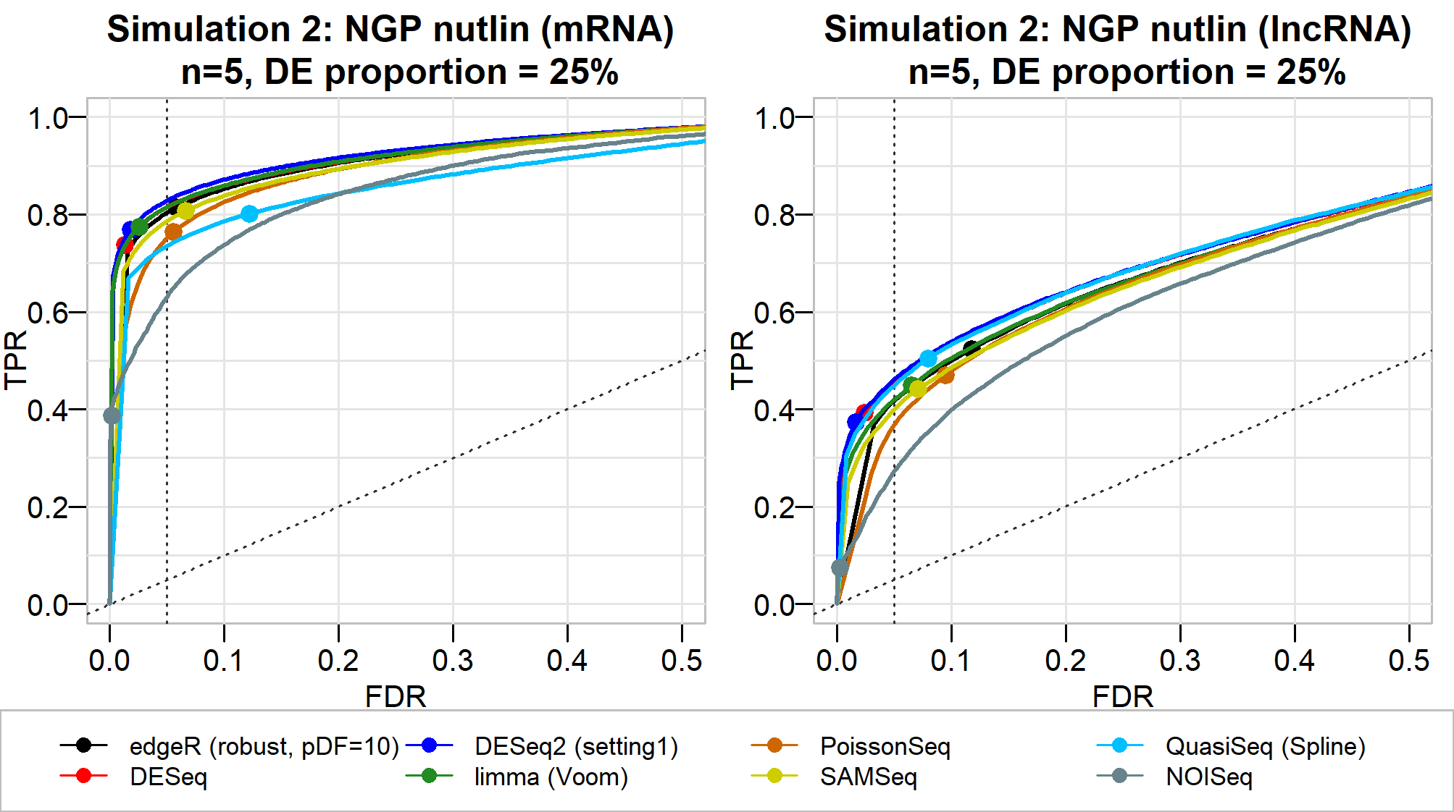
DGE tools perform worse for lncRNAs (also low abundance mRNAs)
e.g. at 5% nominal FDR
edgeR (robust GLM)
  mRNA : TPR = 0.82 FDR = 0.051
  lncRNA: TPR = 0.53 FDR = 0.12
limma (voom)
  mRNA : TPR = 0.79 FDR = 0.02
  lncRNA: TPR = 0.45 FDR = 0.052
SAMSeq (Wilcoxon rank sum test)
  mRNA : TPR = 0.81 FDR = 0.052
  lncRNA: TPR = 0.44 FDR = 0.0525

Slide 18
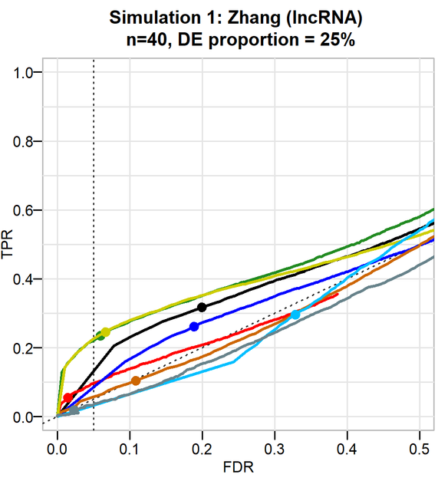
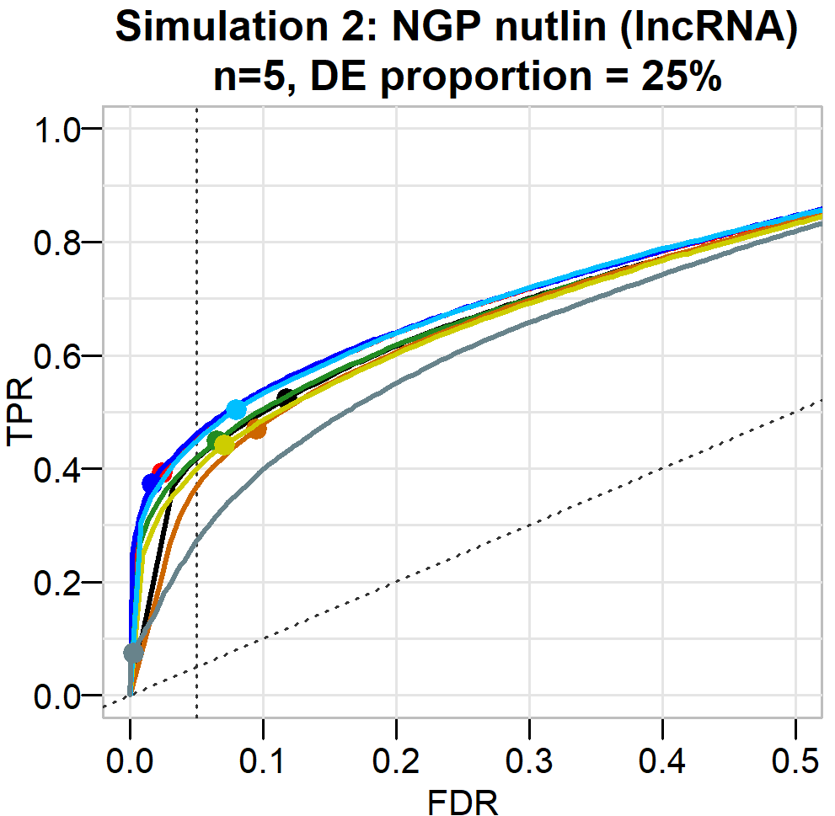

Intra-group biological variability markedly affect the performance of DGE tools
e.g. at 5% nominal FDR
edgeR (robust GLM)
  Sim 1: TPR = 0.31 FDR = 0.20
  Sim 2: TPR = 0.53 FDR = 0.12
limma (voom)
  Sim 1: TPR = 0.22 FDR = 0.051
  Sim 2: TPR = 0.45 FDR = 0.052
SAMSeq (Wilcoxon rank sum test)
  Sim 1: TPR = 0.24 FDR = 0.052
  Sim 2: TPR = 0.44 FDR = 0.0525
Sim 1: starts from the Zhang data (cancer tissues) → high intra-group variability
Sim 2: starts from the NGP nutlin data (cultured cell line data) → low intra-group variability

Slide 19
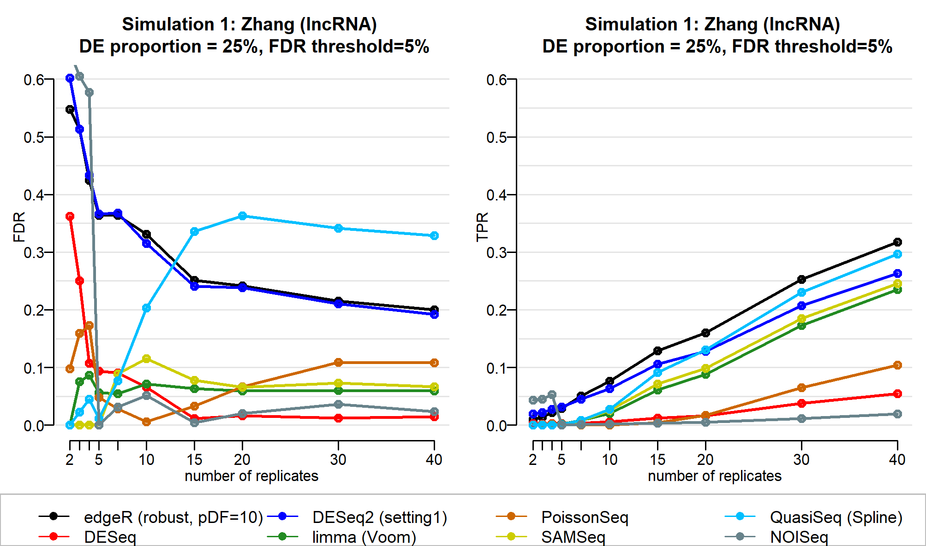
Increasing sample size improves the performance of DGE tools
Increasing number of replicate samples results in
  Reduced FDR
  Increased sensitivity (TPR)

Slide 20
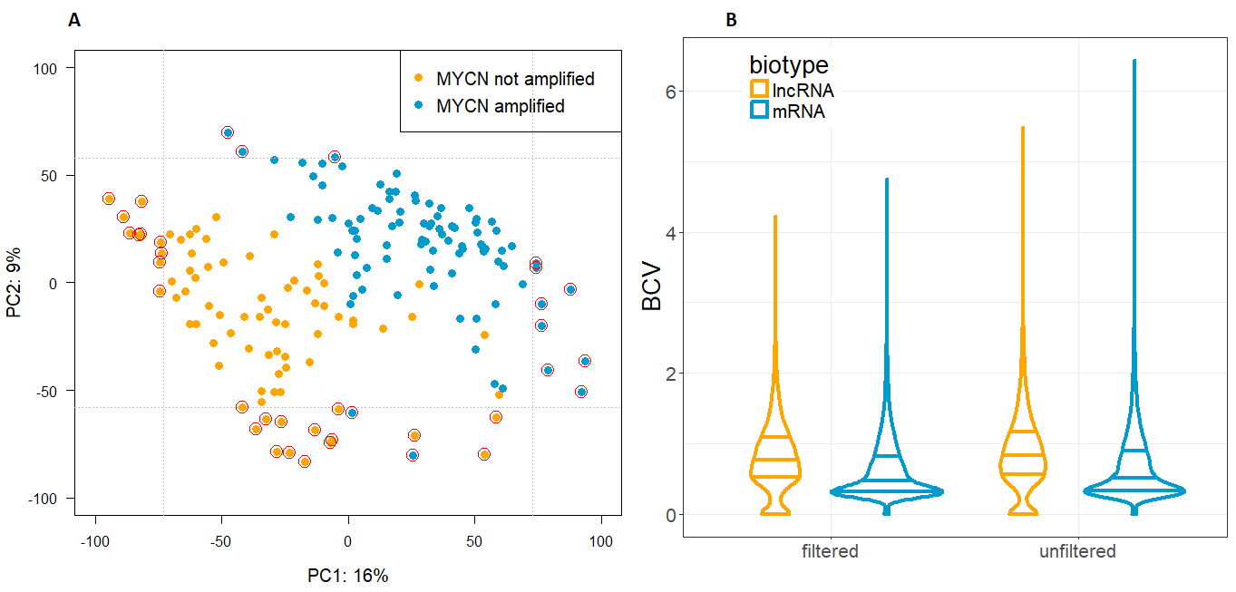
Sample filtering improves the performance of DGE tools
The first two principal components (PC1 and PC2) demonstrate
  the intra-group variability
  the inter-group variability
Principal component analysis based on genes with no zero expression after variance stabilizing (DESeq2) transformation of counts.
Samples with the most 10% extreme values of PC1 and PC2 are filtered

Slide 21
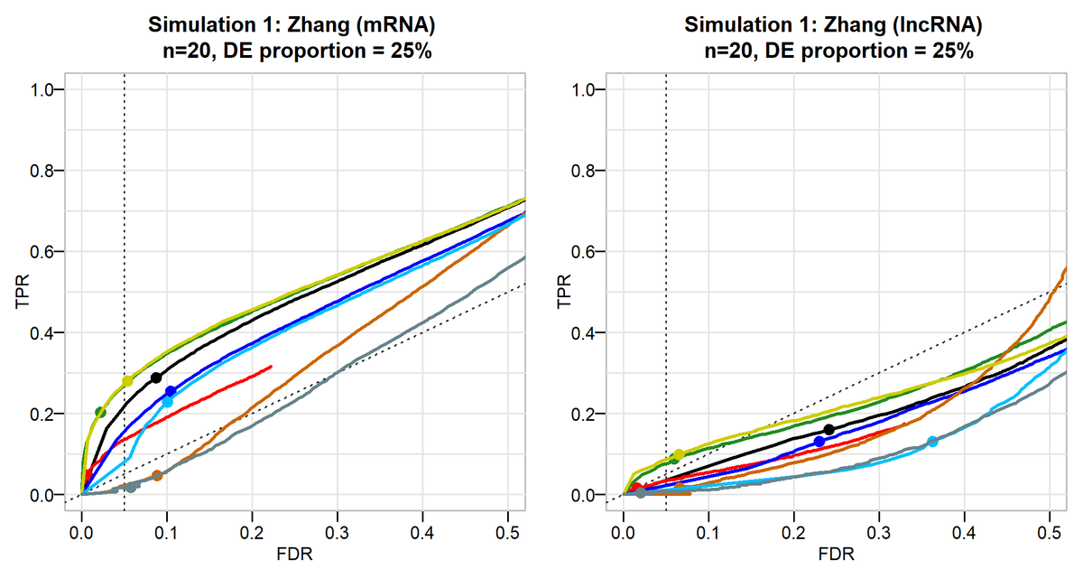
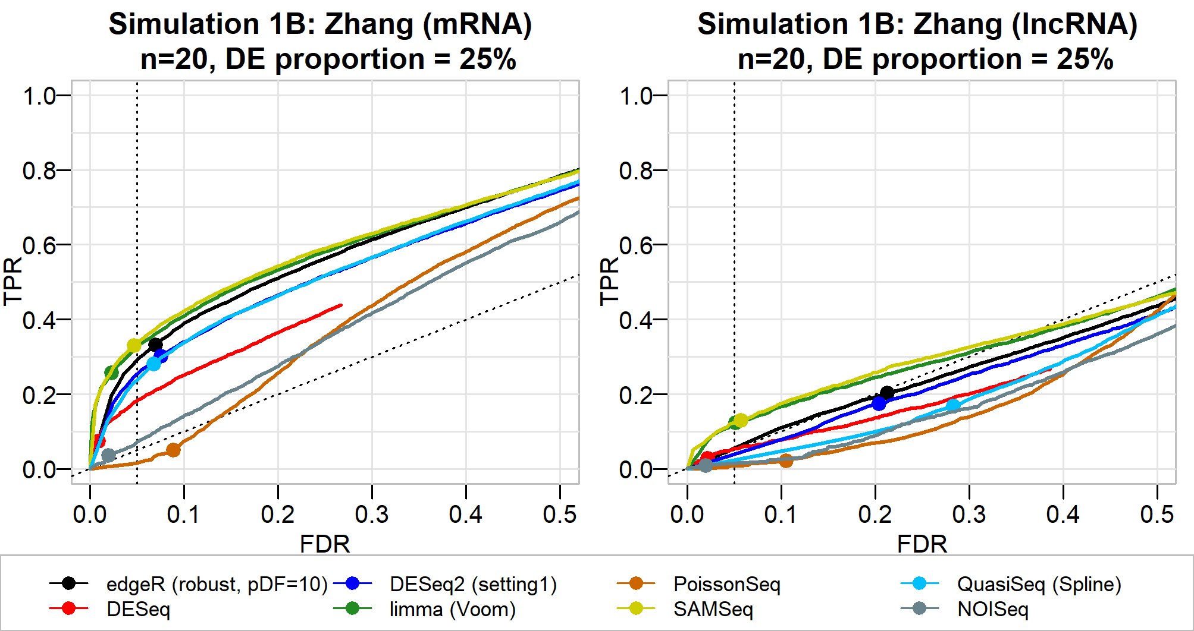
Sample filtering improves the performance of DGE tools
Before outlying samples are filtered
  e.g. at 5% nominal FDR threshold
    edgeR (robust GLM)
      mRNA : TPR = 0.25 FDR = 0.09
      lncRNA: TPR = 0.17 FDR = 0.25
After outlying samples are filtered
  e.g. at 5% nominal FDR threshold
    edgeR (robust GLM)
      mRNA : TPR = 0.33 FDR = 0.053
      lncRNA: TPR = 0.20 FDR = 0.21

Slide 22
Conclusions

Slide 23
Concluding Remarks
Tools lose control of FDR and have low sensitivity for lncRNAs (also low abundance genes)
desirable performance (low FDR and high TPR) is guaranteed only for a
  reasonably large number of replicates
  for samples with low variability.
accurate DE inference of lncRNAs requires more samples than for mRNAs
No tool uniformly performs better but
  limma (with VST; voom; trend), and SAMSeq control the actual FDR reasonably well, while not sacrificing sensitivity.

Slide 24
Concluding Remarks
In the light of promoting reproducible science, it is essential to select a DE tool that succeeds in controlling the FDR level
  among these DE tools, one can select one with a high sensitivity
  high sensitivities are illusive in the light of the large proportion of false discoveries
Increasing number of replicate samples and removing outlying samples can boost DE tools performance

Slide 25
Web tool

Slide 26
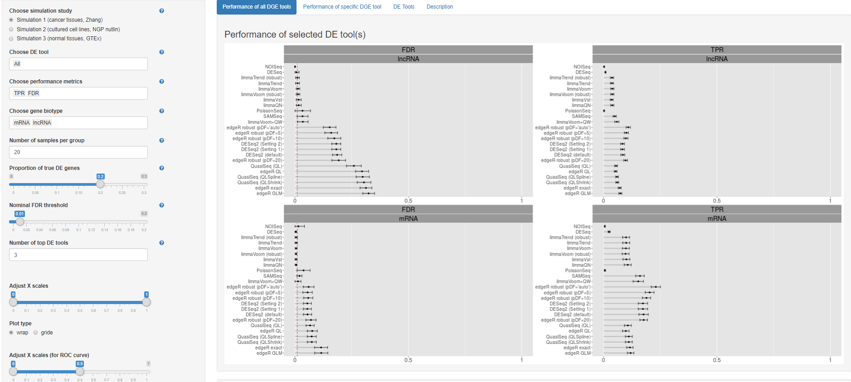
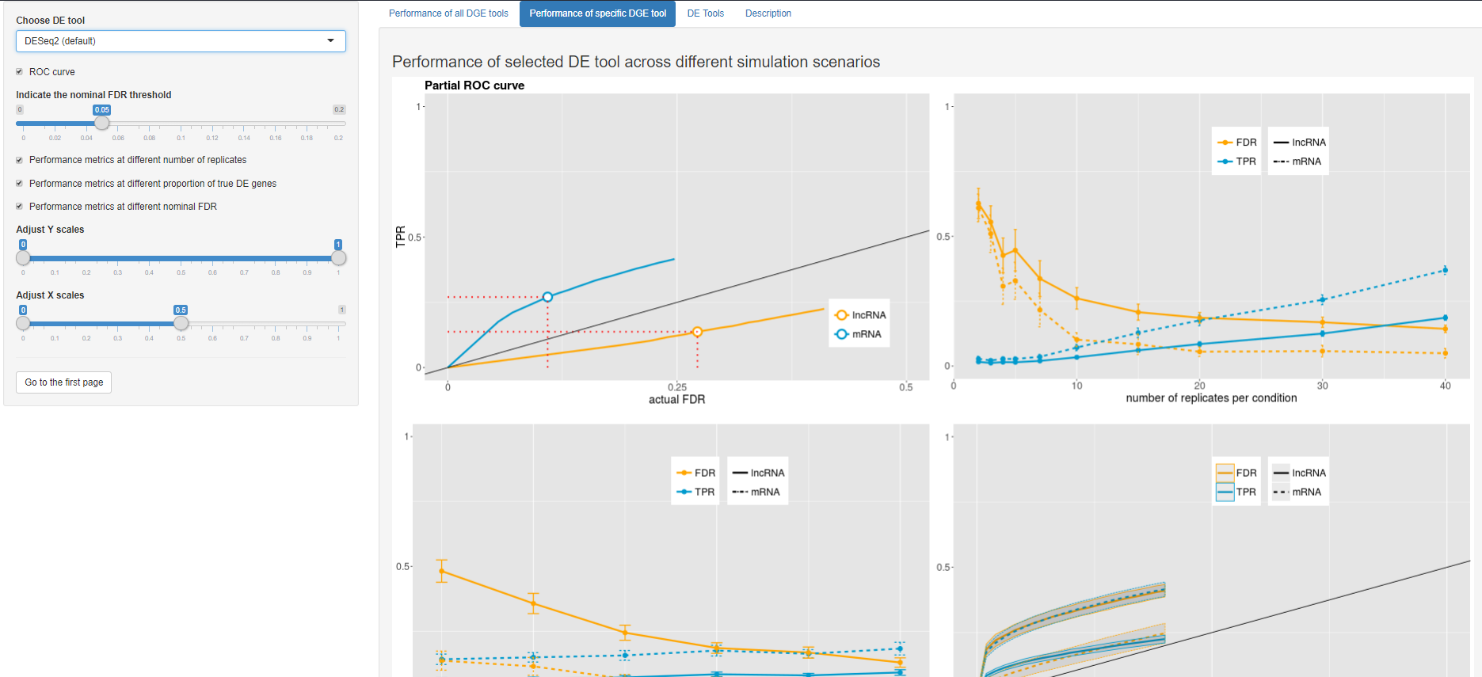
Web tool
detailed results of our simulation study can be consulted through a user-friendly web application,
  giving guidance on selection of the optimal DE tool
the tool can be found at
http://statapps.ugent.be/tools/AppDGE/

Slide 27



Alemu Takele Assefa
PhD student
Department of Data Analysis And Mathematical Modelling
E AlemuTakele.Assefa@ugent.be
T +32 92 64 59 38
M +32 486 76 84 55 http://biostat.ugent.be
Ghent University
@AlemuTakele
Alemu Takele Assefa

