Slide 1


Exercise prescription in patients with cardiometabolic disease
Dominique Hansen, PhD, FESC
Hasselt University, Faculty of Rehabilitation Sciences
Heart Centre Hasselt, Jessa Hospital
Hasselt, Belgium
#BACPRlive

Slide 2
No conflicts of interest to be declared

Slide 3
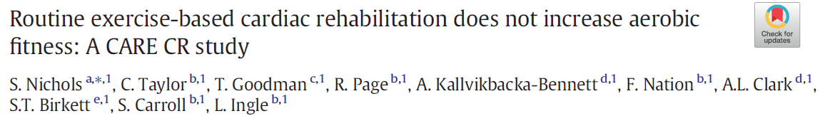
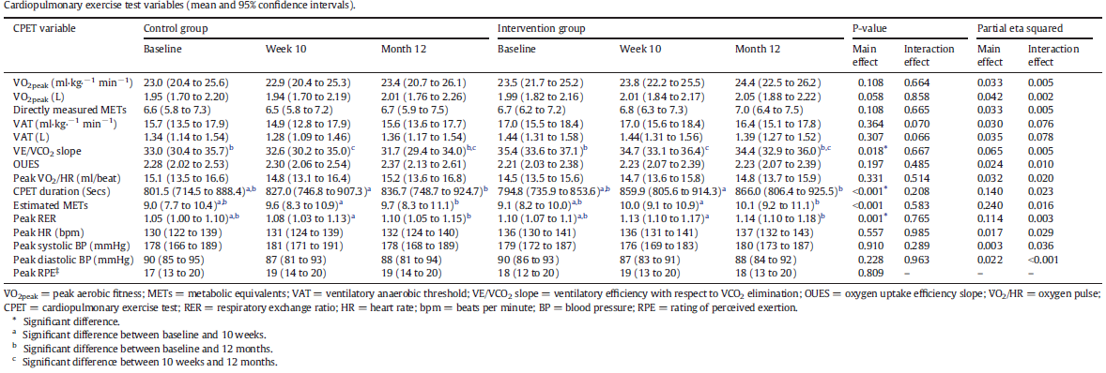
Patients follow 16 supervised training sessions in which the first exercise sessions lasted for 12 min and increased up to 23 min at the final exercise session, while the exercise intensity increased from 46% of the heart rate reserve (HRR) up to 54% of HRR

Slide 4
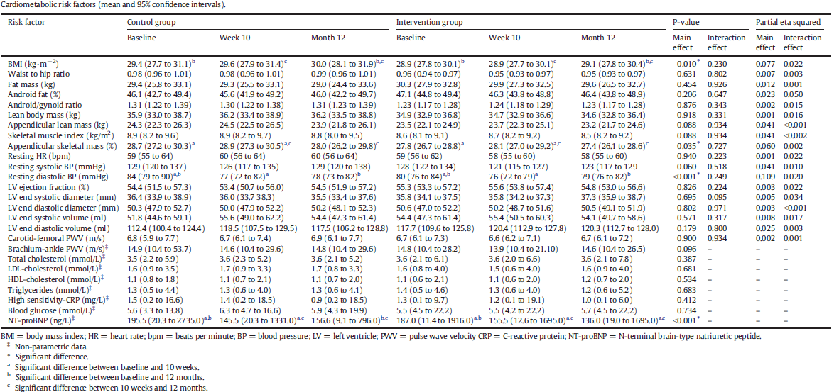
Patients follow 16 supervised training sessions in which the first exercise sessions lasted for 12 min and increased up to 23 min at the final exercise session, while the exercise intensity increased from 46% of the heart rate reserve (HRR) up to 54% of HRR

Slide 5

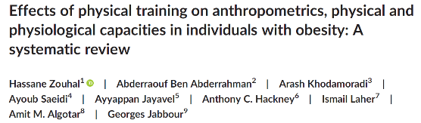
In only 7 of 23 RCT’s an effect size of >0.5 in body weight reduction, as result of exercise/physical activity, could be achieved
In 5 of 10 RCT’s an effect size of >0.5 in fat mass reduction, as result of exercise/physical activity, could be achieved

Slide 6
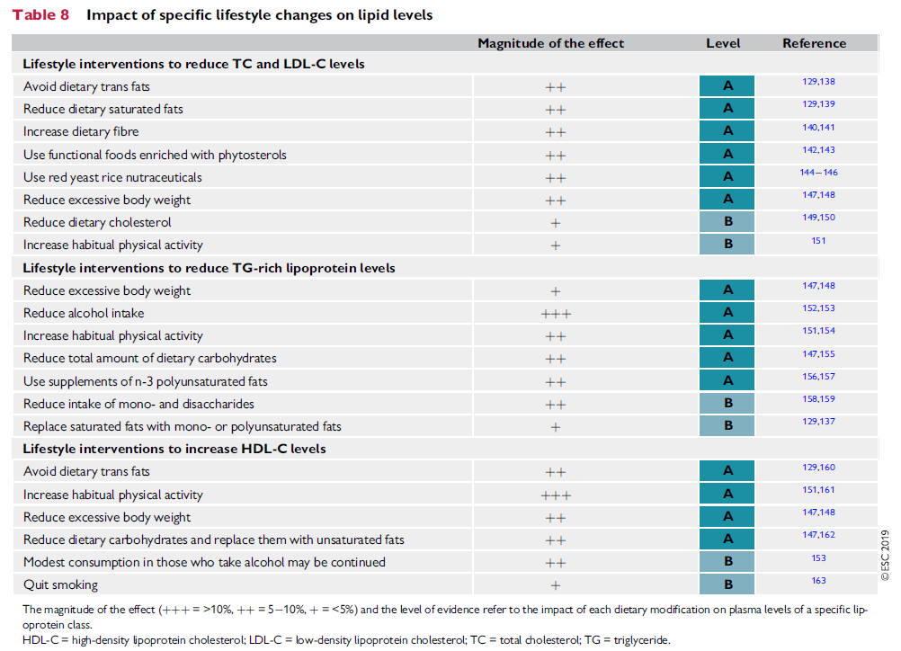

Slide 7
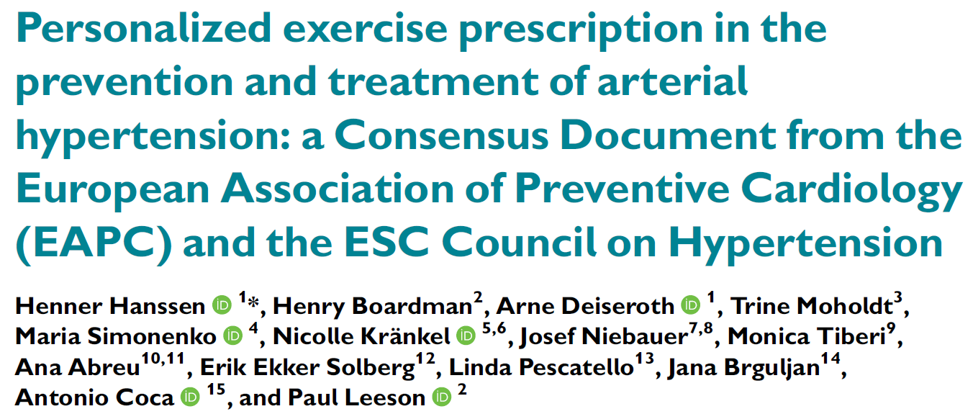
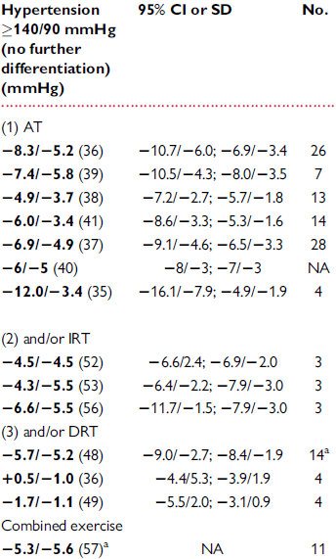
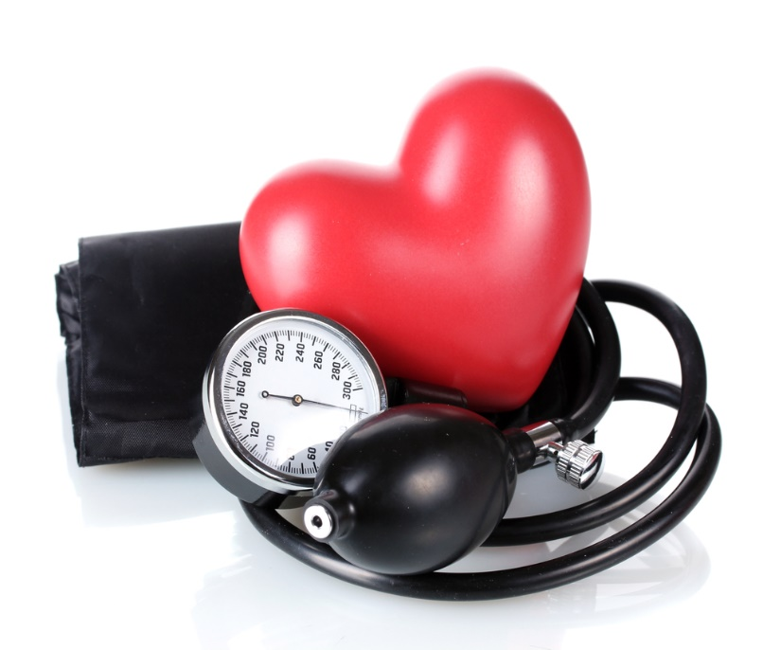


Slide 8
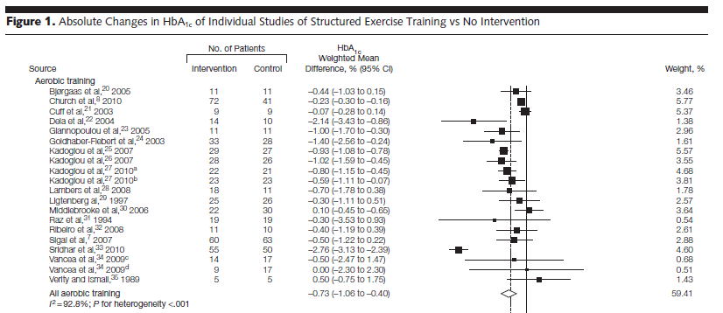
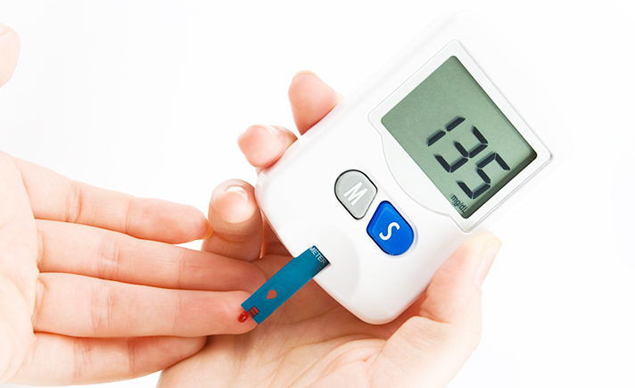
Umpierre D, et al. JAMA 2011; 305: 1790-99

Slide 9
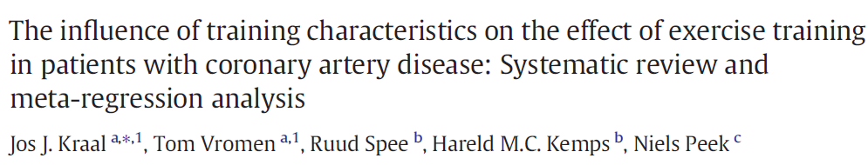
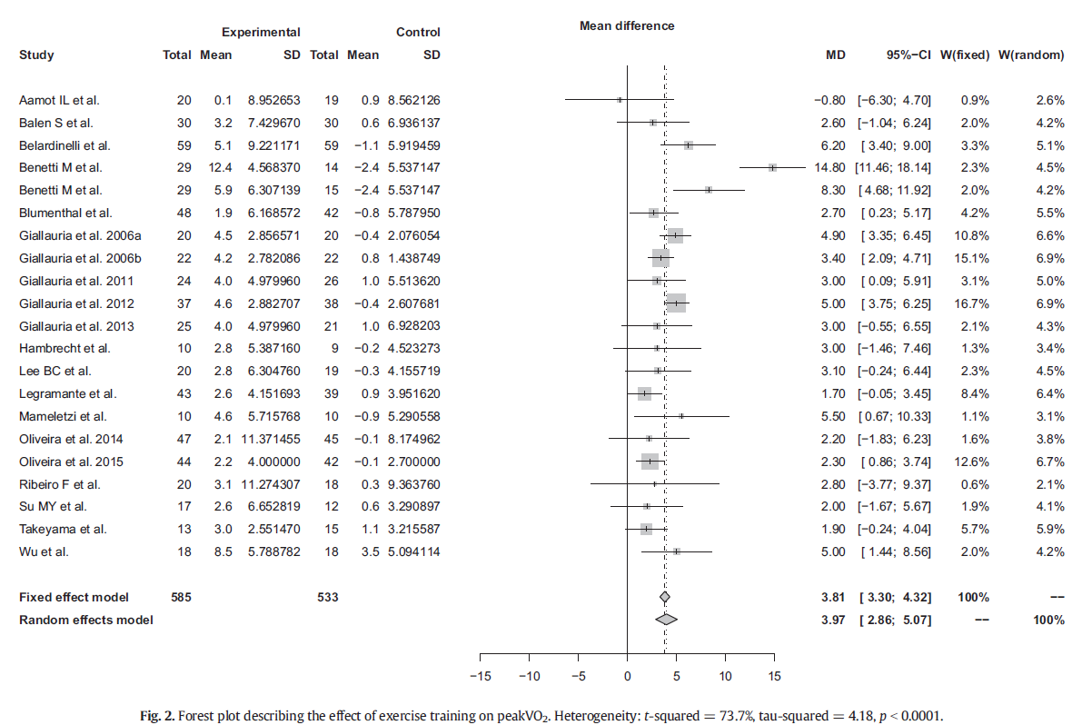

Slide 10
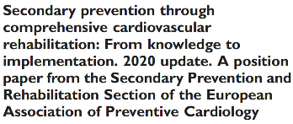
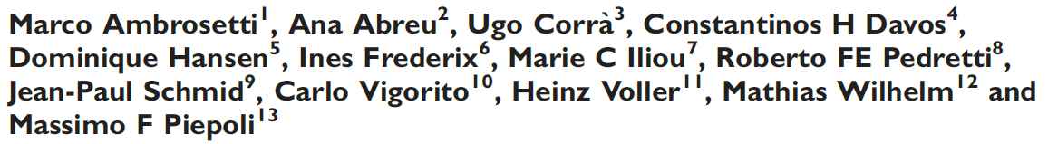
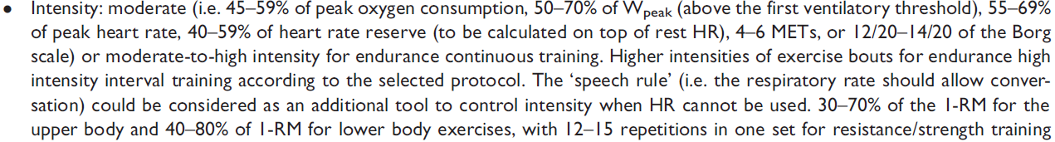
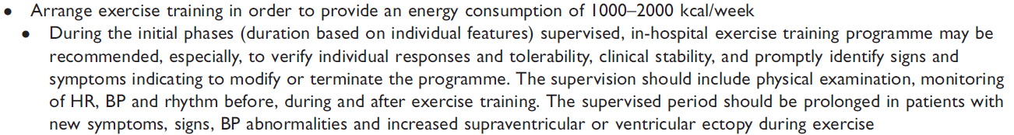
Eur J Prev Cardiol 2020; e-pub ahead of print

Slide 11

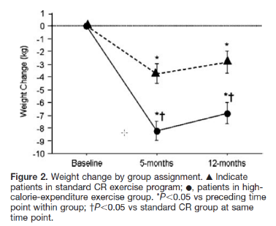
Standard CR
25-40 minutes/session
65% to 70% VO_{2peak}
3 days/week
Adapted CR
45 to 60 min/sessions
50-60% VO_{2peak}
5-7 days/week

Slide 12
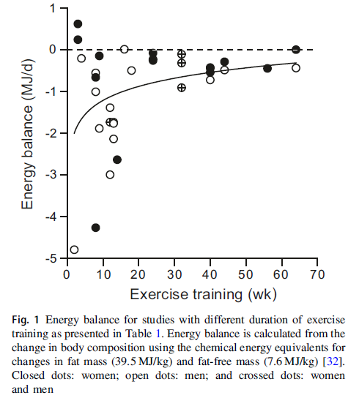
Westerterp K. Eur J Clin Nutr 2018; 72: 1246-50

Slide 13
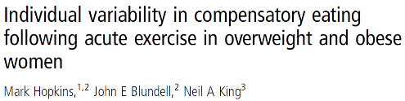
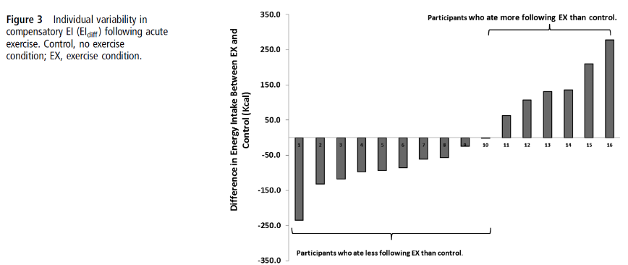

Slide 14
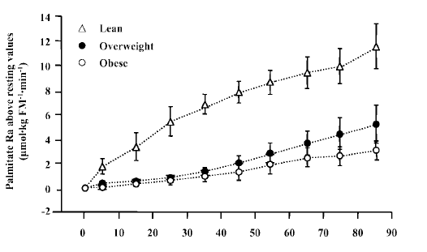
Lowered secretion of growth hormone, epinephrine and ANP
Elevated blood insulin concentrations
Mittendorfer B, et al. Am J Physiol 2004; 286: E354
Notes:
14

Slide 15
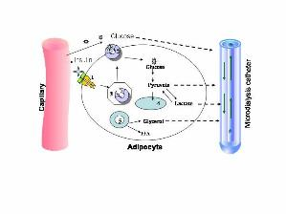

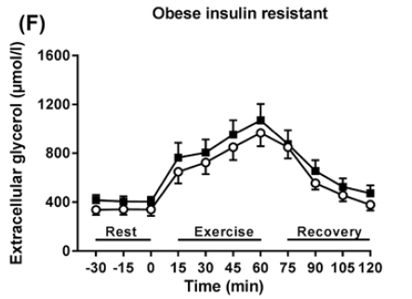
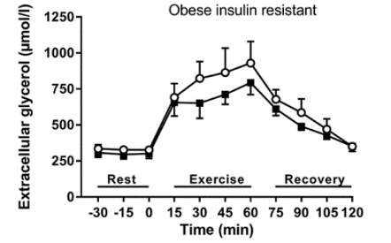
Start of intervention
12 weeks of intervention

Slide 16
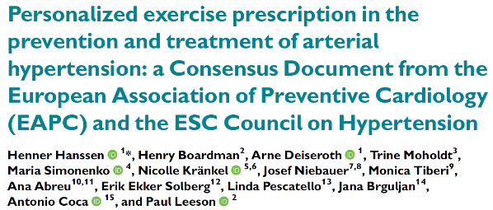

Slide 17






Slide 18
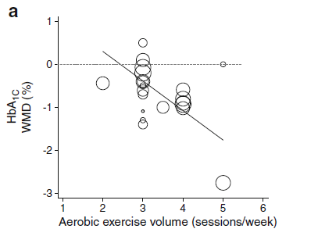
Umpierre D, et al. Diabetologia 2013; 56: 242-51

Slide 19
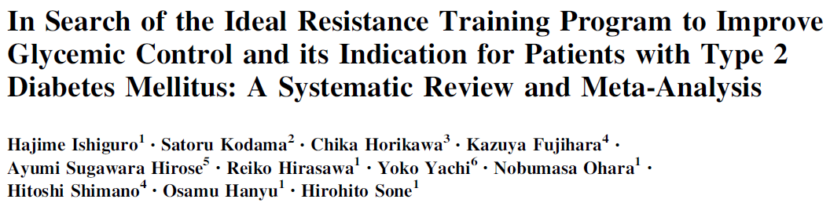
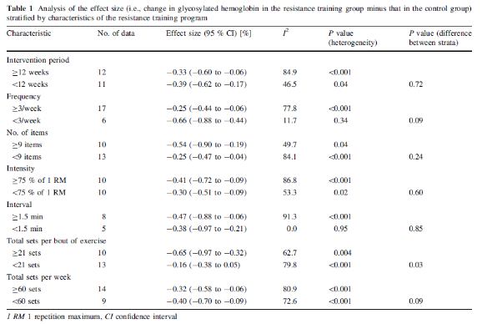


Slide 20
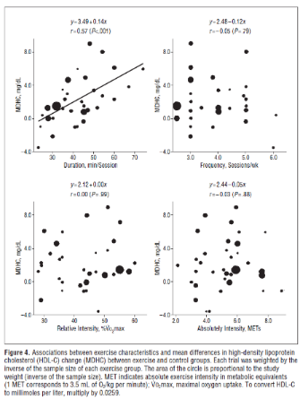

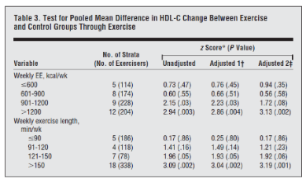

Slide 21
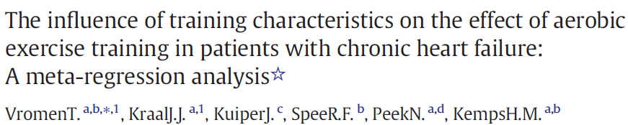
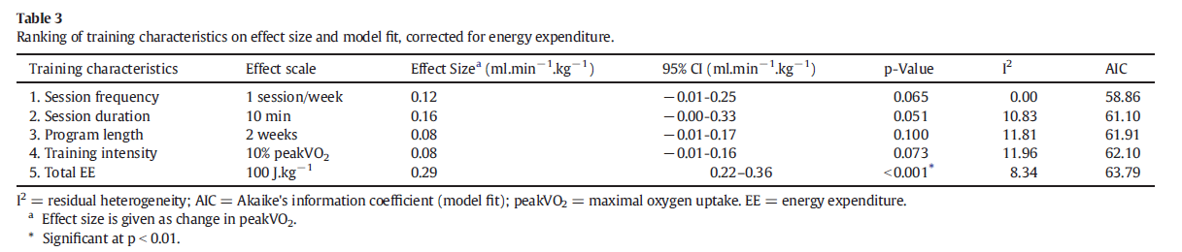

Slide 22
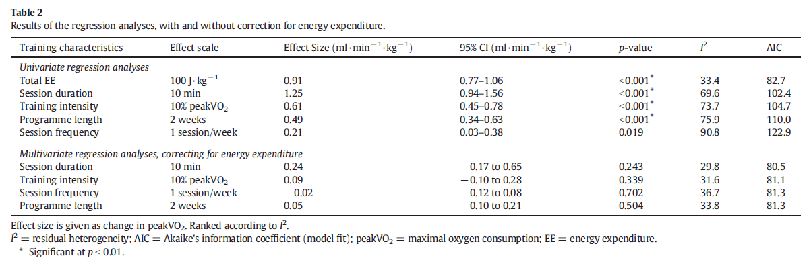

Slide 23
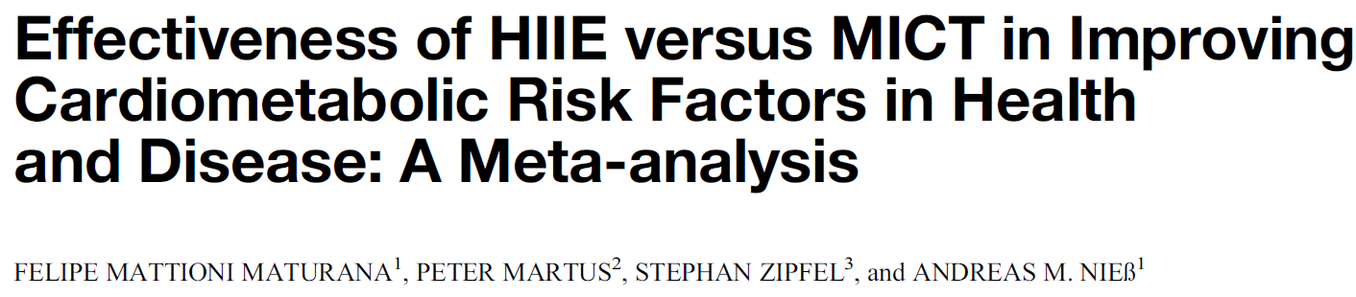
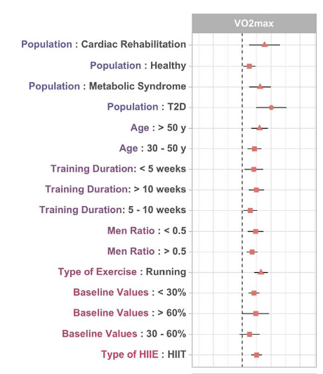


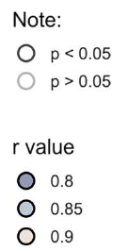

Slide 24

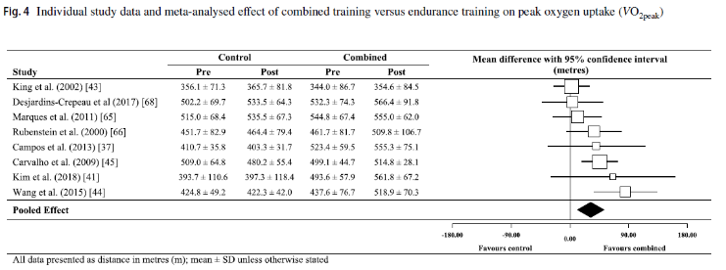

Slide 25
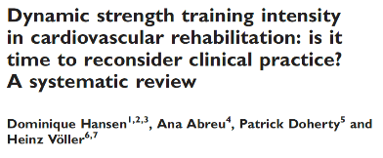
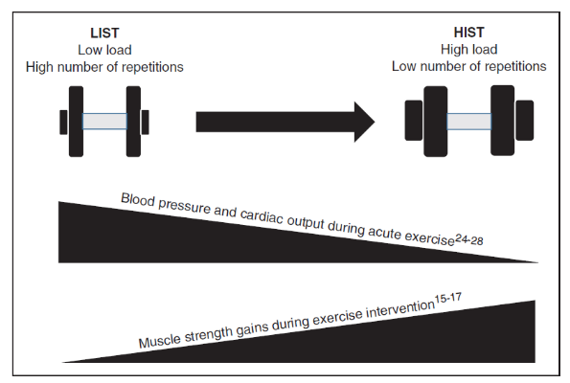
‘General recommendations for training
regimens include using 30–70% of the 1-repetition maximum for the upper body and 40–80% of the 1-repetition maximum for lower body exercises, with 12 to 15 repetitions in 1 set repeated two to three times weekly.’
Ambrosetti M, et al. Eur J Prev Cardiol 2020
Eur J Prev Cardiol 2019; 26:1483-92

Slide 26
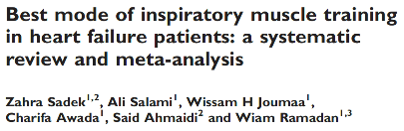
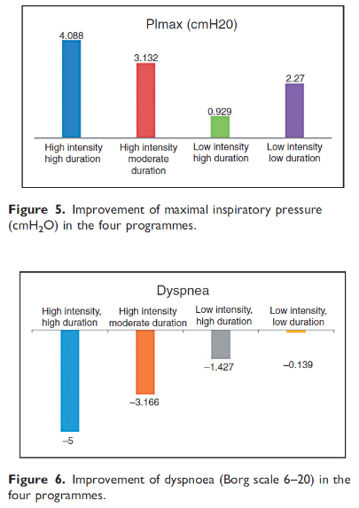
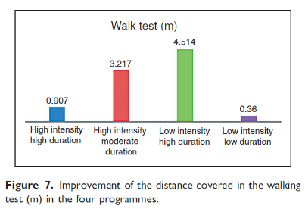
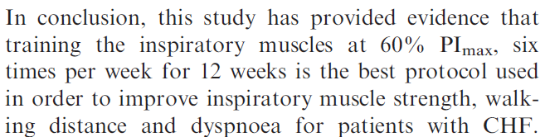


Slide 27
Consider the patient’s phenotype
Optimise exercise modalities
Register co-morbidities
°Respiratory, neurologic, orthopedic diseases or symptoms
°Previous cancer
°Frailty
Sarcopenia
Assess cardiovascular risk
°Fat mass
°Blood pressure
°Blood lipid profile
°Glycemic control
Consider the patient’s functional status
Optimise exercise modalities
Endurance capacity
Muscle strength
Heart failure: cardiac function
Respiratory disease: pulmonary function
Consider the patient’s perspective
Optimise exercise modalities
Preferences/dislikes
Barriers
Personal goals
Current PA, history of PA
Finalise the exercise prescription
Hansen D, et al. Chapter 7, ESC Handbook of Cardiovascular Rehabilitation (The European Society of Cardiology Series)

Slide 28
Conclusions
Exercise is highly effective to improve the CVD risk factors and physical fitness
CR programs however do require personalization in exercise prescription
  Assess and adapt accordingly
Dominique.hansen@uhasselt.be
https://twitter.com/hansen_phd
https://www.researchgate.net/profile/Dominique_Hansen2

