Slide 1
What drives the designation of protected areas? Accounting for spatial dependence using a composite marginal likelihood approach
Introduction – Theory – Econometric model – Data – Results – Conclusion
Anne Nobelª, Sebastien Lizinª, and Robert Malina^{ab}
ª Research Group Environmental Economics, Hasselt University, Belgium
^{b} Laboratory for Aviation and the Environment, Massachusetts Institute of Technology, USA
June 25, 2021

Slide 2
Introduction
Introduction – Theory – Econometric model – Data – Results – Conclusion
Globally, biodiversity is under threat from human activities such as agriculture and residential development (IUCN 2013)
Protected areas can help to reduce biodiversity losses (Geldmann et al. 2013)
U.N. Agenda for Sustainable Development stipulates that protected areas should cover at least 30 percent of the world’s ecosystems by 2030
Within this policy context, land use planners have to designate lands for the purpose of biodiversity conservation

Slide 3
What is the problem?
Introduction – Theory – Econometric model – Data – Results – Conclusion
There are concerns that protected areas are not located in places where they can reduce biodiversity loss most (Joppa and Pfaff 2014)
Protected areas are located mainly in places where the baseline rate of biodiversity loss is already low
This means that there is little conservation impact because biodiversity loss would have been similar without protection (Andam et al. 2008).

Slide 4
Previous work on this topic
Introduction – Theory – Econometric model – Data – Results – Conclusion
Two main strands of literature:
Quasi-experimental approaches to estimate ex-post whether protected areas led to significant reductions in habitat or species loss
The present study fits into the second strand of literature: can protected areas be expected to reduce future biodiversity loss based on where they are sited?
Higher biodiversity levels imply more conservation impacts
Lesser potential for profitable land-uses implies less conservation impact

Slide 5
Previous work on this topic
Introduction – Theory – Econometric model – Data – Results – Conclusion
Two issues in this literature:
Based on highly aggregated input data
Spatial dependence ignored:
Biased parameter estimates
Biased standard errors
These could have led to biased results and policy recommendations
Specifically: is their conclusion that protected area locations are not associated with local biodiversity levels correct?

Slide 6
Contribution of this study
Introduction – Theory – Econometric model – Data – Results – Conclusion
We estimate ‘protection vs. no protection’ spatial logit models based on higher-resolution biodiversity data
Using an emerging statistical approach to account for spatial dependence in nonlinear models that is feasible for large datasets: The copula composite marginal likelihood (CML) approach (Bhat 2009)
Our study represents the first application of the copula-CML approach in the field of environmental economics
Notes:
Conventional statistical approaches to account for spatial dependence are not feasible for econometric land-use modeling with large samples (n-by-n matrix inversions or simulations)

Slide 7
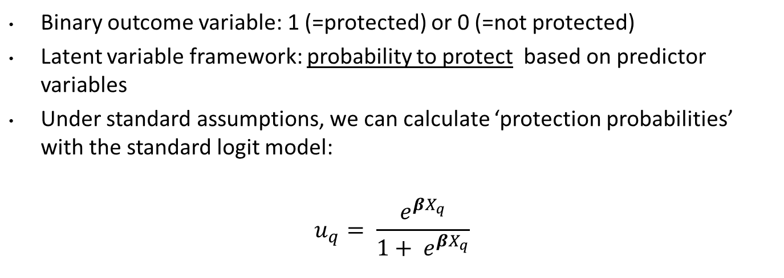
Econometric model
Introduction – Theory – Econometric model – Data – Results – Conclusion
Binary outcome variable: 1 (=protected) or 0 (=not protected)
Latent variable framework: probability to protect based on predictor variables
Under standard assumptions, we can calculate ‘protection probabilities’ with the standard logit model:
$$u_{q}= \frac{e^{{βX}_{q}}}{1+ e^{{βX}_{q}}}$$
Notes:
We do not know how policymakers weigh the various benefits and costs that enter the social welfare function.
We lack information about the benefits, costs, and constraints associated specifically with the decision to protect unit q.

Slide 8
Econometric model (cont’d)
Introduction – Theory – Econometric model – Data – Results – Conclusion
Accounting for spatial error dependence by means of a copula approach:
Independent random variables:
Dependent random variables:
Joint distribution function:
$$u_{1}⸱{ u}_{2}⸱{ u}_{..}⸱{ u}_{q}$$
$$C\left(u_{1},u_{2},..,u_{Q}\right)$$
Notes:
Copulas are jointly distributed functions in which the original marginal distributions of random variables are transformed based on a separately specified dependence structure (Nelsen 2006).

Slide 9

Econometric model (cont’d)
Introduction – Theory – Econometric model – Data – Results – Conclusion
Accounting for spatial error dependence:
Many copula functions ($C_{θ}$) can be used to transform marginal distributions ($u_{1}$ and $u_{2}$) (Gaussian, Archimedean, ..)
In this study, we use a generalized Gumbel function to model correlation between pairs of observations:
$a$ ‘divides’ $u_{1}$ and $u_{2}$ between first and second term
ρ transforms first term
$a_{1}$ and $a_{2}$ = 0 implies independence
ρ = 0 implies independence
$$\begin{aligned}&C_{θ}\left(u_{1},u_{2}\right)\# \\ = \\ \end{aligned}$$
$$\exp\left[\left.−({\left(−a_{1}\ln\left.{ u}_{1}\right)\right.}^{\frac{1}{1−ρ}}+{\left(−a_{2}\ln\left.{ u}_{2}\right)\right.}^{\frac{1}{1−ρ}}−((1−a_{1}\ln{ \left.u_{1}\right)}−(1−a_{2}\ln\left.{ u}_{2}\right)\right)\right]$$

Slide 10
Econometric model (cont’d)
Introduction – Theory – Econometric model – Data – Results – Conclusion
We approximate the full likelihood function by:
Computing pairwise marginal likelihoods
Allowing for correlation between proximate observations only (< 15km)
Empirically estimating $\text{β},$ $\text{}$, and ρ
Likelihood function implemented in Matlab
Model selection based on Composite Likelihood Information Criterion (CLIC)

Slide 11
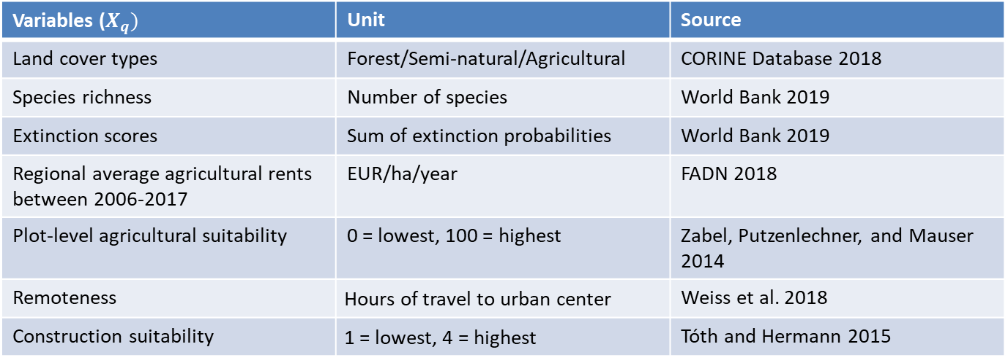
Data
Introduction – Theory – Econometric model – Data – Results – Conclusion
Study area: Spain (n=45,523) and Italy (n=21,598)
Protection status in 2018 based on two major conservation networks: IUCN and Natura 2000 (World Database on Protected Areas )
Variables ($X_{q})$ | Unit | Source
Land cover types | Forest/Semi-natural/Agricultural | CORINE Database 2018
Species richness | Number of species | World Bank 2019
Extinction scores | Sum of extinction probabilities | World Bank 2019
Regional average agricultural rents between 2006-2017 | EUR/ha/year | FADN 2018
Plot-level agricultural suitability | 0 = lowest, 100 = highest | Zabel, Putzenlechner, and Mauser 2014
Remoteness | Hours of travel to urban center | Weiss et al. 2018
Construction suitability | 1 = lowest, 4 = highest | Tóth and Hermann 2015

Slide 12
Spatial correlation results
Introduction – Theory – Econometric model – Data – Results – Conclusion
We find significant evidence of strong spatial dependence:
Logit models that allow (near-)zero correlation may provide biased results
Average marginal effects reflects % increase in protection probability due to:
1 percent increase in continuous variables (agricultural rents/suitability/species richness/extinction risk)
+ 1 in ordinal variables (construction suitability)
From 0 to 1 in categorical variables (land-use dummies)
Spain | Spatial logit |  | Aspatial logit
Log Composite Likelihood | -22599.6 |  | -23212.4
CLIC | -22901.5 |  | -23476.6
Italy | Spatial logit |  | Aspatial logit
Log Composite Likelihood | -8993.8 |  | -9279.8
CLIC | -9144.2 |  | -9396.9

Slide 13
Aggregate-level elasticities
Introduction – Theory – Econometric model – Data – Results – Conclusion
Key takeaways:
Mean absolute difference between spatial and a-spatial elasticities: 36 percent
Protected area locations potentially associated with higher biodiversity levels
Spain | Spatial logit (Copula-based CML) |  | A-spatial logit
 | Est | 95% CI | Est | 95% CI
Agricultural rent | 0.093 | [0.017, 0.168] | 0.077 | [0.017, 0.135]
Soil suitability | -0.063 | [-0.159, 0.032] | -0.058 | [-0.14, 0.026]
Remoteness | 0.182 | [0.087, 0.276] | 0.182 | [0.053, 0.309]
Construction suitability | -0.015 | [-0.089, 0.058] | -0.023 | [-0.047, 0.001]
Semi-natural area | 0.449 | [0.146, 0.752] | 0.442 | [0.163, 0.720]
Forest | 0.469 | [0.217, 0.720] | 0.462 | [0.213, 0.709]
Species richness | 0.590 | [-0.224, 1.404] | 0.652 | [-0.175, 1.478]
Extinction score | 0.046 | [-0.041, 0.134] | 0.041 | [-0.045, 0.127]
Italy | Spatial logit (Copula-based CML) |  | A-spatial logit
 | Est | 95% CI | Est | 95% CI
Agricultural rent | 0.000 | [-0.036, 0.037] | 0.026 | [-0.024, 0.077]
Soil suitability | 0.001 | [-0.090, 0.091] | -0.024 | [-0.051, 0.003]
Remoteness | 0.022 | [-0.017, 0.060] | 0.061 | [-0.020, 0.141]
Construction suitability | -0.005 | [-0.012, 0.002] | -0.012 | [-0.025, 0.002]
Semi-natural area | 0.407 | [0.163, 0.649] | 0.627 | [0.447, 0.806]
Forest | 0.354 | [0.159, 0.548] | 0.548 | [0.493, 0.603]
Species richness | 0.217 | [0.051, 0.382] | 0.176 | [-0.123, 0.474]
Extinction score | 0.037 | [-0.021, 0.094] | 0.101 | [-0.037, 0.238]

Slide 14
Conclusions
Introduction – Theory – Econometric model – Data – Results – Conclusion
We conclude that the copula-based CML approach is a promising solution to estimate and test for spatial dependence in the context of econometric land-use modeling with large datasets (>10,000 observations)
Our study elucidates how accounting for spatial dependence could affect elasticities derived from these models

Slide 15
Implications
Introduction – Theory – Econometric model – Data – Results – Conclusion
Previous studies may have drawn biased conclusions about protected area effectiveness
Future research should consider:
Panel data
Multinomial logit models
Other cost types (e.g. management costs)
Other definitions of biodiversity (e.g. ecosystem diversity)

Slide 16
End of this talk
Thank you for your attention!

Slide 17
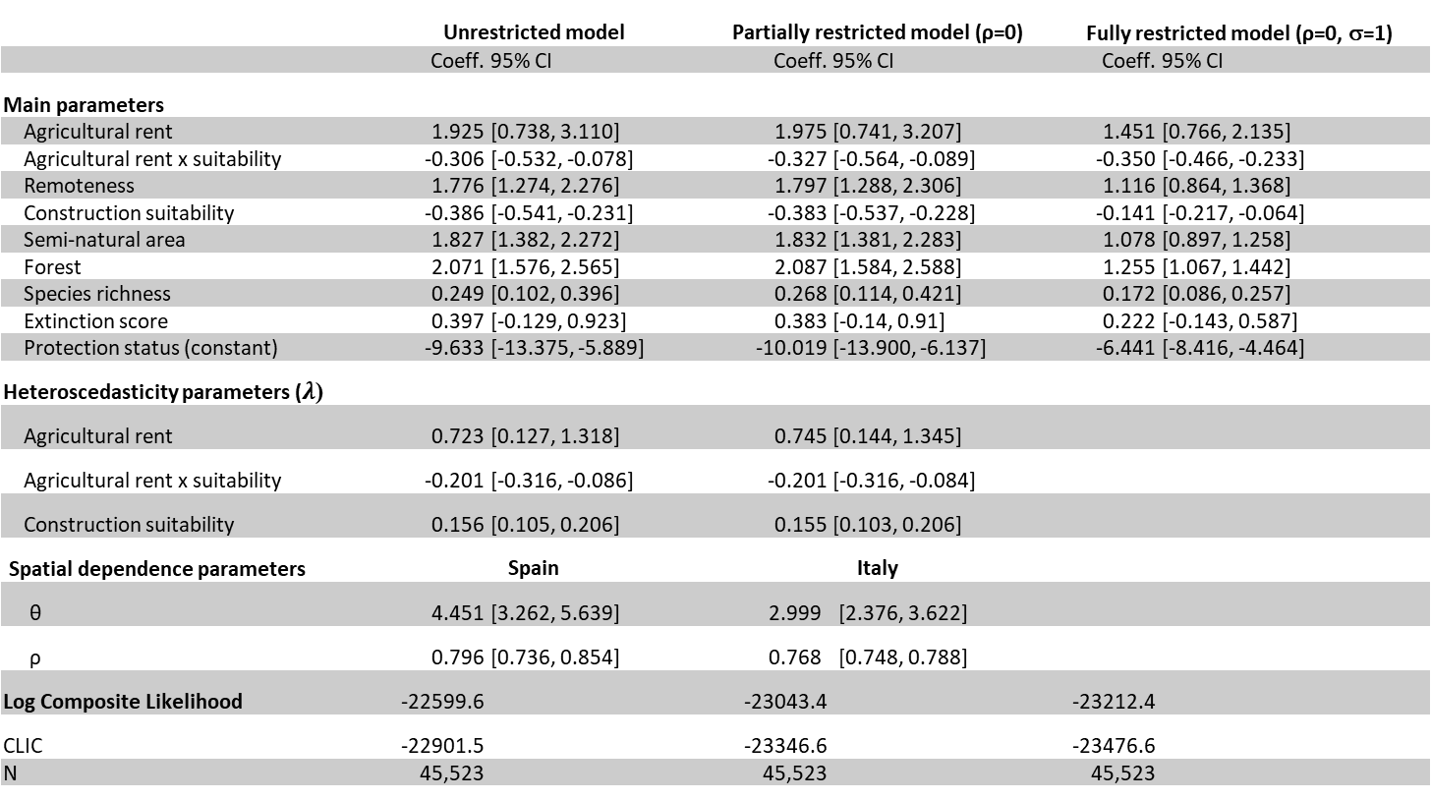
Results (Spain)
Introduction – Theory – Econometric model – Data – Results – Conclusion
 | Unrestricted model |  | Partially restricted model (ρ=0) |  | Fully restricted model (ρ=0, σ=1)
 | Coeff. | 95% CI | Coeff. | 95% CI | Coeff. | 95% CI
Main parameters
Agricultural rent | 1.925 | [0.738, 3.110] | 1.975 | [0.741, 3.207] | 1.451 | [0.766, 2.135]
Agricultural rent x suitability | -0.306 | [-0.532, -0.078] | -0.327 | [-0.564, -0.089] | -0.350 | [-0.466, -0.233]
Remoteness | 1.776 | [1.274, 2.276] | 1.797 | [1.288, 2.306] | 1.116 | [0.864, 1.368]
Construction suitability | -0.386 | [-0.541, -0.231] | -0.383 | [-0.537, -0.228] | -0.141 | [-0.217, -0.064]
Semi-natural area | 1.827 | [1.382, 2.272] | 1.832 | [1.381, 2.283] | 1.078 | [0.897, 1.258]
Forest | 2.071 | [1.576, 2.565] | 2.087 | [1.584, 2.588] | 1.255 | [1.067, 1.442]
Species richness | 0.249 | [0.102, 0.396] | 0.268 | [0.114, 0.421] | 0.172 | [0.086, 0.257]
Extinction score | 0.397 | [-0.129, 0.923] | 0.383 | [-0.14, 0.91] | 0.222 | [-0.143, 0.587]
Protection status (constant) | -9.633 | [-13.375, -5.889] | -10.019 | [-13.900, -6.137] | -6.441 | [-8.416, -4.464]
Heteroscedasticity parameters ($λ$)
Agricultural rent | 0.723 | [0.127, 1.318] | 0.745 | [0.144, 1.345]
Agricultural rent x suitability | -0.201 | [-0.316, -0.086] | -0.201 | [-0.316, -0.084]
Construction suitability | 0.156 | [0.105, 0.206] | 0.155 | [0.103, 0.206]
Spatial dependence parameters | Spain |  | Italy
θ | 4.451 | [3.262, 5.639] | 2.999 | [2.376, 3.622]
ρ | 0.796 | [0.736, 0.854] | 0.768 | [0.748, 0.788]
Log Composite Likelihood | -22599.6 |  | -23043.4 |  | -23212.4
CLIC | -22901.5 |  | -23346.6 |  | -23476.6
N | 45,523 |  | 45,523 |  | 45,523
Notes:
Implies that spatial dependence is nearly at 12.5 kilometers

Slide 18
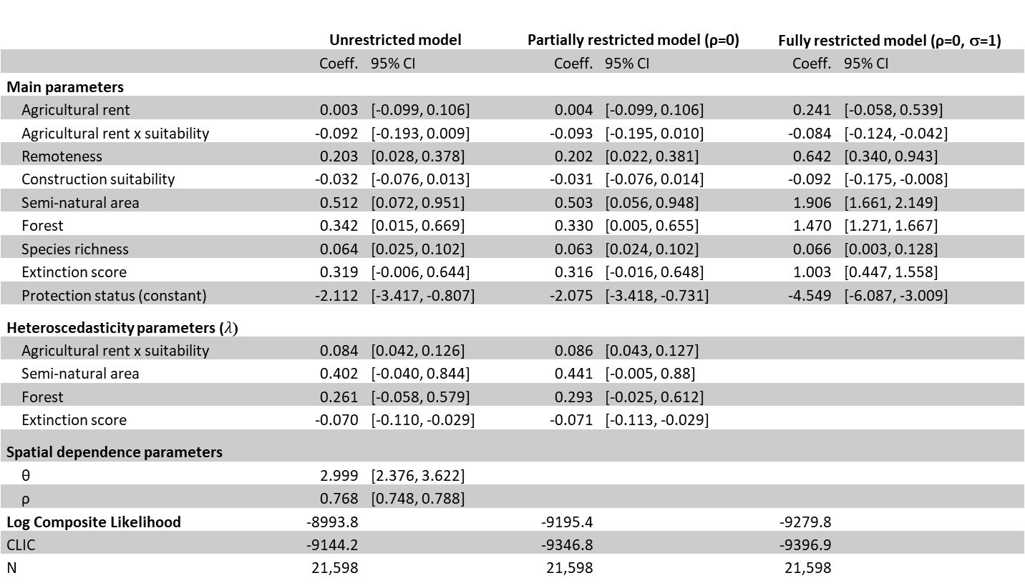
Results (Italy)
Introduction – Theory – Econometric model – Data – Results – Conclusion
 | Unrestricted model |  | Partially restricted model (ρ=0) |  | Fully restricted model (ρ=0, σ=1)
 | Coeff. | 95% CI | Coeff. | 95% CI | Coeff. | 95% CI
Main parameters
Agricultural rent | 0.003 | [-0.099, 0.106] | 0.004 | [-0.099, 0.106] | 0.241 | [-0.058, 0.539]
Agricultural rent x suitability | -0.092 | [-0.193, 0.009] | -0.093 | [-0.195, 0.010] | -0.084 | [-0.124, -0.042]
Remoteness | 0.203 | [0.028, 0.378] | 0.202 | [0.022, 0.381] | 0.642 | [0.340, 0.943]
Construction suitability | -0.032 | [-0.076, 0.013] | -0.031 | [-0.076, 0.014] | -0.092 | [-0.175, -0.008]
Semi-natural area | 0.512 | [0.072, 0.951] | 0.503 | [0.056, 0.948] | 1.906 | [1.661, 2.149]
Forest | 0.342 | [0.015, 0.669] | 0.330 | [0.005, 0.655] | 1.470 | [1.271, 1.667]
Species richness | 0.064 | [0.025, 0.102] | 0.063 | [0.024, 0.102] | 0.066 | [0.003, 0.128]
Extinction score | 0.319 | [-0.006, 0.644] | 0.316 | [-0.016, 0.648] | 1.003 | [0.447, 1.558]
Protection status (constant) | -2.112 | [-3.417, -0.807] | -2.075 | [-3.418, -0.731] | -4.549 | [-6.087, -3.009]
Heteroscedasticity parameters ($λ$)
Agricultural rent x suitability | 0.084 | [0.042, 0.126] | 0.086 | [0.043, 0.127]
Semi-natural area | 0.402 | [-0.040, 0.844] | 0.441 | [-0.005, 0.88]
Forest | 0.261 | [-0.058, 0.579] | 0.293 | [-0.025, 0.612]
Extinction score | -0.070 | [-0.110, -0.029] | -0.071 | [-0.113, -0.029]
Spatial dependence parameters
θ | 2.999 | [2.376, 3.622]
ρ | 0.768 | [0.748, 0.788]
Log Composite Likelihood | -8993.8 |  | -9195.4 |  | -9279.8
CLIC | -9144.2 |  | -9346.8 |  | -9396.9
N | 21,598 |  | 21,598 |  | 21,598

