Slide 1
Optimized care after bariatric surgery by physical activity and exercise
Dominique Hansen, PhD, FESC

Slide 2
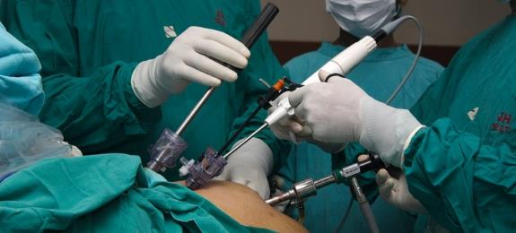
Bariatric surgery is highly effective to reduce body weight
60-86% 12-month excess weight loss
Osland E, et al. Weight Loss Outcomes in Laparoscopic Vertical Sleeve Gastrectomy (LVSG) Versus Laparoscopic Roux-en-Y Gastric Bypass (LRYGB) Procedures: A Meta-Analysis and Systematic Review of Randomized Controlled Trials. Surg Laparosc Endosc Percutan Tech 2017;27:8-18

Slide 3
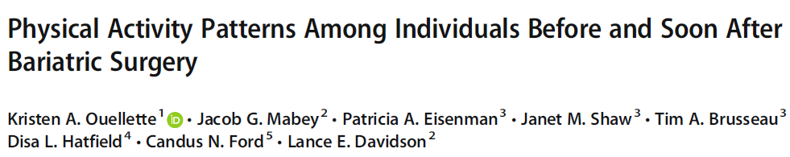
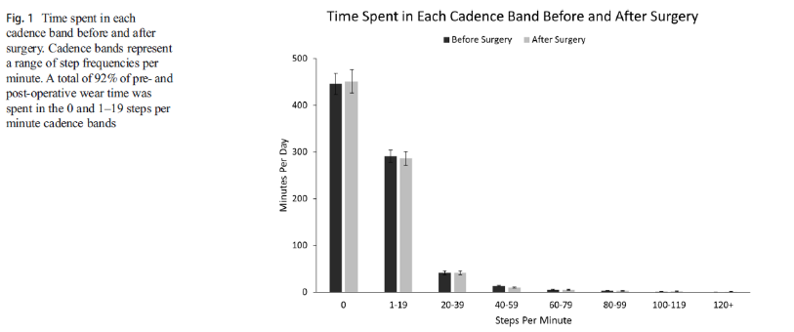
So what!?
After 4 weeks of follow-up, with accelerometry

Slide 4
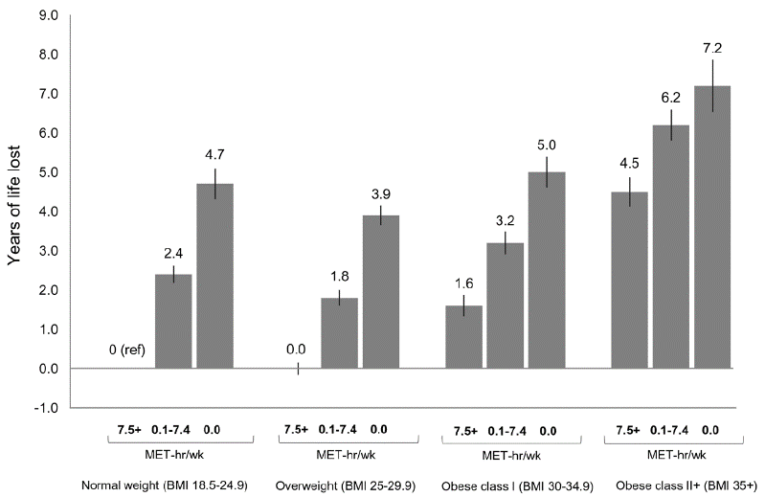
Fitness vs. fatness debate…

Slide 5
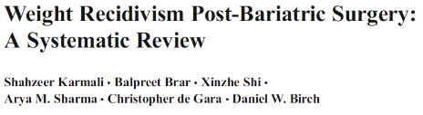
After 1-2 years a significant weight regain is observed in a substantial number of patients

Slide 6

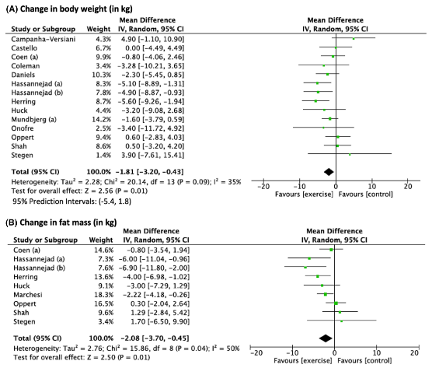
Achieving a greater weight/fat mass reduction after bariatric surgery is not the main aim of exercise intervention

Slide 7
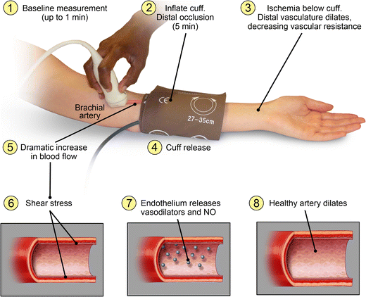
Endothelial function

Slide 8
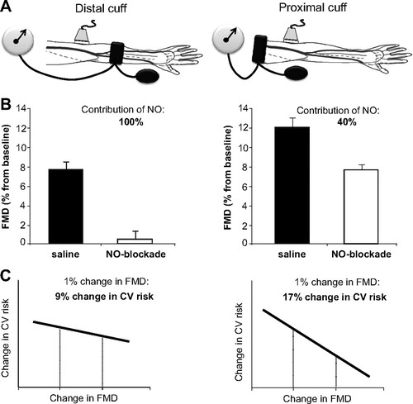
Green DJ, et al. Hypertension. 2011; 57: 363-9

Slide 9
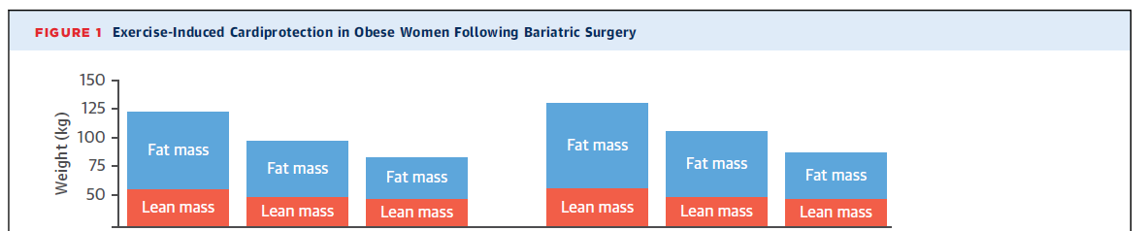
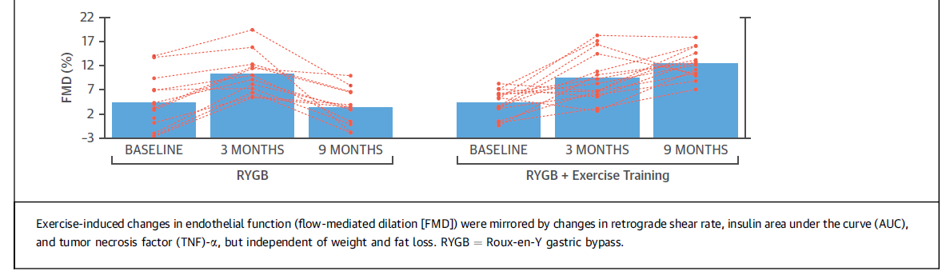
Endothelial function

Slide 10
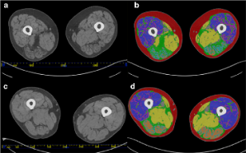
Loss in muscle mass after bariatric surgery
10-28% of total weight loss
Prevalence of sarcopenia: from 8 to 32% after 1 year (sleeve gastrectomy)
Voican CS, et al. PLoS One. 2018;13:e0197248.

Slide 11
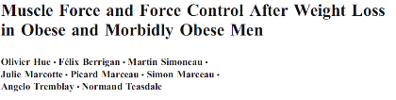
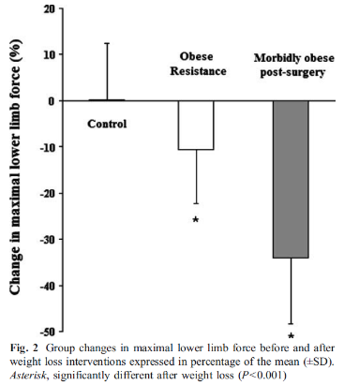
Muscle mass and strength after surgery
Energy intake
restriction
Bariatric surgery

Slide 12
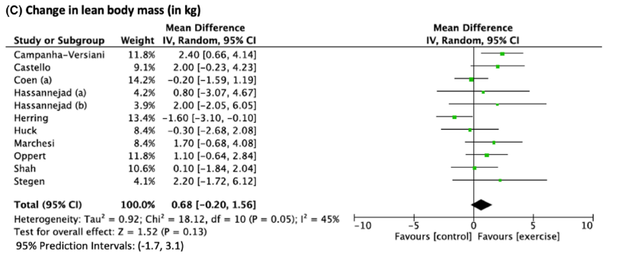
To tackle muscle wasting after bariatric surgery, endurance training is not enough

Slide 13
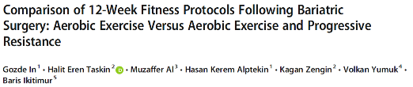
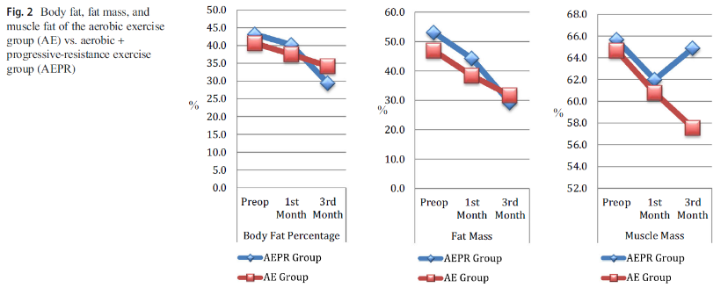
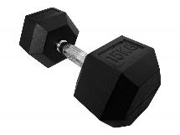

Slide 14
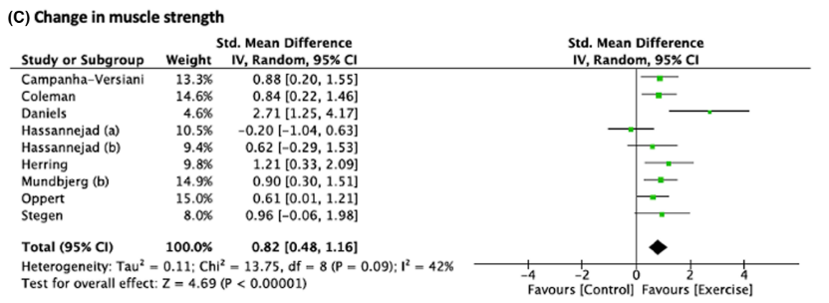
Muscle mass ≠ Muscle strength

Slide 15
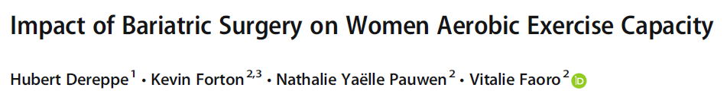
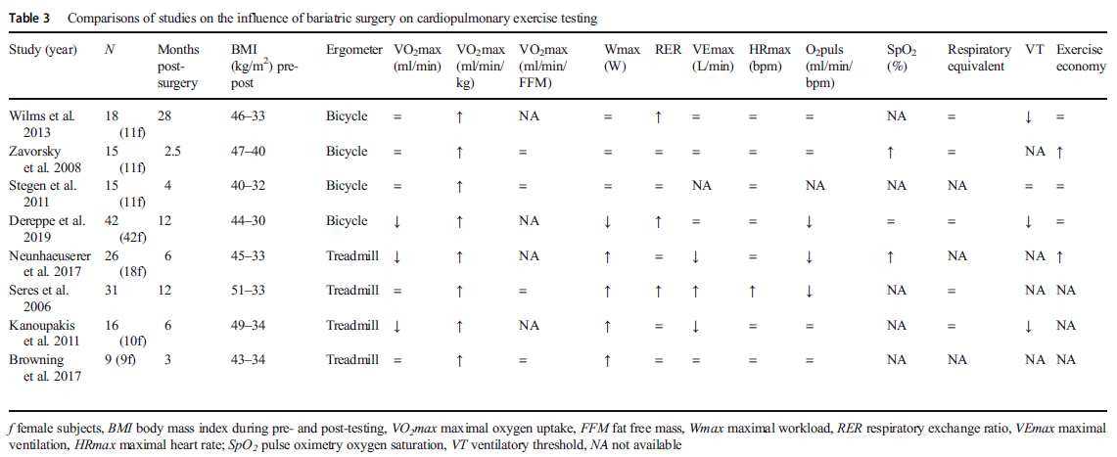
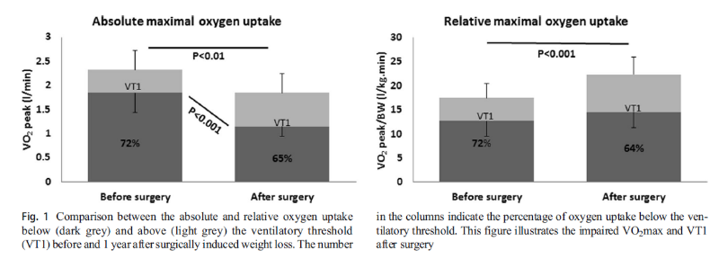

Slide 16
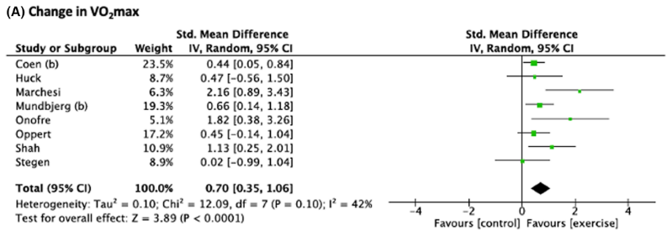

Slide 17
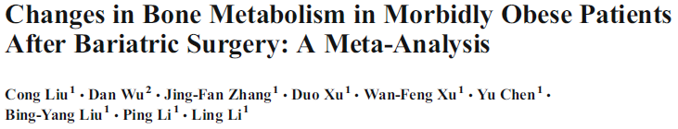
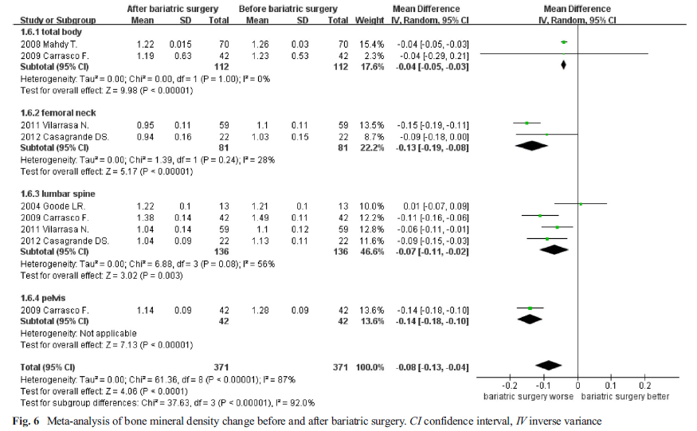

Slide 18

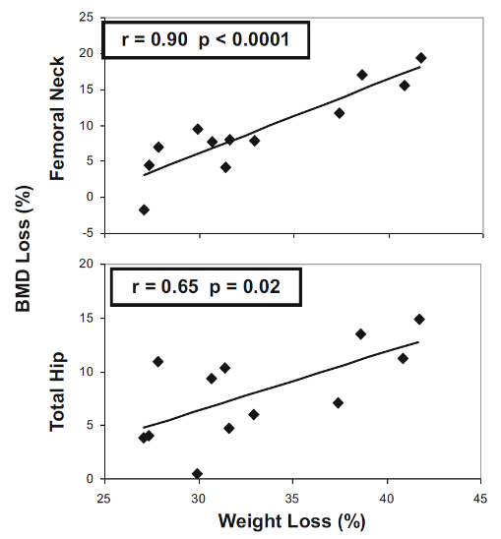

Slide 19
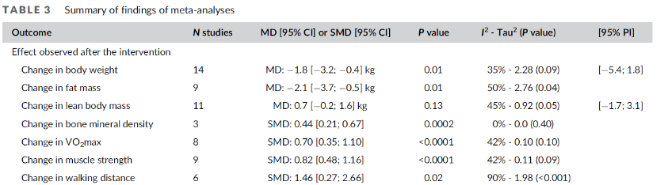

Slide 20

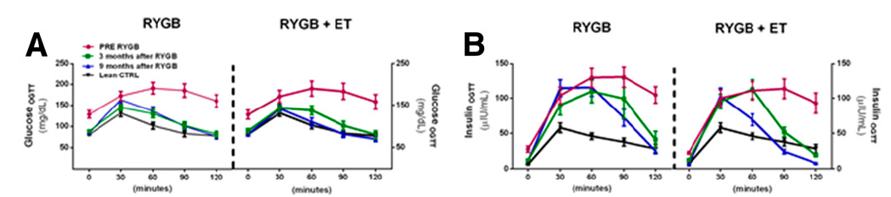
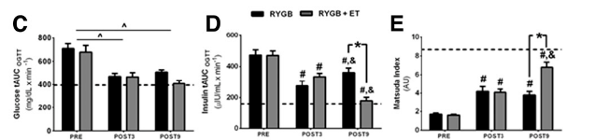


Slide 21
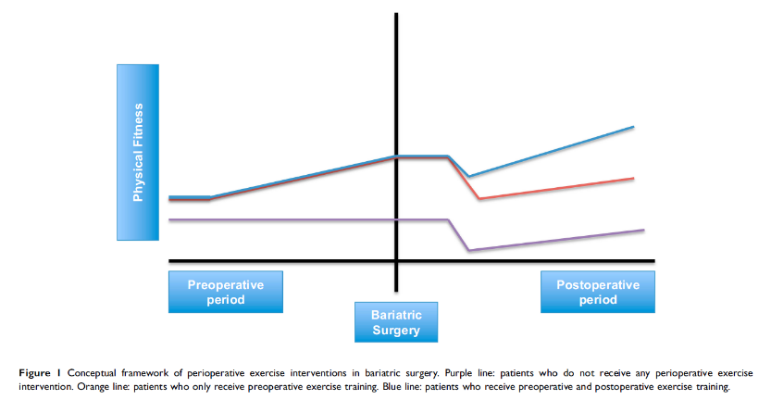
Pre-operative exercise?

Slide 22
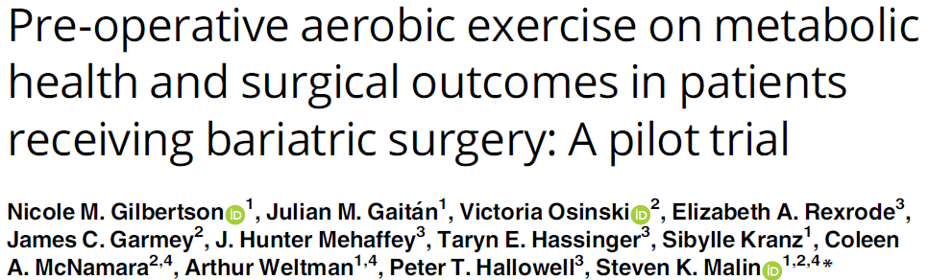
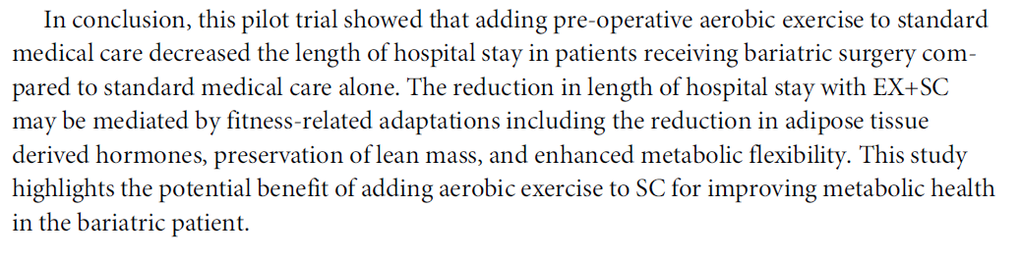
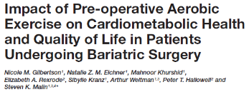

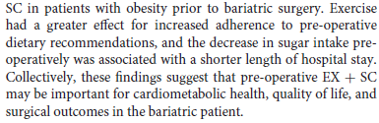

Slide 23
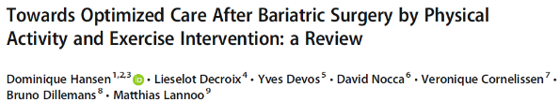
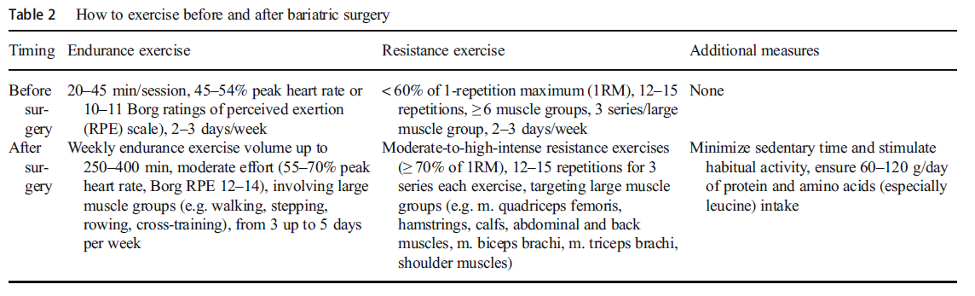
Hansen D, et al. Obes Surg. 2020; 30: 1118-25

Slide 24
Conclusions
Exercise is highly relevant in the post-operative care of bariatric surgery patients
The pre-operative benefits of exercise remain however to be substantiated
Contact:
Dominique.hansen@uhasselt.be
https://twitter.com/hansen_phd
https://www.researchgate.net/profile/Dominique_Hansen2

