Slide 1
Interdisciplinary STEM education:
wave of the future
Master in Materiomics
Educational Master S&T

Slide 2
Three topics
Interdisciplinary breadth vs. Disciplinary depth
Tools and teaching approaches in interdisciplinary STEM degree programmes
Important criteria to consider in the (formative) assessment of interdisciplinary collaborations between STEM students

Slide 3
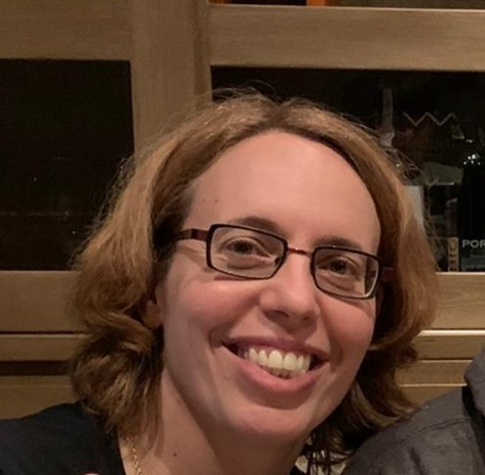
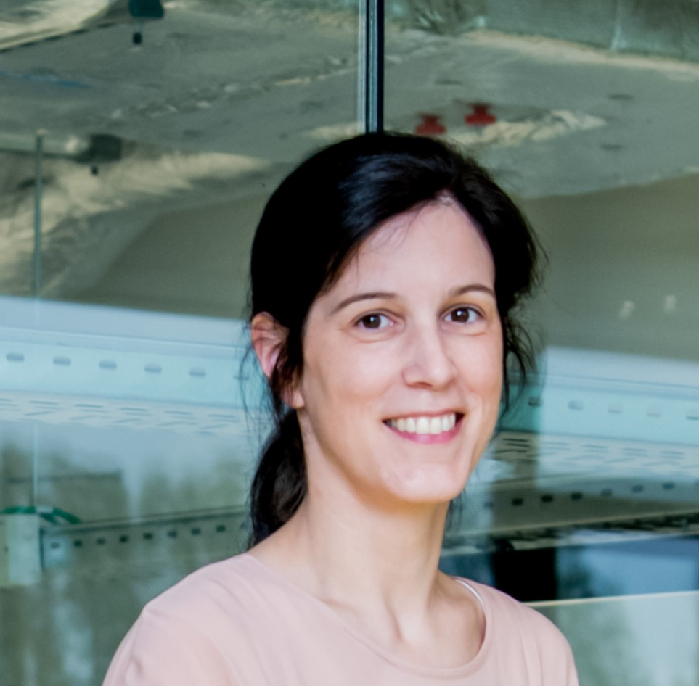
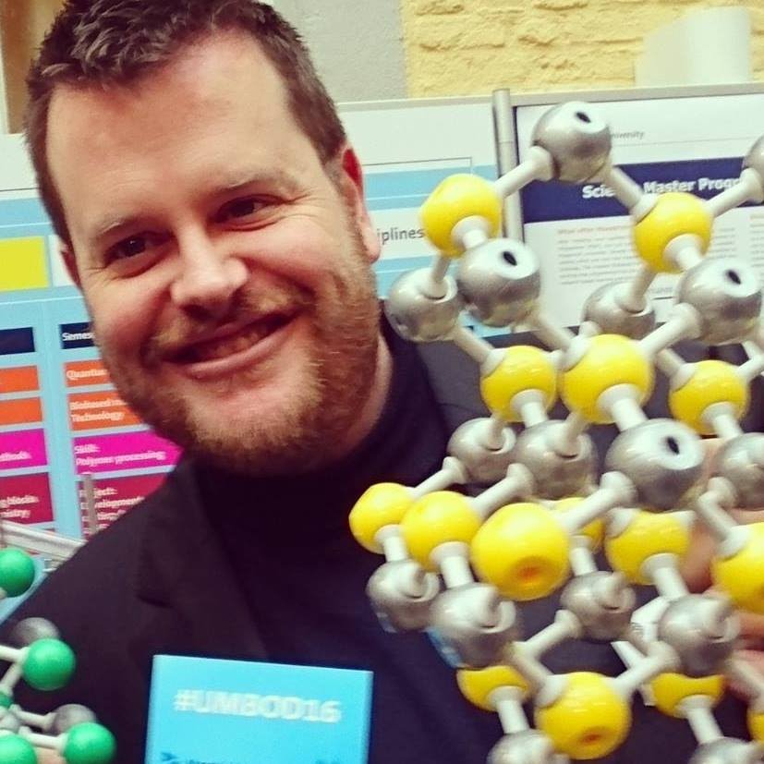
Panel discussion
Ilse Engelen, UHasselt
Educational Master S&T
Donna Carroll, EDLAB, Univ. Maastricht
An Hardy, UHasselt
Ba Chemistry, Ma Materiomics
Jolien Notermans, UHasselt, Master in Materiomics
Katleen Denolf, UHasselt
Educational Master S&T
Burgert Blom, Univ. Maastricht, Maastricht Science Programme
Sarah Doumen, UHasselt, Master in Materiomics
https://www.maastrichtuniversity.nl/
Notes:
Secondary education, bachelor, bachelor+master

Slide 4
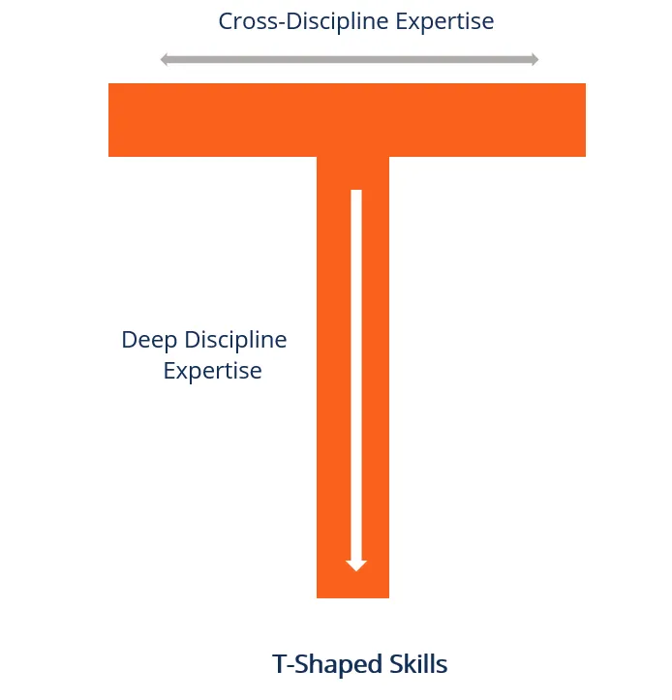
Interdisciplinary breadth vs. Disciplinary depth
How to maintain academic depth in combination with an interdisciplinary approach?
What do interdisciplinary students gain?
Figure from https://corporatefinanceinstitute.com/resources/careers/soft-skills/t-shaped-skills/

Slide 5
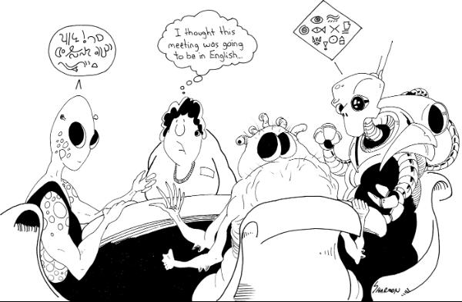
Tools and teaching approaches in interdisciplinary STEM
How to foster interdisciplinary interactions and understanding between STEM students?
Cartoon from https://www.bloomsburycollections.com/book/interdisciplinary-research-journeys-practical-strategies-for-capturing-creativity/

Slide 6
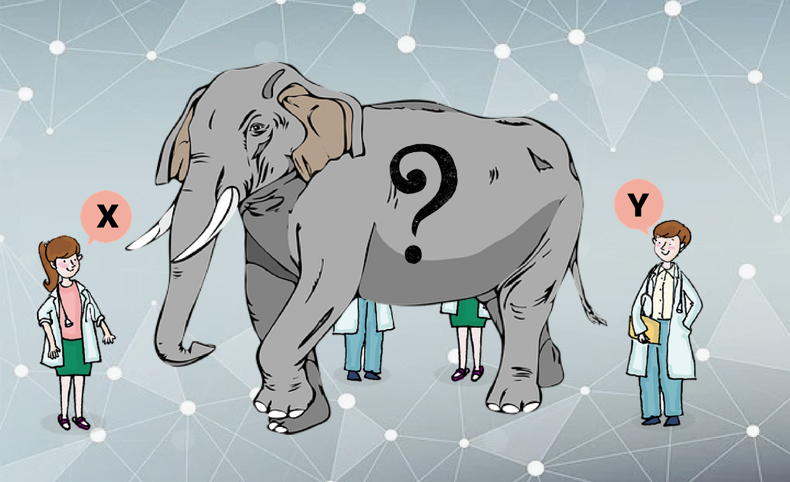
Assessment of interdisciplinary collaborations between STEM students
How to articulate and evaluate students’ interdisciplinary learning process and outcomes?
Image from https://indiabioscience.org/columns/opinion/research-and-let-research

Slide 7
Breakout rooms
Interdisciplinary breadth vs. Disciplinary depth
→ An Hardy & Burgert Blom
Tools and teaching approaches in interdisciplinary STEM degree programmes
→ Katleen Denolf, Ilse Engelen, Sarah Doumen
Important criteria to consider in the (formative) assessment of interdisciplinary collaborations between STEM students
→ Donna Carroll & Jolien Notermans
Notes:
PLEASE ADD A LINK TO THE 3 BREAKOUT ROOMS

Slide 8
Breakout rooms
You will be automatically divided into the breakout rooms.
After 20 min and after 10 min:
1
3
2

