Slide 1
Compatibility between polymeric backbone eutectogel solid electrolyte and NMC cathode materials for lithium-ion batteries
An-Sofie Kelchtermans

Slide 2
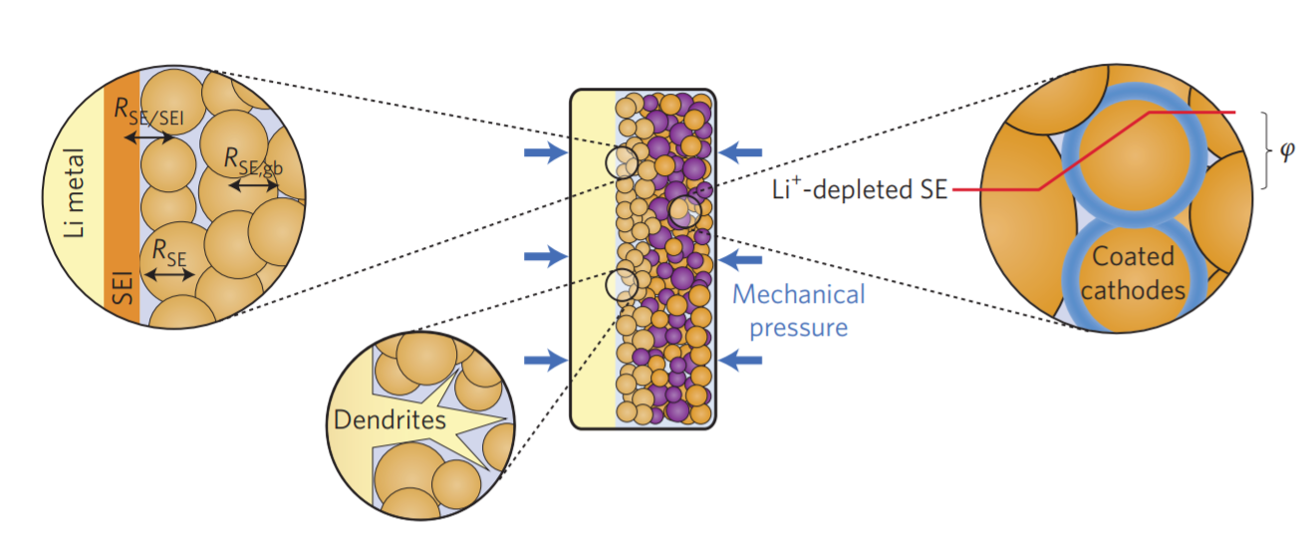
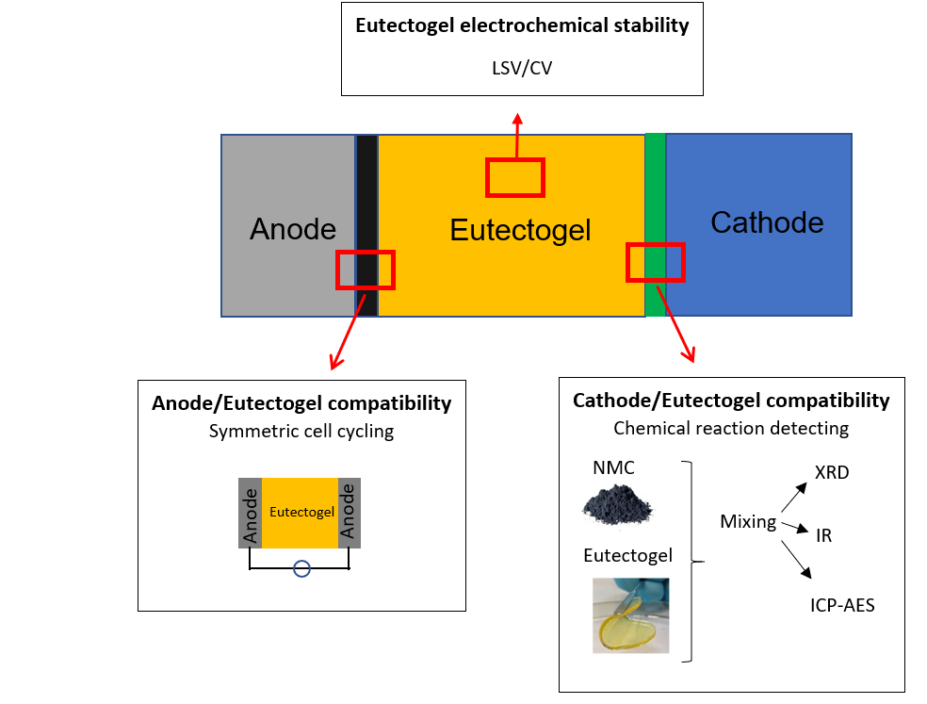
Compatibility between polymeric backbone eutectogel solid electrolyte and NMC cathode materials for lithium-ion batteries
An-Sofie Kelchtermans¹, Bjorn Joos^{1,2}, Dries Desloovere^{1,2,3}, Alexander Tesfaye⁴, Travis Thompson⁴, Marlies K. Van Bael^{1,2,3}, An Hardy^{1,2,3}
¹ Hasselt University, Institute for materials research, DESINe, Martelarenlaan 42, 3500 Hasselt, Belgium
² imo-imomec, devision of imec, Wetenschapspark 1, 3590 Diepenbeek, Belgium
³ EnergyVille 2, Thor Park 8320 , 3600 Genk, Belgium
⁴ Umicore, Corporate Research & Development, Watertorenstraat 33, 2230 Olen, Belgium
Key words: polymer solid electrolyte, litihium ion batteries, interface stability
INTRODUCTION
Polymeric backbone eutectogel (P-ETG)
The need for sustainable mobility leads to the growth of the electric vehicle market. For mobile applications the energy density is a crucial factor. Lithium ion batteries are the most suitable technology for electric vehicles due to their high gravimetric and volumetric energy density. Solid-state batteries are the next step after advanced lithium ion batteries as they offer the potential to significantly increase the energy density combined with a potential higher safety due to the absence of the flammable liquid electrolyte. Research on solid-state batteries has increased, but still faces fundamental challenges; such as the development of a high performant solid electrolyte, and the integration of the cathode and anode materials.
AIM: Obtaining insights in and improving the interaction between polymer-based eutectogel solid electrolyte and state-of-the-art cathode active material.
Polymer-based eutectogel (ETG): a promising solid electrolyte
New class of solid composite electrolytes
Deep eutectic solvent (MAc/LiTFSI) confined in a polymeric matrix
Allows the combination of the processability advantage of polymers with high Li-ion conductivity of liquid electrolytes
Solid electrolyte
Li ion conductivity
Processability
Stability (vs
anode/cathode)
Battery cell
Cell assembly
Cathode
Stability vs solid electrolyte
Material integration
Li-metal anode
Dendrite formation
Stability vs solid electrolyte
Properties of P-ETG
Battery performance
ANIODIC STABILILTY
Compatibility with NMC cathode materials
RESULTS
A higher DES loading results in a better anodic stability, and higher ionic conductivities.
→ P-ETG-85 chosen as the best composition
X-Ray Diffraction diffraction
Overall layered structure is maintained after cycling
Stable cycle life at different C-rates
Loss of capacity after multiple cycles could originate from the continuous SEI layer growth at anode side
Lower capacities at higher discharge rates due to the slower kinetics of ion transport in P-ETG
IONIC CONDUCTIVITY
ATR-FI-IR
No degradation of eutectogel visible after cycling
ICP-AES
Limited transition metal ion leaching into DES
NMC|P-ETG|NMC
Li|P-ETG|Li
Impedance spectroscopy
Increasing resistance in cell over cycle number due to Li | P-ETG interface
CONCLUSIONS AND FUTURE PERSPECTIVE
P-ETG electrolyte holds potential as an inexpensive and flexible solid electrolyte for the next generation solid state Li-ion batteries with NMC-622 cathode materials, as they demonstrate a broad electrochemical stability window (1.5 – 4.8 V vs Li/Li⁺) and a high ionic conductivity at room temperature (0.82 mS cm⁻¹).
As confirmed by means of various techniques, this P-ETG electrolyte and NMC-622 active cathode material show chemical compatibility.
Further research is required to integrate the P-ETG in a practical battery in order to improve the solid-solid contact between electrode and electrolyte.
References
Acknowledgements
1. C. Sun, et al., Recent advantages in all-solid state rechargeable lithium batteries, Nano Energy, 2017.
2. Manthiram, A. et al., Lithium battery chemistries enabled by solid-state electrolytes, Nat. Rev. Mater., 2016.
3. J. Janek, et al., A solid future for battery development, Nature Energy, 2016.
B. Joos, et al., Polymeric backbone eutectogels as a new generation of hybrid solid-state electrolytes, Chem. Mater., 2020.
This project receives the financial support from VLAIO and Umicore (Beakeland project). The authors thank W. Maes for the use of the N₂ glovebox and (ATR-)FT-IR setup, W. Marchal and group members for the use of the ICP-OES device.
ansofie.kelchtermans@uhasselt.be

