Slide 1
An exploration of road crashes in Manipal,
India: trends, patterns,
causes, and time series analysis prediction
Presented by-Kumar Sumit (PhD Candidate)
UHasselt, Belgium and Maastricht University, the Netherlands
Authors;
Kumar Sumit^{1,2}, Veerle Ross¹, Robert A.C. Ruiter², Evelien Polders¹, Geert Wets¹, Kris Brijs¹
1-UHasselt, School of Transportation Sciences, Agoralaan, 3590 Diepenbeek, Belgium
2-Maastricht University, Department of Work & Social Psychology, Maastricht University,
6200 MD, Maastricht, the Netherlands

Slide 2
Introduction
Internationally, road traffic accidents (RTAs) have become the major public health challenge of the 21st century [1].
Annually, more than 1.35 million people lose their life due to road crashes, making it one of the leading causes of death worldwide [1].
Road crashes are the sixth leading cause of death in India and it causes immense socio-economic losses, especially among the young population [2].
Every hour, there are 15 fatalities and 53 injuries associated with road crashes in India and it is expected that the total number of deaths related to road crashes will cross the 250,000 mark by 2025 [3].

Slide 3
Rationale & Aim of the study
A comprehensive analysis of trends, patterns, and causes of crashes are critical for determining the existing gaps causing crashes and proposing solutions for future improvisations for India's diverse road safety situations [4].
Roads have become prone for crashes due to an unprecedented increase in road traffic volume over the last five years.
The current study objective is to explore road crashes in Manipal, Indi by identifying trends, patterns, causes, and prediction through time series analysis.

Slide 4
Data and Methodology
Study area-Manipal
Data source- Crash FIR records of Manipal city police station (2012 to 2018) and district aggregated data (2008 to 2018) retrieved from the Superintendent of the police office.
Statistical analysis-Descriptive statistics for the crash data extracted from the FIR records and time series analysis forecasting method for the district aggregated data.
Statistical Software-IBM SPSS version 24 and R software 2016.

Slide 5
Results
Increase (3.22%) in the number of crash deaths in the district in last ten years.
Fatal crashes in the last ten years have happened due to speeding head-on collision, rear-end collision, skidding.
Motorcyclists contributes to maximum fatal road crashes.

Slide 6
Results
Causes of fatal crashes
Cause for the accident | Frequency | Percentage
Consumption of Alcohol | 16 | 0.74%
Exceeded Lawful Speed | 2078 | 96.16%
Driving on the wrong side | 16 | 0.74%
Improper Overtaking | 17 | 0.79%
Other improper actions | 34 | 1.57%

Slide 7
Results contd…
Crash risk has increased among both the genders in the last ten years.
Crashes are more on Saturday evenings (18.03%), followed by Wednesday (16.39%) and Monday (15.57%).
The results of the time series analysis predict an overall increase of 3% in the number of fatal crashes for the upcoming years in the district.

Slide 8
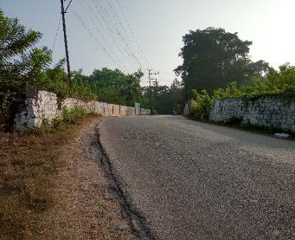
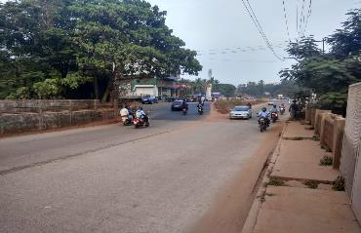
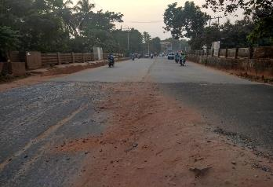
Crash-prone locations

Slide 9
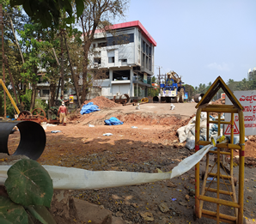
Crash-prone locations-Under repair from March 1, 2021

Slide 10
Discussion
Current study | Previous studies
Increase in the number of crash over the last few years. | Similar to; (Dandona et al., 2008; Kanchan et al., 2012; Sivasankaran et al., 2021).
Higher involvement of motorcyclists in crash. | Similar to; (Bhalla et al., 2017; Mohan et al., 2016.; Singh, 2017; Sivasankaran et al., 2021)
Involvement of young riders | Similar to; (Bhalla et al., 2017; Kanchan et al., 2012; Ruikar, 2013; Sivasankaran et al., 2021)
Speeding is the main cause of crash | Similar to; (Mishra, 2017; Pal et al., 2019; Sharma et al., 2014)
Prediction for increase in number of crash | Similar to; (Manikanandan. et al., 2018; Rakesh & Suman, 2012; Gupta, 2017)

Slide 11
Recommendations
Random checkpoints to check for drink-drive & reckless driving can be installed.
Awareness programs targeting reckless driving, speeding, and mobile phone usage should be initiated at the local level.
Warning signs can be installed at the high-risk crash-prone zones, especially the connecting railway bridges.
The local police authorities should try to collect more information about road crashes as it can be used later for a much comprehensive, in-depth analysis.
The study results can be taken up by local authorities for the sensitization and training of police personnel regarding traffic safety enforcement.

Slide 12
Conclusion
The results provide essential leads for the initiation of specific intervention programs targeting the causes of crashes and sensitizing local authorities for priority-based actions.
Valuable contribution to the existing literature on the use of crash data in understanding trends, patterns, and causes of road crashes.
The findings warrant further studies in other similar settings within India for evidence generation and subsequent localized interventions.

Slide 13
References
GLOBAL STATUS REPORT ON ROAD SAFETY (WHO) (2018): Annual report.
Ministry of Road Transport and Highways (MoRTH) (2019). India: Annual report.
Singh, S. K. (2017). Road Traffic Accidents in India: Issues and Challenges. Transportation Research Procedia, 25, 4708–4719.
Ruikar, M. (2013). National statistics of road traffic accidents in India. Journal of Orthopedics, Traumatology and Rehabilitation.
Pal, R., Ghosh, A., Kumar, R., Galwankar, S., Paul, S., Pal, S., Sinha, D., Jaiswal, A., Moscote-Salazar, L., & Agrawal, A. (2019). Public health crisis of road traffic accidents in India: Risk factor assessment and recommendations on prevention on the behalf of the Academy of Family Physicians of India. Journal of Family Medicine and Primary Care, 8(3), 775.
Sivasankaran, S. K., Rangam, H., & Balasubramanian, V. (2021). Investigation of factors contributing to injury severity in single vehicle motorcycle crashes in India. International Journal of Injury Control and Safety Promotion, 28(2), 243–254.
Sunny et al., "Forecasting of Road Accident in Kerala: A Case Study," 2018 International Conference on Data Science and Engineering (ICDSE), Kochi, 2018, pp. 1-5, doi: 10.1109/ICDSE.2018.8527825.
Dandona, R., Kumar, G. A., Ameer, M. A., Reddy, G. B., & Dandona, L. (2008). Under-reporting of road traffic injuries to the police: Results from two data sources in urban India. Injury Prevention, 14(6), 360–365.
Bhalla, K., Khurana, N., Bose, D., Navaratne, K. V., Tiwari, G., & Mohan, D. (2017). Official government statistics of road traffic deaths in India under-represent pedestrians and motorized two-wheeler riders. Injury Prevention, 23(1), 1–7.
Kanchan, T., Kulkarni, V., Bakkannavar, S. M., Kumar, N., & Unnikrishnan, B. (2012). Analysis of fatal road traffic accidents in a coastal township of South India. Journal of Forensic and Legal Medicine, 19(8), 448–451.
Mishra, P. (2017). Vital Stats Overview of Road Accidents in India. PRS Legislative Research. Institute for Policy Research Studies, 4343(011), 4801–4802. Retrieved from www.prsindia.org.
Mohan, V. R., Sarkar, R., Abraham, V. J., Balraj, V., & Naumova, E. N. (2015). Differential patterns, trends and hotspots of road traffic injuries on different road networks in Vellore district, southern India. Tropical Medicine and International Health, 20(3), 293–303.

Slide 14
Stop accidents before they stop you!!
Thank you

