Slide 1

The Why and How of Exercise and the Heart: A Position Statement from the European Association of Preventive Cardiology
Dominique Hansen, PhD, FESC

Slide 2
Conflicts of interest
None to be declared

Slide 3

In CAD patients, CR leads to
  Significant reductions in total mortality after ACS (HR 0.37)
  Significant reductions in total mortality after CABG (HR 0.62)
  Significant reductions in total mortality in mixed populations (HR 0.52)
Salzwedel A, et al. Eur J Prev Cardiol. 2020;27(16):1756-74

Slide 4

In HF patients, CR leads to
Trends for reductions in total mortality in the longer term (>12 months, RR 0.88)
Significant reductions in total number of hospitalisations (up to 1 year follow-up, RR 0.70), and HF-specific hospitalisations (RR 0.59)
Long L, et al. Cochrane Database Syst Rev. 2019 Jan 29;1:CD003331.

Slide 5
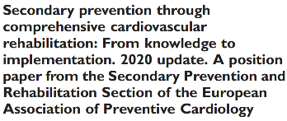

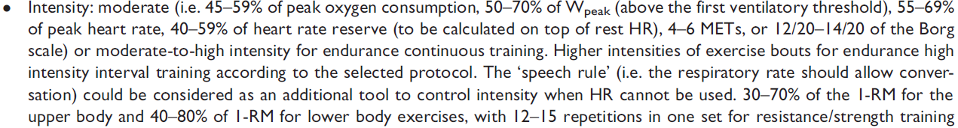
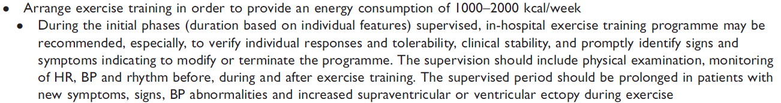
Eur J Prev Cardiol 2020; e-pub ahead of print

Slide 6
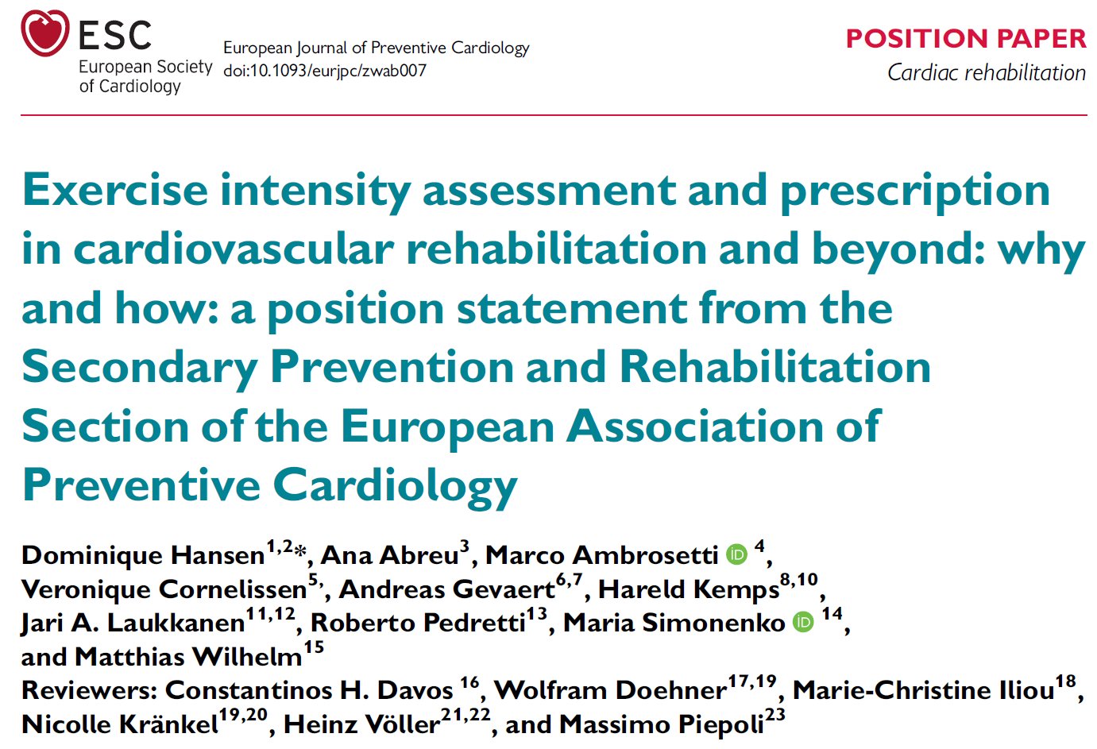

Slide 7
Questions
Does the exercise intensity affect the clinical effectiveness of CR?
Does the exercise intensity affect the medical safety of CR?
How to properly determine the exercise intensity?

Slide 8
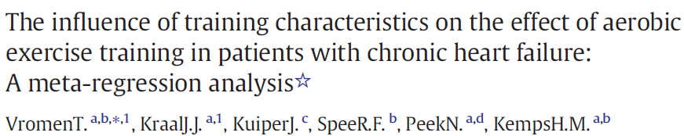
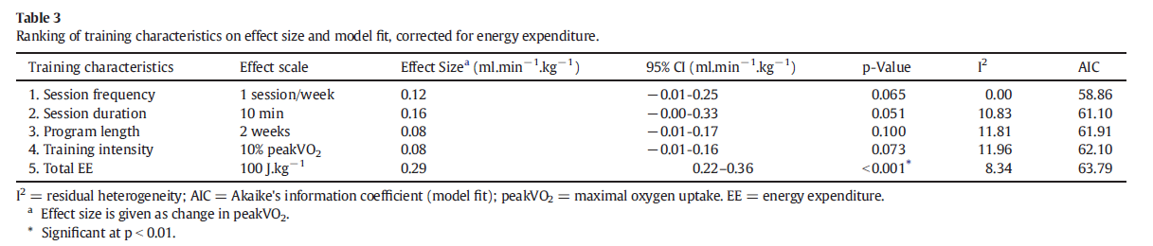

Slide 9
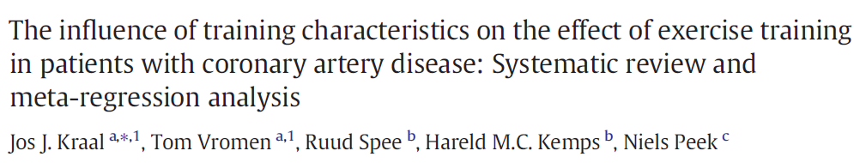
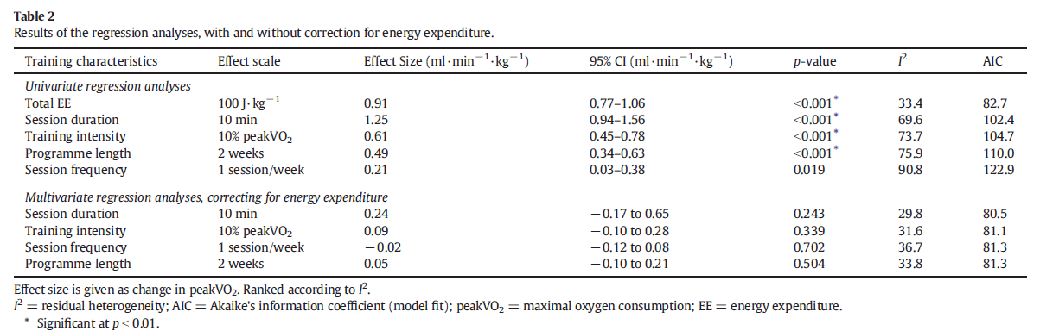

Slide 10
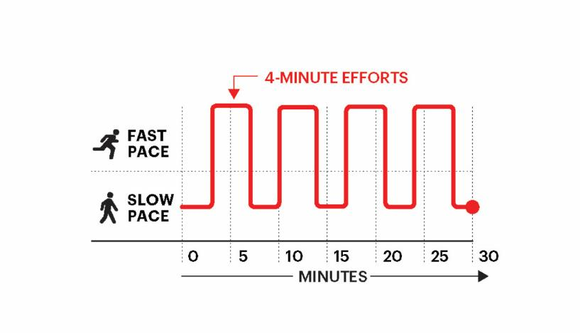

Slide 11
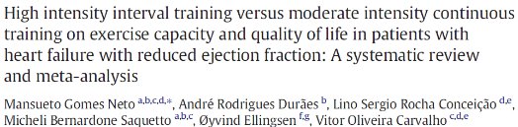
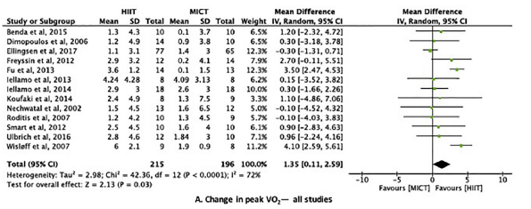
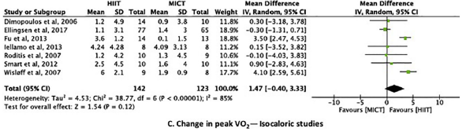

Slide 12
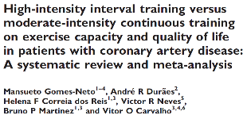
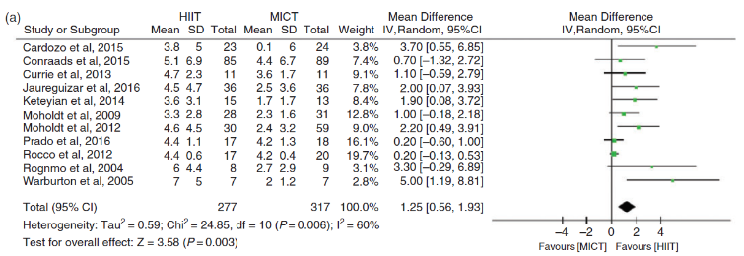
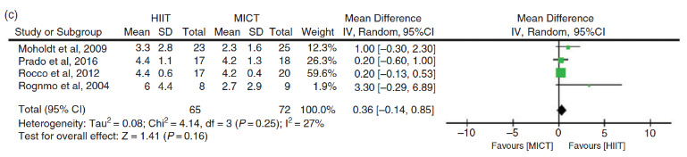

Eur J Prev Cardiol 2017; 24: 1696-1707

Slide 13
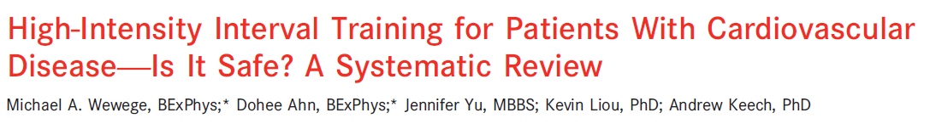
The overall AE rate (all reported events) was:
1 event per 2227 training hours for HIIT
1 event per 5606 training hours for MICT.
Overall, the risk difference for all AEs between HIIT and MICT (19 studies, HIIT=547; MICT=570) was not observed to be significantly different (P=0.70)

Slide 14
Impact of HIIT on medical safety?
But be aware:
  Low-risk and/or clinically stable patients were examined (patients underwent CPET at entry of CR)
  Exercise interventions were of a relatively short duration (most often up to three months)
  Studies were not powered for safety outcomes
  Exercise training was supervised
Absolute risk of CR is however very low:
Major event rate of 1 per 49,565 patient-hours of exercise training, and the cardiac arrest rate of 1.3 per 1,000,000 patient training hours
Pavy B, et al. Safety of Exercise Training for Cardiac Patients. Results of the French Registry of Complications During Cardiac Rehabilitation. Arch Intern Med 2006;166:2329-2334.

Slide 15
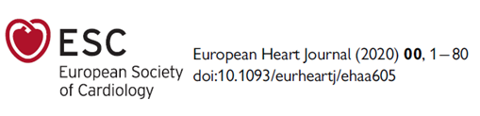
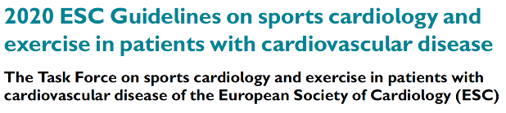
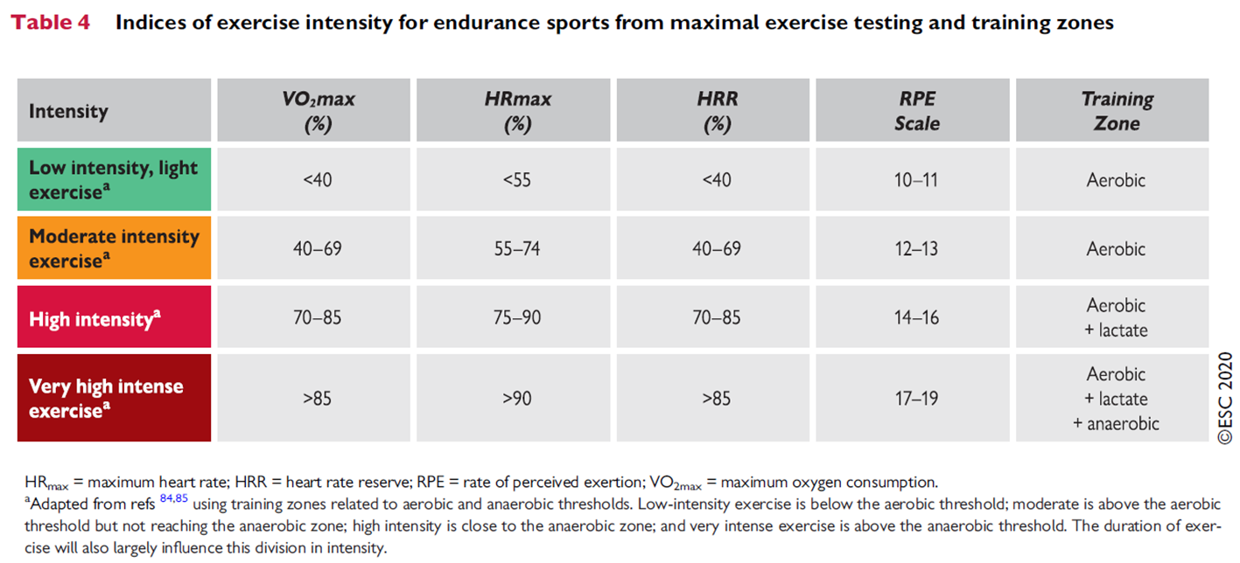

Slide 16
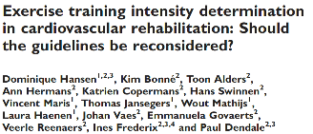
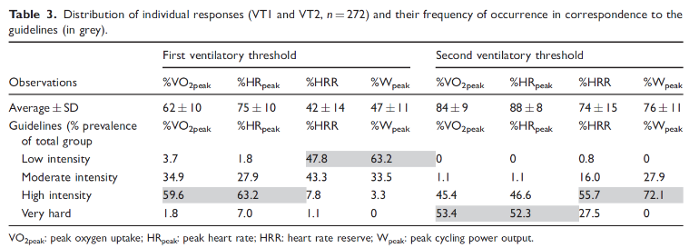
Eur J Prev Cardiol 2019; 26: 1921-8.

Slide 17
Others confirm…
Pymer S, et al. Does exercise prescription based on estimated heart rate training zones exceed the ventilatory anaerobic threshold in patients with coronary heart disease undergoing usual-care cardiovascular rehabilitation? A United Kingdom perspective. Eur J Prev Cardiol 2020;27:579-589.
Iannetta D, et al. A Critical Evaluation of Current Methods for Exercise Prescription in Women and Men. Med Sci Sports Exerc 2020;52:466-473.
Jamnick NA, et al. An Examination and Critique of Current Methods to Determine Exercise Intensity. Sports Med 2020;50:1729-1756.
Anselmi F, et al. The importance of ventilatory thresholds to define aerobic exercise intensity in cardiac patients and in healthy subjects. Scand J Med Sci Sports 2021; e-pub ahead of print.

Slide 18
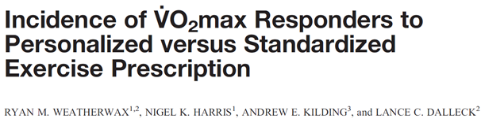
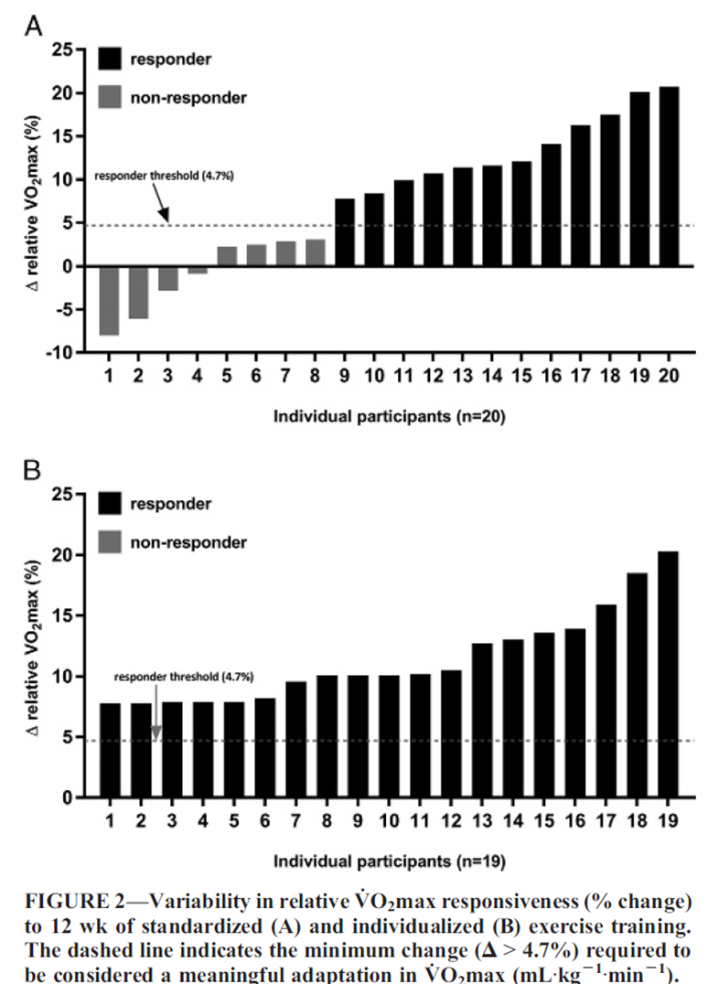
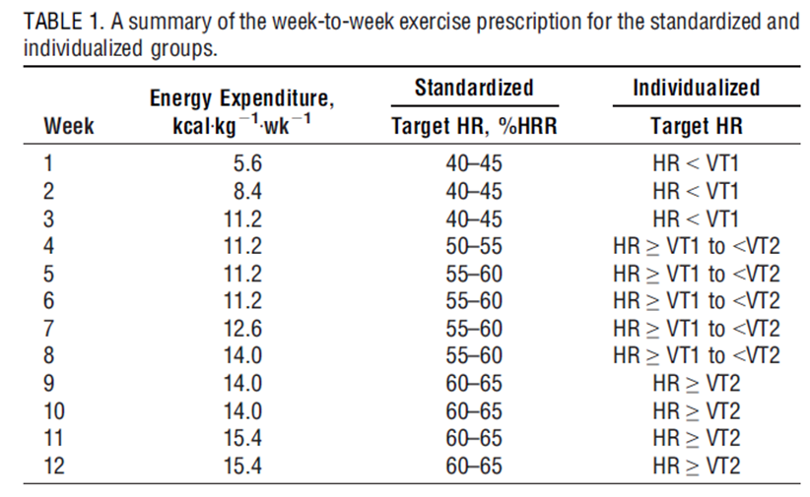

Slide 19
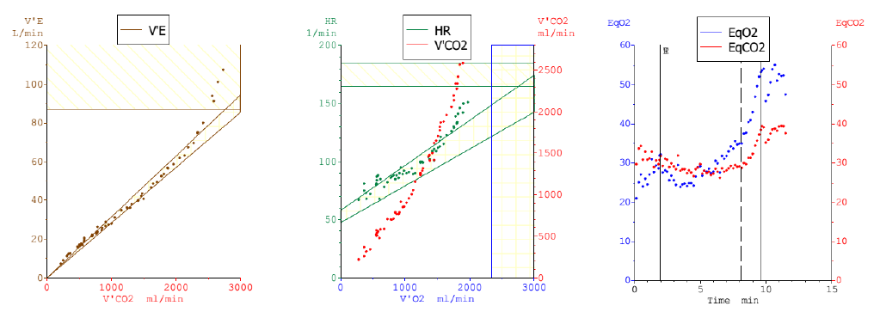
Extrapolation to HR, W, time

Slide 20
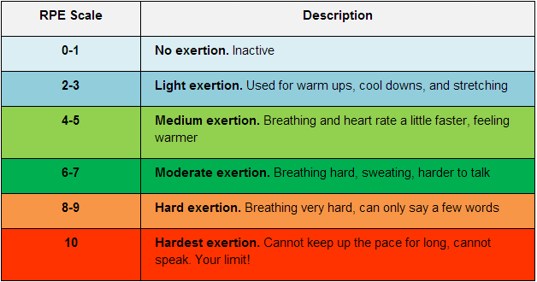
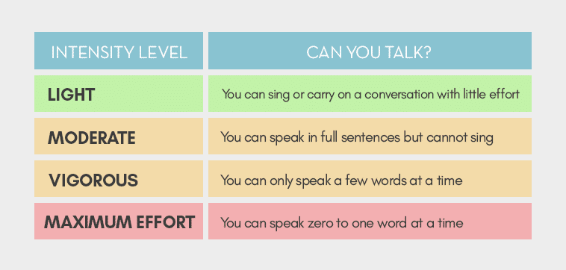
Although Borg's RPE scale has been shown to be a valid measure of exercise intensity, its validity may not be as high as previously thought, except under specific conditions
The test is suitable in patients with CAD and shows quite good intra-class correlation, when comparing self-ratings with external observations.
However, when comparing with VT1 and/or VT2, the level of agreement demonstrates wide ranges.

Slide 21
Borg RPE and/or the talk test are used as an adjunct practical way to guide exercise intensity in daily activities of CVD patients.
They are an essential tool for shared-decision making

Slide 22
Position statements
The assessment of VT1 and VT2 during CPET, preferably by the nadir of the VE/VO2 and VE/VCO2 to WR relationships, provides reliable effort-independent parameters that should be used for the determination of the aerobic exercise intensity in the majority of CVD patients.
The commonly used peak indices such as VO_{2peak}, HR_{peak}, HRR, and W_{peak} should be applied with great caution for the prescription of the aerobic exercise training intensity in CVD patients
The talk test and Borg RPE scale should only be considered as an adjunct to an objective aerobic exercise intensity determination method in CVD patients.
Dominique.hansen@uhasselt.be
https://twitter.com/hansen_phd
https://www.researchgate.net/profile/Dominique_Hansen2

Slide 23
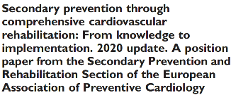

As a general rule of thumb:
The strength training exercise intensity should be set at:
30–70% of the 1-RM for the upper body
40–80% of the 1-RM for lower body exercises
With 12–15 repetitions in one set for resistance/strength training
Ambrosetti M, et al. Eur J Prev Cardiol. 2020 Apr 7:2047487320913379. doi: 10.1177/2047487320913379.

Slide 24

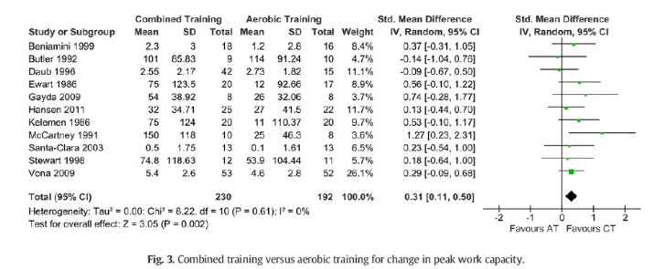

Slide 25
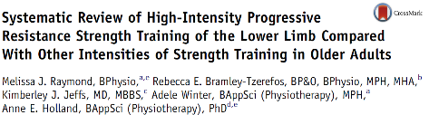
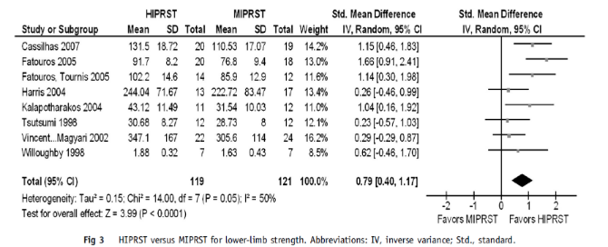

Slide 26
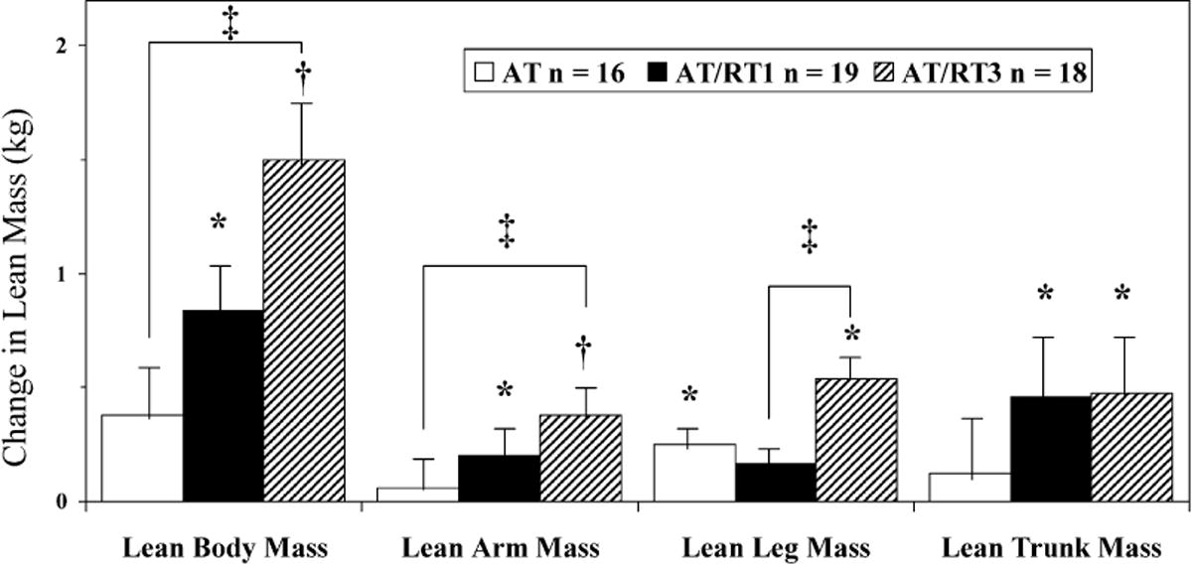
Marzolini et al. Med Sci Sports Exerc 2008; 40: 1557-64

Slide 27
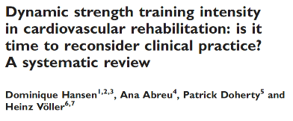
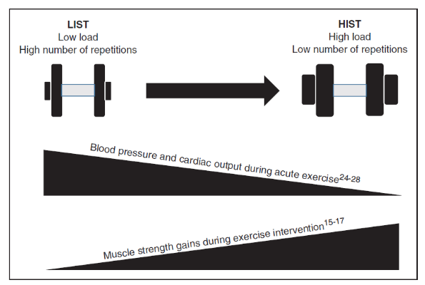
Eur J Prev Cardiol 2019; 26:1483-92

Slide 28
Setting the intensity
1RM = applied weight / (102.78 – 2.78 * repetitions)
or
1RM = (0.033 * repetitions) * applied weight + applied weight
<10 repetitions
Brzycki M. Strength testing – prediction a one rep maximum from reps-to-fatigue. J Phys Educ Recr Dance 1993;64:88-90.
Epley B. Poundage Chart. Boyd Epley Workout. Lincoln, NE: Body Enterprises, 1985.

Slide 29
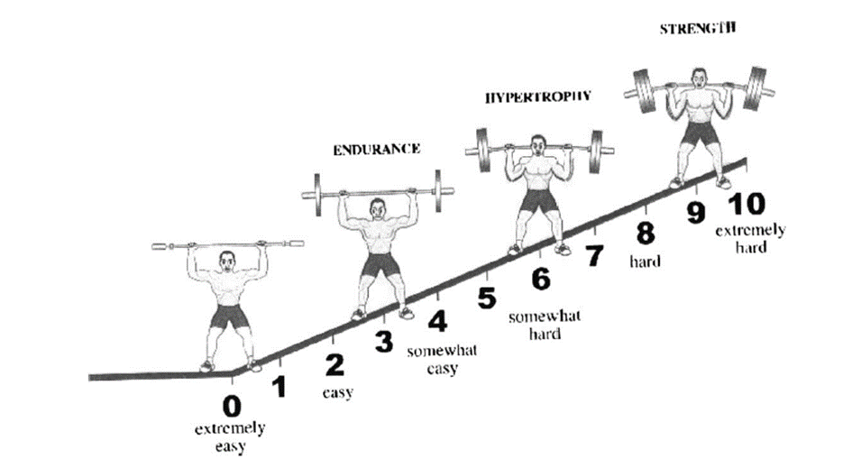
OMNI-RES
Gearhart RF, et al. Strength tracking using the OMNI resistance exercise scale in older men and women. J Strength Conditioning Res 2009;23:1011-1015.

Slide 30
Position statements
To properly determine the exercise intensity during resistance training, a <10RM test can be used to set the initial weight, while the OMNI-RES can be used to track the perceived intensity during the exercise sessions.
The selection of the resistance exercise intensity should be done in dialogue with the patient in a shared-decision making process.

Slide 31
Dominique.hansen@uhasselt.be
https://twitter.com/hansen_phd
https://www.researchgate.net/profile/Dominique_Hansen2

