Slide 1
A qualitative study to explore risky ridership among
young riders in Manipal, India
Presented by-Kumar Sumit (PhD Candidate)
Maastricht University, the Netherlands and UHasselt, Belgium
Authors;
Kumar Sumit^{1,2,3}*, Kris Brijs², Veerle Ross², Geert Wets², Robert A.C. Ruiter¹
1-Maastricht University, Department of Work & Social Psychology, Maastricht University,
6200 MD, Maastricht, the Netherlands
2-UHasselt, School of Transportation Sciences, Agoralaan, 3590 Diepenbeek, Belgium
3-Prasanna School of Public Health, Manipal Academy of Higher Education

Slide 2
Introduction
Road traffic injuries (RTIs) have become a critical public health issue in many low- and middle-income countries (LMICs) [1].
Every year more than 1.35 million people lose their life due to road crashes, making it one of the leading causes of death worldwide [1].
Globally, India accounts for the second-largest number of fatal road traffic crashes.
Riders in the age range of 18-25 years contribute to 41.4% of India's total road crash victims [2].

Slide 3
Rationale & Aim of the study
To assess the dangers associated with risky riding behaviour and associated underlying motives.
To explore strategies of the riders encountering risk on the roads and their suggestions for improving riding safety.
The findings from the current study will provide valuable leads for designing risk reduction programs targeting young riders to motivate them to follow safe riding practices.

Slide 4
Data and Methodology
Study area: Manipal
Study design: Cross-sectional & Qualitative
Sampling methods & data collection: Convenience sampling technique
Five FGDs were conducted with the participants (two each for boys and girls and one with both boys and girls)
Analysis: Thematic analysis
Supportive software: MAXQDA

Slide 5
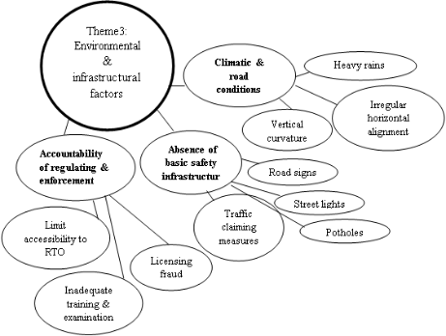
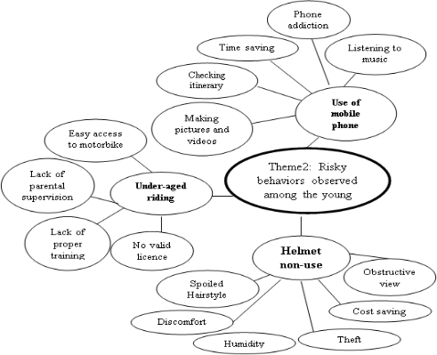
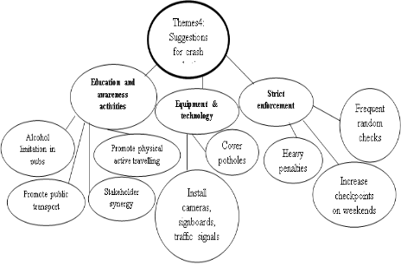
Loss of coordination
Loss of judgment
Using 2nd hand motorbikes
Alcohol impairment
Saving money
Poorly Maintained motorbikes
Using rented motorbikes
Theme 1
Crashes causative factors
Trill seeking
Speeding
Show offs to peers
Empty roads
Competitions

Slide 6
Results
The mean age of the participants was 22.2 (SD = ±2.12).
Out of 35 participants, 18 were males and 17 were females.
Four themes were derived from the transcripts:
  (1) Crash causative factors
  (2) Risky behaviours observed among young riders
  (3) Environmental factors
  (4) Suggestions for crash reduction

Slide 7
Results
Themes | Categories
Crash causative factors | Speeding Alcohol impairment Poorly maintained motorbikes
Risky behaviours observed among young riders | Use of mobile phone while riding. Helmet non-use Access to motorbikes
Environmental factors | Climatic and road conditions Absence of basic safety infrastructure Accountability of regulating & enforcement system
Suggestions for crash reduction | Education and awareness activities Equipment and technology Strict enforcement

Slide 8
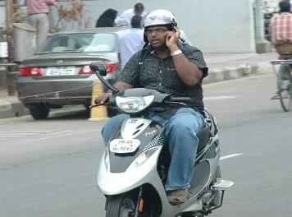
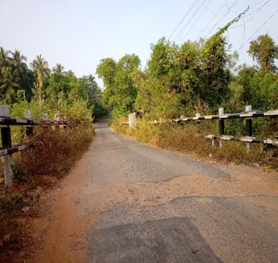
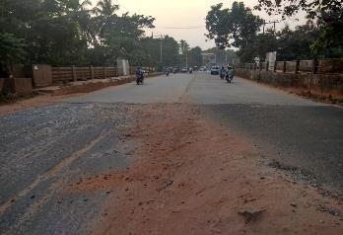

Slide 9
Discussion
Current study | Previous studies
Poorly maintained motorbikes | Similar to; (Gopalakrishnan, 2012; Annadurai et al., 2015)
Mobile phone usage while riding | Similar to; (Save LIFE Foundation, 2017; Hassan et al., 2017)
Speeding is the main cause of crashes | Similar to; (Tetali et al, 2013; Mishra, 2017; Pal et al., 2019; Sharma et al., 2014)
Poor road infrastructure | Similar to; (Lukumay, Outwater, Mkoka, Ndile, & Saveman, 2019; Moran et al., 2010; Tetali et al., 2013)
Road safety awareness program | Similar to; (Gururaj et al, 2016; Gopalakrishnan (2012; Ramos et al., 2008)
Accountability of regulating & enforcement system | Similar to; (Tetali et al., 2013)

Slide 10
Practical implications
The current study explored the opinions of young riders in understanding typical characteristics of motorized two-wheelers crashes, primarily focusing on the prevalence and role of risky riding behaviours.
Speeding, using mobile phones while riding, violations of the traffic rules, and helmet non-use, riding under the influence of alcohol, and poor maintenance of motorbikes was indicated as leading cause of crashes.
The current study’s findings have also generated evidence for the local authorities about the importance of strict law enforcement for any acts of traffic violations.
Fixing of the infrastructural issues with advanced road engineering with the coordinated multisectoral effort, by and large, will end up a more significant commitment to the reduction of road crashes

Slide 11
Conclusion
Impatient behaviour among young riders contributed to the risky riding practices, as well as environmental conditions such as bad roads, climatic conditions, and road and safety infrastructure.
To the best of our knowledge, a focused group study exploring the perspectives of young riders on risky riding behaviour has not been conducted in India.
Multisectoral coordination and subsequent interventions by engaging the young riders, government authorities, university officials, and the RTO can bring a reduction in the number of road crashes.

Slide 12
References
GLOBAL STATUS REPORT ON ROAD SAFETY (WHO) (2018): Annual report.
Ministry of Road Transport and Highways (MoRTH) (2019). India: Annual report.
Bhalla, K., Khurana, N., Bose, D., Navaratne, K. V., Tiwari, G., & Mohan, D. (2017). Official government statistics of road traffic deaths in India under-represent pedestrians and motorized two wheeler riders. Injury Prevention, 23(1), 1–7. https://doi.org/10.1136/injuryprev-2016-042053
Batool, Z., & Carsten, O. (2012). Driver observations contrasted with self-reported driving behaviours: A case study from Pakistan. Groningen: ICTTP.
Broughton, P. S., Fuller, R., Stradling, S., Gormley, M., Kinnear, N., O’Dolan, C., et al. (2009). Conditions for speeding behaviour: A comparison of car drivers and powered two-wheeled riders. Transportation Research Part F: Traffic Psychology, 12, 417–427.
Chauhan, A., Ahmed, N., Singh, J. V., Singh, V. K., Singh, A., & Kumar, S. (2017). Disability and mortality following road traffic injury : a follow-up study from a tertiary care centre of India. 4(12), 4712–4717.
Cdr, S., Neelakantan, A., & Kotwal, B. A. (2016). ScienceDirect Determinants of injuries and Road Traffic Accidents amongst service personnel in a large Defence station. Medical Journal Armed Forces India, 73(3), 216–221. https://doi.org/10.1016/j.mjafi.2016.08.002.
Chen, C.-F. (2009). Personality, safety attitudes and risky driving behaviors—Evidence from young Taiwanese motorcyclists. Accident Analysis and Prevention, 41(5), 963–968.
Dandona, R., Kumar, G. A., Ameer, A., & Brahmananda, G. (2009). Europe PMC Funders Group Underreporting of road traffic injuries to the police: results from two data sources in urban India. 14(6), 360–365. https://doi.org/10.1136/ip.2008.019638.Underreporting.
Elliott, M.A., 2007. Errors and violations in relation to motorcyclists’ crash risk Accident Analysis and Prevention 39, 491–499.
Faryabi, J., Rajabi, M., & Alirezaee, S. (2014). Evaluation of the Use and Reasons for Not Using a Helmet by Motorcyclists Admitted to the Emergency Ward of Shahid Bahonar Hospital of Kerman. Archives of Trauma Research, 3(3). https://doi.org/10.5812/atr.19122
Flores, J. G., & Alonso, C. G. (1995). Using focus groups in educational research. Evaluation Review, 19(1), 84–101.
Gopalakrishnan, S. (2012). Review Article A Public Health Perspective of Road Traffic Accidents. 1(2). https://doi.org/10.4103/2249-4863.104987.

Slide 13
Thank you

