Slide 1
Factors stimulating the integration of transformative learning for sustainable development in higher education institutions
L. Janssens, T. Kuppens, I. Mula Pons De Vall, E. Staniskiene, A. B. Zimmermann

Slide 2
Content
Why is the research valuable?
Which data is used?
How is the research conducted?
What are the results?
What are the next steps?
Notes:
Ingrid?

Slide 3
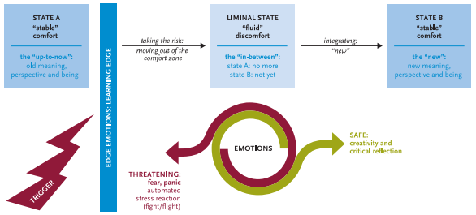
Introduction
Berlin declaration 2021
“Transformative learning for sustainable development is a necessity for our survival and that of the future generations”

Slide 4
Introduction
Mostly no systemic implementation of SD
Quality instruments vital to change HEIs
To which extent do QA frameworks
of HEIs support transformative learning
for sustainable development ?

Slide 5
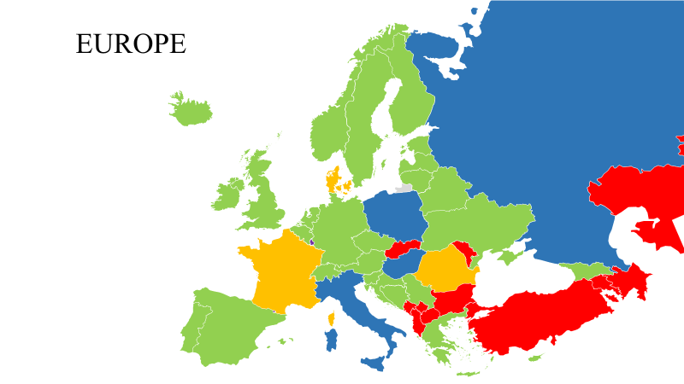
Data: QA frameworks and guidelines
ESG guidelines
National QA frameworks of EHEA

Slide 6
Research proces
Notes:
Lise?

Slide 7
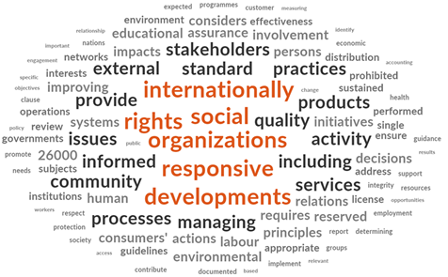
Results Word Frequency Analyses
One or more words with link to SD or TL
→ The ESG guidelines
→ All national QA frameworks except Austria, Bulgaria, Czech Republic, Cyprus, The Netherlands
Most common word ‘Stakeholders’

Slide 8
Results Word Frequency Analyses
‘Sustainable development’
→ Not in ESG guidelines
→ Estonia, Romania, Sweden, Switzerland, UK
‘Sustainable’ / ‘Sustainability’
→Bosnia and Herzegovina, Croatia, Germany, Malta, Spain
!Wrong interpretation!
‘Transformative learning’
→ United Kingdom
‘Transformation’
→ Slovenia and Sweden
!Wrong interpretation!
Notes:
Lise?

Slide 9
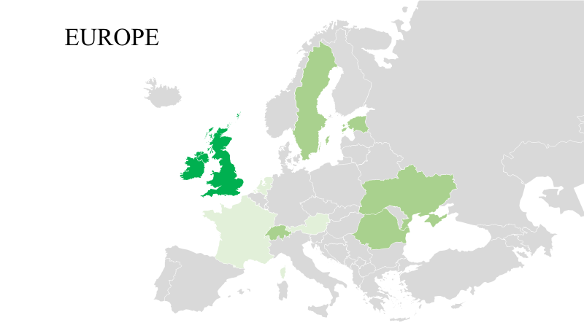
Results coding and analyses
High and explicit support in UK
Some support in Estonia, Holy See, Romania, Sweden, Switzerland and Ukraine
Best practices in Andorra, Austria, France and The Netherlands
Notes:
Lise?

Slide 10
Three key messages
Engage QA agencies and professionals
Critical role for networks and groups
SD and TL principles in ESG guidelnies
Notes:
Ingrid?

Slide 11
Next (research) steps
Detecting the impact of TL approaches
Attitude scale based on SDGs
Scale of a responsible business person
Class observations and interviews
Effective and efficient assessment of TL approaches
Positive ripple effect regarding the implementation of best practices

Slide 12
Thank you for listening!
Questions?
Lise Janssens
Contact: lise.janssens@uhasselt.be

