Slide 1
“Assessment” of European quality assurance frameworks: Do they practice what European policy documents about sustainability in higher education preach?
L. Janssens, T. Kuppens, I. Mula Pons De Vall, E. Staniskiene, A. B. Zimmermann
Notes:
Hello, everybody. We are Ingrid Mulà and Lise Janssens and we will present our research which is focused on transformative learning for sustainable development in higher education and quality assurance.
This research was undertaken during 2021 in the context of a collaboration between different members of the COPERNICUS Alliance, which is a European higher education for sustainable development network. More specifically, the members involved, were Hasselt University (in Belgium) and the University of Girona (in Spain), were Lise and myself are based, as well as the University of Bern (in Switzerland) and Kaunas University of Technology (in Lithuania).

Slide 2
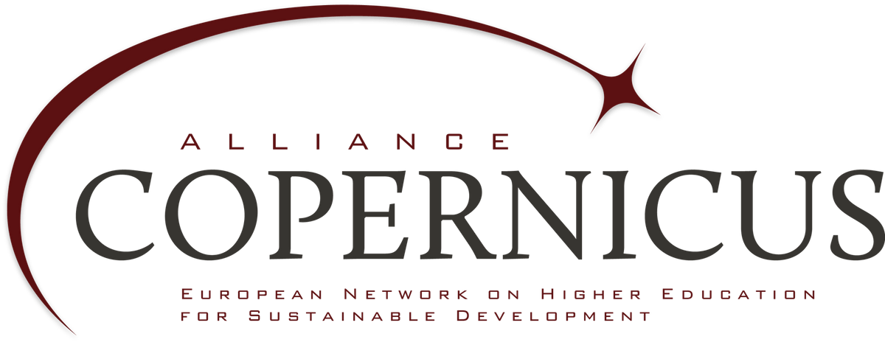
Content
Why is the research valuable?
Which data is used?
How is the research conducted?
What are the results?
Notes:
SLIDE 2
We will start this presentation by providing a little bit the context of our research and underlying the importance of integrating transformative learning and sustainability in quality assurance frameworks.
We will then explain how we selected the different frameworks that we analyzed and how we collected them.
We will move to explain in more detail how we conducted the research, therefore the different methods that we used and how we analysed the data.
And, finally, we will show the results obtained and discuss them in light of identifying some future research pathways.

Slide 3
Introduction
Berlin declaration 2021
“Transformative learning for sustainable development is a necessity for our survival and that of the future generations”
Quality instruments vital to change HEIs
To which extent do QA frameworks
of HEIs support transformative learning
for sustainable development ?
Notes:
Higher education institutions play a critical role in the transformation towards a more sustainable world. But, although the number of universities adopting higher education for sustainable development declarations and engaging with sustainable development is increasing, until now, not many institutions have succeeded in implementing sustainability systematically in all their activities.
Different authors identify a diverse range of barriers to the incorporation of sustainability in universities, such as resistance to change, lack of interdisciplinary culture, lack of institutional sustainability plans or lack of financial resources, amongst others. A very strong barrier is the fact that many universities and researchers are reluctant to associate values with science, as they believe that science must remain free and objective. And this misconception tends to affect how universities understand teaching and makes it difficult to mainstream transformative learning which is, as spelled in the Berlin Declaration, the kind of pedagogy needed for education for sustainable development.
In our research, we argue that most of the barriers to integrate sustainability in HEIs could likely be addressed through greater awareness and understanding of quality assurance processes and their relation to sustainable development. We believe that embedding sustainable development in higher education quality systems and engaging more deeply with quality assurance stakeholders could actualluy support a faster and deeper involvement of universities with the sustainable development agenda.

Slide 4
Introduction
Berlin declaration 2021
“Transformative learning for sustainable development is a necessity for our survival and that of the future generations”
Quality instruments vital to change HEIs
To which extent do QA frameworks
of HEIs support transformative learning
for sustainable development ?
Notes:
A first important thing if we look to this research question is to choose which QA frameworks we would like to include in our analysis.
Their exist different QA frameworks at different levels. Some of them are compulsory while other are voluntary to use and a choise of the insititution itself. Furthemore you have QA frameworks at different levels for example you have the QA frameworks at international level like the ESG guidelines who apply to all institutions within the European higher education area. You also have frameworks at the national level. And even Frameworks or labels for a specific discipline like AACSB guidelines or Equis

Slide 5
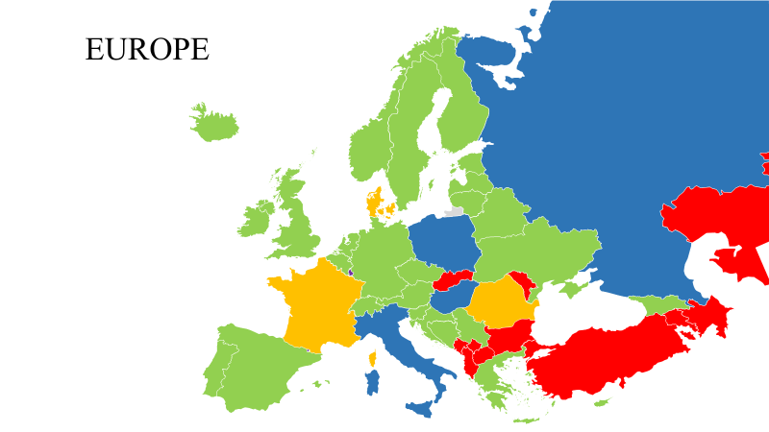
QA frameworks and guidelines
ESG guidelines
National QA frameworks of EHEA
Notes:
We choose to limit our study to the QA frameworks used in the European Higher Education area and analysed the ESG guidelines and the national QA frameworks used in the different countries who are part of the European higher education area. . Our assumption was that, as one of the four principles of QA in the EHEA is taking into account the need and expectations of society (ESG, 2015), we should be able to find the presence of transformative learning and SD in QA frameworks. We also chose to focus on national QA frameworks used in the EHEA because the EHEA claims to be a leader in commitment to pursuing the UN SDGs (European Commision, 2021).
The map on this slide shows the different countries of the EHEA. We were able to get the national QA frameworks from the countries collored in green on the map. The countries collored in blue don’t have their QA framework in English and are therefore excluded from the analysis. Data from the countries in red is missing. From the countries in yellow we didn’t received the full QA frameworks but we were able to collect summaries and other policy documents related to quality assurance in these counties. The countries collored in purple like Luxembourg, Liechtenstein and Andorra don’t have their own QA framework. In Andorra, the quality agency uses the ESGs directly. In Luxembourg and Liechtenstein, HEIs are assessed by foreign EQAR-registered agencies (ENIC-NARIC, 2018).

Slide 6
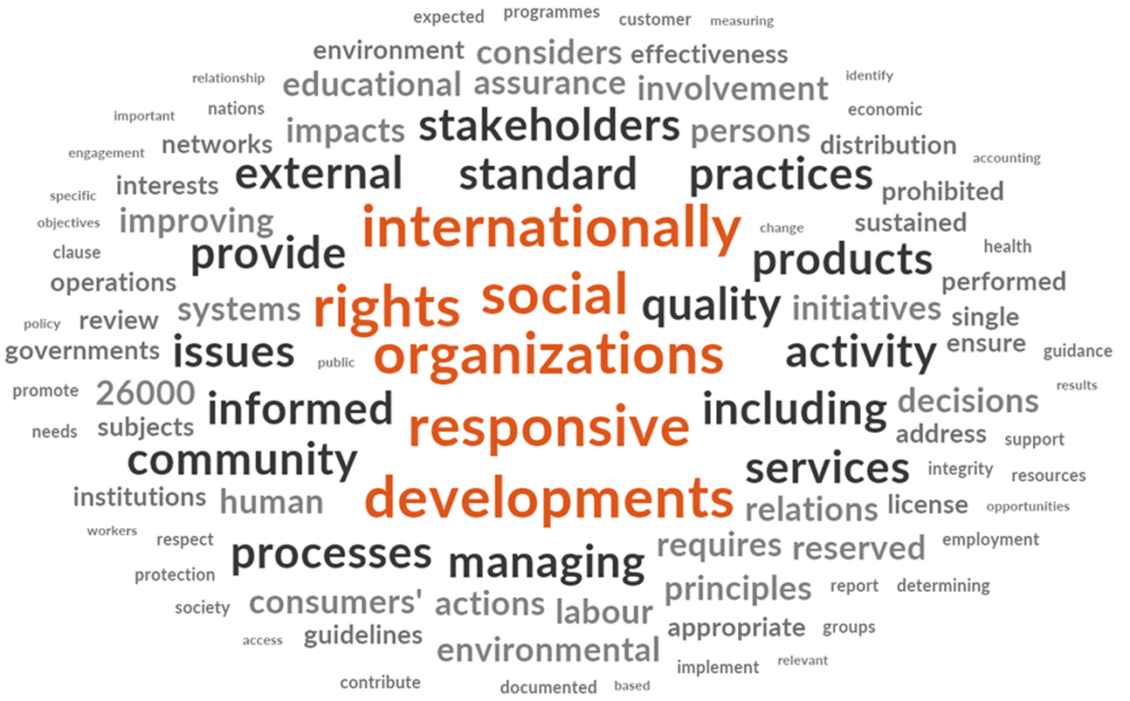
Research proces
Notes:
How was this research conducted?
First a literature study was conduceted to gain deeper inside in the topic
Afterwards QA frameworks were collected. A lot of effort was put in this. First we searched online on the websites of the different QA agencies. Next we requested their QA frameworks by email when we didn’t found the framework online. As the response was low follow up was done by extra emails and phone calls.
We used Nvivo software to conduct the analysis. After data input a word frequency analyses was done to explore the frameworks for the first time. Next a blended coding approach was used to analyse the different QA frameworks in more detail. A combination of deductive en inductive coding was done and a coding scheme with sensitizing concepts based made during the literature review en discussed with the research team was used in this phase of the research. Afterwards the results were compared in different was and lastly also other QA documents and policy documents retrieved during the literature research and data collection were anaylesed .

Slide 7
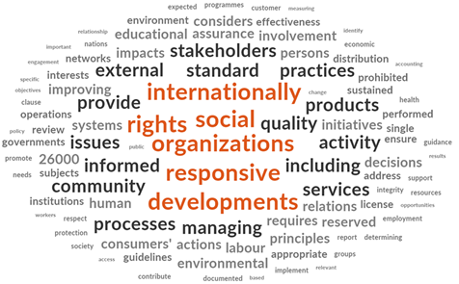
Results Word Frequency Analyses
One or more words with link to SD or TL
→ The ESG guidelines
→ All national QA frameworks except Austria, Bulgaria, Czech Republic, Cyprus, The Netherlands
Most common word ‘Stakeholders’
Notes:
In the query of the word frequency analyses we decided to include only words of 5 letters or more and stemmend variants. Words less than five letters were excluded to avoid meaningless prepositions, articles, or pronouns. With stemmed variants we mean for example sustainable and sustainability are counted together. Assuming that important and significant words would be used more frequently, this word frequency analysis aimed to check if words relating to sustainable development or transformative learning were used frequently in the QA frameworks.
The results of such a word frequency analyses are mostly presented by a word cloud. On this slide you see the word cloud of the ESG guidelines
In general we see that in the word clouds of the national frameworks at least one word is mentioned related to sustainable development or transformative learning. The exceptions are Austria, Bulgaria, Chez Republic, Cyprus and The Netherlands. In none of these a single word with a link to sustainable development or transformative learning is mentioned. Mostly the words refer to sustainable development and less to transformative learning. “Stakeholders” is one of the most popular words in the word clouds. Caution is however necessary as a word without context has the risk of losing meaning. This analyses is only based on words and the context of the words is lost. It provides a good indication but it is no suffient proof.

Slide 8
Results Word Frequency Analyses
‘Sustainable development’
→ Not in ESG guidelines
→ Estonia, Romania, Sweden, Switzerland, UK
‘Sustainable’ / ‘Sustainability’
→Bosnia and Herzegovina, Croatia, Germany, Malta and Spain
!Wrong interpretation!
Notes:
We also investigated where and how many times the word sustainable development was literally mentioned. It was not mentioned literally in the ESG guidelines.
The word ‘sustainable development’ was however literally mentioned at least one time in the QA frameworks used in Estonia, Romania, Sweden, Switzerland and The United Kingdom.
Sustainable and/or sustainability is literally mentioned in the frameworks used in Bosnia and Herzegovina, Croatia, Germany, Malta and Spain. However later in the research we saw that the interpretation or the context was wrong. For example it was used to talk about sustainable use of financial resources or the sustainability of the academic staff rather then in the context of sustainable development.

Slide 9
Results Word Frequency Analyses
‘Transformative learning’
→ United Kingdom
‘Transformation’
→ Slovenia and Sweden
!Wrong interpretation!
Notes:
Transformative learning was only literally mentioned in the QA framework used in the United Kingdom
The word Transform was mentioned in the frameworks used in Slovenia and Sweden. However further analyses again showed that the context wherein the words were used was wrong.

Slide 10
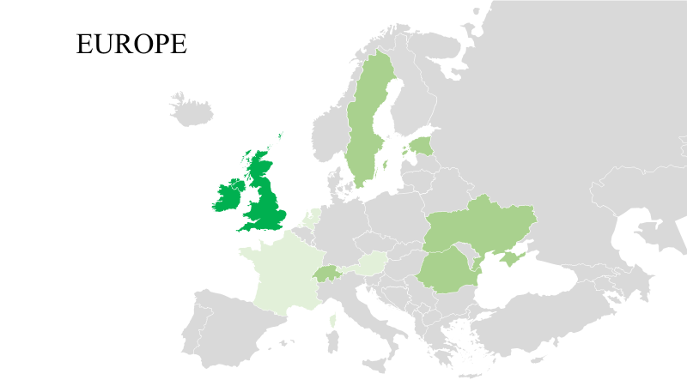
Results coding and analyses
High and explicit support in UK
Some support in Estonia, Holy See, Romania, Sweden, Switzerland and Ukraine
Notes:
Afterwards a blended coding approach was used to analyse the different QA frameworks in more depth.
The ESG guidelines pay attention to ‘responsiveness regarding stakeholders’ by stating for example that “Quality assurance takes into account the needs and expectations of students, all other stakeholders and society” (ESG 2015, p.8). The link to sustainability or sustainable development is in this sense somehow implicit, although sustainability as an orientation for stakeholder processes is not explicitly addressed. Elements of transformative learning are partially present in the ESG guidelines, which support ‘student-centered learning’, ‘experiential learning’ and ‘active learning’ in standard 1.3 of the guidelines (ESG 2015, p.12). Other elements related to transformative learning are not addressed.
For the national QA frameworks we see only that high and explicit support for transformative learning for sustainable development is present in the QA frameworks used in the United Kingdom (Scotland and so on included). In this country, separate guidance about education for sustainable development is available for higher education providers. This additional document aims to assist educational staff to incorporate sustainability in the curriculum and provide students of every discipline with the knowledge, understanding and skills relevant to sustainable development. Transformative learning is mentioned literally as one of the approaches to support education for sustainable development and concrete pedagogical tools are recommended.
More implict support to Tl for SD is provided in the QA frameworks of Estonia, Holy See, Romania, Sweden, Switzerland and Ukraine. Most of the time attention is paid to sustainability but the approach of transformative learning is only implict a bit encouraged.
Lastly when reviewing other QA and policy documents some best practices were detected in Andorra, Austria, France and The Netherlands

Slide 11
Some best practices
Andorra: Proposal to integrate SDGs in HEIs
Austria: UniNEtZ network supports to integrate SDGs in HEIs
France: DD&RS label
The Netherlands: assessment of special sustainable higher education
Notes:
Although the majority of QA frameworks that we analysed do not explicitly support transformative learning for sustainable development, we did discovered different windows of opportunity to promote sustainable development and transformative learning in universities on a national scale.
We also discovered interesting and forward-looking initiatives which are challenging and innovating quality systems. This is the case, for example, of Andorra, which is a small country between Spain and France, and where its quality assurance agency has been working for the past 5 years to define quality indicators that support universities to embed sustainability using a whole school approach. This has taken place using a collaborative approach and involving all the higher education community, including university teaching and support staff, students, employers, sustainability experts and international advisors.
Other good practices identified include innovative assessment initiatives taking in Austria, France and the Netherlands.

Slide 12
Three key messages
Engage QA agencies and professionals
Critical role for networks and groups
SD and TL principles in ESG guidelines
Notes:
To our knowledge, our study is the first attempt to explore to what extent QA frameworks support transformative learning for sustainable development in higher education. This is an underexplored area that requires further attention if we want to achieve the ambitious goals of Agenda 2030 and the ESD for 2030 programme, which include a call for transformative learning and quality.
We would like to end our presentation by highlighting three key messages or lessons learned that can support future research and practice in this area:
First, there is an urgent need to engage more meaningfully with quality assurance agencies and quality professionals if want to influence quality systems. Their voice has not been heart in key international ESD forums and dialogues.
Second, we believe that ESD and higher education networks and groups play a critical role in strengthening the links between quality and higher education, connecting professionals who have never talked together before, and also supporting good practice exchange in this area.
And, third, through our research, we have realized about the potential of embedding transformative learning and sustainability in the European Quality Standards and Guidelines (the ESG) as this could cause a positive ripple effect and accelerate the process of linking sustainability with quality concerns.

Slide 13
Thank you for listening!
Questions?
Prof. dr. Ingrid Mula Pons de Vall
Contact: Ingrid.mula@udg.edu
Lise Janssens
Contact: lise.janssens@uhasselt.be
Notes:
So, we end our presentation here and we hope that you have enjoyed it and found it useful.
Please do send us your questions and write your comments and we will respond as soon as we can.
You can also contact us by email if you are interested in knowing more about this research and our future projects.
Many thanks again and we look forward to hearing from you

