Slide 1
Development of a Portable Optical Sensor for the Evaluation of MIP Dye-Displacement Assays in the context of Food Screening
Juul Goossens^{1,2}, Thijs Vandenryt^{1,2}, Joseph Lowdon³, Gil van Wissen³, Sarah Vandebroek¹,
Hanne Diliën³, Kasper Eersels³, Bart van Grinsven³, Wim Deferme^{1,2}, Ronald Thoelen^{1,2}
¹Institute for Materials Research (IMO), Hasselt University, 3500 Hasselt, Belgium
²Division IMOMEC, IMEC vzw, 3590 Diepenbeek, Belgium
³Sensor Engineering Group, Faculty of Science and Engineering, Maastricht University, 6200 MD Maastricht, The Netherlands

Slide 2
Dye-displacement assay
Lowdon, Joseph W., et al. Molecules (2020)

Slide 3
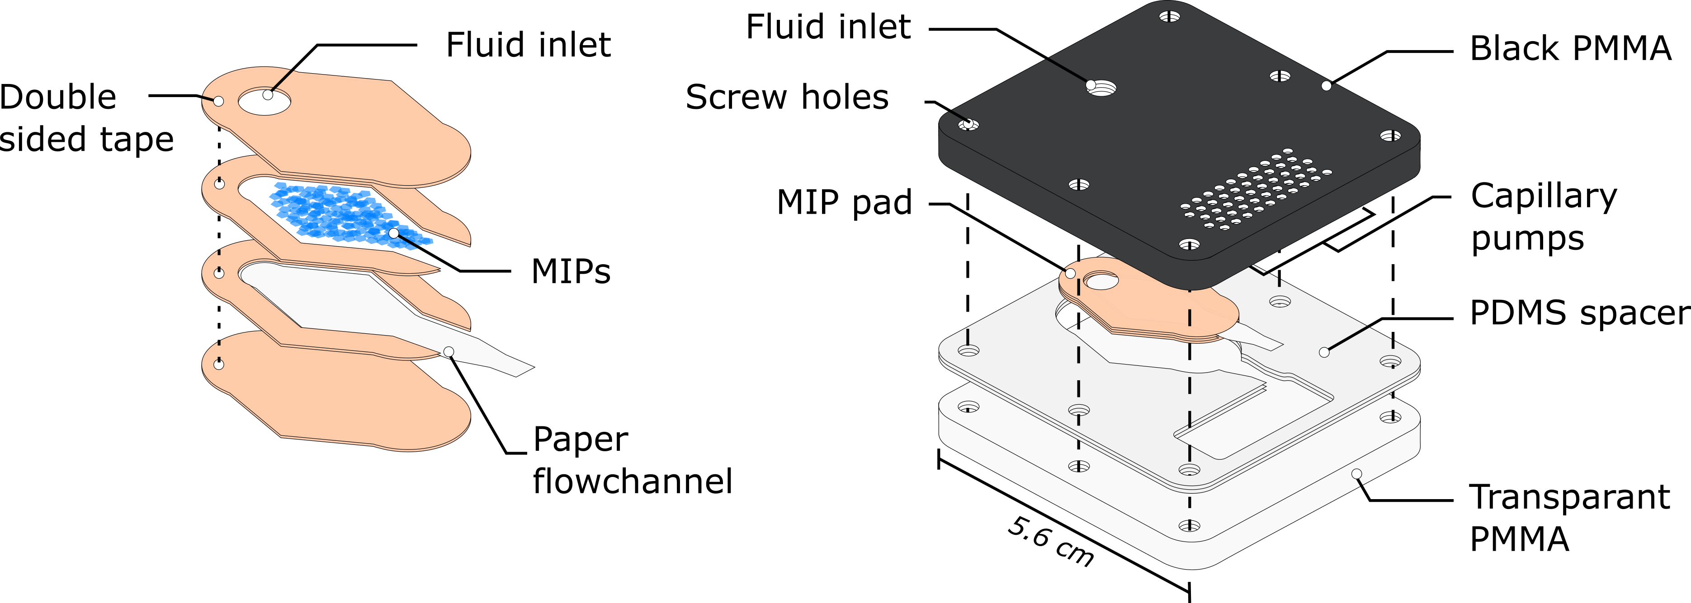
Dye-displacement flow cell
Filter
Flow cell

Slide 4
Portable spectrometer

Slide 5
A8

