Slide 1



Dissolved air flotation of a native Cuban Chlorella sp. using chitosan:
influence of extracellular organic matter on coagulant dose and floc properties
Michaela Pappa¹*, S. Lama¹, W. Marchal¹, D. Vandamme¹
¹ Analytical and Circular Chemistry, Hasselt University, Agoralaan Building D, 3590 Diepenbeek, Belgium,
*michaela.pappa@uhasselt.be

Slide 2

Contents
Introduction
Influence of AOM on the coagulant dose
Influence of the AOM on the floc characteristics
Conclusions
Acknowledgements
References
Algal Organic Matter = AOM
Dissolved Air Flotation = DAF

Slide 3
Introduction: Microalgae biorefinery
Benedetti et al. 2018, Microbial Cell Factories 17(1):1–18

Slide 4
Research goals
Growth phase
Algal Organic Matter
→ Separation efficiency (η) Foam formation
Floc size and characteristics

Slide 5
Influence of AOM on the coagulant dose

Slide 6

Culture start-up
Modified
BG-11
Moheimani et al. 2013, p. 1–288 in Algae for Biofuels and Energy

Slide 7

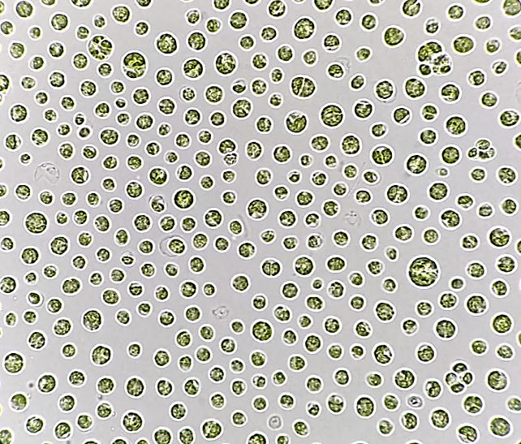
Culture start-up
Modified
BG-11
Chlorella sp.
100x magnification

Slide 8

Culture start-up
Modified
BG-11

Slide 9
Culture start-up
8%
Modified
BG-11

Slide 10

Culture start-up
pH stat system at 8.00
With CO₂ gas
Air bubbling
Day 0
LED lights

Slide 11
Culture growth
Day 6-8

Slide 12
Culture growth
Day 6-8
Dry weight biomass: 0.25 g L⁻¹
Nitrate replete
Dissolved Organic Carbon: 6.4 – 10.8 ppm
Mid exponential phase

Slide 13
Culture growth
Day 20-23
Dry weight biomass: 0.25 g L⁻¹
Nitrate replete
Dissolved Organic Carbon: 6.4 – 10.8 ppm
Mid exponential phase

Slide 14
Culture growth
Day 20-23
Dry weight biomass: 0.25 g L⁻¹
Nitrate replete
Dissolved Organic Carbon: 6.4 – 10.8 ppm
Dry weight biomass : 0.50 g L⁻¹
Nitrate deplete
Dissolved Organic Carbon: 25.9 – 32.7 ppm
Mid exponential phase
Mid stationary phase

Slide 15



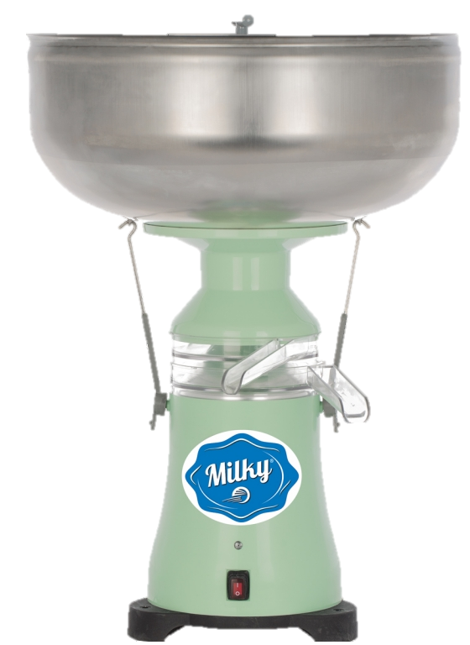


Sample preparation
Microalgal culture
(exp / stat)
Cells resuspended in AOM free medium (AOM-)
(exp / stat)
BG-11
pH 8
Coagulation- DAF jar tests
Microalgal sludge
(exp / stat)
Cells resuspended in AOM rich medium (AOM+)
(exp / stat)
BG-11 rich in AOM
(exp / stat)

Slide 16
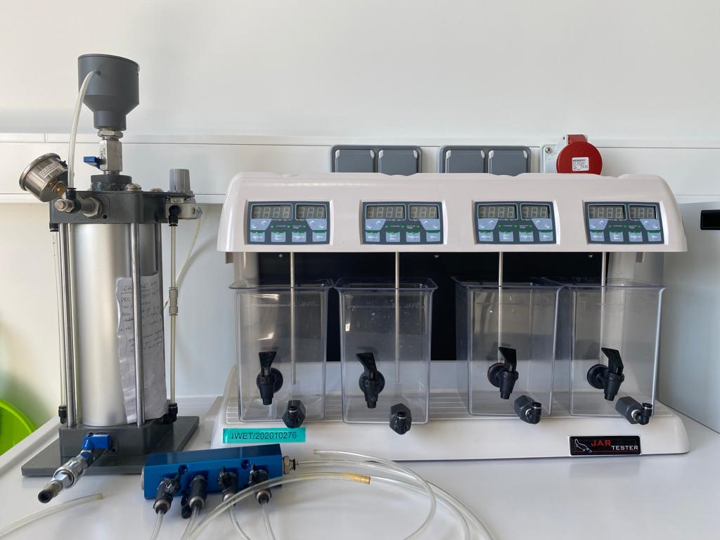

Coagulation-DAF jar tests
1 L sample aliquot
Chitosan (100 – 300 kDa, Degree of Deacetylation ≥75 %)
Benchtop compressor
Overhead stirrers
External air-pump
Platypus DAF jar tester

Slide 17

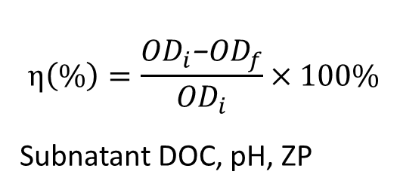
Coagulation-DAF jar tests
Homogenization
10 min
rapid
Floc growth
20 min
slow
DAF
Separation
Chitosan
Foam stability
Sample
$$η\left(\%\right)=\frac{{OD}_{i}\text{−}{OD}_{f}}{{OD}_{i}}×100\%$$
Subnatant DOC, pH, ZP
Air-saturated
water
Gonzalez-Torres et al. 2019, Water Research 163:114887.

Slide 18
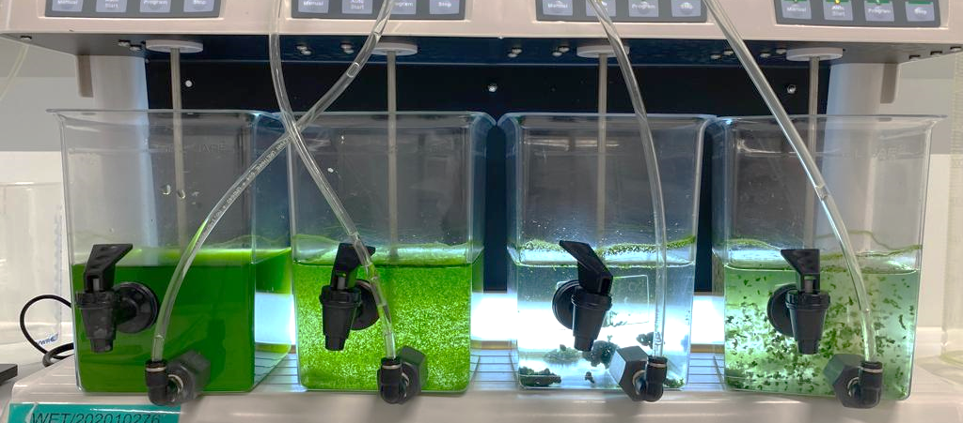
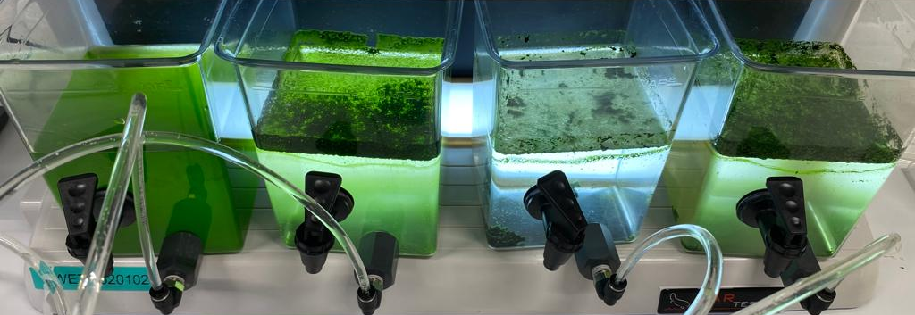
Influence of AOM on separation efficiency
Exponential | AOM-
Weak foam

Slide 19
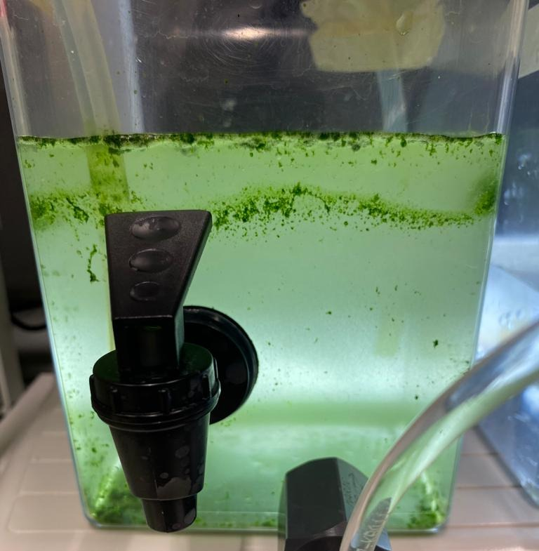
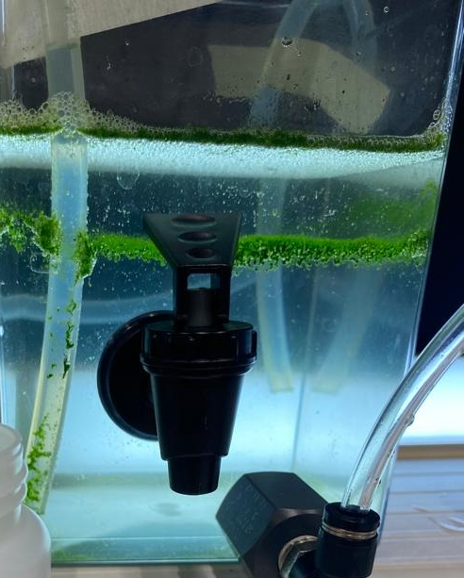
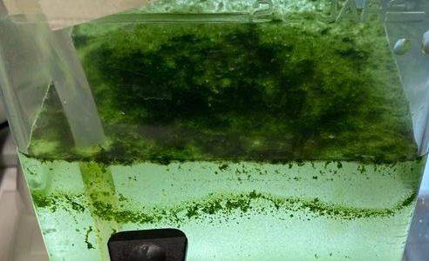
Influence of AOM on separation efficiency
Exponential | AOM-
0.20
Exponential | AOM+
0.21 mg chitosan / mg biomass

Slide 20
Influence of AOM on separation efficiency

Slide 21
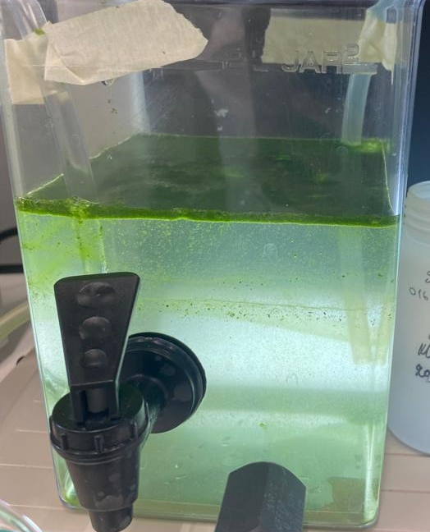
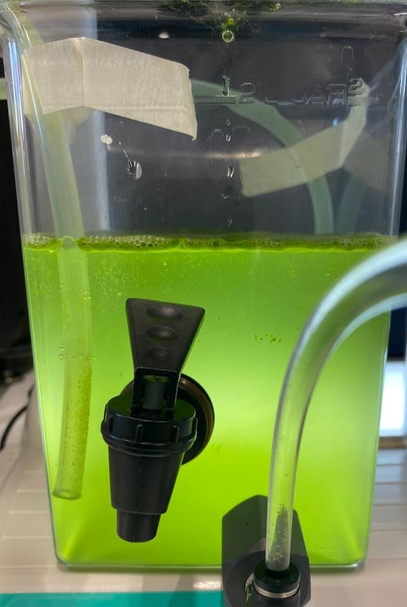
Influence of AOM on separation efficiency
0.16
0.20 mg chitosan / mg biomass
Smaller flocs
Intense foaming

Slide 22
Influence of AOM on the floc characteristics

Slide 23
Floc assessment
Homogenization
10 min
rapid
Floc growth
20 min
slow
DAF
Separation
Floc breakage
10 min
rapid
Floc regrowth
20 min
slow
Chitosan
Air
Sample
Particle size measurements

Slide 24
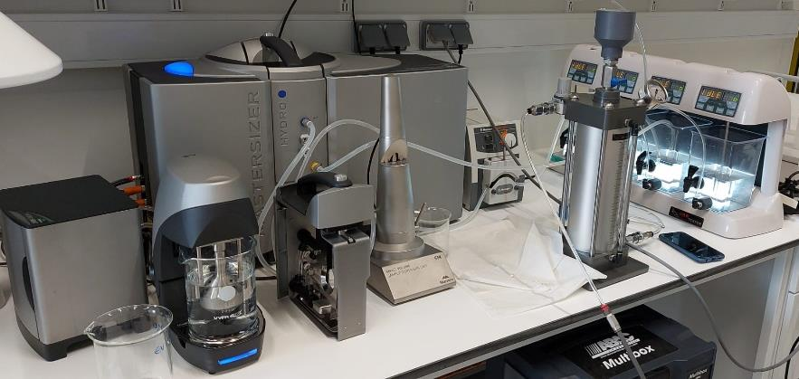
Floc assessment
Mastersizer 3000 coupled with DAF setup

Slide 25


Floc assessment
Limiting step
± 1000 μm
out
in
Peristaltic pump
60 rpm
Mastersizer 3000
Mastersizer 3000 coupled with DAF setup
DAF set-up

Slide 26
Floc assessment table
If floc size during floc growth step > 1000 μm
Scenario | A | B1 | B2 | C1 | C2 | C3
Steady state broken | >1000 | 1000 – 500 | 1000 – 500 | 500 – 4 | 500 – 4 | 500 – 4
Steady state regrown | >1000 | >1000 | 1000 – 500 | >1000 | 1000 – 500 | 500 – 4
Strength Index | High | Moderate | Moderate | Weak | Weak | Weak
Recovery Index | Stable | High | Stable | High | Moderate | Low
All values in μm
Strength Index | Low (0 – 33) | Moderate (34 – 66) | High (67 – 100)
Recovery Index* | Weak ( < 33) | Moderate (34 – 66) | High (67 – 100) | Stable
*Gonzalez-Torres, 2014, Water Research 60:197–209; Jarvis et al. 2006, Water Research 40(14):2727–37.

Slide 27
Floc assessment of exp.AOM-
Homogenization | Floc growth
Floc breakage | Floc regrowth
>LOQ
714.5 ± 234.1
973.9 ± 103.4
*
Strength Index | Moderate
Recovery Index | Stable
LOQ: Limit of quantification

Slide 28
Floc assessment of exp.AOM+
Homogenization | Floc growth
Floc breakage | Floc regrowth
736.5 ± 326.7
374.5 ± 33.6
241.3 ± 82.7
*
Strength Index | 50.8 ± 13.9
Recovery Index | -36.8 ± 23.4

Slide 29
Floc assessment of stat.AOM-
Homogenization | Floc growth
Floc breakage | Floc regrowth
>LOQ
220.4 ± 115.4
327.5 ± 253.1
*
*
*
Strength Index | Weak
Recovery Index | Low
LOQ: Limit of quantification

Slide 30
Floc assessment of stat.AOM+
Homogenization | Floc growth
Floc breakage | Floc regrowth
426.4 ± 71.8
213.3 ± 1.6
199.6 ± 4.4
*
*
*
Strength Index | 50.0 ± 8.1
Recovery Index | -6.4 ± 1.0

Slide 31
Conclusions – Influence of AOM
Absence of AOM
→ High floc size, weak and unstable foam
Presence of AOM
→ Flocs maintain moderate size with foam formation
AOM in stationary phase supports flotation
→ composition ?
At the optimum separation point:
Chitosan- Chlorella sp. flocs after DAF
→moderate- weak strength
→do not recover with exception the cells in the exponential phase in the absence of AOM
→ Analysis of larger particle size

Slide 32

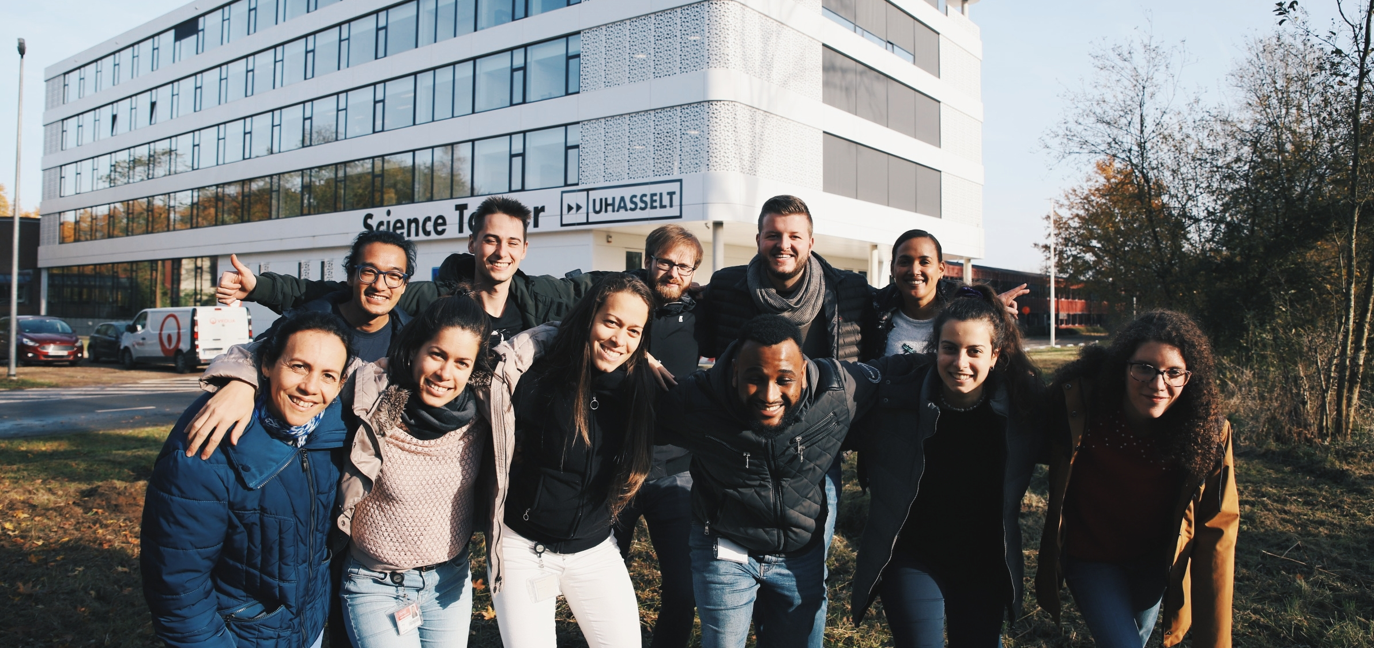


Acknowledgements & Questions
Funding
junior fundamental research project (2020-2024, G050220N)
acchemlab.com
michaela.pappa@uhasselt.be
sanjaya.lama@uhasselt.be
dries.vandamme@uhasselt.be

Slide 33
References
Benedetti, Manuel, Valeria Vecchi, Simone Barera, and Luca Dall’Osto. 2018. “Biomass from Microalgae: The Potential of Domestication towards Sustainable Biofactories.” Microbial Cell Factories 17(1):1–18.
Gonzalez-torres, A., J. Putnam, Bruce Jefferson, Richard M. Stuetz, and Rita K. Henderson. 2014. “Examination of the Physical Properties of Microcystis Aeruginosa Flocs Produced on Coagulation with Metal Salts.” Water Research 60:197–209.
Gonzalez-Torres, A., M. Pivokonsky, and R. K. Henderson. 2019. “The Impact of Cell Morphology and Algal Organic Matter on Algal Floc Properties.” Water Research 163:114887.
Jarvis, Peter, Bruce Jefferson, and Simon A. Parsons. 2006. “Floc Structural Characteristics Using Conventional Coagulation for a High Doc, Low Alkalinity Surface Water Source.” Water Research 40(14):2727–37.
Moheimani, Navid R., Michael A. Borowitzka, Andreas Isdepsky, and Sophie Fon Sing. 2013. “Standard Methods for Measuring Growth of Algae and Their Composition.” p. 1–288 in Algae for Biofuels and Energy.

