Slide 1



Knowledge is not something that you have:
decolonizing images of knowledge in higher education curriculum
Maristela do Nascimento Rocha, Iva Gurgel and Katrien Struyven

Slide 2
Colonialism
  Epistemicide* – silencing other epistemic perceptions
  *Boaventura de Souza Santos

Slide 3
Decolonization
  Decolonizing knowledge requires regaining the power to narrate one’s history, to build one’s own image and identity. (Meneses, 2016)

Slide 4
Current understanding of decolonization
  Changing higher education bibliographical references
  Exploring silenced voices
  Exploring knowledge excluded from academia
  (Arshad, 2021)

Slide 5
It gives attention to not-dominant types of knowledge…

Slide 6
Where is the knowledge to be taught?

Slide 7
Textbook example
Motion
(Halliday, 2018)
Sustainability
(Theis and Tomkin, 2013)
How would subjectivities be part of it?
What are the similarities between the texts?
10 min

Slide 8
Student-centred pedagogies x knowledge

Slide 9
Knowledge is fixed

Slide 10
Selection of knowledge x dominant groups
Giroux, 1997
Bourdieu, 1990

Slide 11


Slide 12

Meaning
  Chair =

Slide 13
Meaning
  Chair = a separate sit for one person, typically with a back and four legs

Slide 14




Meaning
  Knowledge =

Slide 15
There is a way of unfixing it

Slide 16
Knowledge x Language

Slide 17
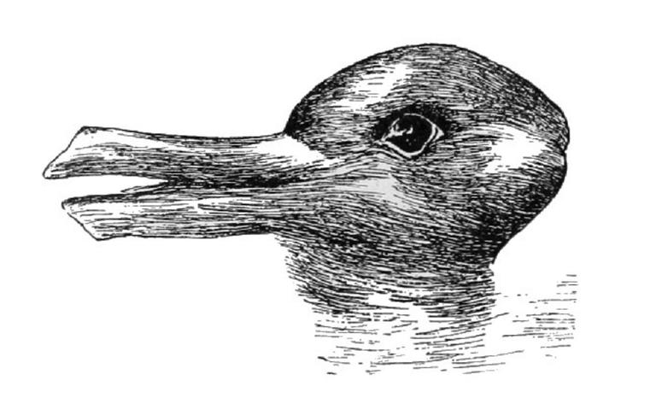

Slide 18
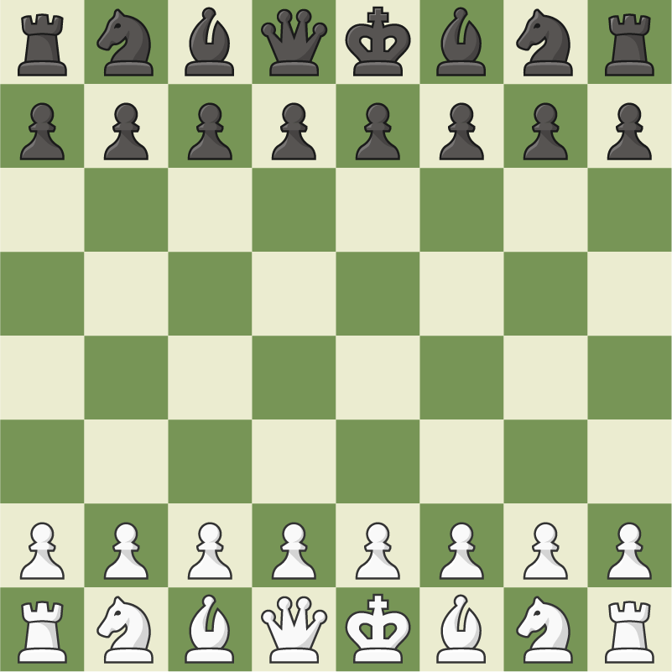
Wittgenstein (1889-1951)
  Language-games

Slide 19



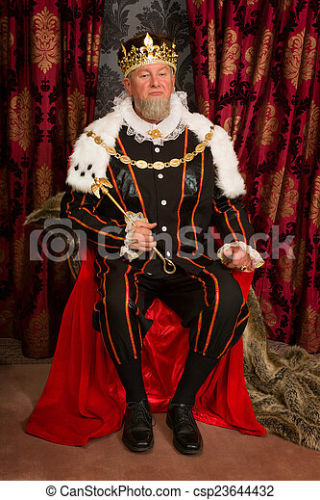
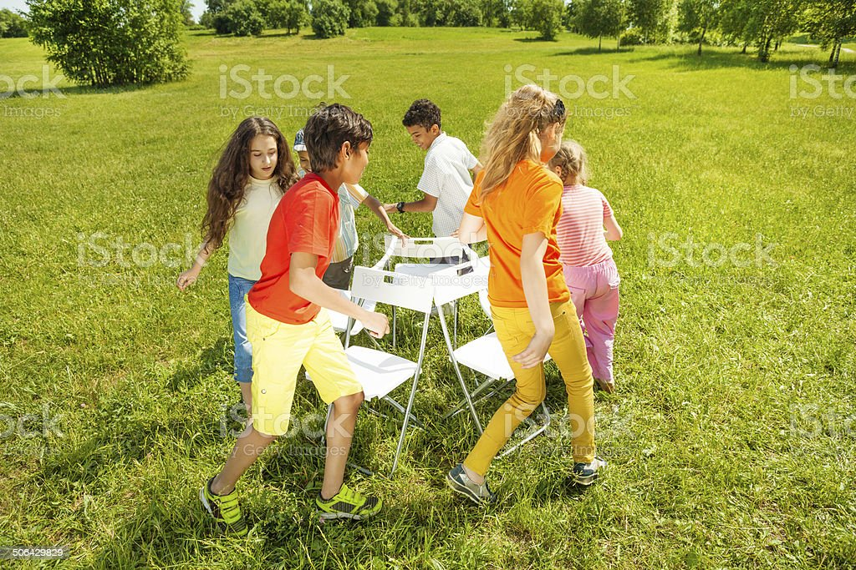


Wittgenstein (1889-1951)
  Meaning as use in language-games

Slide 20
Examples of language games
  describe, make a hypothesis, solve a problem, justify, narrate, tell a story, give orders, describe, report, speculate…

Slide 21
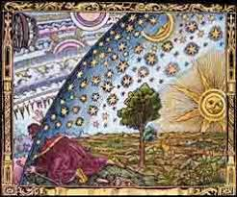

Knowledge and world-pictures
Formal knowledge
World-picture

Slide 22
Textbook example – motion / sustainability
  What are the language games?
  What are their functions?
  Which meanings do words have in them?
7 min

Slide 23
Textbook example
  What are the language games? Description and prediction.
  What are their functions? Explain, describe a phenomenon, and solve textbook problems.
  Which meanings do words have? Movement: displacement, change of place.

Slide 24
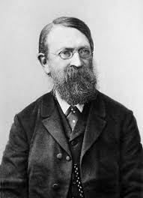
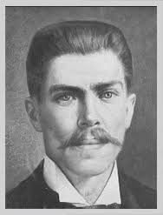
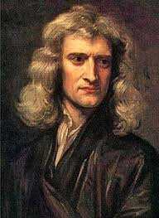
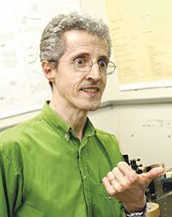
Newton and “marginal” scientists
ERNST MACH (1838-1916)
JULIO GARAVITO ARMERO (1865-1920)
ANDRÉ KOCH TORRES ASSIS (1962 -)

Slide 25
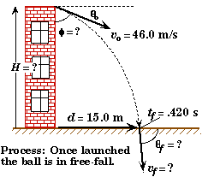
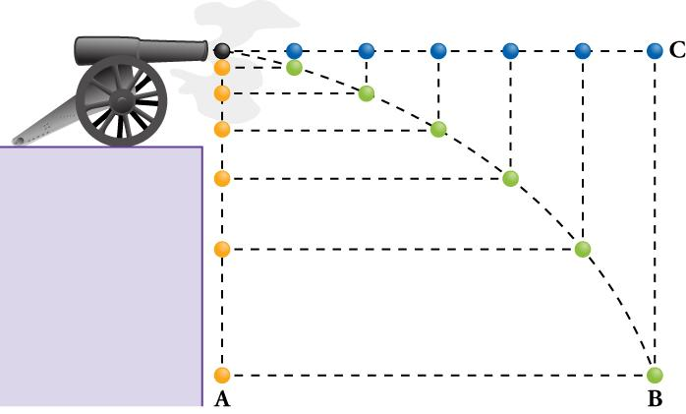

Slide 26
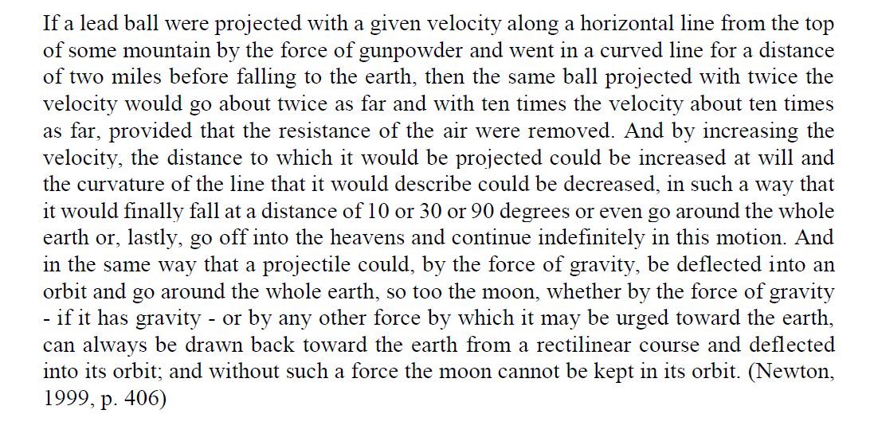
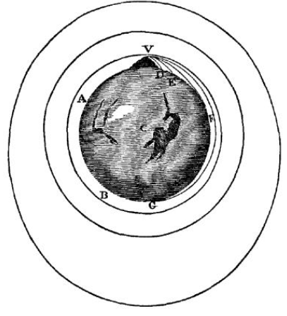
Newton

Slide 27
Newton - example
  What is the language game?
  What is its function?
  Which meanings do words have in them?

Slide 28
Newton - example
  What is the language game? Compare and connect earth and space.
  What is its function? Show that terrestrial and celestial phenomena are similar. Justify the application of the same theories in both regions.
  Which meanings do words have? Movement: moon’s motion, motion caused by gravity, motion is something that can be maintained and stopped, movement as connected to force.

Slide 29
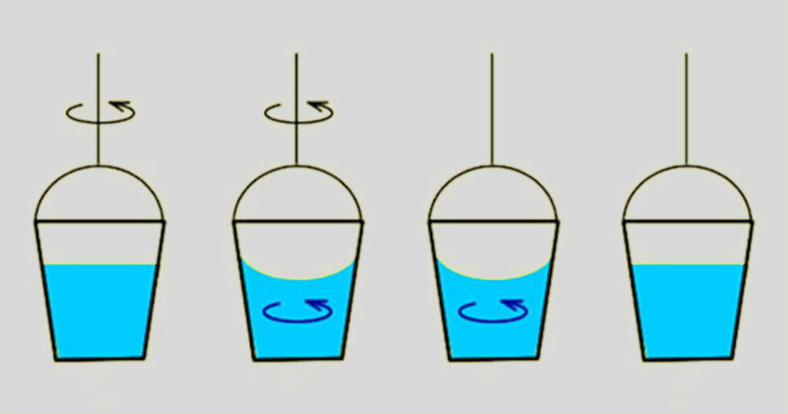

Absolute and relative motion
Newton

Slide 30
Example with sustainability
Historical tekst (The population bomb by Paul R. Ehrlich, 1968)
  Find other language games
  Find other meanings
10 min
15 min
5 min

Slide 31
Discussion

Slide 32
Marginal scientists
  Criticism, hypothesis, creativity, insertion of personal ideas and culture.
JULIO GARAVITO ARMERO (1865-1920)
ANDRÉ KOCH TORRES ASSIS (1962 -)
ERNST MACH (1838-1916)

Slide 33
Garavito
Passions are the moral forces that impel man to crime or virtue, heroism or servility.

Slide 34
Mach
All terms, appropriate or inappropriate rest on convention. It matters little whether a person can correctly derive the words telegraph, tangent, ellipse, evolution, etc., if the correct idea is present in his mind when he uses them.

Slide 35
Assis
In Education, it is important to raise questions even when the teacher does not have the answer.

Slide 36
Newton
Infinity of intellect, power, happiness, etc, is entirely perfect; infinity of ignorance, impotence, misery, etc., is entirely imperfection.

Slide 37
Decolonizing the curriculum - access to world-pictures
  Resistance(ex. Scientism)
  Different styles of thinking (cultures, subjectivities…)
  It overcomes the dichotomy between subjectivity and objectivity, skills and knowledge…
  Shares what has been denied

Slide 38
References
  Arshad et. al. Diversity or Decolonization? Searching for the Tools to Dismantle the 'Master's House’. London Review of Education, v.19, n. 1, 2021
  Giroux, H. A. A pedagogy and the politics of hope. New York, Routledge, 1997.
  Meneses, M.P. Os sentidos da descolonizacao: uma analise a partir de Mocambique. Catalao, v.16, n.1, p. 26-44, 2016
  Wittgenstein, L. Philosophical Investigations. Basil Blackwell. 1986.

