Slide 1
Session 42: Cities, sustainability and quality of life
In plain sight: green views and urbanites’ neighborhood satisfaction
Pieter Fonteyn
UHasselt, Centre for Environmental Sciences (CMK)

Slide 2
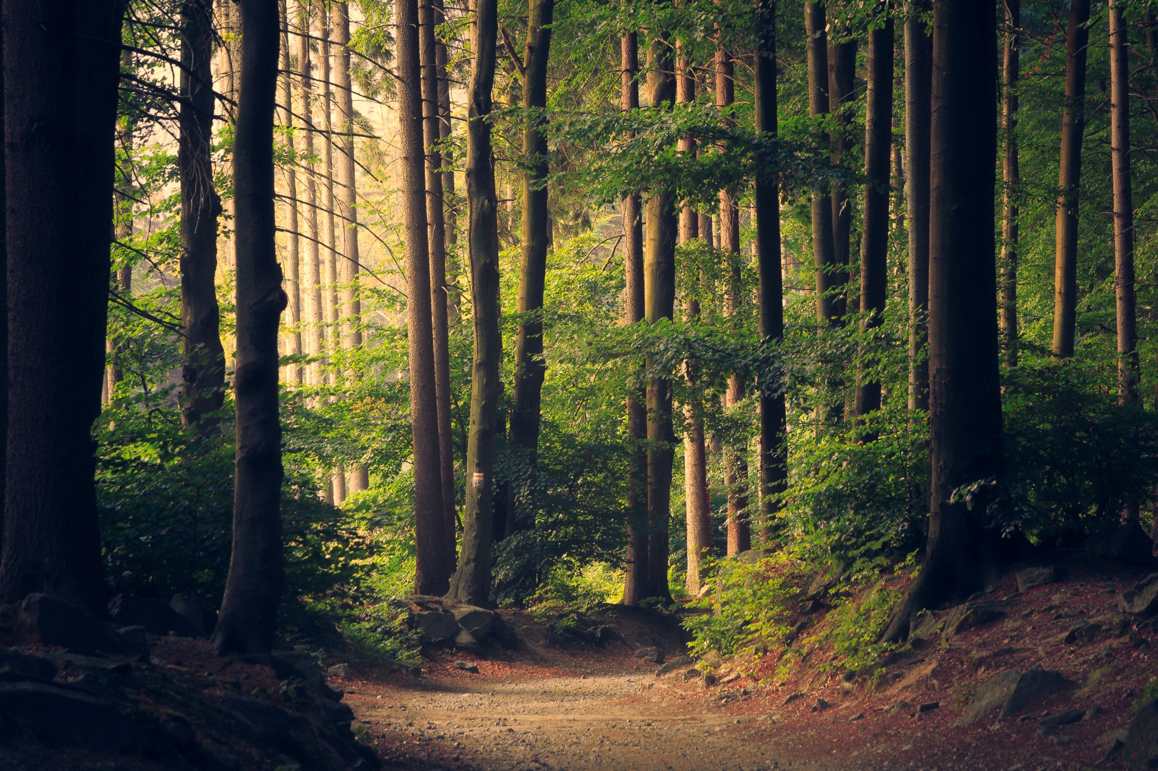
Urban Transitions, 10th November 2022

Slide 3
Nature & well-being
Theories
Biophilia hypothesis [1]
Attention restoration theory [2]
Stress reduction theory [3]
Empirical evidence
E.g. review by
Bratman et al. (2019) [4]
Urban Transitions, 10th November 2022

Slide 4
Nature is diverse
Green spaces
vs.
Green elements
Active use (visit)
vs.
Passive use (view)
In plain sight: green views and urbanites’ neighborhood satisfaction
Pieter Fonteyn (pieter.fonteyn@uhasselt.be), Silvie Daniels, Robert Malina, Sebastien Lizin – CMK, UHasselt
Urban Transitions, 10th November 2022
4

Slide 5
Utility vs. practicality trade-off
Much use potential,
requires open space
Limited use potential (viewing),
can be introduced flexibly
In plain sight: green views and urbanites’ neighborhood satisfaction
Pieter Fonteyn (pieter.fonteyn@uhasselt.be), Silvie Daniels, Robert Malina, Sebastien Lizin – CMK, UHasselt
Urban Transitions, 10th November 2022
5

Slide 6
Urban Transitions, 10th November 2022
6

Slide 7
Data
Respondents from 13 Flemish cities
Stratified sample design
n = 32,585
Core variables:
Neighborhood satisfaction
Satisfaction with green views from residence
Perceived presence of greenery in the neighborhood
In plain sight: green views and urbanites’ neighborhood satisfaction
Pieter Fonteyn (pieter.fonteyn@uhasselt.be), Silvie Daniels, Robert Malina, Sebastien Lizin – CMK, UHasselt
Urban Transitions, 10th November 2022
7

Slide 8
Research question
Satisfaction with green views from the residence
Positively associated with neighborhood satisfaction?
While controlling for general perceived presence of greenery in the neighborhood
In plain sight: green views and urbanites’ neighborhood satisfaction
Pieter Fonteyn (pieter.fonteyn@uhasselt.be), Silvie Daniels, Robert Malina, Sebastien Lizin – CMK, UHasselt
Urban Transitions, 10th November 2022
8

Slide 9
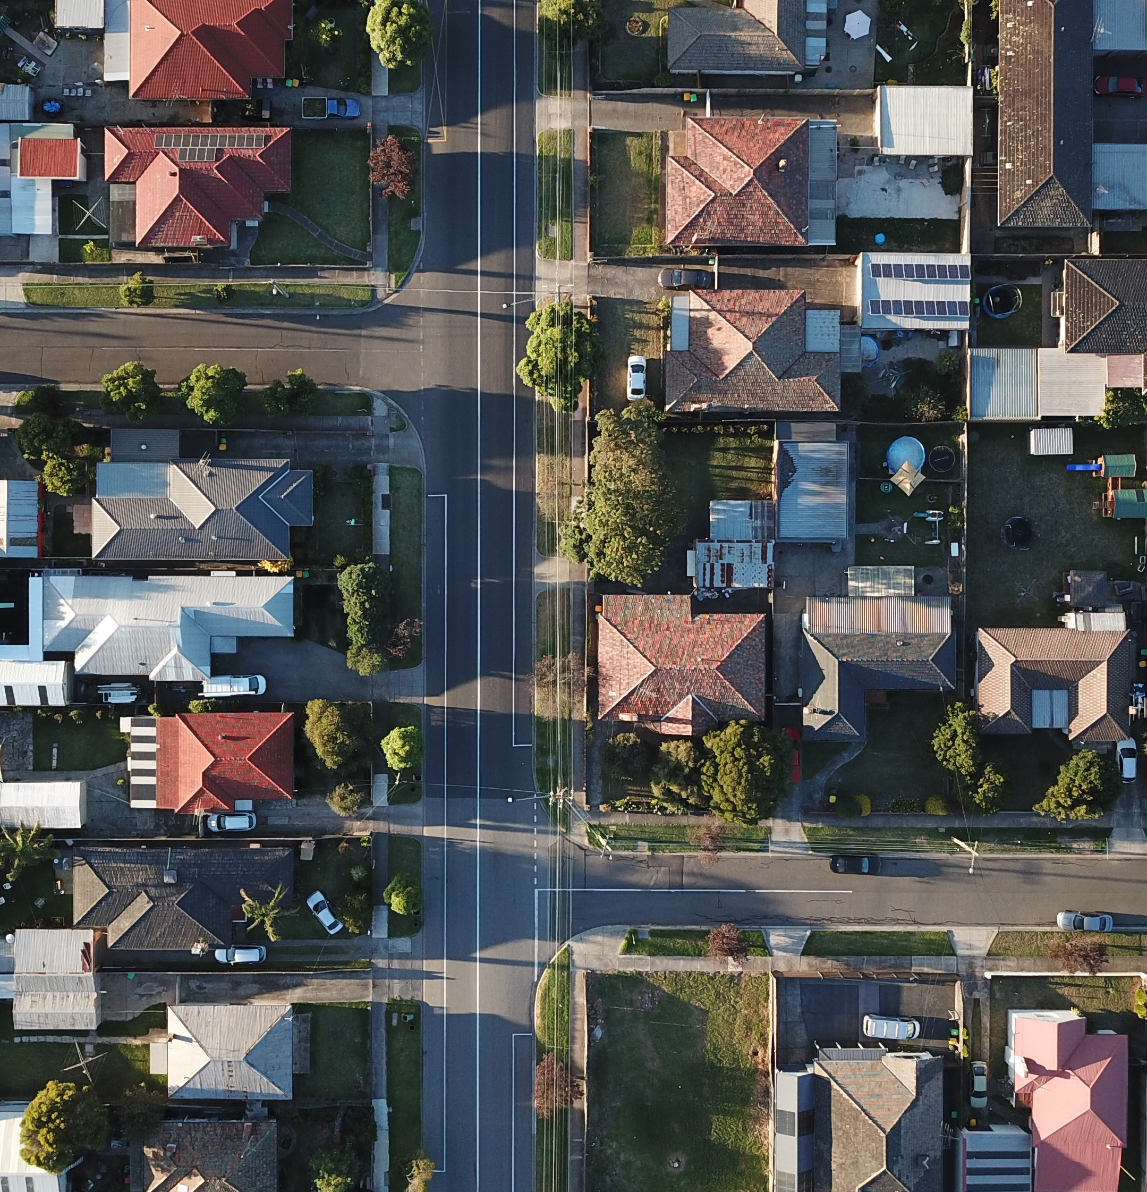
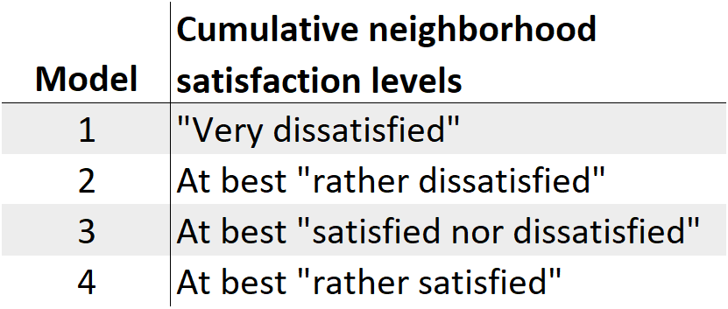
Method
Neighborhood satisfaction
5-point Likert scale: “very dissatisfied” – “very satisfied”
4 binary logistic regression models:
Urban Transitions, 10th November 2022
9

Slide 10
Method
Statistical controls
47 other neighborhood attributes
Personal characteristics
Socio-demographics
Complexities
Stratified sampling design
Missing data → multiply imputed
In plain sight: green views and urbanites’ neighborhood satisfaction
Pieter Fonteyn (pieter.fonteyn@uhasselt.be), Silvie Daniels, Robert Malina, Sebastien Lizin – CMK, UHasselt
Urban Transitions, 10th November 2022
10

Slide 11
Results
Urban Transitions, 10th November 2022
11

Slide 12
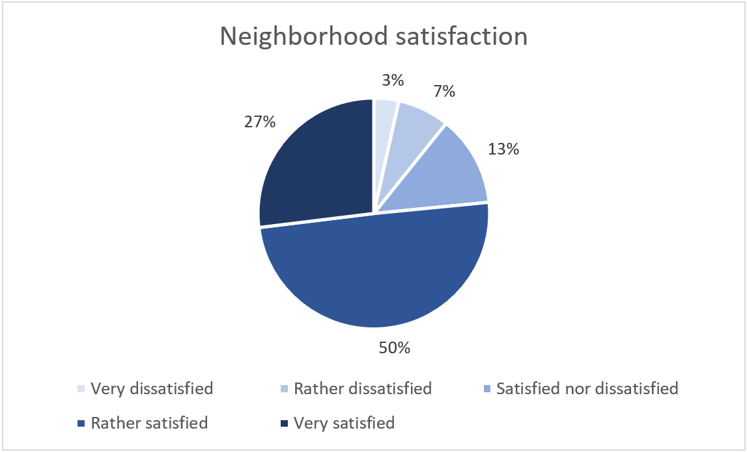
Some descriptives
In plain sight: green views and urbanites’ neighborhood satisfaction
Pieter Fonteyn (pieter.fonteyn@uhasselt.be), Silvie Daniels, Robert Malina, Sebastien Lizin – CMK, UHasselt
Urban Transitions, 10th November 2022
12
Notes:
73% rather or completely agrees

Slide 13
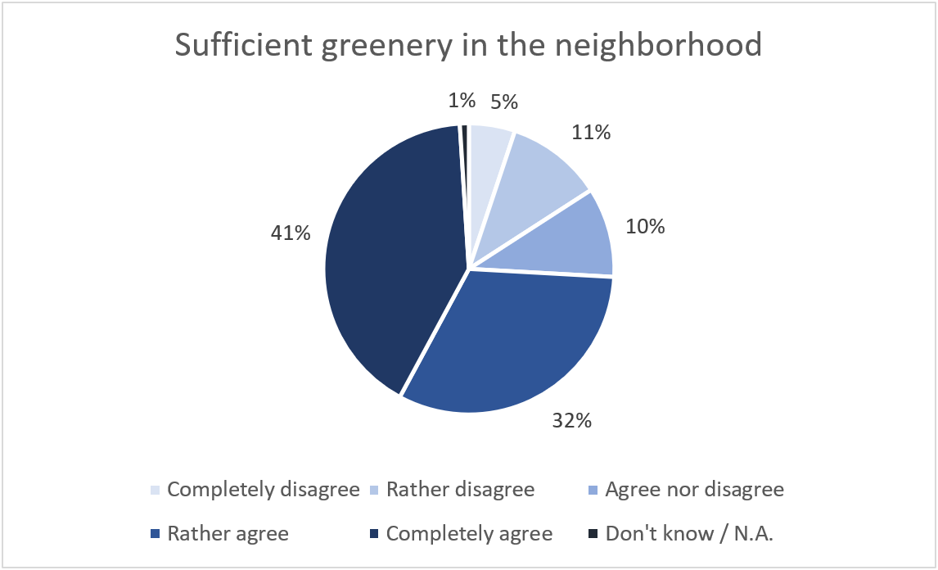
Some descriptives
In plain sight: green views and urbanites’ neighborhood satisfaction
Pieter Fonteyn (pieter.fonteyn@uhasselt.be), Silvie Daniels, Robert Malina, Sebastien Lizin – CMK, UHasselt
Urban Transitions, 10th November 2022
13
Notes:
64% rather or very satisfied

Slide 14
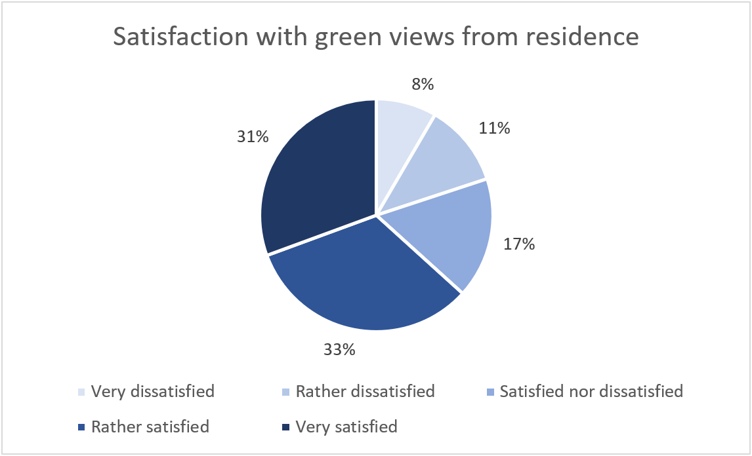
Some descriptives
In plain sight: green views and urbanites’ neighborhood satisfaction
Pieter Fonteyn (pieter.fonteyn@uhasselt.be), Silvie Daniels, Robert Malina, Sebastien Lizin – CMK, UHasselt
Urban Transitions, 10th November 2022
14
Notes:
73% rather or completely agrees

Slide 15
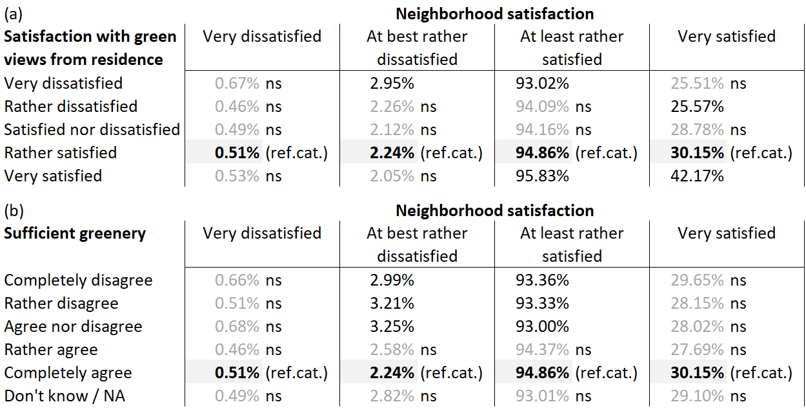
Regression results – predicted probabilities
In plain sight: green views and urbanites’ neighborhood satisfaction
Pieter Fonteyn (pieter.fonteyn@uhasselt.be), Silvie Daniels, Robert Malina, Sebastien Lizin – CMK, UHasselt
Urban Transitions, 10th November 2022
15
Notes:
64% rather or very satisfied

Slide 16
Regression results - context
In plain sight: green views and urbanites’ neighborhood satisfaction
Pieter Fonteyn (pieter.fonteyn@uhasselt.be), Silvie Daniels, Robert Malina, Sebastien Lizin – CMK, UHasselt
Urban Transitions, 10th November 2022
16
Notes:
64% rather or very satisfied

Slide 17
Conclusion
Urban Transitions, 10th November 2022
17

Slide 18
Conclusion
More satisfied with green views from residence → more likely to report high neighborhood satisfaction
Independent of general perceived presence of greenery in neighborhood
Greenery that can be seen but cannot be visited may contribute to neighborhood satisfaction
Urban Transitions, 10th November 2022
18

Slide 19
References
[1] Kellert, S.R. and E.O. Wilson, The biophilia hypothesis. 1993: Island press.
[2] Kaplan, R. and S. Kaplan, The experience of nature: A psychological perspective. 1989: Cambridge university press.
[3] Ulrich, R.S., Aesthetic and Affective Response to Natural Environment, in Behavior and the Natural Environment, I. Altman and J.F. Wohlwill, Editors. 1983, Springer US: Boston, MA. p. 85-125.
[4] Bratman, G.N., et al., Nature and mental health: An ecosystem service perspective. Science Advances, 2019. 5(7).
Urban Transitions, 10th November 2022
19

Slide 20
Photo credits
Slide 1: UHasselt, EcoCities, FWO, green views, Urban Transitions
Slide 2: Forest
Slide 4: Nature area, park, garden, terrace, walkway
Slide 5: Central park, Musée du quai Branly
Slide 7: Stadsmonitor 2017
Slide 9: Neighborhood
Urban Transitions, 10th November 2022
20

Slide 21
Regression results – model fit
McFadden pseudo-R²
M1: 0.2459
M2: 0.2336
M3: 0.2945
M4: 0.2888
Hosmer-Lemeshow GOF test
Null hypothesis of good fit not rejected at 5% significance level in 67.4% (M1), 72.7% (M2), 82.6% (M3), and 85.2% (M4) of 1000 random draws of sample size 1000
In plain sight: green views and urbanites’ neighborhood satisfaction
Pieter Fonteyn (pieter.fonteyn@uhasselt.be), Silvie Daniels, Robert Malina, Sebastien Lizin – CMK, UHasselt
Urban Transitions, 10th November 2022
21
Notes:
McFadden in the good/excellent range (0.2-0.4)

