Slide 1
Next generation of Solar PV Technologies Economic and environmental impact
Alessandro Martulli,¹ Neethi Rajagopalan,^{2,3} Fabrizio Gota,⁴ Ulrich Wilhelm Paetzold,⁴ Toby Meyer,⁵ Cesar Omar Ramirez Quiroz,^{6,7} Robert Malina,¹ Bart Vermang,^{1,8} Sebastien Lizin,¹
¹ Hasselt University, Belgium
² VITO, Belgium
³ DOW, Belgium
⁴ Karlsruhe Institute of Technology, Germany
⁵ Solaronix, Switzerland
⁶ FOM Technologies, Denmark
⁷ NICE Solar Energy, Germany
⁸ IMEC, Belgium

Slide 2
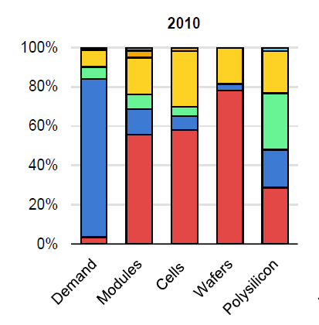
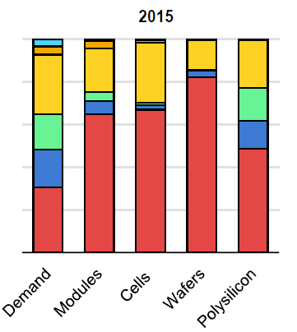
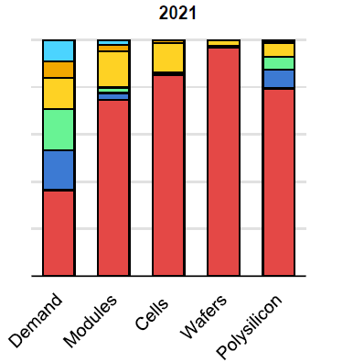
Background: Solar PV techs and supply chain
Silicon SJ (95% of market) | Thin-film SJ | Tandem (novel)
PERC | CIGS | Perovskite/CI(G)S
SHJ | CdTe | Perovskite/PERC
 | Perovskite (novel) | Perovskite/SHJ
IEA (2022)
Silicon: dominant Solar PV technology
China: dominant of silicon PV supply chain

Slide 3
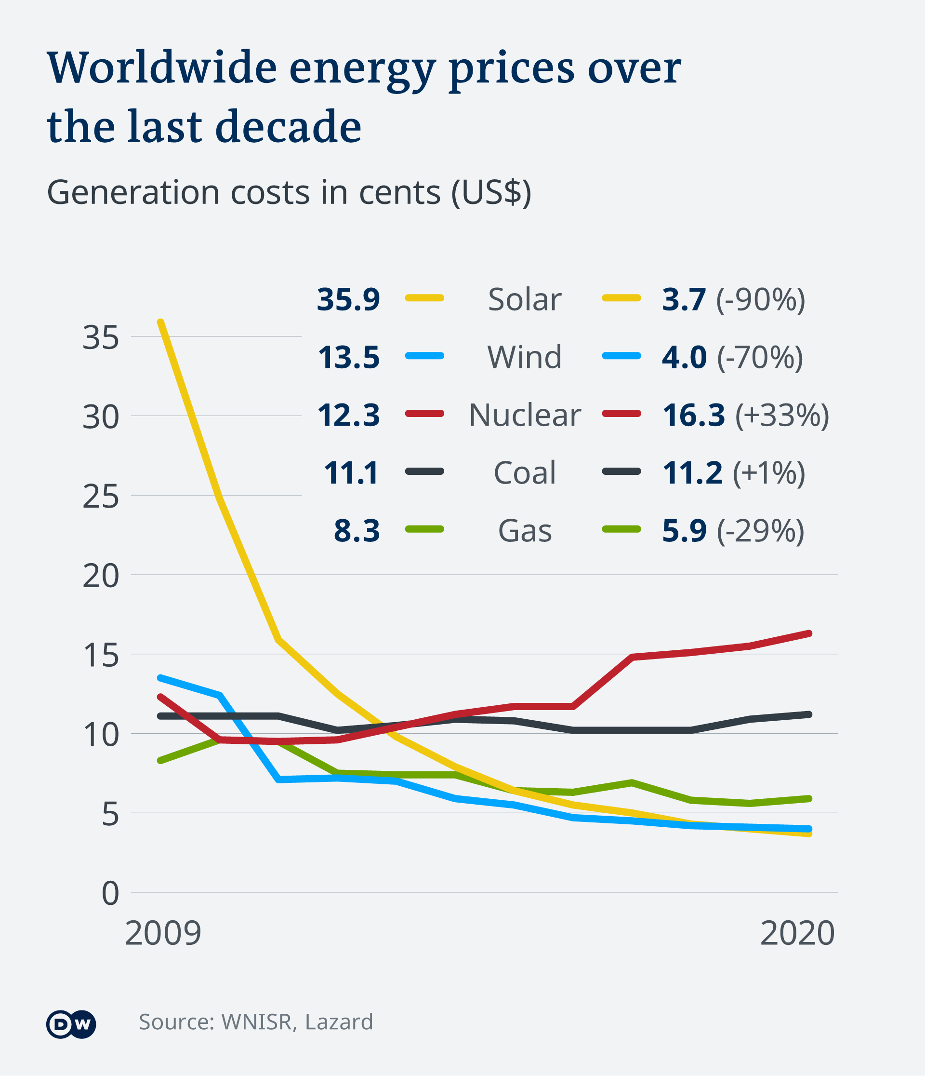
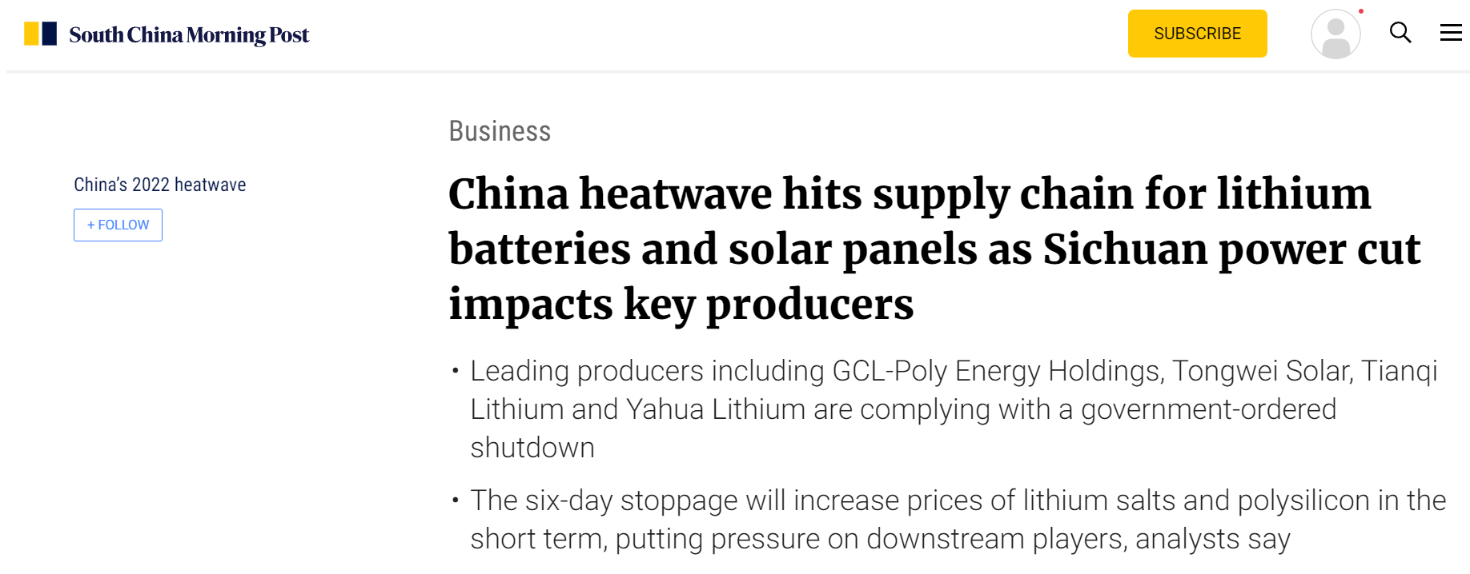
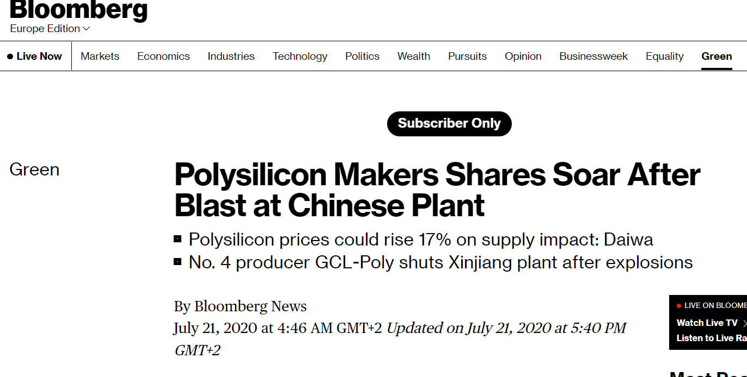
China’s dominance: Pros and Cons
PROS
About 90% solar cost decline
Solar = most affordabable source of electricity
CONS
Market concentration
One technology, a few companies producing it
Geographic concentration (China)
China current energy mix reliant on coal
Higher GHG emissions PV industry

Slide 4
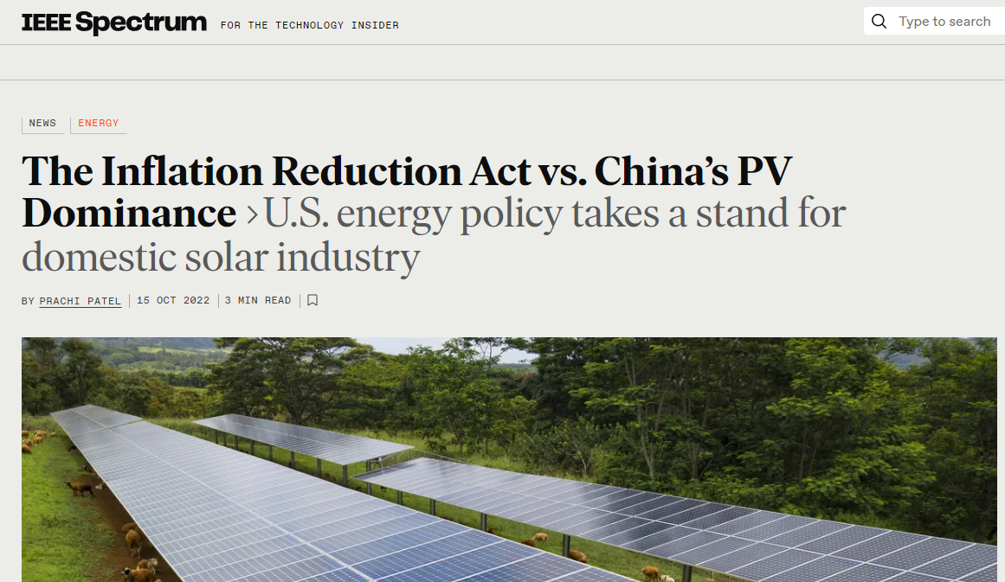
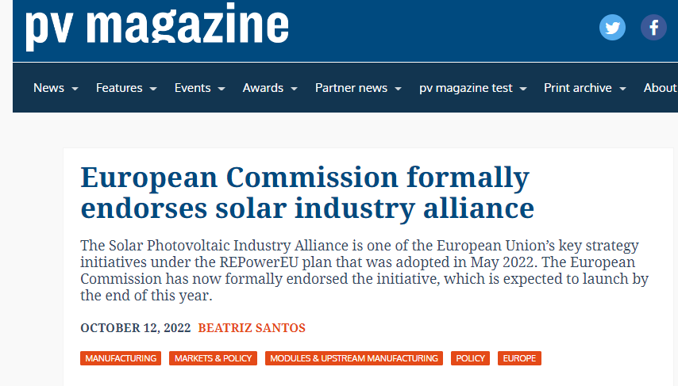
PV Supply chain diversification
Solar PV crucial technology to reduce energy GHG intensity
Supply chain diversification needed
Growing interest of EU and US policymakers to reduce dependence and stimulate domestic manufacturing
Inflation Reduction Act (US)
REPowerEU plan (EU)

Slide 5
Alternative technologies
Silicon (95% of market) SJ | Thin-film SJ | Tandem (novel)
PERC | CIGS | Perovskite/CI(G)S
SHJ | CdTe | Perovskite/PERC
 | Perovskite (novel) | Perovskite/SHJ
Thin-film could be alternative to complement silicon supply
Thin film tandems (perovskite/CI(G)S) show good performance (high-efficiency)
Thin film equipment suppliers location: Europe/US
Thin film R&D location: Europe/US
Can thin-film tandem PVs be competitive with silicon-based PVs (SJ and tandems)?
Economic
Environmental

Slide 6
Research aim
Economic and environmental evaluation of PV technologies
Silicon single-junction PVs: PERC and SHJ
Thin-film single-junction PVs: Perovskite and CIGS
Tandem PVs
Perovskite/CIGS
Perovskite/CIS
Perovskite/PERC
Perovskite/SHJ
Three geographical areas:
Europe
US
China

Slide 7
Economic and environmental indicators
Module-level: analysis until PV module production
$$Minimum sustainable price (MSP) =[\frac{USD\$}{W}]$$
$$Carbon footprint =[\frac{kg CO2 eq}{W}]$$
System-level: deployment of PV modules in PV system to generate electricity
Supported by Energy Yield calculations: annual energy generated at three climatic locations
$$Levelized cost of electricity (LCOE) =[\frac{USD\$}{kWh}]$$
$$Greenhouse gas emission factor (GEF)=[\frac{g CO2 eq}{kWh}]$$

Slide 8
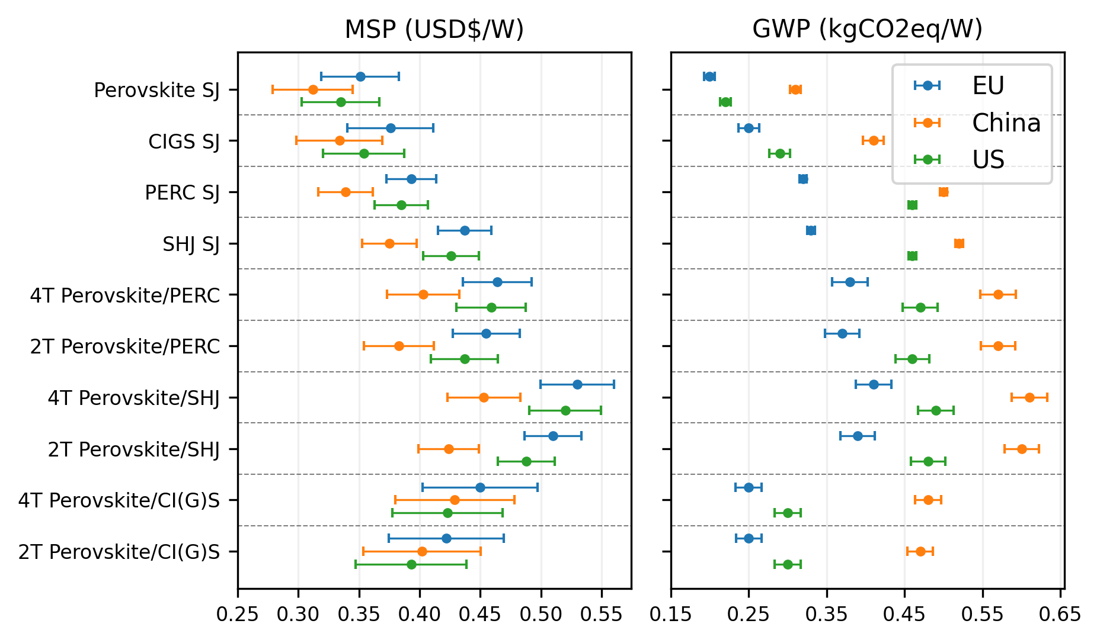
Results – USD$/W and kgCO2eq/W
Results include uncertainty on
Material, Equipment prices
Technical parameters (e.g., layer thickness, material utilization, energy consumption)
Chinese manufactured PVs have lowest price
EU manufactured PVs have lowest kgCO2eq/W
EU and US manufactured perovskite/CI(G)S
Cost competitive with perovskite/silicon (China manufactured)
Much lower carbon footprint if produced in EU
35-47% reduction

Slide 9
Results – Normalized environmental impact
 | PERC | SHJ | CIGS | PVK | PVK/PERC | PVK/SHJ | PVK/CIGS | PVK/CIS
Global warming | 1 | 1.03 | 0.68 | 0.59 | 1.12 | 1.22 | 0.72 | 0.71
Ozone depletion | 1 | 0.87 | 0.35 | 0.27 | 0.74 | 0.68 | 0.41 | 0.40
Freshwater eutrophic. | 1 | 0.96 | 1.04 | 1.02 | 0.70 | 0.59 | 0.74 | 0.74
Marine eutrophication | 1 | 0.95 | 0.22 | 0.14 | 0.63 | 0.61 | 0.20 | 0.15
Freshwater ecotoxicity | 1 | 0.91 | 1.06 | 0.88 | 0.59 | 0.61 | 0.79 | 0.78
Terrestrial ecotoxicity | 1 | 1.02 | 0.89 | 0.46 | 0.91 | 0.78 | 0.80 | 0.79
Acidification | 1 | 0.97 | 0.66 | 0.55 | 0.80 | 0.81 | 0.71 | 0.69
Human toxicity | 1 | 0.95 | 1.07 | 1.06 | 0.58 | 0.57 | 0.75 | 0.74
Mineral scarcity | 1 | 1.12 | 2.67 | 0.61 | 0.98 | 1.04 | 2.21 | 1.78
Fossil scarcity | 1 | 0.96 | 0.62 | 0.57 | 0.72 | 0.71 | 0.57 | 0.56
Overall, environmental impact reduction compared to market available PERC
But, significant increasing mineral supply risk due to utilization of
Indium
Gallium

Slide 10
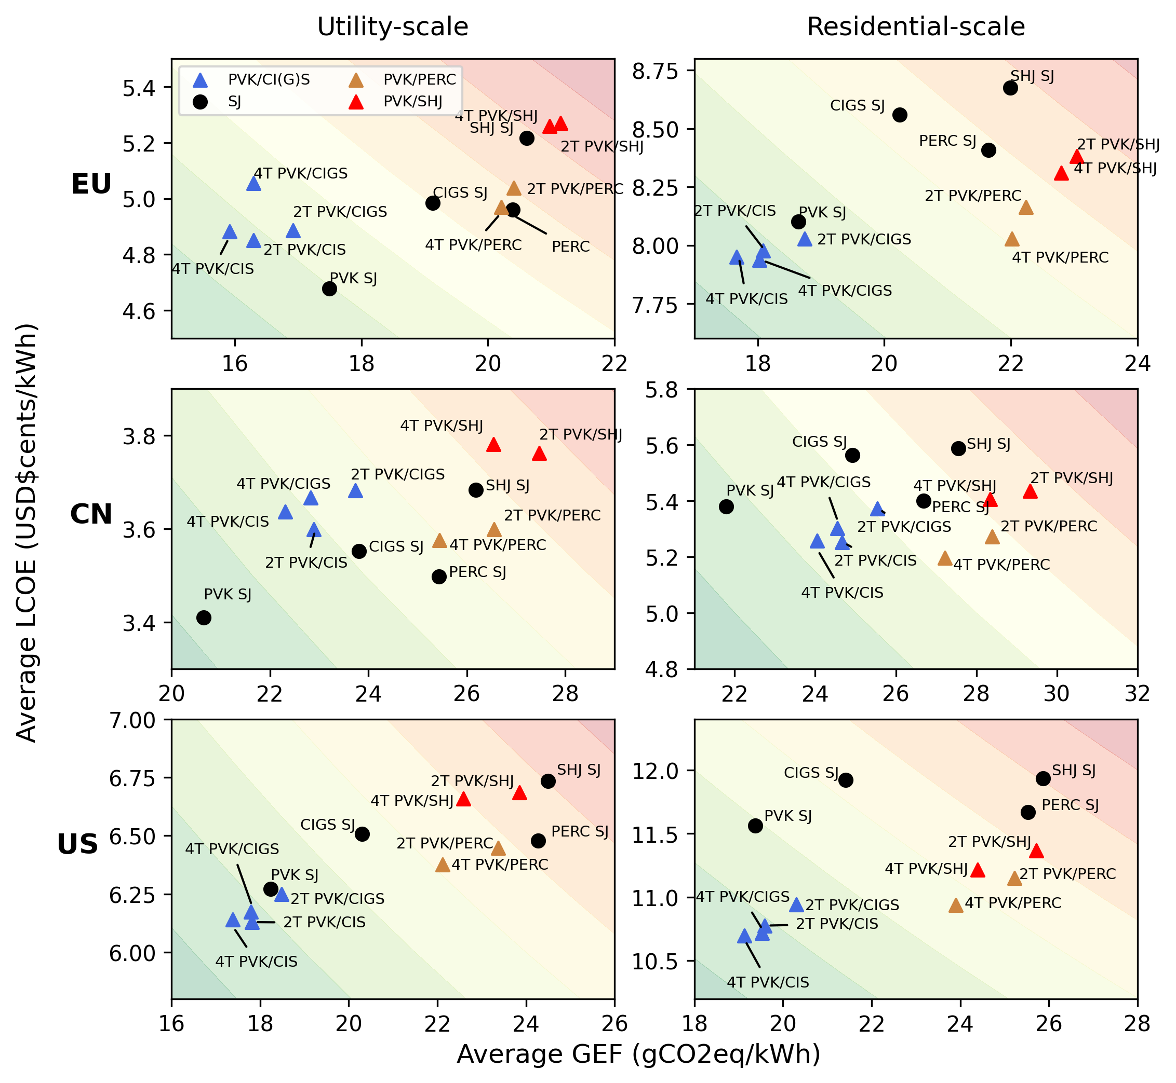
Results – LCOE and GEF
Results represent LCOE and GEF in EU, US and China
PV module manufactured and installed in each region
Thin-film tandems are more cost competitive in areas and scales with higher system costs
US (both scales)
EU – residential
China has already very low system costs
→ Tandem cost advantage is less evident
Thin film tandem GHG emissions advantage is significant for all scales and areas

Slide 11
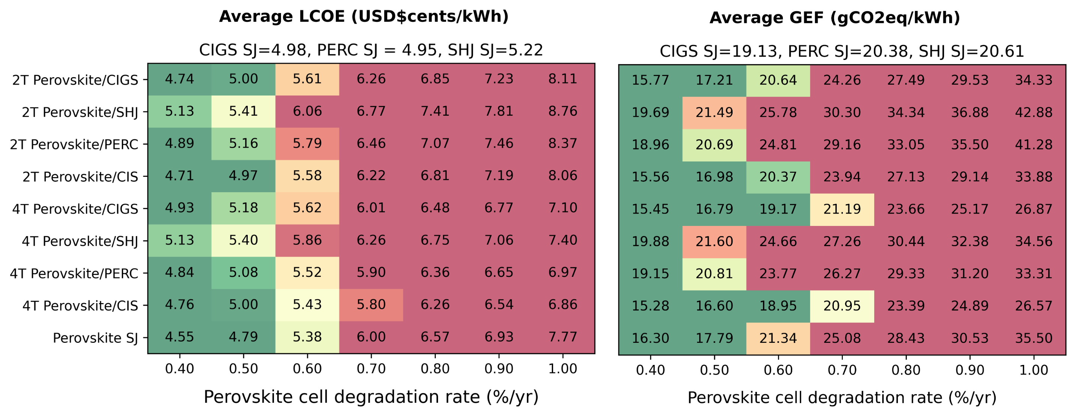
Results - Challenges
Stability is main concern for perovskite development and commercialization
Consider perovskite degradation influence on results
Traditional PV panels degradation ~ 0.40-0.50 %/year
(results refer to PV modules installed in EU)
Results: degradation under 0.70%/year for perovskite devices would be needed
Also here, thin-film competiveness shown

Slide 12
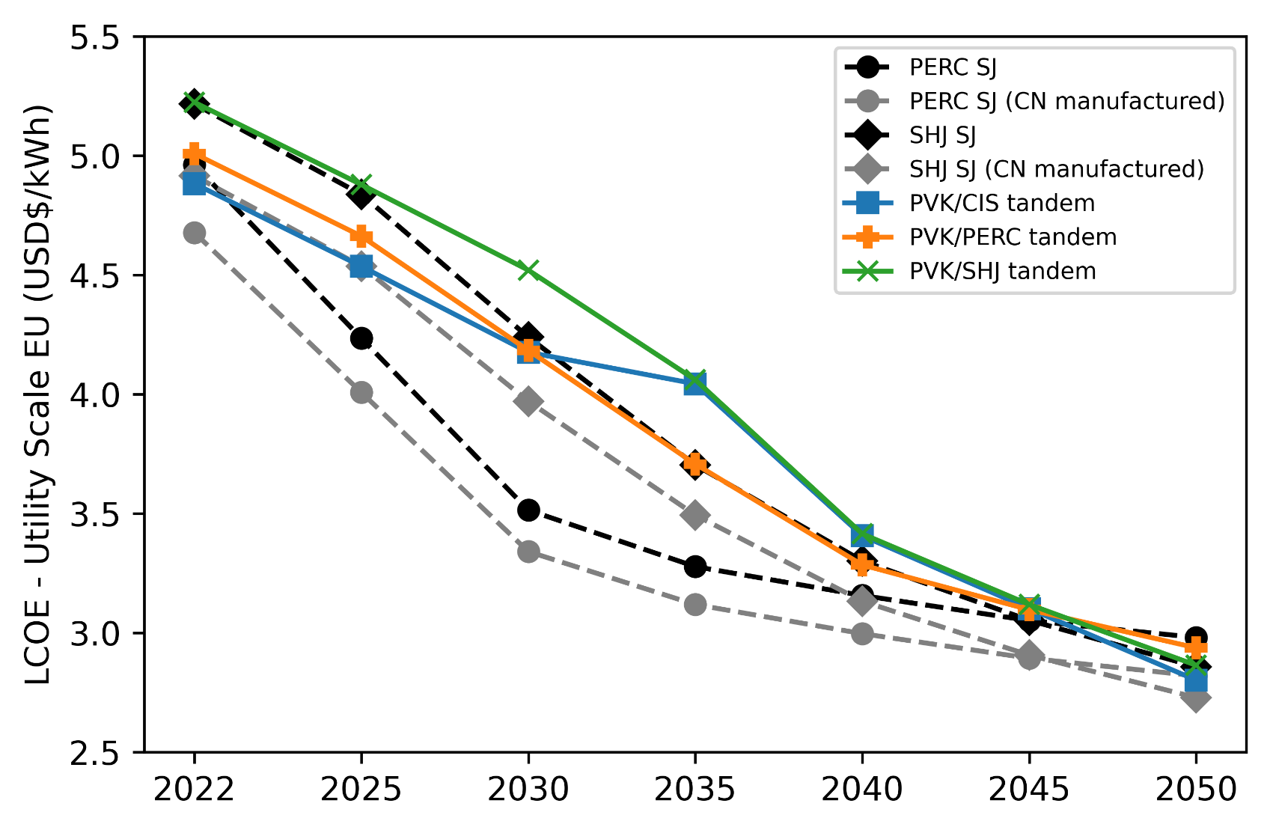
Results - Challenges
Silicon techs, contrary to thin-film, can already rely on large-scale production
Easier cost reductions in the next decades
How PV techs LCOE would change with:
Increasing PV worldwide capacity
Developing market share of PERC, SHJ and tandems
To remain LCOE competitve, thin-film tandem PVs would need:
Higher device efficiency – at least 35%
Further lower costs

Slide 13
Conclusions
Market and geographic concentration: Chinese PV production of silicon-based PVs
Diversification might come from alternative technologies: thin-film tandems
LCOE comparison shows competiveness with traditional PVs, even if manufactured in the EU
Large carbon footprint reduction of Solar PV industry if manufacturing diversification is implemented
US and Europe
Silicon large scale production would favor perovskite/silicon tandems. Some challenges would need to be overcome for thin-films:
Further improve perovskite stability (in common with silicon-tandems)
Consider Indium and Gallium utilization: scarce materials, more costly in the future?
Further improve efficiency and/or reduce costs to maintain competitiveness in the next decades

