Slide 1
Access to Succesion Finance in Private Family Firms: The Role of Governance
By Lien Vekemans (UHasselt), Anneleen Michiels (UHasselt), Tensie Steijvers (UHasselt),
Vincent Molly (KULeuven)
PhD Workshop on Family Firms & Mittelstand

Slide 2
Introduction

Slide 3
Intra-family succession of ownership
Business succession = critical event within the life cycle of a family firm.
HOWEVER
Most family firms fail at the challenge of managing a successful business succession.
CHALLENGE: Financing constraints

Slide 4
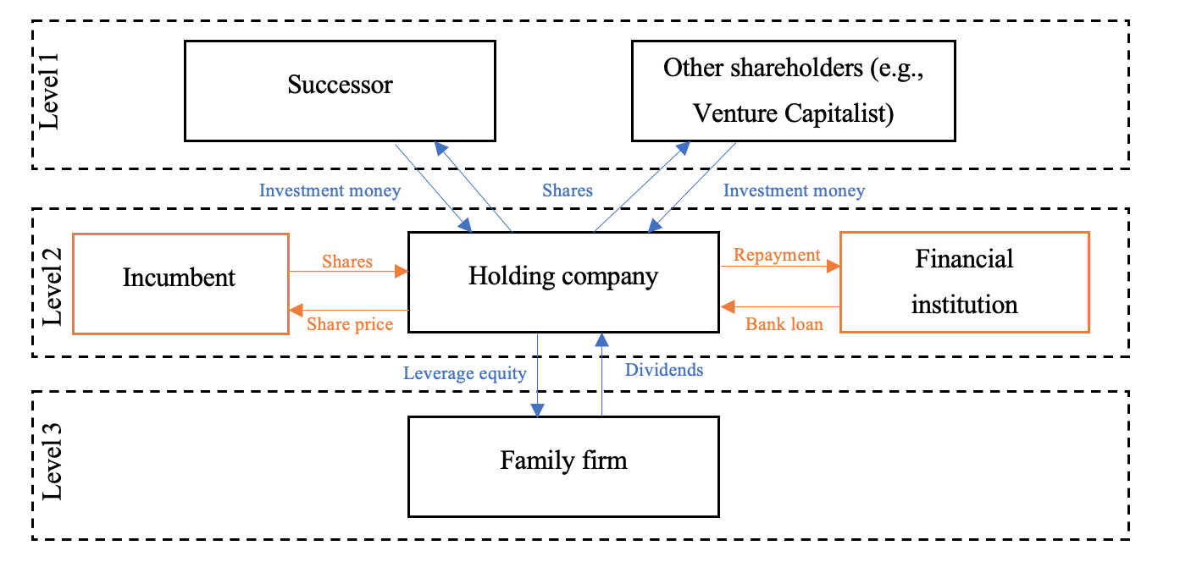

Slide 5
Access to succession finance for FFs
SUCCESSION FINANCE
Financial attitudes toward bank debt
= demand
Bank’s potentially restricted lending behavior
= supply

Slide 6
Research question
FAMILY FIRMS
GOVERNANCE
SUSTAINABILITY (ESG-goals)
RESEARCH QUESTION:
How do governance-related factors influence the access to succession financing in private family firms?
Notes:
Interviews

Slide 7
Theoretical arguments

Slide 8
Credit granting

Slide 9
The role of perceived risk & trust
THEORETICAL ARGUMENTS:
Estimation default risk
Several lending technologies
Individual lending officer
Judgements and perceptions
Influence on credit decision-making
Perceived risk
Credit access
Loan conditions
HYPOTHESES:
Loan officers’ perceived risk has a direct influence on their willingness to provide access to succession financing for family firms in transition.
Loan officers’ perceived risk has a direct influence on their willingness to apply favorably loan conditions to family firms in transition.

Slide 10
The role of perceived risk & trust
THEORETICAL ARGUMENTS:
Trust as under-researched
Allows covering remaining uncertainty
Engenders positive expectations
Influence on credit decision-making
Perceived risk
Credit access
Cognitive-based trust
Loan conditions
HYPOTHESES:
Perceived trust of a bank loan officer has a direct effect on their willingness to provide access to succession financing for family firms in transition.
Perceived trust of a bank loan officer has a direct effect on their willingness to provide favorable loan conditions to family firms in transition.

Slide 11
The role of perceived risk & trust
THEORETICAL ARGUMENTS:
Trust reduces level of information asymmetry
Trust facilitates decision-making in risk scenarios
Influence on perceived levels of risk
Perceived risk
Credit access
Cognitive-based trust
Loan conditions
HYPOTHESES:
Perceived trust of a bank loan officer has a direct negative influence on the perceived risk of a family firm in transition

Slide 12
Governance

Slide 13
Managerial experience of successor
THEORETICAL ARGUMENTS:
Choosing successor
Family members are mainly first choice
Characteristics CEO in debt markets
Family versus non-family CEO
Different types of family CEO’s ?
Human capital theory
Family firm specific knowledge versus general knowledge
Managerial experience
HYPOTHESES:
Inside or outside the managerial experience of the successor has a direct effect on the family firm’s perceived risk.
Inside or outside the managerial experience of the successor has a direct effect on the bank loan officer’s perceived trust.

Slide 14
Knowledge diversity of the BoD
THEORETICAL ARGUMENTS:
Legal responsibility = leadership and ownership succession
Characteristics board in debt markets
Family representation in board of directors
Knowledge diversity of the board?
Resource-based view
Qualified individuals with professional attributes underrepresented on the board
Managerial experience
Board diversity
HYPOTHESES:
Diversity of the board of directors has a direct effect on the family firm’s perceived risk
Diversity of the board of directors has a direct impact on the bank loan officer’s perceived trust

Slide 15
The extent of succession planning
THEORETICAL ARGUMENTS:
Succession planning = key actor to successful transfer
Considerable amount of research on succession planning proces
Perceptions of external stakeholders?
Succession initiates significant levels of uncertainty
Risk varies with succession planning
Reduces altruism and management entrenchment
Managerial experience
Board diversity
Succession planning
HYPOTHESES:
The extent of succession planning of the family firm has a direct effect on the family firm’s perceived risk.
The extent of succession planning of the family firm has a direct effect on the bank loan officer’s perceived trust.

Slide 16
Family protocol for professionalization
THEORETICAL ARGUMENTS:
Succession might increase internal conflicts among family members
Professionalization of the family firm
Professional non-family managers
Family governance?
Family protocol
Control altruism and management entrenchment
Managerial experience
Board diversity
Succession planning
HYPOTHESES:
The presence of a family protocol has a direct effect on the family firm’s perceived risk.
The presence of a family protocol has a direct effect on the bank loan officer’s perceived trust.
Family protocol

Slide 17
Conceptual framework

Slide 18
Conceptual framework
Managerial experience
Board diversity
Perceived risk
Credit access
Succession planning
Cognitive-based trust
Loan conditions
Family protocol

Slide 19
Methodological approach

Slide 20
Methodological approach
EXPERIMENTAL DESIGN
With at least 100 credit loan officers of local offices of the four major Belgian banks who primarily work with small-medium-sized family firms
Need for controlled empirical test
Pilot study
Conjoint choice experiment
Manipulation check
Hybrid design
Engagement check

Slide 21
Access to Succesion Finance in Private Family Firms: The Role of Governance
By Lien Vekemans (UHasselt), Anneleen Michiels (UHasselt), Tensie Steijvers (UHasselt),
Vincent Molly (KULeuven)
PhD Workshop on Family Firms & Mittelstand

