Slide 1

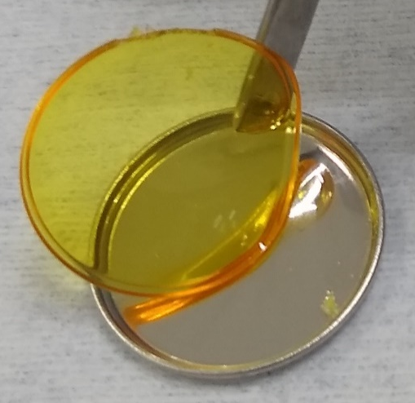
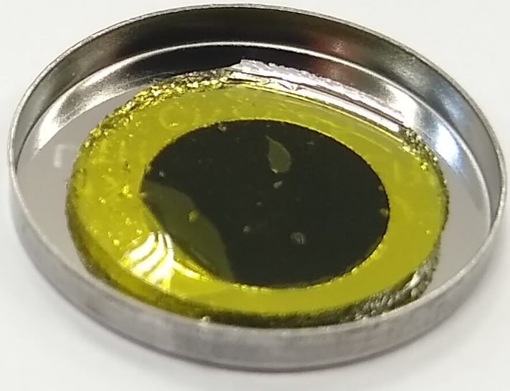
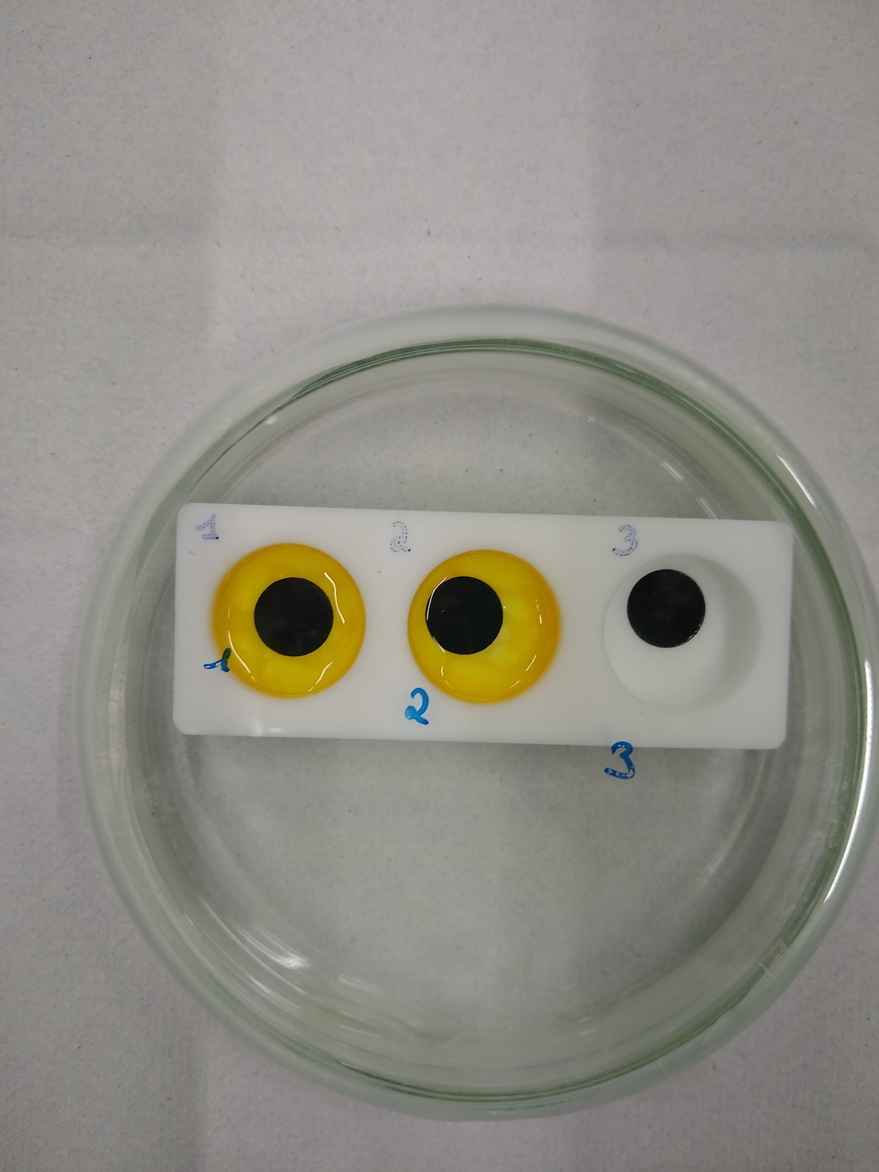
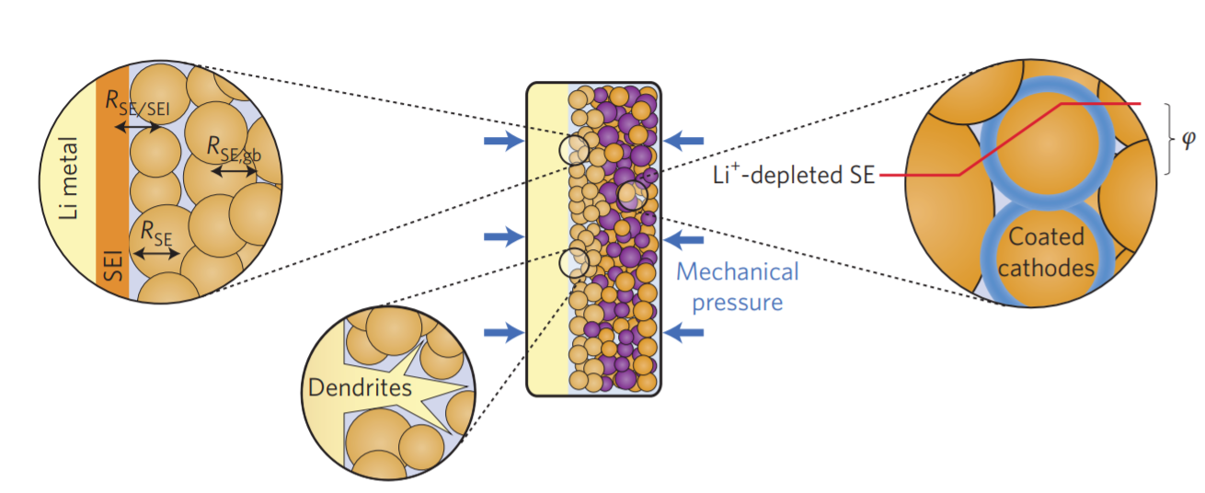






Polymeric backbone eutectogel electrolyte: Preparation of a composite positive electrode for high-energy density lithium-ion batteries
An-Sofie Kelchtermans^{1,3}, Bjorn Joos^{1,2,3}, Dries De Sloovere^{1,2,3}, Alexander Tesfaye⁴, Marlies K. Van Bael^{1,2,3}, An Hardy^{1,2,3}
¹ Hasselt University, Institute for materials research, DESINe, Martelarenlaan 42, 3500 Hasselt, Belgium
² IMEC vzw, imomec associated laboratory, Wetenschapspark 1, 3590 Diepenbeek, Belgium
³ EnergyVille, Thor Park 8320 , 3600 Genk, Belgium
⁴ Umicore, Corporate Research & Development, Watertorenstraat 33, 2230 Olen, Belgium
Key words: hybrid solid-state electrolyte, solid-state batteries, interface stability
INTRODUCTION
METHODS
NMC622 positive electrode
Research on solid-state batteries has increased, but still faces fundamental challenges; ¹
Development of a highly performant solid electrolyte,
Integration of the cathode and anode materials,
New cell production processes.
The replacement of the conventional liquid electrolyte by solid electrolytes introduces new challenges for cell production processes. For commercial application of solid electrolytes, a wet/solution-based process is preferable. An in-situ formation of the solid electrolyte on top of the electrode can form a stable solid-state electrolyte interface on the surface of the electrode, reducing the solid electrolyte interface resistance and improving the transport of lithium ions between electrode and electrolyte, which help to improve the cycle stability, life time, and safety of the battery.
AIM: Improving the electrochemical performance by optimizing the electrolyte composition, and using an in-situ polymerization of a polymeric backbone eutectogel (P-ETG) electrolyte.
Method 1:
Pre-synthesis method for coin cell assembly
Pre-synthesized P-ETG monolith
Photo-initiated polymerization
1 mm thickness P-ETG
electrolyte pre-synthesized monolith
Liquid P-ETG precursor
Photo-initiated polymerization
1 droplet P-ETG precursor
drop-casted on NMC622 electrode,
followed by UV-curing
150 - 300 µL P-ETG precursor
drop-casted on infiltrated NMC622
electrode to form separator layer
followed by UV-curing
Method 2:
In-situ synthesis method for coin cell assembly
RESULTS & DISCUSSION
P-ETG infiltration
Figure 1. Technological challenges for solid-state batteries¹
S mapping
Ni mapping
EUTECTOGEL (P-ETG)
Cross-sectional SEM image
of P-ETG infiltrated positive electrode
112 µm thickness, 2.80 mAh cm⁻²
Polymeric eutectogel: a promising solid-state electrolyte ⁴
Deep eutectic solvent (MAc/LiTFSI) confined in a polymeric matrix
Allows the combination of the processability advantage of polymers with high Li-ion conductivity of liquid electrolytes
Successful infiltration of P-ETG electrolyte inside pores of positive electrode
Electrode | Electrolyte interface
C
(a)
(c)
P-ETG
DES
Bis(trifluoromethane sulfonyl)imide lithium salt (LiTFSI)
Mixing DES and polymeric backbone to form P-ETG precursor
(b)
MONOMER
DES
N-methylacetamide (MAc)
Photo-initiated polymerization
CROSSLINKER
INITIATOR
Electrochemical Impedance spectroscopy (EIS)
NMC622 | liquid electrolyte | NMC622 symmetrical cell
NMC622 | P-ETG | NMC622 symmetric cell
Infiltrated NMC622 | P-ETG | Infiltrated NMC622 symmetric cells
N-isopropylacrylamide
(NIPAM)
The infiltration of the P-ETG electrolyte into the pores of the NMC622 electrode does not lead to a significant increase in charge transfer resistance, indicating that the presence of the P-ETG electrolyte in the pores does not lead to an increased resistance in the cell.
POLYMERIC BACKBONE
Ethylene glycol dimethacrylate
(EGDMA)
2,2-dimethoxy-2-phenyl-
acetophenone
(DMPA)
N,N-diethylacrylamide
(DEAA)
Flexible, self-standing P-ETG
Battery performance
Figure 2. Overview of the composition and synthesis of the P-ETG electrolyte
IONIC CONDUCTIVITY
Properties of P-ETG
ANODIC STABILILTY
Improved stability of discharge capacity for in-situ synthesis of P-ETG on top of NMC622 positive electrode
Optimizing P-ETG composition and electrolyte thickness results in a higher and more stable discharge capacity.
CONCLUSIONS
The P-ETG electrolyte holds potential as a safe, inexpensive, and flexible solid electrolyte for the next generation solid-state LIBs with NMC622 positive electrode materials, as it demonstrates a broad electrochemical stability window, and a high ionic conductivity at 25 °C.
The in-situ synthesis method for the P-ETG electrolyte results in a improved performance of the discharge capacity with an initial discharge capacity of 110 mAh g⁻¹, and 76.2% of the initial capacity is remained after 90 cycles, compared to 56.8% for the pre-synthesis method.
Optimizing the P-ETG composition and thickness resulted in improved performance of the cells.
References
Acknowledgements
1. J. Janek, et al., A solid future for battery development, Nat. Energy, 2016.
2. M.-J. Kim et al., Facile fabrication of solution-processed solid-electrolytes for high-energy-density all-solid-state-batteries by enhanced interfacial contact, Sci. Reports 2020 101, 2020.
3. Q. Zhao et al., Solid-state polymer electrolytes with in-built fast interfacial transport for secondary lithium batteries, Nat. Energy, 2019.
4. B. Joos, et al., Polymeric backbone eutectogels as a new generation of hybrid solid-state electrolytes, Chem. Mater., 2020.
This project receives financial support from VLAIO and Umicore (Baekeland project).
ansofie.kelchtermans@uhasselt.be

