Slide 1
Synchronizing picking and delivery operations under dynamic order arrivals
Ruben D’Haen^{a,b}, Katrien Ramaekersª,
Claudia Archetti^{c}, Kris Braekersª
ªHasselt University, Research Group Logistics
^{b}Research Foundation Flanders
^{c}ESSEC Business School
SynchroTrans 2023

Slide 2
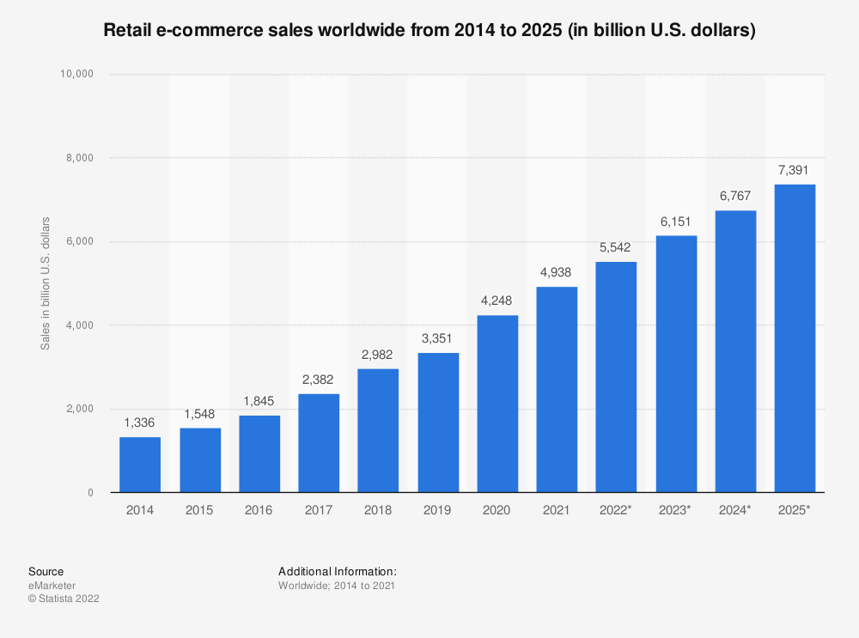
Problem context
E-commerce sales growth

Slide 3
Problem context
Typically both processes are scheduled separately
Our focus: integrated decision-making
How?
What are the benefits?
Order arrival
Order picking
Order delivery
A,F,F,K 1-3p.m.
B,Z 1-3p.m.
1
2
F
E,E,F,Q 3-5p.m.
C
E
B
K
3
P
Q
A
Z
M
4
5
C,M,M,P 2-4p.m.
D
A,C 2-3p.m.

Slide 4
Problem context
Order picking
Assumptions:
Picker-to-parts setting
Limited number of pickers
Not restricted to any routing policy
Batching
Decisions:
Order batching
Picker routing
Batch scheduling
Vehicle routing
Assumptions:
Limited number of vehicles
Vehicle capacity is not a restriction
Vehicles can make multiple trips
Customers have strict delivery time windows
Decisions:
Vehicle routing and scheduling
F
C
E
B
K
A,F,F,K 1-3p.m.
P
Q
B,Z 1-3p.m.
1
A
Z
M
2
E,E,F,Q 3-5p.m.
D
Order | Items
1 | A,F,F,K
2 | B,Z
3 | E,E,F,Q
4 | C,M,M,P
5 | A,C
3
4
5
C,M,M,P 2-4p.m.
A,C 2-3p.m.

Slide 5
Problem context
Synchronization / time dependency:
A vehicle can only leave to deliver an order after the corresponding picking batch is completed
Dynamic order arrivals
Not all orders are known at start of planning period
No information available
Picker 1
2, 5
8, 12
10
9, 11
Picker 2
3, 6, 7
4
1, 14
13
Vehicle 1
5
3, 4
1, 10, 12
Vehicle 2
2, 6, 7
8, 14
9, 11, 13
Time

Slide 6
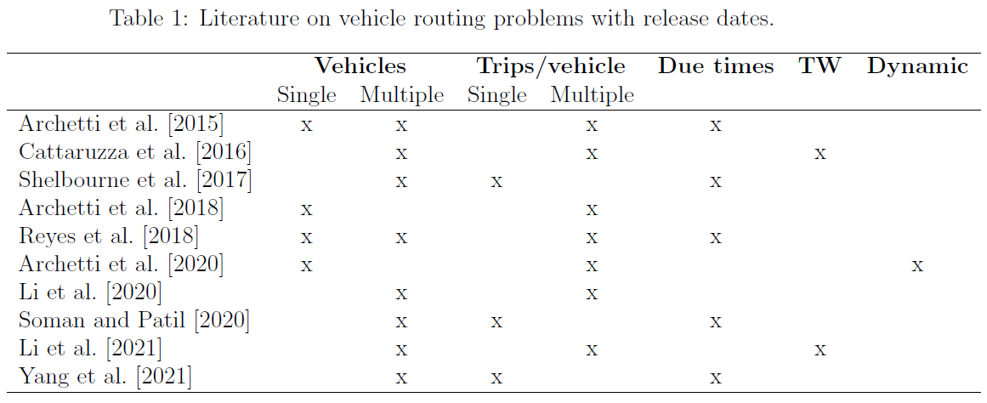
Related literature
Order picking subproblem
D’Haen et al. (2023)
VRP-rd

Slide 7
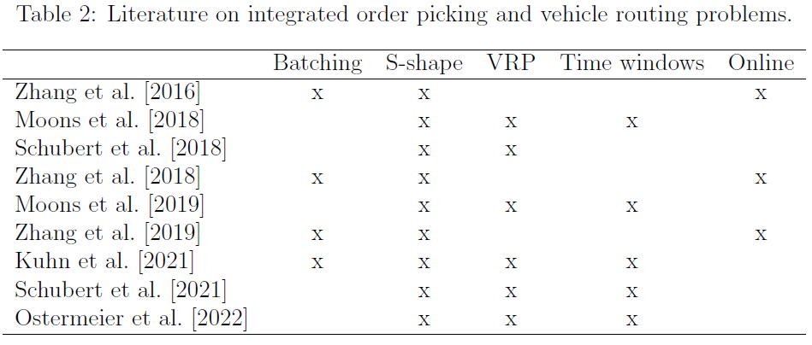
Related literature
Integration of picking and routing decisions

Slide 8
Solution methodology
Online optimization approach
Repeatedly solve a static version of the problem
Every time a picker returns to the depot
No re-routing of pickers (and vehicles)
Given:
A number of pickers that are available from a certain time
A number of vehicles that are available from a certain time
A set of known and unhandled orders (for each subproblem)
Find:
A picking solution (order batching, picker routing, batch scheduling)
A routing solution, accounting for:
Customer time windows
Precedence relation with picking operations
Objective:
Minimize delivery tardiness
Minimize routing cost

Slide 9
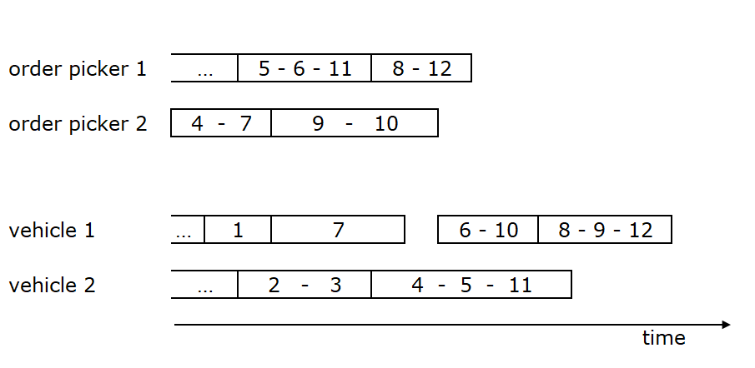
Solution methodology
Online optimization approach
Repeatedly solve a static version of the problem
Every time a picker returns to the depot
No re-routing of pickers (and vehicles)

Slide 10
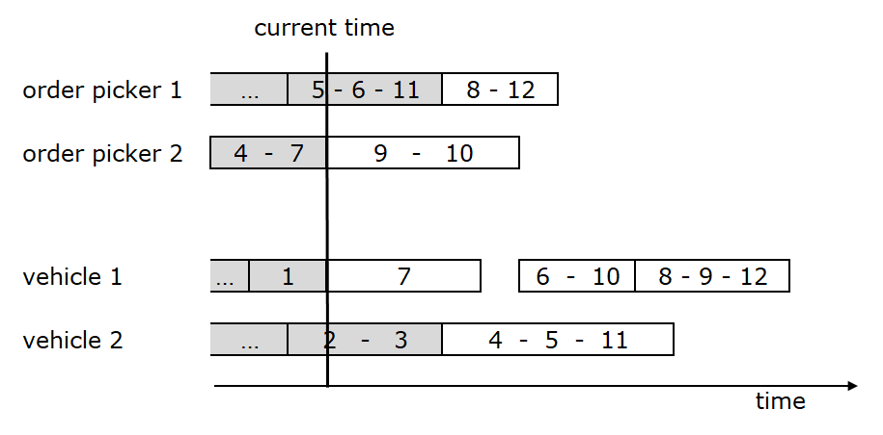
Solution methodology
Online optimization approach
Repeatedly solve a static version of the problem
Every time a picker returns to the depot
No re-routing of pickers (and vehicles)

Slide 11
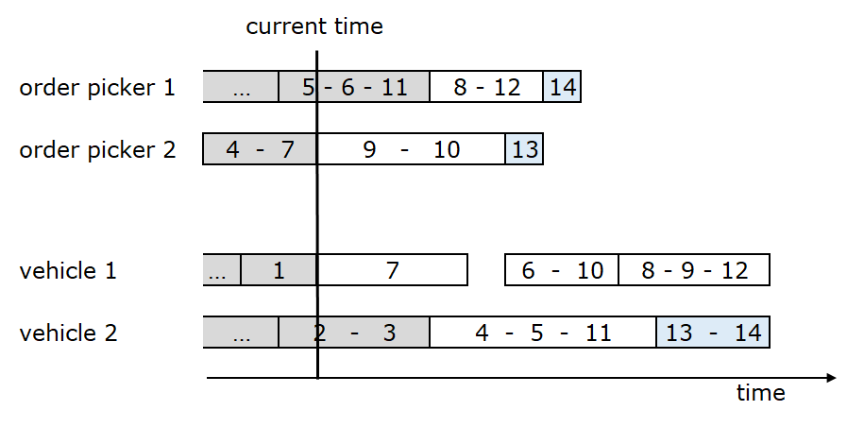
Solution methodology
Online optimization approach
Repeatedly solve a static version of the problem
Every time a picker returns to the depot
No re-routing of pickers (and vehicles)

Slide 12
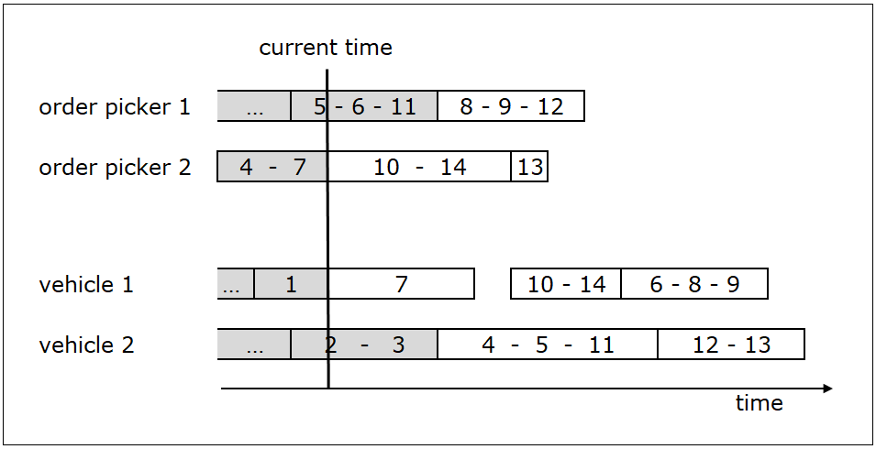
Solution methodology
Online optimization approach
Repeatedly solve a static version of the problem
Every time a picker returns to the depot
No re-routing of pickers (and vehicles)
Picking subproblem: Integrated order batching, picker routing, batch scheduling problem
with:
picker release dates
order due dates
release date
for order 12
due date for order 12
Vehicle routing subproblem: Multi-trip VRP with time windows and release dates (for orders and vehicles)

Slide 13
Solution methodology
Heuristic algorithms for the subproblems
Order picking problem (OPP)
LNS algorithm of D’Haen et al. (2023)
4 destroy operators (1 at order level, 3 at batch level)
Greedy and 2/3/4/5-regret insertion
Simulated annealing acceptance
Minimize tardiness w.r.t. order due dates
→ LNS_{OPP}(orders_{OPP}, picker release dates, order due dates)
Vehicle routing problem (VRP)
New LNS algorithm
10 destroy operators (7 at order level, 3 at trip level)
Greedy, best and 2-regret insertion
Simulated annealing acceptance
Minimize tardiness w.r.t delivery time windows (1st), minimize routing distance (2nd)
→ LNS_{VRP}(orders_{VRP}, vehicle release dates, order release date)

Slide 14
Solution methodology
Approaches to solve the integrated problem
4 different heuristic algorithms
All based on LNS with SA acceptance
Varying in level and way of integration
Compared by using the same amount of CPU time
Sequential
Iterative
Integrated
Integrated iterative

Slide 15
Solution methodology
Approaches to solve the integrated problem
Sequential (baseline)
First, solve picking problem, second, solve routing problem
Set artificial order due dates
LNS_{OPP}(orders_{OPP}, picker release dates, order due dates)
Set order release dates based on picking solution
LNS_{VRP}(orders_{VRP}, vehicle release dates, order release dates)
Iterative
Iterate between both subproblems
Set artificial order due dates for new orders
Iterate
LNS_{OPP}(orders_{OPP}, picker release dates, order due dates)
Update order release dates
LNS_{VRP}(orders_{VRP}, vehicle release dates, order release dates)
Update order due dates

Slide 16
Solution methodology
Approaches to solve the integrated problem
Integrated
Consider as joint optimization problem
LNS algorithm
Destroy:
Remove orders from picking and routing solution simultaneously
3 sets of operators:
Picking subproblem
Routing subproblem
Joint problem: order_tardiness, order_idle_time, order_picking_routing_distribution
Repair
Testing all insertion positions in both subproblems is too time consuming
Randomly select an order to insert
Randomly selected a subproblem
Consider x potential cut-off times
Insert in first subproblem, accounting for the cut-off time
Insert in second subproblem
Select best option
current time
TW end
min. pick time
min. routing time

Slide 17
Solution methodology
Approaches to solve the integrated problem
Integrated
Consider as joint optimization problem
LNS algorithm
Destroy:
Remove orders from picking and routing solution simultaneously
3 sets of operators:
Picking subproblem
Routing subproblem
Joint problem: order_tardiness, order_idle_time, order_picking_routing_distribution
Repair
Testing all insertion positions in both subproblems is too time consuming
Randomly select an order to insert
Randomly selected a subproblem
Consider x potential cut-off times
Insert in first subproblem, accounting for the cut-off time
Insert in second subproblem
Select best option
current time
TW end
min. pick time
feasible cut-off times
min. routing time

Slide 18
Solution methodology
Approaches to solve the integrated problem
Integrated
Consider as joint optimization problem
LNS algorithm
Destroy:
Remove orders from picking and routing solution simultaneously
3 sets of operators:
Picking subproblem
Routing subproblem
Joint problem: order_tardiness, order_idle_time, order_picking_routing_distribution
Repair
Testing all insertion positions in both subproblems is too time consuming
Randomly select an order to insert
Randomly selected a subproblem
Consider x potential cut-off times
Insert in first subproblem, accounting for the cut-off time
Insert in second subproblem
Select best option
current time
TW end
min. pick time
feasible cut-off times
min. routing time

Slide 19
Solution methodology
Approaches to solve the integrated problem
Integrated iterative
Iterate:
LNS_{OPP}(orders_{OPP}, picker release dates, order due dates)
Update order release dates
LNS_{VRP}(orders_{VRP}, vehicle release dates, order release dates)
Update order due dates
LNS_{INT}(order_{OPP}, picker release dates, orders_{VRP}, vehicle release dates)
Update order due and release dates

Slide 20
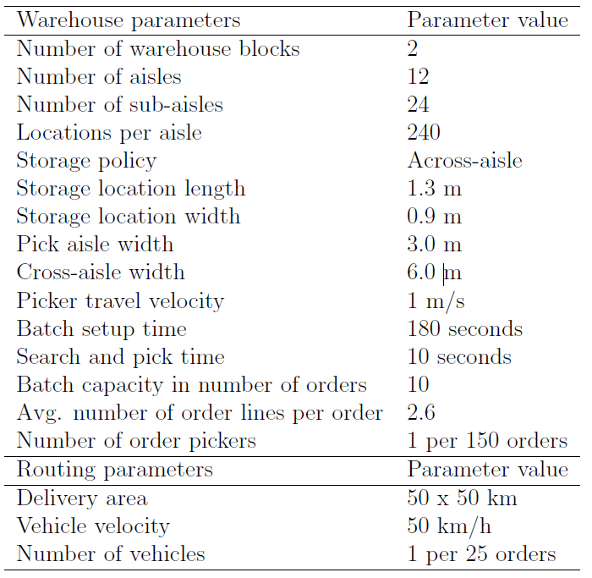
Experimental setup
Randomly generated instances
8 hour planning period
Central warehouse/depot
Random customer locations
Other parameters:

Slide 21
Experimental setup
Randomly generated instances
Factorial design
16 factor combinations
10 instances each
→ 160 instances
Factor | Level 1 | Level 2
#Orders | 300 | 600
Size delivery area | 50x50km | 100x100km
Available response time (h) | 2-3 | 3-4
Time window width (h) | 1 | 2

Slide 22
Experimental setup
Randomly generated instances
Factorial design
Each instance is solved once by each algorithm, allowing the same computation time
Initial schedule: 300s
Re-optimizations: 60s

Slide 23
Experimental setup
Randomly generated instances
Factorial design
Each instance is solved once by each algorithm, allowing the same computation time
Parameter tuning
Iterative + integrated iterative
Iterate 20 times between the different LNS algorithms
Integrated + integrated iterative
Try 5 cut-off times for insertion

Slide 24
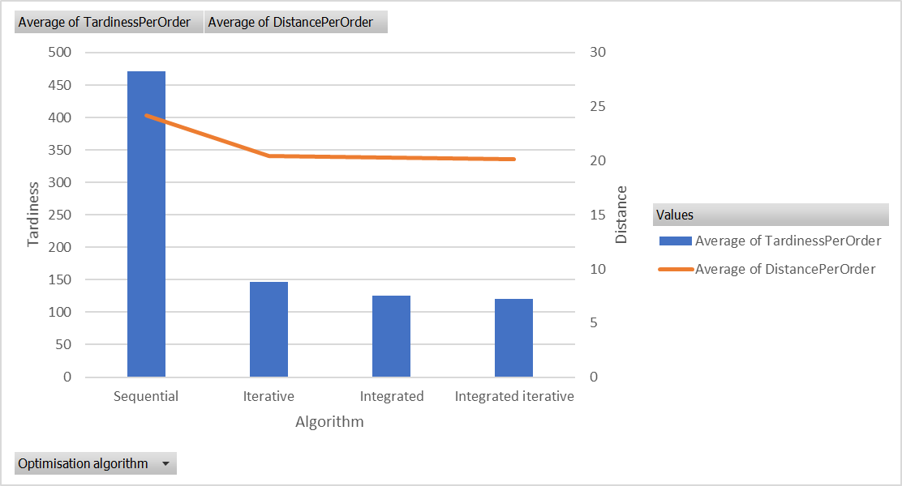
Experimental results
Algorithm comparison

Slide 25
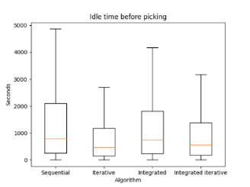
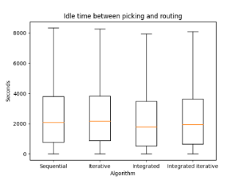
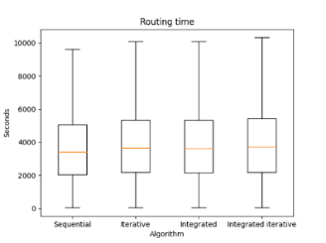
Experimental results
Algorithm comparison
Int.it. results in longest routing time but shortest distance
Integrated postpones picking of non-urgent orders (at small cost of picking efficiency)
Integrated leads to
tightest synchronization

Slide 26
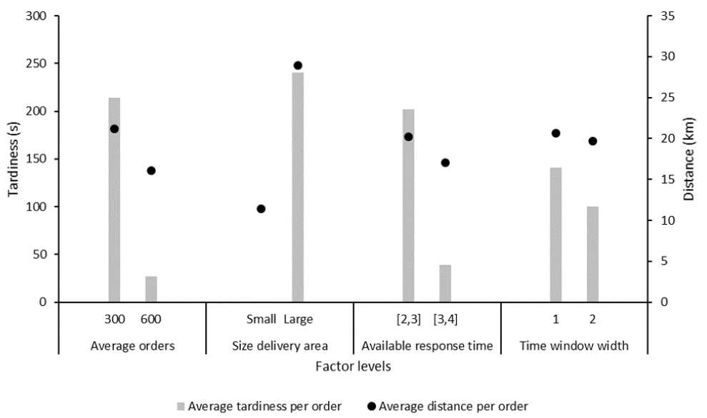
Experimental results
Results factorial design

Slide 27
Conclusions & Future research
Conclusion:
Integration of two complex optimization problems
Best performance when combining:
Global search components (improving the synchronization)
Local search components (optimizing subproblems individually)
Future research ideas:
More complex online optimization strategies
Waiting strategies
Stochastic information
Limited staging area
Notes:
5% distance reduction by longer time windows

Slide 28
Thanks!
Contact:
Kris Braekers
Research group Logisitics
Hasselt University, Belgium
kris.braekers@uhasselt.be

