Slide 1
THE EFFECT OF DIFFERENT EMOTIONAL IMAGERY SCRIPTS ON END-TIDAL CO2 IN HEALTHY INDIVIDUALS IN A STANDING POSITION
Sofie Van Wesemael (PhD), Elke Vlemincx, Katleen Bogaerts, Lotte Janssens
ISARP 2023
Notes:
Hi everyone, I am Sofie Van Wesemael and I am delighted to share my preliminary results today with you guys. This presentation will be about the effect of different emotional imagery scripts on PetCO2 in healthy individuals in a standing position. This research is part of a bigger project where we will examine this in individuals with LBP, but today we will focus on the healthy controls.

Slide 2
01.
INTRODUCTION
Notes:
So, what do we know already about this topic?

Slide 3
01. INTRODUCTION
INTRODUCTION
Emotions
*[1], [2], [3]
Respiration
*[1] Vidotto, el al. (2019)
*[2] Van Diest, et al. (2001)
*[3] Bogaerts, et al. (2007)
Notes:
Research has revealed that emotions affect different aspects of respiration, for example negative emotions may lead to, stress and other negative emotions can lead to a more dysfunctional breathing pattern, biomechanical level, and decrease in PetCO2, on a biochemical level.

Slide 4
01. INTRODUCTION
INTRODUCTION
Emotions
*[4]
Respiration
Postural balance
*[4] Pollock et al. (2000)
Notes:
Additionally, emotions affect postural balance. Is anyone here familiar with postural balance? Yes, indeed, postural balance is the ability of the body to maintain it’s equilibrium

Slide 5
01. INTRODUCTION
INTRODUCTION
Emotions
*[4]
Respiration
Postural balance
*[4] Pollock et al. (2000)
Notes:
This maintenance of equilibrium is essential to perform all daily tasks, ranging from low demanding tasks such as sitting, to more demanding balancing tasks such as sports or specific work situations (e.g. cirque du soleil)

Slide 6
01. INTRODUCTION
INTRODUCTION
Emotions
*[5], [6]
Respiration
Postural balance
*[5] Lelard, et al. (2019)
*[6] Adkin, et al. (2018)
Notes:
So, research shows that emotions can alter postural balance, for example withdrawal and freezing behavior has been observed in response to aversive emotional stimuli.

Slide 7
01. INTRODUCTION
INTRODUCTION
Emotions
*[7], [8], [9]
Respiration
Postural balance
*[7] Kim, et al. (2022)
*[8] Janssens, et al. (2023)
*[9] Lin, et al. (2006)
Notes:
Moreover, research shows that different breathing patterns, such as breath-holding and hyperventilation, affects postural balance. The other way around, different postures can affect breathing parameters, ((((for example slumped sitting significantly decreased lung capacity and expiratory flow compared to normal sitting and standing)))).
Thus, we may conclude that these factors are all connected with each other.

Slide 8
01. INTRODUCTION
INTRODUCTION
*[2], [3]
*[2] Van Diest, et al. (2001)
*[3] Bogaerts, et al. (2007)
Notes:
Now, if we look into the evidence, it is remarkable that the effect of emotions on PetCO2 is mainly conducted in a seated position.

Slide 9
01. INTRODUCTION
INTRODUCTION
FUNCTIONAL POSITION
Notes:
Given the tri – angular relation between those factors, we were curious what would happen if instead of inducing emotions during a non-demanding, seated position, they were induced during a more demanding and functional, standing position.

Slide 10
02.
RESEARCH QUESTION

Slide 11
02. RESEARCH QUESTION
What is the effect of different emotional imagery scripts on
end-tidal CO2 in healthy individuals in a standing position?
Notes:
So, what is the effect of different emotional imagery script on end-tidal CO2 in healthy individuals in a standing position?

Slide 12
03.
METHODS

Slide 13
03. METHODS - DESIGN
Cross-sectional
Repeated measure
Notes:
In order to answer this research question, we used a cross-sectional, repeated measure design.

Slide 14
03. METHODS - PARTICIPANTS
Inclusion:
Healthy individuals
30-40 years old
Notes:
Where we recruted healthy participants of 30-40 years old.

Slide 15
03. METHODS - PARTICIPANTS
Exclusion:
Oswestry Disability Index
> 20% ^{[13]}
Body Mass Index
> 29 kg/m²
Checklist for symptoms in daily life > 75/195 ^{[14], [15]}
Positive And Negative Affect Scale: NA > 21/50 ^{[16]}
Psychiatric comorbidities ^{[17]}
Inclusion:
Healthy individuals
30-40 years old
Exclusion:
Oswestry Disability Index
> 20% ^{[13]}
Body Mass Index
> 29 kg/m²
Checklist for symptoms in daily life > 75/195 ^{[14], [15]}
Positive And Negative Affect Scale: NA > 21/50 ^{[16]}
Psychiatric comorbidities ^{[17]}
Physical
health
Psychological
health
Notes:
By healthy we mean healthy on both physical and psychological aspects.

Slide 16
03. METHODS - PARTICIPANTS
Inclusion:
N= 16
Sex= 8 female, 8 male
Mean age= 33 years (+- 5 years)
Notes:
This resulted in 16 healthy participants (8 males, 8 females) with a mean age of 33 years old completed the protocol from June till August 2023.

Slide 17
03. METHODS - PROTOCOL
Neutral
Notes:
The participants were exposed to a neutral, acceptance, relaxation and hostile resistance script.

Slide 18
03. METHODS - PROTOCOL
Acceptance
Neutral
Notes:
Then there is an acceptance script, in which they were instructed to imagine a script where someone suffers from back pain, but is accepting the pain.

Slide 19
03. METHODS - PROTOCOL
Acceptance
Relaxation
Neutral
Notes:
There is also a relaxation script, whete the participants had to image a script of someone sitting in a very comfortable chair, drinking nice coffee, reading a book

Slide 20
03. METHODS - PROTOCOL
Acceptance
Relaxation
Hostile-resistance
Neutral
Notes:
And there is the hostile resistance script, where they were exposed to a script of someone experiencing very negative and hostile emotional responses to complaints of low back pain.
The sequence of the acceptance, relaxation and hostile-resistance scripts was randomized

Slide 21
03. METHODS - PROTOCOL
Notes:
Participants executed the imagery trials while standing on a foam with their eyes closed. The script was offered by means of a headphone, and lights were turned off.

Slide 22
03. METHODS - PROTOCOL
Baseline
60'’
Notes:
Every script consists of a baseline where they were listening to classic music for 60 seconds

Slide 23
03. METHODS - PROTOCOL
Baseline
Imagery script
60'’
60'’
Notes:
Then, the imagery phase started, so the participants start hearing a story through the headphone. Participants were instructed to image the script as vividly as possible.

Slide 24
03. METHODS - PROTOCOL
Baseline
Imagery script
Silent Imagery
60'’
60'’
90'’
Notes:
When the script stopped, the participant had to continue the imagery for 90 more seconds

Slide 25
03. METHODS - PROTOCOL
Baseline
Imagery script
Silent Imagery
Recovery
60'’
60'’
90'’
60'’
Notes:
This was followed by the recovery phase, consisting of 60 seconds of classic music.

Slide 26
03. METHODS - PROTOCOL
Baseline
Imagery script
Silent Imagery
Recovery
60'’
60'’
90'’
60'’
Notes:
After every script, participants filled in some questionnaires about the imagery, their affect and their physical symptoms.

Slide 27
03. METHODS - PROTOCOL
Baseline
Imagery script
Silent Imagery
Recovery
60'’
60'’
90'’
60'’
x4
Notes:
So this process was repeated four times, for every script. Everyone started with the neutral script, for the other 3 scripts, the order was randomized.

Slide 28
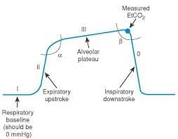
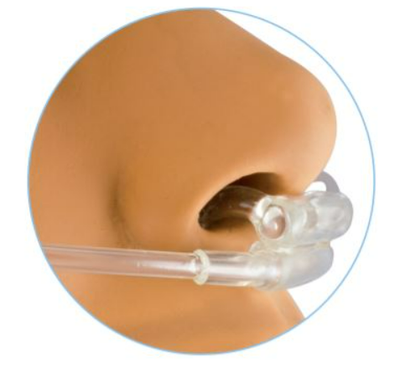
03. METHODS - OUTCOMES
Respiration:
End-Tidal CO2 (PetCO2)
Notes:
The primary outcomes were PetCO2, which is the the maximal concentration of carbon dioxide (CO2) at the end of an exhaled breath.
We measured it with a capnograph and a nasal cannula

Slide 29
03. METHODS - OUTCOMES
Psychological state & physical symptoms:
Positive and negative affect scale (PANAS) ^{[16]}
Checklist for symptoms in daily life (DLKL) ^{[14], [15]}
Notes:
Moreover, positive and negative affect were measured using the PANAS, and physical symptoms were measured using the DLKL. These were acquired after each imagery script.

Slide 30
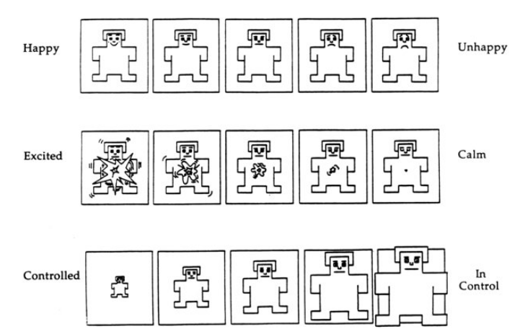
03. METHODS - OUTCOMES
Manipulation checks:
Self-assessment manikin scale ^{[18]}
Valence, arousal, dominance
Likert scales
Effort, vividness, concentration
Notes:
Additionally, manipulation checks were conducted after every trial. These consisted of the manikin scales, rating the experienced valence (happy or unhappy), arousal (excited or calm) and dominance (controlled or in control). Moreover, participants were asked about the effort it took to image the script, the vividness of the imagery and the actual time they concentrated on the script by means of a Likert scale.

Slide 31
04.
RESULTS
Notes:
So, what did we find?

Slide 32
4. RESULTS
F= 0.69
P= 0.51
Notes:
Regarding PetCO2, no significant effects of scripts were found.

Slide 33
4. RESULTS
F= 5.69
P= 0.008*
F= 13,79
P< 0.001*
Notes:
Regarding the effects of the scripts on the psychological state, the positive affect was significantly higher during the RELAX script compared to the HR script. The HR script also significantly evoked more negative affect when compared to both the ACC and RELAX script.

Slide 34
4. RESULTS
Symptoms in daily life
F= 3.25
P= 0.053
DLKL score
Notes:
No significant effects of scripts were found on psychosomatic symptoms.

Slide 35
4. RESULTS
F= 42.49
P< 0.001*
F= 12.39
P< 0.001*
MANIKIN score
F= 11.42
P< 0.001*
Notes:
So, about the manipulation checks.
Regarding the valence (which is rated from pleasant to unpleasant), the HR script was experienced as significantly more unpleasant than both ACC and RELAX, on the other hand, the RELAX script was experienced as significantly more pleasant than both HR and ACC.
Regarding the arousal (ranging from exciting to calm), the RELAX script evoked significantly more calm feelings then both the ACC and HR scripts.
Dominance (ranging from not in control to in control) followed the same pattern, indicating that the participant felt significantly less in control of the situation during the HR script compared with the ACC script and RELAX script. On the other hand, the RELAX script induced significantly more feelings of dominance in comparison to the ACC and HR script.

Slide 36
4. RESULTS
F= 7.44
P= 0.003*
F= 6.50
P= 0.005*
Likert score
F= 6.50
P= 0.005*
Notes:
Than, for the Likert scales.
The imagery of the relaxation scripts was significantly more vividly, it took less effort and the concentration time was higher when compared to the HR en ACC script.

Slide 37
05.
DISCUSSION
Notes:
So, what does this mean?

Slide 38
05. DISCUSSION - OVERVIEW
Manipulation checks:
Effect of script on valence, arousal, dominance
Effect of effort, vividness and concentration
Psychological state and physical complaints:
Effect of script on positive and negative affect
No effect of script on physical complaints
PetCO2:
No effect of script on PetCO2
Notes:
Thus, let's give a short summary.
For the manipulation checks, in an ideal situation, effects of scripts on MANIKIN would be present, and effects on Likert scales would have been absent. However, this was not always the case.
The scripts affected the Manikin questionnaires. An important aspect to take into account, is that differences between ACC and HR scripts were not present for arousal. This may have influenced the results given the impact of high arousal on respiratory parameters.
RELAX script required less effort to imagine, was more vividly experienced and was imaged a significantly higher % of the time, which may have influenced the results.
Scripts did affect positive and negative affect, which is in line with earlier research about imagery and affective picture viewing. Daily complaints were not influenced by the scripts.
PetCO2 was also not affected by the scripts. The mean values all lay within normal ranges. The fact that we did not find any effects may also be due to the scripts made for LBP patients or because the HR script was not arousing enough to provoke respiratory effects.

Slide 39
06.
CONCLUSION
Notes:
So, what do we conclude?

Slide 40
06.
CONCLUSION
Manipulation checks
Psychological state
Physical complaints
PetCO2

Slide 41
THANK YOU FOR LISTENING!
Input?
Ideas?
Suggestions?
Notes:
Thanks a lot for listening, I am very happy to hear your input, ideas, suggestions and answer your questions.

Slide 42
REFERENCE LIST
[1] Vidotto, L. S., Carvalho, C. R. F., Harvey, A., & Jones, M. (2019). Dysfunctional breathing: what do we know?. Jornal brasileiro de pneumologia : publicacao oficial da Sociedade Brasileira de Pneumologia e Tisilogia, 45(1), e20170347. https://doi.org/10.1590/1806-3713/e20170347
[2] Van Diest, I., Winters, W., Devriese, S., Vercamst, E., Han, J. N., Van de Woestijne, K. P., & Van den Bergh, O. (2001). Hyperventilation beyond fight/flight: respiratory responses during emotional imagery. Psychophysiology, 38(6), 961–968. https://doi.org/10.1111/1469-8986.3860961
[3] Bogaerts, K., Hubin, M., Van Diest, I., De Peuter, S., Van Houdenhove, B., Van Wambeke, P., Crombez, G., & Van den Bergh, O. (2007). Hyperventilation in patients with chronic fatigue syndrome: the role of coping strategies. Behaviour research andtherapy, 45(11), 2679–2690. https://doi.org/10.1016/j.brat.2007.07.003
[4] Pollock, A. S., Durward, B. R., Rowe, P. J., & Paul, J. P. (2000). What is balance?. Clinical rehabilitation, 14(4), 402–406. https://doi.org/10.1191/0269215500cr342oaImpact of Types of Breathing on Static Balance Ability in Healthy Adults
[5] Lelard, T., Stins, J., & Mouras, H. (2019). Postural responses to emotional visual stimuli. Clinicalneurophysiology, 49(2), 109–114. https://doi.org/10.1016/j.neucli.2019.01.005
[6] Adkin, A. L., & Carpenter, M. G. (2018). New Insights on Emotional Contributions to Human Postural Control. Frontiers in neurology, 9, 789. https://doi.org/10.3389/fneur.2018.00789
[7] Kim SH, Shin HJ, Cho HY. Impact of Types of Breathing on Static Balance Ability in Healthy Adults. Int J Environ Res Public Health. 2022 Jan 21;19(3):1205. doi: 10.3390/ijerph19031205. PMID: 35162227; PMCID: PMC8835336.
[8] Janssens, L., Jacobs, N., Goossens, N., Brumagne, S., Langer, D., & Hodges P. The effect of acute respiratory demands on postural control: a systematic review (UNDER REVIEW)
[9] Lin, F., Parthasarathy, S., Taylor, S. J., Pucci, D., Hendrix, R. W., & Makhsous, M. (2006). Effect of different sitting postures on lung capacity, expiratory flow, and lumbar lordosis. Archives of physical medicine and rehabilitation, 87(4), 504–509. https://doi.org/10.1016/j.apmr.2005.11.031
Notes:
Nog updaten

Slide 43
REFERENCE LIST
[10] Leon Chaitow, Breathing pattern disorders, motor control, and low back pain, Journal of Osteopathic Medicine, Volume 7, Issue 1,
2004, Pages 33-40, ISSN 1443-8461, https://doi.org/10.1016/S1443-8461(04)80007-8.
[11] Shanbehzadeh, S., Salavati, M., Talebian, S., Khademi-Kalantari, K., & Tavahomi, M. (2018). Attention demands of postural control in non-specific chronic low back pain subjects with low and high pain-related anxiety. Experimental brain research, 236(7), 1927–1938. https://doi.org/10.1007/s00221-018-5267-6
[12] Janssens, L., McConnell, A. K., Pijnenburg, M., Claeys, K., Goossens, N., Lysens, R., Troosters, T., & Brumagne, S. (2015). Inspiratory muscle training affects proprioceptive use and low back pain. Medicine and science in sports and exercise, 47(1), 12–19. https://doi.org/10.1249/MSS.0000000000000385
[13] van Hooff, M.L., et al., The Oswestry Disability Index (version 2.1a): validation of a Dutch language version. Spine (Phila Pa 1976), 2015. 40(2): p. E83-90.
[14] Wientjes, C.J. and P. Grossman, Overreactivity of the psyche or the soma? Interindividual associations between psychosomatic symptoms, anxiety, heart rate, and end-tidal partial carbon dioxide pressure. Psychosom Med, 1994. 56(6): p. 533-40.
[15] Walentynowicz, M., et al., Sensory and affective components of symptom perception. Journal of Experimental Psychopathology, 2018. 9(2).
[16] Watson, D., L.A. Clark, and A. Tellegen, Development and validation of brief measures of positive and negative affect: the PANAS scales. Journal of personality and social psychology, 1988. 54(6): p. 1063-1070
[17] Sheehan, D. V., Lecrubier, Y., Sheehan, K. H., Amorim, P., Janavs, J., Weiller, E., Hergueta, T., Baker, R., & Dunbar, G. C. (1998). The Mini-International Neuropsychiatric Interview (M.I.N.I.): the development and validation of a structured diagnostic psychiatric interview for DSM-IV and ICD-10. The Journal of clinical psychiatry, 59 Suppl 20, 22–57.
[18] Bradley, M. M., & Lang, P. J. (1994). Measuring emotion: The Self-Assessment Manikin (SAM) and the semantic differential. Journal of
Behavior Therapy and Experimental Psychiatry, 25, 49–59.
Notes:
Nog updaten

Slide 44
05.
REFLECTIONS
Notes:
Very simplistic visualisation
Thus, based on the manipulation checks, the scripts were imaged correctly. It had some effect on affect and somatic symptoms, but no effect on PetCO2.
Te veel herhaling?
Moet ik ook OZV'en opstellen over de andere 2 pijlen? (nu enkel eentje over de PetCO2)?

Slide 45
Arousal
05. DISCUSSION - MANIKIN
+
Hostile-resistance
-
+
Valence
Hostile-resistance
-
Notes:
We expected that the HR script would be experienced as highly arousing and higly unpleasant, however, in this study, it was not experienced as arousing. This may be declared by the fact that those scripts were written for individuals with low back pain, which makes it hard for healthies to imagine.

Slide 46
Arousal
05. DISCUSSION - MANIKIN
+
-
+
Valence
Valence
Acceptance
Acceptance
-
Notes:
Additionally, the acceptance script was not experienced as unpleasant as expected. Probably also because of the situation described being not as relevant for healthies.

Slide 47
Arousal
05. DISCUSSION - MANIKIN
+
-
+
Valence
Valence
Relaxation
-
Notes:
Relaxation was experienced as pleasant and non arousing, which was in line with our expactations

Slide 48
01. INTRODUCTION
Bigger picture
*[10]
*[11]
*[12]
*[10] Chaitow, et al. (2004)
*[11] Shanbehzadeh, et al. (2019)
*[12] Janssens, et al. (2015)

Slide 49
4.1.
SUMMARY - MANIPULATION CHECKS

Slide 50
4.2.
SUMMARY - PSYCHOLOGICAL STATE

Slide 51
4.3.
SUMMARY - PETCO2

Slide 52
4. RESULTS - scriptxphase

Slide 53
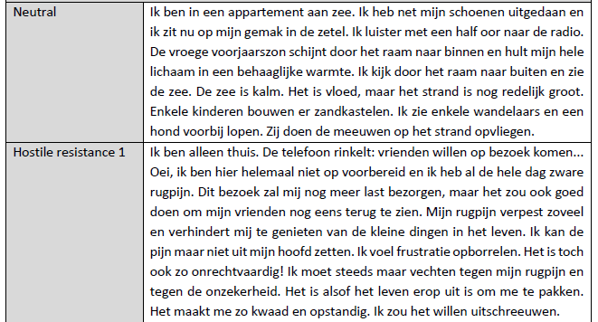

Slide 54
