Slide 1
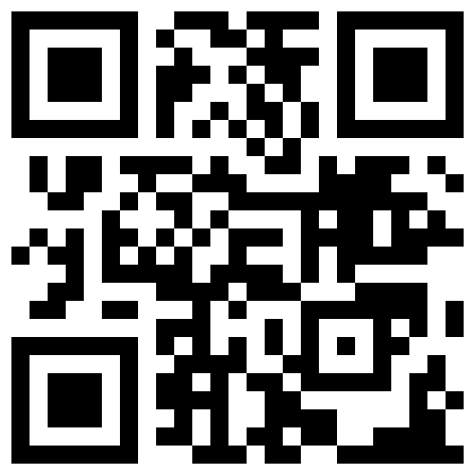
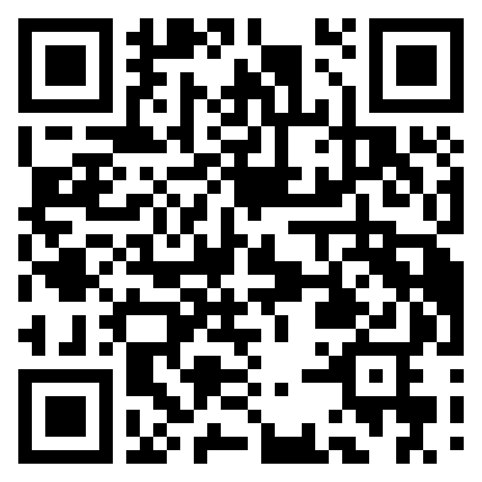
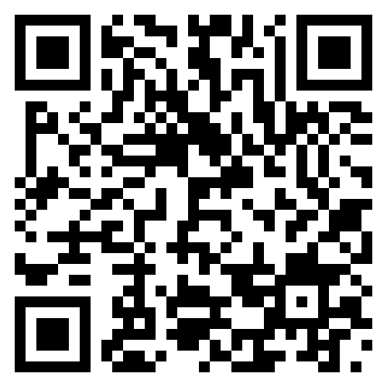
Consulting with Global Data Communities to Converge on Semantic Interoperability Solutions for the European Data Space for Science, Research and Innovation (EOSC)
Interoperability is at the heart of large-scale cross-disciplinary and federated infrastructures
The Semantic Interoperability Task Force of the EOSC Association has 40+ members from across the European research stakeholder community. It has liaised with European projects and stakeholders through a series of discussion papers, workshops and an open survey to build on the EOSC Interoperability Framework and further develop and implement the semantic interoperability recommendations.
Towards a landscape overview of the components required to enable semantic interoperability across disciplines and use cases
Realising semantic interoperability involves a broad spectrum of socio-technical challenges. Representatives from the Task Force are currently conducting an interview-based survey that will inform a landscape overview of solutions, challenges and success factors and the Task Force’s forthcoming recommendations.
An open invitation to the global community to contribute
Individual members of the task force are committed contributors across various RDA interest groups and working groups and by presenting this poster the ambition is to identify synergies and new venues for collaborations. Global stakeholders are welcome to reach out to the Semantic Interoperability Task Force and its members as well as the EOSC Association to discuss opportunities to align activities across regions.
Landscape overview and survey coordination: Kurt Baumann <kurt.baumann@switch.ch> Milan Ojsteršek <milan.ojstersek@um.si>
EOSC Semantic Interoperability Task Force Co-Chairs: (Note: Task Force mandate ends in December 2023) Wolmar Nyberg Åkerström <wolmar.n.akerstrom@uu.se> Oscar Corcho <oscar.corcho@upm.es>
EOSC Association: https://eosc.eu/ https://eosc.eu/advisory-groups/
Poster DOI: https://doi.org/10.17044/scilifelab.24316936
Authors: Baumann, Kurt (SWITCH); Nyberg Åkerström, Wolmar (NBIS); David, Romain (ERINHA AISBL); Magagna, Barbara (GO FAIR); Widmann, Heinrich (DKRZ); Le Franc, Yann (eSDF); Vogt, Lars (TIB); Jouneau, Thomas (UL); Koivula , Hanna (CSC); Madon , Bénédicte (DANUBIUS RI-USE); Molinaro, Marco (INAF); Ojsteršek, Milan (UoM); Schubert, Chris (TU Wien); Shi, Zhengdong (UP Saclay); Tanca, Letizia (PdM); & Vancauwenbergh, Sadia (UHasselt); Scharnhorst, Andrea (DANS-KNAW)
A web of FAIR data and services for research
Science Consumers
(Human or Machine)
Interoperate
Discover &
Access
Domain A
Reuse by
machine actions
Level of Interoperability
Cross -- Domain -- Specific
Crosswalks
Domain B
Standard A.5.3
Interoperate
Standard B.x.7
Science Producers
(Research
Communities and Data spaces )
The EOSC Interoperability Framework
The EOSC Interoperability Framework (EOSC-IF) enables interoperability across resources and services and is essential for building a European Open Science Cloud that is federated and fit for purpose. In turn, interoperability guidelines are necessary to facilitate the cross-discipline collaboration of researchers, providers and research communities.
Semantic Governance Content
Semantic Functional Content
Metadata Catalogue
Semantic Artefact Catalogue
Mapping Repository
FAIR Principles
Semantic Interoperability Specification
Semantic Business Objects
Identifier Scheme
Semantic Interoperability Agreement
Conceptual Metadata Framework
Semantic Artefact
Domain Metadata
Minimal Metadata
Ontology
Terminology
Data Model
Controlled Vocabulary
Presented during Research Data Alliance (RDA) 21st Plenary, International Data Week 2023: A Festival of Data, 23–26 October 2023, Salzburg, Austria
FAIR Digital Object
Data Syntax
Open Formats
The interoperability landscape survey
A Semantic Interoperability Profile (SIP) is a list of FAIR Supporting Resources, such as semantic artefacts, crosswalks, validation services chosen by a community to support semantic interoperability of (meta)data.
FAIR Implementation Community
nanopublication
declared-by
FAIR-Supporting Resource
assertion
Digital Object Type
Considerations
SIP Declaration
Available FAIR-Supporting Resource
FAIR-Supporting Resource to be Developed
provenance
declared-for
publication info
Methodology
declares-current-use-of /
declares-planned-use-of / declares-planned-replacement-of
The SIP Wizard was created as a data entry tool based on the FAIR Implementation Profile (FIP) Ontology
https://sip-wizard.ds-wizard.org/ https://w3id.org/fair/fip/terms
https://eosc.eu/advisory-groups/semantic-interoperability
Notes:
https://www.rd-alliance.org/rdas-21st-plenary-poster-exhibition
Poster number: 41
Poster title: Consulting with Global Data Communities to Converge on Semantic Interoperability Solutions for the European Data Space for Scien
Main author: Kurt Baumann
Affiliation: SWITCH

