Slide 1
Jack of all trades, master of none: the one-stop-shop as a double-edged sword for external accountants
Rob Janssens, Maarten Corten, Nadine Lybaert, Anneleen Michiels, Jelle Schepers

Slide 2
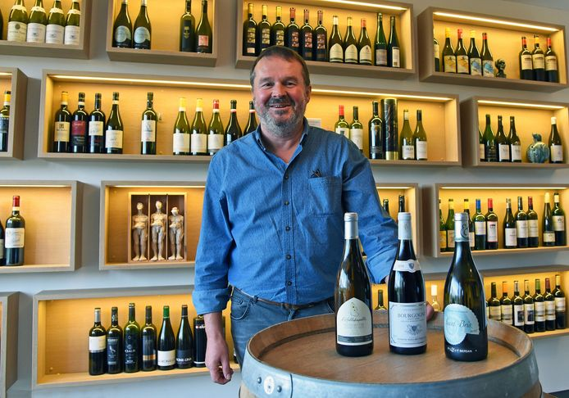

Slide 3
Theory & hypotheses

Slide 4
Accountants
HR services
Insurance services
Legal services
Marketing services
Compliance services
Operational services
Financial services

Slide 5
Accountants
One-stop-shop
Compliance services
Financial services
Operational services
Legal services
Insurance services
Marketing services
HR services

Slide 6
Hypothesis 1
One-stop-shop configuration
+
Customer satisfaction

Slide 7
Hypothesis 2
Perceived competence
-
+
One-stop-shop configuration
+
Customer satisfaction

Slide 8
Methodology

Slide 9
Data
Sample
186 unique accountant-owner-manager pairs
Questionnaire data in combination with archival data (Belfirst)
Dependent variable
Satisfaction
“I am satisfied with my accountant and the services he/she offers”

Slide 10
Data
Independent variables
Service quantity
Total amount of services
Service diversification
The number of service categories in which at least one service is provided
Financial
Legal
Strategic
Operational

Slide 11
Data
Mediator
Perceived competence
Trustworthiness scale of Mayer & Davis (1999)
Control variables
Perceived benevolence (trustworthiness scale of Mayer & Davis (1999))
Perceived integrity (trustworthiness scale of Mayer & Davis (1999))
Length of client relationship in years (ln)
Number of meetings (ln)
Firm age (ln)

Slide 12
Results

Slide 13
Descriptives
Mean Med. SD Min Max
Satisfaction 4.231 4.000 0.927 1.000 5.000
TotalServices 15.98 15.000 7.568 3.000 33.000
DiversificationCount 3.452 4.000 0.721 1.000 4.000
Trust_Competence 4.231 4.333 0.678 1.167 5.000
Trust_Benevolence 4.041 4.200 0.806 1.400 5.000
Trust_Integrity 4.212 4.333 0.642 1.833 5.000
YearsOfRelationship 6.973 4.000 7.373 0.000 42.000
NumberOfMeetings 2.129 2.000 1.781 0.000 15.000
Firm_Age 10.69 7.000 8.856 2.000 51.000

Slide 14
Correlations
(1) (2) (3) (4) (5) (6) (7) (8)
1 - Satisfaction
2 - TotalServices 0.010
3 - DiversificationCount -0.036 0.640***
4 - Trust_Competence 0.684*** -0.160* -0.156*
5 - Trust_Benevolence 0.729*** -0.131 -0.153* 0.799***
6 - Trust_Integrity 0.628*** -0.121 -0.171* 0.809*** 0.834***
7 - YearsOfRelationship 0.023 -0.020 0.003 0.049 0.172* 0.061
8 - NumberOfMeetings 0.276*** 0.081 -0.027 0.280*** 0.240*** 0.210*** 0.043
9 - Firm_Age 0.044 -0.022 -0.071 0.049 0.109 0.031 0.546*** 0.117

Slide 15
Regression results
H2
Perceived competence
-**
+**
One-stop-shop configuration
+**
Customer satisfaction
H1

Slide 16
Conclusions

Slide 17
Conclusions
Increasing the number of advisory services to become a one-stop-shop may be a double-edged sword
On the one hand, you meet the increasing demand of (diverse) advisory services → meeting quantity needs
On the other hand, you may be considered as a jack of all trades but a master of none → not meeting the quality needs

Slide 18
Contributions
As the literature generally considers the transition of accountants from compliance officers to full-fledged business advisors to be a good thing, this study suggests that there may also be a downside
For theory, we therefore provide a more nuanced view based on expectation gap and substance versus quality perspectives
For practice, we highlight that there is no one-size-fits-all solution to become the accountant of the future

Slide 19
Limitations
Small sample
Belgian context
Measures could be refined

Slide 20
Jack of all trades, master of none: the one-stop-shop as a double-edged sword for external accountants
Rob Janssens, Maarten Corten, Nadine Lybaert, Anneleen Michiels, Jelle Schepers

