Slide 1
The impact of the CEO’s entrepreneurial orientation on internationalization: the moderating role of the CEO’s international legal literacy
Work-in-progress paper
Maren Forier, Nadine Lybaert, Maarten Corten, Niels Appermont, Tensie Steijvers
IRMBAM 2023

Slide 2
Internationalization is a valuable strategy for firms’ growth and expansion

Slide 3
Research problem
Firm-level drivers of internationalization:
Financial resources
Product diversification
Firm-specific assets
Firm’s level of entrepreneurial orientation (EO)
Notes:
To achieve this growth, research has focused on the possible drivers of internationalization. Key firm-level drivers that have already been examined in the context of internationalization include the firm’s financial resources, product diversification and firm- specific assets, such as exceptional talent, R&D, but also the firm’s level of EO

Slide 4
Research problem
The Firm’s level of EO
= the firms’ disposition to entrepreneurship
= indicates the intention to internationalize
= a key element in firms’ internationalization process
Upper Echelons theory: the decision and extent of internationalization is made by managers
→ Focus on people that drive these decisions
Notes:
The firm’s level of EO is the firms’ disposition to entrepreneurship, it indicates the intention and thus the willingness to internationalize and it is a key element in firms’ internationalization process
However, while several firm-level determinants are considered to be good predictors for internationalization, the decision and extent of internationalization is made by the managers of the firm
Following the Upper Echelons theory, it is therefore important to examine the people that drive these decisions

Slide 5
Research problem
Upper Echelons theory within SME’s:
Main decision maker = CEO
Organizational structure less hierarchical
→ Focus on individual role of CEO in context of internationalization
Focus on CEO’s entrepreneurial orientation
Hypothesis 1 (H1): There is a positive association between the CEO’s entrepreneurial orientation and internationalization
Notes:
More specifically, according this theory, within SMEs, the main decision maker is generally the CEO because the organizational structure of these firms is less hierarchical
Therefore, we will focus on the individual role of the CEO in the context of internationalization, and more specifically, as previous studies show that EO is a strong firm-level driver of internationalization, we expect, taking into account the upper echelons theory, the EO of the CEO to be a strong individual-level driver, and this brings us to our first hypothesis: H(1):

Slide 6
Research problem
Successful international activity requires specialized and higher quality resources
In-house resources of the firm
KNOWLEDGE
EO = internationalization intentions
Resource Based View (RBV)
Effective internationalization
important resource in internationalization process
Foreign market knowledge
Notes:
However, although entrepreneurial intentions are often a good predictor for (international) entrepreneurial activity, intentions will not always lead to expected action
More specifically, according to The Resource-Based View (RBV), successful international involvement of a firm requires more specialized and higher quality resource types
One of the main, and empirically demonstrated resources that has a fundamental impact on a firm’s early internationalization is the knowledge possessed by the CEO of the firm. More specifically, knowledge is regarded as the most important resource in a firm’s internationalization process. Previous studies on the internationalization of small firms state that international or foreign market knowledge benefits the internationalization process

Slide 7
Research problem
CEO’s international legal knowledge
Lack of (international) legal knowledge:
can complicate the process of strategic business decisions
may cause stress and anxiety
→ never empirically examined
“Empirically examining the moderating impact of the CEO’s level of international legal literacy on the relationship between the CEO’s EO and internationalization”
Notes:
However, in our opinion, what is currently missing in the internationalization research field is the importance of the CEO’s international legal knowledge or legal literacy.
In previous literature, researchers theorise that a lack of legal literacy could complicate the process of strategic business decisions (like the internationalization of a firm), as it may cause stress and anxiety when making decisions
However, these studies never empirically examine the potential impact of the CEO’s level of legal literacy.
Therefore, in this study we fill this gap by empirically examining the moderating impact of the CEO’s level of international legal literacy on the relationship between the CEO’s EO and internationalization

Slide 8
Research problem
Taking into account the RBV, a lack of legal literacy:
negatively influence the relationship between CEO’s EO and internationalization
a barrier in the process of willingness to internationalize and effective internationalization
Hypothesis 2 (H2): The CEO’s lack of international legal knowledge weakens the positive association between the CEO’s entrepreneurial orientation and internationalization
Notes:
More specifically, taking into account the RBV, we expect that the CEO’s lack of international legal literacy will negatively influence the relationship between the CEO’s EO and internationalization
in such a way that it can be a barrier in the process of the willingness to internationalise and effectively conducting (more) international activities.
This brings us to our next hypothesis, H2: The CEO’s lack of legal knowledge weakens the positive association between the CEO’s entrepreneurial orientation and internationalization

Slide 9
Research problem
The role of an (external) legal advisor
→ may compensate for the CEO’s lack of international legal knowledge
Hypothesis 3 (H3): The use of an external (legal) advisor positively moderates the negative moderating effect of the CEO’s lack of international legal knowledge on the positive association between the CEO’s entrepreneurial orientation and internationalization
Notes:
In addition, we also examine the role of an external (legal) advisor in this context, as we expect that hiring an external (legal) advisor may compensate for the CEO’s lack of international legal knowledge, and therefore will also weaken the moderating effect of the CEO’s international legal literacy.
This brings us to our third and last hypothesis: H(3): The use of an external (legal) advisor positively moderates the negative moderating effect of the CEO’s lack of international legal knowledge on the positive association between the CEO’s entrepreneurial orientation and internationalization.

Slide 10
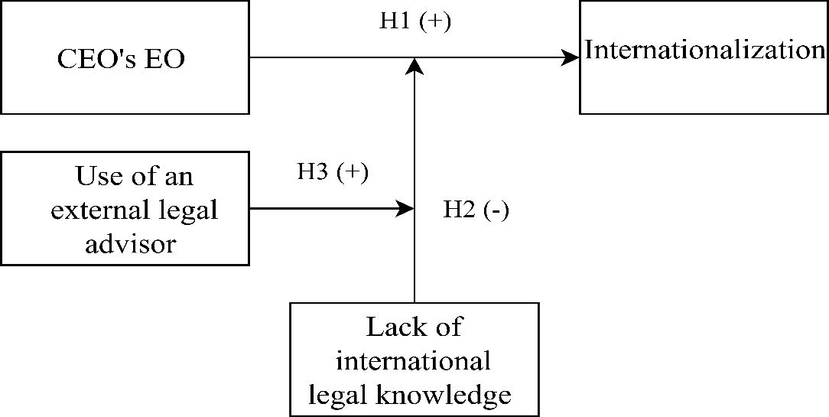
Conceptual research model

Slide 11
Methodology
CEO’s of private Flemish SMEs that are willing to internationalize or are internationally active
→ Small firms are a reflection of their leaders
→ No legal department
Create own scale to measure international legal literacy:
→ Flemish SMEs mainly trade with neighbouring countries or within the European Union
→ Test CEO’s knowledge on international laws and regulations, focusing on European regulations
Questionnaire survey approach
OLS regressions
Notes:
In doing this, we will focus on the CEO’s of private Flemish SMEs, that are willing to internationalize or are internationally active
We focus on small firms since these firms are generally a reflection of their leaders (and thus the CEO), and since these companies will not have a legal department from which they obtain legal advice.
We create our own scale to measure the CEO’s level of international legal literacy. Since this study focuses on Flemish CEOs, and they mainly trade with neighbouring countries or within the European Union, we choose to test their knowledge on international laws and regulations, focusing on European regulations Furthermore
we will employ a survey approach to collect data
Finally, we will perform OLS regressions on this data to test our hypotheses.

Slide 12
Results

Slide 13
The impact of the CEO’s entrepreneurial orientation on internationalization: the moderating role of the CEO’s international legal literacy
Work-in-progress paper
Maren Forier, Nadine Lybaert, Maarten Corten, Niels Appermont, Tensie Steijvers
IRMBAM 2023

Slide 14
The CEO’s level of international legal literacy:
1) You can incorporate a company under Belgian law in any country, and it will always
be recognised in that country.
2) Within the European Union Belgian companies are in in principle free to operate across
national borders trade.
3) Within the European Economic Area (EEA), Belgian companies are in principle free to
operate across national borders trade.
4) When a Belgian company has its registered office in Luxembourg but is actually
managed from Belgium, it has the choice of where it will pay corporate tax.
5) When you, as a Belgian company, have goods transported abroad, the risk of loss due
to force majeure always passes to the buyer from the moment the goods cross the
Belgian land border.
6) When a Belgian company has a shop in the Netherlands, profits relating to that shop
will be taxed at Belgian corporate tax rate.
7) If you are a Belgian company advertising in a German newspaper, the German court
will have jurisdiction when the company has a dispute with a German consumer.

Slide 15
8) If a Belgian company offers a Spanish-language version website, and indicate on it that
you can deliver the products in Spain, then in the event of a dispute with a Spanish
consumer, the Spanish court will have jurisdiction.
9) When a Belgian company enters into a contract with a French company, they are in
principle free to choose whether Belgian or French law applies to this contract.
10) A company incorporated in Belgium, under Belgian law, will only be able to be declared
bankrupt in Belgium.

