Slide 1
The influence of individual entrepreneurial orientation fit on SMEs’ use of external accountants’ advice
Presenter: Rob Janssens
Co-authors: Maarten Corten, Nadine Lybaert, Anneleen Michiels, Jelle Schepers

Slide 5
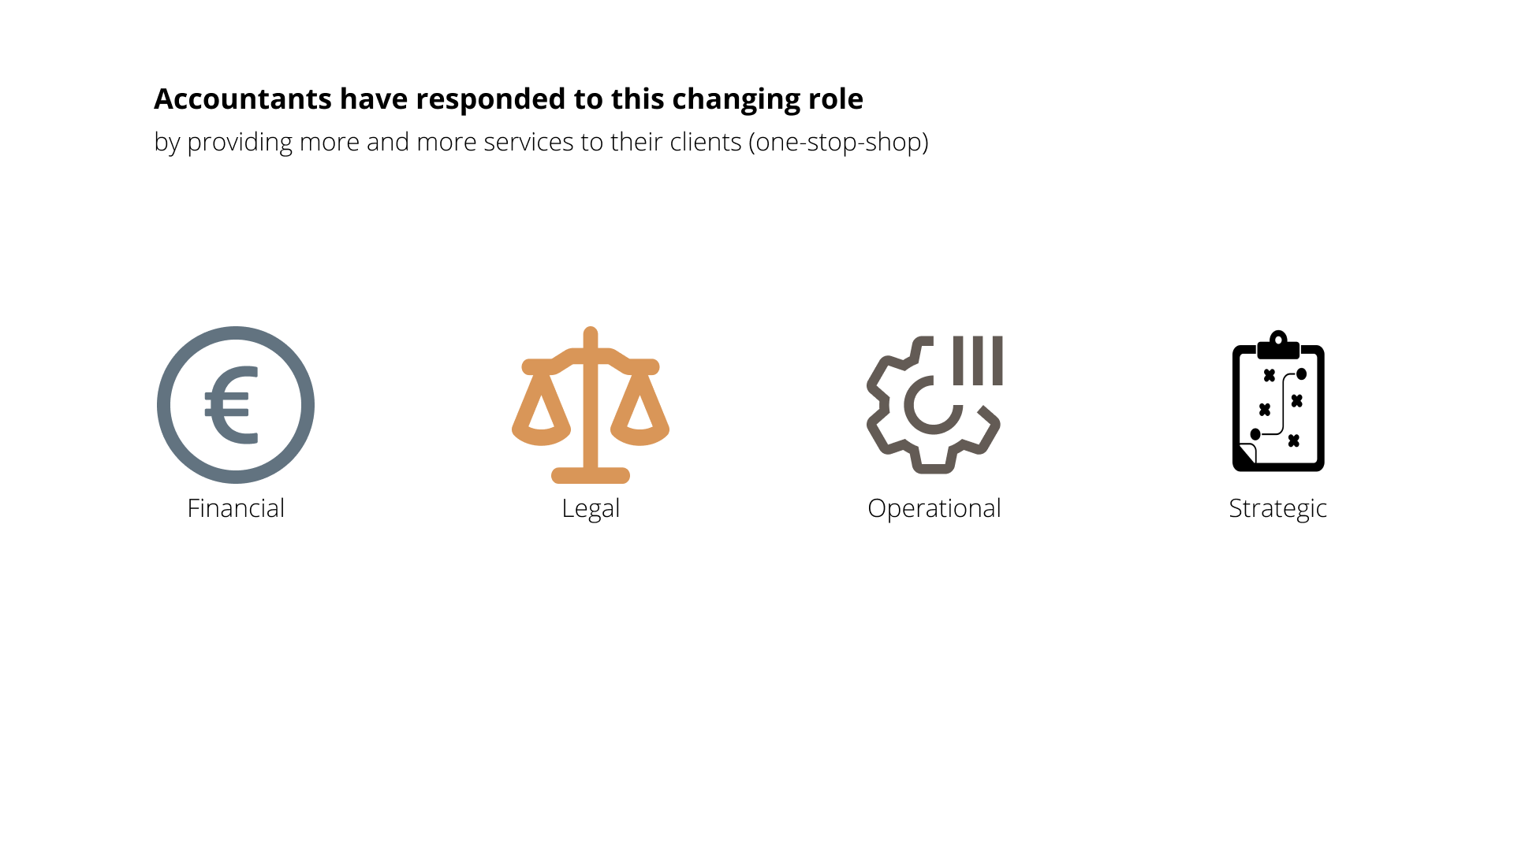

Slide 9
Is the business advisor role only about providing services?

Slide 10
Business advisor = Services

Slide 11
Business advisor = Services | Personal attributes
“What type of external accountant is really important”

Slide 12
Technical aspect
The service outcome or result for the customer
Business advisor = Services | Personal attributes
Functional aspect
The process of delivering the service

Slide 13
Business advisor = Services + Personal attributes

Slide 14
Business advisor = Services + Personal attributes

Slide 15
Goal of this paper
To identify functional aspects that encourage advice use by SMEs

Slide 16
What did we actually find?
A key functional aspect is Individual Entrepreneurial Orientation
The IEO fit between owner-managers and external accountants matters
Owner-managers seek innovativeness-minded and risk-balancing accountants.

Slide 17
Let me tell you how we found that
What is Individual Entrepreneurial Orientation?
What is IEO fit?
What are the results?

Slide 18
What is Individual Entrepreneurial Orientation?
💡
⚡
🎲
Innovativeness
Proactiveness
Risk-taking

Slide 19
IEO could be a key functional aspect of the business advisor
💡
Innovative accountants can solve owner-managers’ problems in unique ways
⚡
Proactive accountants can foresee their needs
🎲
Risk-taking accountants can help them succeed

Slide 20
Does every owner-manager want the same kind of external accountant?

Slide 21
Owner-managers may not use any kind of entrepreneurial accountant
Owner-managers differ in traits and styles, resulting in various IEO profiles

Slide 22
Owner-managers may not use any kind of entrepreneurial accountant
Therefore, we think that owner-managers prefer an accountant who fits with their IEO profile

Slide 23
Owner-managers may not use any kind of entrepreneurial accountant
Person-environment fit literature
Congruence between individuals have positive outcomes

Slide 24
Owner-managers may not use any kind of entrepreneurial accountant
Owner-managers may want a sounding board that fits with their IEO profile

Slide 25
A sounding board ≠ full agreement

Slide 26
A sounding board does not always mean full agreement
Entrepreneurship is the art of finding, pursuing, and balancing
💡
Innovativeness motivates owner-managers to find new opportunities
⚡
Proactiveness enables a forward-looking approach to pursue opportunities
🎲
Risk-taking requires a balance: not too much, not too little.

Slide 27
A sounding board does not always mean full agreement
So we may need a specific ‘type’ of fit for each IEO dimension
Supplementary fit
Complementary fit

Slide 28
A sounding board does not always mean full agreement
We propose two sets of hypotheses
💡
⚡
🎲
Supplementary fit
Complementary fit

Slide 29
Methodology
What did we do?

Slide 30
Methodology
What did we do?
Unique dataset of 161 owner-manager – external accountant pairs
Surveying IEO of owner-managers and external accountants via Bolton & Lane (2012) Likert scale

Slide 31
Methodology
What did we do?
We created fit variables using absolute differences
IEO_[I; P; R]_AD = ⎜OM_{IEO} - ACC_{IEO} ⎜
0 means perfect fit, 4 means total mismatch.

Slide 32
Methodology
What did we do?
We used OLS regression for the following model
OM_UseAdvice = β_{0i} + B_{1i}IEO_Innov_AD + B_{2i}IEO_Proact_AD + B_{3i}IEO_Risk_AD + B_{4-4+n}θ +ε_{i}

Slide 33
Results
What did we find?
💡
-0.22†
⚡
Proactiveness
🎲
Risk-taking
0.27*
Supplementary
Complementary
†= p < 0.10; *= p < 0.05

Slide 34
What’s the conclusion?
Studying the functional aspect is important
IEO is a key functional aspect and the fit matters for the use of advice
Future research should consider the role of fit in advisory relationships

Slide 35
The influence of individual entrepreneurial orientation fit on SMEs’ use of external accountants’ advice
Presenter: Rob Janssens
Co-authors: Maarten Corten, Nadine Lybaert, Anneleen Michiels, Jelle Schepers

