Slide 1
Positive action to tackle systemic discrimination in the Belgian labour market
Dr. Sara Vancleef
FWO PENDL-project G078520N

Slide 2
OVERVIEW
PART I. Employment gap
PART II. Systemic discrimination
PART III. Positive action
PART IV. Legal framework
PART V. Improvement suggestions

Slide 3
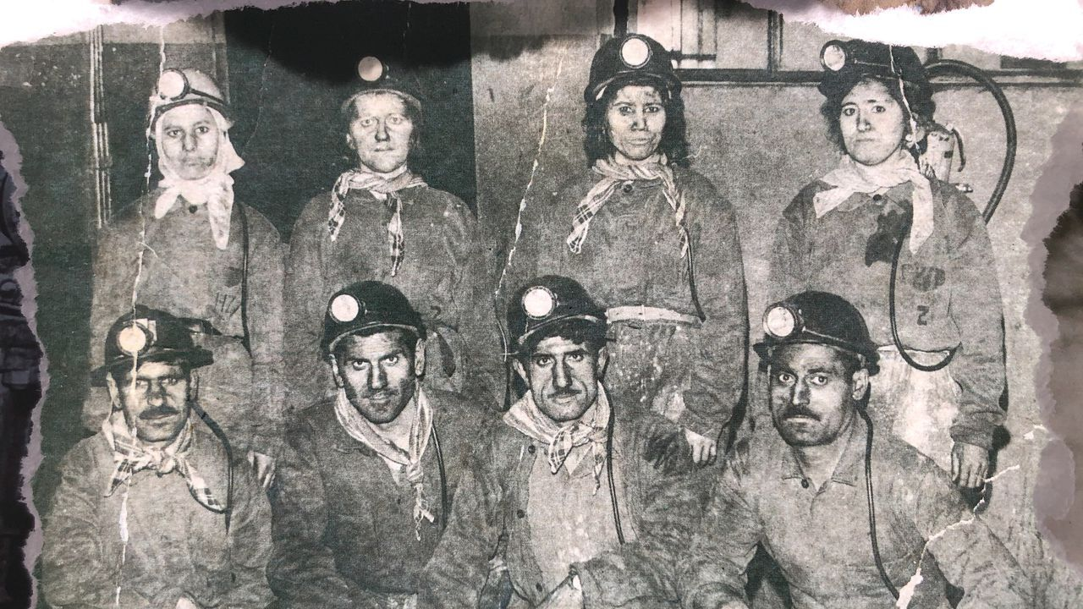
PART I. EMPLOYMENT GAP
Belgium is one of the most multicultural countries…
KINDEREN VAN DE MIGRATIE © VRT NWS
KINDEREN VAN DE MIGRATIE © VRT NWS

Slide 4
PART I. EMPLOYMENT GAP
… but also one of the worst-performing with regard to employment outcomes of persons with a migration background
LABOUR FORCE SURVEY © EUROSTAT

Slide 5
PART I. EMPLOYMENT GAP
What causes this gap?

Slide 6
PART II. SYSTEMIC DISCRIMINATION
Nowadays, discrimination is more systemic in nature
Disparate impact, spill-over effects & many offenders and victims
Individual enforcement model?
Great responsibility for victims of discrimination
Requires proof of discrimination by an identifiable perpetrator
Little potential for structural change

Slide 7
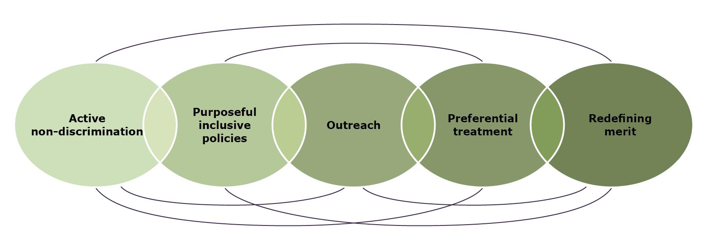
PART III. POSITIVE ACTION
Positive action: all measures and programs that go beyond the prohibition of discrimination, and proactively aim for a better integration of disadvantaged or underrepresented groups in important societal domains

Slide 8
PART IV. EU LEGAL FRAMEWORK
Positive action is mainly an exception to equality
Art. 5 Race Directive 2000/43/EC: “With a view to ensuring full equality in practice, the principle of equal treatment shall not prevent any Member State from maintaining or adopting specific measures to prevent or compensate for disadvantages linked to racial or ethnic origin”.
Positive action is not an obligation, but a possibility for Member States (subsidiarity)
Exc.: Women on Boards Directive no. 2022/2381

Slide 9
PART IV. EU LEGAL FRAMEWORK
Court of Justice of the EU
1997: Reverse discrimination of men
Equally qualified women: no absolute and unconditional priority
2010: Gender stereotyping
No perpetuation of traditional roles between men and women
2017: “New” protected characteristics
Disability and belief: strict proportionality test

Slide 10
PART IV. BELGIAN LEGAL FRAMEWORK
Positive action is mainly an exception to equality
Art. 4, 11°, Anti-racism Law: “Positive action: specific measures to prevent or compensate disadvantages related to one or more protected characteristics, with a view to securing a full equality in practice”.
Art. 10, Anti-racism law: “§1. A direct or indirect distinction based on one or more protected characteristics can never result in a form of discrimination when this direct or indirect distinction constitutes a measure of positive action […]”.
Positive action is usually voluntary
Subject to conditions
Exceptions here and there (eg. for women and disabled persons in public service sector)

Slide 11
PART V. IMPROVEMENT SUGGESTIONS: EU
Encourage or oblige Member States to implement positive action
More efficient application of positive action
Independent initiatives by EU institutions

Slide 12
PART V. IMPROVEMENT SUGGESTIONS: BELGIUM
A better framework for positive action…
Clear legislative framework, information campaigns, more transparency,…
…and a more binding approach:
Diversity analysis
Design positive action plan
Implement positive action plan
Evaluate positive action plan (and report)
Rewards and sanctions
Material and financial support

