Slide 1
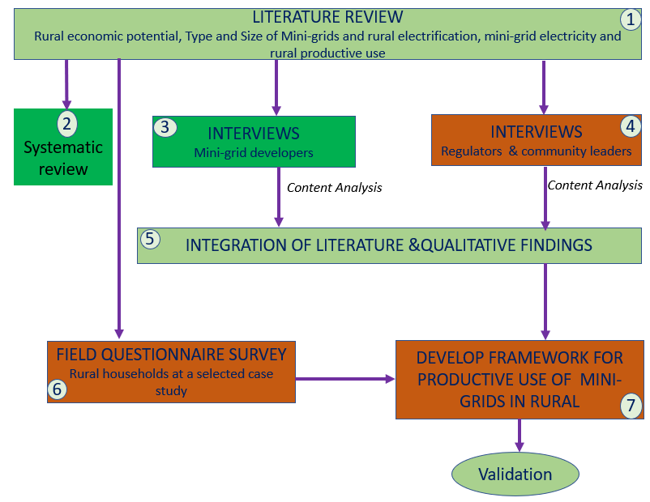
Socio-economic Impacts of Rural Electrification Through Renewable Mini-grids in Tanzania
Gonda, W.O¹; Verbeeck, G²; Kombe, W.³; Deferme, W.⁴; Phoya, S.^{5.}
^{1,3,5} Ardhi University, Tanzania; ^{2,4} Hasselt University, Belgium.
1. Introduction
Rural communities are the most disadvantageous communities in terms of energy provision particularly electricity (Aklin et al., 2017, Szabó et al., 2021).
Rural electrification highly depends on off-grid solutions more than grid connection due to rural challenges such as transmission cost, affordability, disperse population and low consumption rate (Szabo et al., 2021; Crentsil, 2020).
Off-grid solution particularly mini-grids from renewable sources have been the main source of energy for rural communities (Blum et al., 2013, Uamusse, 2019).
5. Research Methodology
2. Problem statement
There is scarce research and unreliable information on how rural communities use mini-grid electricity towards socio-economic development. Therefore, critical analysis of socio-economic benefits of mini-grid electricity in the rural area towards rural livelihood improvement is vital. The focus is on how electricity access is linked to social-economic development through productive use of the electricity.
6. Initial Pilot findings
Main mini-grid type is hybrid solar (solar and generators).
Design of mini-grids depends on customer’s demand assessment
Primary customers: Household (70%-80%)
Secondary customers: Productive users (i.e Local economic activities).
Mini-grid size is closely related to the kind of the productive activities.
Social activities: Churches, Schools, Mosques, Dispensaries.
Economic activities: Milling, Welding, Music shops, Video/cinema shows, Mini shops, Barber shops, Tailoring mat, Phone charging, Restaurants and Bars, Animal keeping and Dairies.
Financial issues:
- Majority cannot afford the electricity as per new tariff set by mini-grid developer
- Affordability of the appliances for economics activities is also a challenge
Political issues: Tariff directives has negatively impacted the supply and reliability of electricity to users.
3. Aim of the Research
This study aims at exploring renewable mini-grid electrification in the context of rural communities focusing on how it has impacted on the productive uses and livelihoods improvement
Specific Objectives
To examine the institutional framework and financialization of mini-
grid in Tanzania
To assess the demand and uses of mini-grid electricity within the context of rural development in Tanzania
To analyse the socio-economic impacts of mini-grid electrification in
rural areas of Tanzania.
To propose a framework and institutional response that guide mini-
grid electrification conditionalities in Tanzania.
4. Initial Literature findings
Renewable mini-grids electrification is pushed into the rural areas in a way that results in more consumptive use rather than productive use.
Minimal link between rural economic potential and productive use of mini-grid electricity.
Productive use of mini-grid electrification pulled by rural economic potential may result in socio-economic benefits.
There is a knowledge gap between renewable mini-grids, productive use and rural potential value chain.
8. Key references
Aklin, M., Bayer, P., Harish, S. P., & Urpelainen, J. (2017). Does basic energy access generate socioeconomic benefits? A field experiment with off-grid solar power in India. Science Advances, 3(5).
Blum, N. U., Sryantoro Wakeling, R., & Schmidt, T. S. (2013). Rural electrification through village grids - Assessing the cost competitiveness of isolated renewable energy technologies in Indonesia. In Renewable and Sustainable Energy Reviews.
Crentsil, A. O., Fenny, A. P., Ackah, C., Asuman, D., & Otieku, E. (2020). Ensuring access to affordable, sustainable and clean household energy for all in Ghana. Ocasional Paper Series, 62(July).
Szabó, S., Pinedo Pascua, I., Puig, D., Moner-Girona, M., Negre, M., Huld, T., Mulugetta, Y., Kougias, I., Szabó, L., & Kammen, D. (2021). Mapping of affordability levels for photovoltaic-based electricity generation in the solar belt of sub-Saharan Africa, East Asia and South Asia. Scientific Reports, 11(1), 1–14.
Uamusse, M. (2019). Sustainable energy solutions Electrification of rural Mozambique Sustainable energy solutions.
7. Expected outcome
Linkage between productive activities and mini-grid electricity towards contextual value chain of the electricity supply and mini-grid development.
How mini-grid investors can synchronize surrounding economic stimulus of the area to support the value chain of mini-grid electricity.
Establish user-oriented solutions for both social and economic challenges related to mini-grid electricity in rural communities.
Framework for productive use of mini-grids electricity in rural areas.

