Slide 1
How to start up cardiac rehab? How to optimize a CR program according to standards?
Prof. Dominique Hansen, PhD, FESC
Hasselt University, Hasselt, Belgium
Baku, Azerbaijan, 4-5 May 2024

Slide 2
Declaration of interest
None to be declared

Slide 3
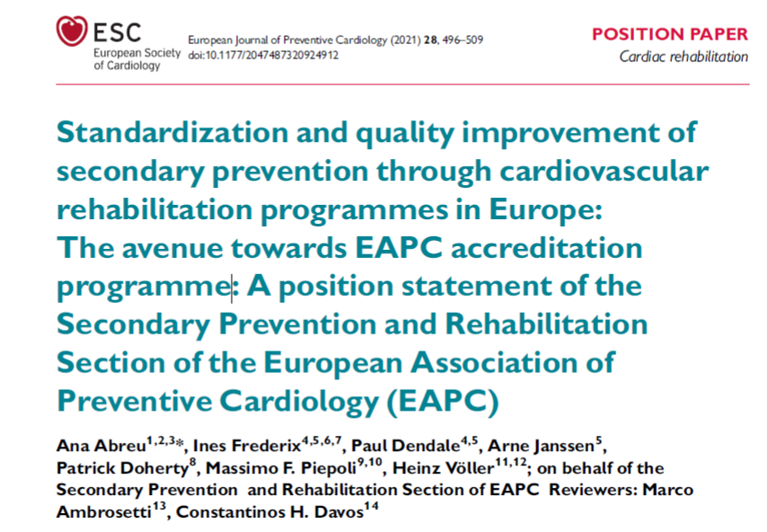
All you need to know…

Slide 4
Why cardiac rehab?
Contemporary CVD risk factor control (at 6-24 months after coronary event or diagnosis):
CVD risk factors:
Hypertension (>140/90 mmHg): 42%
Dyslipidemia (LDL >1.8 mmol/L): 71%
Hyperglycemia (HbA1c >7.0%): 46%
Overweight and obesity: 82%
Lifestyle factors:
Smoking: 19%
Insufficient physical activity: 66%
27 countries: Belgium, Bosnia & Herzegovina, Bulgaria, Croatia, Czech Republic, Egypt, Finland, Germany, Greece, Ireland, Italy, Kazakhstan, Kyrgyzstan, Latvia, Lithuania, The Netherlands, Poland, Portugal, Romania, Russia, Serbia, Slovenia, Spain, Sweden, Turkey, Ukraine, UK, covering 8261 patients
Kotseva K, et al. Lifestyle and impact on cardiovascular risk factor control in coronary patients across 27 countries: Results from the European Society of Cardiology ESC-EORP EUROASPIRE V registry. Eur J Prev Cardiol. 2019;26(8):824-835.

Slide 5
Cardiac rehab = the road to optimal CVD risk factor control
Approximate Mortality Reduction Potential of Preventive Drug Interventions After MI
Intervention Mortality Risk Reduction, Mean (95% CI)
Low-dose aspirin 18% (1%–30%)
Statins 21% (14%–28%)
β-Blockers 23% (15%–31%)
ACE inhibitors 26% (16%–35%)
Iestra JA, et al. Effect size estimates of lifestyle and dietary changes on all-cause mortality in coronary artery disease patients: a systematic review. Circulation. 2005;112(6):924-34.

Slide 6
Cardiac rehab = the road to optimal CVD risk factor control
Approximate Mortality Reduction Potential of Lifestyle and Dietary Changes Estimated From Studies in CAD Patients and the General Population
Mortality Risk Reduction Estimated Mortality Risk Reduction Estimated
in CAD Patients in General Population
Recommendation
Smoking cessation 35% 50%
Physical activity 25% 20%–30%
Moderate alcohol 20% 15%
Combined dietary changes 45% 15%–40%
Iestra JA, et al. Effect size estimates of lifestyle and dietary changes on all-cause mortality in coronary artery disease patients: a systematic review. Circulation. 2005;112(6):924-34.

Slide 7
Why cardiac rehab should be teamwork
Outcome | Component
 | Nutritional Counseling | Risk Factor Modification | Psychosocial Management | Patient Education | Exercise Training
All-Cause Mortality
Estimate & 95% Credible Interval | 1.07 (0.78–1.46) | 0.87 (0.66–1.15) | 0.68 (0.54–0.85) | 0.98 (0.78–1.20) | 0.74 (0.60–0.92)
Probability Best | 0.01 | 0.04 | 0.67 | 0.01 | 0.28
CV Mortality
Estimate & 95% Credible Interval | 1.11 (0.68–1.74) | 0.72 (0.43–1.22) | 0.76 (0.53–1.11) | 0.95 (0.62–1.39) | 0.75 (0.53–1.05)
Probability Best | 0.03 | 0.40 | 0.24 | 0.06 | 0.28
Total MI
Estimate & 95% Credible Interval | 0.94 (0.56–1.55) | 0.86 (0.54–1.38) | 0.76 (0.57–0.99) | 0.68 (0.47–0.99) | 0.75 (0.56–0.99)
Probability Best | 0.08 | 0.10 | 0.17 | 0.45 | 0.20
Fatal MI
Estimate & 95% Credible Interval | 1.99 (0.57–6.86) | 0.54 (0.13–2.34) | 0.50 (0.21–1.13) | 0.58 (0.25–1.13) | 0.54 (0.31–0.87)
Probability Best | 0.01 | 0.34 | 0.29 | 0.15 | 0.21
Non-Fatal MI
Estimate & 95% Credible Interval | 0.93 (0.37–2.47) | 1.05 (0.37–2.68) | 0.86 (0.51–1.40) | 0.83 (0.42–1.47) | 0.78 (0.45–1.28)
Probability Best | 0.23 | 0.16 | 0.16 | 0.21 | 0.25
All-Cause Hospitalization
Estimate & 95% Credible Interval | 1.19 (0.70–1.94) | 0.97 (0.67–1.38) | 0.76 (0.58–0.96) | 0.87 (0.63–1.18) | 0.83 (0.60–1.13)
Probability Best | 0.04 | 0.06 | 0.49 | 0.16 | 0.25
CV Hospitalization
Estimate & 95% Credible Interval | 0.37 (0.09–1.45) | 0.70 (0.44–1.14) | 0.78 (0.55–1.00) | 1.03 (0.73–1.41) | 0.75 (0.39–1.12)
Probability Best | 0.74 | 0.11 | 0.04 | 0.00 | 0.11
Psychosocial management, exercise training and risk factor modification each clearly reduced the hazard of mortality
Patient education, exercise training and psychosocial management each reduced the hazard of morbidity (i.e., MI, re-hospitalization).
All core components interacted synergistically to reduce revascularization.
Kabboul NN, et al. Comparative Effectiveness of the Core Components of Cardiac Rehabilitation on Mortality and Morbidity: A Systematic Review and Network Meta-Analysis. J Clin Med. 2018;7(12):514.

Slide 8
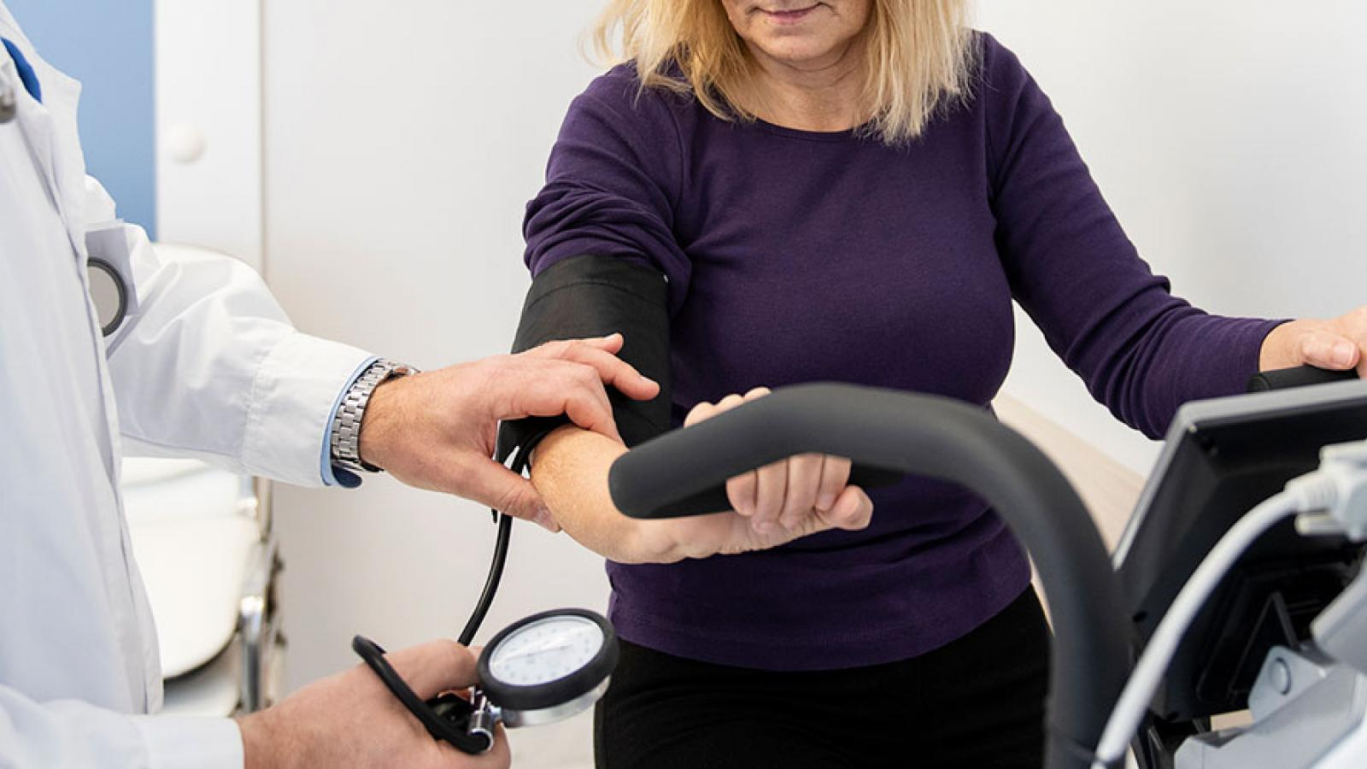
Be aware of the patient heterogeneity…
Age and sex
CVD risk profile
Surgical intervention(s) or devices

Slide 9
Be aware of the patient heterogeneity…
Age and sex
CVD risk profile
Surgical intervention(s) or devices
Non-CV comorbidities
Pulmonary disease, orthopedic disease,
neurological disease,…
Premorbid lifestyle
Psychosocial issues
Anxiety, depression, motivation
Health literacy
Physical fitness
Endurance & muscle strength, balance,
coordination
Occupational issues
Work type and fte%
Environmental issues
Weather conditions
Distance to rehab centre
Urban vs. rural living area
Personal goals/desires
And many more…

Slide 10
The outdated vision
Wide patient
Heterogeneity
CVD risk
Co-morbidities
Health literacy
Psychosocial issues
Socio-economic barriers
…
I will manage it all
Lacking multiple risk factor
and lifestyle control
Low long-term
adherence

Slide 11
Modern CR: who should be involved?
Minimal standard
Nurse
Cardiologist
Often program coordinator
Exercise specialist
Physiotherapist, clinical exercise
physiologist
collaboration
Visits congresses on CV prevention and CR on a regular basis,
organised by recognised organisations such as the national
cardiac societies or EAPC/ESC
Nutritionist
90% have completed a specialization course or attended a congress/symposia in the field of secondary prevention and/or CR, within 3 years, organised by recognised organisations such as the national cardiac societies or EAPC/ESC

Slide 12
Modern CR: who should be involved?
Optimal standard
Any member of the team, with good organizational, management and interpersonal skills may
be the program director/coordinator
Nurse
Cardiologist
Exercise specialist
Physiotherapist, movement scientist
collaboration
Psychologist
Multidisciplinary team includes additional healthcare professionals: diabetologist, psychiatrist, social worker
Nutritionist
One of the staff members recently (actively) contributed to a relevant congress or peer-reviewed medical journal

Slide 13
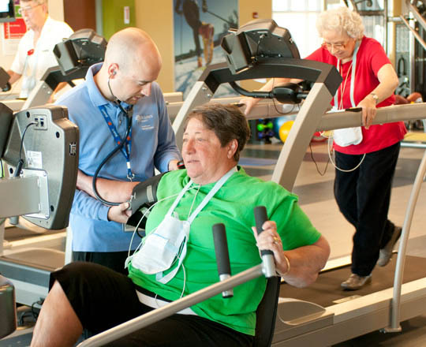
Modern CR: how a centre should look like
Minimal standard
Dedicated consultation area, for medical evaluation and prescription and psychological evaluation and intervention
Exercise facilities (laboratory/room) with equipment for assessment of functional capacity, including appropriate place to perform 6MWT (12 m long
hallway with markers in the corners) or other functional tests and treadmill and/or cycloergometer for standard exercise testing
Dedicated facilities for exercise training, well ventilated, good temperature and humidity conditions, floor space approximately 4 m2 per patient
Equipment for assessment of clinical status: sphygmomanometer, ECG, chemistry analysis, urine analysis (analysis may be outsourced)
Equipment (via outsourcing) for assessment of left ventricular function: echocardiography
Equipment (via outsourcing) for assessment of arrhythmias: ambulatory ECG Holter monitoring
Equipment for conducting an exercise training programme: for aerobic and strength training
Equipment for cardiac monitoring
The means, on site, to summon assistance in case of emergency in the exercise room to start life support: automated external defibrillator, material for
intubation and ventilation, material for intravenous drugs administration
Emergency services available or <10 min away
List of medical equipment and devices in use including details on maintenance and validity (if necessary)

Slide 14
Modern CR: how a centre should look like
Optimal standard
Specific education and counselling area for group interventions
Electronic patient files
Investigation room (e.g. for echocardiography)
Dedicated exercise facilities (laboratory/room) with equipment for cardiorespiratory exercise testing
Resting/dress room with separate toilets and shower facilities
Lockers to safely store the patients’ belongings while training
Equipment for assessment of left ventricular function: echocardiography and other imaging equipment depending on circumstances and type of patients
Equipment for assessment of arrhythmias: ambulatory ECG Holter monitoring
Equipment for assessment of psychosocial status: licensed tests and screening instruments (ideally computerised)

Slide 15
Modern CR: how the centre should be ran
Standard
Minimal
Protocol handling the complaints and list of complaints (it might be a general one from the hospital/clinic)
Protocol handling the adverse events and list of adverse events (it might be a general one from the hospital/clinic)
Organizational team meetings on a 2 weeks basis (which are documented)
Optimal
Organizational team meetings on a weekly basis (which are documented)
Strategic plan, not more than 5 years old (including future perspectives, objectives, care programmes, patient safety and enhancement of quality of care)
Annual evaluation report to monitor service delivery and outcomes

Slide 16
Modern CR: key components
Risk factor management (medication & follow-up)
BP, lipids, diabetes, body weight
Minimal standard
Exercise training
PA counselling
Patient evaluation
CVD risk
Exercise testing
Lifestyle habits
Medication intake (adherence)
Psychosocial issues
Nutritional intervention
Nutrition counselling
Psychosocial support
Education
Minimally 24 sessions

Slide 17
Modern CR: key components
Risk factor management (medication & follow-up)
BP, lipids, diabetes, body weight
Optimal standard
Exercise training
PA counselling
Patient evaluation
CVD risk
Exercise testing (CPET)
Lifestyle habits
Medication intake (adherence)
Psychosocial issues
Nutritional intervention
Nutrition counselling
Psychosocial support
ECG monitoring
e.g., in high-risk patients
Education
Driving, flying, sports
counselling
Sexual counselling
Vocational counselling
Minimally 36 sessions
Remote CR delivery

Slide 18
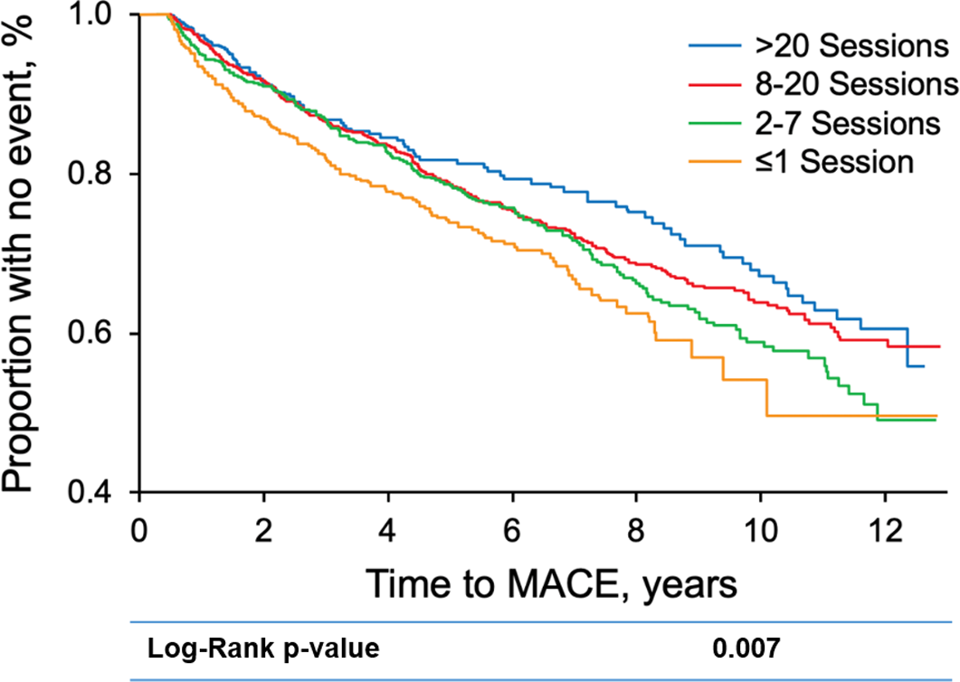
The CR dose matters…
A significant dose–response association between cardiac rehabilitation session attendance and reductions in MACEs is observed.
MACE indicates major adverse cardiovascular event.
Medina-Inojosa JR, et al. Dose of Cardiac Rehabilitation to Reduce Mortality and Morbidity: A Population-Based Study. J Am Heart Assoc. 2021;10(20):e021356.

Slide 19
CR KPI’s
% Patients eligible to CR referred after discharge to CR programme (>80%)
% Eligible patients to CR, enrolled after discharge (>50%)
Median waiting time from referral to start of CR (within 14–28 days)
% CR uptake (minimal 24 sessions with an aim of 36 sessions)
% CR adherence (>75% completes the programme)
% Drop-out (<25%)
% Patients with a recorded assessment before starting CR (>80%)
% Patients with a recorded assessment after starting CR (>80%)
% Pharmachological adherence improvement (>80%)
% Weight reduction in obese and overweight (>5%)
% Functional capacity improvement (>5%)
% Muscle strength improvement (>5%)
% Quality of life score improvement (>10%)
% Anxiety/depression score improvement (>10%)
% Smoking cessation (>50%)
% BP control in hypertension (>50%)
% Lipids control in dyslipidaemia (>50%)
% Glycaemic control in diabetes (>50%)

