Slide 1
Cardiovascular Prevention and Rehabilitation Course
General principles of exercise prescription: aerobic, resistance and inspiratory muscle training
Prof. Dominique Hansen, PhD, FESC
Hasselt University, Hasselt, Belgium
Baku, Azerbaijan, 4-5 May 2024

Slide 2
Declaration of interest
None to be declared

Slide 3
What do the guidelines say?

Slide 4
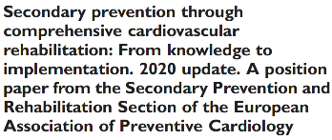
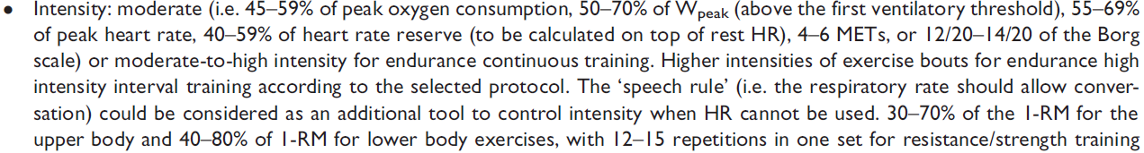

Ambrosetti M, et al. Eur J Prev Cardiol 2021;28(5):460-495

Slide 5
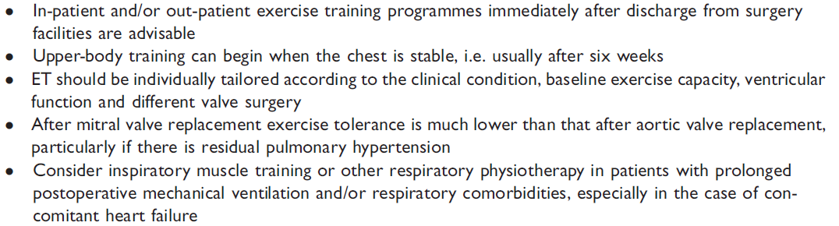

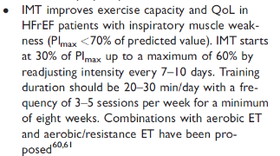
Ambrosetti M, et al. Eur J Prev Cardiol 2021;28(5):460-495

Slide 6
Why aerobic, resistance or inspiratory muscle training?
What are the benefits?

Slide 7
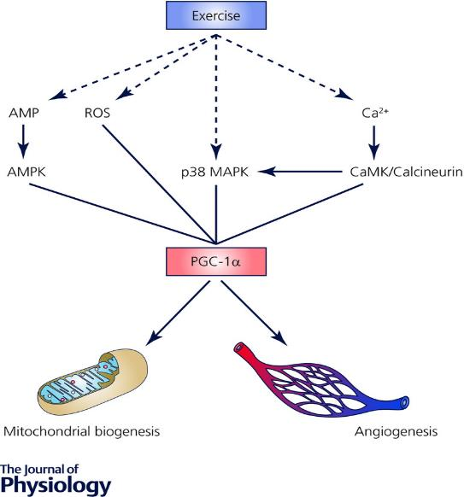
Physiology behind endurance exercise training
Dashed lines show the primary sensors of contractile activity, continuous lines show secondary mediators of signalling pathways proposed to upregulate PGC‐1α expression.
The adenosine monophosphate kinase (AMPK) is an energy sensing protein, reactive oxygen species (ROS) are a metabolic by‐product of oxidative metabolism, which in concert with the p38 mitogen activated protein kinase (MAPK) all respond to the metabolic stress generated within skeletal muscle by exercise.
Modulation of cellular calcium concentration with contraction upregulates calmodulin kinase (CaMK) and/or calcineurin proteins, which also act as a metabolic signal for adaptation responses.
Together, these intermediaries coordinate complex signalling pathways regulating PGC‐1α expression and subsequent mitochondrial biogenesis and angiogenesis in skeletal muscle.
Coffey VG, et al. J Physiol 2017; 595: 2883-96

Slide 8
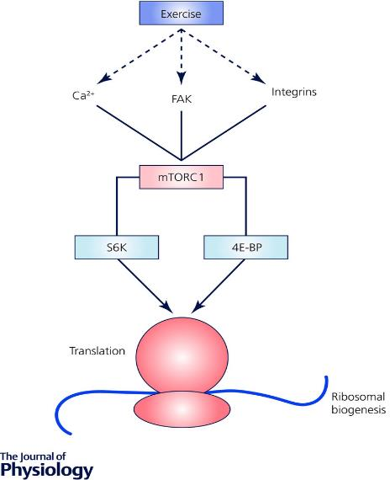
Physiology behind resistance exercise training
Dashed lines show the primary sensors of contractile activity, continuous lines show secondary mediators of signalling pathways proposed to ultimately upregulate protein synthesis.
Calcium, focal adhesion kinases (FAK) and integrin linked kinases have each been proposed as mechanosensors that initiate the signal that generates greater subsequent activity of the mechanistic target of rapamycin complex 1 (mTORC1).
The downstream effectors of mTORC1 are the 70 kDa ribosomal S6 protein kinase (S6K) and eukaryotic initiation factor 4E binding protein (4E‐BP) that have been shown to have key roles in promoting translation initiation and ribosome biogenesis.
Coffey VG, et al. J Physiol 2017; 595: 2883-96

Slide 9
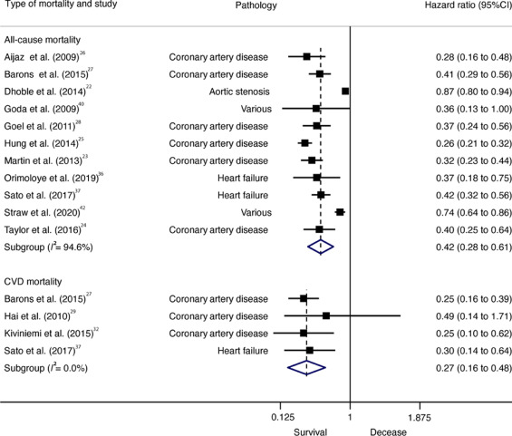
Why endurance exercise capacity matters
According to the dose-response analyses, for each 1-MET increase in CRF there was a 19% reduction in risk for all-cause mortality
All-cause (HR = 0.42; 95%CI: 0.28–0.61, p < 0.001) and CVD (HR = 0.27; 95%CI: 0.16–0.48, p = 0.005) mortality was lower in individuals with highest CRF than in individuals with lowest CRF.
Ezzatvar Y, et al. Cardiorespiratory fitness measured with cardiopulmonary exercise testing and mortality in patients with cardiovascular disease: A systematic review and meta-analysis. J Sport Health Sci. 2021 Dec;10(6):609-619.

Slide 10
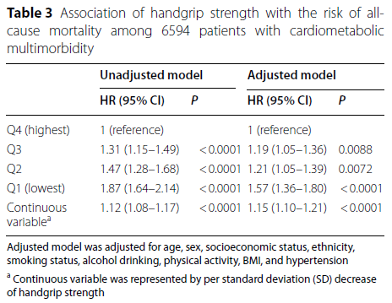
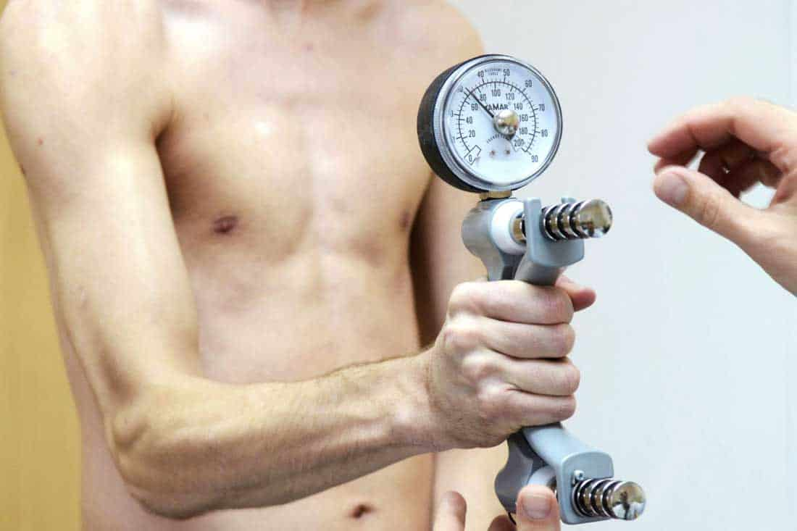

Why muscle strength matters

Slide 11
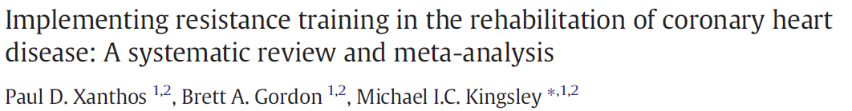
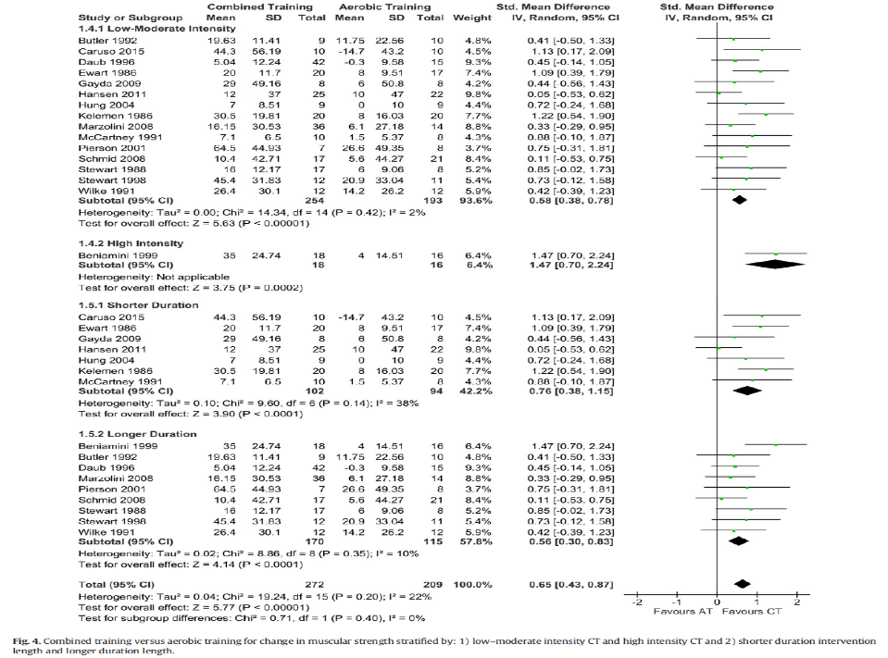
Evidence for resistance exercise training

Slide 12
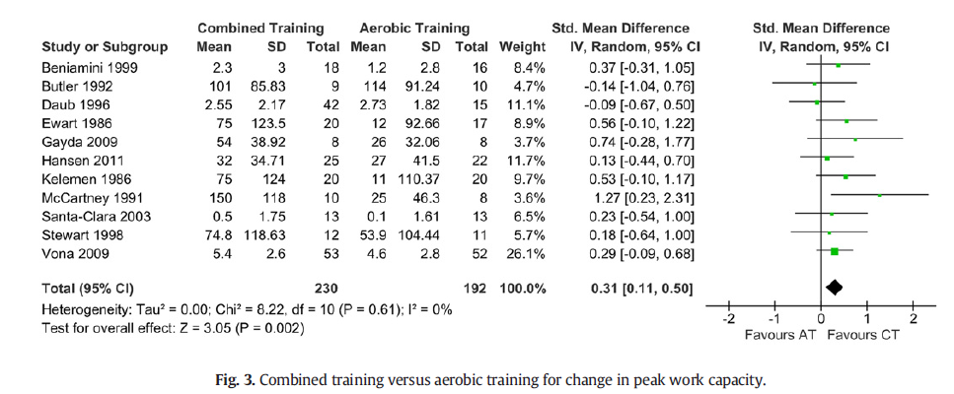
Evidence for resistance exercise training

Slide 13
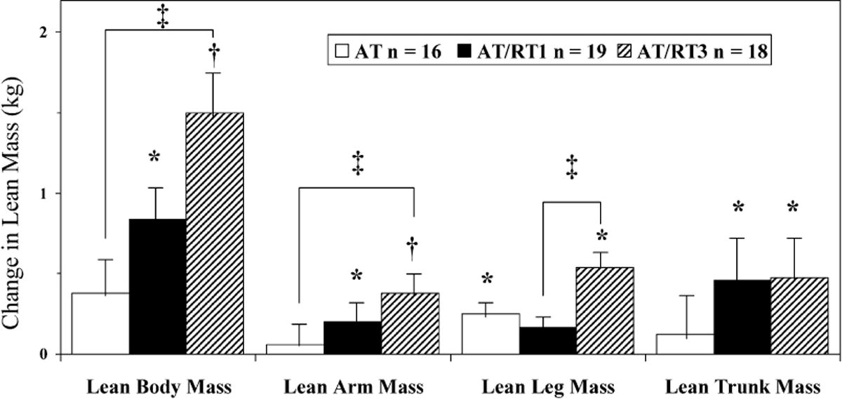
Evidence for resistance exercise training
Marzolini et al. Med Sci Sports Exerc 2008; 40: 1557-64

Slide 14
Evidence for IMT in heart failure
When used in isolation
significantly improved:
PImax,
VE/VCO2 slope,
Quality of life,
Walking capacity,
VO2peak (in some studies),
Dyspnea
When combined with endurance training
Significantly (and additionally) improved:
PImax,
Dyspnea
- Azambuja ACM, et al. Inspiratory Muscle Training in Patients With Heart Failure: What Is New? Systematic Review and Meta-Analysis. Phys Ther. 2020;100(12):2099-2109.
- Gomes Neto M, et al. The impact of high-intensity inspiratory muscle training on exercise capacity and inspiratory muscle strength in heart failure with reduced ejection fraction: a systematic review and meta-analysis. Clin Rehabil. 2018;32(11):1482-1492.
- Gomes-Neto M, et al. Effects of Exercise Interventions on Aerobic Capacity in Patients With Heart Failure With Preserved Left Ventricular Ejection Fraction: Systematic Review and Network Meta-Analysis. Cardiol Rev. 2024;32(1):45-50.

Slide 15
Evidence for IMT after cardiothoracic surgery
Phase 1 setting
significantly improved:
PImax,
Tidal volume,
Significantly lowered:
Pulmonary complication risk
Hospital stay
- Aquino TN, et al. Efficacy of Respiratory Muscle Training in the Immediate Postoperative Period of Cardiac Surgery: A Systematic Review and Meta-Analysis. Braz J Cardiovasc Surg. 2024 Feb 5;39(1):e20220165.
- Kendall F, et al. Inspiratory muscle training is effective to reduce postoperative pulmonary complications and length of hospital stay: a systematic review and meta-analysis. Disabil Rehabil. 2018 Apr;40(8):864-882.
Phase 2 setting
Mixed results…so appropriate selection of patients still needs to be defined
- Miozzo AP, et al. Effects of High-Intensity Inspiratory Muscle Training Associated with Aerobic Exercise in Patients Undergoing CABG: Randomized Clinical Trial. Braz J Cardiovasc Surg. 2018;33(4):376-383.
- Dos Santos TD, Pereira SN, Portela LOC, Cardoso DM, Lago PD, Dos Santos Guarda N, Moresco RN, Pereira MB, de Albuquerque IM. Moderate-to-high intensity inspiratory muscle training improves the effects of combined training on exercise capacity in patients after coronary artery bypass graft surgery: A randomized clinical trial. Int J Cardiol. 2019;279:40-46.

Slide 16
Aerobic, resistance or inspiratory muscle training:
How to do it?

Slide 17
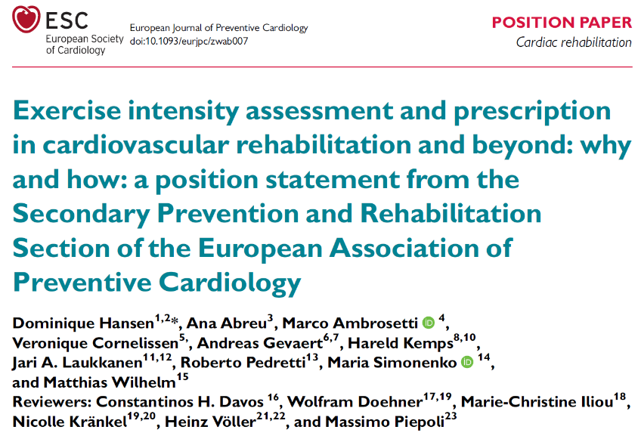
Setting the endurance exercise intensity
Eur J Prev Cardiol. 2022;29(1):230-245.

Slide 18
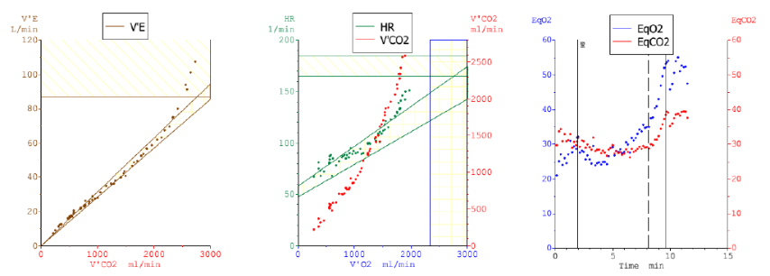
Setting the endurance exercise intensity
Red arrow: VT1
Blue arrow: VT2
Extrapolation to HR, W, time

Slide 19
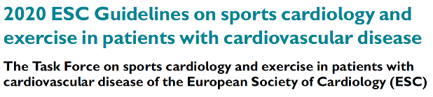
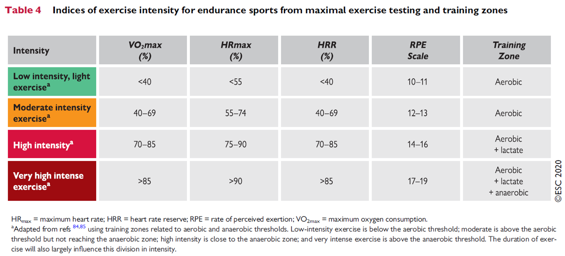
Setting the endurance exercise intensity
Pelliccia A, et al. Eur Heart J. 2021 Jan 1;42(1):17-96.

Slide 20
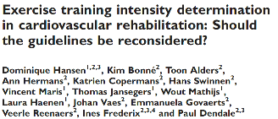
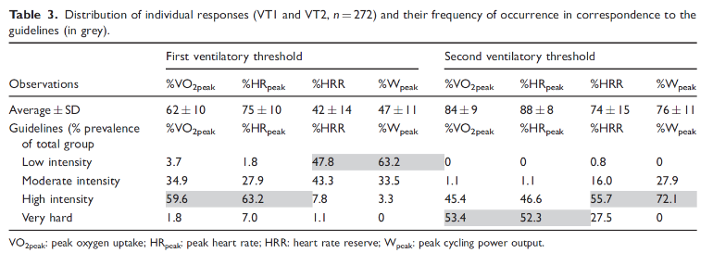
Others confirm:
Pymer S, et al. Does exercise prescription based on estimated heart rate training zones exceed the ventilatory anaerobic threshold in patients with coronary heart disease undergoing usual-care cardiovascular rehabilitation? A United Kingdom perspective. Eur J Prev Cardiol 2020;27:579-589.
Iannetta D, et al. A Critical Evaluation of Current Methods for Exercise Prescription in Women and Men. Med Sci Sports Exerc 2020;52:466-473.
Jamnick NA, et al. An Examination and Critique of Current Methods to Determine Exercise Intensity. Sports Med 2020;50:1729-1756.
Anselmi F, et al. The importance of ventilatory thresholds to define aerobic exercise intensity in cardiac patients and healthy subjects. Scand J Med Sci Sports. 2021;31(9):1796-1808.
Milani JGPO, et al. Exercise intensity domains determined by heart rate at the ventilatory thresholds in patients with cardiovascular disease: new insights and comparisons to cardiovascular rehabilitation prescription recommendations. BMJ Open Sport Exerc Med. 2023;9(3):e001601.
Eur J Prev Cardiol 2019; 26: 1921-8.

Slide 21

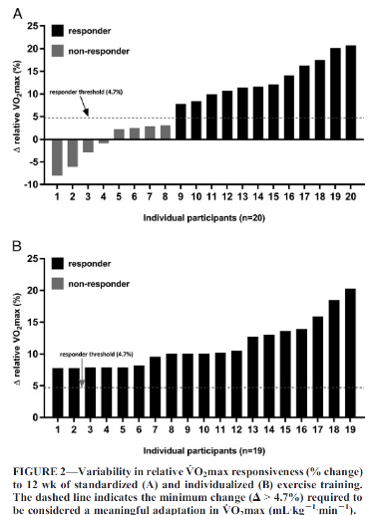
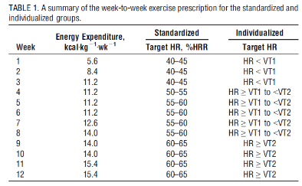

Slide 22
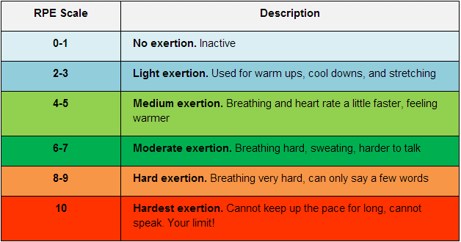
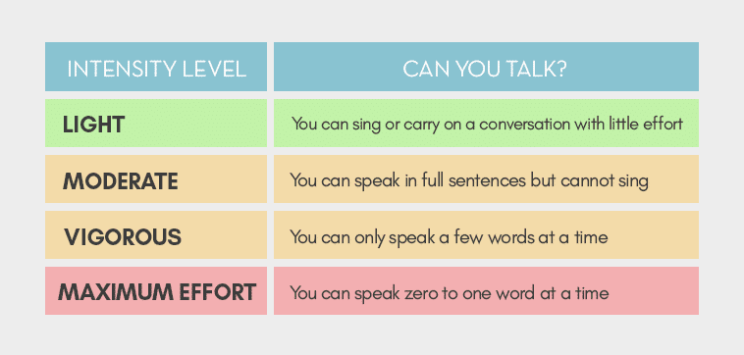
Setting the endurance exercise intensity
Although Borg's RPE scale has been shown to be a valid measure of exercise intensity, its validity may not be as high as previously thought, except under specific conditions
The test is suitable in patients with CAD and shows quite good intra-class correlation, when comparing self-ratings with external observations.
However, when comparing with VT1 and/or VT2, the level of agreement demonstrates wide ranges.

Slide 23
Setting the endurance exercise intensity
Borg RPE and/or the talk test are used as an adjunct practical way to guide exercise intensity in daily activities of CVD patients.
They are an essential tool for shared-decision making

Slide 24

Optimal standards
Minimal standards
Step 1
Determination of exercise intensity at entry of CR (phase II)
From first CPET:
VT1 by VE/VO₂ slope
VT2 by VE/VCO₂ slope
Extrapolate to HR, W or time
From first ergometry test:
W_{peak} and HR_{peak}
Extrapolate to %HR_{peak}, %W_{peak} or time
Step 2
Control of exercise intensity during subsequent exercise sessions
Talk test or Borg RPE guided by clinician/therapist
Step 3
Adjust the exercise intensity during progressive CR
From CPET after 3 months, or preferentially earlier, based on clinical decision:
VT1 by VE/VO₂ slope
VT2 by VE/VCO₂ slope
Extrapolate to HR, W or time
From ergometry after 3 months, or preferentially earlier, based on clinical decision:
W_{peak} and HR_{peak}
Extrapolate to %HR_{peak}, %W_{peak} or time
Step 4
Control of exercise intensity during subsequent exercise sessions
Talk test or Borg RPE guided by clinician/therapist
…
Hansen D, et al. Eur J Prev Cardiol. 2022;29(1):230-245.

Slide 25
But what to do without gas exchange analysis?
N = 1893 CMD patients from Brazil
External validation
N = 975 CMD patients from 8 EU countries
mean absolute percentage error (MAPE)
Equations
VT1: 7.1%
VT2: 5.0%
%peakHR (guidelines)
VT1: 21.3%
VT2: 16.7%
Prediction equation for HR @VT1
= 4.866+(0.405 𝑥 𝐻𝑅𝑝𝑒𝑎𝑘)+(0.542 𝑥 𝐻𝑅𝑟𝑒𝑠𝑡)
Prediction equation for HR @VT2
= −2.606+(0.773 𝑥 𝐻𝑅𝑝𝑒𝑎𝑘)+(0.254 𝑥 𝐻𝑅𝑟𝑒𝑠𝑡)
Milani JGPO, et al. Accurate Prediction Equations for Ventilatory Thresholds in Cardiometabolic Disease When Gas Exchange Analysis is Unavailable: Development and Validation. Eur J Prev Cardiol. 2024 Epub ahead of print.

Slide 26
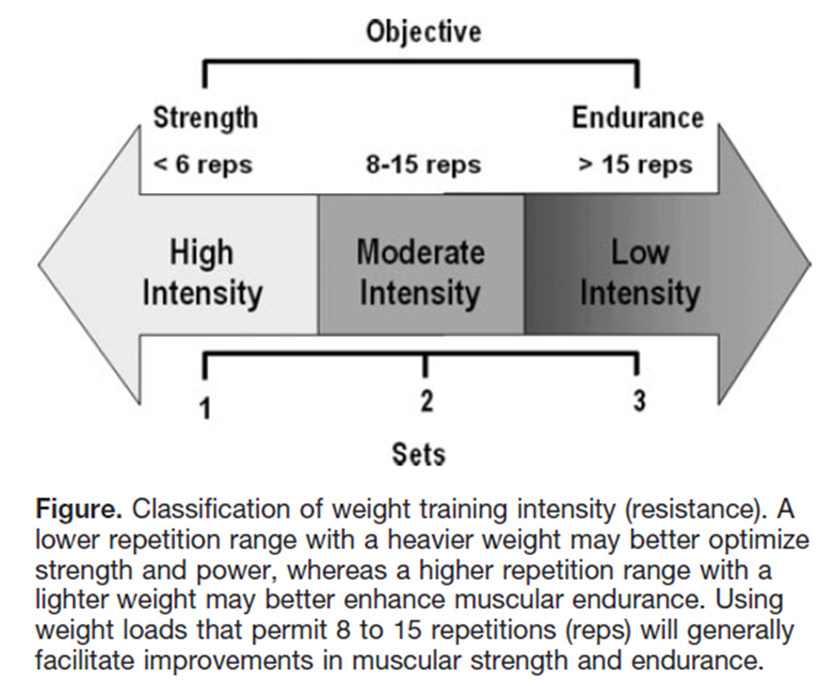
Setting the resistance exercise intensity

Slide 27
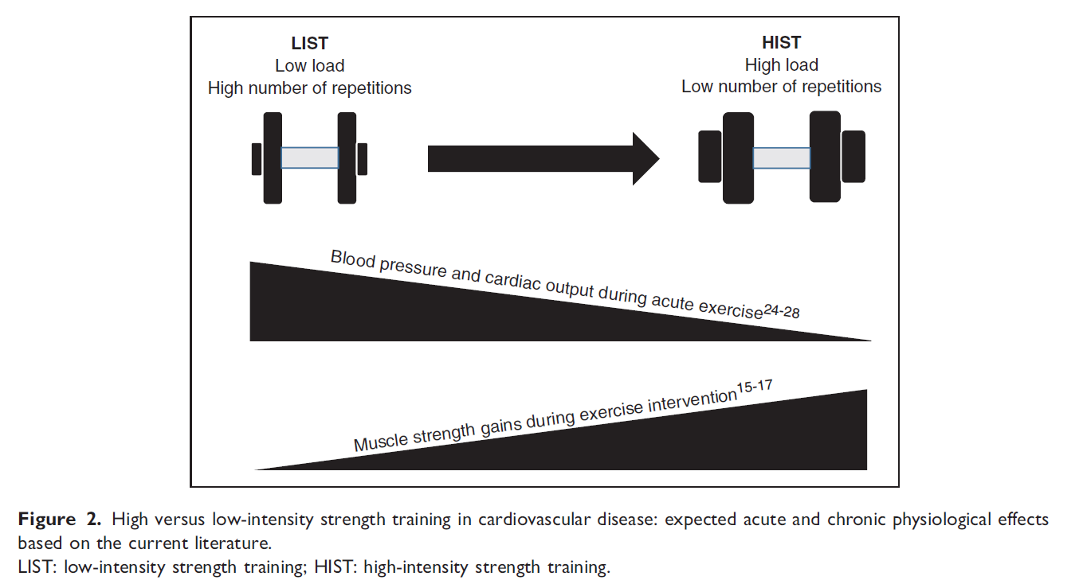
Setting the resistance exercise intensity
Hansen D, et al. Eur J Prev Cardiol. 2019 Sep;26(14):1483-1492

Slide 28
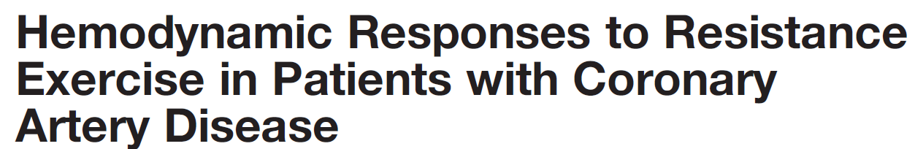
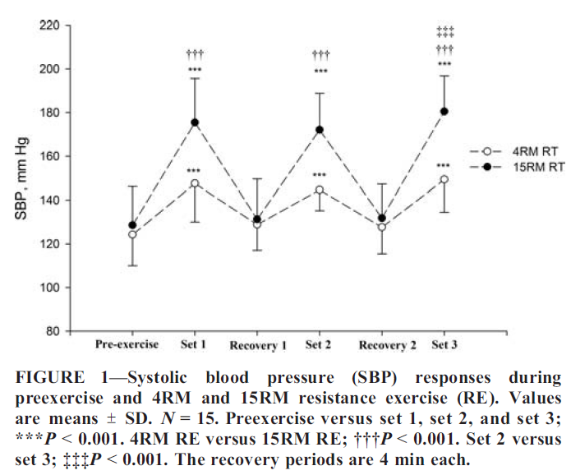
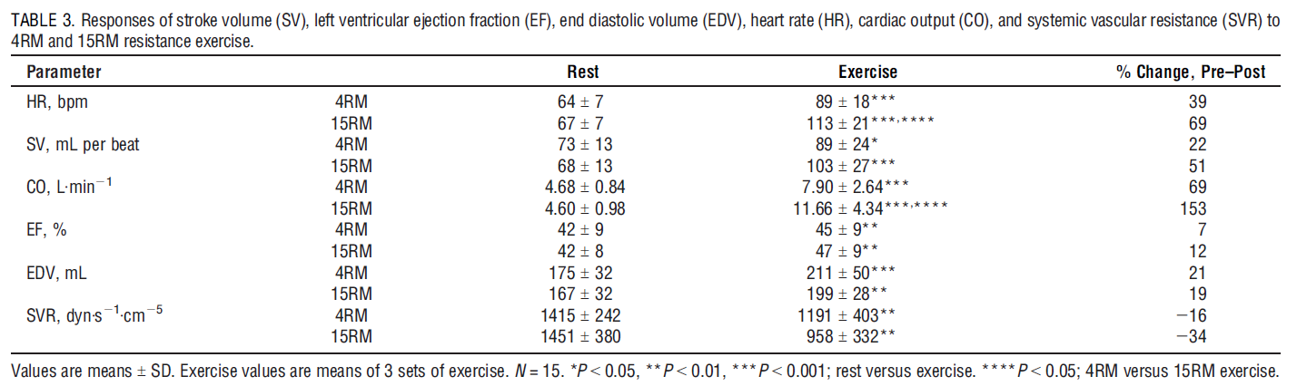
Setting the resistance exercise intensity
Med. Sci. Sports Exerc. Vol. 48, No. 4, pp. 581–588, 2016.

Slide 29
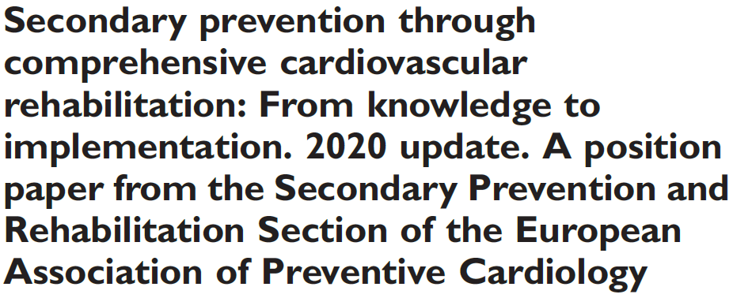
General advice (applicable to all conditions)
Frequency: 2 times/week for resistance/strength training
Intensity: 30–70% of the 1-RM for the upper body and 40-80% of 1-RM for lower body exercises, with 12-15 repetitions in one set for resistance/strength training
Ambrosetti M, et al. Eur J Prev Cardiol 2021; 28: 460–495

Slide 30
Specific advice (applicable to specific conditions)
Median sternotomy: no unilateral weight lifting in the first 6-8 weeks (or only after sufficient sternal healing)
Frailty: greater intensities preferred and mandatory component
In heart failure: Initial instruction phase (<30% 1-RM, RPE 11–12, 5–10 repetitions) is followed by resistance/endurance phase with high number of repetitions (12–25) and a low intensity (30–40% 1-RM, RPE 12) so as to reach the resistance exercise training/muscle build-up phase by increasing weights progressively up to 40–60% of the 1-RM (RPE >15, 8–15 repetitions).
Ambrosetti M, et al. Eur J Prev Cardiol 2021; 28: 460–495

Slide 31
Resistance exercise training
Optimisation of medical safety
  Prevent Valsalva manoeuvre
    Exhale during contraction
  Check for orthopedic symptoms
  Monitoring of ‘cardiovascular’ symptoms
    Diziness, dyspnea, angina, heart rythm disturbances, hypertension, etc.
  Guaruantee correct execution
    Supervision is important
  Provide warming up
  Use correct equipment

Slide 32
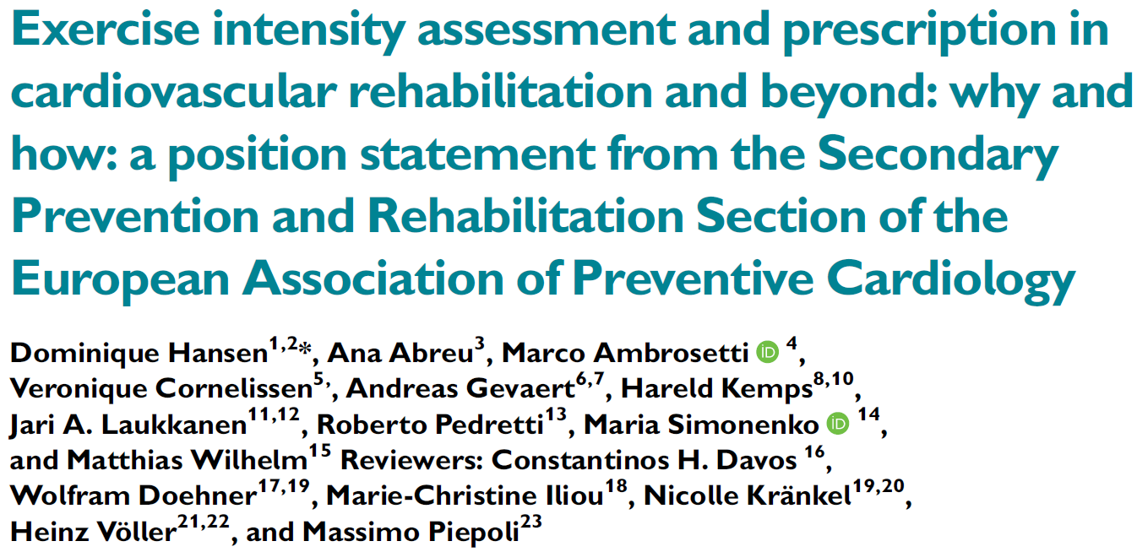
Step 1
Determination of exercise intensity at entry of CR (phase II)
From <10RM test of target muscles every few weeks:
Calculate desired load

Slide 33

Resistance exercise training: setting the intensity
1 RM estimation: approach
  Warm-up with light weight
  Stretching of targeted muscle
  Set greater weight
  Increase weight every set until less then 10 repetitions can be reached (2-5 min break between sets)
  Calculate 1 RM from x repetitions

Slide 34
Step 1
Determination of exercise intensity at entry of CR (phase II)
From <10RM test of target muscles every few weeks:
Calculate desired load
Step 2
Control of exercise intensity during subsequent exercise sessions
OMNI-RES guided by clinician/therapist

Slide 35
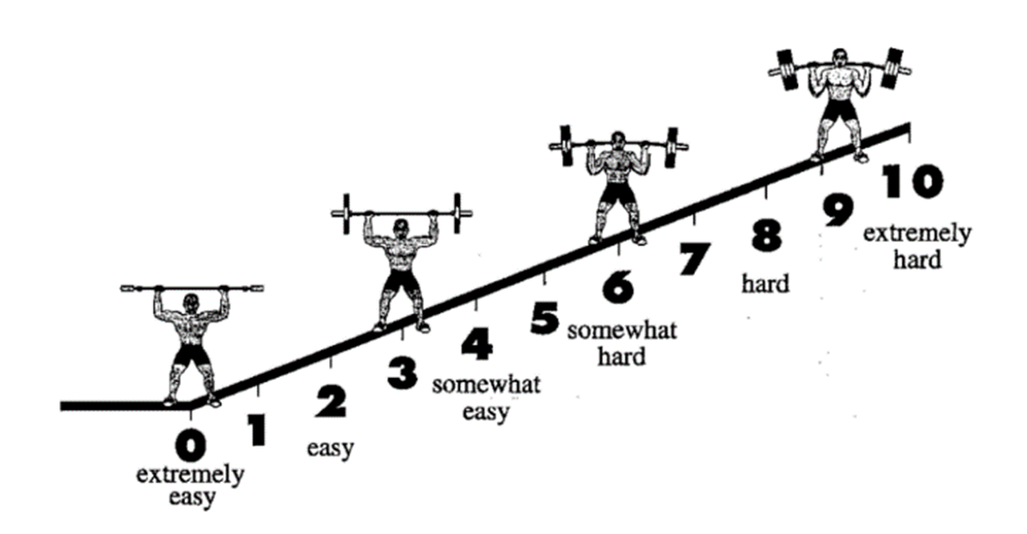
OMNI-RES scale
Gearhart RF, et al. Percept Motor Skills 2008; 106: 893-903.

Slide 36
Step 1
Determination of exercise intensity at entry of CR (phase II)
From <10RM test of target muscles every few weeks:
Calculate desired load
Step 2
Control of exercise intensity during subsequent exercise sessions
OMNI-RES guided by clinician/therapist
Step 3
Adjust the exercise intensity during progressive CR
From <10RM test of target muscles every few weeks, based on clinical decision:
Calculate desired load
Step 4
Control of exercise intensity during subsequent exercise sessions
OMNI-RES guided by clinician/therapist
Step 5
Adjust the exercise intensity during prolonged CR (phase III)
Shift to functional strength training
<10 RM testing not mandatory

Slide 37
Step 1
Determination of exercise intensity at entry of CR (phase II)
From <10RM test of target muscles every few weeks:
Calculate desired load
Step 2
Control of exercise intensity during subsequent exercise sessions
OMNI-RES guided by clinician/therapist
Step 3
Adjust the exercise intensity during progressive CR
From <10RM test of target muscles every few weeks, based on clinical decision:
Calculate desired load
Step 4
Control of exercise intensity during subsequent exercise sessions
OMNI-RES guided by clinician/therapist
Step 5
Adjust the exercise intensity during prolonged CR (phase III)
Shift to functional strength training
<10 RM testing not mandatory
Step 6
Control of exercise intensity during subsequent exercise sessions
OMNI-RES by patient

Slide 38
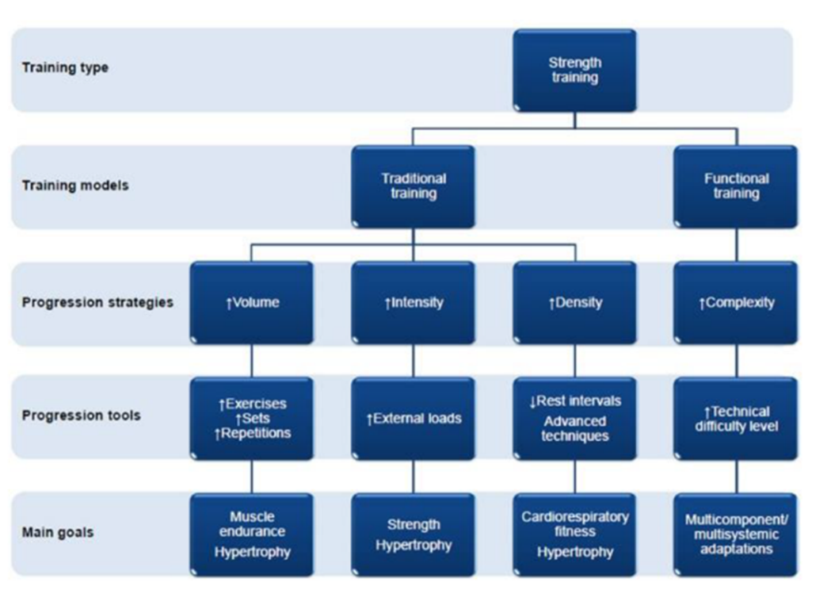
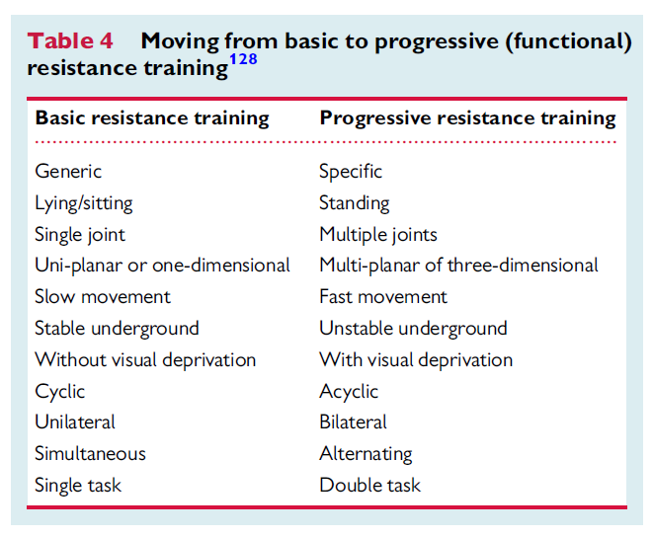
Progressive/functional resistance training
La Scala Teixeira CV, et al. Front Physiol 2019; 10: 839.

Slide 39
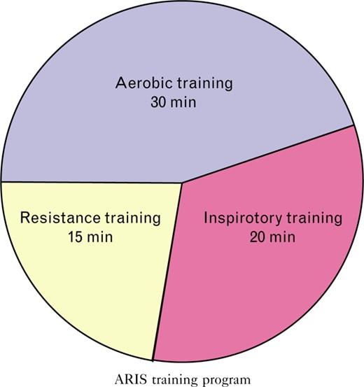
IMT in heart failure: the ‘ARIS’ approach
Trends for greater improvements in VO2peak, and significantly greater improvements in
walking capacity, quality of life, and cardiac dimensions
Laoutaris ID, et al. Combined aerobic/resistance/inspiratory muscle training as the 'optimum' exercise programme for patients with chronic heart failure: ARISTOS-HF randomized clinical trial. Eur J Prev Cardiol. 2021;28(15):1626-1635.

Slide 40
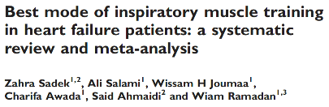
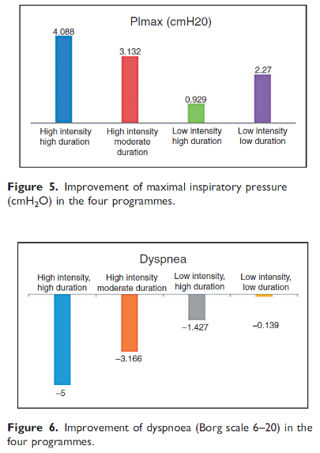
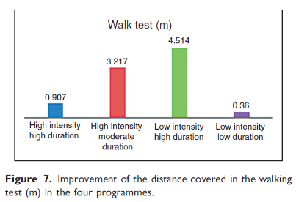
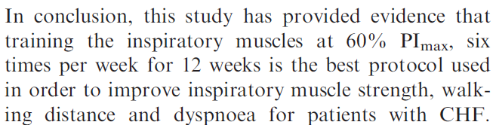
Eur J Prev Cardiol. 2018 Nov;25(16):1691-1701.

