Slide 1
Strategic changes in family firms: The role of socioemotional wealth,
long-term orientation and TMT size
dr. Laura Hoekx
(Hasselt University)
prof. dr. Rüveyda Kelleci
(Open University Heerlen)

Slide 2
Introduction
Strategic changes are indispensable for sustaining long-term organizational performance and long-term organizational survival
For family firms (FFs), socioemotional wealth (SEW) is a primary driver of strategic behavior
Findings on SEW and strategic change in FFs remain inconclusive
SEW is a multidimensional construct and FFs are heterogenous in terms of the importance attached to different SEW dimensions
→ Thus, it is critical use a multidimensional construct for SEW

Slide 3
Introduction: strategic change?
Definition: “Discrete changes in the extent and scope of a firm’s existing strategies in response to environmental changes” (Hermann & Nadkarni, 2014, p. 1320)
Examples of SC (based on measure Hermann & Nadkarni, 2014):
(1) entries/exits in international markets
(2) additions and eliminations of product lines or segments
(3) new mergers and acquisitions completed
(4) buying and selling of properties, plants, and equipment
(5) increases or decreases in R&D expenditures

Slide 4
Introduction: SEW
We chose Debicki et al.’s (2016) multidimensional SEW construct:
Three SEW dimensions which family owners/managers attach importance to: (1) family prominence; (2) family continuity; and (3) family enrichment
Specifically, dimension of interest “family prominence”:
“Family prominence refers to the family's desire for public recognition and visibility through their ownership and control of the business. It reflects the importance placed on the family's reputation and prestige associated with the business (Debicki et al., 2016)”
→ RQ: “When and how does family prominence affect strategic change in family firms?”

Slide 5
Why family prominence?
Family continuity and enrichment are “restrictive” forms of SEW (Miller & Le-Breton Miller, 2014)
→ “family-centric”: extracting funds from the business and using business resources to resolve family disputes leaving little room for strategic investments
Family prominence is an “extended” form of SEW (Miller & Le-Breton Miller, 2014)
→ satisfying stakeholders changing needs is important, strategic renewal is important for maintaining standing in the competitive market, social capital facilitates ability to change and innovate

Slide 6
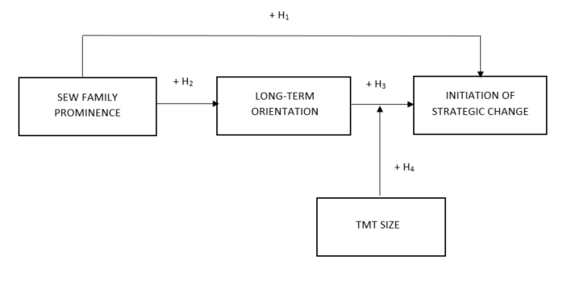
Research model
.

Slide 7
Data collection
Part of a larger research project on “Strategic change in family firms” (collaboration between Hasselt University and University of Antwerp)
Data collected through questionnaire distributed among family firm CEOs in 2020-2021
Final sample = 348 Belgian family firms

Slide 8
Measures
SEW family prominence: 3 items of SEW scale of Debicki et al. (2016)
Initiation of strategic change: measurement of Hermann and Nadkarni (2014); indicate to which extent particular changes occurred in 2018 and 2019
Long-term orientation: scale of Zellweger et al. (2012)
TMT size: number of TMT members
Control variables: firm size, firm age, industry, other two SEW dimensions (family continuity and family enrichment)

Slide 9
Preliminary findings
Results indicate:
No significant relationship (β = -0.056, p = 0.634) between family prominence and the initiation of strategic change (Hypothesis 1 X)
Significant positive relationship (β = 0.270, p < 0.01) between family prominence and long-term orientation (Hypothesis 2 ✔)
Significant positive relationship (β = 0.337, p < 0.01) between long-term orientation and the initiation of strategic change (Hypothesis 3 ✔)
Significant positive moderating effect of TMT size (β = 0.093, p < 0.10) (Hypothesis 4 ✔)

Slide 10
Post-hoc analysis
→ Distinction between “upscaling” (e.g., start exporting to new countries, adding new production lines, investing in additional assets) and “downscaling” (e.g., stop exporting to certain countries, closing production lines, selling assets) strategic changes.
→ Initial results can be mainly confirmed for “upscaling” part of strategic initiations and to a less extent for the “downscaling” part

Slide 11
Discussion
Positive indirect relationship between importance attached to SEW prominence and strategic change initiations, mediated by long-term orientation
→ unraveling the mechanisms explaining the relationship between SEW and strategic change
TMT size positively moderates this relationship
→ family firm’s capability to effectively translate long-term orientation into initiation of strategic changes depends on internal capabilities of their TMT

Slide 12
Thank you!
laura.hoekx@uhasselt.be
ruveydakelleci@ou.nl

