Slide 1
Digital innovation for cardiac rehabilitation
Dominique Hansen, PhD, FESC
Hasselt University, Hasselt, Belgium
30th Annual Meeting of the Japanese Society of Cardiac Rehabilitation
July 13, 2024
Kobe, Japan

Slide 2
Conflicts of interest
None to be declared

Slide 3
Current major challenges in cardiac rehabilitation
Diversity
Uptake
Adherence to
CR program
Permanent (life-long)
lifestyle change

Slide 4
Diversity

Slide 5
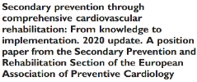
Ambrosetti M, et al. Eur J Prev Cardiol 2021;28(5):460-495

Slide 6
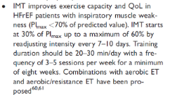
Ambrosetti M, et al. Eur J Prev Cardiol 2021;28(5):460-495

Slide 7
One-size-fits-all approach?
 | Patient 1 | Patient 2 | Patient 3
 | 65 years, male | 45 years, female | 80 years, male
Indication for CR | AMI | pacemaker | HFrEF (LVEF 36%)
BMI | 32,3 kg/m² | 24,6 kg/m² | 19,5 kg/m²
CVD risk factors | Hypertension, dyslipidemia | Type 1 diabetes | Type 2 diabetes
VO2peak (% predicted) | 85 | 99 | 45
Co-morbidities | Sleep apnea | Renal insufficiency | Sarcopenia/muscle weakness

Slide 8
One-size-fits-all approach?
 | Patient 1 | Patient 2 | Patient 3
 | 65 years, male | 45 years, female | 80 years, male
Indication for CR | AMI | pacemaker | HFrEF (LVEF 36%)
BMI | 32,3 kg/m² | 24,6 kg/m² | 19,5 kg/m²
CVD risk factors | Hypertension, dyslipidemia | Type 1 diabetes | Type 2 diabetes
VO2peak (% predicted) | 85 | 99 | 45
Co-morbidities | Sleep apnea | Renal insufficiency | Sarcopenia/muscle weakness
Endurance exercise | 3 days/week, 55-69% HRpeak, 40 min/session | 3 days/week, 55-69% HRpeak, 40 min/session | 3 days/week, 55-69% HRpeak, 40 min/session
Resistance exercise | 2 days/week, 12 repetitions * 3 sets/muscle group, 5 muscle groups, 60% 1RM | 2 days/week, 12 repetitions * 3 sets/muscle group, 5 muscle groups, 60% 1RM | 2 days/week, 12 repetitions * 3 sets/muscle group, 5 muscle groups, 60% 1RM

Slide 9
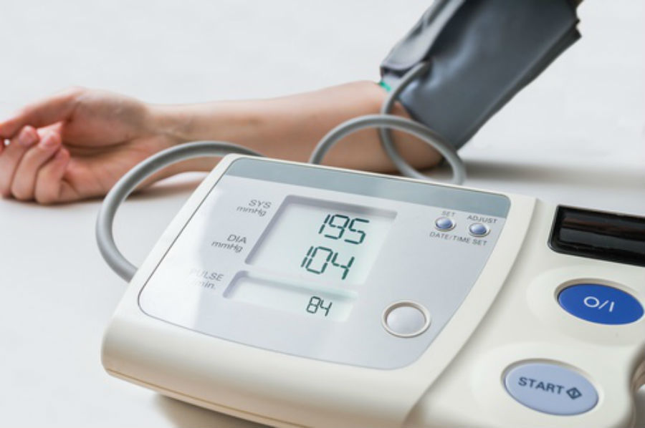
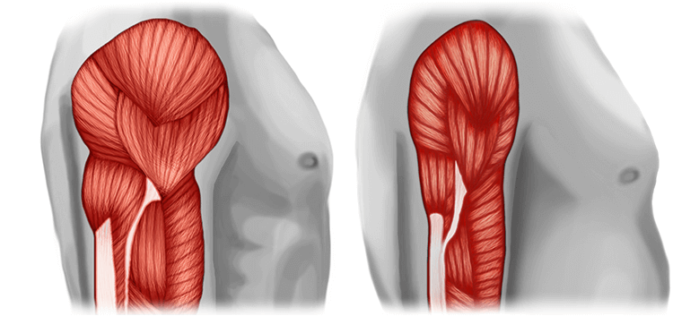
Targeted exercise in CVD (‘precision intervention’)
obesity
?
exercise intolerance
hypertension
?
?
dyslipidemia
type 2 diabetes
?
?
sarcopenia/muscle wasting
type 1 diabetes
?
?
Hansen D, et al. Exercise Prescription in Patients with Different Combinations of Cardiovascular Disease Risk Factors: A Consensus Statement from the EXPERT Working Group. Sports Med. 2018;48:1781-97./ Hansen D, et al. Standardised Exercise Prescription for Patients with Chronic Coronary Syndrome and/or Heart Failure: A Consensus Statement from the EXPERT Working Group. Sports Med. 2023;53:2013-37.

Slide 10
Targeted exercise in CVD (‘precision intervention’)
obesity
exercise intolerance
hypertension
HIIT
(short term)
High endurance exercise volume
(long term)
Endurance exercise
>2000 kcal/week
Endurance exercise
At least moderate-intense
At least 30-45 min/session
dyslipidemia
type 2 diabetes
sarcopenia/muscle wasting
Endurance exercise
5-7 days/week
Resistance exercise
High volume (>21 sets)
type 1 diabetes
Endurance exercise
>1200 kcal/week for HDL-c
Resistance exercise
Higher intensity
Mix with anaerobic exercise
SIT, HIIT, resistance eexercise
Hansen D, et al. Exercise Prescription in Patients with Different Combinations of Cardiovascular Disease Risk Factors: A Consensus Statement from the EXPERT Working Group. Sports Med. 2018;48:1781-97./ Hansen D, et al. Standardised Exercise Prescription for Patients with Chronic Coronary Syndrome and/or Heart Failure: A Consensus Statement from the EXPERT Working Group. Sports Med. 2023;53:2013-37.

Slide 11
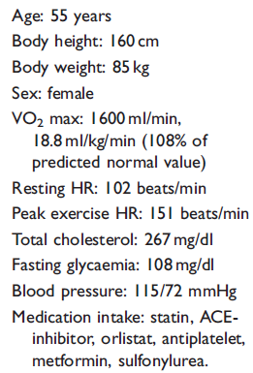
So…what do we prescribe?

Slide 12
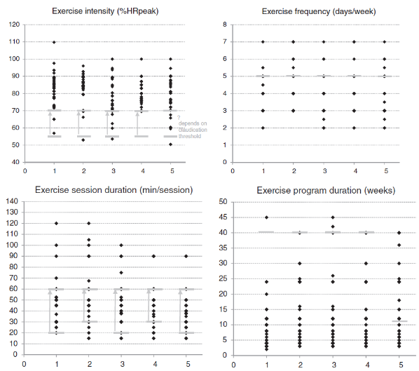
(Case 2)
Hansen D, et al. Eur J Prev Cardiol 2018; 5: 682-91

Slide 13
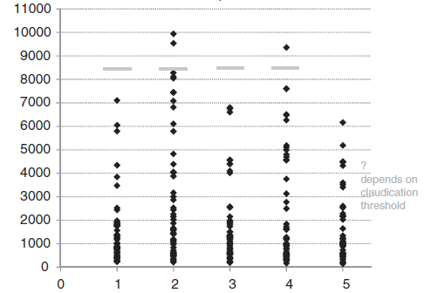
Peak-effort training minutes
(Case 2)
Hansen D, et al. Eur J Prev Cardiol 2018; 5: 682-91

Slide 14
Online clinical decision support
Online training centre
- Use in practice
Exercise prescription
after imputation of
patient data
- Predefined cases
After fill-out = comparison with solution
(tailored prescription)
Evidence:
ESC/EAPC recommendations
& meta-analyses
https://expert-tool.hci-ehealth.uhasselt.be/

Slide 15
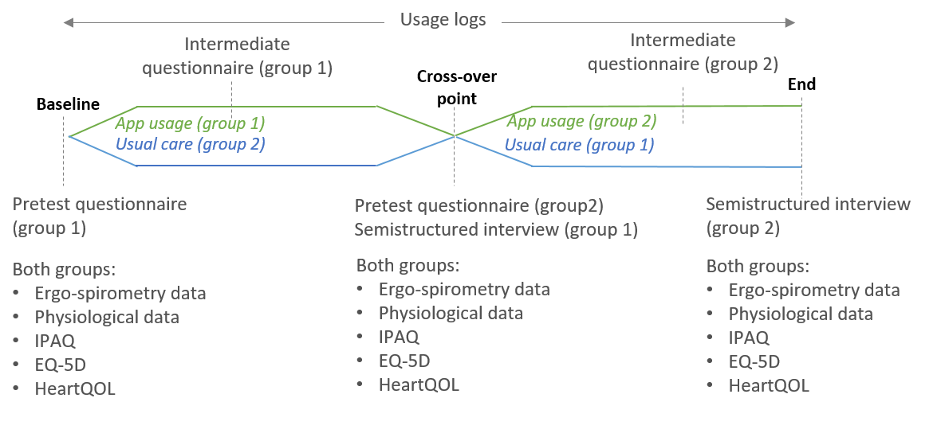
Validation of EXPERT decision support system
Significant (p<0.05) and clinically relevant (effect size d>0.5) impact on:
HDL-c
Body weight
VO2max
HbA1c
Quality of life
Sankaran S, et al. Evaluating the Impact of the HeartHab App on Motivation, Physical Activity, Quality of Life, and Risk Factors of Coronary Artery Disease Patients: Multidisciplinary Crossover Study. JMIR Mhealth Uhealth. 2019 Apr 4;7(4):e10874.

Slide 16
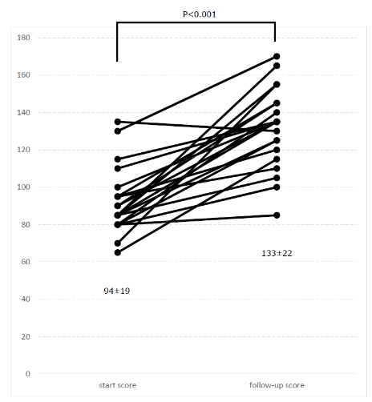
Validation of EXPERT Training tool
+44±32%
p<0.001
Review data on 3 patient cases and prescribe:
exercise intensity (10 points),
frequency (10 points),
session duration (10 points),
program duration (10 points),
exercise type (endurance or strength training) (10 points), additional exercise type (e.g., IMT) (10 points)
Score up to 60 points per patient case * 3 cases = 180 points
Hansen D, et al. Exercise prescription by physiotherapists to patients with cardiovascular disease is in greater agreement with European recommendations after using the EXPERT training tool. Med Educ Online. 2023 Dec;28(1):2182660.

Slide 17
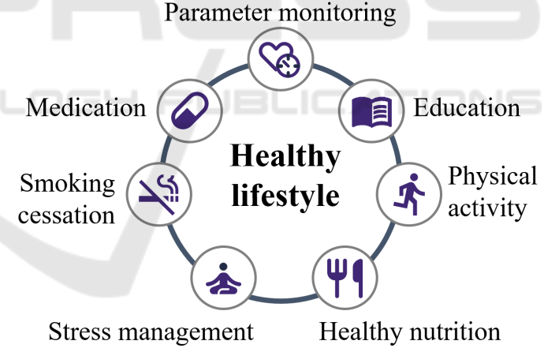
Comprehensive approach?
12,000 patients from six EU countries
1,000 high-risk patients
1,000 high-risk patients
personalised prevention
usual care
3-year follow-up
3-year follow-up
Funded by the European Union’s Horizon 2020 research and innovation program under grant agreement No 848056

Slide 18
Uptake
Adherence to
CR program
Permanent (life-long)
lifestyle change

Slide 19
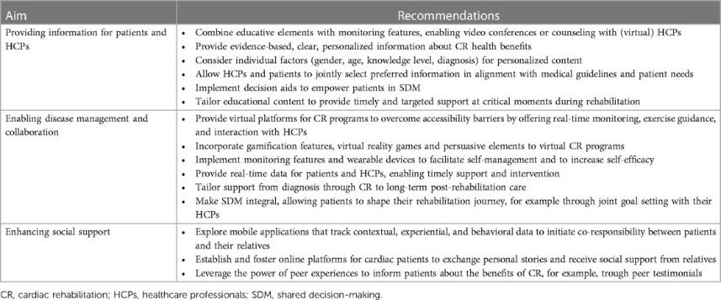
Targeting CR uptake and in-program adherence
After event or during hospitalisation
Information really matters (also to relatives) – use of digital tools with
option to select topics
Allow the voice and thoughts of the patient – shared-decision making
Höppchen I, et al. Targeting behavioral factors with digital health and shared decision-making to promote cardiac rehabilitation-a narrative review. Front Digit Health. 2024 Feb 23;6:1324544.

Slide 20
Targeting CR uptake and in-program adherence
During rehabilitation
Personalisation is key – decision support system and SDM
Progress monitoring really matters – with feedback
Allow the experiences of the patient – digital social contacts and SDM
Höppchen I, et al. Targeting behavioral factors with digital health and shared decision-making to promote cardiac rehabilitation-a narrative review. Front Digit Health. 2024 Feb 23;6:1324544.

Slide 21
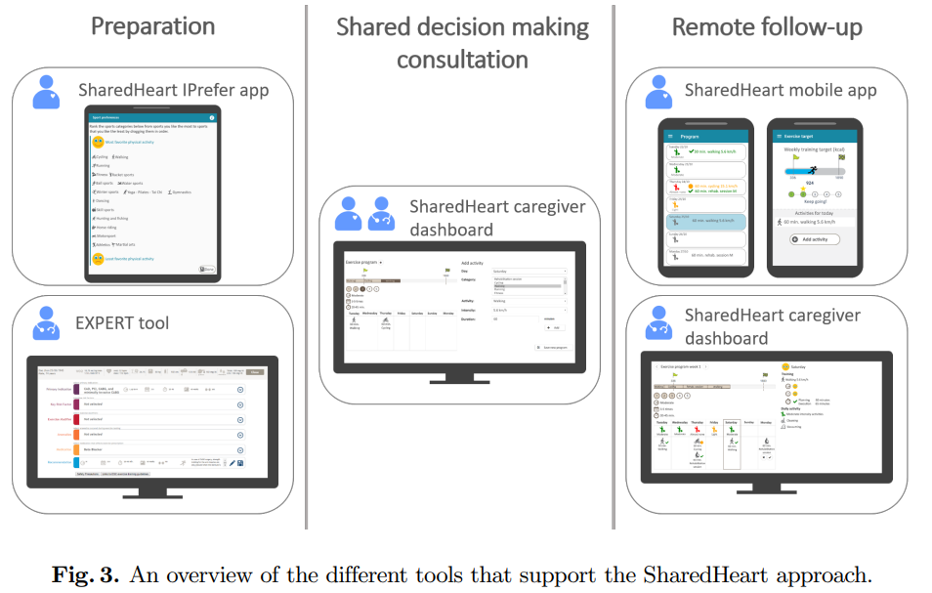
An example - SharedHeart
Bonneux C, et al. The SharedHeart Approach: Technology-Supported Shared Decision Making to Increase Physical Activity in Cardiac Patients. In: Levy Hadas, Barkan Rafael, PERVASIVE COMPUTING TECHNOLOGIES FOR HEALTHCARE, PERVASIVE
HEALTH 2021, SPRINGER INTERNATIONAL PUBLISHING AG, p. 469 -488.

Slide 22
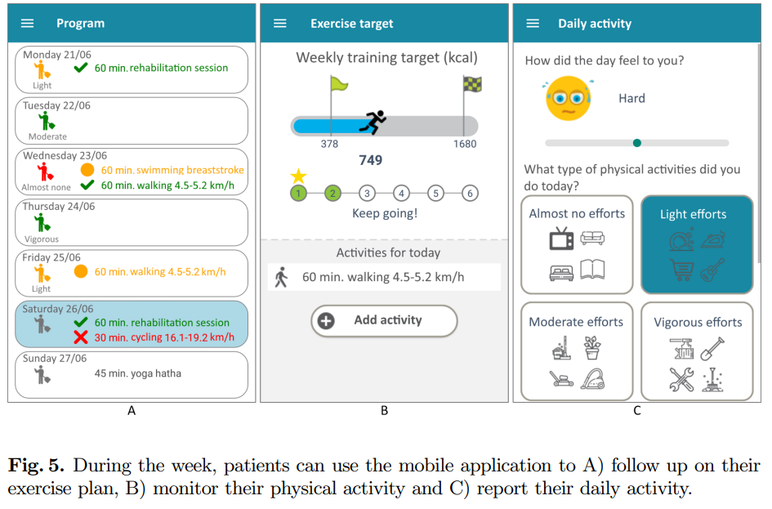
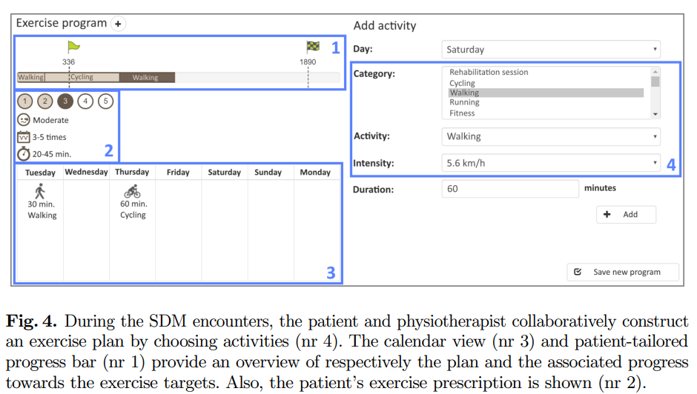
An example - SharedHeart
Bonneux C, et al. The SharedHeart Approach: Technology-Supported Shared Decision Making to Increase Physical Activity in Cardiac Patients. In: Levy Hadas, Barkan Rafael, PERVASIVE COMPUTING TECHNOLOGIES FOR HEALTHCARE, PERVASIVE
HEALTH 2021, SPRINGER INTERNATIONAL PUBLISHING AG, p. 469 -488.

Slide 23
An example - SharedHeart
N=80 CCS patients
CR (EXPERT tool-guided)
CR (EXPERT tool-guided + telemonitoring + SDM)
12 weeks
12 weeks
VO2peak: + 2.55 ml/kg/min
QoL: + 3.0 points
Daily steps: + 0
VO2peak: + 3.55 ml/kg/min
QoL: + 9.5 points
Daily steps: + 1451
P<0.05
Kizilkilic SE, et al. A digitally-supported shared decision making approach for patients during cardiac rehabilitation: a randomised controlled trial. Eur J Prev Cardiol, 2024; Volume 31: S1

Slide 24
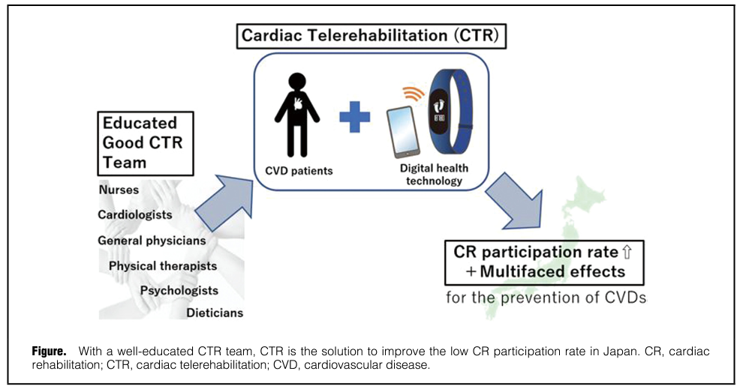
Targeting CR uptake and (long-term) adherence
Kaihara T, et al. Cardiac Telerehabilitation - A Solution for Cardiovascular Care in Japan. Circ Rep. 2021 Oct 29;3(12):733-736.

Slide 25
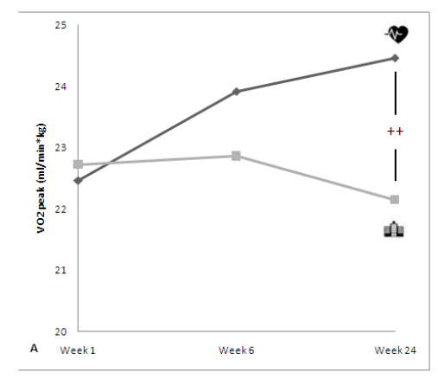
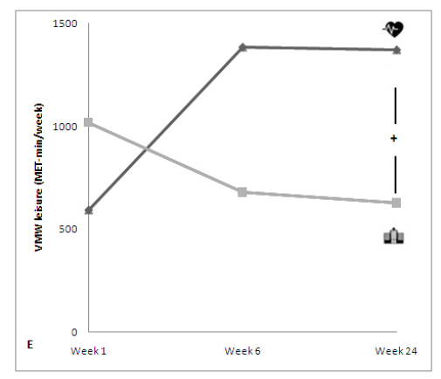
Some experience in Belgium
Adding-in telerehabilitation…
P<0.01
P<0.05
MVPA
Additional telerehabilitation from week 6 in CR (n=70)
Standard CR (n=70)
Frederix I, et al. Medium-Term Effectiveness of a Comprehensive Internet-Based and Patient-Specific Telerehabilitation Program With Text Messaging Support for Cardiac Patients: Randomized Controlled Trial. J Med Internet Res. 2015 Jul 23;17(7):e185.

Slide 26
Conclusions
In current cardiac rehabilitation, we face difficulties with the patient diversity and struggle to reach a high uptake and (long-term) adherence to CR and a healthy lifestyle
Digital systems/tools have been developed with promising impact on
Dealing with diversity (EXPERT (Training) tool)
Improving adherence (telemonitoring systems, SharedHeart)

Slide 27
E-mail: Dominique.hansen@uhasselt.be
https://twitter.com/hansen_phd
https://www.researchgate.net/profile/Dominique_Hansen2

