Slide 2
The effectiveness of breathing interventions on pain and disability in spinal pain:
a systematic review
Lotte Janssens & Sofie Van Wesemael, Charlotte Amerijckx, Nina Goossens, Sim Klaps, Elke Vlemincx & Katleen Bogaerts

Slide 3
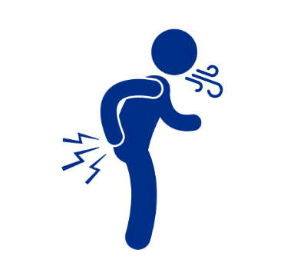
Dysfunctional breathing in spinal pain
Beeckmans et al. 2016, Rasmussen-Barr E et al. 2019
Roussel et al. 2009, Stephen et al. 2022
Kolar et al. 2012, Janssens et al. 2013
Notes:
What we know is that patients with spinal pain often show dysfunctional breathing patterns…
---
individuals with chronic non-specific spinal pain frequently show dysfunctional breathing patterns ^{11,12}, such as predominant thoracic breathing, particularly during tasks that challenge trunk control ¹¹. Thereby, they display smaller diaphragm excursion, an elevated diaphragm position during postural tasks, reduced diaphragm inspiratory muscle strength, and increased diaphragm fatigue compared to persons without LBP ¹³⁻¹⁵. Earlier studies also showed low diurnal end-tidal CO2 pressure (PETCO2) values in individuals with LBP ¹⁶. They reported that almost one in three patients with chronic LBP experience symptoms of hyperventilation (Nijmegen questionnaire score ≥ 23) ¹⁷. Hyperventilation can be seen as a respiratory stress response that occurs most typically in situations of fear, stress, pain, or other highly arousing emotions ^{18,19}. It is often characterized by a shift from a diaphragmatic to a thoracic breathing pattern, with additional recruitment of trapezius, sternocleidomastoid, and scalene muscles ²⁰. Chronic NP has also been associated with respiratory dysfunctions, such as suboptimal maximal voluntary ventilation, reduced respiratory muscle strength, impaired chest mechanics, and low PETCO₂, linked to hyperventilation ²¹⁻²⁴.

Slide 4
Dysfunctional breathing in spinal pain
Symptoms of hyperventilation
Predominant thoracic breathing
Reduced diaphragm strength
Elevated diaphragm position
Increased diaphragm fatigue
Smaller diaphragm excursion
Beeckmans et al. 2016, Rasmussen-Barr E et al. 2019
Roussel et al. 2009, Stephen et al. 2022
Kolar et al. 2012, Janssens et al. 2013
Notes:
Such as predominant thoracic breathing, particularly during tasks that challenge trunk control
Symptoms of hyperventilation, both subjectively as in terms of low end-tidal CO2 values
Furthermore, reduced functional capacity of the diaphragm has been observed in terms of reduced strength, increased fatigue, a smaller excursion and elevated position
…
individuals with chronic non-specific spinal pain frequently show dysfunctional breathing patterns ^{11,12}, such as predominant thoracic breathing, particularly during tasks that challenge trunk control ¹¹. Thereby, they display smaller diaphragm excursion, an elevated diaphragm position during postural tasks, reduced diaphragm inspiratory muscle strength, and increased diaphragm fatigue compared to persons without LBP ¹³⁻¹⁵. Earlier studies also showed low diurnal end-tidal CO2 pressure (PETCO2) values in individuals with LBP ¹⁶. They reported that almost one in three patients with chronic LBP experience symptoms of hyperventilation (Nijmegen questionnaire score ≥ 23) ¹⁷. Hyperventilation can be seen as a respiratory stress response that occurs most typically in situations of fear, stress, pain, or other highly arousing emotions ^{18,19}. It is often characterized by a shift from a diaphragmatic to a thoracic breathing pattern, with additional recruitment of trapezius, sternocleidomastoid, and scalene muscles ²⁰. Chronic NP has also been associated with respiratory dysfunctions, such as suboptimal maximal voluntary ventilation, reduced respiratory muscle strength, impaired chest mechanics, and low PETCO₂, linked to hyperventilation ²¹⁻²⁴.

Slide 5
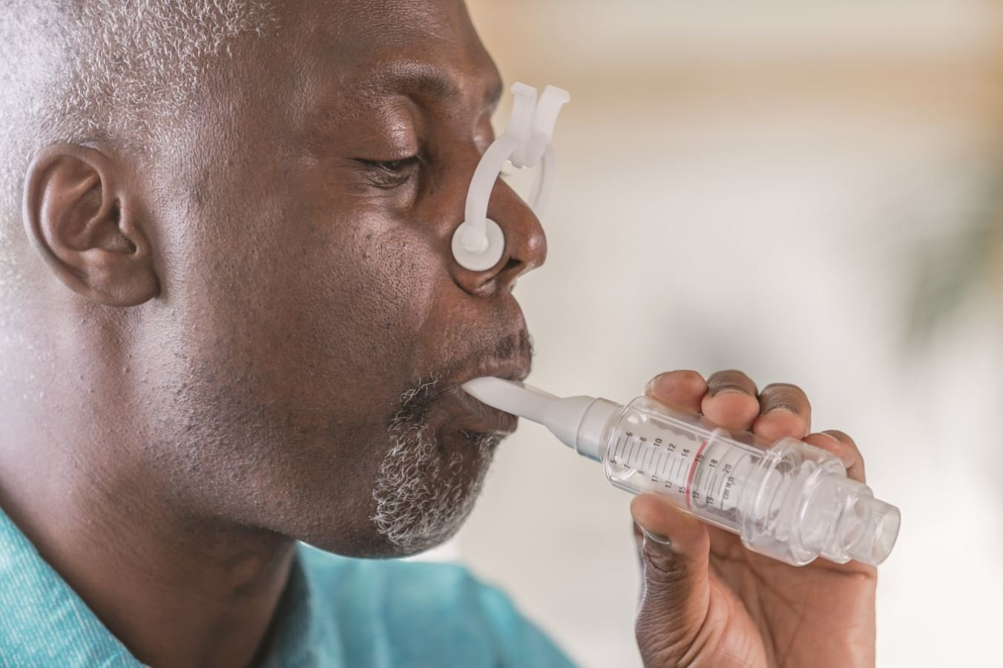
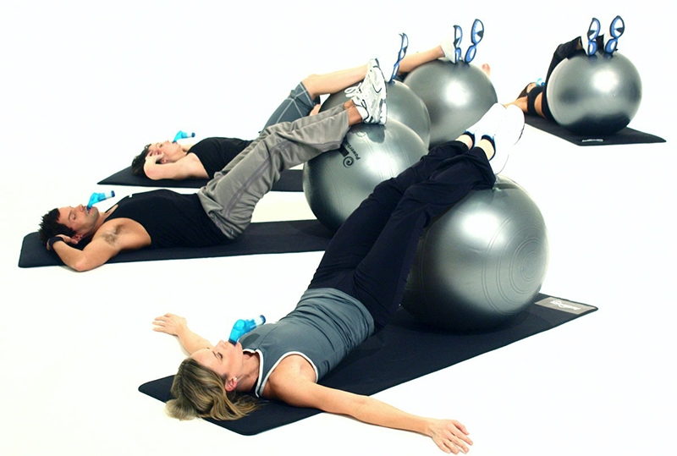
Breathing interventions in spinal pain
Promising to reduce pain (Tatsios et al. 2022, Zhai et al. 2024)
BUT
Which types?
Which working mechanisms?
B
P
S
Notes:
Based on these observations, breathing interventions have been proposed by physiotherapists as well as psychologists, and 2 recent systematic reviews concluded that breathing interventions can reduce pain intensity in patients with chronic LBP
However, there is a lack of distinction of different types of BI in the literature, for example the difference between BA and resistive breathing.
Also, it is unclear which working mechanisms are responsible for the effects. It is important to elaborate on these working mechanisms as the majority of previous studies adopted a isolated view. Some for example focused on strengthening the diaphragm, so from a biological point of view, while others only on a relaxation, so psychological point of view. In the meantime, we all feel that breathing and therefore also breathing interventions only make sense within a BPS framework.

Slide 6
Research question
What are the effects of different types of breathing interventions on pain and disability in individuals with non-specific low back pain or neck pain?

Slide 7
Study selection
Systematic review of 6 databases
Therapies that used active instructions to modulate breathing or increase breathing awareness in adults with non-specific low back or neck pain
Notes:
We performed a systematic review by searching 6 databases.
We include therapies that used active instructions to modulate breathing or increase breathing awareness in adults with spinal pain were

Slide 8
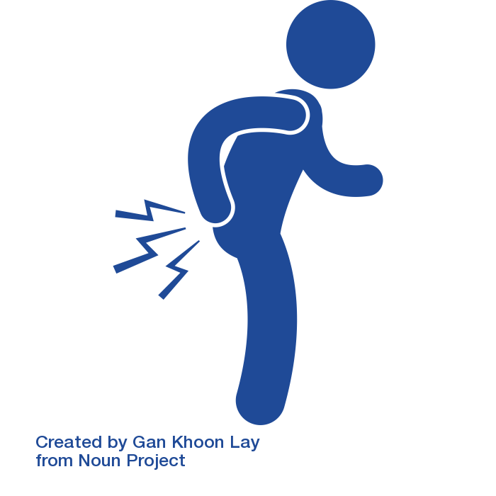
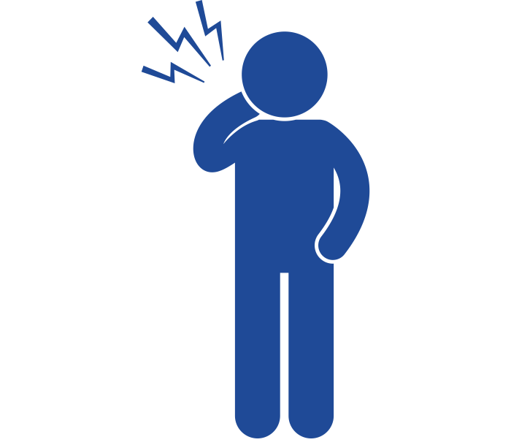
Study population
16 studies
6 studies
22 studies (903 participants)
Average pain intensity 5.3/10
Mild (1/3), moderate (2/3), severe disability
Subacute (1/3), chronic (2/3)
Notes:
Twenty-two studies were included (n= 903), of which 16 on LBP and 6 on NP.
On average the participants had an average pain score, and the majority had a moderate disability and most participants were in a chronic phase of their pain.

Slide 9
Data synthesis
Based on targeted (main) working mechanisms
Combined vs. stand-alone
Slow Deep Breathing
Respiratory Resistive Breathing
Breathing Awareness
Manipulated respiratory rate, volume, or location
Manipulated inspiratory and/or expiratory resistance
Raising awareness to breathing (no manipulations)
Notes:
Breathing interventions were subdivided based on the main working mechanisms being targeted.
(1) Slow deep breathing (SDB): breathing interventions that manipulate the breathing pattern in terms of rate (slow breathing), volume (deep breathing) or location (diaphragmatic breathing)
(2) Respiratory resistive breathing (RRB): breathing interventions that apply breathing resistance (e.g., inspiratory or expiratory muscle training)
(3) Breathing awareness (BA): breathing interventions that raise awareness or attention towards breathing, without manipulating or changing any breath-related parameters, aside from awareness or attention

Slide 10
N studies with significant / non-significant group effect
>
>
Within-group improvements of pain (all) and disability (4/5)
Notes:
In terms of results, this table displays the amount of studies with a significant or non-significant group effect, between a group receiving a BI and a control group.
For SDB, 6 out of 10 and 2 out of 6 studies improved pain and disability, respectively, compared to other/no (breathing) interventions,
For RRB, 3 out of 6 studies (half) improved pain and disability, compared to other/no (breathing) interventions,.
the only study investigating BA did not show any improvement in pain nor disability compared to routine physical therapy.
In general , it appears that adding breathing interventions to other non-breathing-related treatments is more effective compared to stand-alone breathing interventions
In general greater reductions in pain levels (54%) than in disability (38%) probably due to the limited functional character of the interventions (e.g., often performed in seated or lying position),
These within-group results revealed that 100% and 81% of the studies reported significant improvements in pain and disability levels over time, respectively. Thus, although our findings do not support a greater effectiveness of breathing interventions compared to other (breathing) interventions, the within-group findings suggest improvements over time in pain and disability. These may partially be due to natural recovery over time or (increased) expectations of recovery due to the unblinded breathing interventions.

Slide 11
Potential* biomechanical, physiological, and psychological working mechanisms
Slow Deep Breathing | ꜛ tidal volume, diaphragm excursion, chest mobility
 | ꜛ ventilation efficiency, parasympathetic activity, vagal nerve activity, cardiac vagal tone, baroreceptor sensitivity, heart rate variability, respiratory sinus arrhythmia
 | ꜜ anxiety, stress ꜛ well-being, attention, emotional state, expectancy of treatment success
Respiratory Resistive Breathing | ꜛ diaphragm strength, postural and trunk control, chest mobility ꜛ breathing pattern
 | ꜛ ventilation efficiency, endogenous opioids, cardiovascular functions, oxidative metabolic
 | ꜛ attention, emotional state, expectancy of treatment success
Breathing Awareness | ꜛ breathing pattern
 | ?
 | ꜜ stress ꜛ attention, emotional state, expectancy of treatment success
* Based on studies in both spinal pain and general pain populations

Slide 12
Conclusion
No strong evidence for breathing interventions
Promising effects of (additional) Slow Deep Breathing and Respiratory Resistive breathing on spinal pain (mainly) and disability
More studies on Breathing Awareness interventions needed
Knowledge on working mechanisms needed for clinicians
Notes:
No strong evidence for breathing interventions being more effective than other types of interventions
Promising effects of Slow Deep Breathing and Respiratory Resistive breathing on spinal pain (mainly) and disability, particularly as additional therapy
More studies on Breathing Awareness needed
Knowledge of working mechanisms essential for clinicians

Slide 13
Lotte Janssens
Lotte.Janssens@uhasselt.be
@LotteJanssens2

