Slide 1
How to prescribe physical activity in individuals with diabetes and chronic coronary syndrome and/or heart failure
Dominique Hansen, PhD, FESC

Slide 2
Conflicts of interest
None to be declared

Slide 3
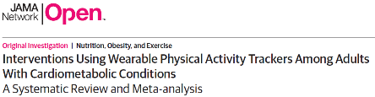
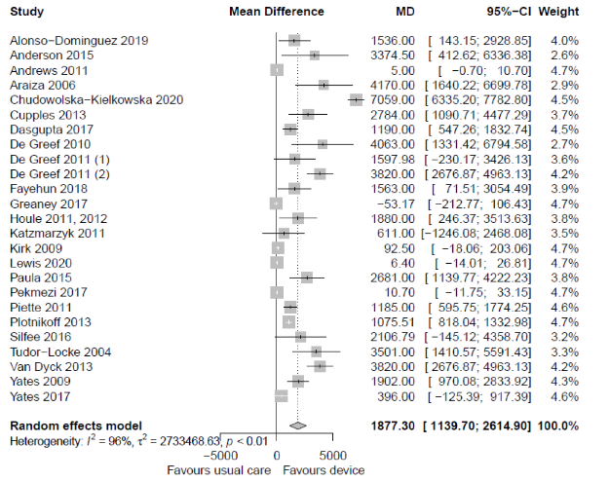
There were no associations of wearable activity tracker interventions with:
systolic blood pressure, diastolic blood pressure, total cholesterol level, high-density lipoprotein cholesterol level, low-density lipoprotein cholesterol level, BMI, and weight.
Impact on glucose (%):
MD (95%CI) of −0.14 (−0.27 to −0.01) (p=0.04)
Hodkinson A, Kontopantelis E, Adeniji C, van Marwijk H, McMillian B, Bower P, Panagioti M. Interventions Using Wearable Physical Activity Trackers Among Adults With Cardiometabolic Conditions: A Systematic Review and Meta-analysis. JAMA Netw Open. 2021 Jul 1;4(7):e2116382.

Slide 4
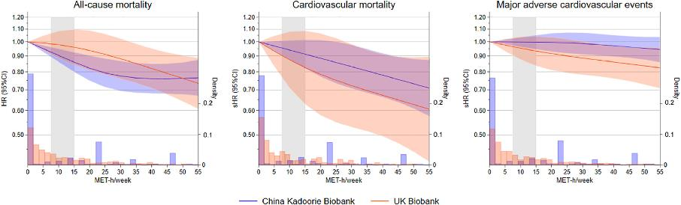
Do type 2 diabetes patients need more physical activity?
Vertical shaded area is recommended level of PA
Physical activity equivalent to 90 min of walking or 38 min of strenuous sports per day, which far exceeds the WHO recommended level, was needed to lower the risk in the UK Biobank.
Tarp J, Luo M, Sanchez-Lastra MA, Dalene KE, Cruz BDP, Ried-Larsen M, Thomsen RW, Ekelund U, Ding D. Leisure-time physical activity and all-cause mortality and cardiovascular disease in adults with type 2 diabetes: Cross-country comparison of cohort studies. J Sport Health Sci. 2024 Mar;13(2):212-221.

Slide 5
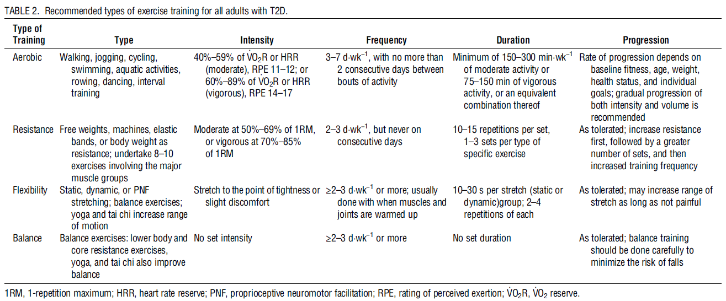
Exercise recommendations for T2DM
Kanaley JA, et al. Exercise/Physical Activity in Individuals with Type 2 Diabetes: A Consensus Statement from the American College of Sports Medicine. Med Sci Sports Exerc. 2022;54:353-68.

Slide 6
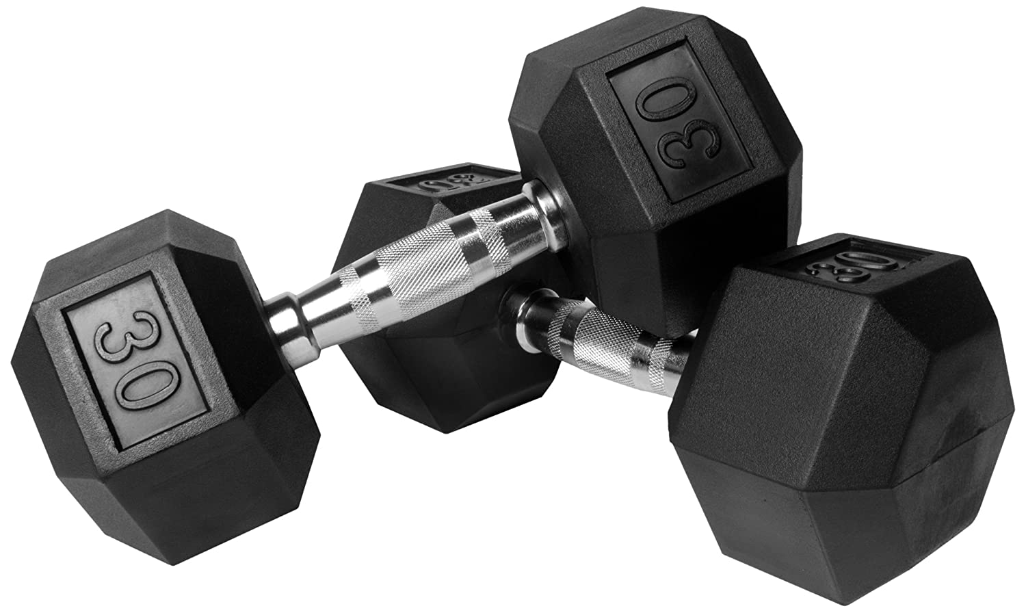
Additional considerations
What modality in resistance training actually matters in T2DM?
Characteristic | No. of data | Effect size (95 % CI) [%] | I ² | P value (heterogeneity) | P value (difference between strata)
Intervention period
≥12 weeks | 12 | −0.33 (−0.60 to −0.06) | 84.9 | <0.001
<12 weeks | 11 | −0.39 (−0.62 to −0.17) | 46.5 | 0.04 | 0.72
Frequency
≥3/week | 17 | −0.25 (−0.44 to −0.06) | 77.8 | <0.001
<3/week | 6 | −0.66 (−0.88 to −0.44) | 11.7 | 0.34 | 0.09
No. of items
≥9 items | 10 | −0.54 (−0.90 to −0.19) | 49.7 | 0.04
<9 items | 13 | −0.25 (−0.47 to −0.04) | 84.1 | <0.001 | 0.24
Intensity
≥75 % of 1 RM | 10 | −0.41 (−0.72 to −0.09) | 86.8 | <0.001
<75 % of 1 RM | 10 | −0.30 (−0.51 to −0.09) | 53.3 | 0.02 | 0.60
Interval
≥1.5 min | 8 | −0.47 (−0.88 to −0.06) | 91.3 | <0.001
<1.5 min | 5 | −0.38 (−0.97 to −0.21) | 0.0 | 0.95 | 0.85
Total sets per bout of exercise
≥21 sets | 10 | −0.65 (−0.97 to −0.32) | 62.7 | 0.004
<21 sets | 13 | −0.16 (−0.38 to 0.05) | 79.8 | <0.001 | 0.03
Total sets per week
≥60 sets | 14 | −0.32 (−0.58 to −0.06) | 80.9 | <0.001
<60 sets | 9 | −0.40 (−0.70 to −0.09) | 72.6 | <0.001 | 0.09
Ishiguro H, et al. In Search of the Ideal Resistance Training Program to Improve Glycemic Control and its Indication for Patients with Type 2 Diabetes Mellitus: A Systematic Review and Meta-Analysis. Sports Med. 2016;46:67-77.

Slide 7
Additional considerations
Optimal volume of endurance exercise
1,100 MET min/week (i.e., the optimal dose) is equivalent on average to 244 min/week of moderate-intensity aerobic physical activity (ranging from 183 to 367 min/week, depending on the intensity of the activity, from 3 to 6 MET min)
Gallardo-Gómez D, et al. Optimal Dose and Type of Physical Activity to Improve Glycemic Control in People Diagnosed With Type 2 Diabetes: A Systematic Review and Meta-analysis. Diabetes Care. 2024;47(2):295-303.

Slide 8

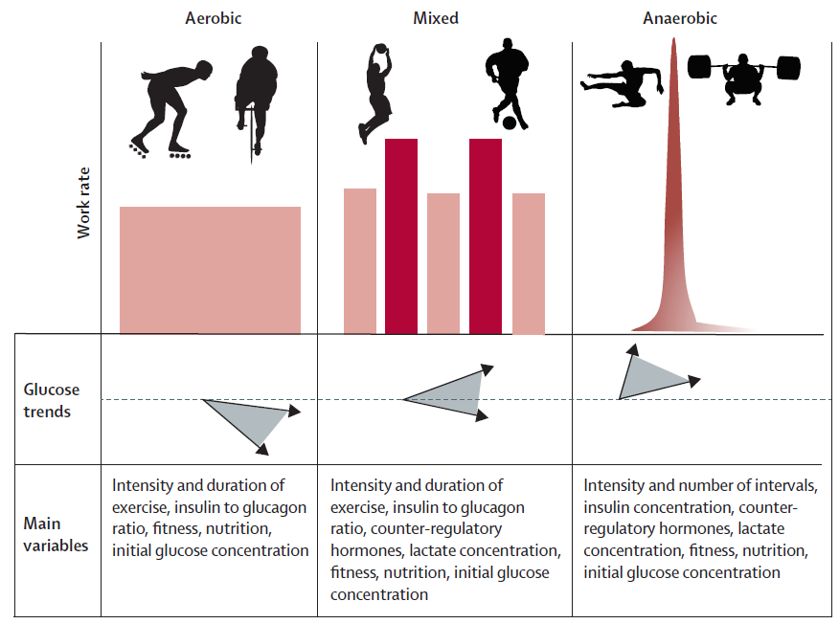
Additional considerations in type 1 diabetes

Slide 9

Targets of exercise in diabetes?
Optimized glycemic control

Slide 10
Targets of exercise in diabetes?
Optimized blood pressure
Optimized physical fitness
Optimized lipid profile
And others…
Optimized body composition
Optimized glycemic control

Slide 11
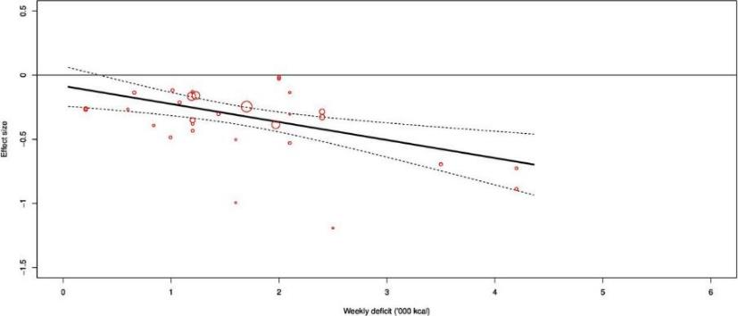
Targeting (abdominal) fat mass
Exercise demonstrated a dose–response effect of −0.15 ((−0.23 to −0.07); p<0.001) on visceral fat mass per 1000 calories deficit per week
Recchia F, et al. Dose-response effects of exercise and caloric restriction on visceral adiposity in overweight and obese adults: a systematic review and meta-analysis of randomised controlled trials. Br J Sports Med. 2023 Aug;57(16):1035-1041.

Slide 12
Targeting blood pressure
Minimal standards
moderate-intense
>30 min/session
4 × 2 min (hand grip), 1 min rest between exercises, 30%–40% maximum voluntary contraction
Hanssen H, et al. Personalized exercise prescription in the prevention and treatment of arterial hypertension: a Consensus Document from the European Association of Preventive Cardiology (EAPC) and the ESC Council on Hypertension. Eur J Prev Cardiol. 2022;29:205-15.

Slide 13
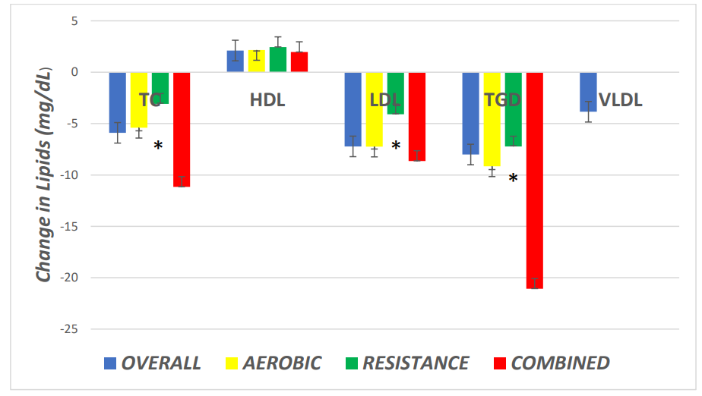
Targeting lipid profile
148 relevant RCTs, with 227 intervention groups, n=5,273 in exercise, n=3,400 sedentary controls
Metaregression showed every extra weekly aerobic session reduced TC -7.68mg/dL
and for every extra week of training by -0.5mg/dL.
Each minute of session time produced an additional 2.11mg/dL HDL increase.
Smart NA, et al. The effect of exercise training on blood lipids: A systematic review and metaanalysis. Sports Med 2024; in press

Slide 14
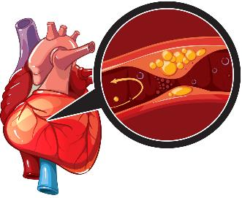
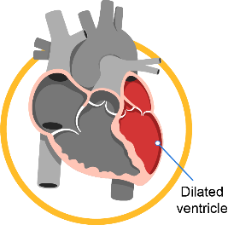
Chronic coronary syndrome
T2DM and T1DM independently increases the risk of CCS
by at least 2-fold, but via different mechanisms.
Diabetes patients have a worse prognosis after AMI.
Major cause of death in DM is of cardiovascular origin.
Chronic heart failure
Diabetes mellitus independently increases
the risk of CHF up to 2-fold in men and
5-fold in women compared with
age-matched controls.
HFpEF is highly prevalent.

Slide 15
General guidances
Medical safety of exercise is of paramount importance
  Rule out (silent) myocardial ischemia and dangerous cardiac arrythmias during exercise
    Exercise testing with ECG
Adhere to progressive build-up of exercise intensity and volume
  After acute myocardial infarction or hospitalisation due to congestion
VO_{2peak} is the key target of exercise intervention now
  Every 1 mL/kg/min increase in VO2peak is associated with an approximate 15% decrease in all-cause or cardiovascular-specific mortality

Slide 16
Progressive build-up in intensity/duration of exercise
CCS
  Low-risk patients
    Frequency: most days (at least 3 days/week and preferably 6–7 days/week) for aerobic training; 2 times/week for resistance training
    Intensity: moderate or moderate-to-high intensity for endurance continuous training. 30–70% of the 1-RM for the upper body and 40–80% of 1-RM for lower body exercises, with 12–15 repetitions in one set for resistance training
    Time: at least 20–30 min (preferably 45–60 min) per session
    Arrange exercise training in order to provide an energy consumption of 1000–2000 kcal/week

Slide 17
Progressive build-up in intensity/duration of exercise
CCS
  Moderate-to-high-risk patients (left ventricular dysfunction, coronary disease severity, comorbidities, ageing)
    Frequency: most days (at least 3 days/week and preferably 6–7 days/week) for aerobic training; 2 times/week for resistance training
    Intensity: start at low intensity and progress to moderate or moderate-to-high intensity for endurance continuous training. 30–70% of the 1-RM for the upper body and 40–80% of 1-RM for lower body exercises, with 12–15 repetitions in one set for resistance training
    Time: at least 20–30 min (preferably 45–60 min) per session

Slide 18
Progressive build-up in intensity/duration of exercise
CCS
  After cardiothoracic surgery
    In-patient and/or out-patient exercise training programmes immediately after discharge from surgery facilities are advisable
    Upper-body training can begin when the chest is stable, i.e. usually after six weeks
    Exercise training should be individually tailored according to the clinical condition, baseline exercise capacity, ventricular function and different valve surgery
    Consider inspiratory muscle training or other respiratory physiotherapy in patients with prolonged postoperative mechanical ventilation and/or respiratory comorbidities

Slide 19
Progressive build-up in intensity/duration of exercise
CHF
  Frequency (ET sessions per week): 2–3/week according to perceived symptoms and clinical status gradually increased to 3–5/week preferably all days per week.
  Intensity: ET should start at a level as low as 40% of VO2peak in patients with low exercise capacity, recent haemodynamic decompensation or high exercise-related risk. Then gradually increased to VT1, which is the safest point. Then, if well tolerated, intensity may increase close to VT2.
  Time: gradually increasing from 15 to 30 min at least, aiming at 45–60 min.
  Resistance exercise: An initial instruction phase (<30% 1-RM, RPE 11–12, 5–10 repetitions) is followed by a gradual increase towards the resistance/endurance phase with high number of repetitions (12–25) and a low intensity (30–40% 1-RM, RPE 12) so as to reach the strength training/muscle build-up phase by increasing weights progressively up to 40–60% of the 1-RM (RPE >15, 8–15 repetitions).

Slide 20

Inspiratory muscle training in CHF
When used in isolation
significantly improved:
PImax,
VE/VCO2 slope,
Quality of life,
Walking capacity,
VO2peak (in some studies),
Dyspnea
When combined with endurance training
Significantly (and additionally) improved:
PImax,
Dyspnea
Start at 30% of Pimax, and build up towards 60% of Pimax,
for 20-30 min/session, at 3-5 sessions/week
- Azambuja ACM, et al. Inspiratory Muscle Training in Patients With Heart Failure: What Is New? Systematic Review and Meta-Analysis. Phys Ther. 2020;100(12):2099-2109.
- Gomes Neto M, et al. The impact of high-intensity inspiratory muscle training on exercise capacity and inspiratory muscle strength in heart failure with reduced ejection fraction: a systematic review and meta-analysis. Clin Rehabil. 2018;32(11):1482-1492.
- Gomes-Neto M, et al. Effects of Exercise Interventions on Aerobic Capacity in Patients With Heart Failure With Preserved Left Ventricular Ejection Fraction: Systematic Review and Network Meta-Analysis. Cardiol Rev. 2024;32(1):45-50.

Slide 21
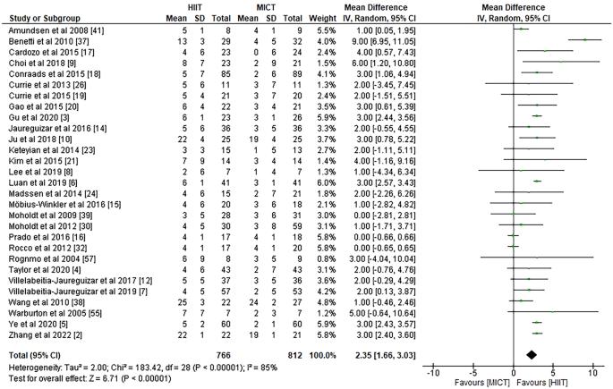
Targeting VO2peak
MICT vs. HIIT
Gomes-Neto M, et al. Effects of Different Exercise Interventions on Cardiorespiratory Fitness, as Measured by Peak Oxygen Consumption in Patients with Coronary Heart Disease: An Overview of Systematic Reviews. Sports Med. 2024 Jul 22. doi: 10.1007/s40279-024-02053-w. Epub ahead of print.

Slide 22
Targeting VO2peak
If you still desire to apply MICT, the volume of endurance exercise is the key driver to improvements in VO2peak
  At 3–6 months:
    In CHF patients: every increment in weekly exercise energy expenditure by >460 kcal is associated with a greater mean increase in VO2peak by 2.6 mL/kg/min, p<0,05
    In CCS patients: A greater total energy expenditure is significantly related to greater improvements in exercise capacity (0.91 mL/min/kg per 100J/kg, p<0,05)
Hansen D, et al. Appropriate exercise prescription in primary and secondary prevention of cardiovascular disease: why this skill remains to be improved among clinicians and healthcare professionals. A call for action from the EXPERT Network†. Eur J Prev Cardiol. 2023 Dec 21;30(18):1986-1995.

Slide 23
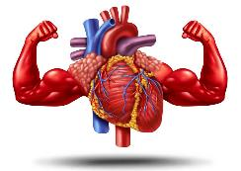
Targeting VO2peak
In CCS
23 studies (N=916)
Combined training is more effective in increasing CRF (SMD 0.26, 95% CI 0.02 to 0.49, p=0.03) compared with aerobic training alone.
Terada T, Pap R, Thomas A, Wei R, Noda T, Visintini S, Reed JL. Effects of muscle strength training combined with aerobic training versus aerobic training alone on cardiovascular disease risk indicators in patients with coronary artery disease: a systematic review and meta-analysis of randomised clinical trials. Br J Sports Med. 2024 Aug 30:bjsports-2024-108530. doi: 10.1136/bjsports-2024-108530. Epub ahead of print.
In CHF
82 studies (N=4574)
VO2peak increases by a greater magnitude when applying combined AET + HiRET (by +3.49 ml/kg/min)
vs. AET only (by + 2.19 ml/kg/min) or combined AET + MiRET (by + 2.77 ml/kg/min)
Li Y, He W, Jiang J, Zhang J, Ding M, Li G, Luo X, Ma Z, Li J, Ma Y, Shen Y, Han X. Non-Pharmacological Interventions in Patients With Heart Failure With Reduced Ejection Fraction: A Systematic Review and Network Meta-analysis. Arch Phys Med Rehabil. 2024 May;105(5):963-974.

Slide 24
Conclusions
Effective PA or exercise prescription in diabetes requires precision
  In particular when also targeting body composition, blood pressure and blood lipid profile
The incidence of CCS or CHF is a major game-changer
  Safety precautions
  Gradual build-up of volume and intensity
  More focus on VO2peak
    HIIT, resistance exercise training

Slide 25

Dominique.hansen@uhasselt.be
https://www.researchgate.net/profile/Dominique_Hansen2

Slide 26
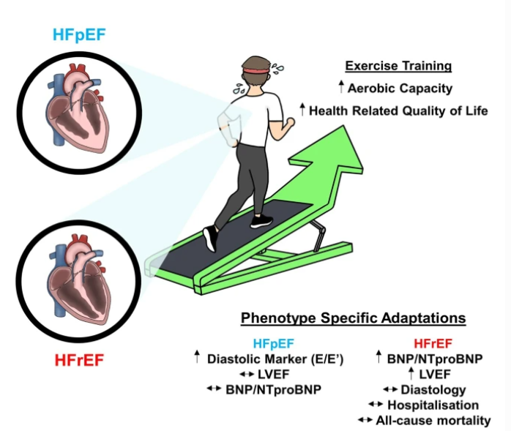
HFrEF vs. HFpEF
Edwards JJ, O'Driscoll JM. Exercise Training in Heart failure with Preserved and Reduced Ejection Fraction: A Systematic Review and Meta-Analysis. Sports Med Open. 2022 Jun 8;8(1):76.

