Slide 1
CO-CREATING CHANGE FOR SUSTAINABILITY
September 8-10, 2024 | Padua, Italy
What characterizes a future-proof business economist?
Tom Kuppens^{1,2,3}, Cathy Macharis¹, Leen Audenaert⁴, Tom Janssen⁴
(1) Vrije Universiteit Brussel; (2) Hasselt University; (3) COPERNICUS Alliance; (4) Duurzaam Educatiepunt

Slide 2
Context of the project
Reform of the curricula for the academic bachelor and master programmes of
Business Economics (180 + 60 ECTS)
Business Engineering (180 + 120 ECTS)
at the Faculty of Social Sciences and Solvay Business School (Vrije Universiteit Brussel)
Collaboration with
Duurzaam Educatiepunt (Flemish Government)
Brussels Research Institute for Teacher Education
Interactive report (Dutch) downloadable via QR code

Slide 3
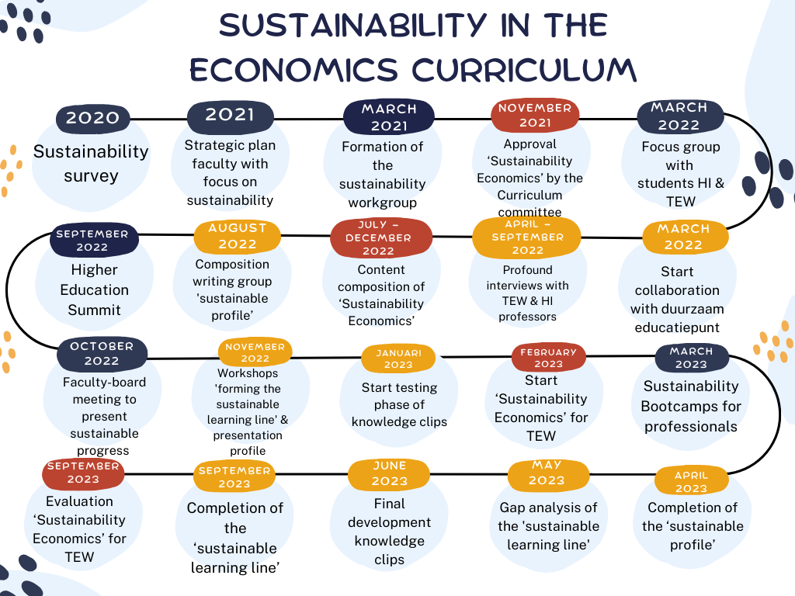
Sustainability in the economics curriculum

Slide 4
A future proof business economist ...
deploys business knowledge in a targeted way for sustainable development;
uses the planetary and social boundaries as a compass;
follows (inter)national sustainability frameworks;
is a systems thinker;
thinks of the long run;
exhibits regenerative leadership;
takes a pluralistic view of the economy;
reports transparently on sustainability efforts;
is an entrepreneur with a multiple mission;
explores new business models in the circular and biobased economy;
is an inclusive entrepreneur;
can develop policy instruments to embed sustainability within organisations.

Slide 5
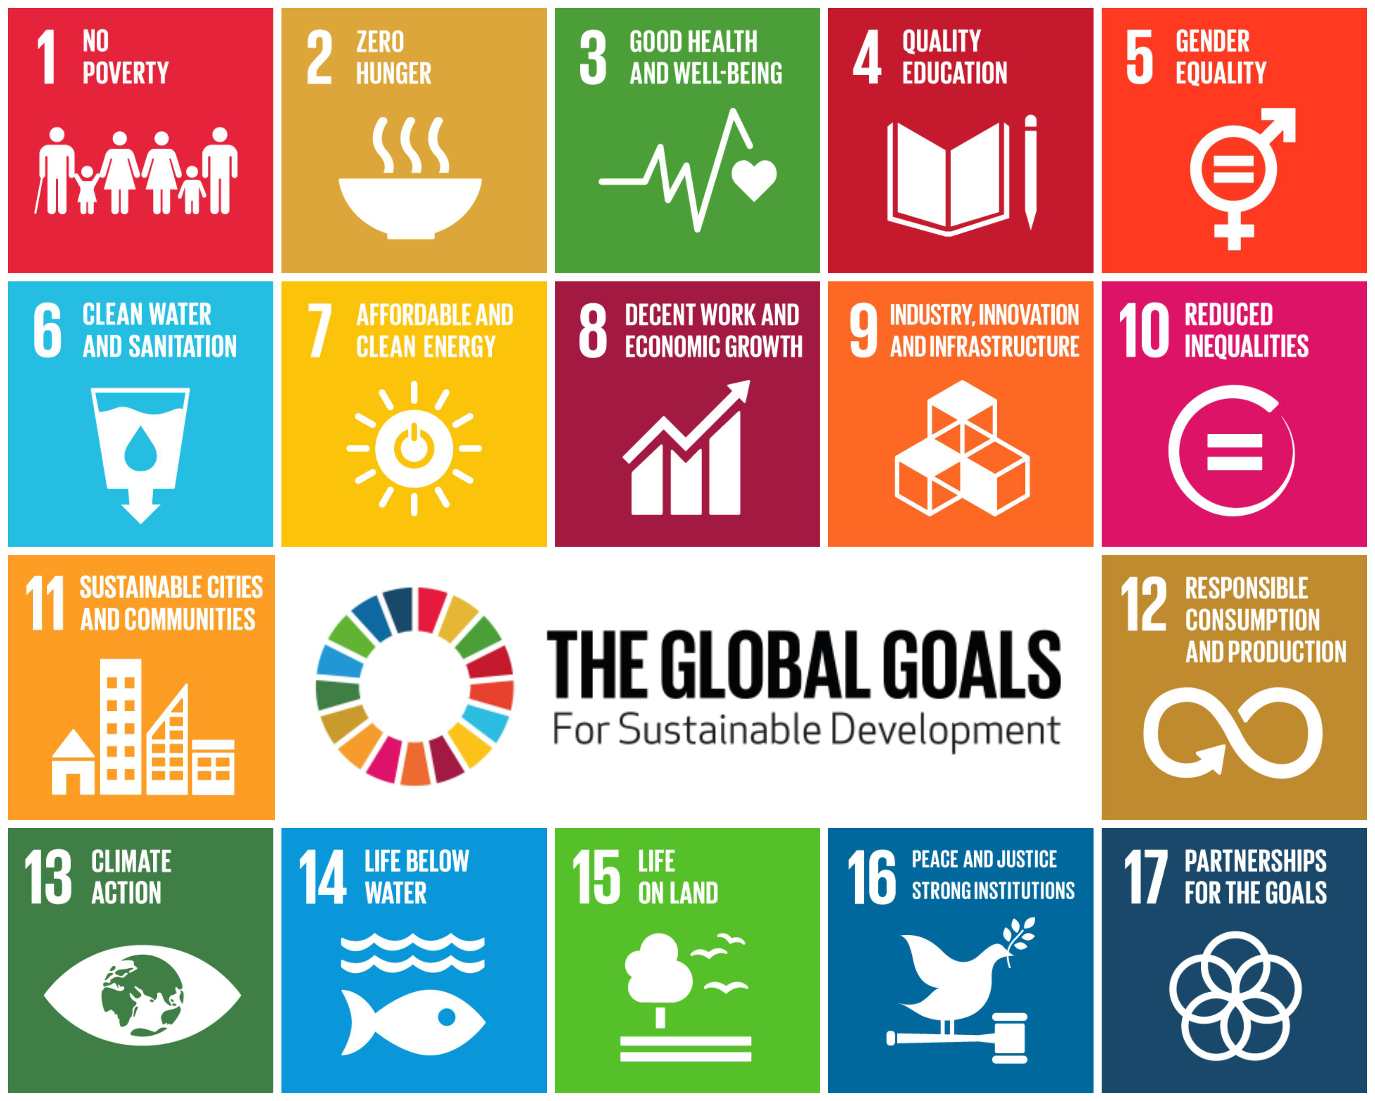
... deploys business knowledge in a targeted way for sustainable development
General economics
Business sciences
Sustainable development:
here and now
in the long run
Resilience

Slide 6
... uses the planetary and social boundaries as a compass
ecological and social sustainability
sustainability as a ‘reflex’
develop personal vision of sustainability
sustainability as a guide for thinking and acting

Slide 7
... follows (inter)national sustainability frameworks
history and milestones
regulations and policy frameworks
can critically reflect on these frameworks
translation to own business context

Slide 8
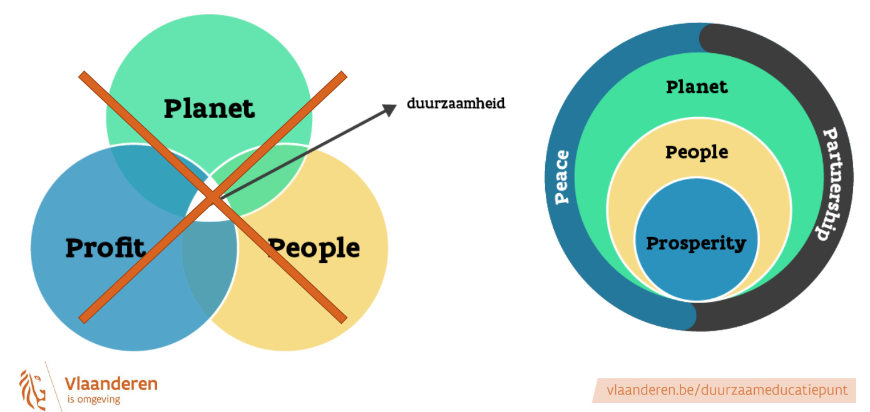
... is a systems thinker
complexity and uncertainty
business ←→ environment
embedded economy

Slide 9
... thinks of the long run
anticipatory competence, visionary
company survival
short-term investments lead to long-term savings
companies that op for sustainability
do not do worse financially
are more resilient in times of crisis
war on talent
from profit to multiple value maximisation

Slide 10
... exhibits regenerative leadership
individual level: inner development in terms of sustainability
organisational level: managing change processes, behavioural and systemic change
value chain level: working together in global and local value chains

Slide 11
... takes a pluralistic view of the economy
goes beyond the neoclassical thinking framework of profit maximisation and economic growth
understands the functioning of energy markets (energy economics)
knows the instruments of government (environmental economics)
understands human actions from a behavioural economic perspective (behavioral economics)
understands old and new economic schools of thought and their history (ecological economics, feminist economics, etc.)

Slide 12
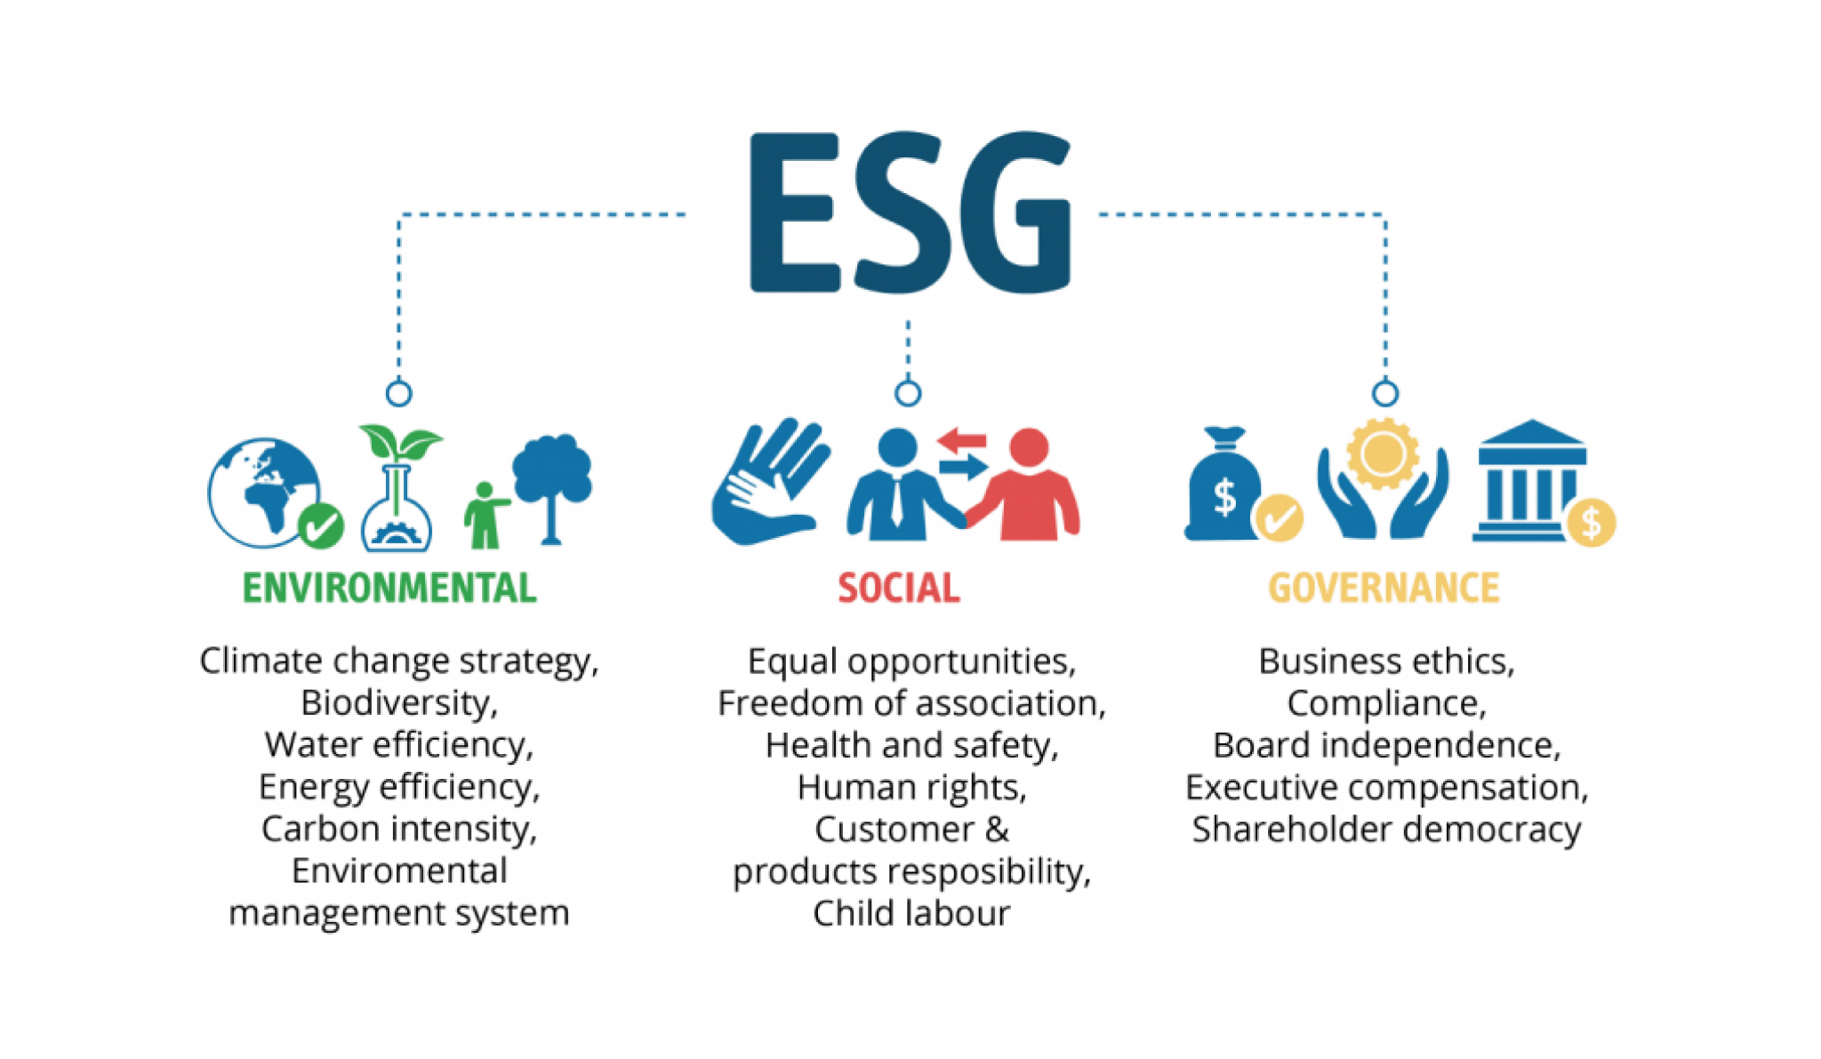
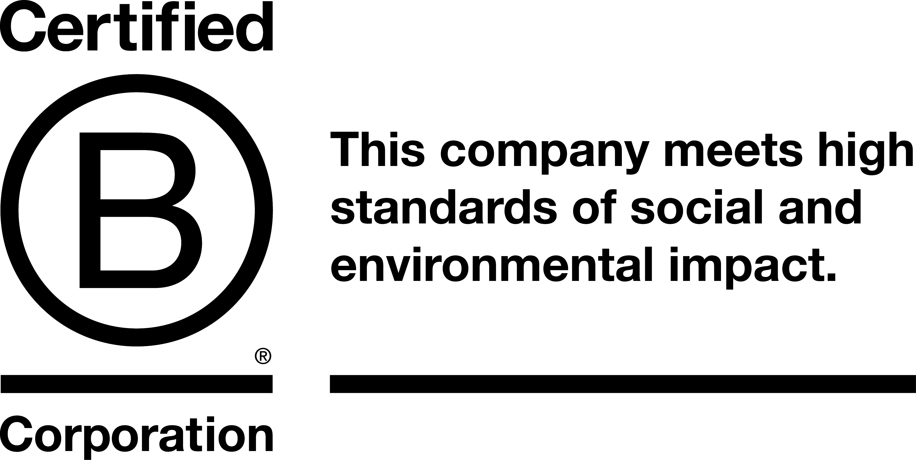
... reports transparently on sustainability efforts
life cycle analysis
ESG reporting regulations
labels
digitisation for reporting

Slide 13
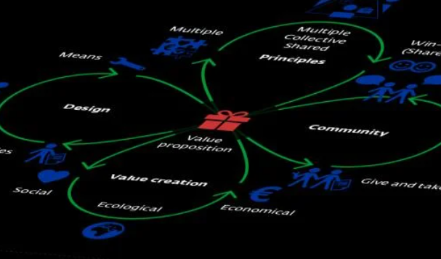
... is an entrepreneur with a multiple mission
purpose-driven
value creation: economic, ecological and social level
value creation for the company and its stakeholders
from ecological footprint to sustainable footprint
diversity of company forms
Source: Jonker & Faber (2021)

Slide 14
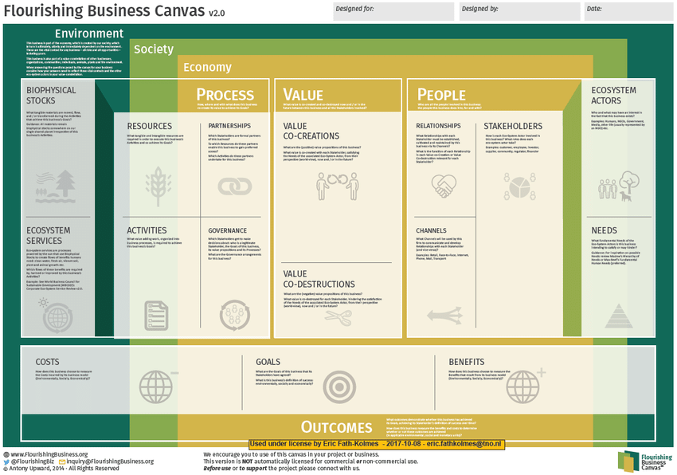
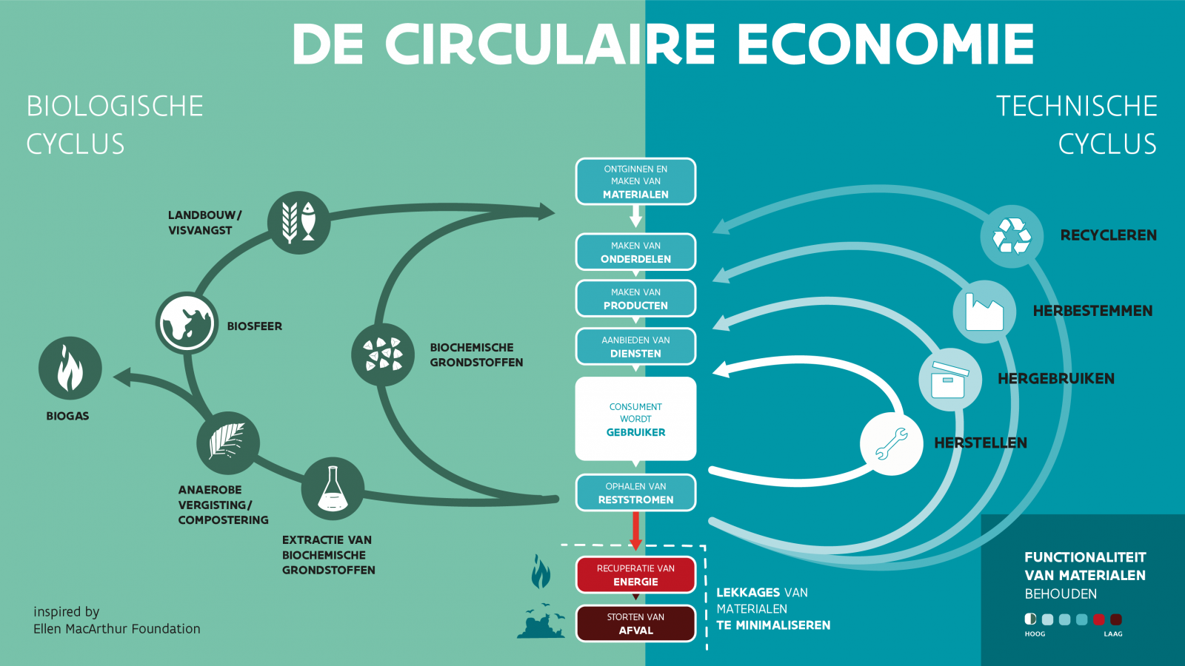
... explores new business models in the circular and biobased economy
extended producer responsibility (EPR)
green, biobased, circular and social economy:
sustainable business models and templates

Slide 15
... is an inclusive entrepreneur
from shareholders to stakeholders
community-driven
empathy
diversity
inclusive human resources policy

Slide 16
... can develop policy instruments to embed sustainability within organisations
government policy: taxes (carbon tax), subsidies, tradable emission rights, ...
company policy: sustainability performance management
circular procurement

Slide 17
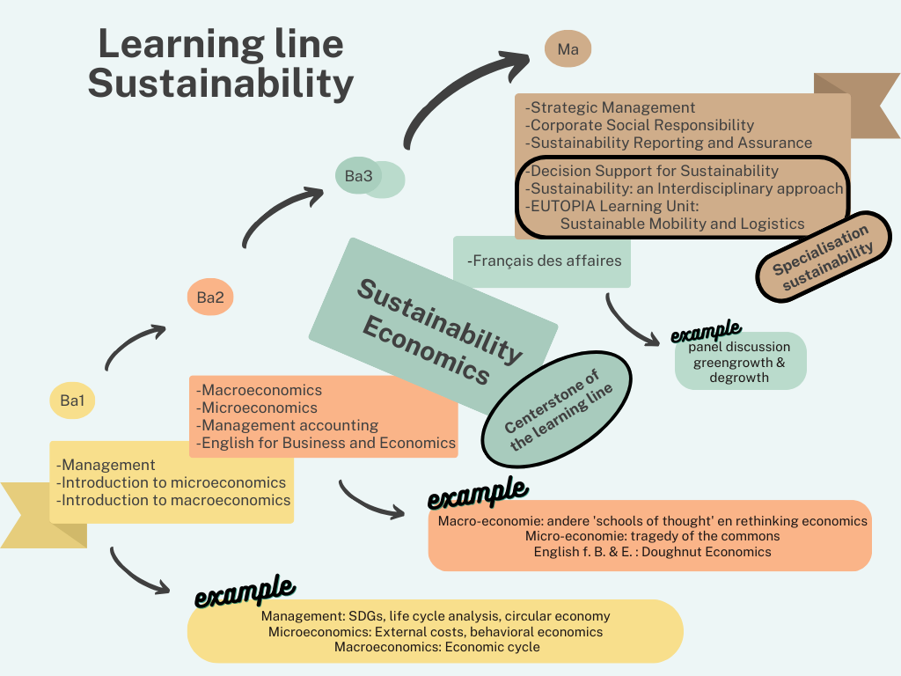
Sustainability learning pathway
Join my colleagues at the Network Corner on Tuesday Sept 10
14.00-15.30
☺

Slide 18
Interested in co-creating transformative change?
prof. dr. Tom Kuppens Associate professor economics, law and sustainability teaching methodology and organisational learning tom.kuppens@uhasselt.be
linkedin.com/in/tomkuppens/
@t_kuppens
Associate professor at Hasselt University School for Educational Studies & Centre for Environmental Sciences (CMK)
Associate professor at Vrije Universiteit Brussel Head of the research group BRITE (Brussels Institute for Teacher Education)
Co-president of Copernicus Alliance European Network on Higher Education for Sustainable Development
Co-founder of werecircle.be

