Slide 1
Training variables crucial to optimize arm/hand training in subacute cervical spinal cord injury
Occupational Therapy Europe Congress
Thursday 17th of october 2024
Nele Bertels, PhD student, REVAL
Under supervision of Prof. Annemie Spooren

Slide 2
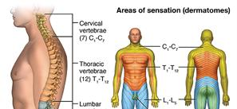
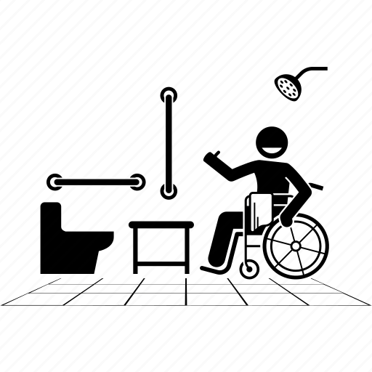
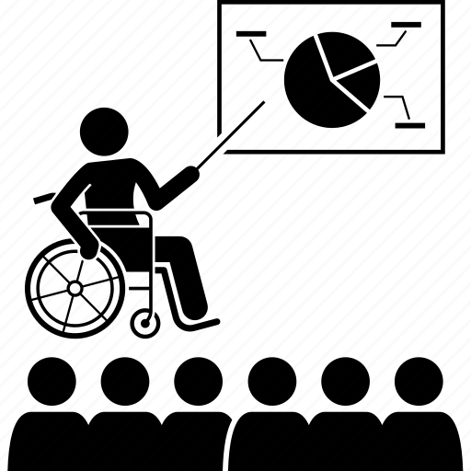
Introduction
Cervical spinal cord injury
Participation
Activities of daily living
Notes:
Upper limb function plays a crucial role in activities of daily living (ADL) and participation. Therefore score people with a cervical spinal cord injury improving AHF and AHSP as essential in their functional recovery. Today I want to define arm/hand function as performing on ICF function level and arm/hand skilled performance performing on ICF activity level.
Spooren et al., 2006; Spooren et al., 2008; Snoek et al., 2004

Slide 3
Introduction
Active motor training
Enhancing upper limb function
In people with cervical spinal cord injury (pwC-SCI)
Motor training strategies
Therapy dose dimensions
Motor training
Persons motivation
Kloosterman et al., 2009; Spooren et al., 2009; Lu et al., 2015; Dunlop, 2008; Kleim & Jones, 2008
Notes:
Active motor training is currently the gold standard for improving upper limb function in individuals witrvical spinal cord injuries. Our recent research on key training variables in these programs confirmed that the variables highlighted in the literature are indeed considered important by clinical experts. However, we observed that these variables are not consistently integrated into current active upper limb motor training programs in clinical practice
Therefore we want to develop a conceptual framework to enhance upper limb function at the ICF activity level and integrate skills into daily life.

Slide 4
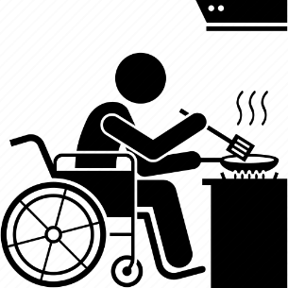
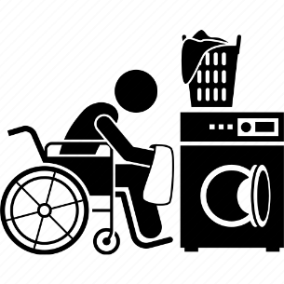
Objective
To develop a conceptual framework for pwC-SCI in subacute rehabilitation phase
to enhance upper limb function at the ICF activity level
to integrate skills into daily life
Notes:
Active motor training is currently the gold standard for improving upper limb function in individuals witrvical spinal cord injuries. Our recent research on key training variables in these programs confirmed that the variables highlighted in the literature are indeed considered important by clinical experts. However, we observed that these variables are not consistently integrated into current active upper limb motor training programs in clinical practice
Therefore we want to develop a conceptual framework to enhance upper limb function at the ICF activity level and integrate skills into daily life.

Slide 5
Method
2. Observational study
3. Qualitative study with experts
(Bertels et al., under review)
Clinical expertise
Patient preferences
Literature
1. Systematic review
(Bertels et al., 2023)
4. Qualitative study with patients
Notes:
Our framework was developed using a multidimensional approach, grounded in a evidence-based practice model widely used in healthcare. This model relies on three essential elements; existing literature, clinical expertise and patient preferences. By integrating these components we ensure that our approach is both scientifically and tailored to meet individual patient needs.
First, we performed a systematic literature review to evaluate motor training strategies and therapy dosages used in active upper limb motor training programs. Following this, we conducted both a longitudinal observational study and a qualitative study across three rehabilitation centers: two in Belgium (UZ Leuven and UZ Gent) and one in the Netherlands (Adelante).
In the observational study, we explored how motor training strategies and therapy doses are currently applied in active upper limb training. For the qualitative study, we held focus group discussions with therapists to explore their views on what essential components should be included in upper limb rehabilitation and their significance in clinical practice.
Finally, we carried out semi-structured interviews with patients to gain insights into their experiences about motivations, which is important in maintaining engagement in upper limb training.

Slide 6
Results
1. Gathering knowledge
Person
Client system
2. Thinking process
Goal-setting process
Patient tailored plan
Motivation
3. Acting process
Therapy content
Therapy dose
4. Practice beyond therapy
Training moments outside of therapy
Training moments after discharge
Notes:
The current conceptual framework exist out of 4 phases of skill training important to achieve skill performance
Gathering knowledge
Thinking process
Acting process
Practice beyond therapy
Throughout all phases of rehabilitation, maintaining motivation to train is critical for ensuring patient engagement. In the first phase, experts emphasize the importance of gathering detailed knowledge about the person and their client system. This information is essential for setting client-centered and realistic goals, collaboratively defined by both the patient and therapist. These goals are then integrated into a highly individualized, goal- and task-oriented rehabilitation plan tailored to the patient’s specific needs. During the acting process, close attention is paid to the content and dosage of therapy. Finally, training beyond formal therapy sessions plays a key role in achieving successful rehabilitation outcomes
If time: mention what is new: e.g. gathered with buikgevoel: learning strategies, coping strategies,...

Slide 7
Gathering knowledge
Person
Personal needs
Performance capacity
Client system
Thinking process
Goal-setting process
Client-centered
Realistic
Patient tailored plan
= goal- and task-oriented approach
Acting process
Therapy content
Therapy dose
= patient-customized training load
Perceived difficulty
Perceived intensity
Active time
Repetitions
Skill training
Strength training
Endurance training
Total skill practice
Context-specific environment
Real-life objects
Client-centered patient goal
Exercise progression
Exercise variety
Feedback
Functional movements
Multiple movement planes
Bimanual practice
Notes:
Now, let’s delve deeper into certain aspects of this conceptual framework.In the knowledge-gathering phase, it is crucial to explore specific elements of the individual, such as their personal needs and performance capacity. Performance capacity can include motor, sensory, and skill-based abilities. Understanding these personal needs is essential for establishing client-centered goals. Equally important, the therapist must assess the patient’s performance capacity to set realistic, achievable goals in collaboration with the patient.During the implementation phase, therapy sessions are carefully structured with a focus on both content and dosage. Evidence shows that when patients aim to relearn a skill, it is essential to combine skill-specific training with strength and endurance exercises. Experts and the literature support incorporating various task-oriented training components, as outlined here. It is particularly important to practice complete skills in context-specific environments, using real-life objects to enhance learning. Additionally, progressing exercises and introducing a variety of activities are key to achieving successful outcomes. Providing patients with different forms of feedback during task relearning is also critical.When considering therapy dosage, a more detailed approach is required beyond just the total hours of therapy provided. For effective neurological recovery, based on motor learning principles, it is important to assess the perceived difficulty and intensity of tasks, as well as the patient’s active time during sessions. In skill training specifically, attention should also be given to the number of task repetitions completed throughout the therapy sessions

Slide 8
Gathering knowledge
Person
Personal needs
Performance capacity
Client system
Thinking process
Goal-setting process
Client-centered
Realistic
Patient tailored plan
= goal- and task-oriented approach
Acting process
Therapy content
Therapy dose
= patient-customized training load
Perceived difficulty
Perceived intensity
Active time
Repetitions
Skill training
Strength training
Endurance training
Total skill practice
Context-specific environment
Real-life objects
Client-centered patient goal
Exercise progression
Exercise variety
Feedback
Functional movements
Multiple movement planes
Bimanual practice
Notes:
We discovered some associations between the task-oriented training components and therapy dose elements. We found during the observation study that patients scored higher perceived difficulty and intensity scores on sessions including client-centered patient goals, exercise progression exercise variety and functional movements. Patients scored higher difficulty scores when feedback was incorporated.

Slide 9
Gathering knowledge
Person
Personal needs
Performance capacity
Client system
Optimal load capacity
Thinking process
Goal-setting process
Client-centered
Realistic
HOW?
Patient tailored plan
= goal- and task-oriented approach
Acting process
Therapy content
Therapy dose
= patient-customized training load
Perceived difficulty
Perceived intensity
Active time
Repetitions
Skill training
Strength training
Endurance training
Total skill practice
Context-specific environment
Real-life objects
Client-centered patient goal
Exercise progression
Exercise variety
Feedback
Functional movements
Multiple movement planes
Bimanual practice
Notes:
A conceptual framework is never fully complete, and I can best illustrate this with the following example.
Evidence in neurological rehabilitation suggests that an adequate therapy dose is essential for relearning skills. However, experts highlight that a patient's load capacity is highly individual and can vary, even within the same day or between sessions. Currently, many therapists rely on their intuition or 'gut feeling' to estimate a patient's load capacity and adjust the therapy dose accordingly. This is, of course, a subjective approach.
In our observational study, we found that therapists tend to systematically overestimate various dimensions of the therapy dose. This raises a critical question: how can we accurately measure a patient's optimal load capacity, and how can we tailor the therapy dose dimensions to match that capacity more precisely?

Slide 10
Gathering knowledge
Person
Personal needs
Performance capacity
Optimal training load
Client system
Thinking process
Goal-setting process
Client-centered
Realistic goal
Patient tailored plan
= goal- and task-oriented approach
Acting process
Motivation
Therapy content
Skill training
Strength training
Endurance training
Total skill practice
Context-specific environment
Real-life objects
Client-centered patient goal
Exercise progression
Exercise variety
Feedback
Functional movements
Multiple movement planes
Bimanual practice
Therapy dose
= patient-customized training load
Perceived difficulty
Perceived intensity
Active time
Repetitions
Active time
Practice beyond therapy
Training moments outside of therapy
More training moments need after discharge
Notes:
The final phase, practicing beyond therapy, is often overlooked but is crucial for transferring relearned skills into daily life. Experts emphasize the importance of focusing more on training outside the therapy room—such as on the rehabilitation ward. For example, if a patient practices a skill like showering only during therapy sessions and not independently in the rehab ward, they are unlikely to apply this skill once they return home.
This highlights the importance of setting client-centered training goals. Patients are more motivated to relearn skills that matter to them personally, which encourages them to practice these skills beyond therapy sessions, thereby increasing their overall therapy dose. Experts also stress the need for continued training opportunities after discharge, particularly for patients with cervical spinal cord injuries, whose personal needs evolve over time.
.

Slide 11
Conclusion
Conceptual framework based on different training variables to enhance upper limb function at ICF activity level and integrating skills into daily life
to guide therapists throughout the process of skill training
to provide insights into the interconnection of different phases and components

Slide 12
Next step
E-Delphi study with experts worldwide to verify the completeness of the framework internationally
Are you a OT or PT with at least 5 years of experiences in SCI rehabilitation and interested to participate?
Nele.bertels@uhasselt.be

Slide 13
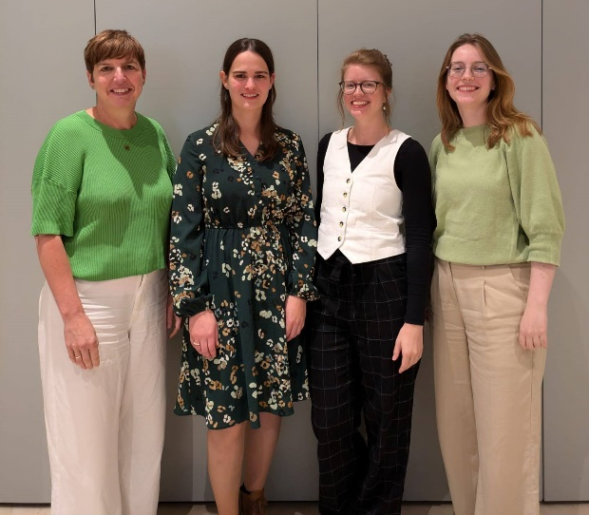
Thank you!
Participants and therapists
Dr. van Laake-Geelen and team
Dr. Yvonne Janssen-Potten
Dr. Borgions and team
Prof. Oostra and team
Upper limb team REVAL Hasselt university

