Slide 1
Interdisciplinary approach of arm-hand rehabilitation in cervical spinal cord injury: therapists' perspectives
Occupational Therapy Europe Congress
Thursday 17th of October 2024
Nele Bertels, PhD student, REVAL
Under supervision of Prof. Annemie Spooren

Slide 2
Introduction

Slide 3
Objectives
Identifying the ingredients in arm-hand rehabilitation
Exploring why these ingredients are important
Exploring which information is needed to apply these ingredients
according to experienced therapists

Slide 4
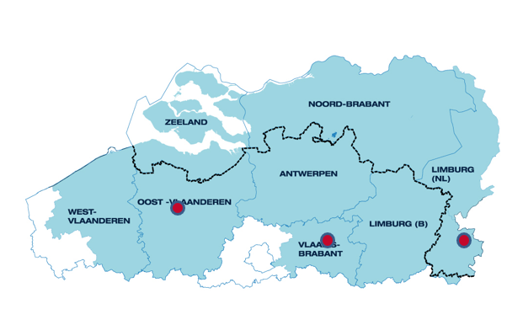
Methods
Three focus group discussions included
Occupational therapists
Physiotherapists
with at least 2 years experience in SCI rehabilitation
Data-collection by 4 female rehabilitation researchers with backgrounds in occupational and rehabilitation science
Data-analysis with inductive thematic analysis according to Braun and Clarke (2013)

Slide 5
Methods
Rehabilitation center (country) | Profession | Number of participants | Years of experience Mean (SD)
Adelante Zorggroep (NL) | OT | 2 | 18.8 (5.3)
 | PT | 2 | 16 (5.7)
University Hospital Ghent (BE) | OT | 2 | 8 (0)
 | PT | 2 | 16 (14.1)
University Hospitals Leuven (BE) | OT | 3 | 7 (5)
 | PT | 3 | 7.8 (6.3)
Notes:
10 women and 4 men
7 OT; 7PT
Mean 11.5 year of experience

Slide 6
Results
Gathering knowledge
Person
Implicit
Explicit
Elements to explore
Client system
Life partner and close family members
Other rehabilitants
Experts by experience
Therapists
Thinking process
Goal-setting process
Patient tailored plan
Motivation
Acting process
Therapy content
Goal and task-oriented approach
Training strategies
Training modalities, forms and techniques
Therapy dose
Amount of therapy
Based on personal load capacity
Practice beyond therapy
More training moments need at rehabilitation ward
More training moments need after discharge

Slide 7
Theme 1: Gathering knowledge
Person
Implicit
Explicit
Elements to explore
Client system
Life partner and close family members
Other rehabilitants
Experts by experience
Therapists
I find estimating the hardest, especially the load capacity, to determine how much exercise he can handle in an hour. I need to know what he did that day to ensure he does not overload his shoulder or determine the ideal dose. Unfortunately, I don't think there will be one correct answer.
(A312; 2 years of experience)
Notes:
It would be nice to know someone’s learning strategy. Is it someone who needs to hit a wall to grasp what’s required, or is it someone who just needs a bit of guidance, perhaps already able to abstractly figure it out on their own at home?
(A12; 12 years of experience)
Implicit: Personality, acceptation of SCI, coping mechanisms, emotional processing
Explicit: Motor performance, Sensory performance, Skill performance, tonus, person’s need
Additional aspects; learning strategy, problem-solving ability, optimaol load capacity

Slide 8
Theme 2: The thinking process
Goal-setting process
Patient tailored plan
A patient decides for themselves what is important. One wants to operate a telephone quickly, while another may want to tickle their nose, write, or do something else. You start with that instead of imposing as a therapist; I think the most important skills are… . Recently, it has focused on what is important for the rehabilitant because, like A12 mentioned, it leads to higher motivation.
(A14; 20 years of experience)
Notes:
Linking all the exercises to a goal, the more personal the goal, the more motivated a patient is automatically. When the goal is clear, they understand the purpose of the exercise.
(A39; 8 years of experience)

Slide 9
Theme 3: The acting process
Therapy content
Goal and task-oriented approach
Training strategies
Training modalities, forms and techniques
Therapy dose
Amount of therapy
Based on personal load capacity
I believe you get a lot more density by focusing on valuable and meaningful tasks, so people do the task a lot. As A14 also mentioned, this approach extends beyond typical therapy frequencies and integrates into activities of daily living. I think you get more effective training moments by training in task-specific ways.
(A12; 12 years of experience)
Notes:
Training strategies: shaping, varity in training context

Slide 10
Theme 4: Practice beyond therapy
More training moments need at rehabilitation ward
More training moments need after discharge
Yes, I think that the activities at the rehab ward are currently lacking. Nurses can also play a role in rehabilitation. Patients need to get to therapy quickly, so we don’t offer therapy in the rehab ward in the morning. This is contradictory; they rush to get to occupational therapy, but they can actually do valuable exercises—sometimes even more valuable— at the ward.
(A39; 8 years of experience)

Slide 11
Theme 5: Motivation
Linking all the exercises to a goal, the more personal the goal, the more motivated a patient is automatically. When the goal is clear, they understand the purpose of the exercise.
(A39; 8 years of experience)

Slide 12
Discussion
1. Gathering knowledge
Person
Client system
2. Thinking process
Goal-setting process
Patient tailored plan
Motivation
3. Acting process
Therapy content
Therapy dose
4. Practice beyond therapy
Training moments outside of therapy
Training moments after discharge

Slide 13
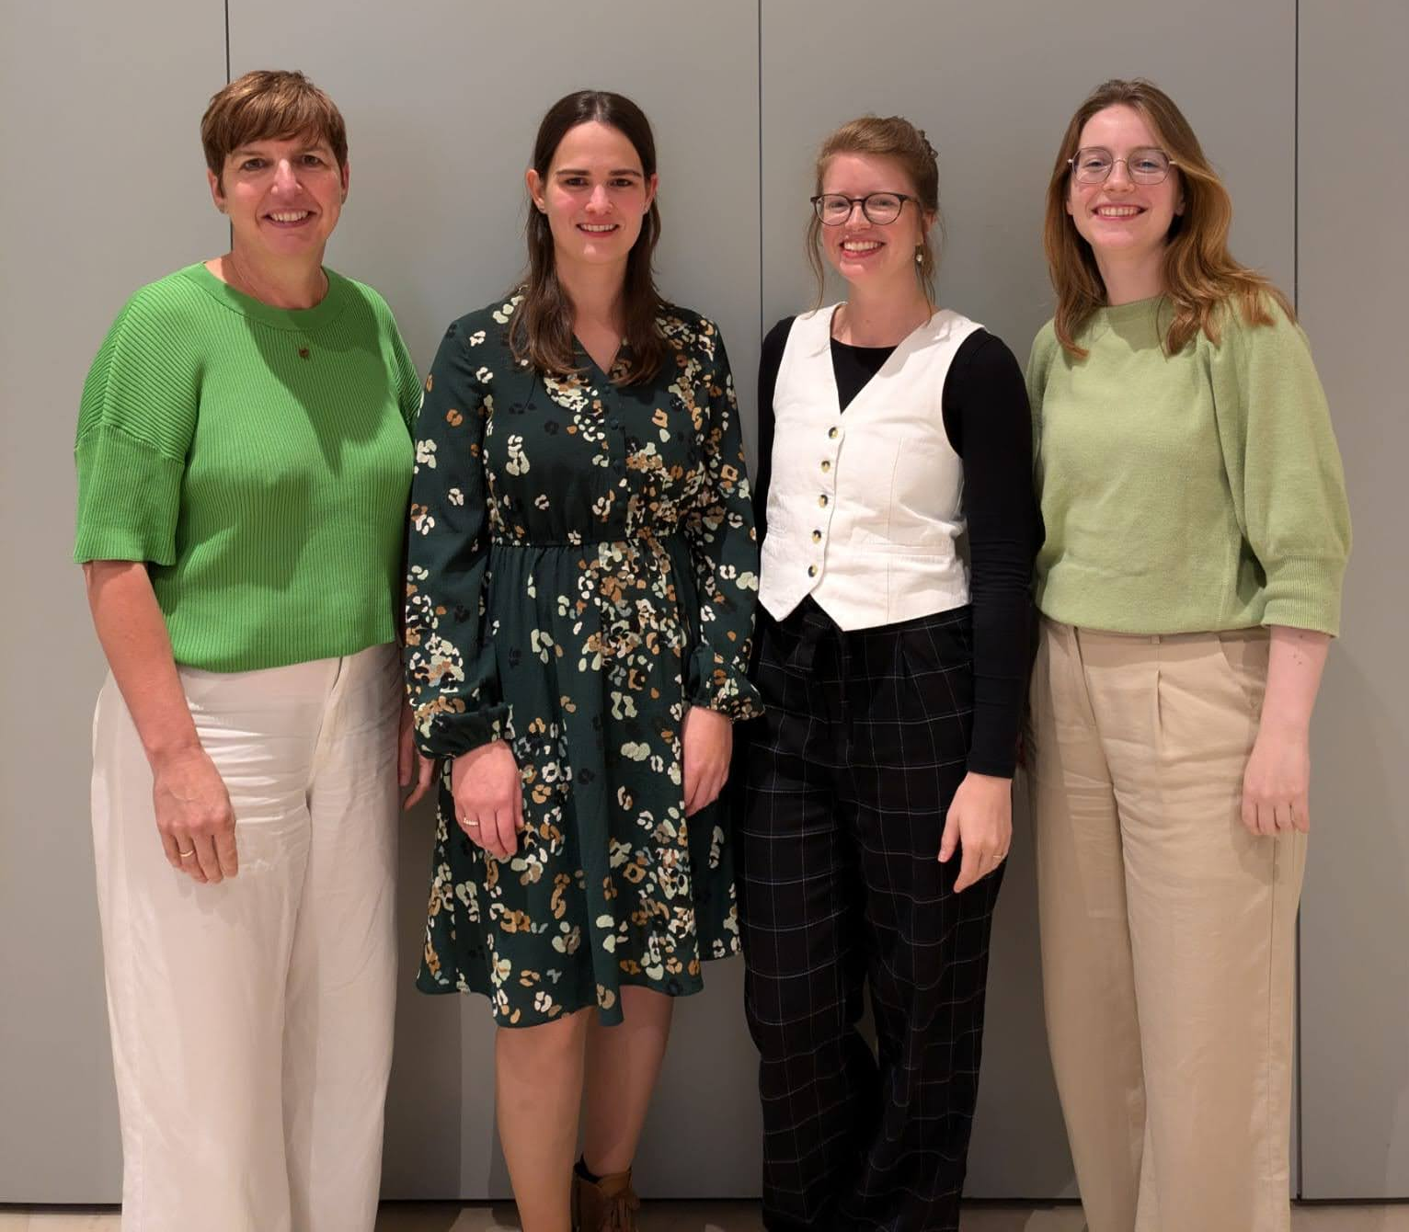
Thank you!
Participants and therapists
Dr. van Laake-Geelen and team
Dr. Yvonne Janssen-Potten
Dr. Borgions and team
Prof. Oostra and team
Upper limb team REVAL Hasselt university and master students occupational science

