Slide 1
“Can a gender-neutral parentage law be justified from a social science perspective?”
Emilie Hermans

Slide 2
Overview
Homosexual and lesbian parents
1.1. On the road to parenthood
1.2 During parenthood
2. Children of homosexual and lesbian parents
2.1 Parent-child relationship
2.2 Well-being and experiences
3. Conclusion

Slide 3
1. Homosexual and lesbian parents 1.1 Road to parenthood
Concerns, insecurities and internalised assumptions
Social disapproval

Slide 4
1. Homosexual and lesbian parents 1.1 Road to parenthood
“It was very strange since she was looking at us the whole time, but saying ‘the mother and father’, ‘the woman and man’ and ‘the man’ and ‘the father’. There was never any ‘partner’ or ‘supporting mother’ or ‘other mother’ or anything... So it didn’t feel very good, so we were very upset and got a lot of strange ideas about exactly how aware the staff was”
(RÖNDAHL et al., 2009, p. 2342)

Slide 5
1. Homosexual and lesbian parents 1.1 Road to parenthood
Concerns, insecurities and internalised assumptions
Social and professional support
Social disapproval

Slide 6
1. Homosexual and lesbian parents 1.2 During parenthood
Concerns, insecurities and internalised assumptions
Social disapproval

Slide 7
1. Homosexual and lesbian parents 1.2 During parenthood
Concerns, insecurities and internalised assumptions
Social, professional and legal support
Social disapproval

Slide 8
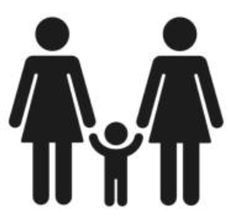
2. Children of homosexual and lesbian parents 2.1 Parent-child relationship
Intrinsic parental desire, motivation and commitment
Notes:
Picture: iStock

Slide 9
2. Children of homosexual and lesbian parents 2.2 Well-being and experiences
Parental stress
Interparental conflict
Children’s behavioral problems
Social support

Slide 10
2. Children of homosexual and lesbian parents 2.2 Well-being and experiences
Social disapproval
Children’s behavioral problems

Slide 11
2. Children of homosexual and lesbian parents 2.2 Well-being and experiences
“By sixth grade, I had moved to a different school district. I made friends with this guy and one time he came over, discovered that I had gay moms, and acted really funny about it. Then he went back to school and told all of our other friends, and then later most of our class”
(VAN GELDEREN et al., 2012, p. 1002)

Slide 12
3. Conclusion: family processes > family structure
Social disapproval
Social disapproval
Parental stress
Interparental conflict
Children’s behavioral problems
Social support

Slide 13
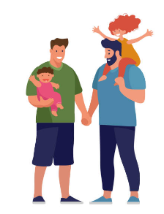
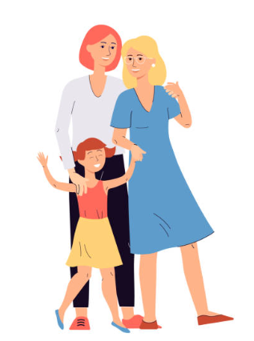
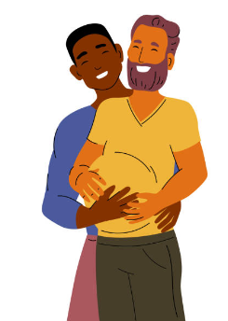
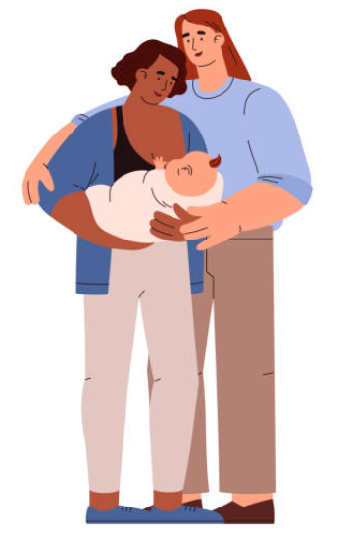
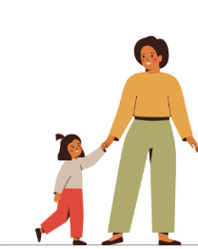
3. Conclusion
Notes:
Pictures: iStock

Slide 14
Questions – thoughts – remarks?
- Emilie.hermans@uhasselt.be
Hermans.emilie@unamur.be

Slide 15
Bibliography
RÖNDAHL, G., BRUHNER, E. and LINDHE, J., “Heteronormative communication with lesbian families in antenatal care, childbirth and postnatal care”, Journal of Advanced nursing 2009, vol. 65, nr. 11, 2337-2344.
VAN GELDEREN, L., GARTRELL, N., BOS, H.-M.-W., VAN ROOIJ, F.-B. and HERMANNS, J.-M.-A., “Stigmatization associated with growing up in a lesbian-parented family: What do adolescents experience and how do they deal with it?”, Children and Youth Services Review 2012, vol. 34, 999-1006.

